Slide 1

SMART INDIA HACKATHON 2026
TITLE PAGE
Problem Statement ID
SIH26003
Problem Statement Title
AI-Based Cognitive Gaming and Memory Assistance Platform for Elderly Dementia Patients in the North Eastern Region
Theme
MedTech / BioTech / HealthTech
PS Category
Software
Team ID
—
Team Name
Tesseract
TESSERACT — Cognitive Gaming for Elderly & Dementia Care
1
Notes:
Introduce the problem statement and the team. Keep this to fifteen seconds.

Slide 2

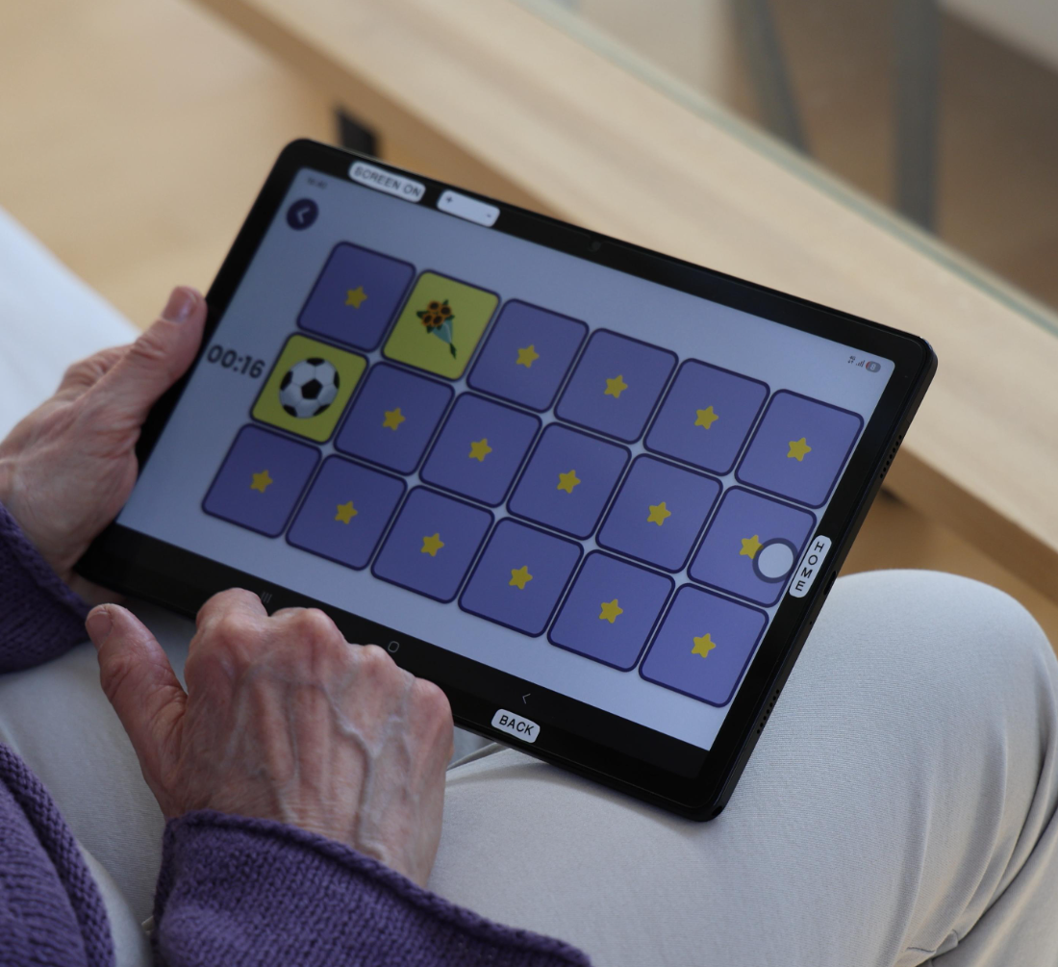
IDEA TITLE
Proposed Solution (Describe your Idea/Solution/Prototype)
One offline-first app, three connected views: a joyful patient game space, a caregiver dashboard and a healthcare-worker review layer. Gameplay itself produces the signals that personalise the next activity.
7.4% of Indians aged 60+ live with dementia — LASI-DAD, 2023
Detailed explanation of the proposed solution
How it addresses the problem
Innovation and uniqueness of the solution
Caregiver builds a “Know Me” profile: people, places, interests and 15–20 meaningful words.
Personalised, culturally familiar content replaces one-size-fits-all exercises.
Gameplay is the measurement instrument — no separate test session.
A short baseline session sets an app-level performance profile — not a diagnosis.
Difficulty follows observed performance: challenge and comfort , not maximum difficulty.
Clinical stage ≠ game difficulty. Difficulty is earned in play.
Word Search, Picture Recall and Route Quest use the patient’s own words and places.
Nine games run offline, logging time, accuracy, errors, hints and route.
Caregivers get one clear recommendation a day, not scattered notes.
Patient view: Reveal Match Cards — large targets, no failure state.
AI recommends; a caregiver or healthcare worker approves or modifies.
Medicine, hydration and routine reminders sit beside the games.
Runs on low-cost Android without a network, and syncs when one returns.
THE PRODUCT LOOP
Know
›
Baseline
›
Personalise
›
Play
›
Observe
›
Analyse
›
Adapt
›
Assist
›
Monitor
TESSERACT — Cognitive Gaming for Elderly & Dementia Care
2
Notes:
One platform, three views. Gameplay is the measurement instrument: the patient plays, the app observes, the caregiver acts, the healthcare worker reviews.

Slide 3
TECHNICAL APPROACH
Technologies to be used · Methodology and process for implementation
Technologies to be used
Methodology and process for implementation
FRONTEND
01
›
02
›
03
›
04
Flutter (Android-first)
Patient App
Game & Interaction Layer
Event & Performance Logger
AI / Analytics Engine
SIMPLE 2D GAMES
Flutter, large targets, voice prompts
Features → performance profile
Flame / Flutter components
Flame; Phaser/Godot for Route Quest
SQLite / Hive, structured per session
FLAGSHIP GAME
Phaser or Godot
›
›
BACKEND
05
06
07
Python + FastAPI
Recommendation & Adaptive Difficulty
Caregiver Dashboard
Healthcare Worker Review
DATABASE
Trends, reminders, observations
PostgreSQL
Next game, next level, support level
Longitudinal view, approve or modify
ON-DEVICE STORAGE
SQLite / Hive event queue
AUTH & NOTIFICATIONS
EVERY SESSION LOGS
Firebase
Time
Accuracy
Errors
Retries
Hints
Route efficiency
Completion
Engagement
AI / ANALYTICS
Python analytics & recommendation engine
OFFLINE-FIRST SYNCHRONISATION
Games and content are modular — new games and language packs use the same event schema.
Connected
Profile and content packs
download
Offline
Games run, events queue locally
Reconnect
Encrypted sync, dashboard
updates
›
›
TESSERACT — Cognitive Gaming for Elderly & Dementia Care
3
Notes:
Walk the chain left to right, then point at the offline band. Emphasise that the AI layer is explainable and that nothing in the chain requires a live network.

Slide 4
FEASIBILITY AND VIABILITY
Feasibility · Potential challenges and risks · Strategies for overcoming them
Analysis of the feasibility of the idea
Potential challenge / risk
Strategy for overcoming it
Built on a mature open stack — Flutter, FastAPI, PostgreSQL — shippable in one hackathon cycle.
Intermittent connectivity across NER districts
Offline-first by default; an encrypted local queue syncs when a network appears.
Phase 1 AI is a transparent weighted-feature engine; no training data needed on day one.
Language and script coverage beyond English and Hindi
Content-pack framework: Assamese, Bengali, Meitei, Khasi and Mizo added as packs.
Runs on entry-level Android devices already in households and health centres.
Elderly usability — fatigue and frustration
Large targets, one action per screen, voice prompts, no failure states.
Language packs and word lists are data, not code — a new region needs content, not a release.
Caregiver effort to enter “Know Me” data
Guided ten-minute setup with photo and voice capture; ASHA-assisted enrolment.
Over-reading game scores as clinical results
App-level indicators only; no diagnostic claim; every output is human-reviewed.
AI IMPLEMENTATION PHASING
HUMAN IN THE LOOP
Phase 1 — rule / weighted-feature engine over accuracy, time, errors, completion, hints, efficiency and engagement. Phase 2 — personalised ML recommendation once session data accumulates.
AI observes → analyses → recommends. The caregiver or healthcare worker approves or modifies . The system supports clinicians; it does not replace them.
TESSERACT — Cognitive Gaming for Elderly & Dementia Care
4
Notes:
The point of this slide is that the MVP is buildable in a hackathon cycle and that we are honest about the risks. Land on human-in-the-loop.

Slide 5

IMPACT AND BENEFITS
Potential impact on the target audience · Benefits of the solution
Patient
Caregiver
Healthcare Worker
Play in their own language
Games built from their own people and places
Medicine, hydration and routine reminders
Difficulty that meets them where they are
Encouragement instead of scores
One clear recommendation a day
Completion, engagement, 7- and 30-day trends
Reminders handled by the app
A place to record observations
Personalisation they control
Longitudinal indicators between visits
Strongest and hardest activities at a glance
Caregiver observations on the same record
Approve or modify every AI recommendation
A shared view across a caseload
The patient is supported, not tested — warm language, familiar content.
SYSTEM-LEVEL IMPACT
NER-ready deployment
Works without connectivity
Extensible multilingual framework
Culturally adaptable content
Scales to new games and regions
Low-cost Android hardware
Supports NPHCE community care
Personalized. Adaptive. Offline-first. Caregiver-guided.
TESSERACT — Cognitive Gaming for Elderly & Dementia Care
5
Notes:
Three audiences, three kinds of value, then the system-level case for NER. Close on the four words.

Slide 6
RESEARCH AND REFERENCES
Details / Links of the reference and research work
Epidemiology and burden
Technical documentation
Lee J. et al. Prevalence of dementia in India (LASI-DAD). Alzheimer’s & Dementia, 2023 — 7.4% of adults 60+, and 7.35% across the North Eastern states excluding Assam. doi:10.1002/alz.12928
Flutter — flutter.dev · Flame — flame-engine.org
Phaser — phaser.io · Godot — godotengine.org
FastAPI — fastapi.tiangolo.com
World Health Organization. Dementia — fact sheet. who.int/news-room/fact-sheets
PostgreSQL — postgresql.org · SQLite — sqlite.org
Hive — pub.dev/packages/hive · Firebase — firebase.google.com
Alzheimer’s and Related Disorders Society of India. The Dementia India Report. ardsi.org
Accessibility and design guidance
Clinical and programme context
W3C. Web Content Accessibility Guidelines (WCAG) 2.2 — contrast, target size and timing criteria applied to the patient interface. w3.org/TR/WCAG22
Woods B. et al. Cognitive stimulation to improve cognitive functioning in people with dementia. Cochrane Database of Systematic Reviews. doi:10.1002/14651858.CD005562.pub3
Reference imagery illustrates interaction concepts only; final artwork will be original and produced with caregiver input.
WHO. Global action plan on the public health response to dementia.
MoHFW, Government of India. National Programme for Health Care of the Elderly (NPHCE).
The platform reports app-level cognitive performance indicators derived from gameplay. It does not diagnose dementia and does not replace clinical assessment.
TESSERACT — Cognitive Gaming for Elderly & Dementia Care
6
Notes:
Do not read these out. Point at the LASI-DAD figure for the North Eastern states if a judge asks about scale.

