Slide 1

Database Systems:
Design, Implementation, and Management
Tenth Edition
Chapter 7
Introduction to Structured Query Language (SQL)

Slide 2
Objectives
In this chapter, students will learn:
The basic commands and functions of SQL
How to use SQL for data administration (to create tables and indexes)
How to use SQL for data manipulation (to add, modify, delete, and retrieve data)
How to use SQL to query a database for useful information
Database Systems, 10th Edition

Slide 3
Introduction to SQL
SQL functions fit into two broad categories:
  Data definition language
  Data manipulation language
Basic command set has vocabulary of fewer than 100 words
American National Standards Institute (ANSI) prescribes a standard SQL
Several SQL dialects exist
Database Systems, 10th Edition

Slide 4
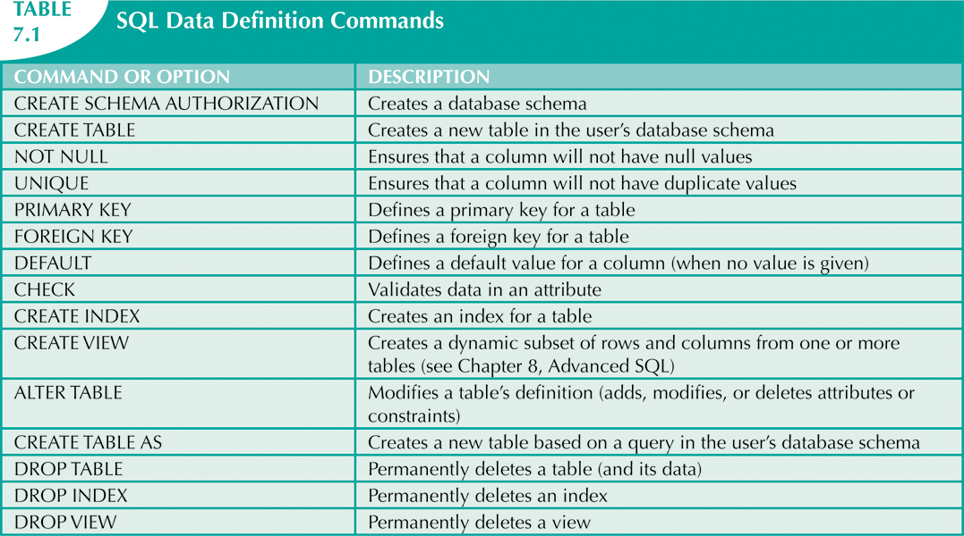
Database Systems, 10th Edition

Slide 5
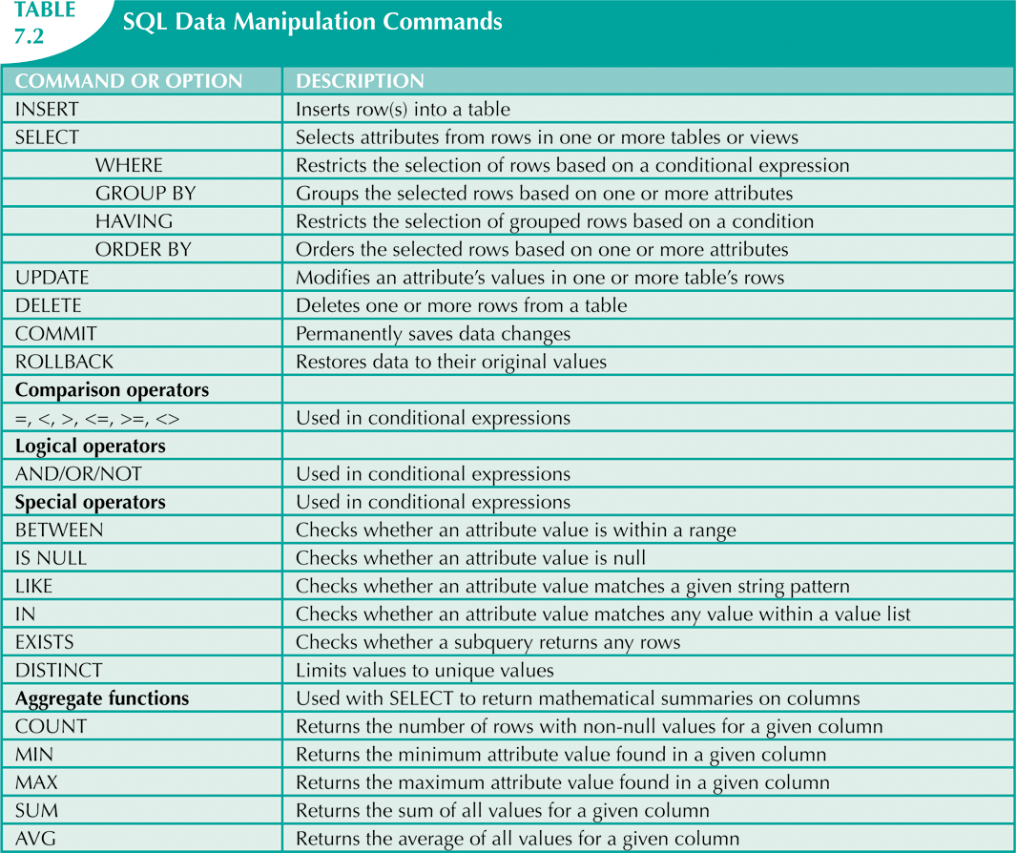
Database Systems, 10th Edition

Slide 6
Data Definition Commands
The database model
  In this chapter, a simple database with these tables is used to illustrate commands:
    CUSTOMER
    INVOICE
    LINE
    PRODUCT
    VENDOR
  Focus on PRODUCT and VENDOR tables
Database Systems, 10th Edition

Slide 7
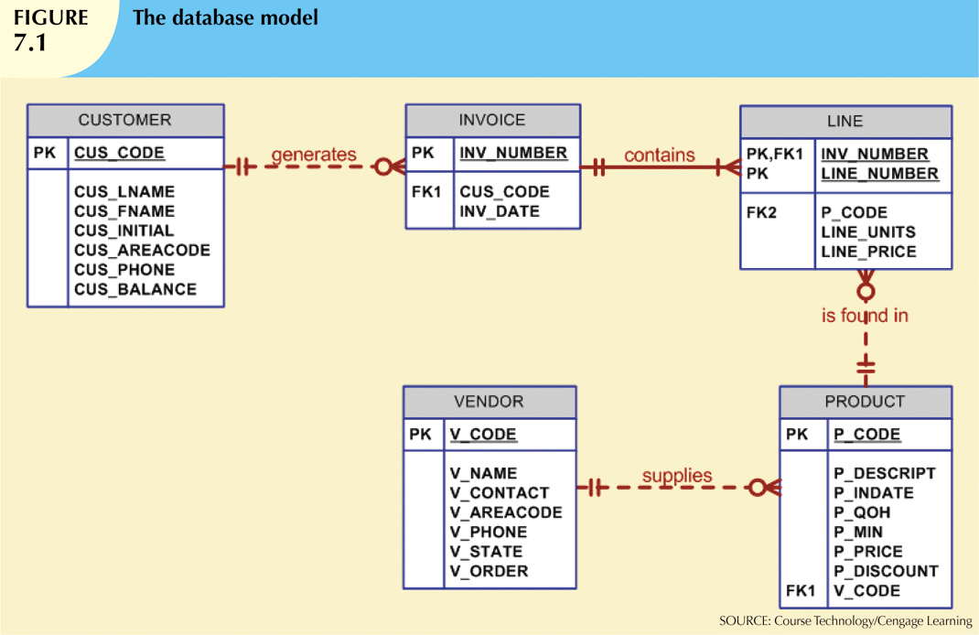
Database Systems, 10th Edition

Slide 8
Creating the Database
Two tasks must be completed:
  Create database structure
  Create tables that will hold end-user data
First task:
  RDBMS creates physical files that will hold database
  Differs substantially from one RDBMS to another
Database Systems, 10th Edition

Slide 9
Creating the Database (cont’d.)
Authentication
  DBMS verifies that only registered users are able to access database
  Log on to RDBMS using user ID and password created by database administrator
Database Systems, 10th Edition

Slide 10
The Database Schema
Schema
  Group of database objects that are related to each other
CREATE SCHEMA AUTHORIZATION {creator};
  Command is seldom used directly
Database Systems, 10th Edition

Slide 11
Data Types
Data type selection is usually dictated by nature of data and by intended use
Supported data types:
  Number(L,D), Integer, Smallint, Decimal(L,D)
  Char(L), Varchar(L), Varchar2(L)
  Date, Time, Timestamp
  Real, Double, Float
  Interval day to hour
  Many other types
Database Systems, 10th Edition

Slide 12
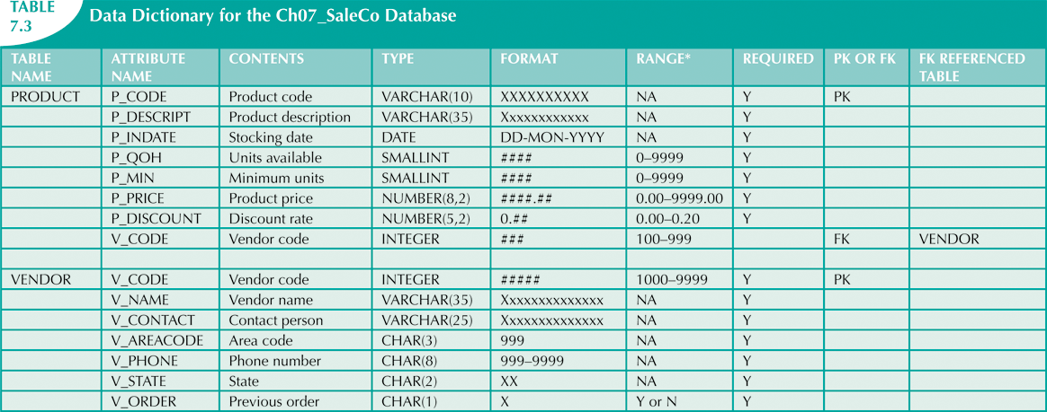
Database Systems, 10th Edition

Slide 13
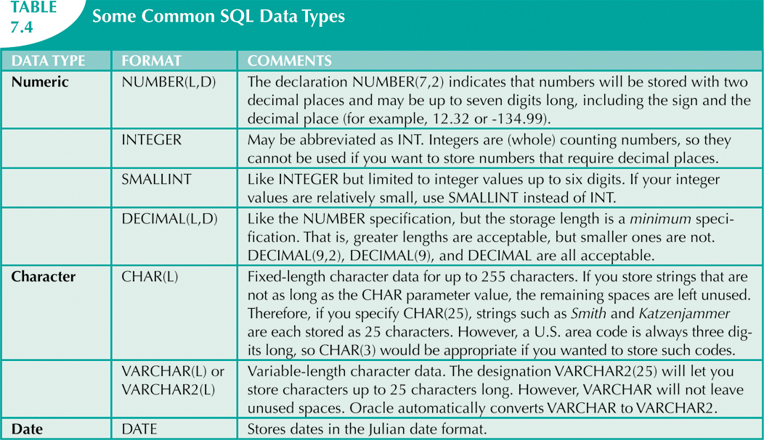
Database Systems, 10th Edition

Slide 14
Creating Table Structures
Use one line per column (attribute) definition
Use spaces to line up attribute characteristics and constraints
Table and attribute names are capitalized
NOT NULL specification
UNIQUE specification
Database Systems, 10th Edition

Slide 15
Creating Table Structures (cont’d.)
Primary key attributes contain both a NOT NULL and a UNIQUE specification
RDBMS will automatically enforce referential integrity for foreign keys
Command sequence ends with semicolon
Database Systems, 10th Edition

Slide 16
SQL Constraints
NOT NULL constraint
  Ensures that column does not accept nulls
UNIQUE constraint
  Ensures that all values in column are unique
DEFAULT constraint
  Assigns value to attribute when a new row is added to table
CHECK constraint
  Validates data when attribute value is entered
Database Systems, 10th Edition

Slide 17
SQL Indexes
When primary key is declared, DBMS automatically creates unique index
Often need additional indexes
Using CREATE INDEX command, SQL indexes can be created on basis of any selected attribute
Composite index
  Index based on two or more attributes
  Often used to prevent data duplication
Database Systems, 10th Edition

Slide 18
Data Manipulation Commands
INSERT
SELECT
COMMIT
UPDATE
ROLLBACK
DELETE
Database Systems, 10th Edition

Slide 19
Adding Table Rows
INSERT
  Used to enter data into table
  Syntax:
    INSERT INTO columnname
    VALUES (value1, value2, … , valueN);
Database Systems, 10th Edition

Slide 20
Adding Table Rows (cont’d.)
When entering values, notice that:
  Row contents are entered between parentheses
  Character and date values are entered between apostrophes
  Numerical entries are not enclosed in apostrophes
  Attribute entries are separated by commas
  A value is required for each column
Use NULL for unknown values
Database Systems, 10th Edition

Slide 21
Saving Table Changes
Changes made to table contents are not physically saved on disk until:
  Database is closed
  Program is closed
  COMMIT command is used
Syntax:
  COMMIT [WORK];
Will permanently save any changes made to any table in the database
Database Systems, 10th Edition

Slide 22
Listing Table Rows
SELECT
  Used to list contents of table
  Syntax:
    SELECT columnlist
    FROM tablename;
Columnlist represents one or more attributes, separated by commas
Asterisk can be used as wildcard character to list all attributes
Database Systems, 10th Edition

Slide 23
Updating Table Rows
UPDATE
  Modify data in a table
  Syntax:
    UPDATE tablename
    SET columnname = expression [, columnname = expression]
    [WHERE conditionlist];
If more than one attribute is to be updated in row, separate corrections with commas
Database Systems, 10th Edition

Slide 24
Restoring Table Contents
ROLLBACK
  Undoes changes since last COMMIT
  Brings data back to prechange values
Syntax:
  ROLLBACK;
COMMIT and ROLLBACK only work with commands to add, modify, or delete table rows
Database Systems, 10th Edition

Slide 25
Deleting Table Rows
DELETE
  Deletes a table row
  Syntax:
    DELETE FROM tablename
    [WHERE conditionlist ];
WHERE condition is optional
If WHERE condition is not specified, all rows from specified table will be deleted
Database Systems, 10th Edition

Slide 26
Inserting Table Rows with a
SELECT Subquery
INSERT
  Inserts multiple rows from another table (source)
  Uses SELECT subquery
  Subquery: query embedded (or nested or inner) inside another query
  Subquery executed first
  Syntax:
    INSERT INTO tablename SELECT columnlist FROM tablename;
Database Systems, 10th Edition

Slide 27
SELECT Queries
Fine-tune SELECT command by adding restrictions to search criteria using:
  Conditional restrictions
  Arithmetic operators
  Logical operators
  Special operators
Database Systems, 10th Edition

Slide 28
Selecting Rows with
Conditional Restrictions
Select partial table contents by placing restrictions on rows to be included in output
  Add conditional restrictions to SELECT statement, using WHERE clause
Syntax:
  SELECT columnlist
  FROM tablelist
  [ WHERE conditionlist ] ;
Database Systems, 10th Edition

Slide 29
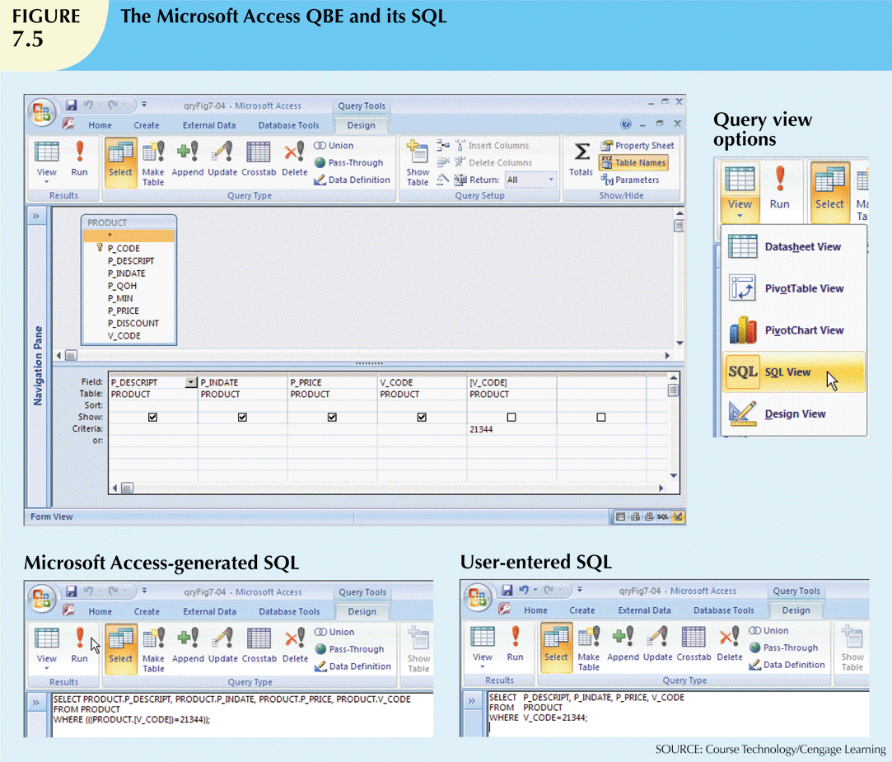
Database Systems, 10th Edition

Slide 30
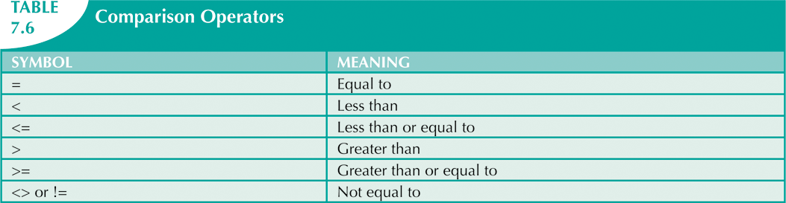
Database Systems, 10th Edition

Slide 31
Selecting Rows with
Conditional Restrictions (cont’d.)
Using comparison operators on dates
  Date procedures are often more software-specific than other SQL procedures
Using computed columns and column aliases
  SQL accepts any valid expressions (or formulas) in the computed columns
  Alias
    Alternate name given to a column or table in any SQL statement
Database Systems, 10th Edition

Slide 32
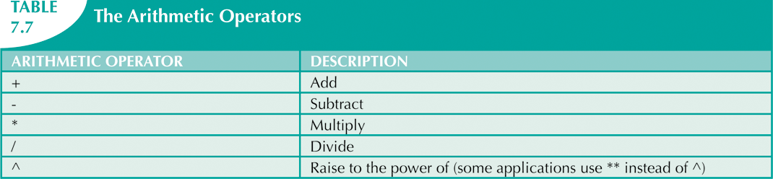
Arithmetic Operators:
The Rule of Precedence
Perform operations within parentheses
Perform power operations
Perform multiplications and divisions
Perform additions and subtractions
Database Systems, 10th Edition

Slide 33
Logical Operators: AND, OR, and NOT
Searching data involves multiple conditions
Logical operators: AND, OR, and NOT
Can be combined
  Parentheses enforce precedence order
    Conditions in parentheses are always executed first
Boolean algebra: mathematical field dedicated to use of logical operators
NOT negates result of conditional expression
Database Systems, 10th Edition

Slide 34
Special Operators
BETWEEN: checks whether attribute value is within a range
IS NULL: checks whether attribute value is null
LIKE: checks whether attribute value matches given string pattern
IN: checks whether attribute value matches any value within a value list
EXISTS: checks if subquery returns any rows
Database Systems, 10th Edition

Slide 35
Advanced Data Definition Commands
All changes in table structure are made by using ALTER command
Three options:
  ADD adds a column
  MODIFY changes column characteristics
  DROP deletes a column
Can also be used to:
  Add table constraints
  Remove table constraints
Database Systems, 10th Edition

Slide 36
Changing a Column’s Data Type
ALTER can be used to change data type
Some RDBMSs do not permit changes to data types unless column is empty
Database Systems, 10th Edition

Slide 37
Changing a Column’s Data Characteristics
Use ALTER to change data characteristics
Changes in column’s characteristics are permitted if changes do not alter the existing data type
Database Systems, 10th Edition

Slide 38
Adding a Column
Dropping a Column
Use ALTER to add column
  Do not include the NOT NULL clause for new column
Use ALTER to drop column
  Some RDBMSs impose restrictions on the deletion of an attribute
Database Systems, 10th Edition

Slide 39
Advanced Data Updates
UPDATE command updates only data in existing rows
If relationship between entries and existing columns, can assign values to slots
Arithmetic operators are useful in data updates
In Oracle, ROLLBACK command undoes changes made by last two UPDATE statements
Database Systems, 10th Edition

Slide 40
Copying Parts of Tables
SQL permits copying contents of selected table columns
  Data need not be reentered manually into newly created table(s)
First create the table structure
Next add rows to new table using table rows from another table
Database Systems, 10th Edition

Slide 41
Adding Primary and Foreign Key Designations
When table is copied, integrity rules do not copy
  Primary and foreign keys are manually defined on new table
User ALTER TABLE command
  Syntax:
    ALTER TABLE tablename ADD PRIMARY KEY(fieldname);
  For foreign key, use FOREIGN KEY in place of PRIMARY KEY
Database Systems, 10th Edition

Slide 42
Deleting a Table from the Database
DROP
  Deletes table from database
  Syntax:
    DROP TABLE tablename;
Can drop a table only if it is not the “one” side of any relationship
  Otherwise, RDBMS generates an error message
  Foreign key integrity violation
Database Systems, 10th Edition

Slide 43
Additional SELECT Query Keywords
Logical operators work well in the query environment
SQL provides useful functions that:
  Count
  Find minimum and maximum values
  Calculate averages, etc.
SQL allows user to limit queries to:
  Entries having no duplicates
  Entries whose duplicates may be grouped
Database Systems, 10th Edition

Slide 44
Ordering a Listing
ORDER BY clause is useful when listing order is important
Syntax:
SELECT columnlist
FROM tablelist
[WHERE conditionlist]
[ORDER BY columnlist [ASC | DESC]];
Ascending order by default
Database Systems, 10th Edition

Slide 45
Listing Unique Values
DISTINCT clause produces list of only values that are different from one another
Example:
  SELECT DISTINCT V_CODE
  FROM PRODUCT;
Access places nulls at the top of the list
  Oracle places it at the bottom
  Placement of nulls does not affect list contents
Database Systems, 10th Edition

Slide 46
Aggregate Functions
COUNT function tallies number of non-null values of an attribute
  Takes one parameter: usually a column name
MAX and MIN find highest (lowest) value in a table
  Compute MAX value in inner query
  Compare to each value returned by the query
SUM computes total sum for any specified attribute
AVG function format is similar to MIN and MAX
Database Systems, 10th Edition

Slide 47
Grouping Data
Frequency distributions created by GROUP BY clause within SELECT statement
Syntax:
  SELECT columnlist
  FROM tablelist
  [WHERE conditionlist]
  [GROUP BY columnlist]
  [HAVING conditionlist]
  [ORDER BY columnlist [ASC | DESC] ] ;
Database Systems, 10th Edition

Slide 48
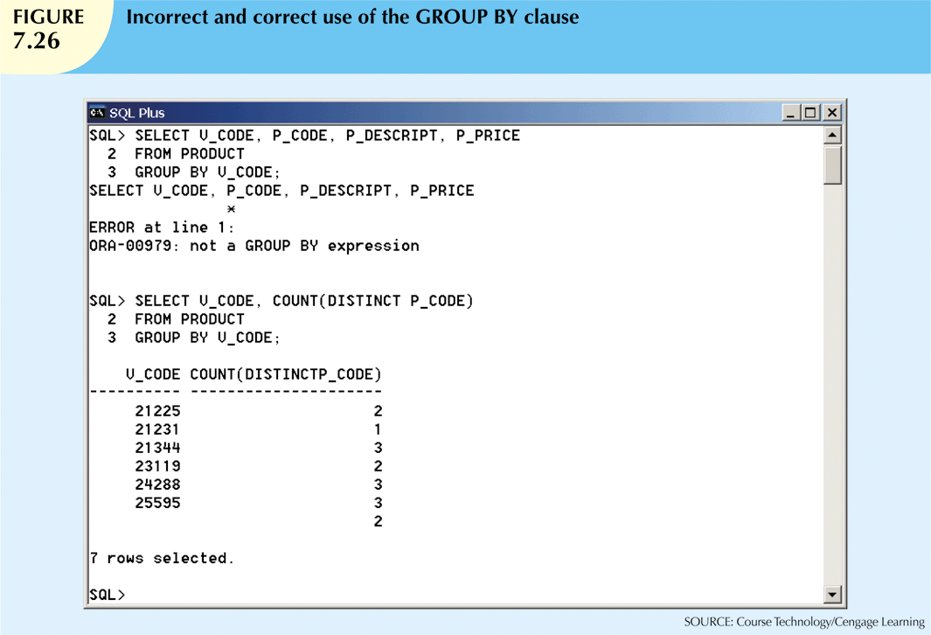
Database Systems, 10th Edition

Slide 49
Joining Database Tables
Joining tables is the most important distinction between relational database and other DBs
Join is performed when data are retrieved from more than one table at a time
  Equality comparison between foreign key and primary key of related tables
Join tables by listing tables in FROM clause of SELECT statement
  DBMS creates Cartesian product of every table
Database Systems, 10th Edition

Slide 50
Joining Tables with an Alias
Alias identifies the source table from which data are taken
Alias can be used to identify source table
Any legal table name can be used as alias
Add alias after table name in FROM clause
  FROM tablename alias
Database Systems, 10th Edition

Slide 51
Recursive Joins
Alias is especially useful when a table must be joined to itself
  Recursive query
  Use aliases to differentiate the table from itself
Database Systems, 10th Edition

Slide 52
Summary
SQL commands can be divided into two overall categories:
  Data definition language commands
  Data manipulation language commands
The ANSI standard data types are supported by all RDBMS vendors in different ways
Basic data definition commands allow you to create tables and indexes
Database Systems, 10th Edition

Slide 53
Summary (cont’d.)
DML commands allow you to add, modify, and delete rows from tables
The basic DML commands:
  SELECT, INSERT, UPDATE, DELETE, COMMIT, and ROLLBACK
SELECT statement is main data retrieval command in SQL
Database Systems, 10th Edition

Slide 54
Summary (cont’d.)
WHERE clause can be used with SELECT, UPDATE, and DELETE statements
Aggregate functions
  Special functions that perform arithmetic computations over a set of rows
ORDER BY clause
  Used to sort output of SELECT statement
  Can sort by one or more columns
  Ascending or descending order
Database Systems, 10th Edition

Slide 55
Summary (cont’d.)
Join output of multiple tables with SELECT statement
  Join performed every time you specify two or more tables in FROM clause
  If no join condition is specified, DBMX performs Cartesian product
Natural join uses join condition to match only rows with equal values in specified columns
Database Systems, 10th Edition

