Slide 1


Slide 2

University of West England Phenikaa Campus
UCFF-30-1 Foundation of Computing - Graph
Instructor: Duc Minh Vu
Email: vudm.vn [at] gmail.com
12/24/2023
UFCFF-30-1 Foundation of Computing
2

Slide 3
Learning Objectives
Graph and Graph Models
Graph Terminology
Graph Representations

Slide 4
Introduction
Discrete structures consisting of vertices and edges that connect these vertices
Different kinds of graphs
Problems in almost every conceivable discipline can be solved using graph models

Slide 5
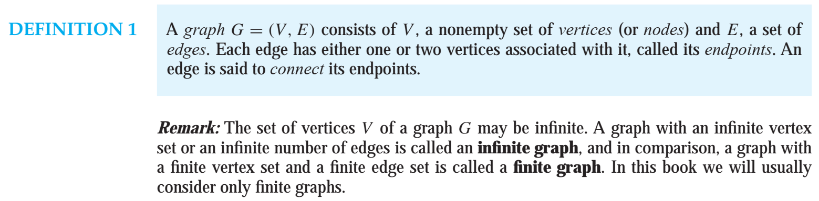
10.1 Graphs and Graph Models

Slide 6
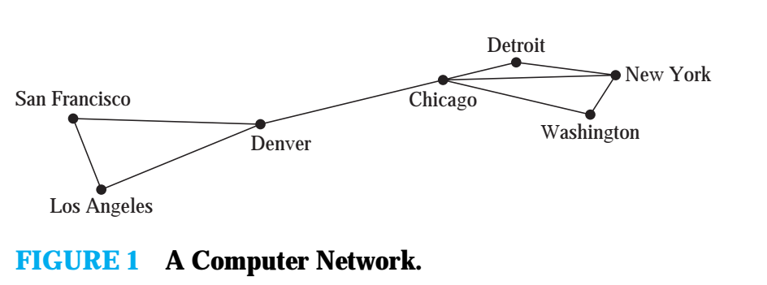
A network is made up of data centers and communication links between computers.
Represent the location of each data center by a point and each communications link by a line segment, as shown in Figure 1
Can be modeled using a graph in which the vertices of the graph represent the data centers and the edges represent communication links

Slide 7
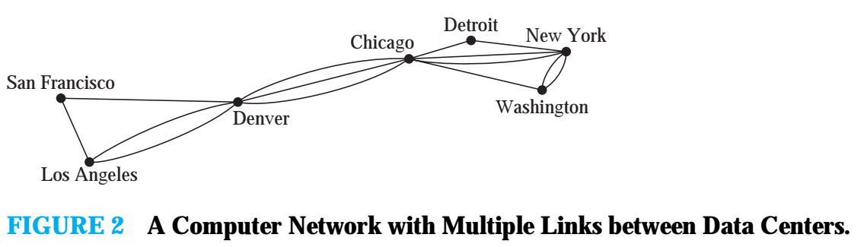
A computer network may contain multiple links between data centers, as shown in Figure 2.
To model such networks, we need graphs that have more than one edge connecting the same pair of vertices

Slide 8
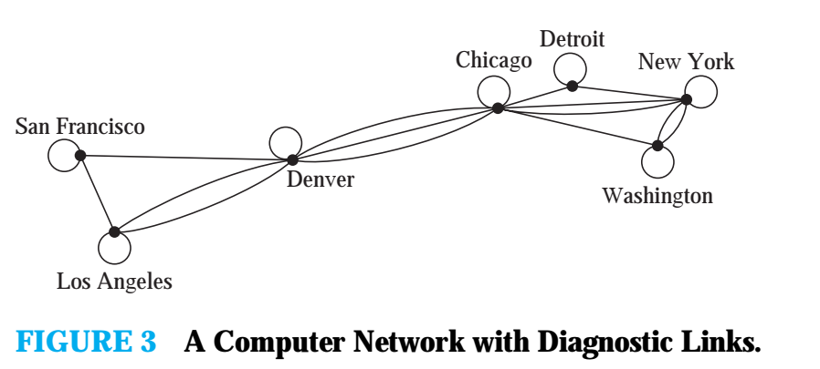
A communications link connects a data center with itself, perhaps a feedback loop for diagnostic purposes. Such a network is illustrated in Figure 3.

Slide 9
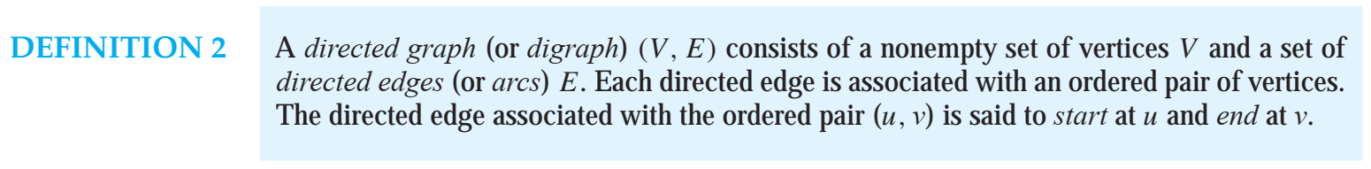

Slide 10
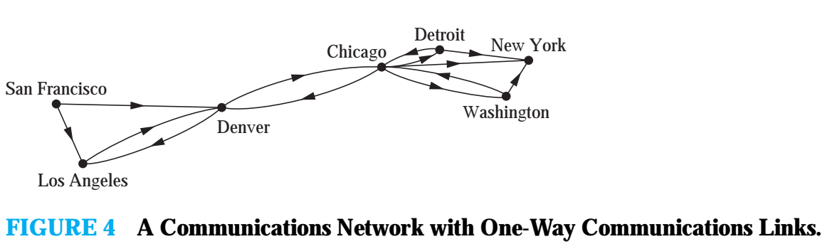
This may be the case if there is a large amount of traffic sent to some data centers, with little or no traffic going in the opposite direction. Such a network is shown in Figure 4

Slide 11
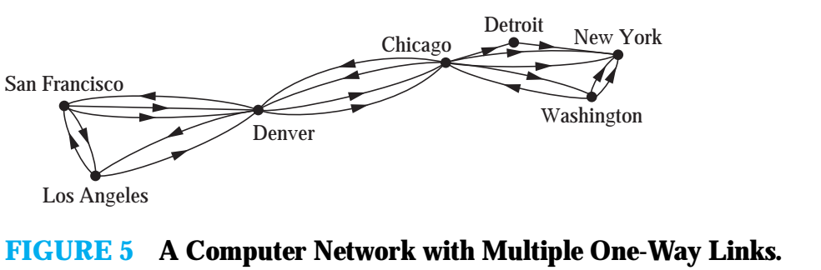

Slide 12
A graph in which each edge connects two different vertices and where no two edges connect the same pair of vertices is called a simple graph.
Graphs that may have multiple edges connecting the same vertices are called multigraphs.
Such edges are called loops, and sometimes we may even have more than one loop at a vertex
Graphs that may include loops, and possibly multiple edges connecting the same pair of vertices or a vertex to itself, are sometimes called pseudographs.

Slide 13
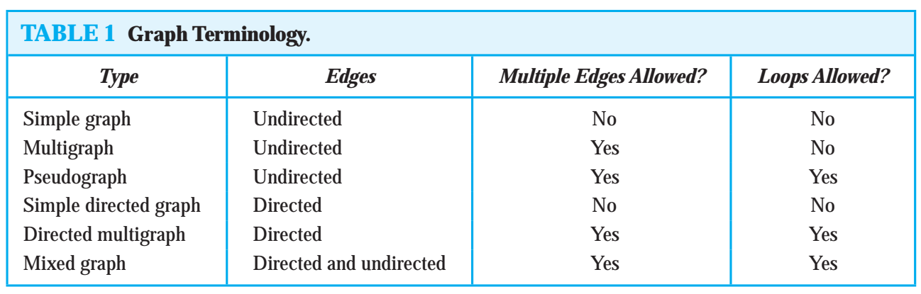

Slide 14
Graph Model
Social Networks
Acquaintanceship and Friendship Graphs
Influence Graphs
Collaboration Graphs
Call Graph
INFORMATION NETWORKS
The Web Graph
Citation Graphs
SOFTWARE DESIGN APPLICATIONS
Module Dependency Graphs
Precedence Graphs and Concurrent Processing

Slide 15
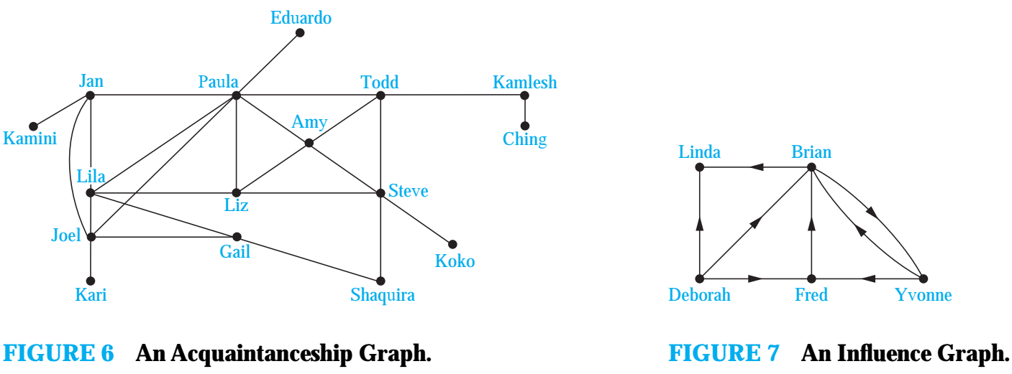

Slide 16
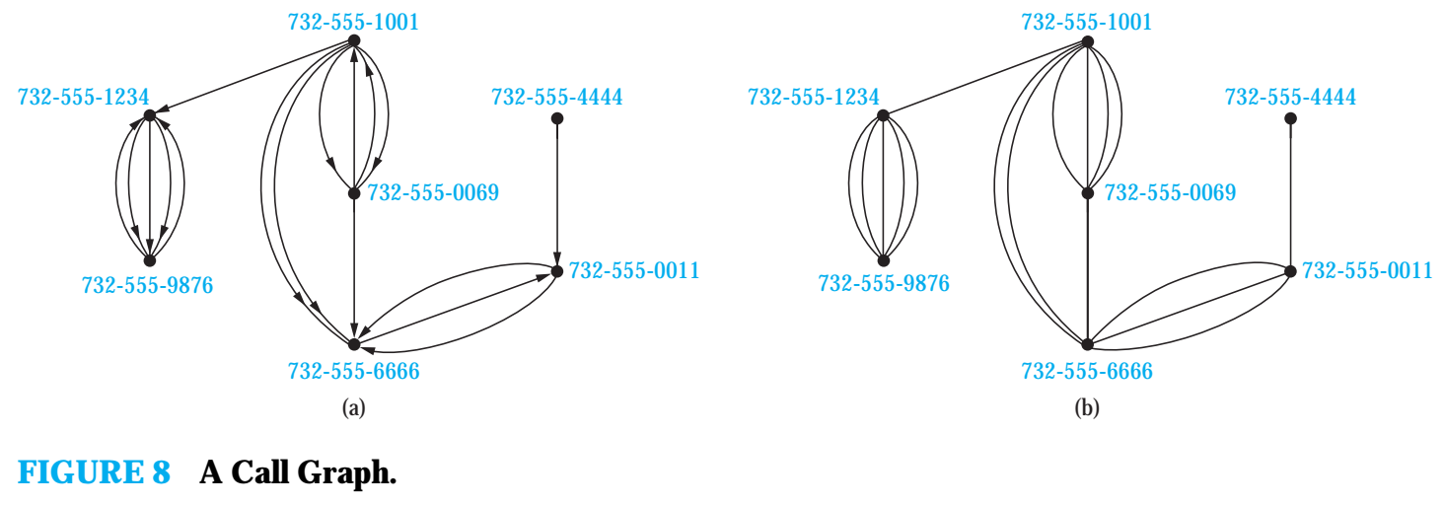

Slide 17
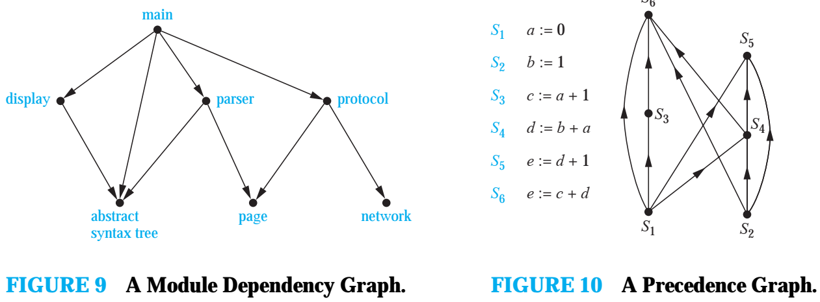

Slide 18
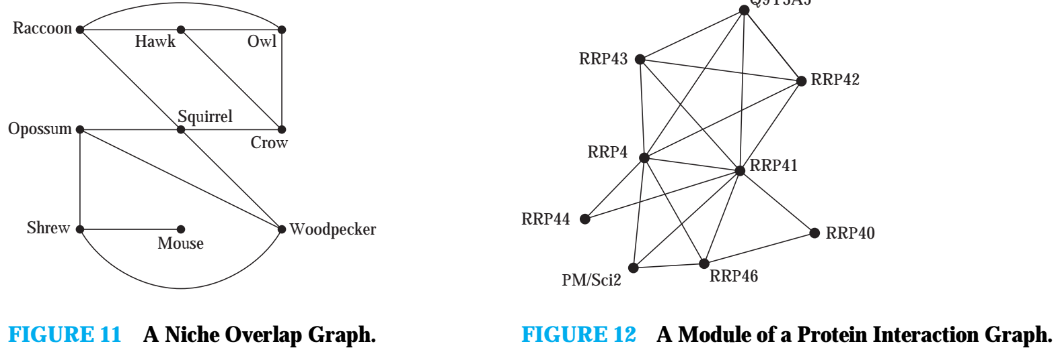

Slide 19
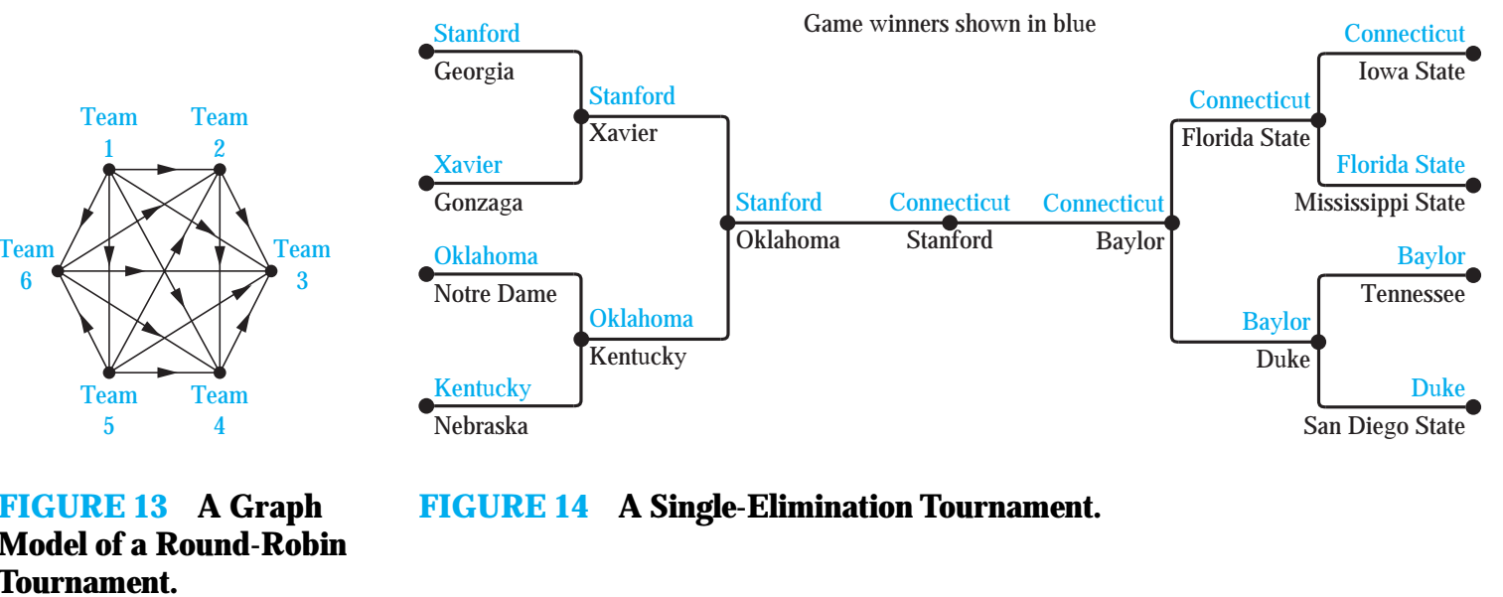

Slide 20
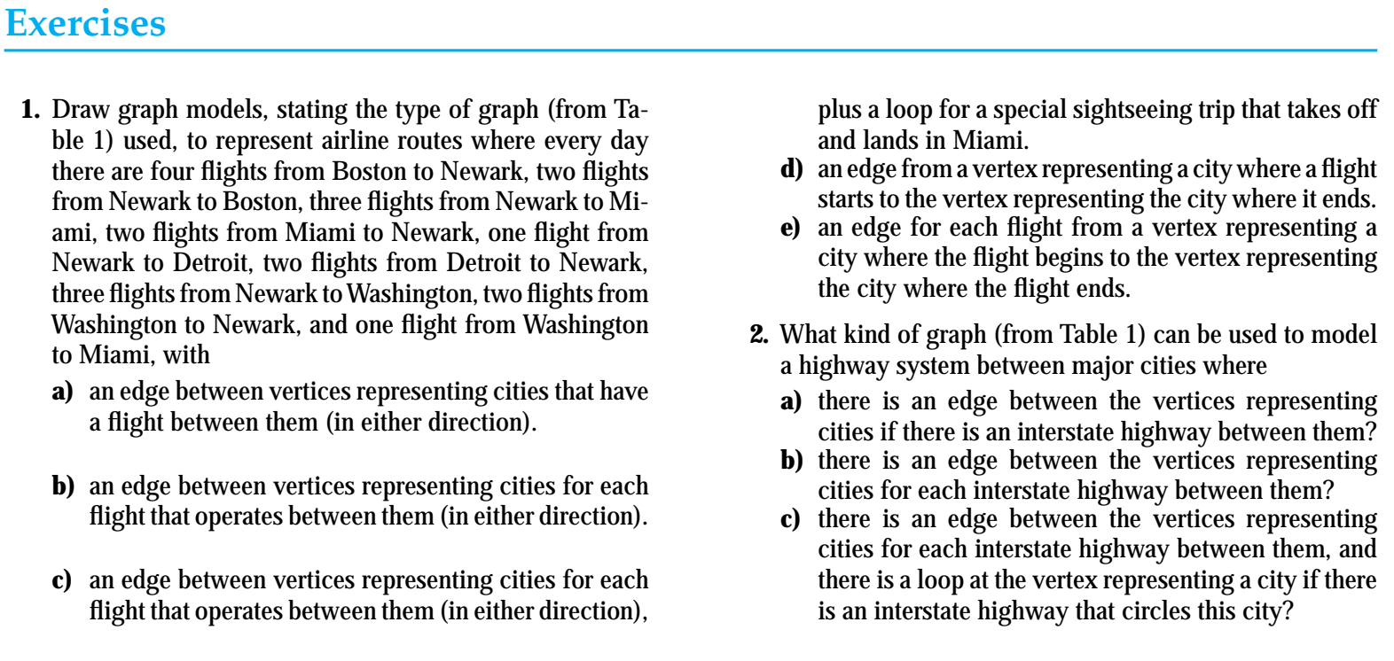

Slide 21
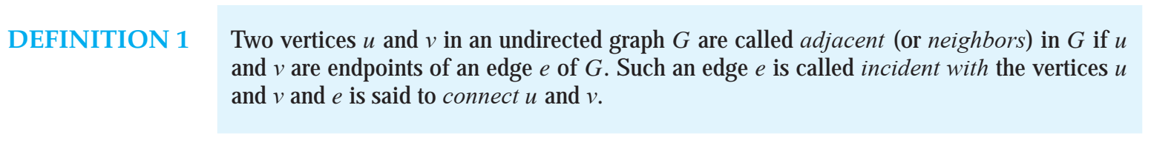
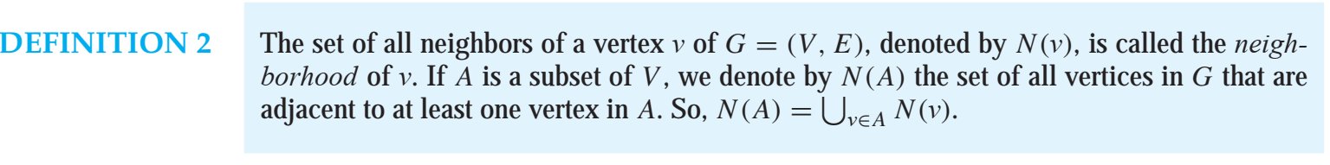
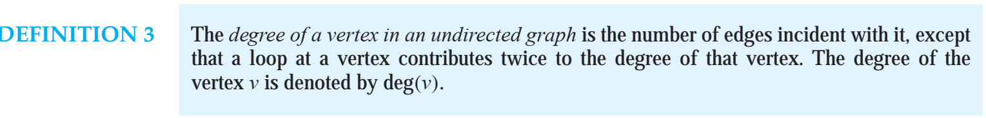
10.2 Graph Terminology and Special Types of Graphs

Slide 22
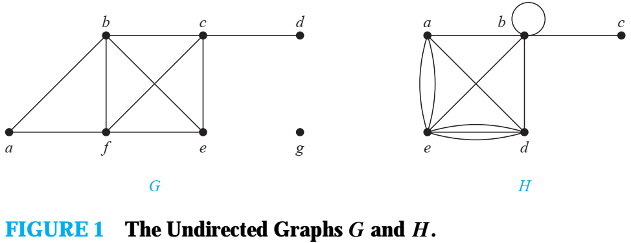

Slide 23
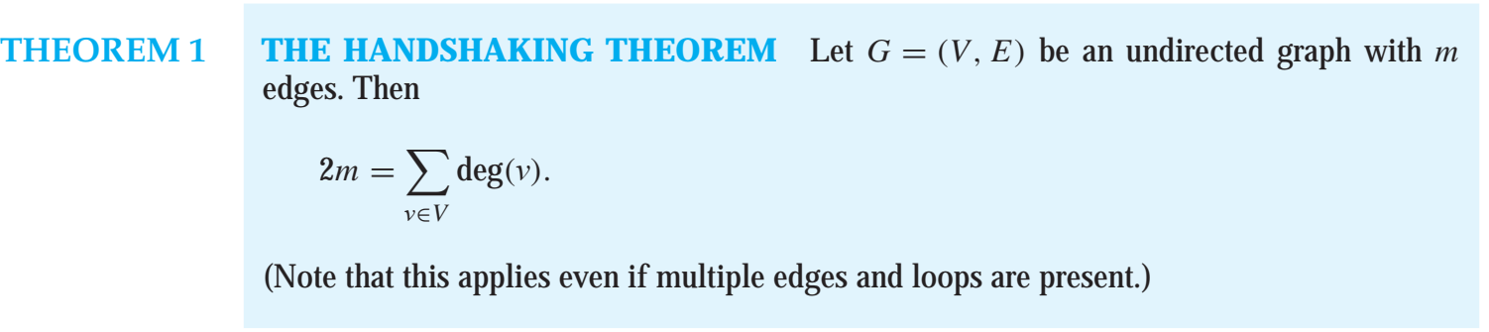

Slide 26
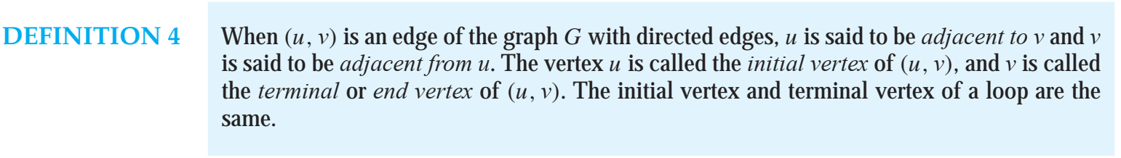

Slide 27
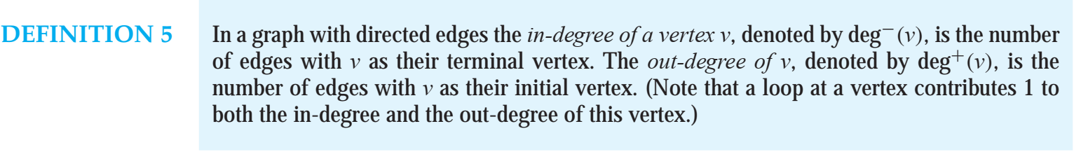

Slide 28
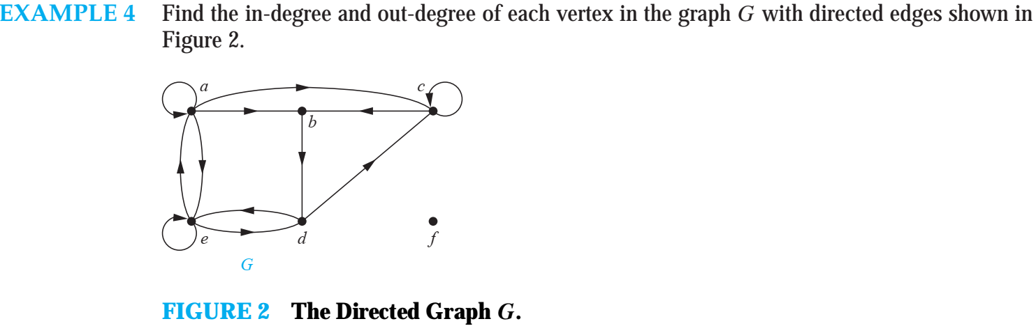

Slide 29
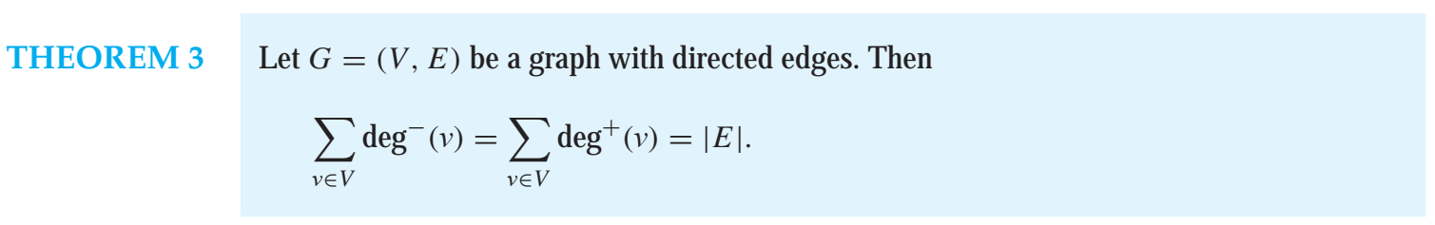

Slide 30
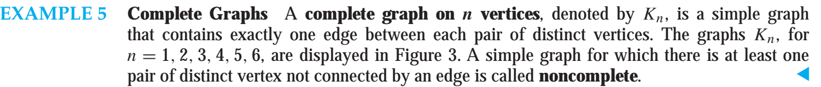
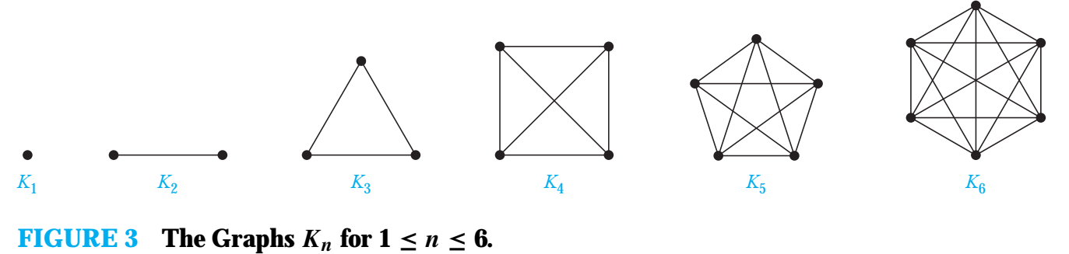

Slide 31
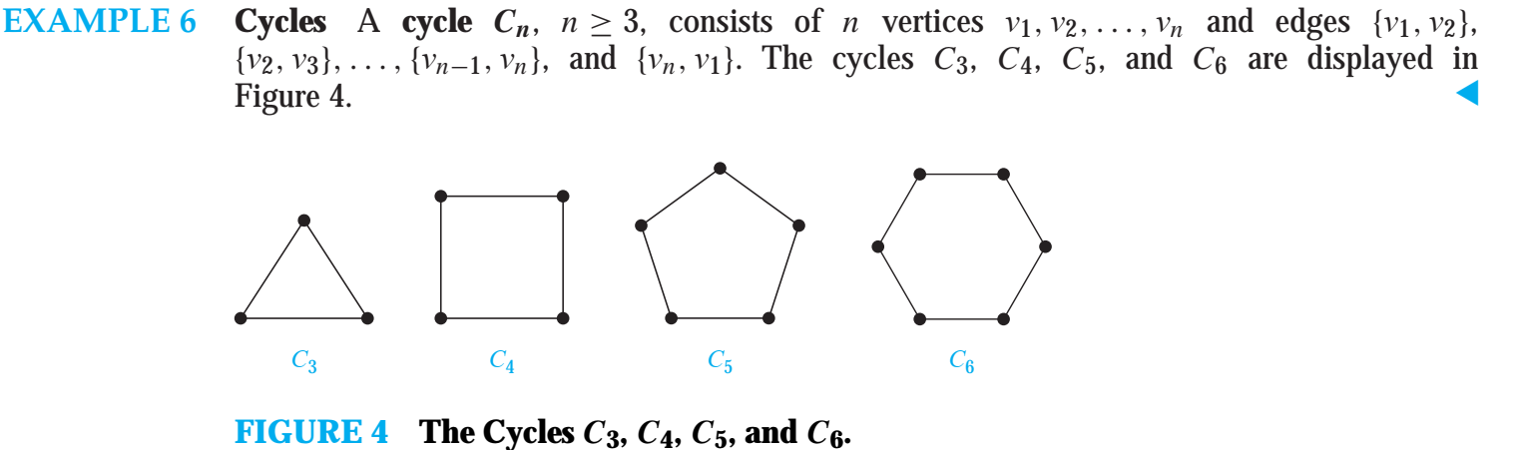

Slide 32
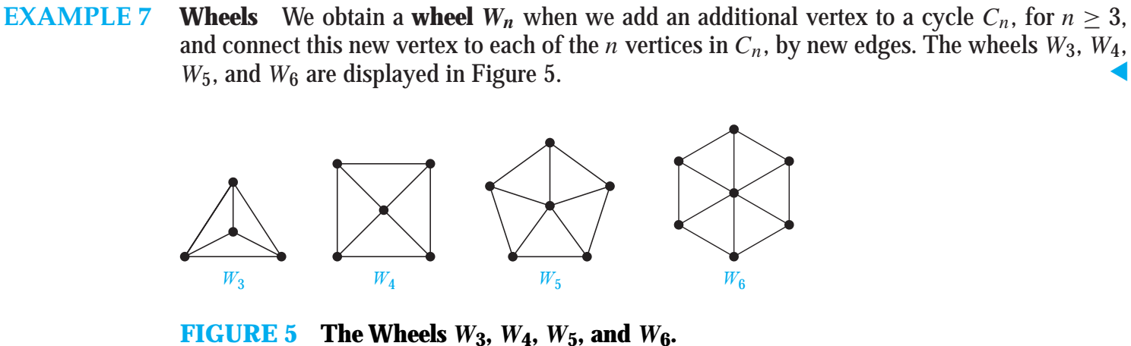

Slide 33
10.3 Representing Graphs and Graph Isomorphism
List all the edges of this graph.
Use adjacency lists, which specify the vertices that are adjacent to each vertex of the graph
Matrices
One is based on the adjacency of vertices,
The other is based on incidence of vertices and edges.

Slide 34
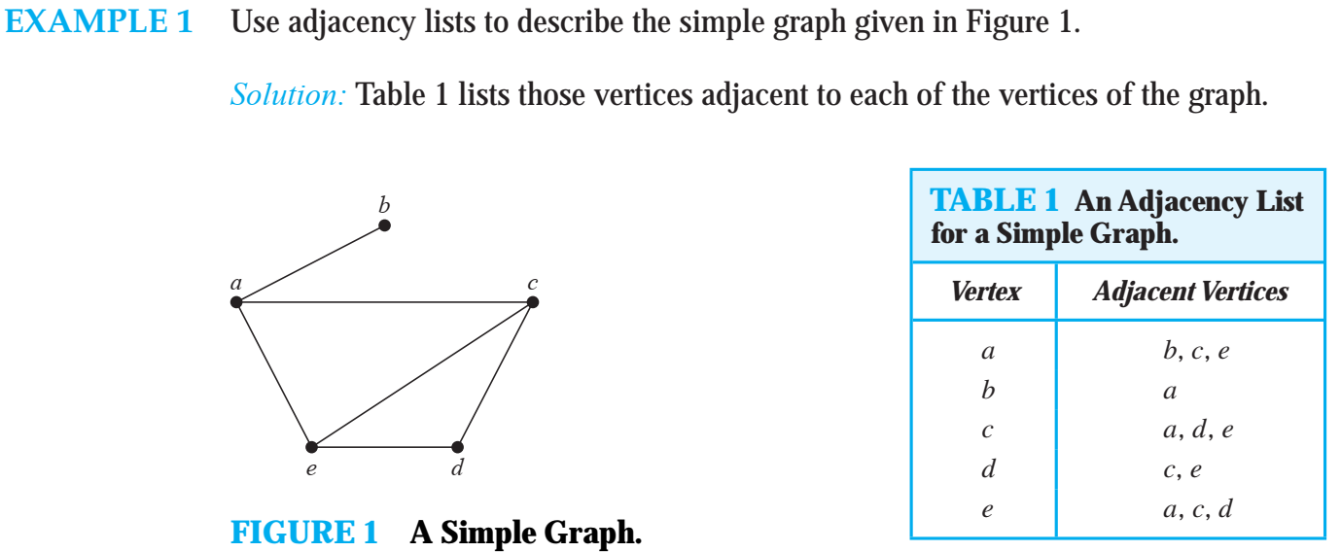

Slide 35
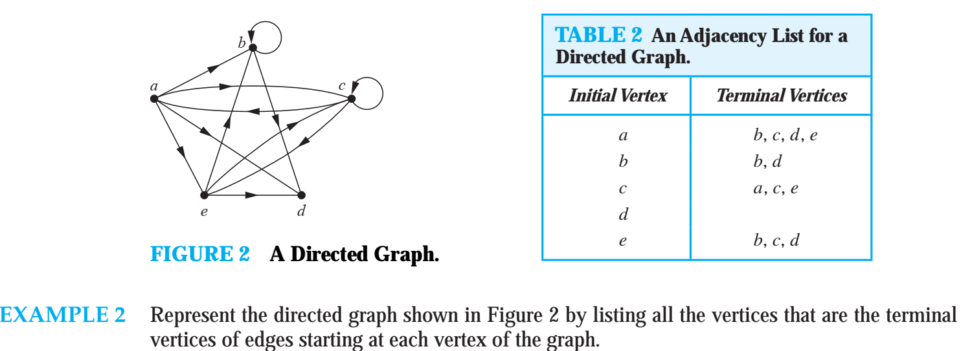

Slide 36
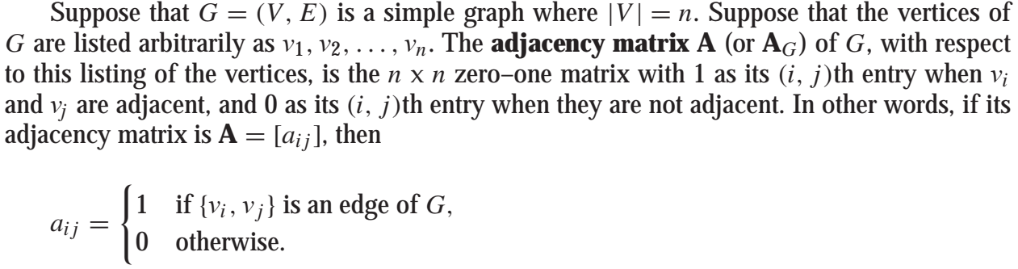
Adjacency Matrices

Slide 37
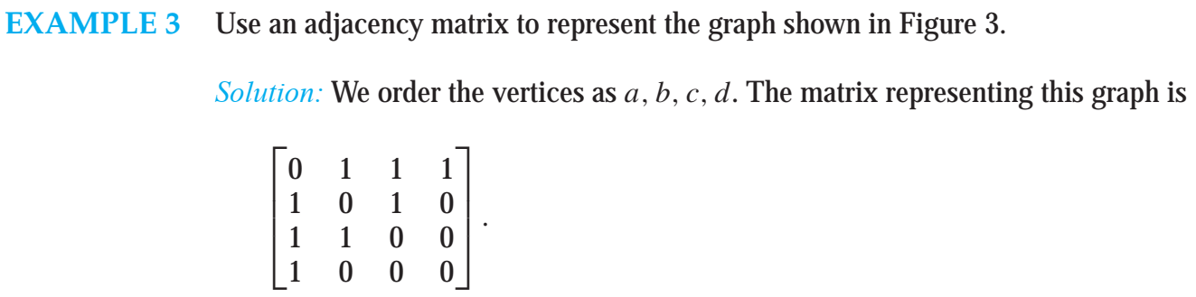
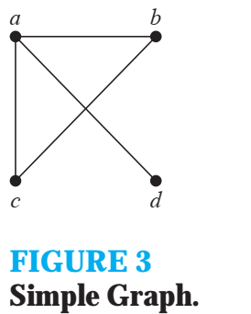

Slide 38
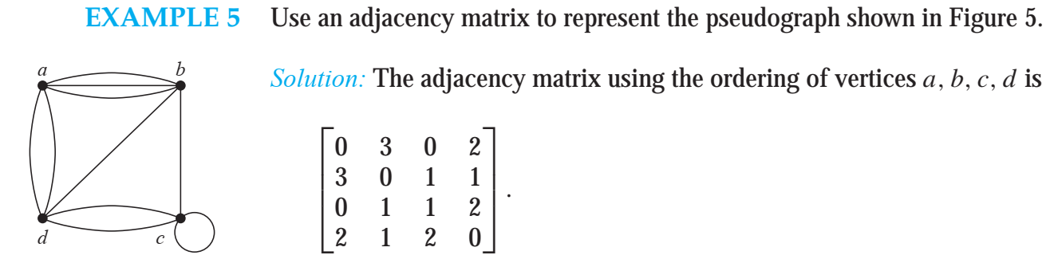


Slide 39
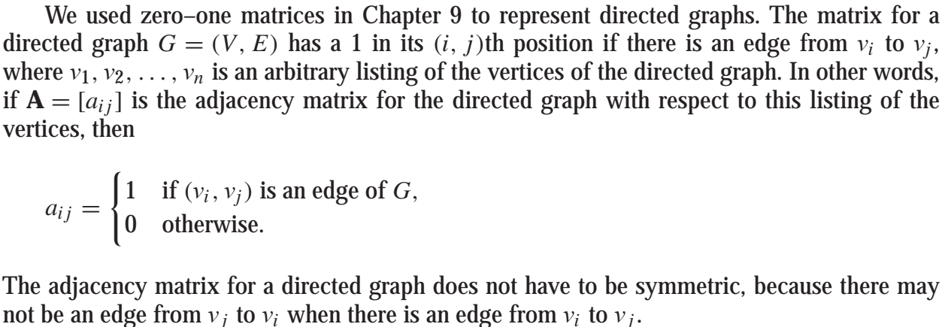

Slide 40
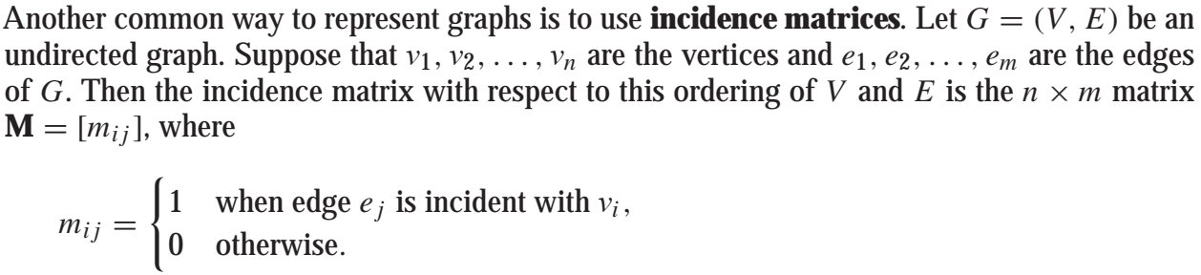
Incidence Matrices

Slide 41
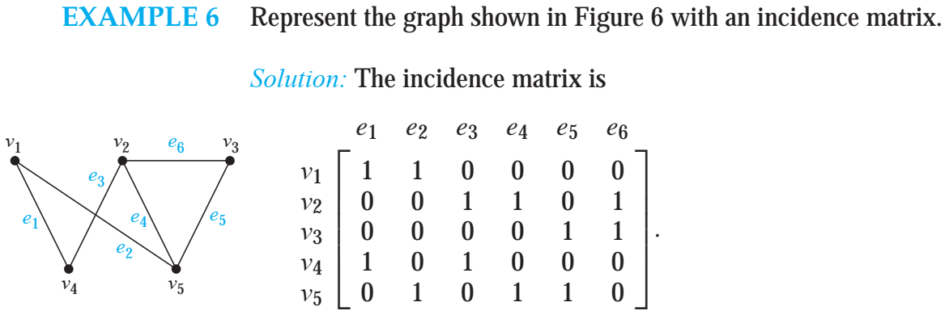
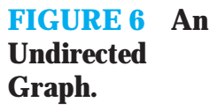

Slide 42
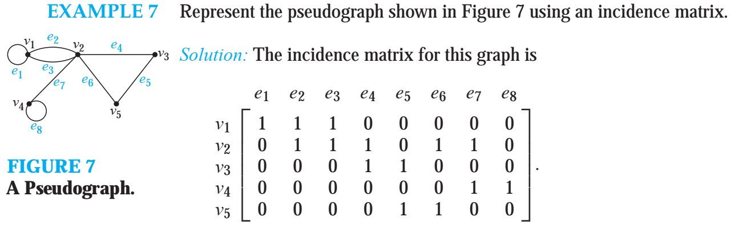

Slide 43
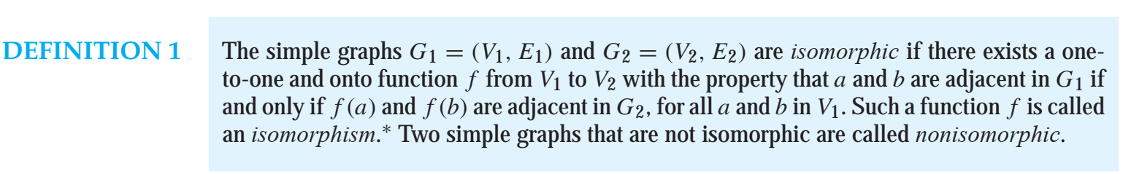

Slide 44
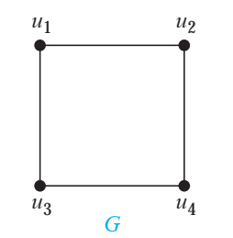
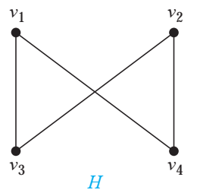


Slide 45
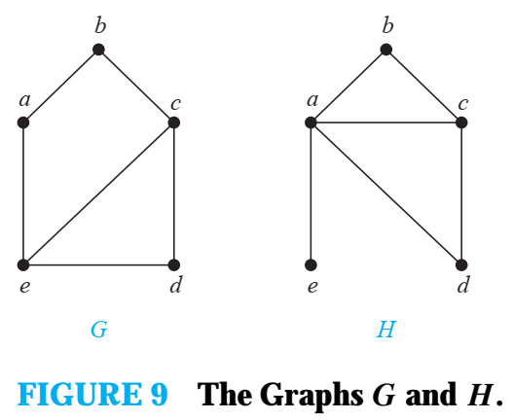

Slide 46
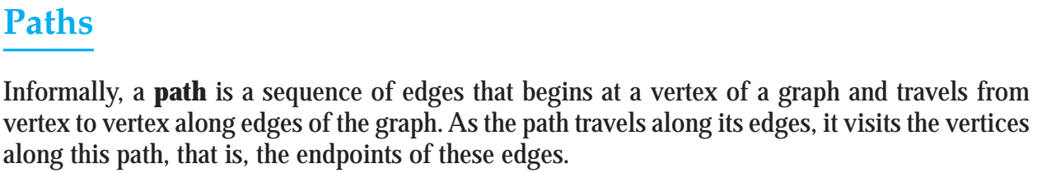
10.4 Connectivity
Many problems can be modeled with paths formed by traveling along the edges of graphs

Slide 47
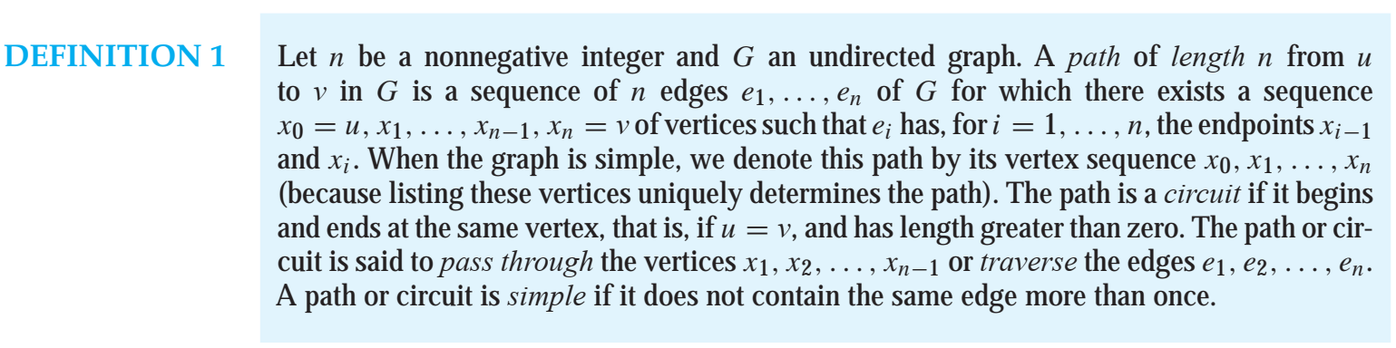

Slide 48
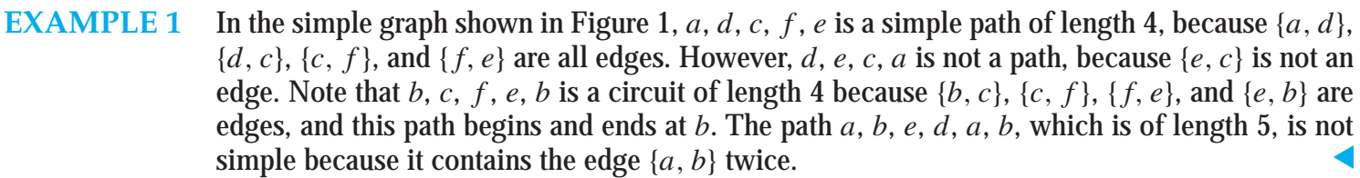
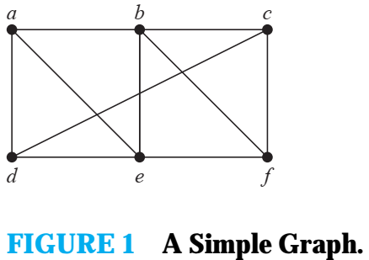

Slide 49
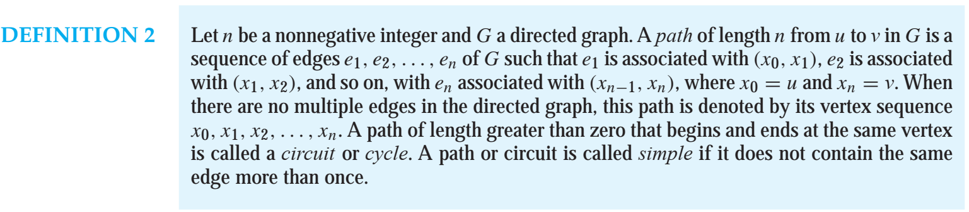

Slide 50
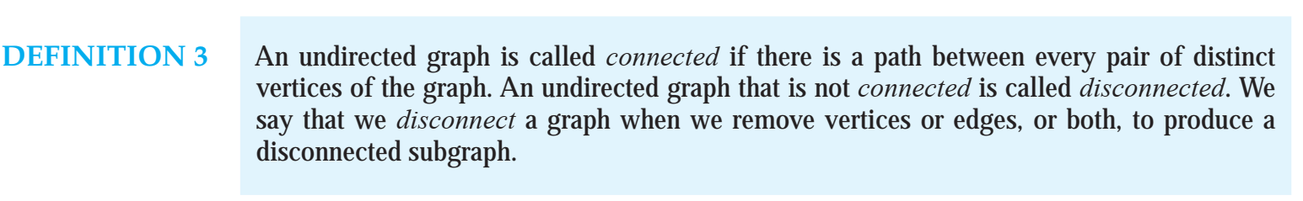
Connectedness in Undirected Graphs
When does a computer network have the property that every pair of computers can share information, if messages can be sent through one or more intermediate computers

Slide 51
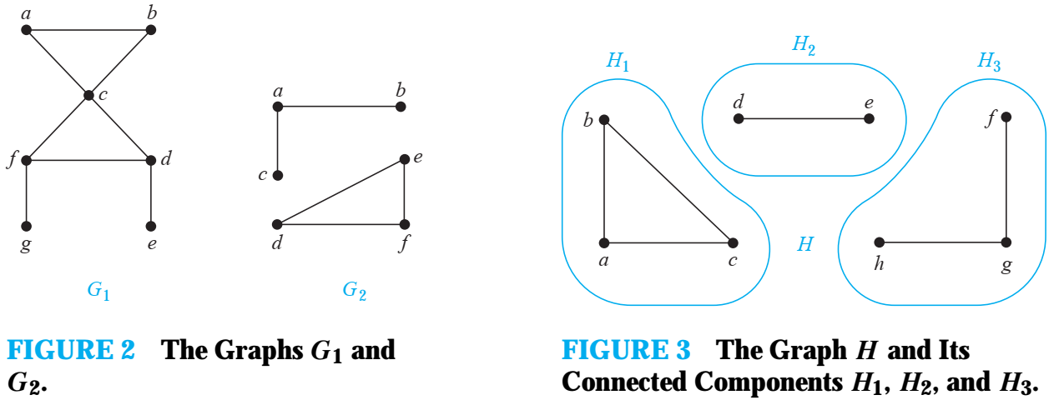

Slide 52
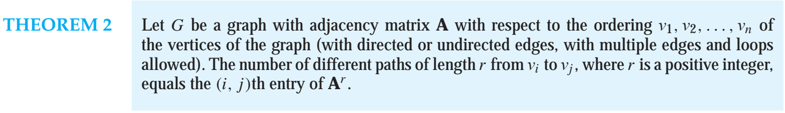
Counting Paths Between Vertices

Slide 53


