Slide 1
Chapter 2: An Overview of Collections
Fundamentals of Python: Data Structures, Second Edition

Slide 2
Learning Objectives
Define the four general categories of collections – linear, hierarchical, graph, and unordered
List the specific types of collections that belong to each of the four categories of collections
Recognize which collections are appropriate for given applications
Describe the commonly used operations on every type of collection
Describe the difference between an abstract collection type and its implementations

Slide 3
An Overview of Collections
Collection
A group of zero or more items that can be treated as a conceptual unit
All collections have the same fundamental purposes:
They help programmers effectively organize data in programs
They also help model the structure and behavior of objects in the real world
Collections can be viewed from two perspectives:
Users or clients of collections are concerned with what they do in various applications
Developers or implementers are concerned with how they can best perform as general-purpose resources

Slide 4
Collection Types (1 of 2)
Built-in collection types include
String, list, tuple, set, and dictionary
String and list are the most common and fundamental types
Other important types of collections include
Stacks, queues, priority queues, binary search trees, heaps, graphs, bags, and various types of sorted collections
Collections can be
Homogeneous – all items in the collection must be of the same type
Heterogeneous – items can be of different types

Slide 5
Collection Types (2 of 2)
Collections are typically dynamic rather than static:
Can grow or shrink with the needs of the problem
Contents can change throughout the course of a program
Exception to the above
Immutable collection – such as Python’s string or tuple
Items are added during its creation and no items can be added, removed, or replaced later
Categories of collections include
Linear, hierarchical, graph, unordered, and sorted

Slide 6
Linear Collections (1 of 2)
Items in a linear collection are ordered by position:
Each item (except the first) has a unique predecessor
Each item (except the last) has a unique successor

Slide 7
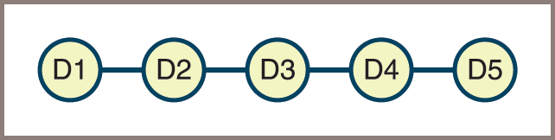
Linear Collections (2 of 2)
Figure 2-1: A linear collection

Slide 8
Hierarchical Collections (1 of 2)
Data items are ordered in a structure resembling an upside-down tree:
Each data item (except the top) has just one predecessor, called its parent, but potentially many successors, called its children

Slide 9
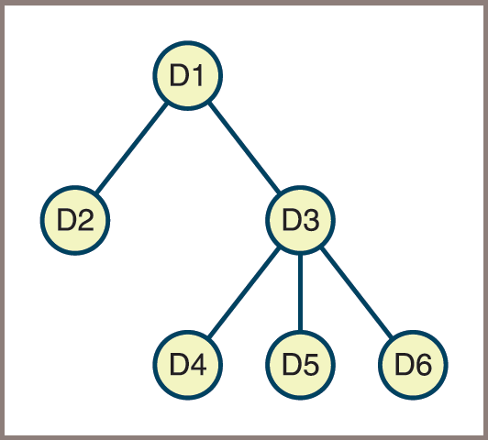
Hierarchical Collections (2 of 2)
Figure 2-2: A hierarchical collection

Slide 10
Graph Collections (1 of 2)
Each data item can have many predecessors and many successors

Slide 11
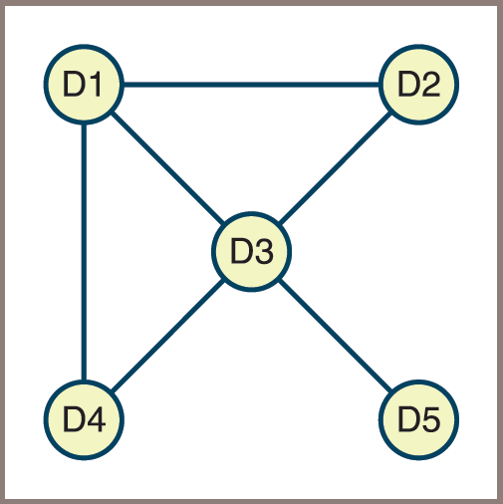
Graph Collections (2 of 2)
Figure 2-3: A graph collection

Slide 12
Unordered Collections (1 of 2)
Items are not in any particular order:
Not possible to meaningfully speak of an item’s predecessor or successor
Example
A bag of marbles

Slide 13
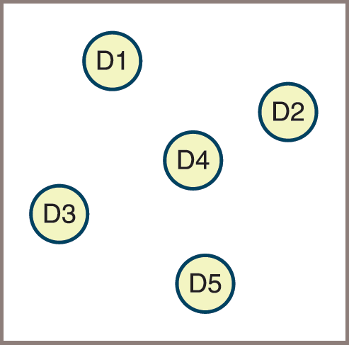
Unordered Collections (2 of 2)
Figure 2-4: An unordered collection

Slide 14
Sorted Collections
Imposes a natural ordering on its items
Examples
Entries in a phone book and the names on a class roster
Must be some rule for comparing items
Sorted list is the most common example of a sorted collection
A special type of hierarchical collection also imposes a natural ordering on its items,
Known as a binary search tree
Sorted collections allow clients to visit all of its items in sorted order

Slide 15
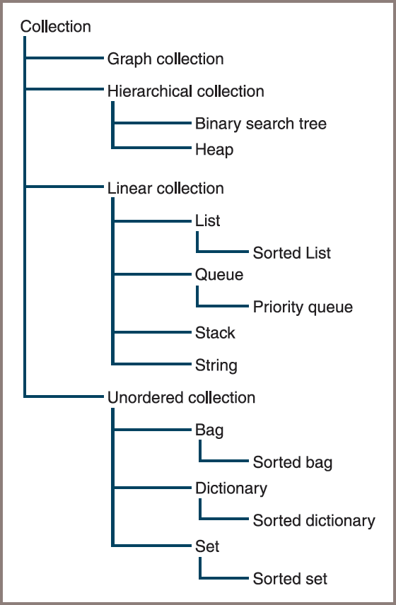
A Taxonomy of Collection Types
Figure 2-5: A taxonomy of collection types

Slide 16
Operations on Collections (1 of 2)
Category of Operation | Description
Determine the size | Use Python’s len function to obtain the number of items currently in the collection.
Test for item membership | Use Python’s in operator to search for a given target item in the collection. Returns True if the item is found, or False otherwise.
Traverse the collection | Use Python’s for loop to visit each item in the collection. The order in which the items are visited depends upon the type of collection.
Obtain a string representation | Use Python’s str function to obtain the string representation of the collection.
Test for equality | Use Python’s == operator to determine whether two collections are equal. Two collections are equal if they are of the same type and contain the same items. The order in which pairs of items are compared depends on the type of collection.

Slide 17
Operations on Collections (2 of 2)
Category of Operation | Description
Concatenate two collections | Use Python’s + operator to obtain a new collection of the same type as the operands, and containing the items in the two operands.
Convert to another type of collection | Create a new collection with the same items as a source collection. Cloning is a special case of type conversion, where the two collections are of the same type.
Insert an item | Add the item to the collection, possibly at a given position.
Remove an item | Remove the item from the collection, possibly at a given position.
Replace an item | Combine removal and insertion into one operation.
Access or retrieve an item | Obtain an item, possibly at a given position.

Slide 18
Fundamental Operations on All Collection Types
Note that several of these operations are associated with standard Python operators, functions, or control statements:
Such as in, +, len, str, and the for loop
There is no single name for
Insertion, removal, replacement, or access operations in Python
There are a few standard variations:
The method pop is used to remove items at given positions from a Python list or values at given keys from a Python dictionary
The method remove is used to remove given items from a Python set or a Python list

Slide 19
Type Conversion (1 of 2)
You might already know about type conversion from its use in the input of numbers:
Convert a string of digits from the keyboard to an int or float by applying the int or float function to the input string
You can convert one type of collection to another type of collection in a similar manner:
Converting a Python string to a Python list and a Python list to a Python tuple:
>>> message = "Hi there!"
>>> lyst = list(message)
>>> lyst
['H', 'i', ' ', 't', 'h', 'e', 'r', 'e', '!']
>>> toople = tuple(lyst)
>>> toople
('H', 'i', ' ', 't', 'h', 'e', 'r', 'e', '!')

Slide 20
Type Conversion (2 of 2)
Creating a list from a range:
>>> lyst = list(range(1, 11, 2))
>>> lyst
[1, 3, 5, 7, 9]
Other functions expect more specific types of iterable objects as arguments,
Such as a list of (key, value) tuples
If an argument is omitted,
A collection’s type conversion function returns a new, empty collection of that type

Slide 21
Cloning and Equality (1 of 2)
Cloning
A special case of type conversion
Returns an exact copy of the argument to the conversion function
Example – this code segment makes a copy of a list and then compares the two lists using the is and == operators:
>>> lyst1 = [2, 4, 8]
>>> lyst2 = list(lyst1)
>>> lyst1 is lyst2
False
>>> lyst1 == lyst2
True

Slide 22
Cloning and Equality (2 of 2)
The list function makes a shallow copy of its argument list
The items in the previous code are not themselves cloned before being added to the new list:
Instead, references to these objects are copied
When collections share mutable items,
Side effects can occur
To prevent this from happening, the programmer can create a deep copy by writing a for loop over the source collection
This explicitly clones its items before adding them to the new collection

Slide 23
Iterators and Higher-Order Functions
Each type of collection supports an iterator or for loop:
The order in which the for loop serves up a collection’s items depends on the manner in which the collection is organized
The for loop plays a useful role in the implementation of several other basic collection operations, such as
+, str, and type conversions
It also plays a role in standard Python functions, such as
Sum, max, and min
And also supports the use of higher-order functions, such as
Map, filter, and reduce
These functions can be used with any type of collection, not just lists

Slide 24
Implementations of Collections (1 of 3)
Programmers who use collections need to know how to instantiate and use each type of collection
From a user’s perspective, a collection is an abstraction:
For this reason, collections are also called abstract data types (ADTs)
Developers of collections
Are concerned with implementing a collection’s behavior in the most efficient manner possible
Some programming languages provide only one implementation of each of the available collection types:
Python is one of those
Java provides several

Slide 25
Implementations of Collections (2 of 3)
One aim of this book is to give Python programmers the same options as the Java programmer
As well as introduce abstract collection types and their implementations that are not available in either language
For each category of collection,
You’ll see one or more abstract collection types and one or more implementations of each type
A software system is often built layer by layer
With each layer treated as an abstraction by the layers above that utilize it
Without abstraction,
You would need to consider all aspects of a software system simultaneously

Slide 26
Implementations of Collections (3 of 3)
In Python,
Functions and methods are the smallest units of abstraction
Classes are next in size
Modules are the largest
This text implements abstract collection types as classes or sets of related classes in modules
General techniques for organizing these classes are covered in Chapter 5 and Chapter 6

Slide 27
Chapter Summary (1 of 2)
Collections are objects that hold zero or more objects:
A collection has operations for accessing its objects, inserting them, removing them, determining the collection’s size, and traversing or visiting the collection’s objects
The five main categories of collections are linear, hierarchical, graph, unordered, and sorted
Linear collections order their items by position, with each but the first having a unique predecessor and each but the last having a unique successor
With one exception, the items in a hierarchical collection have a unique predecessor and zero or more successors:
A single item called the root has no predecessor

Slide 28
Chapter Summary (2 of 2)
The items in a graph can have zero or more successors and zero or more predecessors
The items in an unordered collection are in no particular order
Collections are iterable—each item contained within a collection can be visited with a for loop:
The programmer can also use the higher-order functions map, filter, and reduce to simplify data processing with collections
An abstract data type is a set of objects and operations on those objects:
Collections are thus abstract data types
A data structure is an object that represents the data contained in a collection

