Slide 1
Chapter 3: Searching, Sorting, and Complexity
Fundamentals of Python: Data Structures, Second Edition
Fundamentals of Python: Data Structures, Second Edition. © 2019 Cengage. May not be copied, scanned, or duplicated, in whole or in part, except for use as permitted in a license distributed with a certain product or service or otherwise on a password-protected website for classroom use.

Slide 2
Learning Objectives
Determine the rate of growth of the work of an algorithm in terms of its problem size
Use big-O notation to describe the running time and memory usage of an algorithm
Recognize the common rates of growth of work, or complexity classes – constant, logarithmic, linear, quadratic, and exponential
Convert an algorithm to a faster version that reduces its complexity by an order of magnitude
Describe how the sequential search and binary search algorithms work
Describe how the selection sort and quicksort algorithms work

Slide 3
Measuring the Efficiency of Algorithms
When choosing algorithms,
You often have to settle for a space/time trade-off
An algorithm can be designed to gain faster run times
At the cost of using extra space (memory) or the other way around
Space/time trade-off is more relevant for miniature devices

Slide 4
Measuring the Run Time of an Algorithm (1 of 6)
Use the computer’s clock to obtain an actual run time:
Process is called benchmarking or profiling
Starts by determining the time for several different data sets of the same size and then calculates the average time
Next, similar data are gathered for larger and larger data sets:
After several tests, enough data are available to predict how the algorithm will behave for a data set of any size
Code for a tester program is found on the following slide

Slide 5
Measuring the Run Time of an Algorithm (2 of 6)
"""
File: timing1.py
Prints the running times for problem sizes that double,
using a single loop.
"""
import time
problemSize = 10000000
print("%12s%16s" % ("Problem Size", "Seconds"))
for count in range(5):
start = time.time()
# The start of the algorithm
work = 1
for x in range(problemSize):
work += 1
work -= 1
# The end of the algorithm
elapsed = time.time() - start
print("%12d%16.3f" % (problemSize, elapsed))
problemSize *= 2

Slide 6
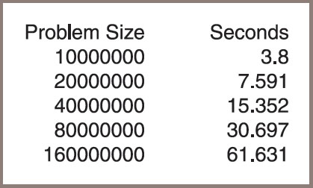
Measuring the Run Time of an Algorithm (3 of 6)
Figure 3-1: The output of the tester program

Slide 7
Measuring the Run Time of an Algorithm (4 of 6)
As another example, consider the following change in the tester’s program’s algorithm:
for j in range(problemSize):
for k in range(problemSize):
work += 1
work -= 1
The extended assignments have been moved into a nested loop:
Loop iterates through the size of the problem within another loop that also iterates through the size of the problem
The results are shown in Figure 3.2 on the following slide.

Slide 8
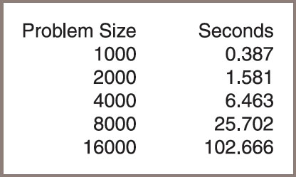
Measuring the Run Time of an Algorithm (5 of 6)
Figure 3-2: The output of the second tester program

Slide 9
Measuring the Run Time of an Algorithm (6 of 6)
This method permits accurate predictions of running times of many algorithms with only two problems:
Different hardware platforms have different processing speeds, so the running times of an algorithm differ from machine to machine
It is impractical to determine the running time for some algorithms with very large data sets

Slide 10
Counting Instructions (1 of 5)
Another technique to estimate efficiency of an algorithm
Count the instructions executed with different problem sizes
When analyzing an algorithm this way, you distinguish between two classes of instructions:
Instructions that execute the same number of times regardless of the problem size
Instructions whose execution count varies with the problem size
For now, ignore the instructions in the first class:
They do not figure significantly in this kind of analysis
The instructions in the second class normally are found in loops or recursive functions:
In the case of loops, zero in on instructions performed in any nested loops

Slide 11
Counting Instructions (2 of 5)
"""
File: counting.py
Prints the number of iterations for problem sizes
that double, using a nested loop.
"""
problemSize = 1000
print("%12s%15s" % ("Problem Size", "Iterations"))
for count in range(5):
number = 0
# The start of the algorithm
work = 1
for j in range(problemSize):
for k in range(problemSize):
number += 1
work += 1
work -= 1
# The end of the algorithm
print("%12d%15d" % (problemSize, number))
problemSize *= 2

Slide 12
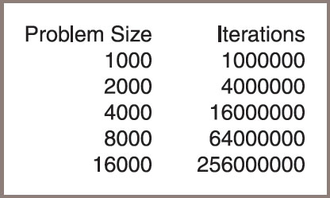
Counting Instructions (3 of 5)
Figure 3-3: The output of a tester program that counts iterations

Slide 13
Counting Instructions (4 of 5)
>"""
File: countfib.py
Prints the number of calls of a recursive Fibonacci
function with problem sizes that double.
"""
from counter import Counter
def fib(n, counter):
"""Count the number of calls of the Fibonacci function."""
counter.increment()
if n < 3:
return 1
else:
return fib(n − 1, counter) + fib(n − 2, counter)
problemSize = 2
print("%12s%15s" % ("Problem Size", "Calls"))
for count in range(5):
counter = Counter()
# The start of the algorithm
fib(problemSize, counter)
# The end of the algorithm
print("%12d%15s" % (problemSize, counter))
problemSize *= 2

Slide 14
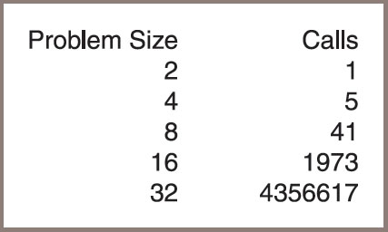
Counting Instructions (5 of 5)
Figure 3-4: The output of a tester program that runs the Fibonacci function

Slide 15
Measuring the Memory Used by an Algorithm
A complete analysis of the resources used by an algorithm includes the amount of memory required:
Once again, focus on rates of potential growth
Some algorithms require the same amount of memory to solve any problem
Other algorithms require more memory as the problem size gets larger
Later chapters consider several of these algorithms

Slide 16
Complexity Analysis
This section focuses on developing a method of determining the efficiency of algorithms that allows you to rate them
Independently of platform-dependent timings or impractical instruction counts
This method is called complexity analysis:
Entails reading the algorithm and using pencil and paper to work out some simple algebra

Slide 17
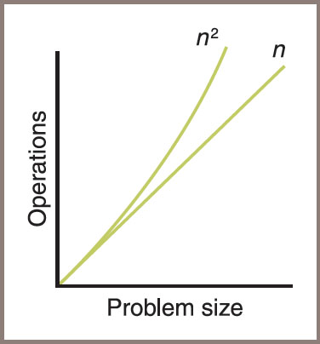
Orders of Complexity (1 of 5)
Figure 3-5: A graph of the amounts of work done in the tester programs

Slide 18
Orders of Complexity (2 of 5)
Table 3.1 The Amounts of Work in the Tester Programs
Problem Size | Work of the First Algorithm | Work of the Second Algorithm
2 | 2 | 4
10 | 10 | 100
1000 | 1000 | 1,000,000

Slide 19
Orders of Complexity (3 of 5)
Performances of these algorithms differ by an order of complexity:
First algorithm is linear – work grows in direct proportion to the size of the problem
Second algorithm is quadratic – work grows as a function of the square of the problem size
Other orders:
Constant – requires the same number of operations for any problem size
Logarithmic – amount of work is proportional to the log₂ of the problem size
Polynomial time – grows at a rate of
where k is a constant greater than 1
Exponential – example rate of growth of this order is

Slide 20
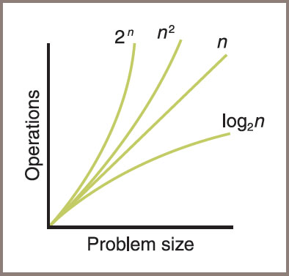
Orders of Complexity (4 of 5)
Figure 3-6: A graph of some sample orders of complexity

Slide 21
Orders of Complexity (5 of 5)
Table 3.2 Some Sample Orders of Complexity
n | Logarithmic (log₂n) | Linear (n) | Quadratic (n squared) | Exponential (2 to the power n)
100 | 7 | 100 | 10,000 | Off the chart
1,000 | 10 | 1000 | 1,000,000 | Off the chart
1,000,000 | 20 | 1,000,000 | 1,000,000,000,000 | Really off the chart

Slide 22
Big-O-Notation (1 of 2)
An algorithm rarely performs a number of operations exactly equal to
An algorithm usually performs other work in the body of a loop, above the loop, and below the loop
Whenever the amount of work is expressed as a polynomial, one term is dominant:
As n becomes large, the dominant term becomes so large that you can ignore the amount of work represented by the other terms
For example,
In the polynomial
you focus on the quadratic term,
in effect dropping the linear term,
from consideration
You can also drop the coefficient
because the ratio between
does not change as n grows

Slide 23
Big-O-Notation (2 of 2)
One notation used to express the efficiency or computational complexity of an algorithm is called big-O notation:
“O” stands for “on the order of,” a reference to the order of complexity of the work of the algorithm
For example,
The order of complexity of a linear-time algorithm is O(n)
Big-O notation formalizes our discussion of orders of complexity

Slide 24
The Role of the Constant of Proportionality
Constant of proportionality
Involves the terms and coefficients that are usually ignored during the big-O analysis
For example,
The work performed by a linear time algorithm might be expressed as work = 2 * size, where the constant of proportionality, 2 in this case, is work / size
Try to determine the constant of proportionality for the first algorithm discussed in this chapter – the code:
work = 1
for x in range(problemSize):
work += 1
work -= 1</

Slide 25
Search Algorithms
This section covers several algorithms that can be used for searching and sorting lists
You will
Learn the design of an algorithm
See its implementation as a Python function
See an analysis of the algorithm’s computational complexity

Slide 26
Search for the Minimum
Python code for algorithm in function indexOfMin:
def indexOfMin(lyst):
"""Returns the index of the minimum item."""
minIndex = 0
currentIndex = 1
while currentIndex < len(lyst):
if lyst[currentIndex] < lyst[minIndex]:
minIndex = currentIndex
currentIndex += 1
return minIndex

Slide 27
Sequential Search of a List
Python code for a sequential search function:
def sequentialSearch(target, lyst):
"""Returns the position of the target item if found,
or -1 otherwise."""
position = 0
while position < len(lyst):
if target == lyst[position]:
return position
position += 1
return -1

Slide 28
Best-Case, Worst-Case, and Average-Case Performance
The performance of some algorithms depends on the placement of the data processed:
The sequential search algorithm does less work to find a target at the beginning of a list than at the end of the list
Analysis of a sequential search considers three cases:
In the worst case, the target item is at the end of the list or not in the list at all:
Algorithm must visit every item and perform n iterations for a list of size n
Thus, the worst-case complexity of a sequential search is O(n)
In the best case, the algorithm finds the target at the first position, after making one iteration, for an O(1) complexity
To determine the average case, add the number of iterations required to find the target at each possible position and divide the sum by n:
Thus, the algorithm performs

Slide 29
Binary Search of a Sorted List (1 of 2)
Python code for the binary search function:
def binarySearch(target, sortedLyst):
left = 0
right = len(sortedLyst) - 1
while left <= right:
midpoint = (left + right) // 2
if target == sortedLyst[midpoint]:
return midpoint
elif target < sortedLyst[midpoint]:
right = midpoint - 1
else:
left = midpoint + 1
return -1

Slide 30
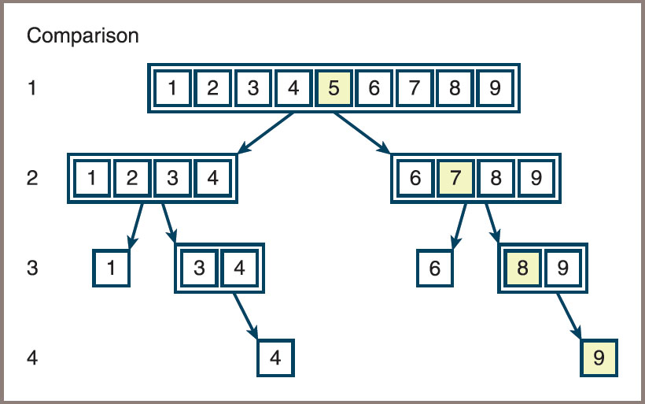
Binary Search of a Sorted List (2 of 2)
Figure 3-7: The items of a list visited during a binary search for 10

Slide 31
Comparing Data Items (1 of 3)
To allow algorithms to use the comparison operators ==, <, and > with a new class of objects,
The programmer should define the __eq__, __lt__, and __gt__ methods in that class
If you do this, the methods for the other comparison operators will automatically be provided
The header of __lt__ is the following:
def __lt__(self, other):
This method returns True if self is less than other, or False otherwise

Slide 32
Comparing Data Items (2 of 3)
The criteria for comparing the objects depend on their internal structure and on the manner in which they should be ordered
For example:
class SavingsAccount(object):
"""This class represents a savings account
with the owner’s name, PIN, and balance."""
def __init__(self, name, pin, balance = 0.0):
self.name = name
self.pin = pin
self.balance = balance
def __lt__(self, other):
return self.name < other.name
# Other methods, including __eq__

Slide 33
Comparing Data Items (3 of 3)
<CDTX>>>> s1 = SavingsAccount("Ken", "1000", 0)
>>> s2 = SavingsAccount("Bill", "1001", 30)
>>> s1 < s2
False
>>> s2 < s1
True
>>> s1 > s2
True
>>> s2 > s1
False
>>> s2 == s1
False
>>> s3 = SavingsAccount("Ken", "1000", 0)
>>> s1 == s3
True
>>> s4 = s1
>>> s4 == s1
True

Slide 34
Basic Sort Algorithms
Each of the Python sort functions that are developed operates on a list of integers and uses a swap function to exchange the positions of two items in the list
Here is the code for that function:
def swap(lyst, i, j):
"""Exchanges the items at positions i and j."""
# You could say lyst[i], lyst[j] = lyst[j], lyst[i]
# but the following code shows what is really going on
temp = lyst[i]
lyst[i] = lyst[j]
lyst[j] = temp

Slide 35
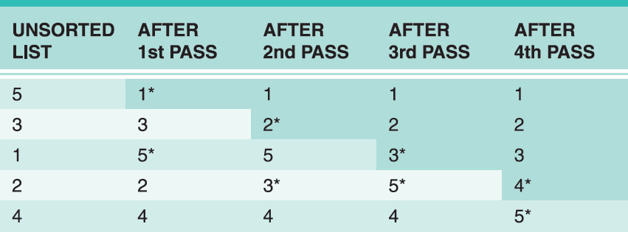
Selection Sort (1 of 2)
Figure 3.8 shows the states of a list of five items after each search and swap pass of a selection sort:
The two items just swapped on each pass have asterisks next to them and the sorted portion of the list is shaded
Figure 3-8: A trace of data during a selection sort

Slide 36
Selection Sort (2 of 2)
Python function for a selection sort:
def selectionSort(lyst):
i = 0
while i < len(lyst) - 1: # Do n - 1 searches
minIndex = i # for the smallest
j = i + 1
while j < len(lyst): # Start a search
if lyst[j] < lyst[minIndex]:
minIndex = j
j += 1
if minIndex != i: # Exchange if needed
swap(lyst, minIndex, i)
i += 1

Slide 37
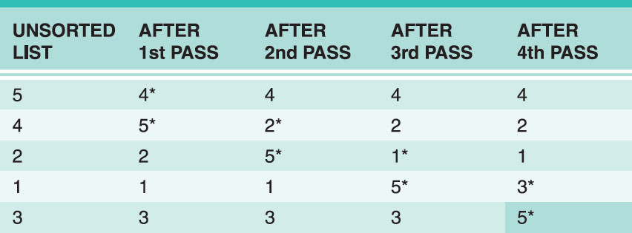
Bubble Sort (1 of 2)
Figure 3.9 shows a trace of the bubbling process through a list of five items:
This process makes four passes through a nested loop to bubble the largest item down to the end of the list
Figure 3-9: A trace of data during a bubble sort

Slide 38
Bubble Sort (2 of 2)
You can make a minor adjustment to the bubble sort to improve its best-case performance to linear
Modified bubble sort function:
def bubbleSortWithTweak(lyst):
n = len(lyst)
while n > 1:
swapped = False
i = 1
while i < n:
if lyst[i] < lyst[i - 1]: # Exchange if needed
swap(lyst, i, i - 1)
swapped = True
i += 1
if not swapped: return # Return if no swaps
n -= 1

Slide 39
Insertion Sort (1 of 3)
An insertion sort attempts to exploit the partial ordering of the list in a different way
The strategy:
On the ith pass through the list, where i ranges from 1 to n − 1, the ith item should be inserted into its proper place among the first i items in the list
After the ith pass, the first i items should be in sorted order:
This process is analogous to the way in which many people organize playing cards in their hands. That is, if you hold the first i − 1 cards in order, you pick the ith card and compare it to these cards until its proper spot is found
Insertion sort consists of two loops:
The outer loop traverses the positions from 1 to n − 1
For each position i in this loop, you save the item and start the inner loop at position i − 1
For each position j in this loop, you move the item to position j + 1 until you find the insertion point for the saved (ith) item

Slide 40
Insertion Sort (2 of 3)
Code for the insertionSort function:
def insertionSort(lyst):
i = 1
while i < len(lyst):
itemToInsert = lyst[i]
j = i - 1
while j >= 0:
if itemToInsert < lyst[j]:
lyst[j + 1] = lyst[j]
j -= 1
else:
break
lyst[j + 1] = itemToInsert
i += 1

Slide 41
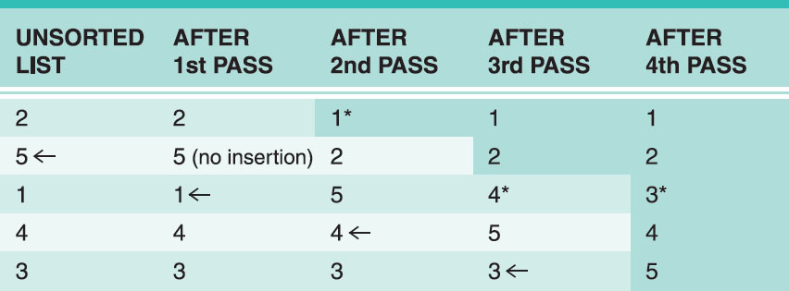
Insertion Sort (3 of 3)
Figure 3-10: A trace of data during insertion sort

Slide 42
Best-Case, Worst-Case, and Average-Case Performance Revisited
Best case
Under what circumstances does an algorithm do the least amount of work?
What is the algorithm’s complexity in this best case?
Worst case
Under what circumstances does an algorithm do the most amount of work?
What is the algorithm’s complexity in this worst case?
Average case
Under what circumstances does an algorithm do a typical amount of work?
What is the algorithm’s complexity in this typical case?

Slide 43
Faster Sorting (1 of 2)
The secret to these better algorithms is a divide-and-conquer strategy:
Each algorithm finds a way of breaking the list into smaller sublists
These sublists are then sorted recursively
Ideally, if the number of these subdivisions is log(n) and the amount of work needed to rearrange the data on each subdivision is n,
Then the total complexity of such a sort algorithm is O(n log n)

Slide 44
Faster Sorting (2 of 2)
Table 3.3 Comparing n log n and
n | n log n | ^{n squared}
512 | 4608 | 262,144
1024 | 10240 | 1,048,576
2048 | 22,458 | 4,194,304
8192 | 106,496 | 67.108,864
16,384 | 229,376 | 268,435,456
32,768 | 491,520 | 1,073,741,824

Slide 45
Overview of Quicksort (1 of 5)
Outline of the strategy used in the quicksort algorithm:
Select the item at the list’s midpoint (called the pivot)
Partition items in the list so that all items less than the pivot are moved to the left of the pivot (rest are moved to the right)
Divide and conquer
Process terminates each time it encounters a sublist with fewer than two items
Partitioning
The most complicated part of the algorithm is partitioning the items in a sublist
See Figures 3.11 and 3.12 on the following slides for an illustration of the steps

Slide 46
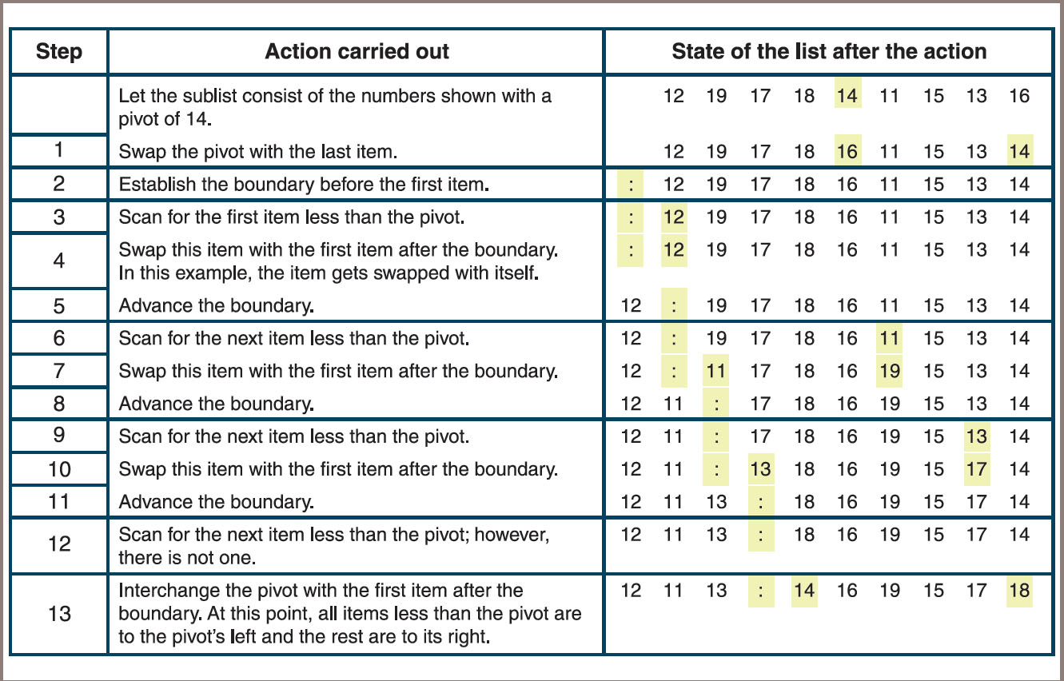
Overview of Quicksort (2 of 5)
Figure 3-11: Partitioning a sublist

Slide 47
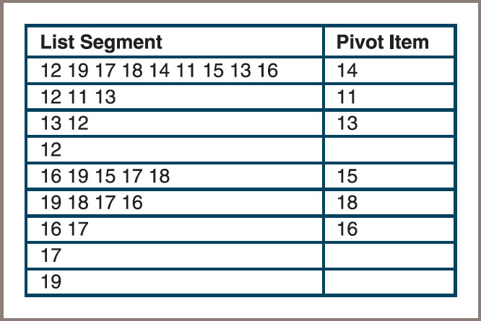
Overview of Quicksort (3 of 5)
Figure 3-12: Partitioning a sublist

Slide 48
Overview of Quicksort (4 of 5)
Complexity analysis of quicksort
During the first partition operation, you scan all the items from the beginning of the list to its end
The amount of work during this operation is proportional to n, the list’s length
The amount of work after this partition is proportional to the left sublist’s length plus the right sublist’s length, which together yield n − 1
When these sublists are divided, there are four pieces whose combined length is approximately n, so the combined work is proportional to n yet again
As the list is divided into more pieces, the total work remains proportional to n.
To complete the analysis, you need to determine how many times the lists are partitioned

Slide 49
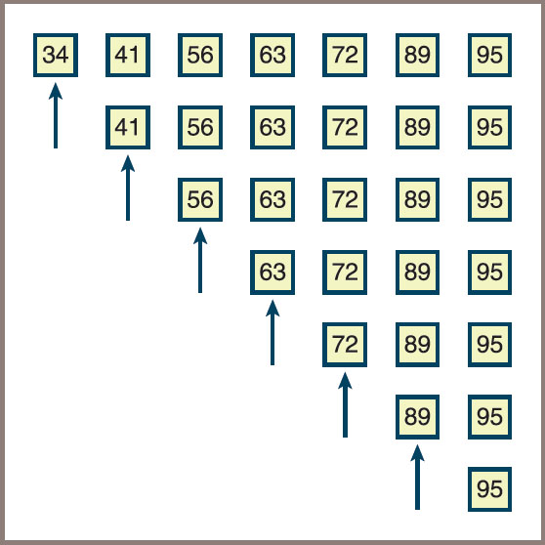
Overview of Quicksort (5 of 5)
Figure 3-13: A worst-case scenario for quicksort (arrows indicate pivot elements)

Slide 50
Implementation of Quicksort (1 of 2)
The quicksort algorithm is most easily coded using a recursive approach
The following script defines a top-level quicksort function for the client, a recursive quicksortHelper function to hide the extra arguments for the endpoints of a sublist, and a partition function:
Script is continued on the next slide
def quicksort(lyst):
quicksortHelper(lyst, 0, len(lyst) - 1)
def quicksortHelper(lyst, left, right):
if left < right:
pivotLocation = partition(lyst, left, right)
quicksortHelper(lyst, left, pivotLocation - 1)
quicksortHelper(lyst, pivotLocation + 1, right)

Slide 51
Implementation of Quicksort (2 of 2)
def partition(lyst, left, right):
# Find the pivot and exchange it with the last item
middle = (left + right) // 2
pivot = lyst[middle]
lyst[middle] = lyst[right]
lyst[right] = pivot
# Set boundary point to first position
boundary = left
# Move items less than pivot to the left
for index in range(left, right):
if lyst[index] < pivot:
swap(lyst, index, boundary)
boundary += 1
# Exchange the pivot item and the boundary item
swap (lyst, right, boundary)
return boundary
# Earlier definition of the swap function goes here
import random
def main(size = 20, sort = quicksort):
lyst = []
for count in range(size):
lyst.append(random.randint(1, size + 1))
print(lyst)
sort(lyst)
print(lyst)
if __name__ == "__main__":
main()

Slide 52
Merge Sort (1 of 7)
A merge sort employs a recursive, divide-and-conquer strategy to break the O
Compute the middle position of a list and recursively sort its left and right sublists
Merge the two sorted sublists back into a single sorted list
Stop the process when sublists can no longer be subdivided
Three Python functions collaborate:
Function called by users
Helper function that hides the extra parameters required by recursive calls
A function that implements the merging process

Slide 53
Merge Sort (2 of 7)
Implementing the merging process
Merging process uses an array of the same size as the list
Array is called the copyBuffer
The buffer is allocated once in mergeSort and subsequently passed as an argument to mergeSortHelper and merge
Code for mergeSort:
from arrays import Array
def mergeSort(lyst):
# lyst list being sorted
# copyBuffer temporary space needed during merge
copyBuffer = Array(len(lyst))
mergeSortHelper(lyst, copyBuffer, 0, len(lyst) - 1)

Slide 54
Merge Sort (3 of 7)
Code for mergeSortHelper:
def mergeSortHelper(lyst, copyBuffer, low, high):
# lyst list being sorted
# copyBuffer temp space needed during merge
# low, high bounds of sublist
# middle midpoint of sublist
if low < high:
middle = (low + high) // 2
mergeSortHelper(lyst, copyBuffer, low, middle)
mergeSortHelper(lyst, copyBuffer, middle + 1, high)
merge(lyst, copyBuffer, low, middle, high)

Slide 55
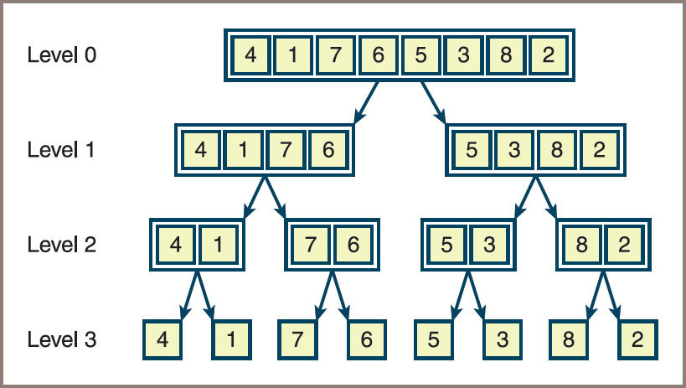
Merge Sort (4 of 7)
Figure 3-14: Sublists generated during calls of mergeSortHelper

Slide 56
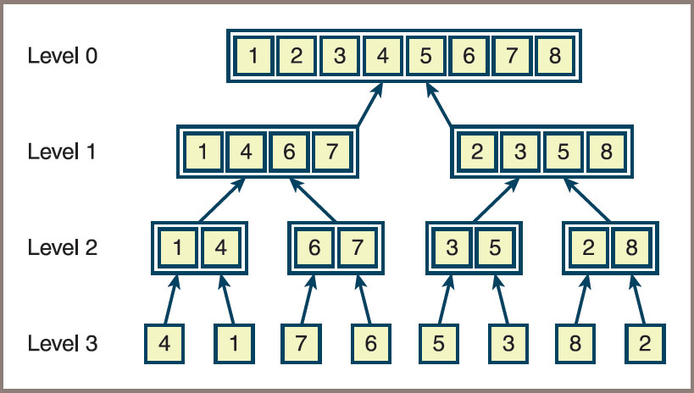
Merge Sort (5 of 7)
Figure 3-15: Merging the sublists generated during a merge sort

Slide 57
Merge Sort (6 of 7)
Code for the merge function:
def merge(lyst, copyBuffer, low, middle, high):
# lyst list that is being sorted
# copyBuffer temp space needed during the merge process
# low beginning of first sorted sublist
# middle end of first sorted sublist
# middle + 1 beginning of second sorted sublist
# high end of second sorted sublist
# Initialize i1 and i2 to the first items in each sublist
i1 = low
i2 = middle + 1
# Interleave items from the sublists into the
# copyBuffer in such a way that order is maintained.
for i in range(low, high + 1):
if i1 > middle:
copyBuffer[i] = lyst[i2] # First sublist exhausted
i2 += 1
elif i2 > high:
copyBuffer[i] = lyst[i1] # Second sublist exhausted
i1 += 1
elif lyst[i1] < lyst[i2]:
copyBuffer[i] = lyst[i1] # Item in first sublist <
i1 += 1
else:
copyBuffer[i] = lyst[i2] # Item in second sublist <
i2 += 1
for i in range(low, high + 1): # Copy sorted items back to
lyst[i] = copyBuffer[i] # proper position in lyst

Slide 58
Merge Sort (7 of 7)
Complexity analysis for merge sort
The running time of the merge function is dominated by the two for statements, each of which loops (high − low + 1) times
The function’s running time is O(high − low)
All the merges at a single level take O(n) time
Because mergeSortHelper splits sublists as evenly as possible at each level, the number of levels is O(log n), and the maximum running time for this function is O(n log n) in all cases

Slide 59
Exponential Algorithm: Recursive Fibonacci (1 of 3)
Code for the Fibonacci function:
def fib(n):
"""The recursive Fibonacci function."""
if n < 3:
return 1
else:
return fib(n − 1) + fib(n − 2)

Slide 60
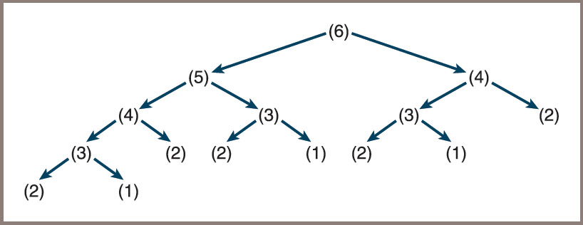
Exponential Algorithm: Recursive Fibonacci (2 of 3)
Figure 3.16 shows the calls involved when using the recursive function to compute the sixth Fibonacci number
Figure 3-16: A call tree for fib(6)

Slide 61
Exponential Algorithm: Recursive Fibonacci (3 of 3)
Exponential algorithms are generally impractical to run with anything but very small problem sizes
Although recursive Fibonacci is elegant in its design,
There is a less beautiful but much faster version that uses a loop to run in linear time (see the next section)
Alternatively, recursive functions that are called repeatedly with the same arguments can be made more efficient by a technique called memorization:
The program maintains a table of the values for each argument used with the function
Before the function recursively computes a value for a given argument, it checks the table to see if that argument already has a value
If so, that value is simply returned
If not, computation proceeds and the argument and value are added to the table afterward

Slide 62
Converting Fibonacci to a Linear Algorithm (1 of 2)
An alternate algorithm starts a loop if n is at least the third Fibonacci number:
This number will be at least the sum of the first two (1 + 1 = 2)
The loop computes this sum and then performs two replacements:
The first number becomes the second one, and the second one becomes the sum just computed
The loop counts from 3 through n
The sum at the end of the loop is the nth Fibonacci number

Slide 63
Converting Fibonacci to a Linear Algorithm (2 of 2)
Pseudocode for this algorithm:
Set sum to 1
Set first to 1
Set second to 1
Set count to 3
While count <= N
Set sum to first + second
Set first to second
Set second to sum
Increment count

Slide 64
Chapter Summary (1 of 2)
Different algorithms for solving the same problem can be ranked according to the time and memory resources that they require
You can measure the running time of an algorithm empirically with the computer’s clock
Counting instructions provide another empirical measurement of the amount of work that an algorithm does
The rate of growth of an algorithm’s work can be expressed as a function of the size of its problem instances
Big-O notation is a common way of expressing an algorithm’s run-time behavior
Common expressions of run-time behavior are O(log₂n)
(logarithmic), O(n) (linear),

Slide 65
Chapter Summary (2 of 2)
An algorithm can have different best-case, worst-case, and average-case behaviors
In general, it is better to try to reduce the order of an algorithm’s complexity than it is to try to enhance performance by tweaking the code
A binary search is substantially faster than a sequential search
The n log n sort algorithms use a recursive, divide-and-conquer strategy to break the
Exponential algorithms are primarily of theoretical interest and are impractical to run with large problem sizes

