Slide 1
Chapter 4: Arrays and Linked Structures
Fundamentals of Python: Data Structures, Second Edition
Fundamentals of Python: Data Structures, Second Edition. © 2019 Cengage. May not be copied, scanned, or duplicated, in whole or in part, except for use as permitted in a license distributed with a certain product or service or otherwise on a password-protected website for classroom use.

Slide 2
Learning Objectives (1 of 2)
Create arrays
Perform various operations on arrays
Determine the running times and memory usage of array operations
Describe how costs and benefits of array operations depend on how arrays are represented in computer memory
Create linked structures using singly linked nodes
Perform various operations on linked structures with singly linked nodes

Slide 3
Learning Objectives (2 of 2)
Describe how costs and benefits of operations on linked structures depend on how they are represented in computer memory
Compare the trade-offs in running time and memory usage of arrays and linked structures

Slide 4
The Array Data Structure (1 of 6)
Array – represents a sequence of items that can be accessed or replaced at given index positions:
Data structure underlying a Python list is an array
It is the primary implementing structure in the collections of Python
A programmer can
Access and replace an array’s items at given positions
Examine an array’s length
Obtain its string representation
A programmer cannot
Add or remove positions
Make the length of the array larger or smaller (length of an array is fixed when created)

Slide 5
The Array Data Structure (2 of 6)
Python’s array model includes an array class:
Behaves more like a list but is limited to storing numbers
You will define a new class named Array that adheres to the restrictions mentioned earlier but can hold items of any type
This Array class uses a Python list to hold its items
The class defines methods that allow clients to use
The subscript operator []
The len function
The str function
The for loop with array objects

Slide 6
The Array Data Structure (3 of 6)
Table 4.1 Array Operations and the Methods of the Array Class
User’s Array Operation | Method in the Array Class
a = Array(10) | __init__(capacity, fillValue = None)
len(a) | __len__()
str(a) | __str__()
for item in a: | __iter__()
a[index] | __getitem__(index)
A[index] = newitem | __setitem__(index, newItem)

Slide 7
The Array Data Structure (4 of 6)
Code for the Array class (in arrays.py):
"""
File: arrays.py
An Array is like a list, but the client can use
only [], len, iter, and str.
To instantiate, use
<variable> = Array(<capacity>, <optional fill value>)
The fill value is None by default.
"""
class Array(object):
"""Represents an array."""
def __init__(self, capacity, fillValue = None):
"""Capacity is the static size of the array.
fillValue is placed at each position."""
self.items = list()
for count in range(capacity):
self.items.append(fillValue)

Slide 8
The Array Data Structure (5 of 6)
Code for the Array class (in arrays.py) (continued):
def __len__(self):
"""-> The capacity of the array."""
return len(self.items)
def __str__(self):
"""-> The string representation of the array."""
return str(self.items)
def __iter__(self):
"""Supports traversal with a for loop."""
return iter(self.items)
def __getitem__(self, index):
"""Subscript operator for access at index."""
return self.items[index]
def __setitem__(self, index, newItem):
"""Subscript operator for replacement at index."""
self.items[index] = newItem

Slide 9
The Array Data Structure (6 of 6)
Shell session showing use of an array:
from arrays import Array
>>> a = Array(5) # Create an array with 5 positions
>>> len(a) # Show the number of positions
5
>>> print(a) # Show the contents
[None, None, None, None, None]
>>> for i in range(len(a)): # Replace contents with 1..5
a[i] = i + 1
>>> a[0] # Access the first item
1
>>> for item in a: # Traverse the array to print all
print(item)
1
2
3
4
5

Slide 10
Random Access and Contiguous Memory (1 of 2)
Array indexing is a random access operation:
The computer obtains the location of the ith item by performing a constant number of steps
No matter how large the array, it takes the same amount of time to access the first item as it does to access the last item
The computer supports random access for arrays by allocating a block of contiguous memory cells for the array’s items

Slide 11
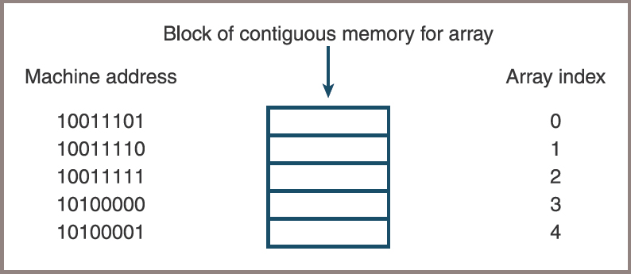
Random Access and Contiguous Memory (2 of 2)
Figure 4-1: A block of contiguous memory

Slide 12
Static Memory and Dynamic Memory
Arrays in older languages were static data structures
Modern languages allow dynamic arrays:
Occupies a contiguous block of memory and supports random access
The Python Array class allows the programmer to specify the length of a dynamic array during instantiation
Ways that programmers can read just an array’s length
Create an array with a reasonable default size at program start-up
When the array cannot hold more data, create a new, larger array and transfer the data items from the old array
When the array seems to be wasting memory, decrease its length in a similar manner
These adjustments happen automatically with a Python list

Slide 13
Physical Size and Logical Size (1 of 2)
Physical size of an array
Its total number of array cells or the number used to specify its capacity when the array is created
Logical size of an array
The number of items in it that should be currently available to the application
Logical and physical size tell you several things:
If the logical size is 0, the array is empty
Otherwise, at any given time, the index of the last item in the array is the logical size minus 1
If the logical size equals the physical size, there is no more room for data in the array

Slide 14
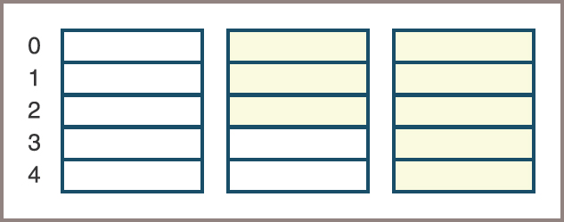
Physical Size and Logical Size (2 of 2)
Figure 4-2: Arrays with different logical sizes

Slide 15
Operations on Arrays
This section shows the implementation of several operations on arrays
In these examples, assume the following data settings:
DEFAULT_CAPACITY = 5
logicalSize = 0
a = Array(DEFAULT_CAPACITY)

Slide 16
Increasing the Size of an Array
The resizing process consists of three steps:
Create a new, larger array
Copy the data from the old array to the new array
Reset the old array variable to the new array object
Code:
if logicalSize == len(a):
temp = Array(len(a) + 1) # Create a new array
for i in range(logicalSize):# Copy data from the old
temp [i] = a[i] # array to the new array
a = temp # Reset the old array variable
# to the new array

Slide 17
Decreasing the Size of an Array
The process of decreasing the size of an array is the inverse of increasing it
Steps
Create a new, smaller array
Copy the data from the old array to the new array
Reset the old array variable to the new array object
Code:
if logicalSize <= len(a) // 4 and len(a) >= DEFAULT_CAPACITY * 2:
temp = Array(len(a) // 2) # Create new array
for i in range(logicalSize): # Copy data from old array
temp [i] = a [i] # to new array
a = temp # Reset old array variable to
# new array

Slide 18
Inserting an Item into an Array That Grows (1 of 3)
In the case of an insertion, the programmer must do four things:
Check for available space before attempting an insertion and increase the physical size of the array, if necessary, as described earlier
Shift the items from the logical end of the array to the target index position down by one:
This process opens a hole for the new item at the target index
Assign the new item to the target index position
Increment the logical size by one

Slide 19
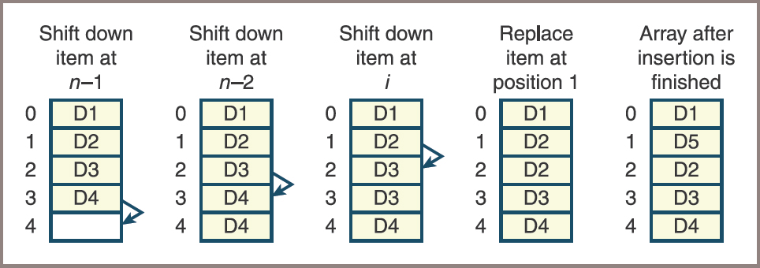
Inserting an Item into an Array That Grows (2 of 3)
Figure 4-3: Inserting an item into an array

Slide 20
Inserting an Item into an Array That Grows (3 of 3)
Python code for the insertion operation:
# Increase physical size of array if necessary
# Shift items down by one position
for i in range(logicalSize, targetIndex, -1):
a[i] = a[i - 1]
# Add new item and increment logical size
a[targetIndex] = newItem
logicalSize += 1

Slide 21
Removing an Item from an Array (1 of 2)
Steps for removing an item from an array
Shift the items from the one following the target index position to the logical end of the array up by one. This process closes the hole left by the removed item at the target index
Decrement the logical size by one
Check for wasted space and decrease the physical size of the array, if necessary
Code:
# Shift items up by one position
for i in range(targetIndex, logicalSize - 1):
a[i] = a[i + 1]
# Decrement logical size
logicalSize -= 1
# Decrease size of array if necessary

Slide 22
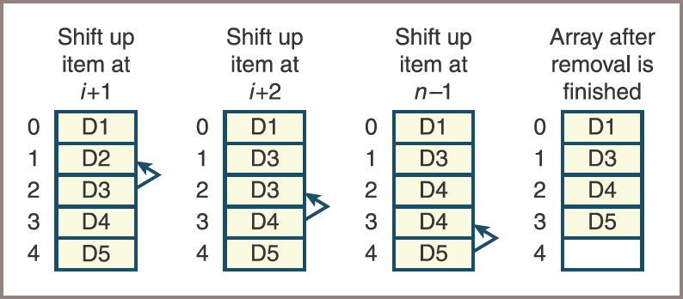
Removing an Item from an Array (2 of 2)
Figure 4-4: Removing an item from an array

Slide 23
Complexity Trade-Off: Time, Space, and Arrays
Table 4.2 The Running Times of Array Operations
Operation | Running Time
Access at ith position | 0(1), best and worse cases
Replacement at ith position | O(1), best and worst cases
Insert at logical end | O(1), average case
Insert at ith position | O(n), average case
Remove from ith position | O(n), average case
Increase capacity | O(n), best and worst cases
Decrease capacity | O(n), best and worst cases
Remove from logical end | O(1), average case
Insert at ith position | O(n), average case
Remove from ith position | O(n), average case
Increase capacity | O(n), best and worst cases
Decrease capacity | O(n), best and worst cases

Slide 24
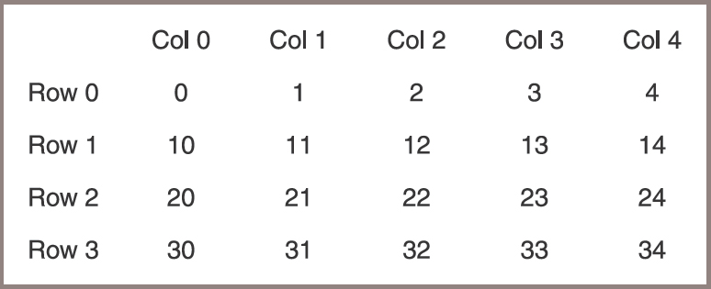
Two-Dimensional Arrays (Grids)
Figure 4-5: A two-dimensional array or grid with four rows and five columns

Slide 25
Processing a Grid
A grid must recognize two methods that return the number of rows and the number of columns:
For purposes of discussion, these methods are named getHeight and getWidth
Techniques for manipulating one-dimensional arrays are easily extended to grids
The following code segment computes the sum of all the numbers in the variable grid:
sum = 0
for row in range(grid.getHeight()): # Go through rows
for column in range(grid.getWidth()):# Go through columns
sum += grid[row][column]

Slide 26
Creating and Initializing a Grid (1 of 2)
To create a Grid object,
Run the Grid constructor with three arguments: height, width, and an initial fill value
Next session instantiates Grid with 4 rows, 5 columns, and a fill value of 0:
>>> from grid import Grid
>>> grid = Grid(4, 5, 0)
>>> print(grid)
0 0 0 0 0
0 0 0 0 0
0 0 0 0 0
0 0 0 0 0

Slide 27
Creating and Initializing a Grid (2 of 2)
The following code segment traverses the grid to reset its cells to the values shown in Figure 4.5:
# Go through rows
for row in range(grid.getHeight()):
# Go through columns
for column in range(grid.getWidth()):
grid[row][column] = int(str(row) + str(column))

Slide 28
Defining a Grid Class
Code for the Grid class (in grid.py):
"""
Author: Ken Lambert
"""
from arrays import Array
class Grid(object):
"""Represents a two-dimensional array."""
def __init__(self, rows, columns, fillValue = None):
self.data = Array(rows)
for row in range (rows):
self.data[row] = Array(columns, fillValue)
def getHeight(self):
"""Returns the number of rows."""
return len(self.data)
def getWidth(self):
"Returns the number of columns."""
return len(self.data[0])
def __getitem__(self, index):
"""Supports two-dimensional indexing
with [row][column]."""
return self.data[index]
def __str__(self):
"""Returns a string representation of the grid."""
result = ""
for row in range (self.getHeight()):
for col in range (self.getWidth()):
result += str(self.data[row][col]) + " "
result += "\n"
return result

Slide 29
Ragged Grids and Multidimensional Arrays
Ragged grid
Has a fixed number of rows, but the number of columns of data in each row can vary
An array of lists or arrays provides a suitable structure for implementing a ragged grid
Dimensions can be added to the definition of a grid when necessary:
The only limit is the computer’s memory

Slide 30
Linked Structures
Linked structure
A concrete data type that implements many types of collections
This section covers characteristics that programmers must keep in mind when using linked structures to implement any type of collection

Slide 31
Singly Linked Structures and Doubly Linked Structures (1 of 4)
The two simplest linked structures
Singly linked structure
Doubly linked structure
It is useful to draw diagrams of linked structures using a box and pointer notation (see Figure 4.6 on next slide)
A user of a singly linked structure accesses the first item by following a single external head link:
User then accesses other items by chaining through the single links that emanate from the items
Easy to get the successor of an item
Not so easy to get to the predecessor of an item

Slide 32
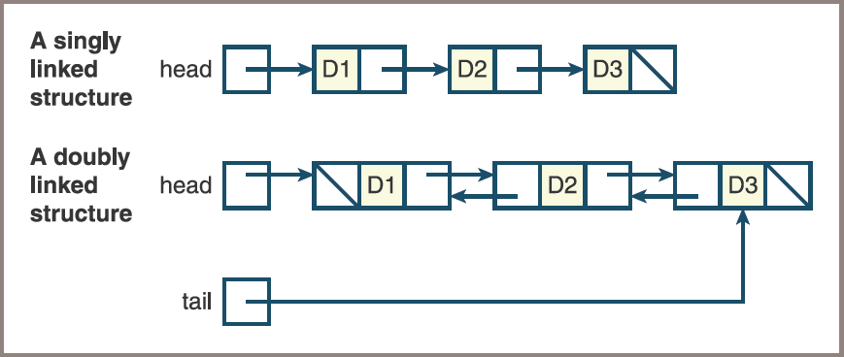
Singly Linked Structures and Doubly Linked Structures (2 of 4)
Figure 4-6: Two types of linked structures

Slide 33
Singly Linked Structures and Doubly Linked Structures (3 of 4)
A doubly linked structure contains links running in both directions:
A second external link, called the tail link, allows the user of a doubly linked structure to access the last item directly
The last item in either type of linked structure has no link to the next item:
Figure indicates the absence of a link, called an empty link, by means of a slash instead of an arrow
A programmer who uses a linked structure cannot immediately access an item by specifying its index position:
Programmer must start at one end of the structure and follow the links until the desired position (item) is reached

Slide 34
Singly Linked Structures and Doubly Linked Structures (4 of 4)
The way in which memory is allocated for linked structures is unlike that of arrays and has two important consequences for insertion and removal operations:
Once an insertion or removal point has been found, the insertion or removal can take place with no shifting of data items in memory
The linked structure can be resized during each insertion or removal with no extra memory cost and no copying of data items

Slide 35
Noncontiguous Memory and Nodes (1 of 4)
A linked structure decouples the logical sequence of items in the structure from any ordering in memory:
The cell for a given item in a linked structure can be found anywhere in memory as long as the computer can follow a link to its address or location
Called noncontiguous memory
Basic unit of representation in a linked structure is a node
A singly linked node contains the following components or fields:
A data item
A link to the next node in the structure (a doubly linked node contains a link to the previous node in the structure as well)

Slide 36
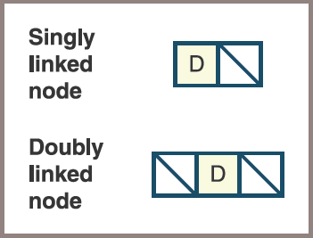
Noncontiguous Memory and Nodes (2 of 4)
Figure 4-7: Two types of nodes with empty links

Slide 37
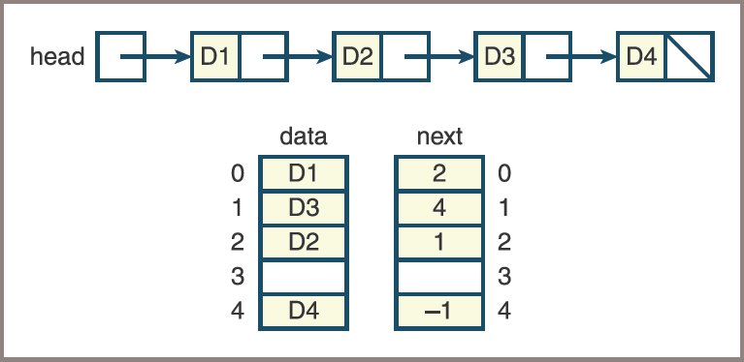
Noncontiguous Memory and Nodes (3 of 4)
Figure 4.8 shows a linked structure and its array representation
Figure 4-8: An array representation of a linked structure

Slide 38
Noncontiguous Memory and Nodes (4 of 4)
In more modern languages the programmer has direct access to the addresses of data in the form of pointers:
A node in a singly linked structure contains a data item and a pointer value
Python programmers set up nodes and linked structures by using references to objects:
Programmers define a singly linked node by defining an object that contains two fields: a reference to a data item and a reference to another node

Slide 39
Defining a Singly Linked Node Class
Code for a singly linked node class:
class Node(object):
"""Represents a singly linked node."""
def __init__(self, data, next = None):
"""Instantiates a Node with a default next of None."""
self.data = data
self.next = next

Slide 40
Using the Singly Linked Node Class (1 of 4)
Node variables are initialized to either the None value or a new Node object
Code segment that shows some variations on these two options:
# Just an empty link
node1 = None
# A node containing data and an empty link
node2 = Node("A", None)
# A node containing data and a link to node2
node3 = Node("B", node2)

Slide 41
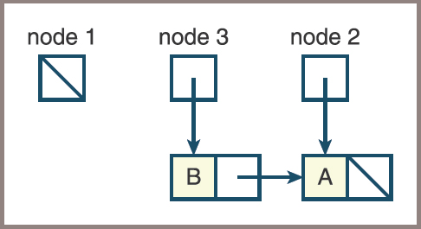
Using the Singly Linked Node Class (2 of 4)
Figure 4.9 shows the state of the three variables after this code is run
Figure 4-9: Three external links

Slide 42
Using the Singly Linked Node Class (3 of 4)
Suppose you attempt to place the first node at the beginning of the linked structure that already contains node2 and node3 by running the following statement:
node1.next = node3
Python responds by raising an AttributeError
To create the desired link, you could run either
node1 = Node("C", node3)
or
node1 = Node("C", None)
node1.next = node3

Slide 43
Using the Singly Linked Node Class (4 of 4)
Linked structures are processed with loops:
Use loops to create a linked structure and visit each node in it
Code to create a singly linked structure and print its contents:
"""
File: testnode.py
Tests the Node class.
"""
from node import Node
head = None
# Add five nodes to the beginning of the linked structure
for count in range(1, 6):
head = Node(count, head)
# Print the contents of the structure
while head != None:
print(head.data)
head = head.next

Slide 44
Operations on Singly Linked Structures
The programmer must emulate index-based operations on a linked structure by manipulating links within the structure
This section covers how these manipulations are performed in common operations, such as
Traversals
Insertions
Removals

Slide 45
Traversal (1 of 2)
Traversal
Uses a temporary pointer variable named probe
This variable is initialized to the linked structure’s head pointer and then controls a loop as follows:
probe = head
while probe != None:
<use or modify probe.data>
probe = probe.next

Slide 46
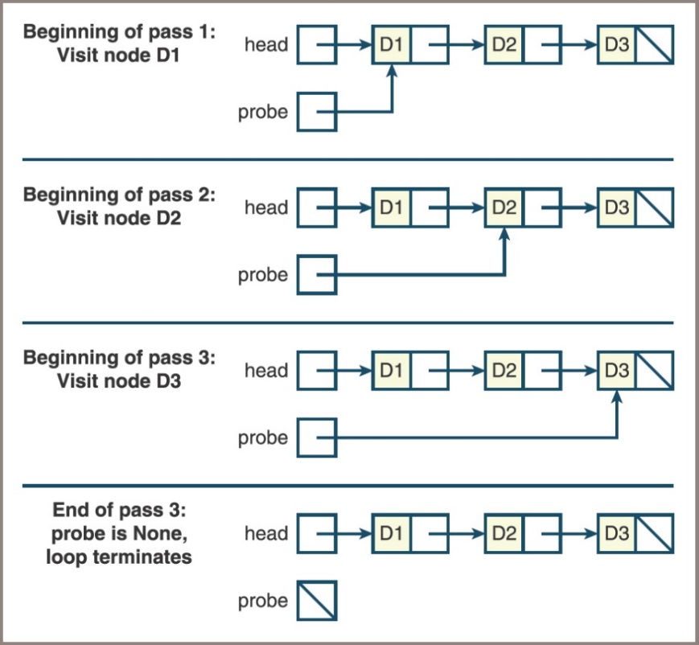
Traversal (2 of 2)
Figure 4.10 shows the state of the pointer variables probe and head during each pass of the loop
Figure 4-10: Traversing a linked structure

Slide 47
Searching (1 of 2)
The sequential search of a linked structure resembles a traversal:
You must start at the first node and follow the links until you reach a sentinel
Two possible sentinels
The empty link, indicating there are no more data items to examine
A data item that equals the target item, indicating a successful search
The form of the search for a given item:
probe = head
while probe != None and targetItem != probe.data:
probe = probe.next
if probe != None:
<targetItem has been found>
else:
<targetItem is not in the linked structure>

Slide 48
Searching (2 of 2)
Accessing the ith item of a linked structure is also a sequential search operation
Here is the form for accessing the ith item:
# Assumes 0 <= index < n
probe = head
while index > 0:
probe = probe.next
index -= 1
return probe.data

Slide 49
Replacement (1 of 2)
Replacement operations also employ the traversal pattern:
Search for a given item or position in the linked structure and replace the item with a new item
The form of the operation:
probe = head
while probe != None and targetItem != probe.data:
probe = probe.next
if probe != None:
probe.data = newItem
return True
else:
return False

Slide 50
Replacement (2 of 2)
The operation to replace the ith item assumes that 0 <= i < n
Here is the form:
# Assumes 0 <= index < n
probe = head
while index > 0:
probe = probe.next
index -= 1
probe.data = newItem

Slide 51
Inserting at the Beginning (1 of 2)
The form:
head = Node(newItem, head)
Figure 4.11 traces this operation for two cases:
The pointer is None in the first case, so the item is inserted into the structure
In the second case, the second item is inserted at the beginning of the same structure

Slide 52
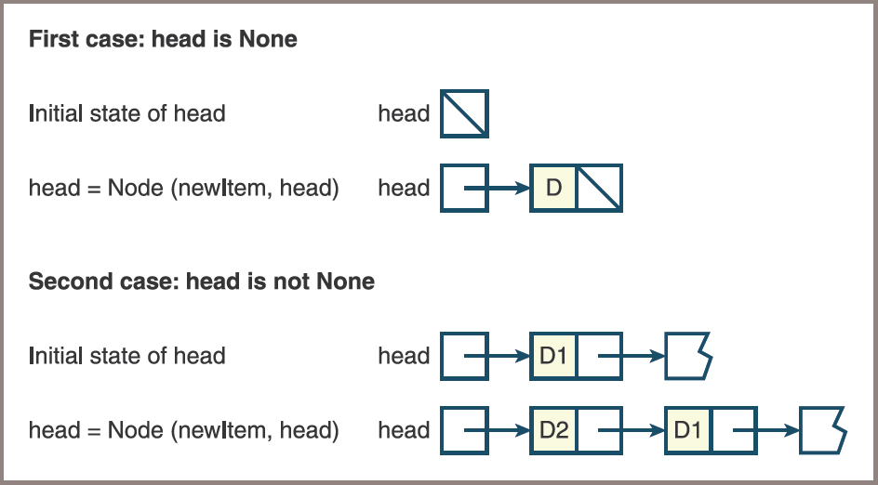
Inserting at the Beginning (2 of 2)
Figure 4-11: The two cases of inserting an item at the beginning of a linked structure

Slide 53
Inserting at the End (1 of 2)
Inserting an item at the end of a singly linked structure must consider two cases:
The head pointer is None, so the head pointer is set to the new node
The head pointer is not None, so the code searches for the last node and aims its next pointer at the new node
The second case returns you to the traversal pattern. Here is the form:
newNode = Node(newItem)
if head is None:
head = newNode
else:
probe = head
while probe.next != None:
probe = probe.next
probe.next = newNode

Slide 54
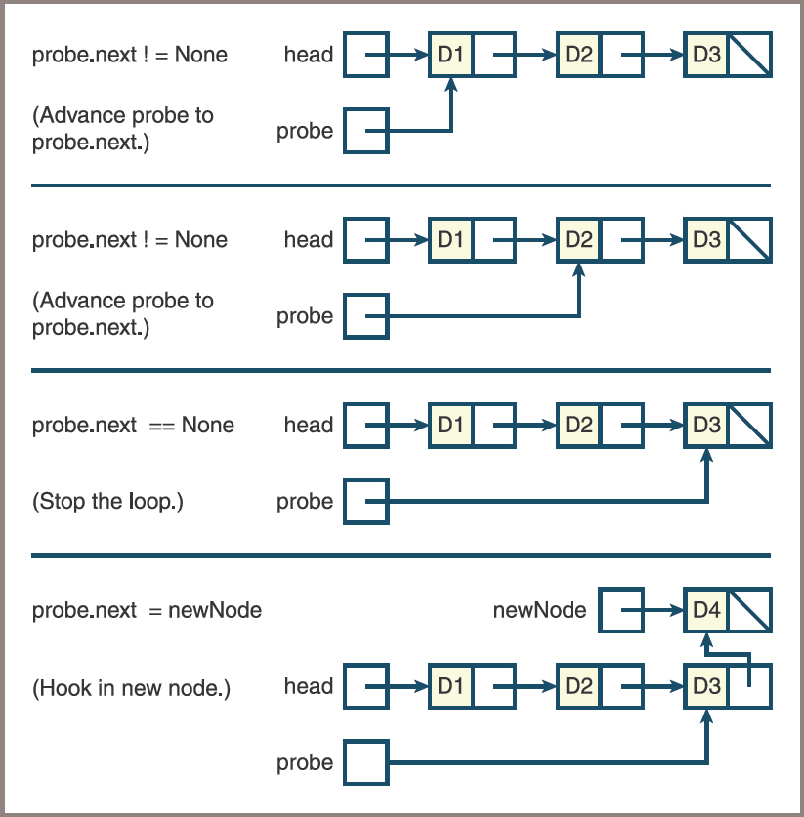
Inserting at the End (2 of 2)
Figure 4-12: Inserting an item at the end of a linked structure

Slide 55
Removing at the Beginning (1 of 2)
Here is the form:
# Assumes at least one node in the structure
removedItem = head.data
head = head.next
return removedItem

Slide 56
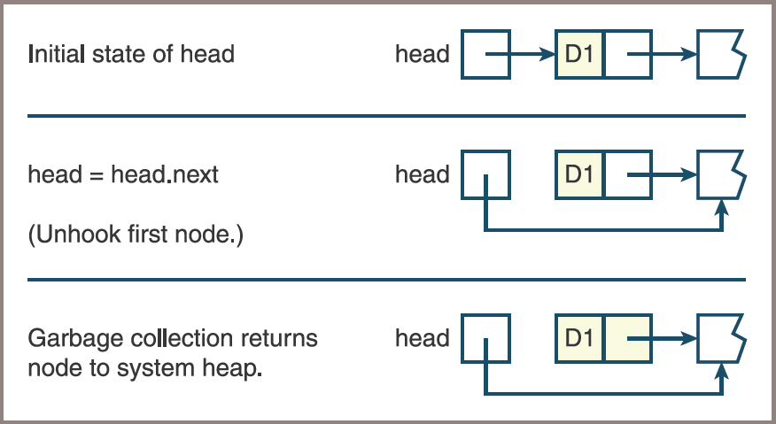
Removing at the Beginning (2 of 2)
Figure 4-13: Removing an item at the beginning of a linked structure

Slide 57
Removing at the End (1 of 3)
Removing an item at the end of a singly linked structure assumes at least one node in the structure
Two cases to consider
There is just one node and the head pointer is set to None
There is a node before the last node and the code searches for this second-to-last node and sets its next pointer to None
In either case, the code returns the data item contained in the deleted node

Slide 58
Removing at the End (2 of 3)
Here is the form:
# Assumes at least one node in structure
removedItem = head.data
if head.next is None:
head = None
else:
probe = head
while probe.next.next != None:
probe = probe.next
removedItem = probe.next.data
probe.next = None
return removedItem

Slide 59
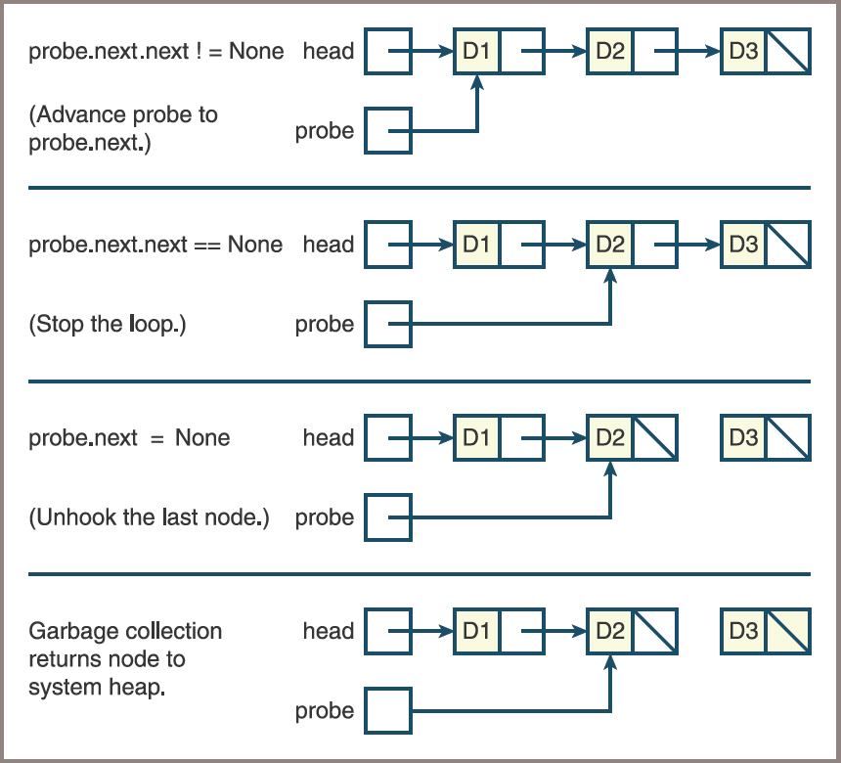
Removing at the End (3 of 3)
Figure 4-14: Removing an item at the end of a linked structure

Slide 60
Inserting at Any Position (1 of 3)
The case of an insertion at the beginning uses the code presented earlier
In the case of an insertion at some other position i,
The operation must first find the node at position i − 1 (if i < n) or the node at position n − 1 (if i >= n)
There are two cases to consider:
That node’s next pointer is None
That node’s next pointer is not None

Slide 61
Inserting at Any Position (2 of 3)
Here is the form:
if head is None or index <= 0:
head = Node(newItem, head)
else:
# Search for node at position index - 1 or the last position
probe = head
while index > 1 and probe.next != None:
probe = probe.next
index -= 1
# Insert new node after node at position index - 1
# or last position
probe.next = Node(newItem, probe.next)

Slide 62
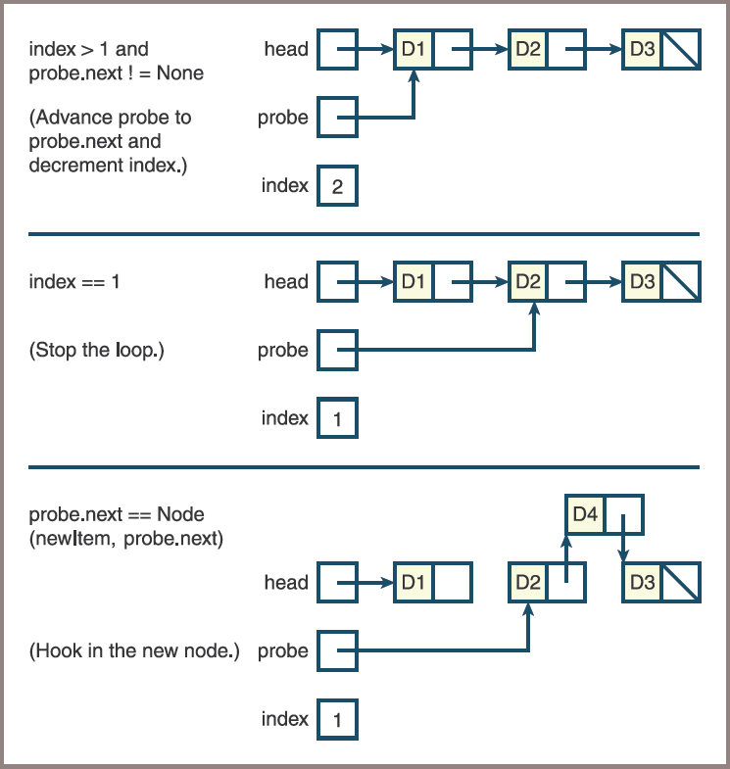
Inserting at Any Position (3 of 3)
Figure 4-15: Inserting an item between two items in a linked structure

Slide 63
Removing at Any Position (1 of 3)
The removal of the ith item from a linked structure has three cases:
i <= 0—You use the code to remove the first item
0 < i < n—You search for the node at position i – 1, as in insertion, and remove the following node
i >= n—You remove the last node

Slide 64
Removing at Any Position (2 of 3)
Here is the form:
# Assumes that the linked structure has at least one item
if index <= 0 or head.next is None:
removedItem = head.data
head = head.next
return removedItem
else:
# Search for node at position index - 1 or
# the next to last position
probe = head
while index > 1 and probe.next.next != None:
probe = probe.next
index -= 1
removedItem = probe.next.data
probe.next = probe.next.next
return removedItem

Slide 65
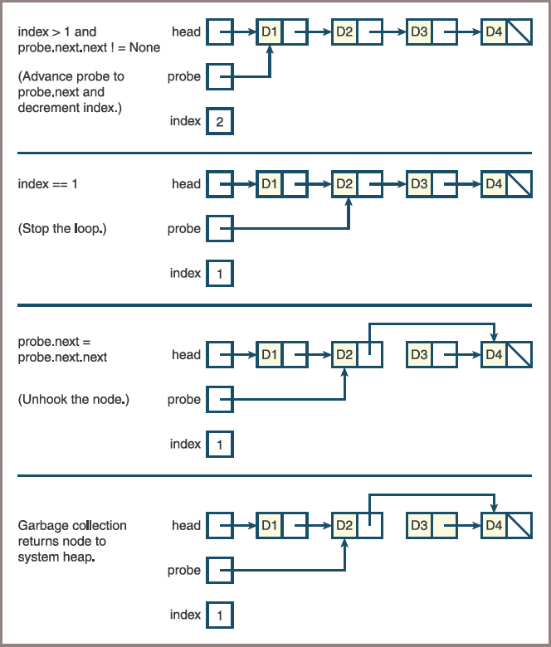
Removing at Any Position (3 of 3)
Figure 4-16: Removing an item between two items in a linked structure

Slide 66
Complexity Trade-Off: Time, Space, and Singly Linked Structures
Table 4.3 The Running Times of Operations on Singly Linked Structures
Operation | Running Time
Access at ith position | O(n), average case
Replacement at ith position | O(n), average case
Insert at beginning | O(1), best and worst case
Remove from beginning | O(1), best and worst case
Insert at ith position | O(n), average case
Remove from ith position | O(n), average case

Slide 67
Variations on a Link
This section examines two types of linked structures with extra pointers that can help to improve performance and simplify code

Slide 68
A Circular Linked Structure with a Dummy Header Node (1 of 4)
The insertion and the removal of the first node are special cases of the insert ith and remove ith operations on singly linked structures:
These cases are special because the head pointer must be reset
You can simplify these operations by using a circular linked structure with a dummy header node:
A circular linked structure contains a link from the last node back to the first node in the structure
This node, the dummy header node, contains no data but serves as a marker for the beginning and the end of the linked structure

Slide 69
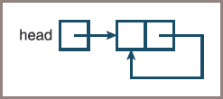
A Circular Linked Structure with a Dummy Header Node (2 of 4)
Figure 4-17: An empty circular linked structure with a dummy header node

Slide 70
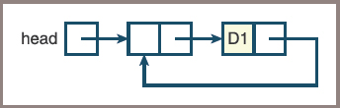
A Circular Linked Structure with a Dummy Header Node (3 of 4)
Figure 4-18: A circular linked structure after inserting the first node

Slide 71
A Circular Linked Structure with a Dummy Header Node (4 of 4)
Code for insertions at the ith position using the new representation of a linked structure:
# Search for node at position index - 1 or the last position
probe = head
while index > 0 and probe.next != head:
probe = probe.next
index -= 1
# Insert new node after node at position index - 1 or
# last position
probe.next = Node(newItem, probe.next)

Slide 72
Doubly Linked Structures (1 of 4)
A doubly linked structure has the advantages of a singly linked structure
In addition, it allows the user to do the following:
Move left, to the previous node, from a given node
Move immediately to the last node
Figure 4.19 shows a doubly linked structure that contains three nodes:
Note the presence of two pointers, conventionally known as next and previous, in each node
Note also the presence of a second external tail pointer that allows direct access to the last node in the structure

Slide 73
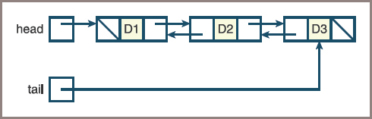
Doubly Linked Structures (2 of 4)
Figure 4-19: A doubly linked structure with three nodes

Slide 74
Doubly Linked Structures (3 of 4)
Code:
class Node(object):
def __init__(self, data, next = None):
"""Instantiates a Node with default next of None"""
self.data = data
self.next = next
class TwoWayNode(Node):
def __init__(self, data, previous = None, next = None):
"""Instantiates a TwoWayNode."""
Node.__init__(self, data, next)
self.previous = previous

Slide 75
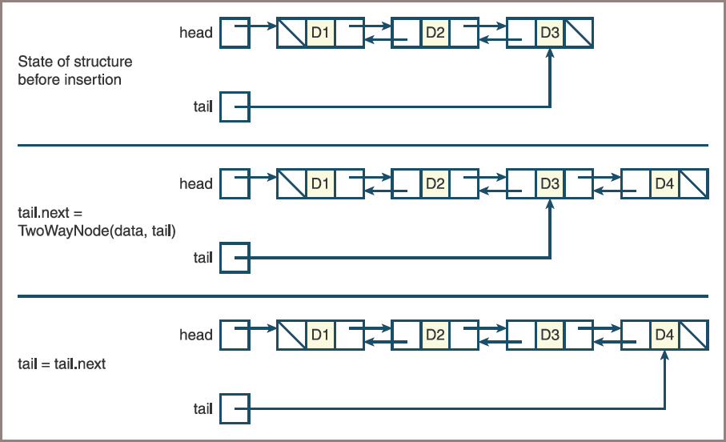
Doubly Linked Structures (4 of 4)
Figure 4-20: Inserting an item at the end of a doubly linked structure

Slide 76
Chapter Summary (1 of 2)
A data structure is an object that represents the data contained in a collection
The array is a data structure that supports random access to an item by position
A two-dimensional array locates each data value at a row and column in a rectangular grid
A linked structure is a data structure that consists of zero or more nodes
A singly linked structure’s nodes contain a data item and a link to the next node

Slide 77
Chapter Summary (2 of 2)
Insertions or removals in linked structures require no shifting of data elements
Using a header node in a linked structure can simplify some of the operations
Such as adding or removing items

