Slide 1
Chapter 6: Inheritance and Abstract Classes
Fundamentals of Python: Data Structures, Second Edition
Fundamentals of Python: Data Structures, Second Edition. © 2019 Cengage. May not be copied, scanned, or duplicated, in whole or in part, except for use as permitted in a license distributed with a certain product or service or otherwise on a password-protected website for classroom use.

Slide 2
Learning Objectives
Use inheritance to share code among a set of classes
Customize the behavior of a class by creating a subclass
Factor the redundant data and methods of a set of classes into an abstract class
Override the behavior of an inherited method by redefining it
Decide where to place data and methods in a class hierarchy

Slide 3
Using Inheritance to Customize an Existing Class
Easiest way to take advantage of inheritance
Use it to customize an existing class
Example: sorted bag class ArraySortedBag (Project 3 of Chapter 5)
The sorted bag behaves just like a regular bag, but with exceptions:
The sorted bag allows the client to visit its elements in sorted order via the for loop
The sorted bag’s in operator runs in logarithmic time
The items added to the bag must be comparable with each other

Slide 4
Subclassing an Existing Class (1 of 3)
This section covers inheritance by making the ArraySortedBag class a subclass of the ArrayBag class:
ArrayBag is called the parent or superclass of ArraySortedBag
Note
Because the ArrayBag class implements BagInterface, the ArraySortedBag class also implements this interface via inheritance

Slide 5
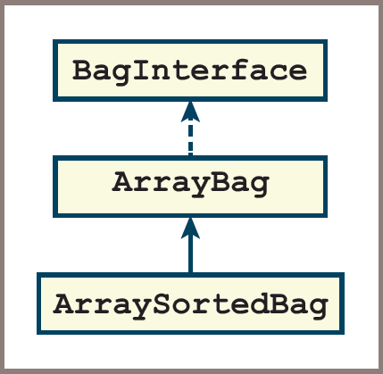
Subclassing an Existing Class (2 of 3)
Figure 6-1: Depicting a subclass and inheritance in a class diagram

Slide 6
Subclassing an Existing Class (3 of 3)
Creating a subclass of an existing class consists of working on a copy of the parent’s class file and performing the following steps:
Begin by deleting all the methods that do not have to change:
You still need the _init_ method in the new class
To guarantee that the inheritance happens, you must place the name of the parent class within the parentheses of the class header
Modify the code for the methods that must change
Add any new methods

Slide 7
Revising the _init_ Method (1 of 2)
There is one case where inheritance is not automatic
The _init_ method in ArraySortedBag must call the _init_ method in the parent class ArrayBag
So that it can initialize the data contained there
The syntax to call this method in the parent class is
ArrayBag._init_(self, sourceCollection)
The parent class name enables Python to select which version of the _init_ method to run
Note the additional argument, self, at the beginning of the argument list
The optional source collection is also passed as an argument to the parent class’s _init_ method

Slide 8
Revising the _init_ Method (2 of 2)
Code for the changes to ArraySortedBag so far:
"""
File: arraysortedbag.py
Author: Ken Lambert
"""
from arraybag import ArrayBag
class ArraySortedBag(ArrayBag):
"""An array-based sorted bag implementation."""
# Constructor
def __init__(self, sourceCollection = None):
"""Sets the initial state of self, which includes the
contents of sourceCollection, if it’s present."""
ArrayBag.__init__(self, sourceCollection)

Slide 9
Adding a New _contains_ Method (1 of 2)
There is no _contains_ method in ArrayBag:
Python automatically generates a sequential search operation, using the ArrayBag iterator, when the in operator is used on a bag
To override this behavior, include a _contains_method in ArraySortedBag:
When Python sees the in operator used on a sorted bag, it also sees that bag’s _contains_method and calls it
This method implements a binary search on the sorted bag’s array of items:
This array, named self.items is accessible in any of its subclasses
You can reference this variable directly during the search

Slide 10
Adding a New _contains_ Method (2 of 2)
Code:
# Accessor methods
def __contains__(self, item):
"""Returns True if item is in self, or False otherwise."""
left = 0
right = len(self) - 1
while left <= right:
midPoint = (left + right) // 2
if self.items[midPoint] == item:
return True
elif self.items[midPoint] > item:
right = midPoint - 1
else:
left = midPoint + 1
return False

Slide 11
Modifying the Existing add Method (1 of 4)
The add method in ArraySortedBag must place a new item in the appropriate position in a sorted array
In most cases you have to search for this position
Two cases in which this search is unnecessary:
When the bag is empty
When the new item is greater than or equal to the last item
In those cases you can add the new item by passing it along to the add method in the ArrayBag class
If not, you must look in the array for the first item that’s greater than or equal to the new item:
Then open a hole, insert the new item, and increment the size of the bag

Slide 12
Modifying the Existing add Method (2 of 4)
Code:
# Mutator methods
def add(self, item):
"""Adds item to self."""
# Empty or last item, call ArrayBag.add
if self.isEmpty() or item >= self.items[len(self) - 1]:
ArrayBag.add(self, item)
else:
# Resize the array if it is full here
# Search for first item >= new item
targetIndex = 0
while item > self.items[targetIndex]:
targetIndex += 1
# Open a hole for new item
for i in range(len(self), targetIndex, -1):
self.items[i] = self.items[i - 1]
# Insert item and update size
self.items[targetIndex] = item
self.size += 1

Slide 13
Modifying the Existing add Method (3 of 4)
Note the different prefixes used in the method call to ArrayBag.add and in the variable reference to self.items:
The first is a class name, and the second is a reference to an instance of a class.
Because ArraySortedBag does not introduce a new version of the instance variable items, the reference to self.items here locates the variable directly in the ArrayBag class

Slide 14
Modifying the Existing add Method (4 of 4)
The __add__ method, which Python runs when it sees the + operator used with two bags, has practically the same code in the ArrayBag class and the LinkedBag class:
The only difference is the class name used to create a new instance for the result bag
You simply repeat this pattern for __add__ in ArraySortedBag, as follows:
def __add__(self, other):
"""Returns a new bag with the contents of self and other."""
result = ArraySortedBag(self)
for item in other:
result.add(item)
return result

Slide 15
Run-Time Performance of ArraySortedBag (1 of 2)
The in operator has a worst-case running time of O(logn):
This is a big improvement on the linear running time of the in operator for regular bags
The improved search time also has an impact on the methods that use the new in operator,
Even though these methods are still defined in ArrayBag
Although the improved search still leaves remove with a linear running time on average,
Less time is spent on the test of the precondition

Slide 16
Run-Time Performance of ArraySortedBag (2 of 2)
The performance improvement in the __eq__ method can be more dramatic,
Even though it does not use the in operator
When this method is run on two regular bags of the same length, its average running time is
If you are willing to redefine the __eq__ method in ArraySortedBag,
You can reduce its average running time to O(n)
This implementation takes advantage of the fact that the pairs of items being compared in the two sorted bags appear in the same order as you iterate through them

Slide 17
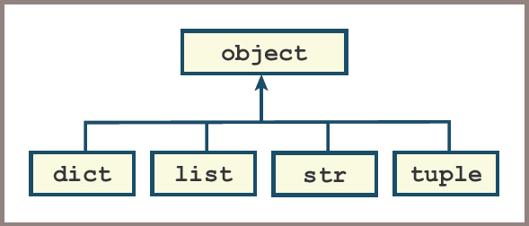
A Note on Class Hierarchies in Python (1 of 2)
Figure 6-2: A portion of Python’s class hierarchy

Slide 18
A Note on Class Hierarchies in Python (2 of 2)
When you define a new class and omit the parent class from the syntax,
Python automatically installs this class under the object class
When you design a new set of collection classes,
It’s generally not a good idea to subclass under a built-in Python collection class
Instead, develop your own classes to conform to interfaces
And place the topmost class in your hierarchy under the object class

Slide 19
Using Abstract Classes to Eliminate Redundant Code
Keep potentially redundant methods in a parent class and share them with another class via inheritance
This section covers how to eliminate redundant methods and data in a set of existing classes by factoring the code for them into a common superclass:
Called an abstract class, it captures the common features and behavior of a set of related classes
Its subclasses are called concrete classes to indicate that they are the classes actually used to create objects in client applications

Slide 20
Designing an AbstractBag Class (1 of 4)
In the case of your bag classes, the most redundant methods include:
isEmpty, _str_, _add_, count, and _eq_
Redundant instance variables are trickier to spot:
Your bag classes use two instance variables: self.items and self.size
To discovery redundancy:
Look at the types of data to which the variables refer
Only self.size is redundant as it refers to an integer value in every bag class (safe to move to an abstract class)
Because the _len_ method accesses self.size but not self.items:
It counts as a redundant method

Slide 21
Designing an AbstractBag Class (2 of 4)
You can remove redundant methods from the bag classes and place them in a new class called AbstractBag
The bag classes then access these methods via inheritance by becoming subclasses of AbstractBag
Note that the AbstractBag class does not implement the bag interface:
You also now have a more obvious class hierarchy, with two levels of inheritance
The ArraySortedBag class now inherits some methods and data directly from its parent class ArrayBag
And other methods and data indirectly from its ancestor class AbstractBag

Slide 22
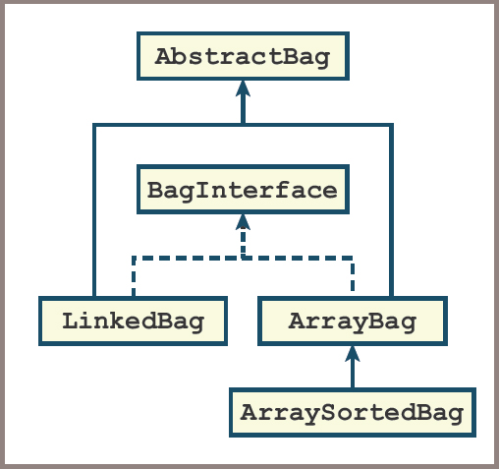
Designing an AbstractBag Class (3 of 4)
Figure 6-3: Adding an abstract bag class to the collection framework

Slide 23
Designing an AbstractBag Class (4 of 4)
To create the AbstractBag class, you start by copying the contents of one of its subclasses to a new file and save that file as abstractbag.py
Then perform the following steps:
Delete any irrelevant imports and rename the class AbstractBag
Delete all the methods that directly access the instance variable self.items, except for the __init__ method:
The next subsection shows you how to modify the __init__ method

Slide 24
Redoing the _init_ Method in AbstractBag (1 of 2)
The __init__ method in AbstractBag is responsible for performing two steps:
Introducing the variable self.size and initializing it to 0
Adding the items from the source collection to self, if the source collection is present
Therefore, you delete the line of code that initializes the variable self.items:
This code is still the responsibility of the _init_ method in the subclasses

Slide 25
Redoing the _init_ Method in AbstractBag (2 of 2)
Code:
"""
File: abstractbag.py
Author: Ken Lambert
"""
class AbstractBag(object):
"""An abstract bag implementation."""
# Constructor
def __init__(self, sourceCollection = None):
"""Sets the initial state of self, which includes the
contents of sourceCollection, if it’s present."""
self.size = 0
if sourceCollection:
for item in sourceCollection:
self.add(item)

Slide 26
Modifying the Subclasses of AbstractBag (1 of 3)
Each subclass of AbstractBag must now
Import this class
Place its name within the parentheses in the class header
Omit the redundant methods mentioned earlier
Include a modified _init_ method
Examine the changes to the _init_ method of ArrayBag:
This method is still responsible for setting self.items to a new array
That’s the only line of code kept from before
Run the _init_ method
Initializes the bag’s size and adds the items from the source collection, if necessary

Slide 27
Modifying the Subclasses of AbstractBag (2 of 3)
Code for the changes to _init_ in ArrayBag:
"""
File: arraybag.py
Author: Ken Lambert
"""
from arrays import Array
from abstractbag import AbstractBag
class ArrayBag(AbstractBag):
"""An array-based bag implementation."""
# Class variable
DEFAULT_CAPACITY = 10
# Constructor
def __init__(self, sourceCollection = None):
"""Sets the initial state of self, which includes the
contents of sourceCollection, if it’s present."""
self.items = Array(ArrayBag.DEFAULT_CAPACITY)
AbstractBag.__init__(self, sourceCollection)

Slide 28
Modifying the Subclasses of AbstractBag (3 of 3)
Note the order in which the two statements are written in __init__
It is critical to initialize self.items to the new array before running the constructor in the superclass
So that there will be storage for any items that are added to the new bag

Slide 29
Generalizing the _add_ Method in AbstractBag (1 of 2)
If you test the bag classes with your tester function at this point,
The + operator (which uses the __add__ method in AbstractBag) raises an exception
The exception states that AbstractBag does not know about ArrayBag (or LinkedBag or ArraySortedBag)
The cause of this error is that the __add__ method has attempted to create an instance of ArrayBag to hold its results
As shown in the next code segment:
def __add__(self, other):
"""Returns a new bag containing the contents
of self and other."""
result = ArrayBag(self)
for item in other:
result.add(item)
return result

Slide 30
Generalizing the _add_ Method in AbstractBag (2 of 2)
To solve this problem,
Use Python’s type function to access the type of self
Then use the resulting type to create a clone of self in the usual manner
Code for an __add__ method that works with all bag types:
def __add__(self, other):
"""Returns a new bag containing the contents
of self and other."""
result = type(self)(self)
for item in other:
result.add(item)
return result

Slide 31
An Abstract Class For All Collections
Review the code for the AbstractBag and note the following:
All of its methods, including __init__, run other methods or functions or simply access the variable self.size
They make no mention of bag classes
With the exception of the __str__ method, which creates a string with curly braces, and the __eq__ method, which does not compare pairs of items at given positions
The AbstractBag’s methods are also methods that could be run on any other types of collections, such as lists, stacks, and queues
Finally, the one instance variable, self.size, could be used in the implementation of any collection as well

Slide 32
Integrating AbstractCollection into the Collection Hierarchy (1 of 3)
The AbstractCollection class is responsible for introducing and initializing self.size:
This variable is used by all the collection classes below it in the hierarchy
The __init__ method of AbstractCollection can also add the items from the source collection to self (if necessary)
This class also includes the most general methods available to all collections:
isEmpty, __len__, count, and __add__
AbstractCollection also includes default implementations of the __str__ and __eq__ methods:
Their current form in AbstractBag is appropriate for unordered collections, but most collection classes are likely to be linear rather than unordered

Slide 33
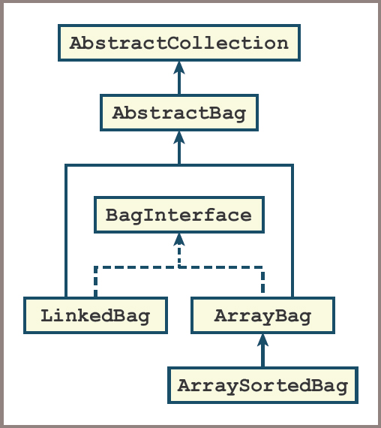
Integrating AbstractCollection into the Collection Hierarchy (2 of 3)
Figure 6-4: Adding an abstract collection class to the collection framework

Slide 34
Integrating AbstractCollection into the Collection Hierarchy (3 of 3)
To create the AbstractCollection class, copy code as usual from another module, in this case, AbstractBag
You can now perform the following steps:
Rename the class to AbstractCollection
Modify the __init__ method by removing the call to __init__ in a parent class
Modify the __str__ and __eq__ methods to provide reasonable default behavior
Then remove the isEmpty, __len__, and __add__ methods from AbstractBag

Slide 35
Using Two Iterators in the _eq_ Method (1 of 3)
The implementation of the _eq_ method in the AbstractCollection class compares pairs of items in the two collections
The following two code segments perform the same task, but the first one uses Python’s for loop and the second one directly manipulates the collection’s iterator object:
# Print all the items in theCollection using a for loop
for item in theCollection:
print(item)
# Print all the items in theCollection using an explicit iterator
iteratorObject = iter(theCollection)
try:
while True:
print(next(iteratorObject))
except StopIteration: pass

Slide 36
Using Two Iterators in the _eq_ Method (2 of 3)
When you employ an explicit iterator in the __eq__ method of AbstractCollection:
There is no need to trap a StopIteration exception
Because the two collections have the same length, the for loop on the first collection will stop when the iterator on the second collection reaches the end of its sequence of items

Slide 37
Using Two Iterators in the _eq_ Method (3 of 3)
Code for the new _eq_ method
def __eq__(self, other):
"""Returns True if self equals other, or False otherwise."""
if self is other: return True
if type(self) != type(other) or \
len(self) != len(other):
return False
otherIter = iter(other)
for item in self:
if item != next(otherIter):
return False
return True

Slide 38
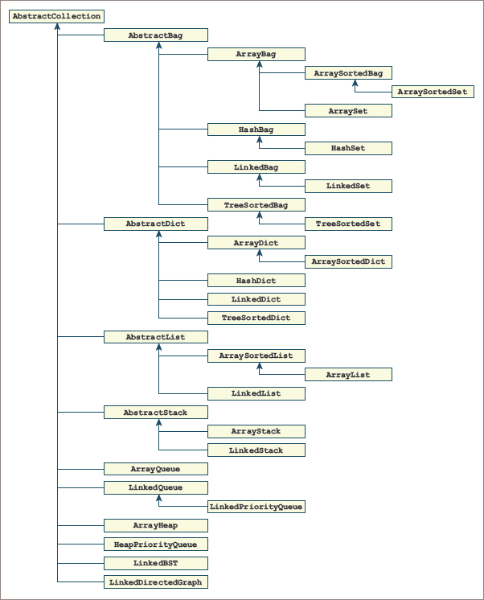
A Professional-Quality Framework of Collections
Figure 6-5: A professional-quality collection framework

Slide 39
Chapter Summary (1 of 2)
Two classes can be related as subclass and superclass:
A subclass generally is a more specialized version of its superclass
The superclass is also called the parent of its subclasses
A subclass inherits all the methods and variables from its parent class, as well as any of its ancestor classes
A subclass specializes the behavior of its superclass by modifying its methods or adding new methods
A class can call a method in its superclass by using the superclass name as a prefix to the method
An abstract class serves as a repository of data and methods that are common to a set of other classes

Slide 40
Chapter Summary (2 of 2)
Abstract classes are not instantiated
Python includes all classes in a hierarchy, with the object class as the topmost parent class
The methods with more general behavior should be located further up in a class hierarchy

