Slide 1
Chapter 7: Stacks
Fundamentals of Python: Data Structures, Second Edition
Fundamentals of Python: Data Structures, Second Edition. © 2019 Cengage. May not be copied, scanned, or duplicated, in whole or in part, except for use as permitted in a license distributed with a certain product or service or otherwise on a password-protected website for classroom use.

Slide 2
Learning Objectives
Describe the features and behavior of a stack
Choose a stack implementation based on its performance characteristics
Recognize applications where it is appropriate to use a stack
Explain how the system call stack provides run-time support for recursive subroutines
Design and implement a backtracking algorithm that uses a stack

Slide 3
Overview of Stacks (1 of 3)
Stacks – linear collections
Access is completely restricted to just one end called the top
Use a last-in-first-out (L I F O) protocol
Analogy
Stack of clean trays in a cafeteria
New tray is removed from top of the stack, when needed
Operations for putting items on and removing items from a stack are called push and pop

Slide 4
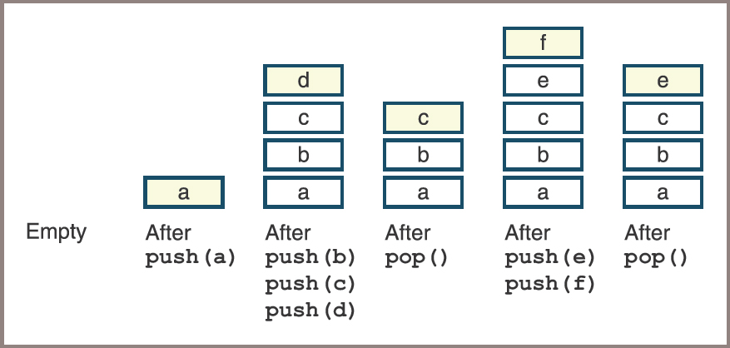
Overview of Stacks (2 of 3)
Figure 7-1: Some states in the lifetime of a stack

Slide 5
Overview of Stacks (3 of 3)
Applications of stacks in computer science
Translating infix expressions to postfix form and evaluating postfix expressions
Backtracking algorithms
Managing computer memory in support of function and method calls
Supporting the undo feature in text editors, word processors, spreadsheet programs, drawing programs, and similar applications
Maintaining a history of the links visited by a web browser

Slide 6
Using a Stack
A stack type is not built into Python
Programmers can use a Python list to emulate an array-based stack:
The list method append pushes an element onto this stack
The list method pop removes and returns the element at its top
The main drawback of this option is as follows:
All other list operations can manipulate the stack as well

Slide 7
The Stack Interface (1 of 5)
A stack interface provides an operation named peek for examining the element at the top of a stack
The stack type can also include operations such as
clear, isEmpty, len, str, in, and +
These operations are listed as Python methods in Table 7.1 (see next slide)

Slide 8
The Stack Interface (2 of 5)
Table 7.1 The Methods in the Stack Interface
Stack Method | What It Does
s.isEmpty() | Returns True if s is empty or False otherwise.
s._len_() | Same as len(s). Returns the number of items in s.
s._str_() | Same as str(s). Returns the string representation of s.
s._iter_() | Same as iter(s), or for item in s:. Visits each item in s, from bottom to top.
s._contains.(item) | Same as item in s. Returns True if item is in s or False otherwise.
s1._add_(s2) | Same as s1 + s2. Returns a new stack containing the items in s1 and s2.

Slide 9
The Stack Interface (3 of 5)
Table 7.1 The Methods in the Stack Interface (continued)
Stack Method | What It Does
s._eq_(anyObject) | Same as s==anyObject.
s.clear() | Makes s become empty.
s.peek() | Returns the item at the top of s. Precondition: s must not be empty; raises a KeyError if the stack is empty.
s.push(item) | Adds item to the top of s.
s.pop() | Removes and returns the item at the top of s. Precondition: s must not be empty; raises a KeyError if the stack is empty.

Slide 10
The Stack Interface (4 of 5)
Table 7.2 The Effect of Stack Operations
Operation | State of Stack after the Operation | Value Returned | Comment
s = <Stack Type> () | blank | blank | Initially, stack is empty.
s.push (a) | a | blank | The stack contains the single item.
s.push (b) | ab | blank | b is the top item.
s.push (c) | abc | blank | c is the top item.
s.isEmpty () | abc | False | The stack is not empty.
len (s) | abc | 3 | The stack contains three items.
s.peek () | abc | c | Return the top item without removing it.

Slide 11
The Stack Interface (5 of 5)
Table 7.2 The Effect of Stack Operations (continued)
Operation | State of Stack after the Operation | Value Returned | Comment
s.pop () | ab | c | Remove and return the top item. b is now the top item.
s.pop () | a | b | Remove and return the top item. a is now the top item.
s.pop () | blank | a | Remove and return the top item.
s.isEmpty () | blank | True | The stack is empty.
s.peek () | blank | KeyError | Peeking at an empty stack raises an exception.
s.pop () | blank | KeyError | Popping an empty stack raises an exception.
s.push (d) | D | blank | d is the top item.

Slide 12
Instantiating a Stack
Later in this chapter, two different implementations are considered:
ArrayStack
LinkedStack
This code segment shows how you might instantiate them:
s1=ArrayStack ()
s2=LinkedStack ([20, 40, 60])

Slide 13
Example Application: Matching Parentheses (1 of 3)
Compilers need to determine if the bracketing symbols in expressions are balanced correctly
Table 7.3 provides some examples:
See next slide

Slide 14
Example Application: Matching Parentheses (2 of 3)
Table 7.3 Balanced and Unbalanced Brackets in Expressions
Example Expression | Status | Reason
(…)….(…) | Balanced | blank
(…)….(… | Unbalanced | Missing a closing ) at the end
)…(...(…) | Unbalanced | The closing ) at the beginning has no matching opening ( and one of the opening parentheses has no closing parenthesis
[…(…)…] | Balanced | blank
[…(…]…) | Unbalanced | The bracketed sections are not nested properly

Slide 15
Example Application: Matching Parentheses (3 of 3)
To check an expression, take the following steps:
Scan across the expression, pushing opening brackets onto a stack
On encountering a closing bracket, if the stack is empty or if the item on the top of the stack is not an opening bracket of the same type, you know the brackets do not balance; therefore, you can quit the process and signal that the expression is improperly formed
Otherwise, pop the item off the top of the stack and continue scanning the expression
When you reach the end of the expression, the stack should be empty, and if it is not, you know the brackets do not balance

Slide 16
Three Applications of Stacks
First, you’ll see algorithms for evaluating arithmetic expressions:
These algorithms apply to problems in compiler design, and you will use them in the chapter’s case study
Second, you’ll learn a general technique for using stacks to solve backtracking problems:
The programming projects explore applications of the technique
Third, you’ll witness the role of stacks in computer memory management

Slide 17
Evaluating Arithmetic Expressions (1 of 3)
An indirect approach to evaluating arithmetic expressions works best:
Transform an expression from its familiar infix form to a postfix form
Evaluate the postfix form
In the infix form, each operator is located between its operands
In the postfix form, an operator immediately follows its operands

Slide 18
Evaluating Arithmetic Expressions (2 of 3)
Table 7.4 Some Infix and Postfix Expressions
Infix Form | Postfix Form | Value
34 | 34 | 34
34 + 22 | 34 22 + | 56
34 + 22 * 2 | 34 22 2*+ | 78
34 * 22 + 2 | 34 22 * 2 + | 750
(34 + 22) * 2 | 34 22 + 2 * | 112

Slide 19
Evaluating Arithmetic Expressions (3 of 3)
Consider the steps in evaluating the following:
Infix evaluation: 34 + 22 * 2 → 34 + 44 → 78
Postfix evaluation: 34 22 2 * + → 34 44 + → 78
The use of parentheses and operator precedence in infix expressions is for the convenience of the human beings who read them and write them
By eliminating these parentheses,
The equivalent postfix expressions present a computer with a format that is much easier and more efficient for it to evaluate

Slide 20
Evaluating Postfix Expressions (1 of 3)
Evaluating a postfix expression involves three steps:
Scan across the expression from left to right
On encountering an operator, apply it to the two preceding operands and replace all three by the result
Continue scanning until you reach the expression’s end, at which point only the expression’s value remains

Slide 21
Evaluating Postfix Expressions (2 of 3)
Table 7.5 Tracing the Evaluation of a Postfix Expression
Postfix Expression: 4 5 6 * +3 − Portion of Postfix Expression Scanned So Far | Operand Stack | Resulting Value: 31 Comment
blank | blank | No tokens have been scanned yet, so the stack is empty
4 | 4 | Push the operand 4
4 5 | 4 5 | Push the operand 5
4 5 6 | 4 5 6 | Push the operand 6
4 5 6 * | 4 30 | Replace the top two operands by their product

Slide 22
Evaluating Postfix Expressions (3 of 3)
Table 7.5 Tracing the Evaluation of a Postfix Expression (continued)
Postfix Expression: 4 5 6 * +3 − Portion of Postfix Expression Scanned So Far | Operand Stack | Resulting Value: 31 Comment
4 5 6 *+ | 34 | Replace the top two operands by their sum
4 5 6 * + 3 | 34 3 | Push the operand 3
4 5 6 * + 3 − | 31 | Replace the top two operands by their difference and pop the final value

Slide 23
Converting Infix to Postfix (1 of 3)
Detailed steps
Start with an empty postfix expression and an empty stack, which will hold operators and left parentheses
Scan across the infix expression from left to right
On encountering an operand, append it to the postfix expression
On encountering a left parenthesis, push it onto the stack
On encountering an operator, pop off the stack all operators that have equal or higher precedence, append them to the postfix expression, and then push the scanned operator onto the stack
On encountering a right parenthesis, shift operators from the stack to the postfix expression until meeting the matching left parenthesis, which is discarded
On encountering the end of the infix expression, transfer the remaining operators from the stack to the postfix expression

Slide 24
Converting Infix to Postfix (2 of 3)
Table 7.6 Tracing the Conversion of an Infix Expression to a Postfix Expression
Infix Expression: 4 + 5 * 6 − 3 Portion of Infix Expression Scanned So Far | Operator Stack | Postfix Expression: 4 5 6 * + 3 − | Comment
blank | blank | blank | No tokens have been scanned yet, so the stack and PE are empty
4 | blank | 4 | Append 4 to the PE
4 + | + |  | Push + onto the stack
4 + 5 | + | 4 5 | Append 5 to the PE
4 + 5 * | + * | 4 5 | Push * onto the stack
4 + 5 * 6 | + * | 4 5 6 | Append 6 to the PE

Slide 25
Converting Infix to Postfix (3 of 3)
Table 7.6 Tracing the Conversion of an Infix Expression to a Postfix Expression (continued)
Infix Expression: 4 + 5 * 6 − 3 Portion of Infix Expression Scanned So Far | Operator Stack | Postfix Expression: 4 5 6 * + 3 − | Comment
4 + 5 * 6 − | − | 4 5 6 * + | + Pop * and +, append them to the PE, and push – onto the stack
4 + 5 * 6 – 3 | − | 4 5 6 * + 3 | Append 3 to the PE
4 + 5 * 6 – 3 |  | 4 5 6 * + 3 | Pop the remaining operators off the stack and append them to the PE

Slide 26
Backtracking (1 of 3)
Backtracking algorithm
Begins in a predefined starting state and moves from state to state in search of a desired ending state
If the algorithm reaches a state that represents an undesirable outcome, it backs up to the last point at which there was an unexplored alternative and tries it
Two principal techniques for implementing backtracking algorithms
One uses stacks
The other uses recursion

Slide 27
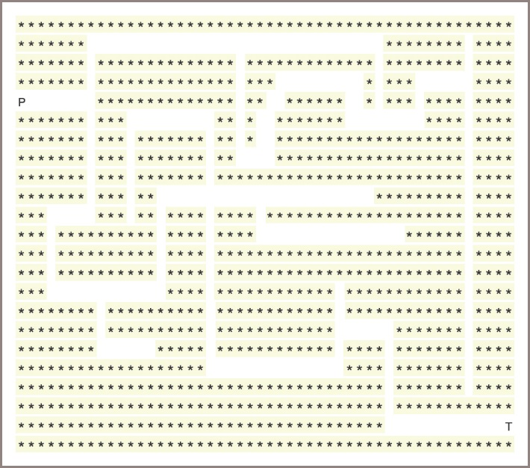
Backtracking (2 of 3)
The role of a stack in the process is to remember the alternative states that occur at each juncture:
Consider the problem of finding a path out of a maze
Figure 7-2: A maze problem

Slide 28
Backtracking (3 of 3)
Sample backtracking algorithm:
Create a new stack
Locate the character 'P' in the grid
Push its location onto the stack
While the stack is not empty
Pop a location, (row, column), off the stack
If the grid contains 'T' at this location, then
A path has been found
Return True
Else if this location does not contain a dot
Place a dot in the grid at this location
Examine the adjacent cells to this one and
for each one that contains a space,
push its location onto the stack
Return False

Slide 29
Memory Management (1 of 6)
During a program’s execution, both its code and its data occupy computer memory
The computer’s run-time system must keep track of various details that are invisible to the program’s author, which include the following:
Associating variables with data objects stored in memory so they can be located when these variables are referenced
Remembering the address of the instruction in which a method or function is called, so control can return to the next instruction when that function or method finishes execution
Allocating memory for a function’s or a method’s arguments and temporary variables, which exist only during the execution of that function or method

Slide 30
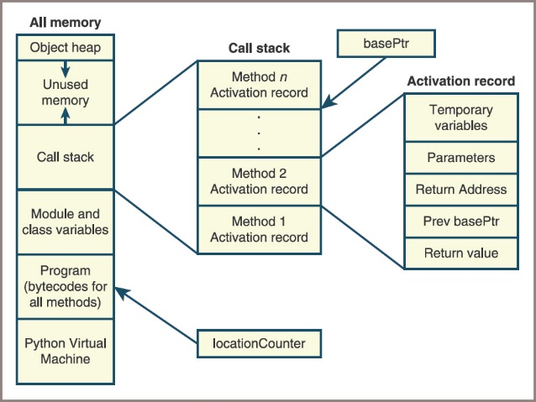
Memory Management (2 of 6)
A Python compiler translates a Python program into bytecodes:
A complex program called the Python Virtual Machine (PVM) then executes these
The memory, or run-time environment, controlled by the PVM is divided into six regions
Figure 7-3: The architecture of a run-time environment

Slide 31
Memory Management (3 of 6)
The activation records shown in the figure contain two types of information:
The regions labeled Temporary Variables and Parameters hold data needed by the executing subroutine
The remaining regions hold data that allow the PVM to pass control backward from the currently executing subroutine to the subroutine that called it

Slide 32
Memory Management (4 of 6)
When a subroutine is called, the PVM performs the following steps:
Creates the subroutine’s activation record and pushes it onto the call stack
Saves the basePtr’s current value in the region labeled Prev basePtr and sets the basePtr to the new activation record’s base
Saves the locationCounter’s current value in the region labeled Return Address and sets the locationCounter to the first instruction of the called subroutine
Copies the calling parameters into the region labeled Parameters
Starts executing the called subroutine at the location indicated by the locationCounter

Slide 33
Memory Management (5 of 6)
When a subroutine has finished executing, the PVM performs the following steps:
Reestablishes the settings needed by the calling subroutine by restoring the values of the locationCounter and the basePtr from values stored in the activation record
Pops the activation record from the call stack
Resumes execution of the calling subroutine at the location indicated by the locationCounter

Slide 34
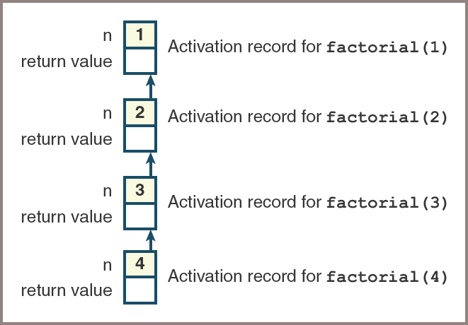
Memory Management (6 of 6)
Figure 7-4: The call stack needed to execute factorial(4)

Slide 35
Implementations of Stacks
Stacks are implemented easily using arrays or linked structures
The following sections show that there are trade-offs involved in using these two recurring approaches

Slide 36
Test Driver
Two stack implementations are the classes ArrayStack and LinkedStack
Before you develop these, write a short tester program that shows how you can test them immediately
The code in this program exercises all the methods in any stack implementation and gives you an initial sense that they are working as expected:
See the text for the code along with the output

Slide 37
Adding Stacks to the Collection Hierarchy (1 of 2)
ArrayStack and LinkedStack
Implement the same interface, called StackInterface
Are subclasses of the AbstractStack class, which in turn is a subclass of AbstractCollection
Inherit the add method from the AbstractStack class, the size variable, and the methods isEmpty, __len__, __str__, __add__, and __eq__ from AbstractCollection
The only methods that need to be implemented in ArrayStack and LinkedStack are _init_, peek, push, pop, clear, and _iter_

Slide 38
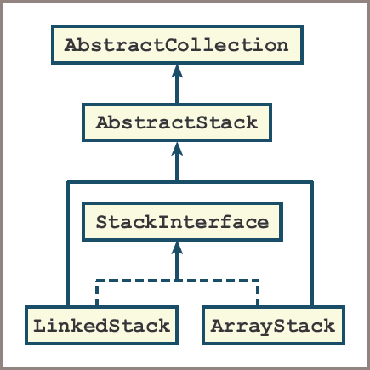
Adding Stacks to the Collection Hierarchy (2 of 2)
Figure 7-5: The stack resources in the collection hierarchy

Slide 39
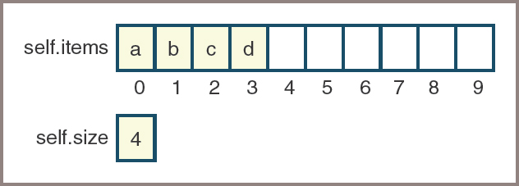
Array Implementation
The first implementation is built around an array called self.items and an integer called self.size
Figure 7.6 shows how self.items and self.size appear when four items are on the stacks
Figure 7-6: An array representation of a stack with four items

Slide 40
Linked Implementation (1 of 4)
The linked implementation requires two classes:
LinkedStack and Node
The Node class contains two fields:
data — An item on the stack
next — A pointer to the next node
Because new items are added to and removed from just one end of the linked structure, the methods pop and push are easy to implement, as shown in Figures 7.8 and 7.9

Slide 41
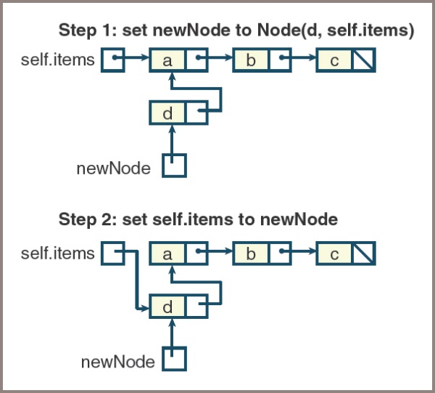
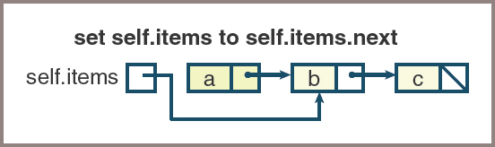
Linked Implementation (2 of 4)
Figure 7-8: Pushing an item onto a linked stack
Figure 7-9: Popping an item from a linked stack

Slide 42
Linked Implementation (3 of 4)
Code for LinkedStack:
from node import Node
from abstractstack import AbstractStack
class LinkedStack(AbstractStack):
""" Link-based stack implementation."""
def __init__(self, sourceCollection = None):
self.items = None
AbstractStack.__init__(self, sourceCollection)
# Accessors
def __iter__(self):
"""Supports iteration over a view of self.
Visits items from bottom to top of stack."""
def visitNodes(node):
if node != None:
visitNodes(node.next)
tempList.append(node.data)
tempList = list()
visitNodes(self.items)
return iter(tempList)
def peek(self):
"""Returns the item at top of the stack.
Precondition: the stack is not empty."""
if self.isEmpty():
raise KeyError("The stack is empty.")
return self.items.data

Slide 43
Linked Implementation (4 of 4)
Code for LinkedStack (continued):
# Mutators
def clear(self):
"""Makes self become empty."""
self.size = 0
self.items = None
def push(self, item):
"""Inserts item at top of the stack."""
self.items = Node(item, self.items)
self.size += 1
def pop(self):
"""Removes and returns the item at top of the stack.
Precondition: the stack is not empty."""
if self.isEmpty():
raise KeyError("The stack is empty.")
oldItem = self.items.data
self.items = self.items.next
self.size -= 1
return oldItem

Slide 44
The Role of the Abstract Stack Class (1 of 2)
The __init__ method in AbstractCollection uses the add method to add items in a source collection to self:
If self is a stack, Python raises an exception, stating that the add method is undefined for stacks
To remedy this problem and maintain consistency with the interfaces of other collections,
You need to include an add method with your stack types
The logical place to put this method, so that all stack types can use it, is in the AbstractStack class

Slide 45
The Role of the Abstract Stack Class (2 of 2)
Code for AbstractStack:
"""
File: abstractstack.py
Author: Ken Lambert
"""
from abstractcollection import AbstractCollection
class AbstractStack(AbstractCollection):
"""An abstract stack implementation."""
# Constructor
def __init__(self, sourceCollection):
"""Sets the initial state of self, which includes the
contents of sourceCollection, if it's present."""
AbstractCollection.__init__(self, sourceCollection)
# Mutator methods
def add(self, item):
"""Adds item to self."""
self.push(item)

Slide 46
Time and Space Analysis of the Two Implementations (1 of 2)
With the exception of the __iter__ method,
All the stack methods are simple and have a maximum running time of O(1), or constant
In the array implementation, the analysis becomes more complex:
At the moment of doubling, the push method’s running time jumps to O(n), or linear, but the rest of the time it remains at O(1)
Similar remarks can be made about the pop method
On average, both are still O(1)
The recursive function used in the linked implementation causes a linear growth of memory because of its use of the system call stack:
Avoid this problem by using a doubly linked structure; the iterator can begin at the last node and follow links to previous nodes

Slide 47
Time and Space Analysis of the Two Implementations (2 of 2)
A linked stack of n items requires n nodes, each containing two references:
One to an item and the other to the next node
In addition, there must be a variable that points to the top node and a variable for the size, yielding a total space requirement of 2n + 2
For an array implementation,
Assuming that an integer and a reference occupy the same amount of space, the total space requirement is the array’s capacity + 2
An array implementation is more space-efficient than a linked implementation whenever the load factor is greater than

Slide 48
Chapter Summary (1 of 2)
A stack is a linear collection that allows access to one end only, called the top:
Elements are pushed onto the top or popped from it
Other operations on stacks include peeking at the top element, determining the number of elements, determining whether the stack is empty, and returning a string representation
Stacks are used in applications that manage data items in a last-in-first-out manner
These applications include the following:
Matching bracket symbols in expressions, evaluating postfix expressions, backtracking algorithms, and managing memory for subroutine calls on a virtual machine

Slide 49
Chapter Summary (2 of 2)
Arrays and singly linked structures support simple implementations of stacks

