Slide 1
Chapter 9: Lists
Fundamentals of Python: Data Structures, Second Edition
Fundamentals of Python: Data Structures, Second Edition. © 2019 Cengage. May not be copied, scanned, or duplicated, in whole or in part, except for use as permitted in a license distributed with a certain product or service or otherwise on a password-protected website for classroom use.

Slide 2
Learning Objectives
Describe the features of a list and the operations on it
Choose a list implementation based on its performance characteristics
Recognize applications where it is appropriate to use a list
Describe the features of a list iterator and the operations on it
Recognize applications where it is appropriate to use a list iterator
Develop some recursive list-processing functions

Slide 3
Overview of Lists (1 of 3)
A list supports manipulation of items at any point within a linear collection
Common examples of lists
A recipe – a list of instructions
A string – a list of characters
A document – a list of words
A file – a list of data blocks on a disk
Array implementations of lists use physical positions to represent logical order:
Linked implementations do not

Slide 4
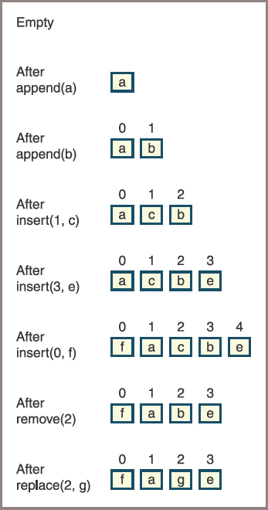
Overview of Lists (2 of 3)
Figure 9.1 shows how a list changes in response to a succession of operations
Figure 9-1: The states in the lifetime of a list

Slide 5
Overview of Lists (3 of 3)
Table 9.1 The Operations Used in Figure 9.1
Operation | What It Does
add(item) | Adds item to the tail of the list.
insert(index, item) | Inserts item at position index, shifting other items to the right by one position if necessary.
replace(index, item) | Replaces the item at position index with item.
pop(index) | Removes the item at position index, shifting other items to the left by one position if necessary.

Slide 6
Using Lists
Categories of operations
Index-based
Content-based
Position-based

Slide 7
Index-Based Operations (1 of 2)
Index-based operations
Manipulate items at designated indices within a list
In the case of array-based implementations,
These operations provide the convenience of random access
Suppose a list contains n items:
Because a list is ordered linearly, you can refer unambiguously to an item in a list via its relative position from the head of the list using an index that runs from 0 to n − 1
Thus, the head is at index 0, and the tail is at index n − 1

Slide 8
Index-Based Operations (2 of 2)
Table 9.2 Index-Based Operations for a List
List Method | What It Does
L.Insert (I, item) | Adds item at index i, after shifting items to the right by one position.
L.Pop (i=None) | Removes and returns the item at index i. If i is absent, removes and returns the last item.
L [i] | Returns the item at index i.
L [i] = item | Replaces the item at index i with item.

Slide 9
Content-Based Operations (1 of 2)
Content-based operations
Based not on an index, but on the content of a list
Usually expect an item as an argument and do something with it and the list
Table 9.3 lists three basic content-based operations for a list named L

Slide 10
Content-Based Operations (2 of 2)
Table 9.3 Content-Based Operations for a List
List Method | What It Does
L.add(item) | Adds item after the list’s tail.
L.remove(item) | Removes item from the list.
blank | Precondition: item is in the list.
L.index(item) | Returns the position of the first instance of item in the list.
blank | Precondition: item is in the list.

Slide 11
Position-Based Operations (1 of 14)
Position-based operations
Performed relative to a currently established position called the cursor
Allow the programmer to navigate through a list by moving the cursor
A separate object called a list iterator provides these operations
A list iterator supports movement to
Previous positions
Directly to the first position
Directly to the last position
Also supports
Insertions, replacements, and removal of items at cursor positions

Slide 12
Position-Based Operations (2 of 14)
A list iterator is created by running the listIterator method on a list:
listIterator=aList.listIterator ()
The list can be either empty or already have items in it:
List is sometimes called the list iterator’s backing store
With respect to items in its backing store, a list iterator’s cursor is always in one of three places:
Just before the first item
Between two adjacent items
Just after the last item

Slide 13

Position-Based Operations (3 of 14)
Figure 9-2: A list iterator attached to its backing store (a list)

Slide 14
Position-Based Operations (4 of 14)
Table 9.4 Navigational Operations for a List Iterator
Operation | What It Does
LI.hasNext() | Returns True if there is an item after the cursor. Returns False if the cursor is undefined or is positioned after the last item.
LI.next() | Returns the next item and moves the cursor to the right by one position.
LI.hasPrevious() | Returns True if there is an item before the cursor. Returns False if the cursor is undefined or is positioned before the first item.
LI.previous() | Returns the previous item and moves the cursor to the left by one position.
LI.first() | Moves the cursor before the first item, if there is one.
LI.last() | Moves the cursor after the last item, if there is one.

Slide 15
Position-Based Operations (5 of 14)
Table 9.5 Mutator Operations for a List Iterator
Operation | What It Does
LI.insert(item) | If the cursor is defined, inserts item after it; otherwise, inserts item at the tail of the list.
LI.remove() | Removes the item returned by the most recent next or previous operation.
LI.replace(item) | Replaces the item returned by the most recent call of next or previous operation.

Slide 16
Position-Based Operations (6 of 14)
Table 9.6 The Effects of List Iterator Operations on a List
Operation | Position after Operation | The List after Operation | Value Returned | Comment
Instantiation | Undefined | Empty | blank | A new list iterator.
insert(a) | Undefined | a | blank | When the cursor is undefined, each item inserted goes at the tail of the list.
insert(b) | Undefined | a b | blank | blank
hasNext() | Undefined |  | False | When the cursor is undefined, there is no next or previous item.
first() | 0 | , a b | blank | Establish the cursor before the first item, if there is one.

Slide 17
Position-Based Operations (7 of 14)
Table 9.6 The Effects of List Iterator Operations on a List (continued)
Operation | Position after Operation | The List after Operation | Value Returned | Comment
hasNext() | 0 | blank | True | There is an item to the right of the cursor, so there is a next item.
next() | 1 | a , b | a | Return a and move the cursor to the right.
replace(c) | 1 | c , b | blank | Replace a , the item most recently returned by next , with c .
next() | 2 | c b , | b | Return b and move the cursor to the right.
next() | 2 | c b, | Exception | The cursor is at the tail of the list, so it is impossible to move to the next item.

Slide 18
Position-Based Operations (8 of 14)
Table 9.6 The Effects of List Iterator Operations on a List (continued)
Operation | Position after Operation | The List after Operation | Value Returned | Comment
hasNext() | 2 | c b, | False | The cursor is at the tail of the list; therefore, there is no next item.
hasPrevious() | 2 | c b , | True | There is an item to the left of the cursor, so there is a previous item.
previous() | 1 | c b , | b | Return b and move the cursor to the left.
insert(e) | 1 | c , e b | blank | Inserts e to the right of the cursor position.
remove() | 1 | c , e b | Exception | An insert has occurred since the most recent next or previous .

Slide 19
Position-Based Operations (9 of 14)
Table 9.6 The Effects of List Iterator Operations on a List (continued)
Operation | Position after Operation | The List after Operation | Value Returned | Comment
previous() | 0 | ,c e b | c | Return c and move the cursor to the left.
remove() | 0 | ,e b | blank | Remove c , the item most recently returned by previous .

Slide 20
Position-Based Operations (10 of 14)
Code segment illustrating the use of a list iterator:
print("Create a list with 1-9")
lyst = ArrayList(range(1, 10))
print("Length:", len(lyst))
print("Items (first to last): ", lyst)
# Create and use a list iterator
listIterator = lyst.listIterator()
print("Forward traversal: ", end = "")
listIterator.first()
while listIterator.hasNext():
print (listIterator.next(), end = " ")
print("\nBackward traversal: ", end = "")
listIterator.last()
while listIterator.hasPrevious():
print(listIterator.previous(), end = " ")
print("\nInserting 10 before 3: ", end = "")
listIterator.first()
for count in range(2):
listIterator.next()

Slide 21
Position-Based Operations (11 of 14)
Code segment illustrating the use of a list iterator (continued):
listIterator.insert(10)
print(lyst)
print("Removing 2: ", end = "")
listIterator.first()
for count in range(3):
listIterator.next()
listIterator.remove()
print(lyst)
print("Removing all items")
listIterator.first()
while listIterator.hasNext():
listIterator.next()
listIterator.remove()
print("Length:", len(lyst))

Slide 22
Position-Based Operations (12 of 14)
Output of the code segment:
Create a list with 1–9
Length: 9
Items (first to last): 1 2 3 4 5 6 7 8 9
Forward traversal: 1 2 3 4 5 6 7 8 9
Backward traversal: 9 8 7 6 5 4 3 2 1
Inserting 10 before 3: 1 2 10 3 4 5 6 7 8 9
Removing 2: 1 10 3 4 5 6 7 8 9
Removing all items
Length: 0

Slide 23
Position-Based Operations (13 of 14)
Table 9.7 Summary of Basic List Operations
Operation | Content-Based Operation | Position-Based Operation
L.insert(i, item) | L.add(item) | LI.hasNext()
L.pop(i) | L.remove(item) | LI.next()
L[i] | L.index(item) | LI.hasPrevious()
L[i] = item | blank | LI.first() LI.last() LI.insert(item) LI.remove(item) LI.replace(item)

Slide 24
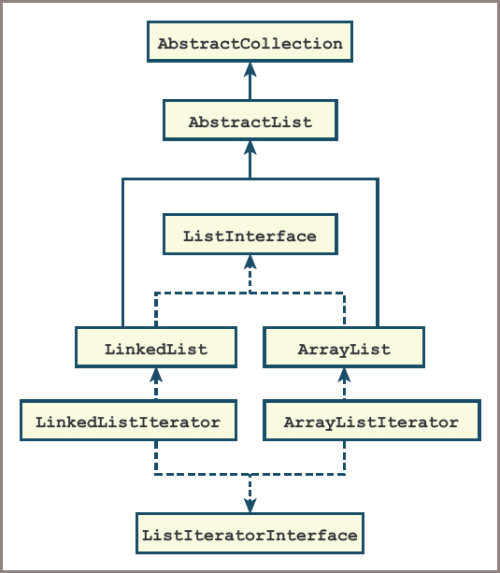
Position-Based Operations (14 of 14)
Figure 9-3: The interfaces and implementing classes for lists and list iterators

Slide 25
Applications of Lists
This section examines three important applications:
Heap-storage management
Disk file management
Implementation of other collections

Slide 26
Heap-Storage Management
The object heap is an area of memory from which the Python virtual machine allocates segments of various sizes for all new data objects
When an object no longer can be referenced from a program, the Python Virtual Machine (PVM) can return that object’s memory segment to the heap for use by other objects
Heap-management schemes can have a significant impact on an application’s overall performance:
Contiguous blocks of free space on the heap are linked in a free list
When an application instantiates a new object, the PVM searches the free list for the first block large enough to hold the object
When the object is no longer needed, the garbage collector returns the object’s space to the free list

Slide 27
Organization of Files on a Disk (1 of 3)
A computer’s file system has three major components:
A directory of files
The files
Free space
Disk’s surface is divided into concentric tracks
Each track is further subdivided into sectors
Number of tracks vary depending on the disk’s capacity and physical size
All tracks contain the same number of sectors and all sectors contain the same number of bytes

Slide 28
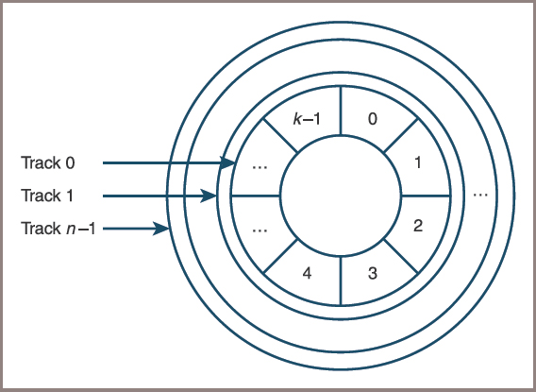
Organization of Files on a Disk (2 of 3)
Figure 9-4: Tracks and sectors on the surface of a disk

Slide 29
Organization of Files on a Disk (3 of 3)
A file system’s directory is organized as a hierarchical collection
A file system does not experience the same fragmentation problem encountered in Python’s object heap:
There is still a difficulty
To transfer data to or from the disk, read/write heads must first be positioned to the correct track:
The disk must rotate until the desired sector is under the heads
Data can be transferred to or from several adjacent sectors during a single rotation:
A disk system’s performance is optimized when multisector files are not scattered across the disk

Slide 30
Implementation of Other Collections
Two ways in which lists are used to implement other collections
Extend the list class, making the new class a subclass of the list class
Use an instance of the list class within the new class and let the list contain the data items
Collections that use lists also inherit their performance characteristics
Primary advantage
Coding becomes easier
Instead of operating on a concrete array or linked structure, the implementer of a stack needs only call the appropriate list methods

Slide 31
List Implementations
This section develops array-based and linked implementations

Slide 32
The Role of the AbstractList Class (1 of 3)
Each concrete list class is subclassed under an abstract class
Called AbstractList
Because this class is a subclass of AbstractCollection
The list classes inherit the usual collection methods, as well as the variable self.size
You can also include some other list methods in AbstractList to reduce the number of methods you need to define in the concrete classes

Slide 33
The Role of the AbstractList Class (2 of 3)
Code for the AbstractList class:
"""
File: abstractlist.py
Author: Ken Lambert
"""
from abstractcollection import AbstractCollection
class AbstractList(AbstractCollection):
"""An abstract list implementation."""
def __init__(self, sourceCollection):
"""Maintains a count of modifications to the list."""
self.modCount = 0
AbstractCollection.__init__(self, sourceCollection)
def getModCount(self):
"""Returns the count of modifications to the list."""
return self.modCount
def incModCount(self):
"""Increments the count of modifications
to the list."""
self.modCount += 1

Slide 34
The Role of the AbstractList Class (3 of 3)
Code for the AbstractList class (continued):
def index(self, item):
"""Precondition: item is in the list.
Returns the position of item.
Raises: ValueError if the item is not in the list."""
position = 0
for data in self:
if data == item:
return position
else:
position += 1
if position == len(self):
raise ValueError(str(item) + " not in list.")
def add(self, item):
"""Adds the item to the end of the list."""
self.insert(len(self), item)
def remove(self, item):
"""Precondition: item is in self.
Raises: ValueError if item in not in self.
Postcondition: item is removed from self."""
position = self.index(item)
self.pop(position)

Slide 35
An Array-Based Implementation (1 of 4)
The array-based implementation of the list interface is a class called ArrayList:
An ArrayList maintains its data items in an instance of the Array class
Has an initial default capacity that is automatically increased when necessary
Because the ArrayList class is a subclass of AbstractList
Only the index-based methods, the __iter__ method, and the listIterator methods are defined here
The index-based operations __getitem__ and __setitem__ simply use the subscript operator on the array variable self.items

Slide 36
An Array-Based Implementation (2 of 4)
Code for the class ArrayList:
"""
File: arraylist.py
Author: Ken Lambert
"""
from arrays import Array
from abstractlist import AbstractList
from arraylistiterator import ArrayListIterator
class ArrayList(AbstractList):
"""An array-based list implementation."""
DEFAULT_CAPACITY = 10
def __init__(self, sourceCollection = None):
"""Sets the initial state of self, which includes the
contents of sourceCollection, if it's present."""
self.items = Array(ArrayList.DEFAULT_CAPACITY)
AbstractList.__init__(self, sourceCollection)
# Accessor methods
def __iter__(self):
"""Supports iteration over a view of self."""
cursor = 0
while cursor < len(self):
yield self.items[cursor]
cursor += 1
def __getitem__(self, i):
"""Precondition: 0 <= i < len(self)
Returns the item at position i.
Raises: IndexError."""
if i < 0 or i >= len(self):
raise IndexError("List index out of range")
return self.items[i]

Slide 37
An Array-Based Implementation (3 of 4)
Code for the class ArrayList (continued):
# Mutator methods
def __setitem__(self, i, item):
"""Precondition: 0 <= i < len(self)
Replaces the item at position i.
Raises: IndexError."""
if i < 0 or i >= len(self):
raise IndexError("List index out of range")
self.items[i] = item
def insert(self, i, item):
"""Inserts the item at position i."""
# Resize array here if necessary
if i < 0: i = 0
elif i > len(self): i = len(self)
if i < len(self):
for j in range(len(self), i, -1):
self.items[j] = self.items[j - 1]
self.items[i] = item
self.size += 1
self.incModCount()

Slide 38
An Array-Based Implementation (4 of 4)
Code for the class ArrayList (continued):
def pop(self, i = None):
"""Precondition: 0 <= i < len(self).
Removes and returns the item at position i.
If i is None, i is given a default of len(self) - 1.
Raises: IndexError."""
if i == None: i = len(self) - 1
if i < 0 or i >= len(self):
raise IndexError("List index out of range")
item = self.items[i]
for j in range(i, len(self) - 1):
self.items[j] = self.items[j + 1]
self.size -= 1
self.incModCount()
# Resize array here if necessary
return item
def listIterator(self):
"""Returns a list iterator."""
return ArrayListIterator(self)

Slide 39
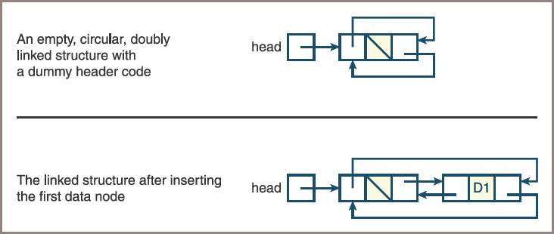
A Linked Implementation (1 of 4)
Figure 9-5: Two circular, doubly linked structures with sentinel nodes

Slide 40
A Linked Implementation (2 of 4)
Setup code for the LinkedList class:
"""
File: linkedlist.py
Author: Ken Lambert
"""
from node import TwoWayNode
from abstractlist import AbstractList
class LinkedList(AbstractList):
"""A link-based list implementation."""
def __init__(self, sourceCollection = None):
"""Sets the initial state of self, which includes the
contents of sourceCollection, if it's present."""
# Uses a circular structure with a sentinel node
self.head = TwoWayNode()
self.head.previous = self.head.next = self.head
AbstractList.__init__(self, sourceCollection)
# Accessor methods
def __iter__(self):
"""Supports iteration over a view of self."""
cursor = self.head.next
while cursor != self.head:
yield cursor.data
cursor = cursor.next

Slide 41
A Linked Implementation (3 of 4)
Code for getNode, _setitem_, and insert methods:
# Helper method returns node at position i
def getNode(self, i):
"""Helper method: returns a pointer to the node
at position i."""
if i == len(self): # Constant-time access to head node
return self.head
if i == len(self) - 1: # or last data node
return self.head.previous
probe = self.head.next
while i > 0:
probe = probe.next
i -= 1
return probe

Slide 42
A Linked Implementation (4 of 4)
Code for getNode, _setitem_, and insert methods (continued):
# Mutator methods
def __setitem__(self, i, item):
"""Precondition: 0 <= i < len(self)
Replaces the item at position i.
Raises: IndexError."""
if i < 0 or i >= len(self):
raise IndexError("List index out of range")
self.getNode(i).data = item
def insert(self, i, item):
"""Inserts the item at position i."""
if i < 0: i = 0
elif i > len(self): i = len(self)
theNode = self.getNode(i)
newNode = TwoWayNode(item, theNode.previous, theNode)
theNode.previous.next = newNode
theNode.previous = newNode
self.size += 1
self.incModCount()

Slide 43
Time and Space Analysis for the Two Implementations (1 of 3)
Table 9.8 Average Running Times for List Operations
List Method | ArrayList | LinkedList
__getitem__(i) | O(1) | O(n)
__setitem__(i, item) | O(1) | O(n)
insert(i, item) | O(n) | O(n)
pop(i) | O(n) | O(n)
add(item) | O(1) | O(1)
remove(item) | O(n) | O(n)
index(item) | O(n) | O(n)

Slide 44
Time and Space Analysis for the Two Implementations (2 of 3)
A minimal array implementation requires memory for the following items:
An array that can hold capacity references, where capacity >= n
A reference to the array
Variables for the number of items and the mod count
Thus, the total space requirement for the minimal array implementation is capacity + 3

Slide 45
Time and Space Analysis for the Two Implementations (3 of 3)
The linked implementation requires memory for the following items:
n + 1 nodes, where each node contains three references
A reference to the head node
Variables for the number of items and the mod count
Thus, the total space requirement for the linked implementation is 3n + 6

Slide 46
Implementing a List Iterator
In this section, you develop a list iterator for an array-based list

Slide 47
Role and Responsibilities of a List Iterator
Three types of preconditions
A programmer cannot run a next or a previous operation if the hasNext or the hasPrevious operation returns False , respectively
A programmer cannot run consecutive mutator methods on a list iterator:
A next or a previous must first be run before each mutation to establish a cursor position
A programmer cannot run mutations on the list itself, with the list’s mutator methods, while using a list iterator on that list
To help determine some of these preconditions, the list iterator maintains two additional variables:
The first one is its own mod count variable
The second variable tracks the position at which the list iterator can perform a mutation on the list

Slide 48
Setting Up and Instantiating a List Iterator Class (1 of 2)
The list iterator class for array lists is called ArrayListIterator
This class includes the following instance variables:
self.backingStore —The list on which the iterator is opened
self.modCount —The iterator’s notion of the mod count
self.cursor —The cursor position manipulated by the iterator’s navigational methods first , last , hasNext , next , hasPrevious , and previous
self.lastItemPos —The cursor position used by the iterator’s mutator methods insert , remove , and replace
This position is established by running next or previous and is undefined after running insert or remove

Slide 49
Setting Up and Instantiating a List Iterator Class (2 of 2)
Code for this portion of the ArrayListIterator class:
"""
File: arraylistiterator.py
Author: Ken Lambert
"""
class ArrayListIterator(object):
"""Represents the list iterator for an array list."""
def __init__(self, backingStore):
"""Set the initial state of the list iterator."""
self.backingStore = backingStore
self.modCount = backingStore.getModCount()
self.first()
def first(self):
"""Resets the cursor to the beginning
of the backing store."""
self.cursor = 0
self.lastItemPos = -1

Slide 50
The Navigational Methods in the List Iterator (1 of 4)
The navigational methods hasNext and next work with a cursor that is moving from the beginning of an array-based list to its end
The method hasNext returns True as long as the cursor is less than the backing store’s length
The method next must check two preconditions before advancing the cursor and returning an item from the backing store:
First, the method hasNext must return True
Second, the two mod counts—one belonging to the list iterator and the other to the backing store—must be equal

Slide 51
The Navigational Methods in the List Iterator (2 of 4)
Code for these two methods:
def hasNext(self):
"""Returns True if the iterator has
a next item or False otherwise."""
return self.cursor < len(self.backingStore)
def next(self):
"""Preconditions: hasNext returns True.
The list has not been modified except by this
iterator’s mutators.
Returns the current item and advances the cursor.
to the next item."""
if not self.hasNext():
raise ValueError("No next item in list iterator")
if self.modCount != self.backingStore.getModCount():
raise AttributeError(
"Illegal modification of backing store")
self.lastItemPos = self.cursor
self.cursor += 1
return self.backingStore[self.lastItemPos]

Slide 52
The Navigational Methods in the List Iterator (3 of 4)
The methods last , hasPrevious , and previous work with a cursor that is moving from the end of an array-based list to its beginning
The method last sets the position of the cursor to the right of the last item in the list
This position will be equal to the length of the list
The method hasPrevious returns True if the cursor is greater than position 0
The method previous checks the same two preconditions as the method next
It then decrements the cursor by 1, sets self.lastItemPos to self.cursor , and returns the item at self.lastItemPos in the backing store

Slide 53
The Navigational Methods in the List Iterator (4 of 4)
Code for the three methods:
def last(self):
"""Moves the cursor to the end of the backing store."""
self.cursor = len(self.backingStore)
self.lastItemPos = -1
def hasPrevious(self):
"""Returns True if the iterator has a
previous item or False otherwise."""
return self.cursor > 0
def previous(self):
"""Preconditions: hasPrevious returns True.
The list has not been modified except
by this iterator’s mutators.
Returns the current item and moves
the cursor to the previous item."""
if not self.hasPrevious():
raise ValueError("No previous item in list iterator")
if self.modCount != self.backingStore.getModCount():
raise AttributeError(
"Illegal modification of backing store")
self.cursor -= 1
self.lastItemPos = self.cursor
return self.backingStore[self.lastItemPos]

Slide 54
Mutator Methods in the List Iterator (1 of 3)
The mutator methods remove and replace must check two preconditions
First, the cursor must be established, meaning that the variable self.lastItemPos must not equal −1
Second, the two mod counts must be equal
The method insert checks only the precondition on the mod counts

Slide 55
Mutator Methods in the List Iterator (2 of 3)
Code for the three mutator methods:
def replace(self, item):
"""Preconditions: the current position is defined.
The list has not been modified except by this
iterator’s mutators."""
if self.lastItemPos == -1:
raise AttributeError(
"The current position is undefined.")
if self.modCount != self.backingStore.getModCount():
raise AttributeError(
"List has been modified illegally.")
self.backingStore[self.lastItemPos] = item
self.lastItemPos = -1
def insert(self, item):
"""Preconditions:
The list has not been modified except by this
iterator’s mutators."""
if self.modCount != self.backingStore.getModCount():
raise AttributeError(
"List has been modified illegally.")
if self.lastItemPos == -1:
# Cursor not defined, so add item to end of list
self.backingStore.add(item)
else:
self.backingStore.insert(self.lastItemPos, item)
self.lastItemPos = -1
self.modCount += 1

Slide 56
Mutator Methods in the List Iterator (3 of 3)
Code for the three mutator methods (continued):
def remove(self):
"""Preconditions: the current position is defined.
The list has not been modified except by this
iterator’s mutators."""
if self.lastItemPos == -1:
raise AttributeError(
"The current position is undefined.")
if self.modCount != self.backingStore.getModCount():
raise AttributeError(
"List has been modified illegally.")
item = self.backingStore.pop(self.lastItemPos)
# If the item removed was obtained via next,
# move cursor back
if self.lastItemPos < self.cursor:
self.cursor -= 1
self.modCount += 1
self.lastItemPos = -1

Slide 57
Design of a List Iterator for a Linked List
It is possible to use the ListIterator class just described with a linked list
However, because this implementation of the list iterator runs the index-based methods __getitem__ and __setitem__ on the backing store,
The next , previous , and replace operations will run in linear time when this backing store is a linked list

Slide 58
Time and Space Analysis of List Iterator Implementations
The running times of all the methods in the linked implementation of a list iterator are O(1)
Compare to the array-based implementation, whose insert and remove methods are both O(n)

Slide 59
Recursive List Processing
Lisp
Stands for list processing
The list is the basic data structure of Lisp
A Lisp list is a recursive data structure
Lisp programs often consist of a set of recursive functions for processing lists

Slide 60
Basic Operations on a Lisp-Like List (1 of 3)
Users of a Lisp-like list have three basic functions to examine lists:
First function is a predicatenamed isEmpty:
This function returns True if its argument is an empty list, or False otherwise
The function first returns the data item at the head of the list
The function rest returns a list containing the data items after this first one.

Slide 61
Basic Operations on a Lisp-Like List (2 of 3)
Table 9.11 Applying the basic list functions to a list containing 34, 22, and 16
Function Application | Result
isEmpty(lyst) | Returns False .
first(lyst) | Returns 34.
rest(lyst) | Returns a list containing 22 and 16.
first(rest(lyst)) | Returns 22.
first(rest(rest(lyst))) | Returns 16.
isEmpty(rest(rest(rest(lyst)))) | Returns True .
first(rest(rest(rest(lyst)))) | Raises an error (no data in an empty list).

Slide 62
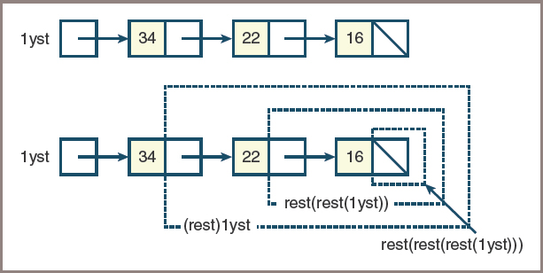
Basic Operations on a Lisp-Like List (3 of 3)
Figure 9-10: A lisp-like list containing 34, 22, and 16

Slide 63
Recursive Traversals of a Lisp-Like List (1 of 4)
The function contains searches a list for a given item:
This function expects a target item and a list as arguments and returns True or False
If the list is empty, you’ve run out of items to examine, so the function returns False
Otherwise, if the target item equals the first item in the list, the function returns True
Otherwise, you use contains to search the rest of the list recursively for the given item

Slide 64
Recursive Traversals of a Lisp-Like List (2 of 4)
The code:
def contains(item, lyst):
"""Returns True if item is in lyst or
False otherwise."""
if isEmpty(lyst):
return False
elif item == first(lyst):
return True
else:
return contains(item, rest(lyst))

Slide 65
Recursive Traversals of a Lisp-Like List (3 of 4)
The index-based function get returns the ith element of a given list
The definition of get follows:
def get(index, lyst):
"""Returns the item at position index in lyst.
Precondition: 0 <= index < length(lyst)"""
if index == 0:
return first(lyst)
else:
return get(index - 1, rest(lyst))

Slide 66
Recursive Traversals of a Lisp-Like List (4 of 4)
Suppose you do not know the length of a list,
Which is a part of the precondition of the get function
The definition of the length of a Lisp-like list can be stated recursively:
Its length is 0 if the list is empty
Otherwise, a list’s length is one plus the length of the rest of the list after the first item
Code for the recursive function length:
def length(lyst):
"""Returns the number of items in lyst."""
if isEmpty(lyst):
return 0
else:
return 1 + length(rest(lyst))

Slide 67
Building a Lisp-Like List (1 of 5)
A Lisp-like list has a single basic constructor function named cons:
This function expects two arguments: a data item and another list
The relationships between the functions cons , first , and rest can be expressed algebraically in the following pair of equations:
first(cons(A, B)) == A
rest(cons(A, B)) == B

Slide 68
Building a Lisp-Like List (2 of 5)
Table 9.12 Building Lists with cons
Function Application or Variable Reference | Resulting List
THE_EMPTY_LIST | An empty list.
cons(22, THE_EMPTY_LIST) | A list containing 22.
cons(11, cons(22, THE_EMPTY_LIST)) | A list containing 11 and 22.

Slide 69
Building a Lisp-Like List (3 of 5)
Code for buildRange:
def buildRange(lower, upper):
"""Returns a list containing the numbers from
lower through upper.
Precondition: lower <= upper"""
if lower == upper:
return cons(lower, THE_EMPTY_LIST)
else:
return cons(lower, buildRange(lower + 1, upper))

Slide 70
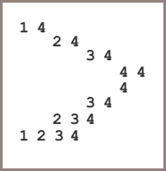
Building a Lisp-Like List (4 of 5)
Figure 9-11: Tracing the recursive building of a list with buildRange

Slide 71
Building a Lisp-Like List (5 of 5)
The remove function decrements the index and moves to the rest of the list on each recursive call
Here is the code:
def remove(index, lyst):
"""Returns a list with the item at index removed.
Precondition: 0 <= index < length(lyst)"""
if index == 0:
return rest(lyst)
else:
return cons(first(lyst),
remove(index - 1, rest(lyst)))

Slide 72
The Internal Structure of a Lisp-Like List (1 of 2)
A Lisp-like list consists of a sequence of nodes, where each node contains a data item named data and a link to the next node named next:
The next link in the last node is None
A Lisp-like list is an abstract data type (ADT)
Includes four basic functions and the constant for the empty list
The user of this ADT doesn’t have to know anything about nodes, links, or pointers

Slide 73
The Internal Structure of a Lisp-Like List (2 of 2)
Code:
"""
File: lisplist.py
Data and basic operations for Lisp-like lists.
"""
from node import Node
THE_EMPTY_LIST = None
def isEmpty(lyst):
"""Returns True if lyst is empty or False otherwise."""
return lyst is THE_EMPTY_LIST
def first(lyst):
"""Returns the item at the head of lyst.
Precondition: lyst is not empty."""
return lyst.data
def rest(lyst):
"""Returns a list of the items after the head of lyst.
Precondition: lyst is not empty."""
return lyst.next
def cons(data, lyst):
"""Returns a list whose head is item and whose tail
is lyst."""
return Node(data, lyst)

Slide 74
Printing Lisp-Like Lists in IDLE with _repr_ (1 of 2)
Add a method named _repr_ to the Node class:
When Python evaluates a value for display in the IDLE shell, it looks for this method in the value’s class
If _repr_ is included in the Node class,
You can build and return a string with the data of the entire sequence of nodes enclosed in parentheses

Slide 75
Printing Lisp-Like Lists in IDLE with _repr_ (2 of 2)
Code:
class Node(object):
"""Represents a singly linked node."""
def __init__(self, data, next = None):
self.data = data
self.next = next
def __repr__(self):
"""Returns the string representation of a
nonempty lisp list."""
def buildString(lyst):
if isEmpty(rest(lyst)):
return str(first(lyst))
else:
return str(first(lyst)) + " " + buildString(rest(lyst))
return "(" + buildString(self) + ")"

Slide 76
Lists and Functional Programming (1 of 2)
The remove function does not change the structure of its list argument,
It simply returns a list with the ith item removed
This code segment illustrates this by removing list A’s first item and assigning the result to list B:
>>> A = buildRange(1, 3)
>>> print(A)
(1 2 3)
>>> B = remove(0, A) # Remove the item at position 0
>>> print(B)
(2 3)
>>> print(A) # List referenced by A not changed
(1 2 3)

Slide 77
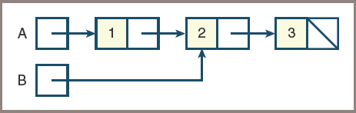
Lists and Functional Programming (2 of 2)
Figure 9-12: The shared structure of two lists A and B

Slide 78
Chapter Summary (1 of 2)
A list is a linear collection that allows users to insert, remove, access, and replace elements at any position
Operations on lists are index based, content based, or position based:
An index-based operation allows access to an element at a specified integer index
A position-based list lets the user scroll through it by moving a cursor
List implementations are based on arrays or on linked structures:
A doubly linked structure is more convenient and faster when used with a list iterator than a singly linked structure

Slide 79
Chapter Summary (2 of 2)
A sorted list is a list whose elements are always in ascending or descending order
A list can have a recursive definition — it is either empty or consists of a data item and another list
The recursive structure of such lists supports a wide array of recursive list-processing functions

