Slide 1

Atmosphere Framework
TMA OmniVista 2500 Core Team

Slide 2
Outline
Introducing Atmosphere Framework.
Plugins and extensions.
Communication channels and Atmosphere Framework.
Supported (Web Servers & Web Browsers)
Demo (Spring MVC and Atmosphere Framework)
Conclusion
References

Slide 3
Introduction- What Atmosphere is?
A Java OpenSource framework led by Jean-Francois Arcand
A Java/Javascript framework which is the creation of portable asynchronous application using Java, Groovy and Scala
Contains client and server side components for building Asynchronous web application
Supports all majors Browsers and Servers
Discovers the best communication channel between the client and the server (WebSockets, Server Side Events, Long-polling, HTTP Streaming and JSONP).
Latest version: 1.0.14
Notes:
Note 1. Developers can write an application that will use WebSocket protocol with specific supporting versions of browsers/servers. The browsers can transparently fall back to Polling, SSE… in case the WebSocket protocol isn’t supported. For example, an Atmosphere application will use WebSocket to work with Internet Explorer 10 and other techniques for Internet Explorer 6/7/8/9.
Note2. To use Atmosphere, add the following dependency
<dependency>
<groupId>org.atmosphere</groupId>
<artifactId>atmosphere-{atmosphere-module}</artifactId>
<version>1.0.14</version>
</dependency>
Where atmosphere-module can be: jersey, runtime (main module), guice, redis, hazelcast, jms, jgroups or gwt

Slide 4
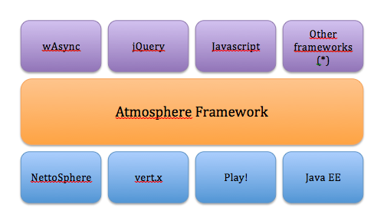
Introduction – Stack
The Atmosphere Framework Stack consists of:
Work on all Servlet based server (Tomcat, Jboss Jetty, Resin, GlassFish, WebSphere, WebLogic etc)

Slide 5
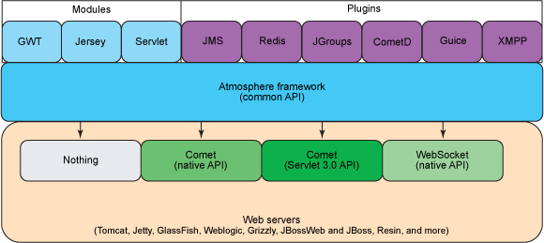
Introduction - Architecture
Architectural view of Atmosphere:

Slide 6
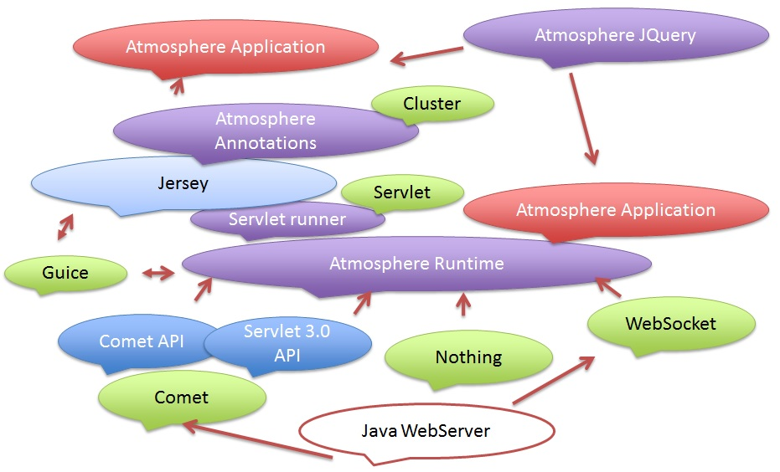
Introduction –Relation

Slide 7
Introduction – Server Modules
Atmosphere runtime:
The core module.
All other modules are built on top of this one.
Exposes two simple APIs for building applications
AtmosphereHandler : simple interface to implements
Meteor API: a class that can be retrieved or injected in servlet based applications
Notes:
public interface AtmosphereHandler {
void onRequest(AtmosphereResource resource) throws IOException;
void onStateChange(AtmosphereResourceEvent event) throws IOException;
void destroy();
}

Slide 8
Introduction – Server Modules
Atmosphere Annotations:
Defines the set of annotations that can be implemented to support Atmosphere concepts

Slide 9
Introduction – Server Modules
Atmosphere Jersey:
An extension to the Jersey REST framework
Exposes a new set of annotations, thus exposing the Atmosphere’s runtime functionality.

Slide 10
Introduction – Server Modules
Atmosphere Meteor:
Used with existing Servlet or Servlet based technology like JSP, JSF, Struts, etc.
A Meteor can easily be looked up from any Java Object.

Slide 11
Introduction – Server Modules
Atmosphere GWT:
An extension to the GWT Framework.

Slide 12
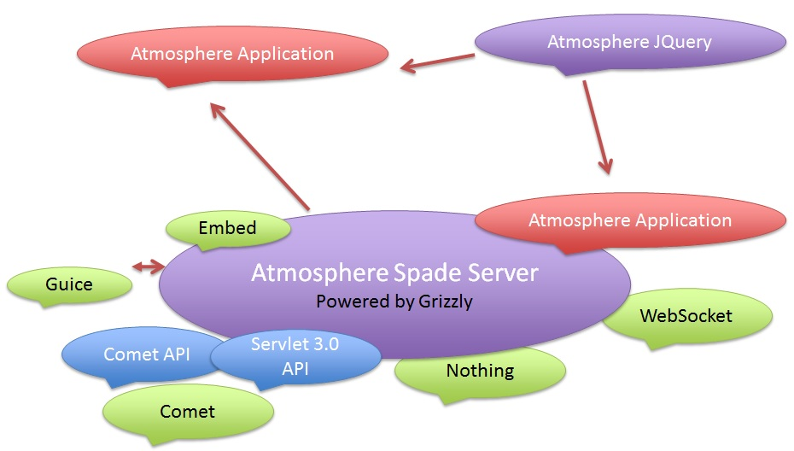
Introduction – Server Modules
Atmosphere Spade Server:

Slide 13
Introduction – Server Modules
Atmosphere Spade Server:
Consist of an end to end stack containing the Grizzly Web Server, Jersey and all Atmosphere modules and Plug-in.
Supports natively the following Web Server asynchronous API:
Tomcat’s CometProcessor
Tomcat WebSocket
GlassFish’s CometHandler
GlassFish’s WebSocket
Etc…

Slide 14
Introduction – Client Module
Atmosphere Jquery Plugin:
Jquery.atmosphere.js API
Supports all browsers
Could fallback to another transport in case transport is not support
Using the script can be summarized as:
Create a request object
Subscribe
Received Events
Publish Messages
UnSubscribe

Slide 15
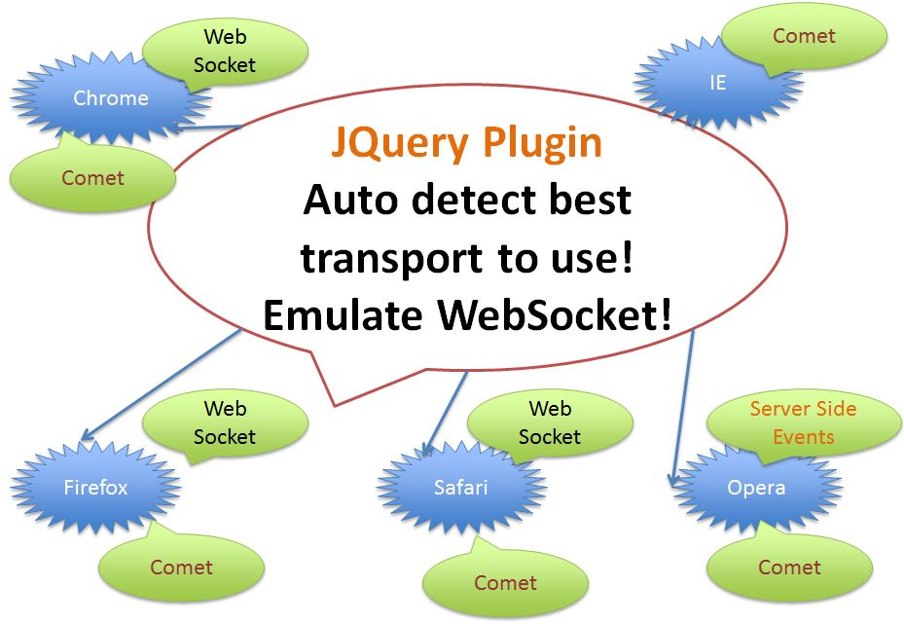
Introduction – Client Module
Atmosphere Jquery Plugin:
Notes:
Atmosphere comes with a Jquery client library to facilitate the connection setup, which is able to automatically detect the best transport available. Usage of Atmosphere’s Jquery plugin is similar to the HTML5 WebSocket API. First, you connect to the server, register a callback to receive message, and then you can push some data.

Slide 16
Introduction – Main Concepts
Suspend:
Consist of telling the underlying Web Server to not commit the response.

Slide 17
Introduction – Main Concepts
Resume:
The action of resuming consist of completing the response.

Slide 18
Introduction – Main Concepts
Broadcast:
Producing an event and distributing that event to one or many suspended response.
Suspended response can then decide to discard the event or send it back to the browser.

Slide 19
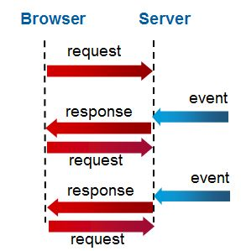
Introduction – Main Concepts
Long-polling:
Consists of resuming a suspended as soon as event is getting broadcasted

Slide 20
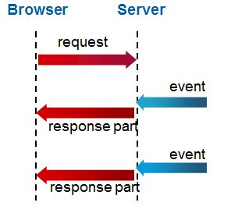
Introduction – Main Concepts
Http Streaming:
Consists of resuming a suspended response after multiples events are getting broadcasted

Slide 21
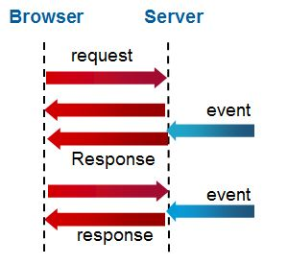
Introduction – Main Concepts
WebSocket:
A new protocol allowing bi-directional communication between a browser and server

Slide 22
Introduction – Main Concepts
Native Asynchronous API:
Means an API that is proprietary.

Slide 23
Plug-ins and Extensions
External Plug-ins:
PrimeFaces
Netty Framework
Wicket
Vaadin
Grails
Grails-Event-Push
RichFaces
Scalatra

Slide 24
Plug-ins and Extensions
External Plug-ins:
Apache Tuscany.
Portal

Slide 25
Plug-ins and Extensions
Atmosphere Plugins:
SocketIO.
GWT
Spring
Guice
Redis
Hazelcast
JMS
XMPP

Slide 26
Plug-ins and Extensions
Atmosphere Plugins:
JAXRS 2.
CometD/Bayeux Protocol.
Jetty Early WebSocket Implementation.
WebLogic 11 and lower Native Support

Slide 27
Communication Channel and Atmosphere Framework
Atmosphere transparently supports WebSockets, Server Side Events, Long-Polling, HTTP Streaming and JSONP

Slide 28
Safari
Tomcat7
Jetty7
Firefox
Jetty8
Chrome
GlassFish3.
Opera
GlassFish
3.1.2
IE

Slide 29
Safari
Tomcat7
HELP
Jetty7
Firefox
Jetty8
Chrome
GlassFish3.
Opera
GlassFish
3.1.2
IE

Slide 30
Streaming
Tomcat7
Safari
Au Secours!!
Jetty7
Firefox
Jetty8
Chrome
GlassFish3.
Opera
GlassFish
3.1.2
IE

Slide 31
Streaming
Tomcat7
Safari
Au Secours!!
Jetty7
Firefox
SSE
Jetty8
Chrome
GlassFish3.
Opera
GlassFish
3.1.2
IE

Slide 32
Streaming
Tomcat7
Safari
Au Secours!!
Jetty7
Firefox
SSE
Jetty8
Chrome
JSONP
GlassFish3.
Opera
GlassFish
3.1.2
IE

Slide 33
Streaming
Tomcat7
Safari
Au Secours!!
Jetty7
Firefox
SSE
Jetty8
Chrome
JSONP
Long Polling
GlassFish3.
Opera
GlassFish
3.1.2
IE

Slide 34
Atmosphere to the rescue!!!
Safari
Tomcat7
Jetty7
Firefox
Jetty8
Chrome
GlassFish3.
Opera
GlassFish
3.1.2
IE

Slide 35

Atmosphere -WebSockets
Safari
Tomcat7
Jetty7
Firefox
Jetty8
Chrome
atmosphere.js
Atmosphere API
GlassFish3.
Opera
GlassFish
3.1.2
IE

Slide 36
Atmosphere - HTML5 Server Side Events
Safari
Tomcat7
Jetty7
Firefox
Servlet3
Chrome
atmosphere.js
Atmosphere API
WebLogic
Opera
GlassFish
3.1.2
IE

Slide 37
Atmosphere Long-Polling/HTTP Streaming
Safari
JBoss
Jetty7
Firefox
Servlet3
Chrome
atmosphere.js
Atmosphere API
WebLogic.
Opera
GlassFish
IE

Slide 38
Atmosphere Framework
One API to rule them all
Safari
JBoss
Jetty7
Firefox
Servlet3
Chrome
atmosphere.js
Atmosphere API
WebLogic.
Opera
GlassFish
IE

Slide 39
Supported
The following table describes what Atmosphere supports:
NC: Native Commet
NWS: Native WebSockets
W: WebSockets
LP: Long-Polling
HS: HTTP Streaming
J: JSONP
SSE: Server-Sent Events

Slide 40
Supported
Web Servers:
Server | Version | NC | NWS | W | LP | HS | J | SSE
Tomcat | 7.0.27 and up | X | X | X | X | X | X | X
Tomcat | 7.0.26 and lower | X |  |  | X | X | X | X
Tomcat | 6.x | X |  |  | X | X | X | X
Jetty | 8.x | X | X | X | X | X | X | X
Jboss | 7.x | X |  |  | X | X | X | X

Slide 41
Supported
Web Browsers:
Browser | Version | W | LP | HS | J | SSE
Firefox | 9.x to 12.x | X | X | X | X | X
Chrome | 12.x and lower |  | X | X | X | X
Chrome | 13.X and higher | X | X | X | X | X
Internet Explorer | 6.x to 9.x |  | X | X | X
Internet Explorer | 10.X | X | X | X | X

Slide 42
Demo
This is a part of training app.
Use:
Spring MVC.
Atmosphere Framework.
Notes:
Deploy on tomcat 7.0.41.
Create new alarms by using api/generate.
Check live update checkbox on GUI.
Notes:
If you're using a web framework (Wicket, Struts, Spring MVC), you can transparently support by using the MeteorServlet of Atmosphere. This servlet exposes a Meteor object that can be retrieved within your controllers and services to suspend or resume the requests.

Slide 43
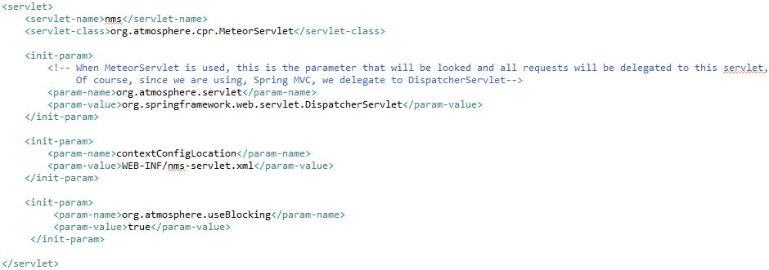
Demo - config
Web.xml:
Use MeteorServlet.

Slide 44

Demo - config
Nms-servlet.xml (for contextConfigLocation):
A request made with an {@link AtmosphereResource} will be consider as SpringMVC request and will be treated with Spring MVC (@link Controller).

Slide 45
Demo – Server Side
Server side:
When a new alarm is created, server will broadcast the new alarm to the clients.
Steps:
Expose an api for the clients to connect.
Lookup / Init a broadcaster for connected clients
Broadcast the update to the clients.

Slide 46

Demo – Server Side
Expose an api for the clients to connect:
Note: suspend the AtmosphereResource: tell the server to not commit anything until it has an update which is broadcasted.

Slide 47

Demo – Server Side
Lookup / Init a broadcaster for connected clients:
Use the exist broadcaster (for broadcasting a new alarm), if it’s not exist then create a new broadcaster

Slide 48
Demo – Server Side
Broadcast the update to clients:
When a new alarm is created, we use ObjectMapper to convert the alarm to string and broadcast to clients.

Slide 49
Demo – Client Side
Client side:
Update information about the new alarm (receive from server side)
Steps:
Subscribe a request to server side
There are 2 ways to a listen for incoming messages:
Using property ‘onMessage’ in request object
Or using ‘addCallback’ of $.atmosphere.

Slide 50
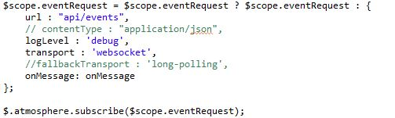
Demo – Client Side
Subscribe a request to server side

Slide 51
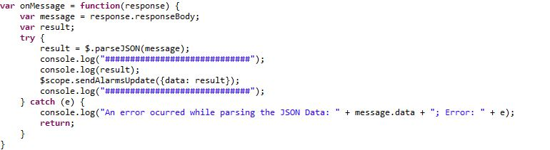
Demo – Client Side
Listen for incoming messages (onMessage): when have returned response from server, onMessage will listener, get data, parse to JSON and send data for updating.

Slide 52
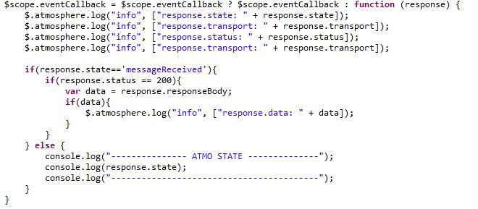
Demo – Client Side
Listen for incoming messages(addCallback): A function to be invoked when there is a response from server.

Slide 53
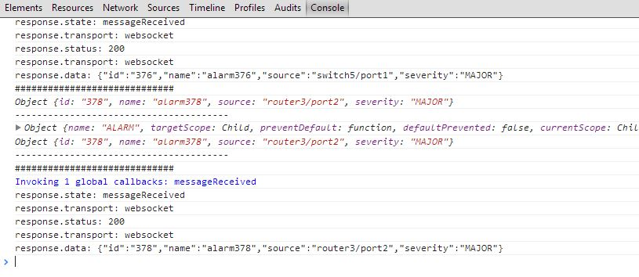
Demo – Client Side
Logs coming from addCallback handler

Slide 54
Conclusion
Write once, Run Anywhere.
Transport free.
Browser nightmare free.

Slide 55
References
https://github.com/Atmosphere/atmosphere/wiki/Atmosphere-Framework-Concepts
https://github.com/Atmosphere/atmosphere/wiki/Getting-Started-with-Atmosphere-1.1
https://github.com/Atmosphere/atmosphere/wiki/Supported-WebServers-and-Browsers
https://github.com/Atmosphere/atmosphere/wiki/Atmosphere-PlugIns-and-Extensions

Slide 56
References
5. “Reverse Ajax, Part 4: Atmosphere and CometD”, Mathieu Carbou, 06 Sep 2011.
6. “Building Powerful WebSocket, Comet, and RESTful Applications Using Atmosphere”, Jeanfrancois Arcand and Paul Sandoz, 2011
7. “Building WebSocket and Server Side Events application using Atmosphere”, Jeanfrancois Arcand, 2012

