Slide 1

NGINX
CREATED BY NGHIA VU

Slide 2
AGENDA
Introduction
Architecture
Install and Use
Configuration
Cache

Slide 3
INTRODUCTION
WHAT?
NGINX is an HTTP and reverse proxy server, as well as a mail proxy server
WHY?
Performance, Scalability, Availability, Easy

Slide 4
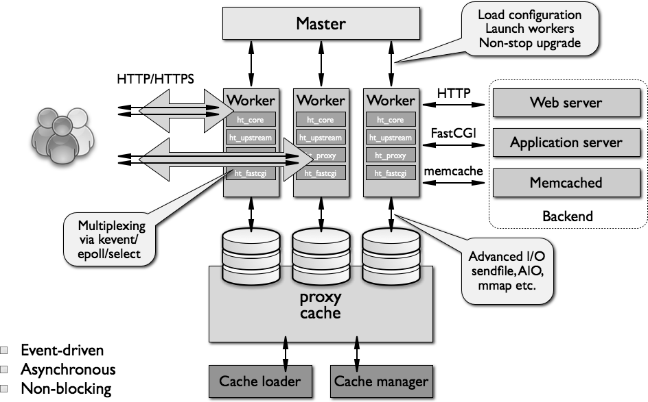
ARCHITECTURE

Slide 5
INSTALL & USE
Install
sudo apt-get update
sudo apt-get install nginx
Check that NGINX is running
sudo service nginx status
Starting, stopping and restarting NGINX
sudo service nginx start
sudo service nginx stop
sudo service nginx restart

Slide 6
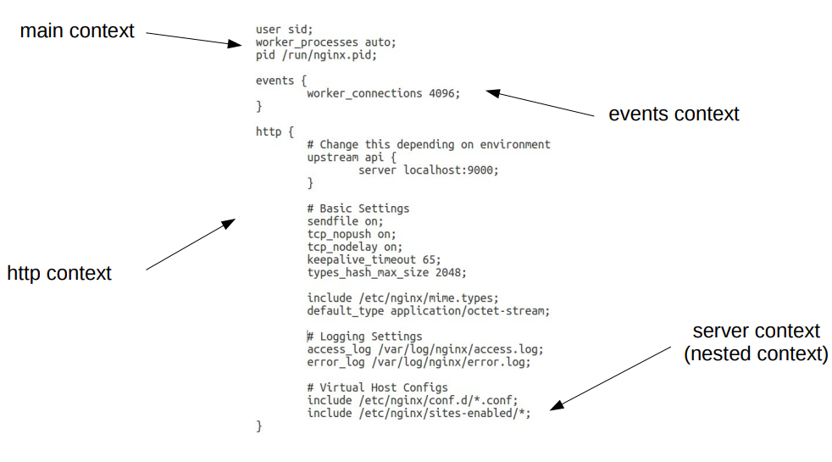
NGINX CONF

Slide 7
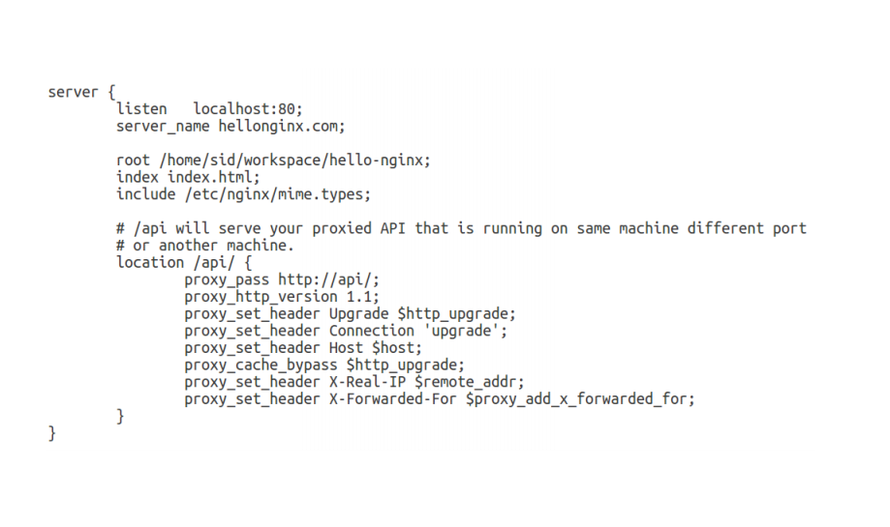
SERVER CONFIGURATION

Slide 8
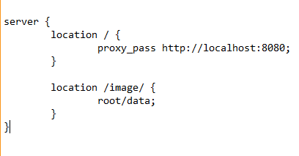
NGINX as PROXY SERVER
As a proxy server, nginx receives requests, sends them off to another server. Retrieves responses and sends them to client.
proxy_pass directive defines the background server via the protocol, domain and port.
In the code snippet, server block handles all requests to images locally & acts as a proxy and sends any other request to the background server.

Slide 9
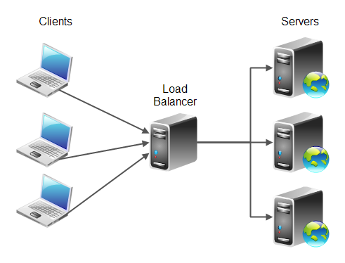
LOAD BALANCER
Load balancer is a reverse proxy that divides requests to multiple backend servers to
increase bandwidth
reduce processing latency
reduce the load on each backend server
ensuring fault-tolerance.

Slide 10
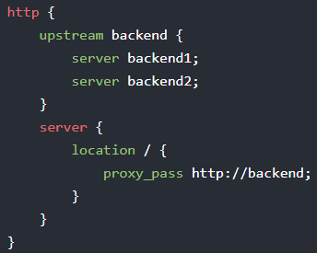
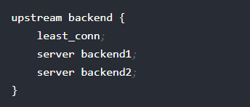
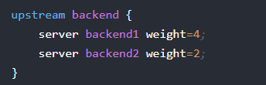
LOAD BALANCER
Both backend1 & backend2 contain the source code and connect to the same database
Algorithm : round-robin, least_conn, least_time, ip_hash,…or weight

Slide 11
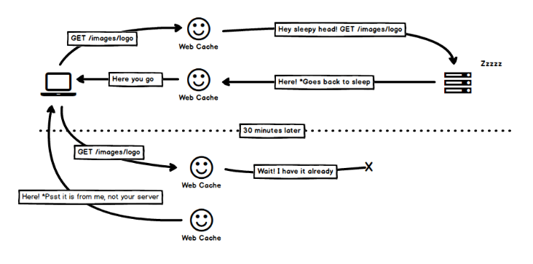
CACHE
Browser cache
Proxy cache
Reverse Proxy Cache

Slide 12
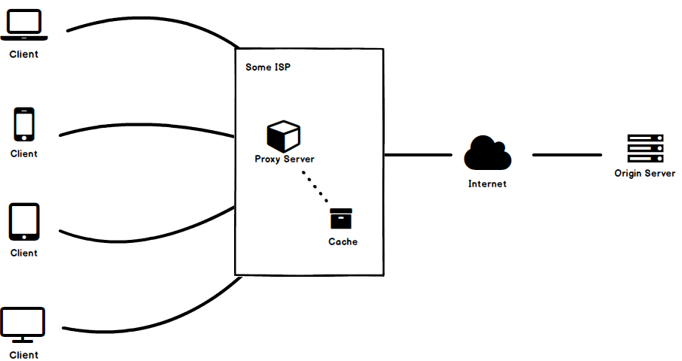
PROXY CACHE
Web proxy caching stores copies of frequently accessed Web objects (such as documents, images, and articles) close to users and serves this information to them. Internet users get their information faster, and Internet bandwidth is freed for other tasks

Slide 13
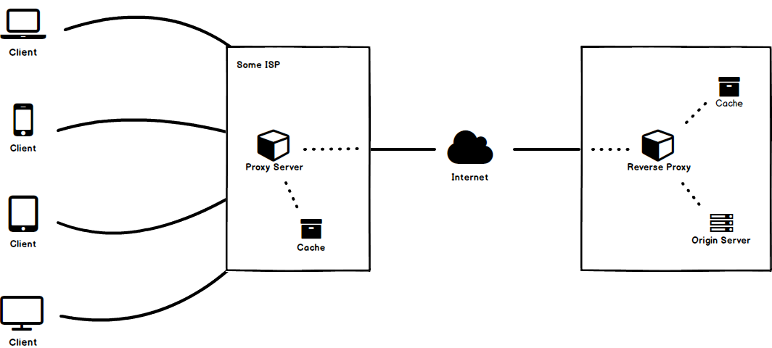
REVERSE PROXY CACHE
Hide the existence and characteristics of an origin server or servers.
Load balancing
Control all requests sent by clients to protected servers

Slide 14
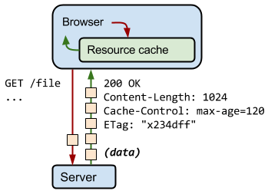
CACHING HEADERS

Slide 15
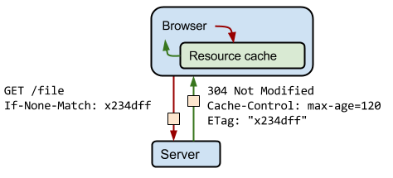
ETAGS
The server uses the ETag HTTP header to return a validation token
The validation token allows for optimal resource monitoring: no need to reload the data if there is nothing to change the server side.

Slide 16
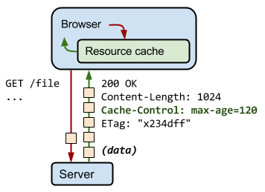
CACHE-CONTROL
Cache-Control directives control who can cache the response, under which conditions, and for how long.
no-cache : notice that the response returned can not be used for the next request to the same URL if the server does not check whether the response has changed.
no-store : notice that the server does not allow the browser to keep any version of the response returned
public & private
max-age

Slide 17
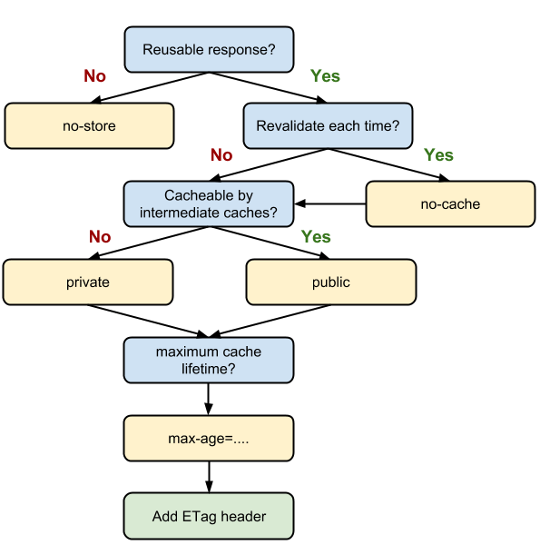
OPTIMAN CACHE-CONTROL

