Slide 1
What is Elasticsearch ?
Created by NghiaVu

Slide 2
Elasticsearch is a real-time distributed search and analytics engine, designed for horizontal scalability with easy management

Slide 3
Basic Terms
Cluster is a collection of nodes.
Node is a single server, part of a cluster.
Index is a collection of shards ~ database.
Shard is a collection of documents.
Type is a category/partition of an index ~ table in database.
Document is a json object ~ record in database.

Slide 4
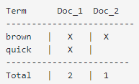
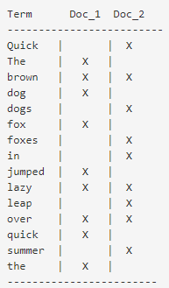
Inverted index
Inverted index, which consists of a list of all the unique words that appear in any document, and for each word, a list of the documents in which it appears.
Example:
The quick brown fox jumped over the lazy dog
Quick brown foxes leap over lazy dogs in summer
quick brown
split the content field of docs into separate words (call terms, or tokens)
Quick
create list of all the unique terms, and then list in which document each term appears.
dogs
leap

Slide 5
Analysis and Analyzers
analysis is a process that consists of the following:
first, tokenizing a block of text into individual terms suitable for use in an inverted index
then normalizing these terms into a standard form to improve their “searchability,” or recall
analyzer is really just a wrapper that combines three functions into a single package:
character filters : Tidy up the string before tokenization
Tokenizer: split the text into terms ( ex : when encounter whitespace or punctuation)
token filters : can change terms(for example, lowercasing Quick), remove terms(for example, stopwords such as a, an, the) or add terms(like jump and lead)

Slide 6
Tokenizer
"set the shape to semi-transparent by calling set_trans(5)“
Standard analyzer: splits the text on word boundaries, as defined by the unicode consortium
set, the, shape, to, semi, transparent, by, calling, set_trans, 5
Simple analyzer : splits the text on anything that isn’t a letter, and lowercases the terms
set, the, shape, to, semi, transparent, by, calling, set, trans
Whitespace analyzer : splits the text on whitespace. it doesn’t lowercase
Set, the, shape, to, semi-transparent, by, calling, set_trans(5)
UAX URL Email Tokenizers, Classic Tokenizers, Partial Word Tokenizers, …

Slide 7
SCORE
TF/IDF : term frequency / Inverse document frequency
Term frequency : the more often, the more relevant (term in field)
EX : tf(t, d) = √frequency
Inverse document frequency : the more often, the less relevant (all term in index)
EX : idf(t) = 1 + log ( numDocs / (docFreq + 1))
Field-length norm : the longer it is, the less likely it is that words in the field will be relevant
EX : norm(d) = 1 / √numTerms
_score = IDF score * TF score * fieldNorms

Slide 8
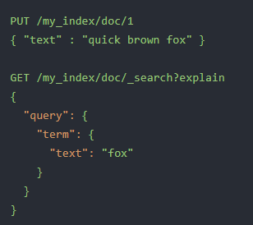
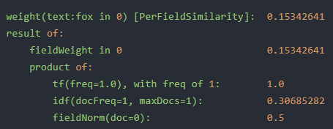
example
Tf = 1 result/1doc = 1.0
Idf = 1 + log((numDocs) / (docFreqs+1)) = 1 + log(1/2.) = 0.306852
fieldNorm = 1/sqrt(3) =0.577350

Slide 9
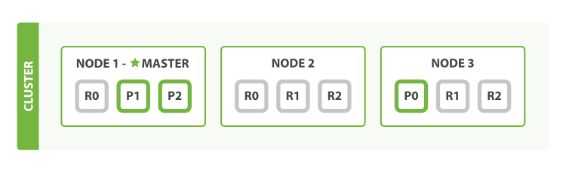
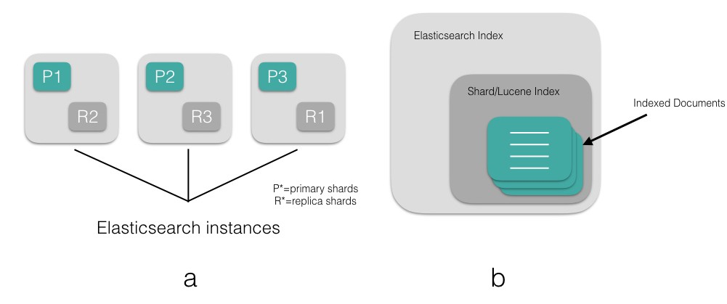
Distributed Search
Shard : primary shard, replica shard
P1, P2, P3 : primary shard

Slide 10
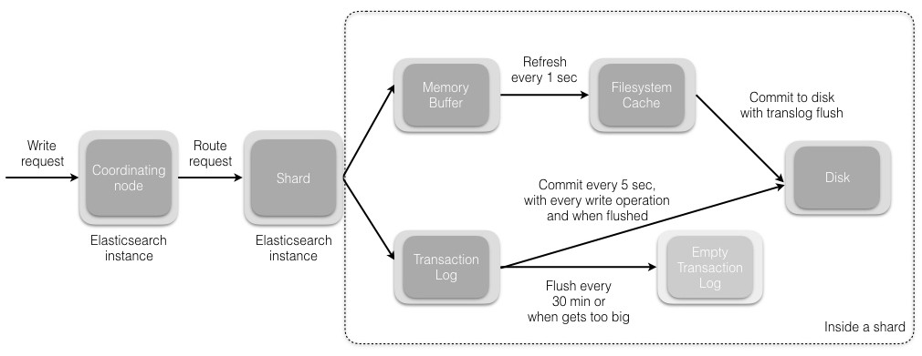
Write request

Slide 11
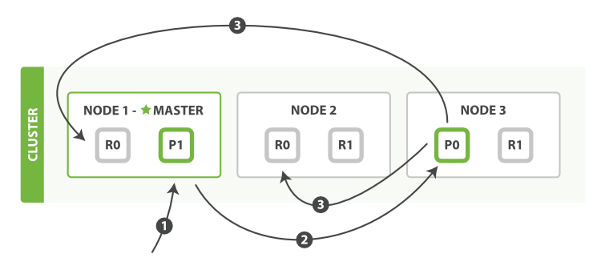
DISTRIBUTED DOCUMENT STORE
Creating, indexing, or deleting a single document
The client sends a create, index, or delete request to NODE 1
The node uses the document’s _id to determine that the document belongs to SHARD 0. It forwards the request to NODE 3, where the primary copy of SHARD 0 is currently allocated
NODE 3 executes the request on the primary shard. If it is successful, it forwards the request in parallel to the replica shards on NODE 1, NODE 2. Once all of the replica shards report success, NODE 3 reports success to the coordinating node, which reports success to the client

Slide 12
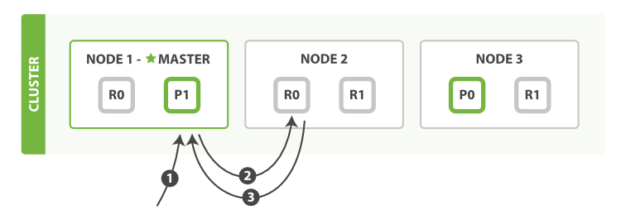
DISTRIBUTED DOCUMENT STORE
RETRIEVING A SINGLE DOCUMENT
The client sends a get request to NODE 1
The node uses the document’s _id to determine that the document belongs to SHARD 0. Copies of SHARD 0 exist on all three nodes. On this occasion, it forwards the request to NODE 2 (used Round-robin algorithm)
NODE 2 returns the document to NODE 1 , which returns the document to the client

Slide 13
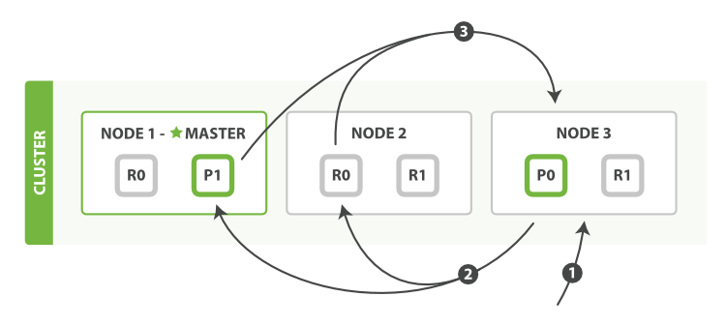
Distributed search execution
The client sends a search request to NODE 3, which which creates an empty priority queue of size from+size
NODE 3 forwards the search request to a primary or replica copy of every shard in the index. Each shard executes the query locally and adds the results into a local sorted priority queue of size from+size
Each shard returns the doc ids and sort values of all the docs in its priority queue to the coordinating node, NODE 3, which merges these values into its own priority queue to produce a globally sorted list of results

Slide 14
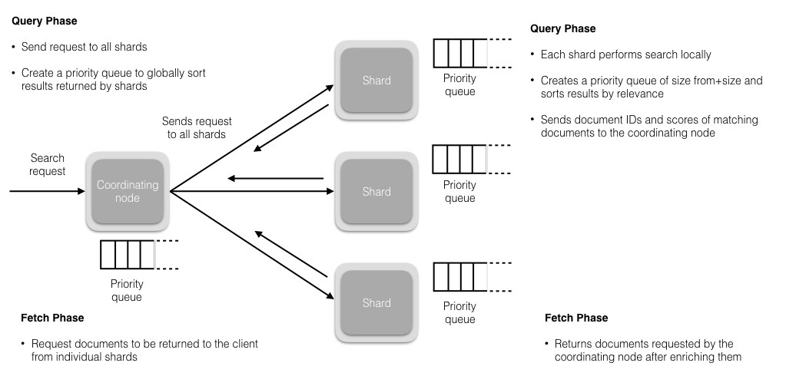
SEARch request

Slide 15
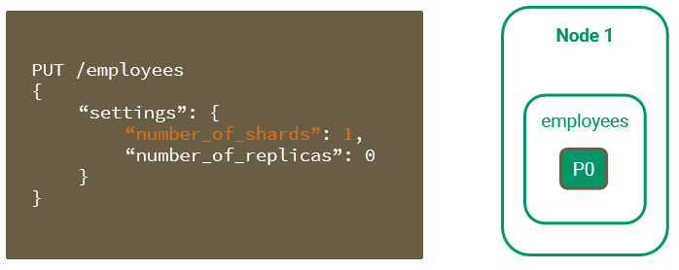
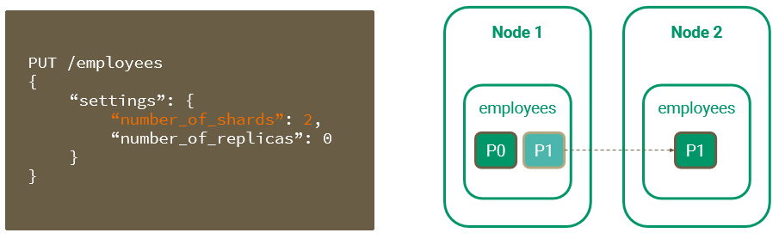
Shards & Replicas
One node, One shard
Two Nodes, Two Shards

Slide 16
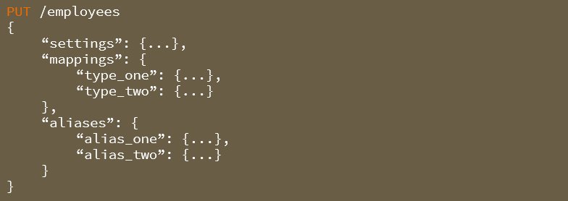
Create Index

Slide 17
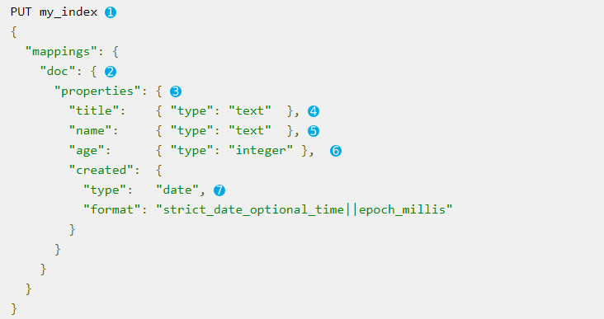
Index Mappings
Create an index called my_index
Add a mapping type called doc
Specify fields or properties
Specify the data type and mapping for each field.

Slide 18

Delete Index

Slide 19
Structured Search Date, Times, Numbers, Text
Finding Exact Values
Finding Multiple Exact Values
Ranges
Working with Null Values
Combining Filters

Slide 20
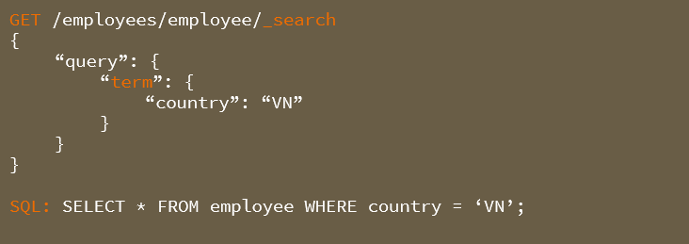
Finding Exact Values

Slide 21
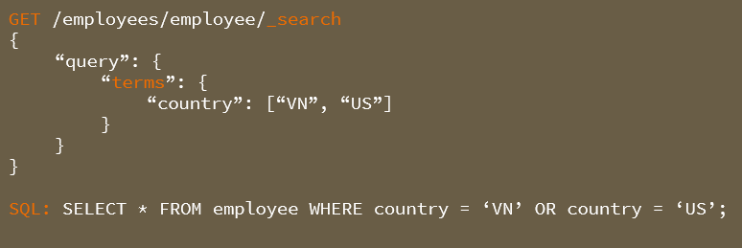
Finding Multiple Exact Values

Slide 22
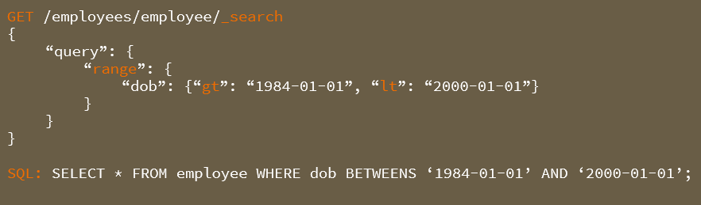
Ranges

Slide 23
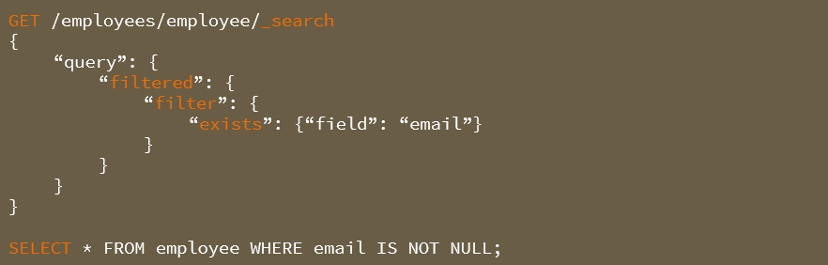
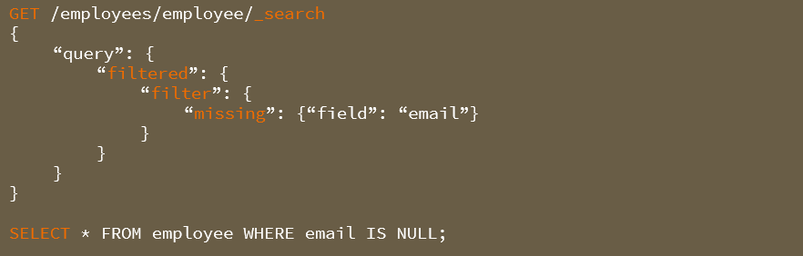
Working with Null values

Slide 24
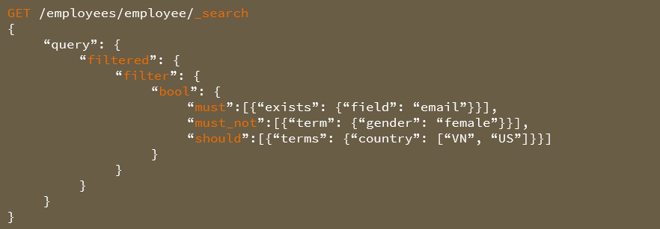
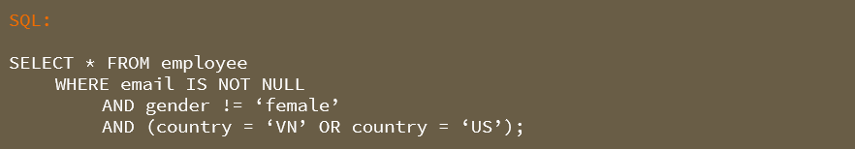
Combining Filters

