Slide 1
Task Control Block
What is Task Control Block
Why use TCB/PCBs?
RTOS Task Control Functions
TCB’s process

Slide 2
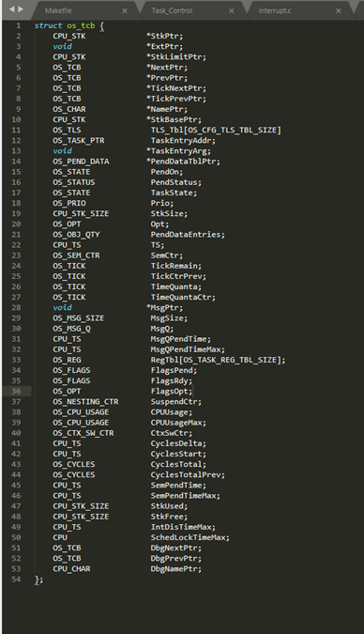
What is
Task Control Block
A task control block (TCB) is a data structure used by kernels to maintain information about a task. Each task requires its own TCB and, for Micro-Controller Operating Systems, the user assigns the TCB in user memory space (RAM). The address of the task’s TCB is provided to Micro-Controller Operating Systems when calling task-related services

Slide 3
Why use TCB/PCBs?
Necessary for OS-based embedded applications.
Encourages good practices, even if not using full OS
Encapsulation of functionality
Well defined global data access
Easier to upgrade to OS

Slide 4
RTOS Task Control Functions
Once a task is switched, the execution context represented by program stack, registers, and counter contents is saved by the OS in a data structure known as a task control block to ensure that the task resumes when rescheduled.
Task Context
Task Scheduling and Dispatch
Coroutines
Interrupts
Task scheduling and dispatch ensure that every task accesses the CPU as well as other system resources effectively to ensure timely and successful completion of system computations.
When such scenarios occur, the interrupt capabilities available on all processors are used to facilitate task switching. Different tasks in the system are either switched by software or hardware interrupts.
The tasks exchange program control mutually as opposed to relinquishing it to the RTOS, so every task transfers control to other scheduled tasks once its data and control state is saved

Slide 5
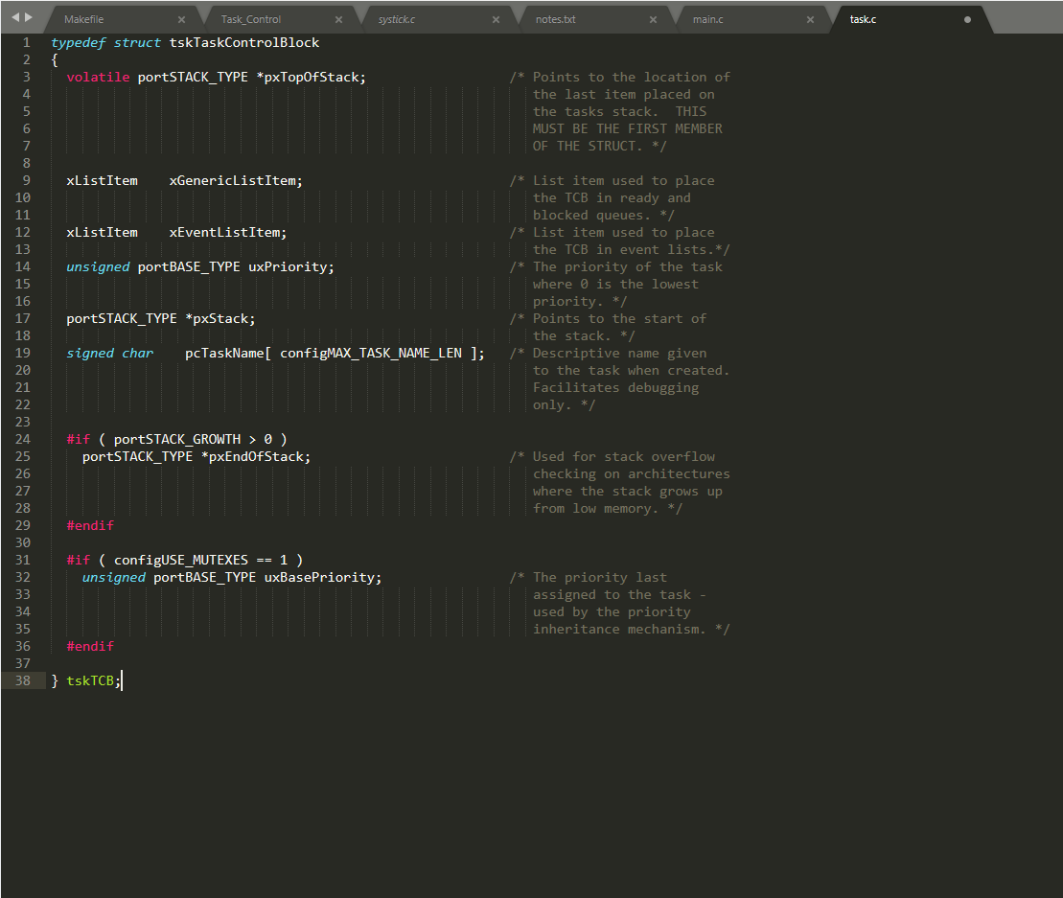
TCB/PCB’s process
The TCB stores the address of the stack start address in pxStack and the current top of stack in pxTopOfStack. It also stores a pointer to the end of the stack in pxEndOfStack to check for stack overflow if the stack grows "up" to higher addresses. If the stack grows "down" to lower addresses then stack overflow is checked by comparing the current top of stack against the start of stack memory in pxStack.
The TCB stores the initial priority of the task in uxPriority and uxBasePriority. A task is given a priority when it is created, and a task's priority can be changed. If FreeRTOS implements priority inheritance then it uses uxBasePriority to remember the original priority while the task is temporarily elevated to the "inherited" priority.
Each task has two list items for use in FreeRTOS's various scheduling lists. When a task is inserted into a list FreeRTOS doesn't insert a pointer directly to the TCB. Instead, it inserts a pointer to either the TCB's xGenericListItem or xEventListItem. These xListItem variables let the FreeRTOS lists be smarter than if they merely held a pointer to the TCB. We'll see an example of this when we discuss lists later.

Slide 6
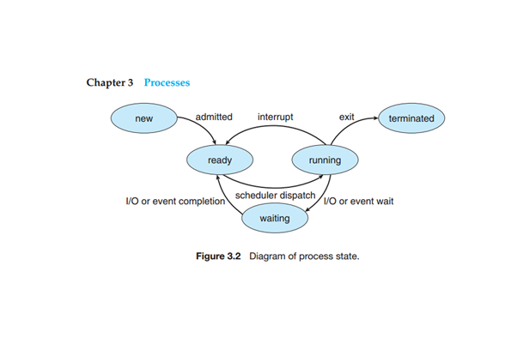
About its process
Process State
• New. The process is being created. • Running. Instructions are being executed. • Waiting. The process is waiting for some event to occur (such as an I/O completion or reception of a signal). • Ready. The process is waiting to be assigned to a processor. • Terminated. The process has finished execution.

Slide 7
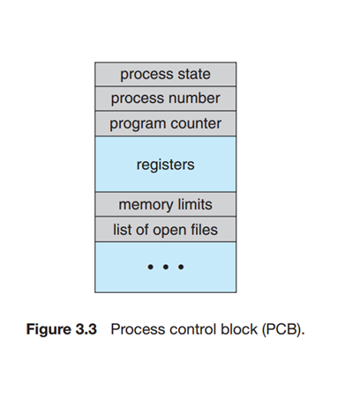
Process Control Block
• Process state. The state may be new, ready, running, waiting, halted, and so on. • Program counter. The counter indicates the address of the next instruction to be executed for this process. • CPU registers. The registers vary in number and type, depending on the computer architecture. They include accumulators, index registers, stack pointers, and general-purpose registers, plus any condition-code information. Along with the program counter, this state information must be saved when an interrupt occurs, to allow the process to be continued correctly afterward. • CPU-scheduling information. This information includes a process priority, pointers to scheduling queues, and any other scheduling parameters.
• Memory-management information. This information may include such items as the value of the base and limit registers and the page tables, or the segment tables, depending on the memory system used by the operating system.

Slide 8
Sources:
https://www.aosabook.org/en/freertos.html
https://www.freertos.org/FreeRTOS_Support_Forum_Archive/January_2018/freertos_Task_control_block_memory_allocation_55c3c1a5j.html
https://doc.micrium.com/display/kernel304/Task+Control+Blocks+TCBs
Abraham-Silberschatz-Operating-System-Concepts---9th2012.12 pages 107-108-109
https://www.intervalzero.com/real-time-2/rtos-task-control-functions/
https://courses.cs.washington.edu/courses/cse466/12au/calendar/12-tcb-fsm.pdf

Slide 9
Thanks for your attention

