Slide 1
COVID-19 Intelligent Query System
Hoang Vu, Khanh Le

Slide 2
Project Purposes
Develop a website that helps users interact with a database of research documents related to COVID-19.
Provide a text-based search engine to search for relevant documents based on the entered query.
Collect users' interactions for research purposes.

Slide 3
Members
Hoang Vu - UC CS 2022 - vuhg@mail.uc.edu
Khanh Le - UC CS 2022 - lekq@mail.uc.edu
Advisor: Dr. Danny Wu - UC College of Medicine - wutz@ucmail.uc.edu

Slide 4
Abstract
As the fight against COVID-19 continues, it is critical to discover and accumulate knowledge in scientific literature to combat the pandemic. In this work, we shared the experience in developing an intelligent query system on COVID-19 literature. The system includes a text-based search engine using Elasticsearch for users to query the COVID-19 literature database. We also collect users' interactions and feedbacks to research user needs and improve our search algorithms with learning to rank techniques. The successful implementation of the COVID-IQS can support knowledge discovery and hypothesis generation in our institution and can be shared with other institutions to make a broader impact.

Slide 5
User Stories
As a user of the website, I want to search for medical articles from my desired keywords, so that I could have a better understandings of the progress in our medical world.
As an UI designer, I want to collect the interactions of the users with the UI, so that I could come up with a better and more convenient design for our website.
As the project researcher, I want to know which articles are interesting based on user's interactions, so that I could use that record to develop ranking algorithm.

Slide 6
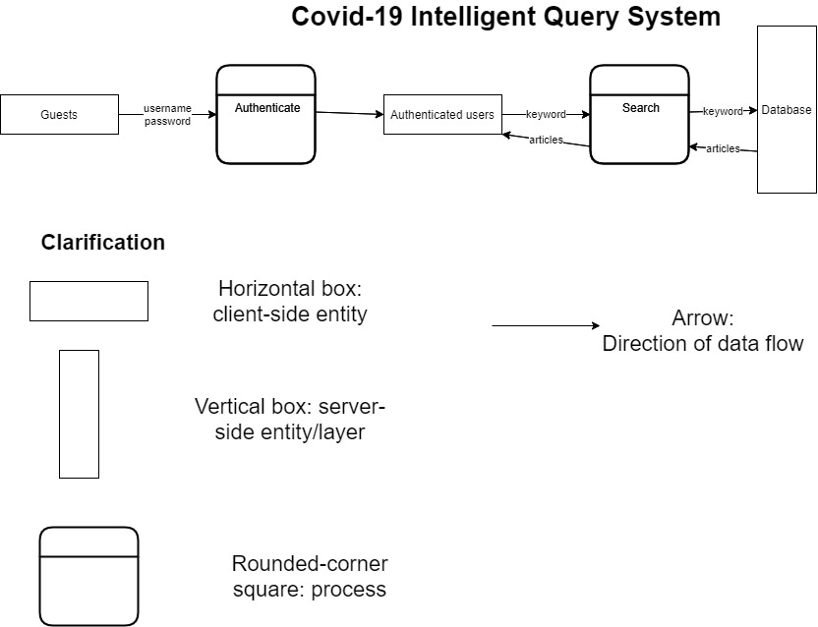
Design Diagrams

Slide 7
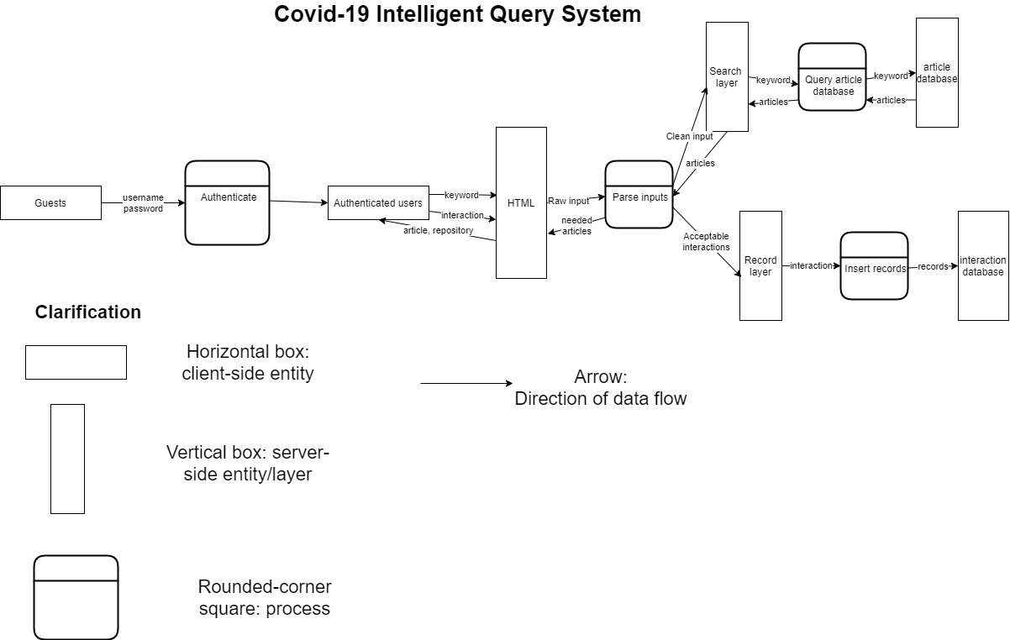
Design Diagram (Cont.)

Slide 8
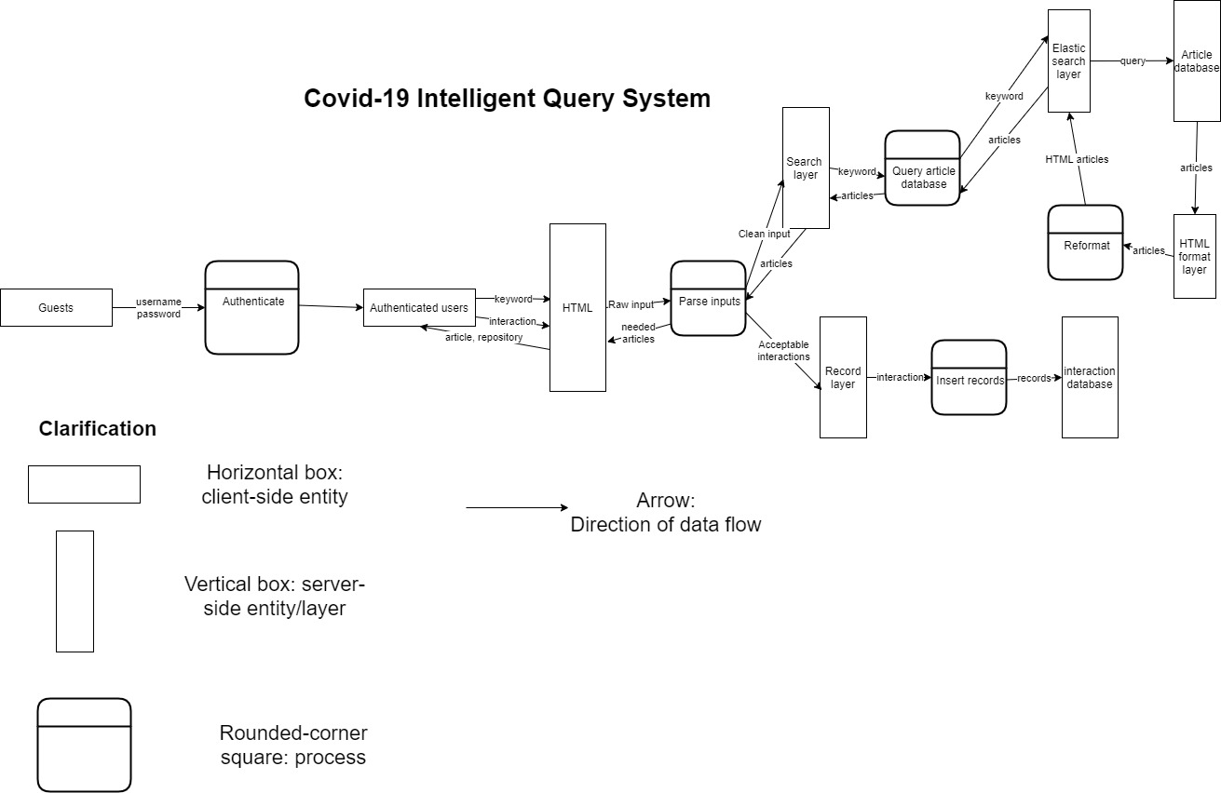
Design Diagram (Cont.)

Slide 9
Major Project Constraints
Time - Two academic semesters are short to fully develop the complete system.
Time - We both are not experienced with front-end development, so front-end progress can be slow.
Social - The ultimate goal of this project is to create a tool used for public service. In our scope, we aim to create a tool used for research purposes.

Slide 10
Project Progress
Done: Base Flask and HTML code.
Done: Pull the COVID-19 literature and store in MySQL database.
Done: Create Elasticsearch index.
Todo: Implement the search engine interface and back-end.
Todo: Enhance front-end design.
Todo: Design functionalities to collect user interactions.

Slide 11
Expected Accomplishments
A full, complete, functional, and well-designed web application. The user should be able to login using their UC6+2, search for their interested articles, interacts with their repositories and peers.
If we have time: functionalities to collect user interactions and additional ways for users to organize their interested articles.

Slide 12
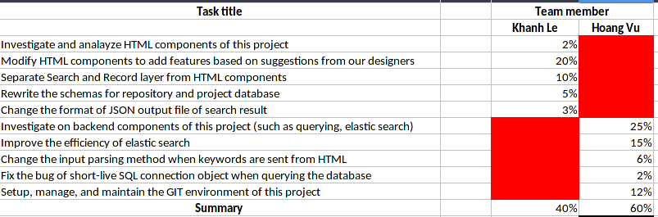
Division of Work

Slide 13
Expected Demo at Expo
Fully functional website.
Database storing user interactions.

