Slide 1
COVID-19 Intelligent Query System
Team members:
Khanh Le (lekq@mail.uc.edu)
Hoang Vu (vuhg@mail.uc.edu)
Advisor:
Dr. Danny T. Y. Wu (wutz@mail.uc.edu)

Slide 2
1. Goals
Develop a website that helps users interact with a database of research documents related to COVID-19.
Provide a text-based search engine to search for relevant documents based on the entered query.
Collect users' interactions for research purposes.

Slide 3
2. Progress
Jan 2020
Crawled medical documents from Pubmed
June 2020
Organized nearly 29,000 articles into database
Jan 2021
Created the first version of COVID-IQS
June 2021
Finished first stable elastic search for COVID-IQS
Dec 2021
Finished most of user interface
Mar 2022 (*)
Completed elastic search
(*): Planned when this presentation was created

Slide 4
3. Intellectual Merits
This project could provide a great input for us to understand more about user interaction on a website. Our designers could use the collected data to determine which page components are used mostly. From there, they could either improve the components or twist the design to improve user experience
Understands of user’s interest in medical articles could also be a potential contribution of this project. Through collected data, we can know which topics/articles could attract more readers. This information could be useful for publishers to make their articles more appealing and readable to ordinary users

Slide 5

4. Broader Impacts
We aim to provide Internet users:
a tool to search for medical information they need from prestigious and reliable sources
a platform for them to store, exchange, and share medical knowledge

Slide 6
4. Broader Impacts (cont.)
The collected user’s interaction will be used to:
generate understands of user behavior on a website
research on factors that makes an article more appealing to readers

Slide 7
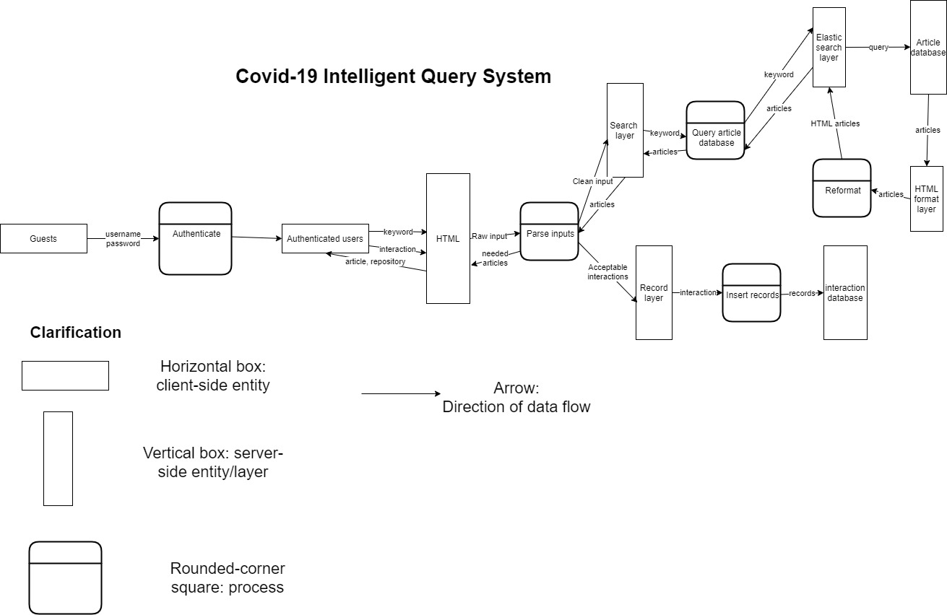
5. Design Diagram

Slide 8
5. Design Diagram (cont.)
In general, our project has four main layers:
1st layer: user interface. This layer contains HTML pages where the user will interact
2nd layer: input-parsing layer. This layer will collect the input of user and translate it into the format that the next layer could understand or reject such input
3rd layer: request-processing layer. This layer will receive parsed input from 2nd layer, check the privilege, and execute the request if appropriate
4th layer: database. This layer contains SQL tables of important information such as accounts, articles, etc.

Slide 9







6. Technology
Front-end development
Bootstrap 4
jQuery
Jinja
Back-end development
Python
Flask
MySQL
Elasticsearch

Slide 10
7. Milestone
Before the Tech Expo on April 12th , we expect to achieve the following targets:
Complete both searching mode for elastic search (before March 15th)
Integrate completed elastic search into project (before April 1st)
At the Tech Expo, we expect to deliver a project with all searching functions and a table of user interactions that could be used on researches in the future

Slide 11
8. Result
Finished
Search by term
Create/edit/delete project
Create/edit/delete repository
Save/remove articles
Unfinished
Search by concept
Expand the search limit to be bigger than 30

Slide 12
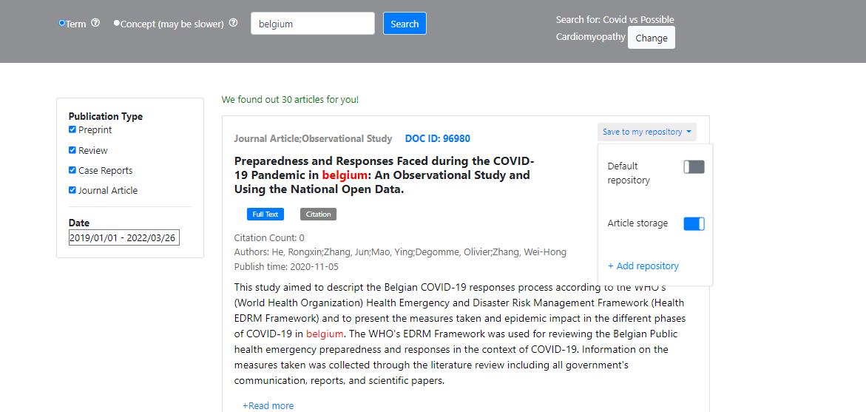
8. Result (cont.)

Slide 13
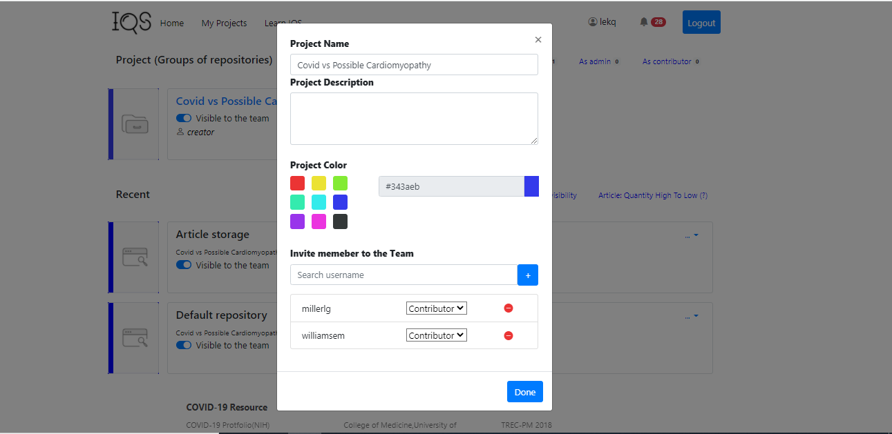
8. Result (cont.)

Slide 14
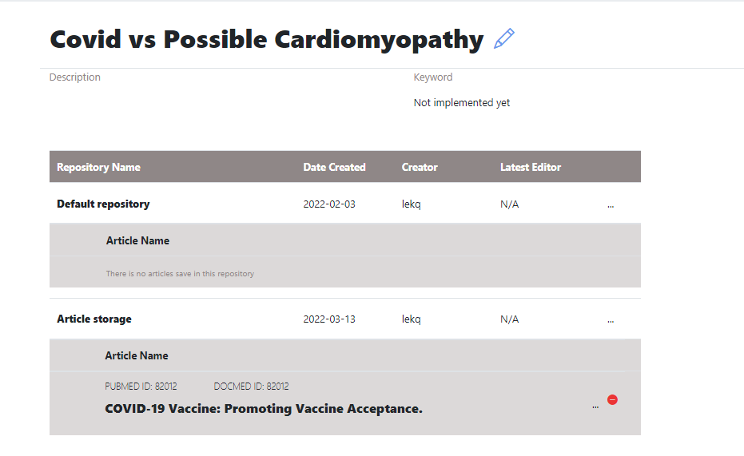
8. Result (cont.)

Slide 15
9. Challenge
Challenge: Our team lacks the cross-designing skill. That means the designer can create blueprints but cannot translate it into code. Vice versa, the developer can generate HTML pages but struggle to recreate the exact page and its behavior specified by the designer
Solution: More informal and formal communications were established between designers and developers. The designer supervised the page-creating process of developers and gave suggestions as soon as possible

Slide 16
9. Challenge
Challenge: The initial code is very messy. A huge number of lines of code are compacted into small number of files. There was a symptom of “god object” at the beginning of the project, and it was difficult for simultaneous development.
Solution: Code-separating phase was added into our development process.

