Slide 2
SHA-256
Daniel Whitaker

Slide 3


History of SHA-256
SHA-256 stands for Secure Hashing Algorithm, produces 256 bit hash
Part of the SHA-2 family of algorithms, created in 2001 by the NSA
More secure than MD5, SHA-0, and SHA-1
  More secure as these algorithms have documented collisions
  A collision is when two distinct inputs map to the same output
Used in cryptocurrency, Secure Sockets Layer (SSL) Certificates, and Blockchain

Slide 4
Example Phase 1
Let us walk through the SHA-256 algorithm using password as the input
Phase 1: Pre-process the input
Convert input to binary
  ‘p’ = 112 in ASCII
  In 8 bit binary 0111000
01110000 01100001 01110011 01110011
01110111 01101111 01110010 01100100
Pad the input until the length is a multiple of 512 (minus 64 bits)
  After we pad, our input is 448 bits
01110000 01100001 01110011 01110011 01110111 01101111 01110010
01100100 10000000 00000000 00000000 00000000 00000000 00000000
00000000 00000000 00000000 00000000 00000000 00000000 00000000
00000000 00000000 00000000 00000000 00000000 00000000 00000000
00000000 00000000 00000000 00000000 00000000 00000000 00000000
00000000 00000000 00000000 00000000 00000000 00000000 00000000
00000000 00000000 00000000 00000000 00000000 00000000 00000000
00000000 00000000 00000000 00000000 00000000 00000000 00000000

Slide 5
Example Phase 1
For the last 64 bits, we take the original input in its binary representation and count its length in bits
  ‘password’ has 64 bits
  In binary, 64 is 01000000
00000000 00000000 00000000 00000000
00000000 00000000 00000000 01000000
Pre-processed input, is now 512 bits
01110000 01100001 01110011 01110011 01110111 01101111 01110010
01100100 10000000 00000000 00000000 00000000 00000000 00000000
00000000 00000000 00000000 00000000 00000000 00000000 00000000
00000000 00000000 00000000 00000000 00000000 00000000 00000000
00000000 00000000 00000000 00000000 00000000 00000000 00000000
00000000 00000000 00000000 00000000 00000000 00000000 00000000
00000000 00000000 00000000 00000000 00000000 00000000 00000000
00000000 00000000 00000000 00000000 00000000 00000000 00000000
00000000 00000000 00000000 00000000 00000000 00000000 00000000
01000000

Slide 6
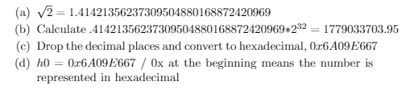
Example Phase 2
Phase 2: Generate Hash Values
h0 - h7 , created by using the first 8 prime numbers
  h0 maps to 2, h1 maps to 3, etc.
Each hash is created in this process:
Take the square root of given prime number
Take first 32 bits after the decimal
Multiply the result by 2^32
Convert the result to hexadecimal
Calculating h0

Slide 7

Example Phase 2
Generate k, an array that stores 64 hash values using the first 64 prime numbers
Each hash is calculated by the following:
Take the cubic root of given prime number
Take first 32 bits after the decimal
Multiply the result by 2^32
Convert the result to hexadecimal
Calculating k[0]
Review of process:
Input has been pre-processed into a 512 bit number
We’ve generated h0 - h7
We’ve generated the array k

Slide 8
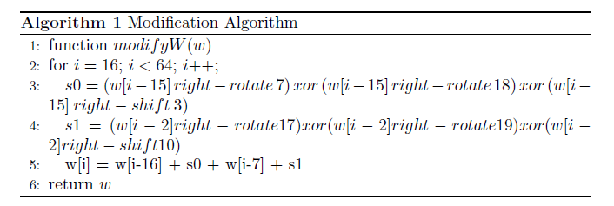
Example Phase 3
Phase 3: 512-bit loop
For each 512-bit chunk run the following loop:
  Create a new array w by converting the 512-bit chunk into 16 32-bit words
01110000011000010111001101110011 01110111011011110111001001100100
10000000000000000000000000000000
…
Append 48 additional 32-bit words to w made up of 0’s
  w now has 64 words, each word 32 bits long
Perform the Modification Algorithm on w

Slide 9
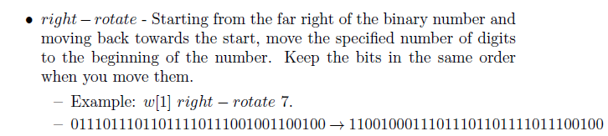
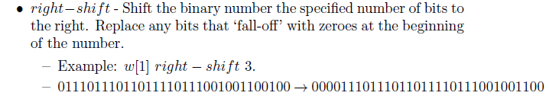
Example Phase 3
…

Slide 10
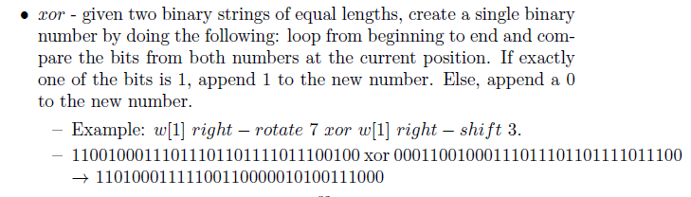

Example Phase 3
…

Slide 11
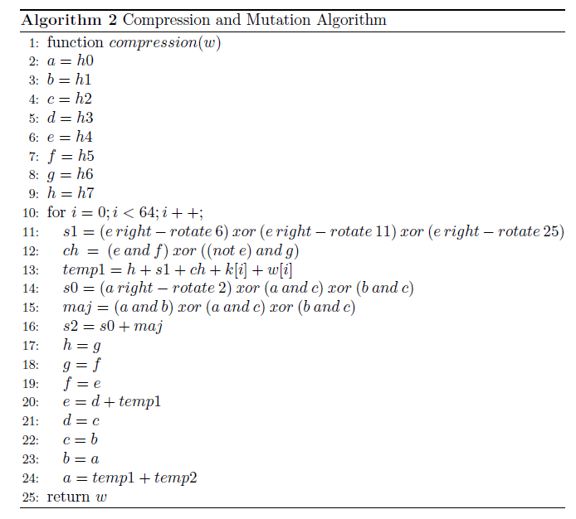
Example Phase 3
Create and modify variables a-h using the Compression and Mutation Algorithm. The variables a-h will be used to generate the final hash value.
Note that we’re using w, which is made up of 32-bit numbers.
h0 is also 32 bits in binary, 8 bits in hexadecimal
a-h, 8 variables, 32 bits each, 256 bits

Slide 12
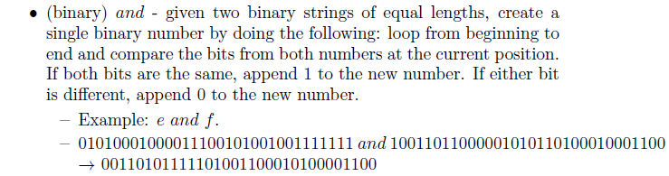


Example Phase 3
…

Slide 13
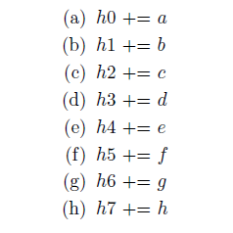

Example Phase 3 and Phase 4
Modify h0 - h7
Phase 4: Generate the final hash
Convert h0 - h7 to hexadecimal
Concatenate h0 - h7 to one 64-bit string
The SHA-256 hash of ‘Password’ is:
E7CF3EF4F17C3999A94F2C6F612E8A888E5B1026878E4E19398B23BD38EC221A

Slide 14
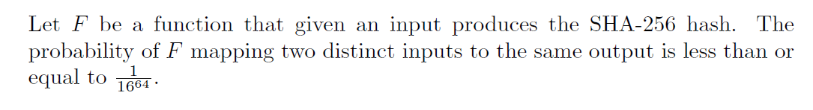
Theorem
…

Slide 15
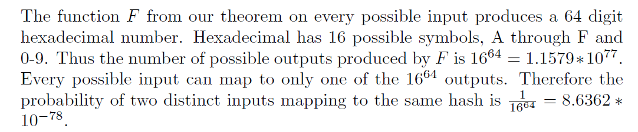
Proof of Theorem
…

Slide 16
300 Quadrillion
(300 X 10^15)
Parting Thoughts
The number of SHA-256 hashes being computed per second by Bitcoin as of January 2015. In order to perform a collision attack, you would need to calculate 2^128 hashes. At Bitcoin’s rate, it would take roughly 3.6 X 10^13 years to complete. In comparison, the known universe is only 13.7 X 10^9 years old.
https://crypto.stackexchange.com/questions/47809/why-havent-any-sha-256-collisions-been-found-yet

Slide 17
Questions?

