Slide 1


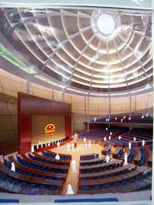
Chính phủ điện tử
TS. Phạm Văn Tính
Khoa CNTT, ĐH Nông Lâm TP.HCM
pvtinh@hcmuaf.edu.vn

Slide 2
Page Navigation
JSF 2.0: Explicit Page Navigation
and faces-config.xml

Slide 3
Outline
Explicit navigation rules
Explicit bean declarations
Advanced navigation options
Wildcards in navigation rules
Conditional navigation rules
Dynamically computed to-ids
Static navigation
Common navigation problems

Slide 4
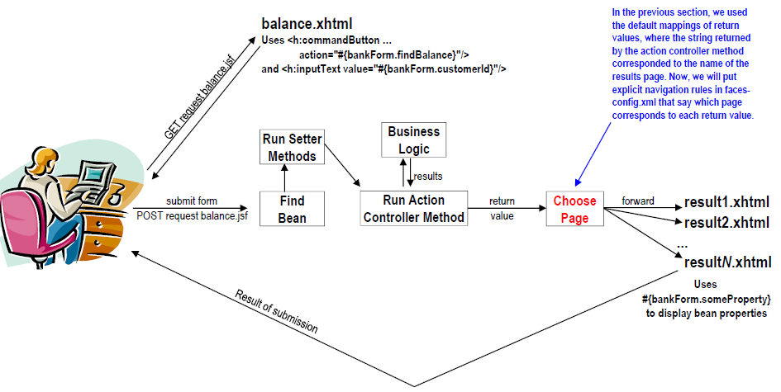
JSF Flow of Control

Slide 5
faces-config.xml: Overview
Location WEB-INF/faces-config.xml
Purposes
Give navigation rules Map return conditions to results pages
Declare beans Map bean names to bean classes

Slide 6
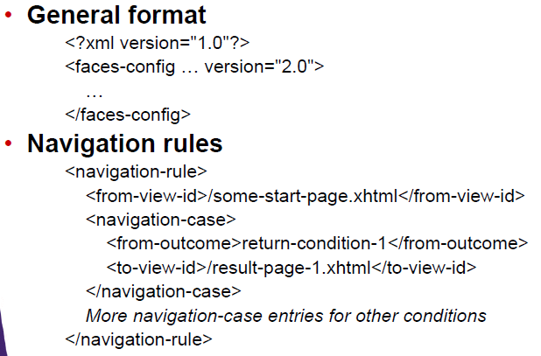
faces-config.xml: Syntax

Slide 7
faces-config.xml: Details
General format
<?xml version="1.0"?>
<faces-config xmlns="…" xmlns:xsi="…"
xsi:schemaLocation="…" version="2.0">
…
</faces-config>
Notes
JSF 1.x faces-config.xml files are still supported, so you can run JSF 1.x applications in JSF 2.0 implementations without changes. However, you must use 2.0 version of faces-config.xml if you use the new 2.0 features
Copy a starting-point faces-config.xml file from the jsf blank application on the Web site

Slide 8
faces-config.xml: Details
<?xml version="1.0"?>
<faces-config … version="2.0">
<navigation-rule>
<from-view-id>/starting-page.xhtml</from-view-id>
<navigation-case>
<from-outcome>return-value-1</from-outcome> <to-view-id>/result-page-1.xhtml</to-view-id>
</navigation-case>
<navigation-case>
<from-outcome>return-value-2</from-outcome>
<to-view-id>/result-page-2.xhtml</to-view-id>
</navigation-case>
…
</navigation-rule>
</faces-config>

Slide 9
Pros and Cons of Explicit Mappings
Default mappings (return values=pages)
Simpler to start with. Faster to make quick test cases.
Explicit mappings in faces-config.xml
Better understanding of project. Lets you look in one place for navigation rules, instead of searching many Java files
There are even tools that automatically make charts of page flow based on faces-config.xml
More flexible
Can remap conditions to other pages later
Can use wildcards for starting page
Can use wildcards for outcomes

Slide 10
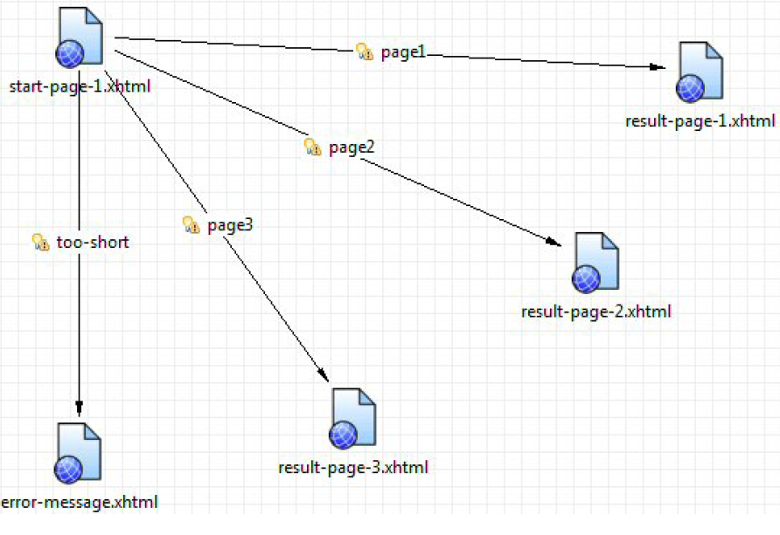
Pros and Cons of Explicit Mappings

Slide 11
Explicit Bean Declarations

Slide 12
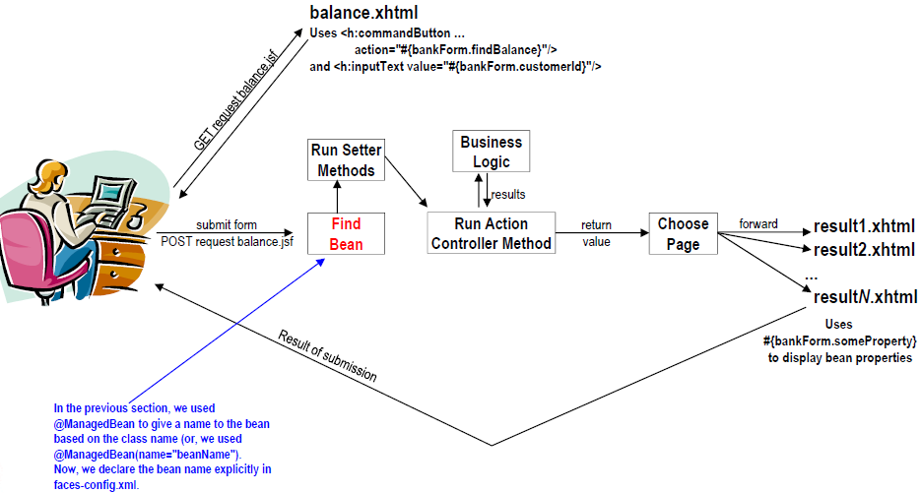
JSF Flow of Control

Slide 13
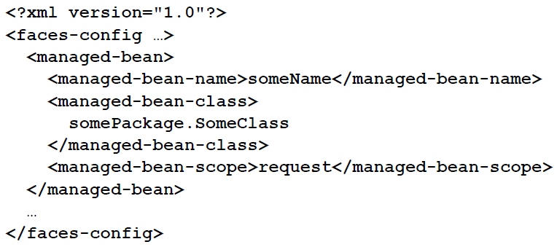
Bean Declarations: Syntax
Scopes are request, session, application, view, none, custom. They are discussed elsewhere. Unlike with @ManagedBean, there is no default, so you cannot omit <managed-bean-scope> altogether.

Slide 14
Pros and Cons of Explicit Bean Declarations
@ManagedBean
Simpler/faster to start with
Java developer knows the bean name
Explicit declarations in faces-config.xml
Easier for facelets developer to find bean. If you have a large project with many packages, even knowing the bean class name (as with @ManagedBean) requires you to search many packages to find the class
Can use multiple instances of the same bean class in the same page. See temperature converter in first PrimeFaces lecture for example.
Can use same class in different pages with different scopes
Better understanding of beans used in project .One central file lists all managed beans

Slide 15
Wildcards in Navigation Rules

Slide 16
Summary
Overview
* for from-view-id matches any starting page
Omitting from-outcome: all other return conditions match Except for null, which always means redisplay form
Application
* for from-view-id Multiple forms can share some of the results pages without repeating entries in navigation-rule
Omitting from-outcome Can have multiple return values point at the same results page. Useful when you want to change results pages independently of Java code

Slide 17
Example: * for from-view-id
Problem
Both of the previous examples used the same error page
The navigation-case was repeated
Solution
Make a shared entry that maps “too-short” to the error page

Slide 18
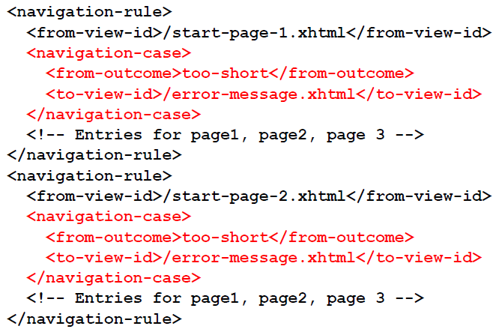
faces-config.xml: Before

Slide 19
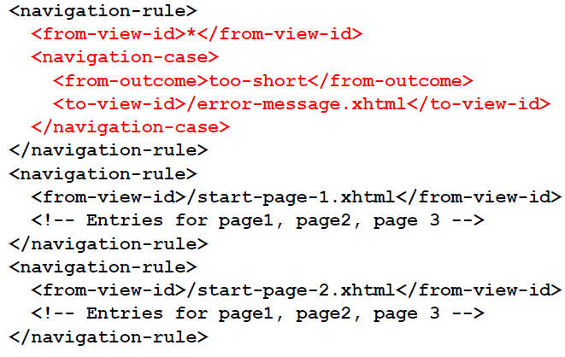
faces-config.xml: After

Slide 20
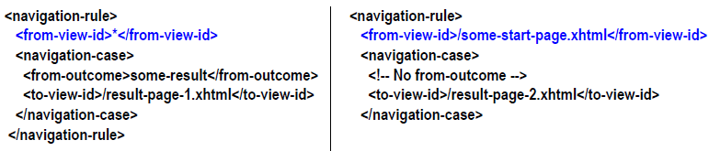
Precedence for Wildcards
The right rule takes precedence, so all results from somestart-page will be mapped to result-page-2, including "some-result".
You cannot mix wildcards for from-view-id with defaults for outcomes (by omitting from-outcome) for same start page!

Slide 21
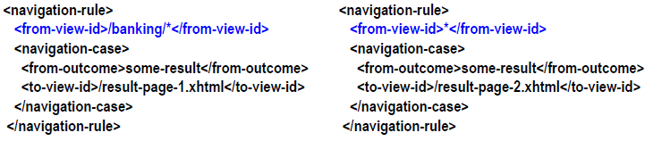
Precedence for Wildcards
Left rule takes precedence if both rules match. For a start page of /banking/blah.xhtml and a return value of "some-result", the result page is result-page-1 (left rule), not result-page-2 (right rule).

Slide 22
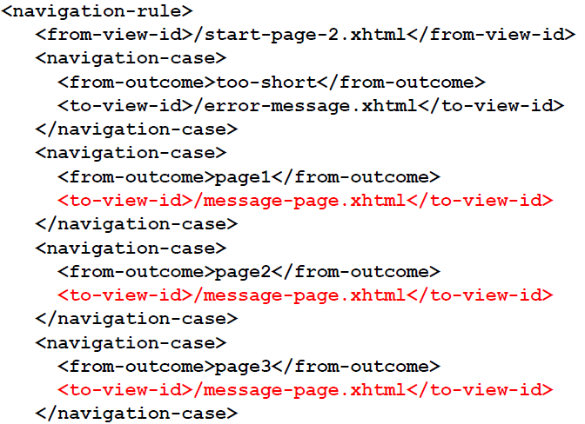
faces-config.xml: Before

Slide 23
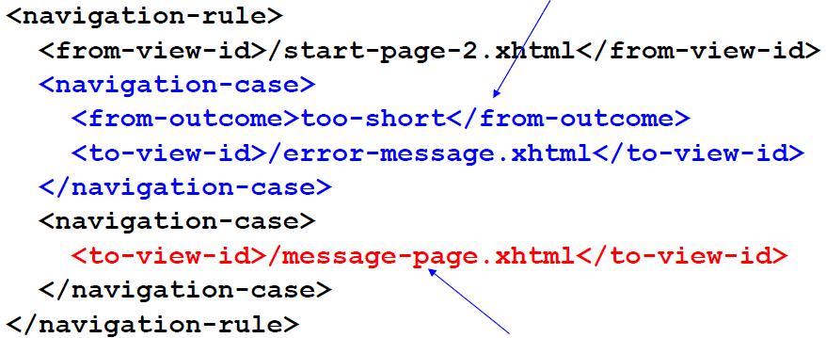
faces-config.xml: After
You canNOT move this to a wildcard as we did before, because the rule below takes precedence over wildcard rules. So, without this case here, all conditions including too-short would be mapped to message-page.xhtml.
All conditions except for too-short are mapped to message-page.xhtml.

Slide 24
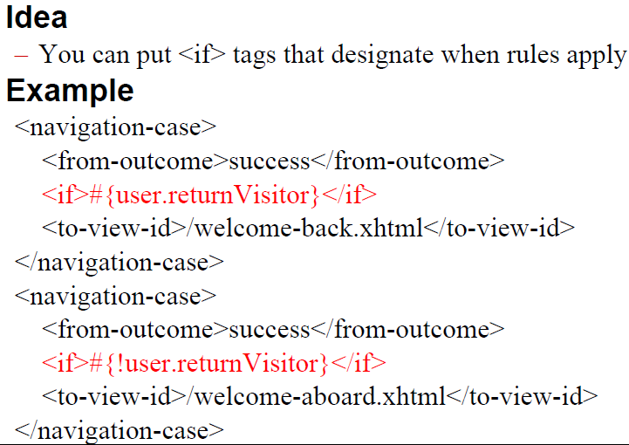
Conditional Navigation Rules

Slide 25
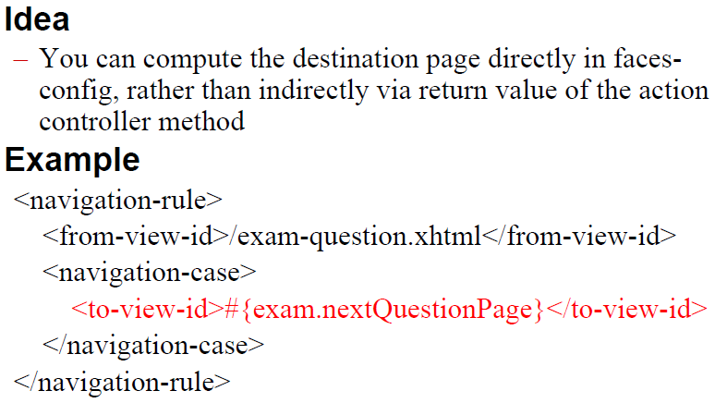
Dynamic To-Ids

Slide 26
Static Navigation
Situation Sometimes you don’t want/need Java code
No input elements
No logic needed to determine results page
Sometimes used for simple testing. But also used in real projects when you want a button for navigation.
Approach
Instead of this
• <h:commandButton … action="#{someBean.doNav}"/>
• Have the doNav method always return “fixed-page”
Use this
• <h:commandButton … action="fixed-page"/>
You can use either default mapping or explicit navigation rules to determine the meaning of “fixed-page”

Slide 27
Example
Overview
page-a.xhtml has a button that causes navigation to page-b.xhtml
page-b.xhtml has a button that causes navigation to page-a.xhtml
Implementation
Page A
• <h:commandButton … action="page-b"/>
Page B
• <h:commandButton … action="page-a"/>

