Slide 1
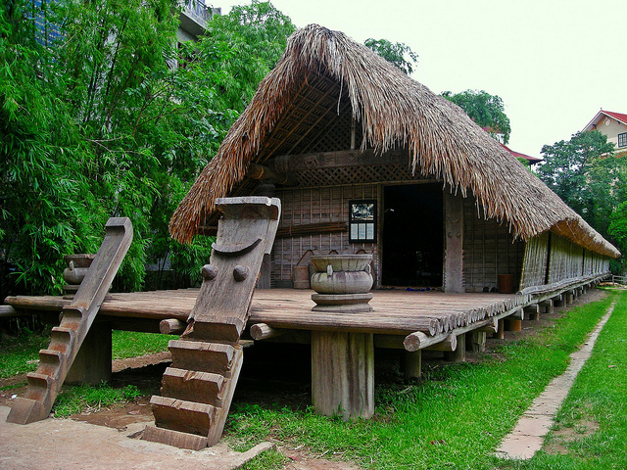
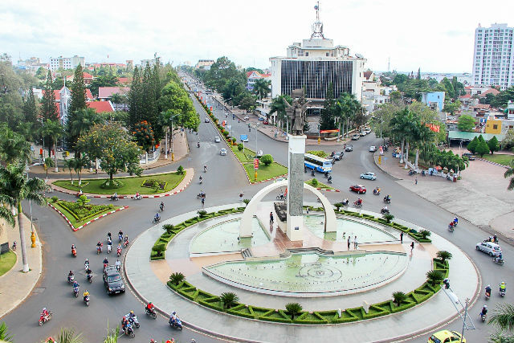
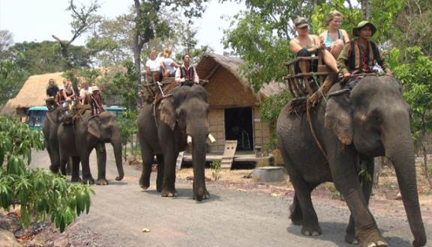
home sweet home “tây nguyên”
Rough translation – “The Highland in the West”

Slide 2
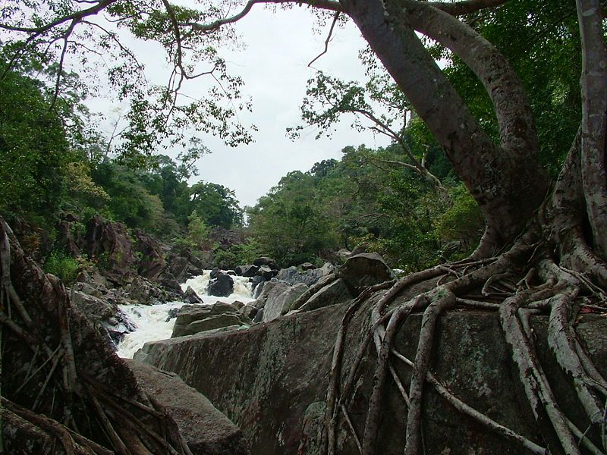
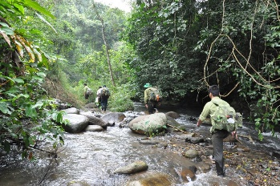
Magnificent Lanscape
Chu Yang Sin National Park
Notes:
My hometown is famously known for the nature.
Most other places are urbanized, but not here.
This is one of a few primary forests still be unaffected by human. There are many tourist visit this park, most are foreigner.

Slide 3
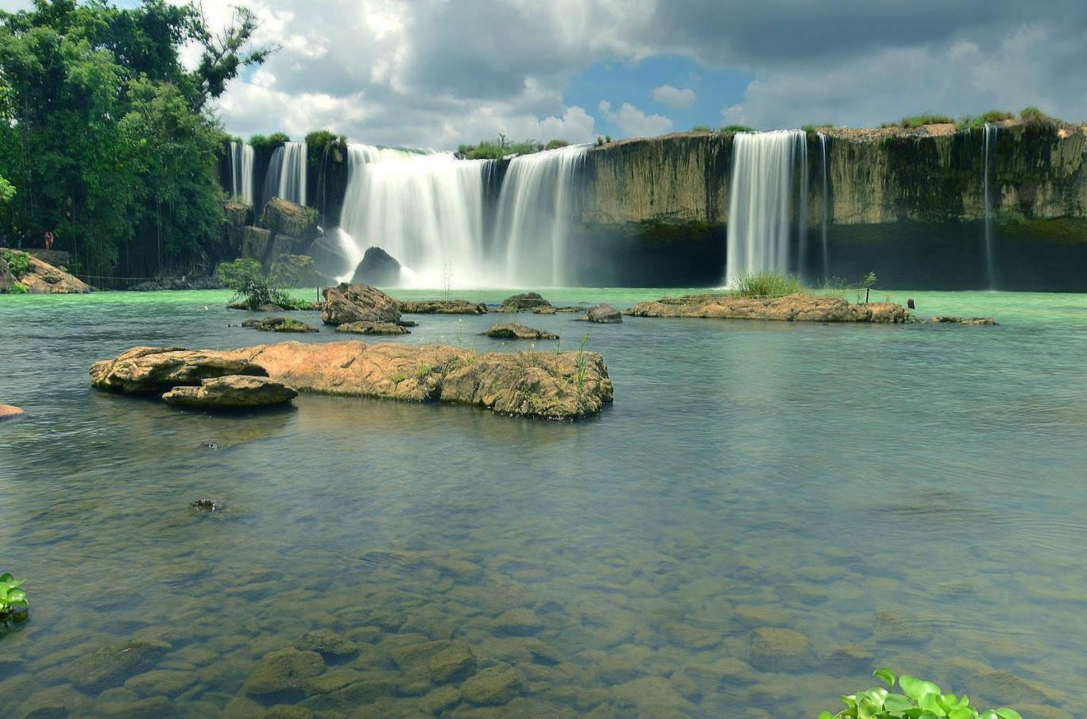
Magnificent Lanscape
Trinh Nữ Waterfall – Virgin Waterfall

Slide 4
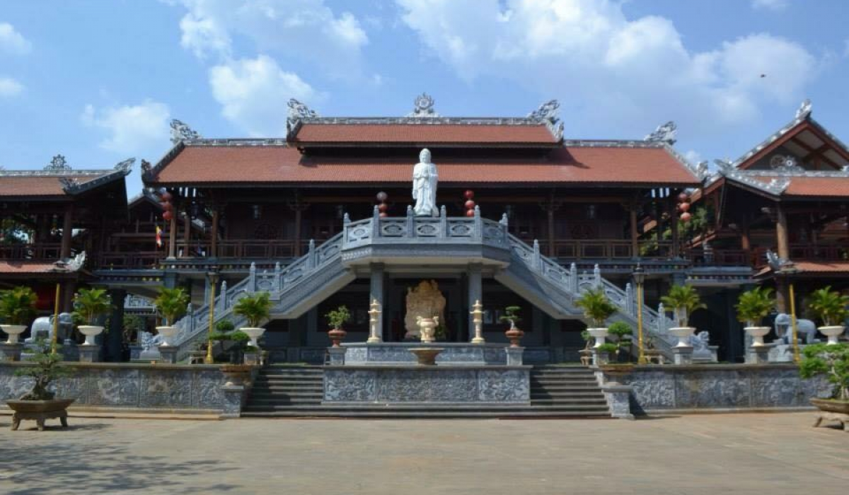
Khải Đoan Pagoda

Slide 5
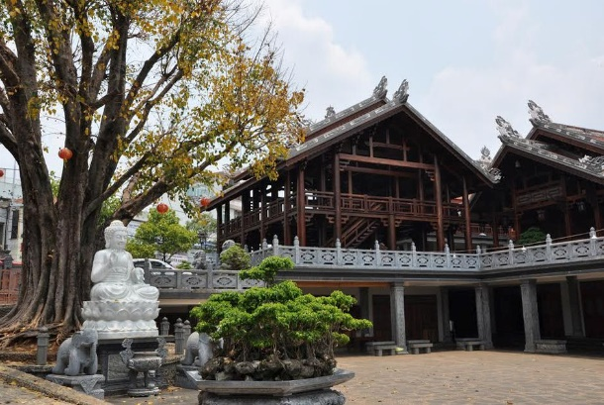
Khải Đoan Pagoda
It was built under Vietnamese last Emperor’s mother command, by hundreds of artisan from the ancient capital.
Many people visit Khai Doan pagoda on New year holiday, pray, joy, hope for a new wonderful year.

Slide 6
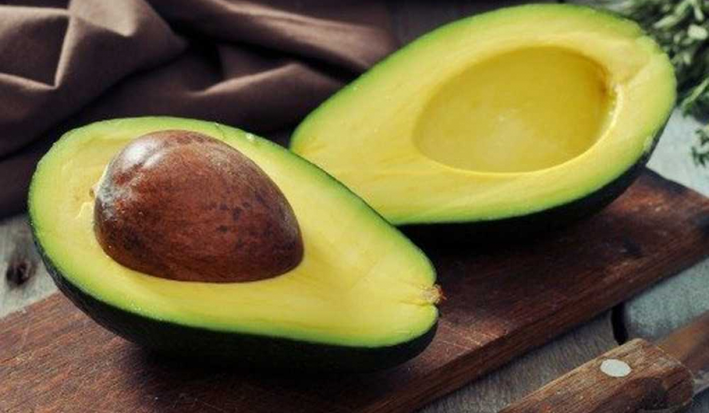
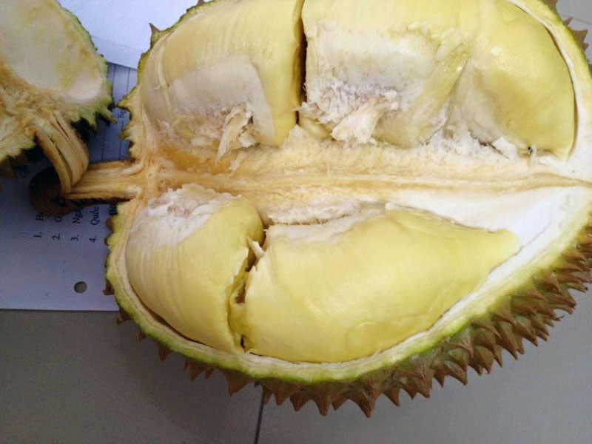
Food

Slide 7
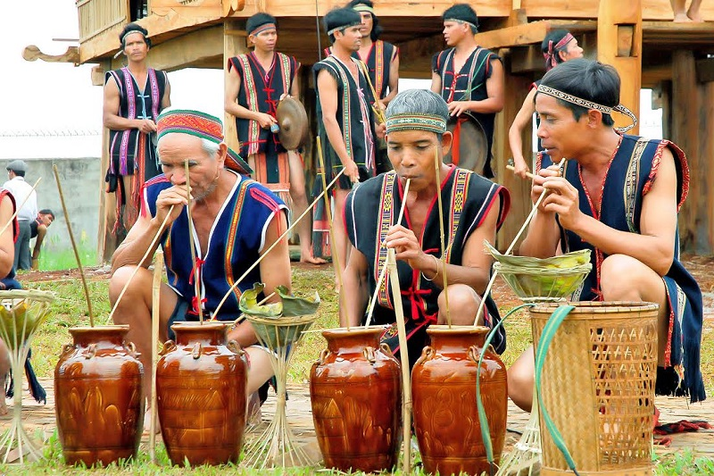
Drink (liquor)
“Rượu Cần” – the famous traditional drink of native ethnic – the Degar.
Its is made from “cào cào” seed and a secret yeast. This yeast makes the unique flavor of the liquor, is made from special herbs collected in the deep jungle, and only some elder can make it.
Some says the secret yeast recipe has been lost long ago, the yeast they are using today is just a poor copycat.

Slide 8
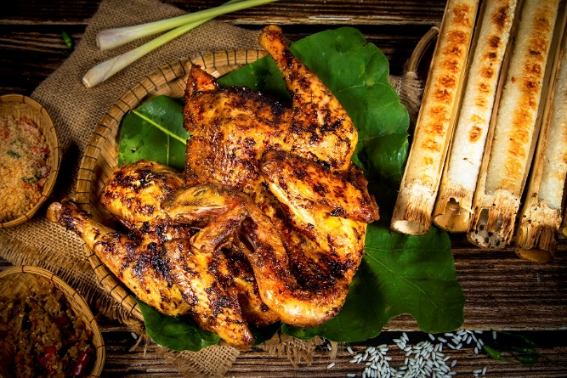
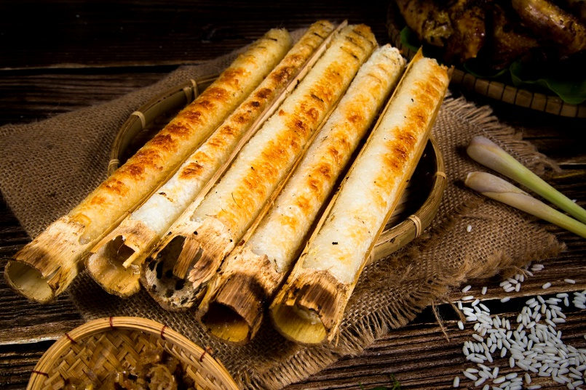
grilled chicken
“cơm lam” – rice cooked in bamboo tube.

