Slide 1
Upload Image
Save Image Data
Save to pickle
Collect Data
Use Camera
Capture Frames
User
(Web browser)
Face Recognition
Load Face Data
Train (check in data)
Present
Absent
Attendance Log

Slide 2
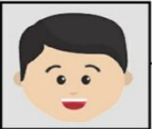
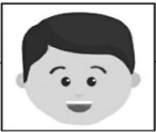
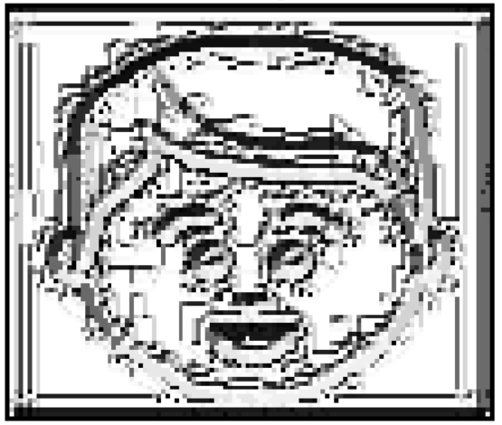
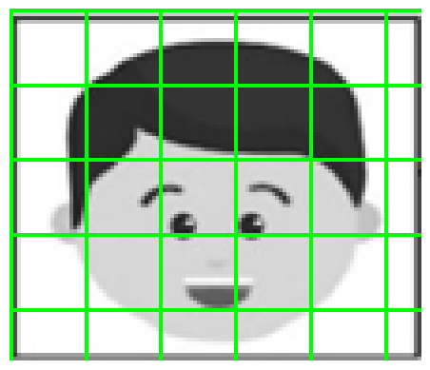

step1
Step 2
12 | 15 | 18
5 | 8 | 3
8 | 1 | 2
1 | 1 | 1
0 | 8 | 0
1 | 0 | 0
11100010 = 226

Slide 3
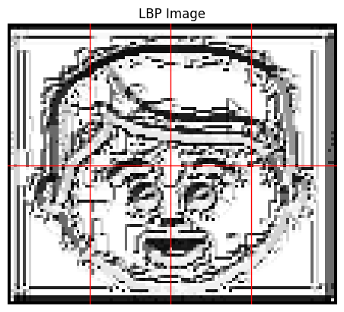



Step 3
Step 4
 | …..
 | …..
…
 | …..
 | …..
New input
Euclidean distance
Step 1 - 4
…
 | …..
 | …..
 | …..
…
 | …..
cosine similarity

