Slide 1

P
PACE
CAR
EXE201 • PRODUCT DEVELOPMENT
PACE CAR
From MVP to a more transparent
and safer car rental platform
Project overview • Validation • Feedback → improvements • 3 product levels
PRODUCT PRESENTATION
05 NOV 2026
Sources: PaceCar Technical Report (04 Nov 2026) and mentor feedback.

Slide 2
P
PACE
02
CAR
01 • OVERVIEW
The project in 60 seconds
A marketplace that does not hold customer funds—but preserves evidence, process, and transparency.
56
3
16
20
2
commit • 23/09–04/11
user roles
active feature groups
demo vehicles
public vehicles
PROBLEM
SOLUTION
MODEL
Social-media car rentals lack transparency in pricing, availability, and accountability.
Search → quote → digital contract → evidence-based handover → dispute support.
Owners pay a 3–5% commission after each trip; renters pay no platform fee.
WHY
HOW
VALUE
The current version is complete within the EXE201/demo scope; production gaps are outlined at the end.

Slide 3
P
PACE
03
CAR
01 • TRUST SCORE
Trust Score: how reliability is calculated
Every account starts at 50 points. Real behavior adds or subtracts points, with the final score capped at 0–100.
50
+
≤ 25
+
≤ 25
+
−10 … +10
−
Penalties
=
0 – 100
Base score
Profile verification
Transaction history
Reviews (Bayesian)
Disputes • cancellations
TRUST SCORE
Example: a renter's score across events
AUTOMATED RISK LEVEL
Score after each event
Example: 58
+8
+5
−10
HIGH
MEDIUM
LOW
+25
−20
0
50
75
100
58
75 • Low
LOW requires a score ≥75 and verified status • a severe dispute immediately sets HIGH.
50
50 • Medium
+ POINTS
− POINTS
First trip +5, then +2
On-time deposit +1
Complete handover record +1
On-time return +1
Renter cancellation −5 / −10
Owner cancellation −8 / −15
Minor dispute −10
Medium −20 • Severe −30
Base score
Fully verified
profile
First trip
completed
5-star
review
Paid booking
cancelled
Medium-fault
dispute
Final score
Source: server/src/trustScore.js. The example follows current rules; cancellations use two tiers: unpaid / paid.

Slide 4
P
PACE
04
CAR
02 • PROBLEM → MODEL
Defining PaceCar's role
The core decision after mentor feedback
VALUE FLOW
PACE CAR = A CONNECTION MARKETPLACE
RENTER
PACE CAR
VEHICLE OWNER
● Direct contract: renter ↔ vehicle owner
● Deposit and rental payment go directly to the owner
● PaceCar provides quotes, digital contracts, and evidence
● PaceCar supports dispute review and does not own vehicles
→
→
Find a vehicle
Transparent costs
Connect
Protect the process
Increase utilization
Manage transactions
NO FUND CUSTODY
NO HIDDEN FEES
EVIDENCE RECORDED
Revenue: 5% / 4% / 3% commission paid by owners after trip completion.
The most important feedback outcome: moving from an unclear role to a connection marketplace with a protected process.

Slide 5
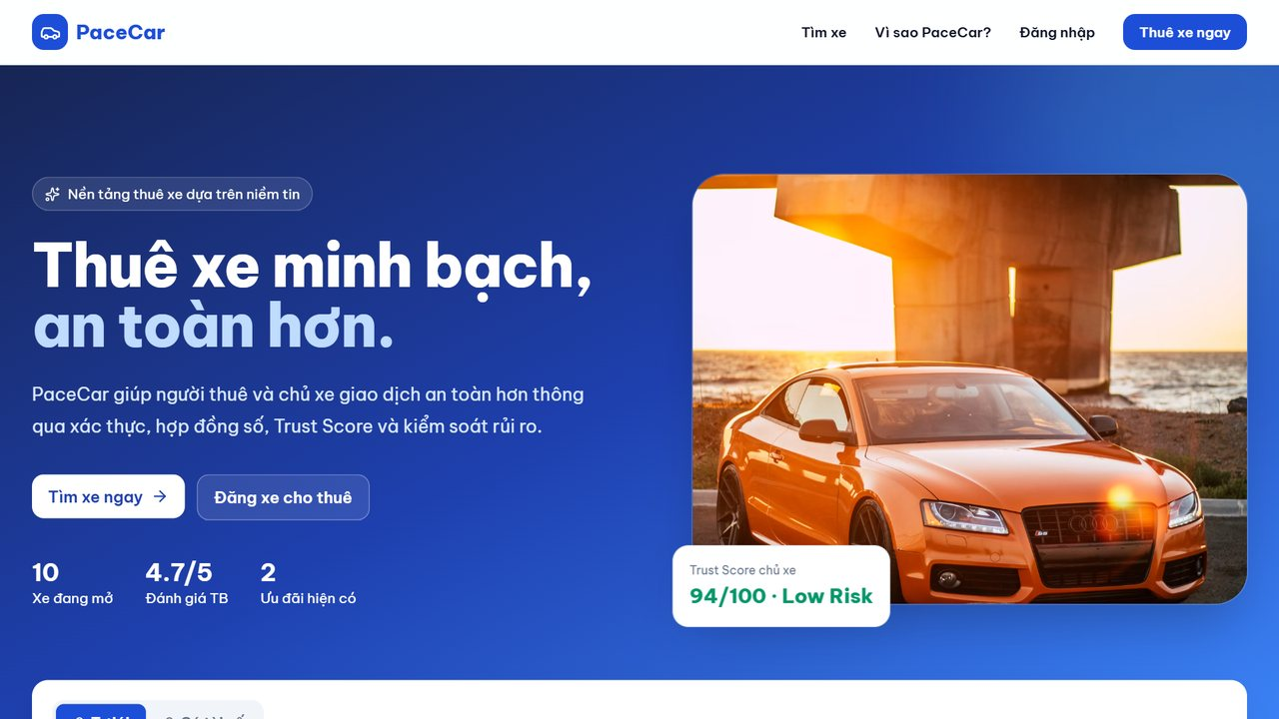
P
PACE
05
CAR
03 • MVP
Initial MVP: a complete working flow
First commit • 23 Sep 2026 • 30 files • approximately 15,000 lines of code
MVP SCOPE
MVP 23/09
● Search / filter / view vehicle details
● Quotes and booking
● Three roles with dedicated dashboards
● Digital contract + vehicle handover
● Reviews + disputes + Trust Score
INITIAL LIMITATIONS
No real payment • dates without times • data stored in one file • 10% fee charged to renters.
Image source: the MVP was rerun from the first commit and captured on 04 Nov 2026.

Slide 6
P
PACE
06
CAR
04 • VALIDATION & EVIDENCE
Validation: listen — measure — test end to end
No customer-survey claims are inferred because no separate quantitative survey dataset was provided.
BEHAVIOR DATA • 03–04 NOV
Three available evidence layers
356
13
11
24
mentor issue groups
Business model → real operations
page views
new registrations
bookings in system
90
UI QA combinations
4
2
2
5 viewport widths
completed bookings
active users / 5 min
public vehicles
01
end-to-end scenario
Hanoi → Hai Phong • 06:00–22:00
Note: bookings include sample and test data; page views do not identify unique users. These are early signals, not an official conversion rate.
Evidence gaps: structured demand survey, interviews with real rental operators, and real-user data separated from internal traffic.

Slide 7
P
PACE
07
CAR
05 • PRODUCT DEVELOPMENT
The six-step product development process
Every feedback cycle becomes a product decision, code change, test, and subsequent deployment.
1
Ideation
2
Product definition
3
Prototyping
4
Detailed design
5
Validation
6
Commercialization
24 issue groups
mentor + QA
Define the connection
marketplace model
End-to-end MVP
23 Sep
Figma + policies
price / time / deposit
90 QA combinations
E2E + Lighthouse
Render deployment
3–5% commission
DISCOVERY
PRODUCT DEVELOPMENT
LAUNCH
OUTCOMES
01
02
03
04
05
Clear business model
Clearer search UX
Transparent pricing
Evidence-based operations
Deployed demo
Yellow = the transition from demo to real commercial validation.

Slide 8
P
PACE
08
CAR
06 • FEEDBACK LOOP
Mentor feedback → backlog → improvements
13 condensed feedback groups in the technical report
SIX-GROUP MASTER LIST
01
Business Model
Model + commission defined
69%
02
Contract & Responsibility
Digital contract; owner cancellation still missing
resolved
03
Website UX
Time, location, availability
04
Pricing
Itemized quote, full-to-full fuel
05
Operation
Handover + disputes; image issue remains
9 • Resolved
1 • Partially resolved
06
Real-world Validation
Not yet validated with a real rental operator
3 • Not resolved
Status classification is summarized directly from Table 2.1 of the technical report.

Slide 9
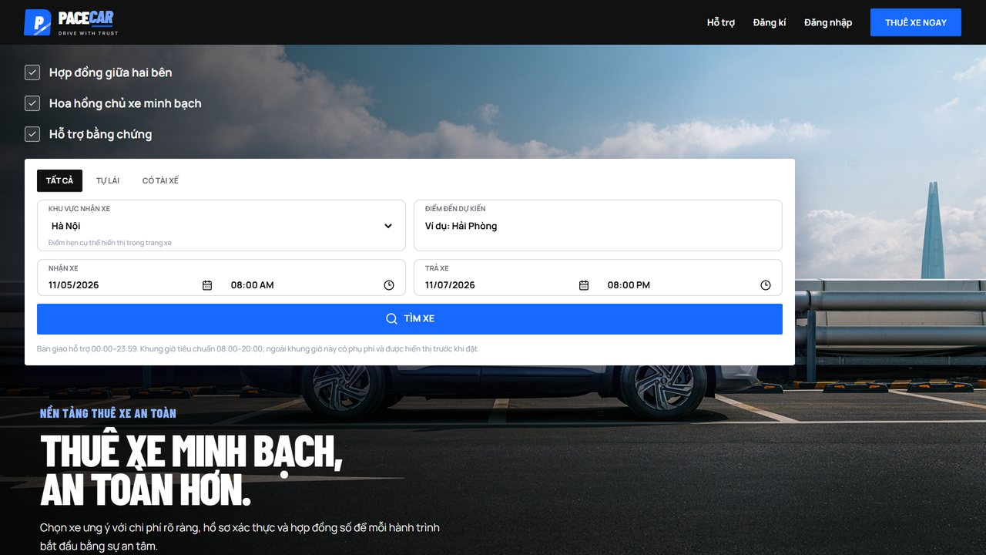
P
PACE
09
CAR
07 • PRODUCT EVOLUTION
Before & after: more than a visual redesign
From an assumption-heavy demo → a product with clearer policies, evidence, and operations.
BEFORE • MVP
AFTER • 04 NOV
→
Dates
10 demo vehicles
10% renter fee
Server file
Dates + times
20 demo vehicles
3–5% owner commission
PostgreSQL
Key changes: clearer search, pickup/return times, pricing, QR payments, contracts, handover, disputes, and admin analytics.

Slide 10
P
PACE
10
CAR
08 • END-TO-END FLOW
Improved customer journey
One connected flow from rental intent to completion and review.
01
SEARCH
02
FILTER
03
QUOTE
04
REQUEST
→
→
→
Area • date & time
Available vehicles
Itemized costs
2 confirmations
05
DEPOSIT
06
SIGN
07
PICKUP/RETURN
08
COMPLETE
→
→
→
QR → owner
Digital contract
Photos • fuel • mileage
Review / dispute
Key differentiator: transaction data and evidence remain on the platform—giving both parties a reason to keep using PaceCar.
The operating flow has eight steps; statuses are recorded in renter, owner, and administrator dashboards.

Slide 11
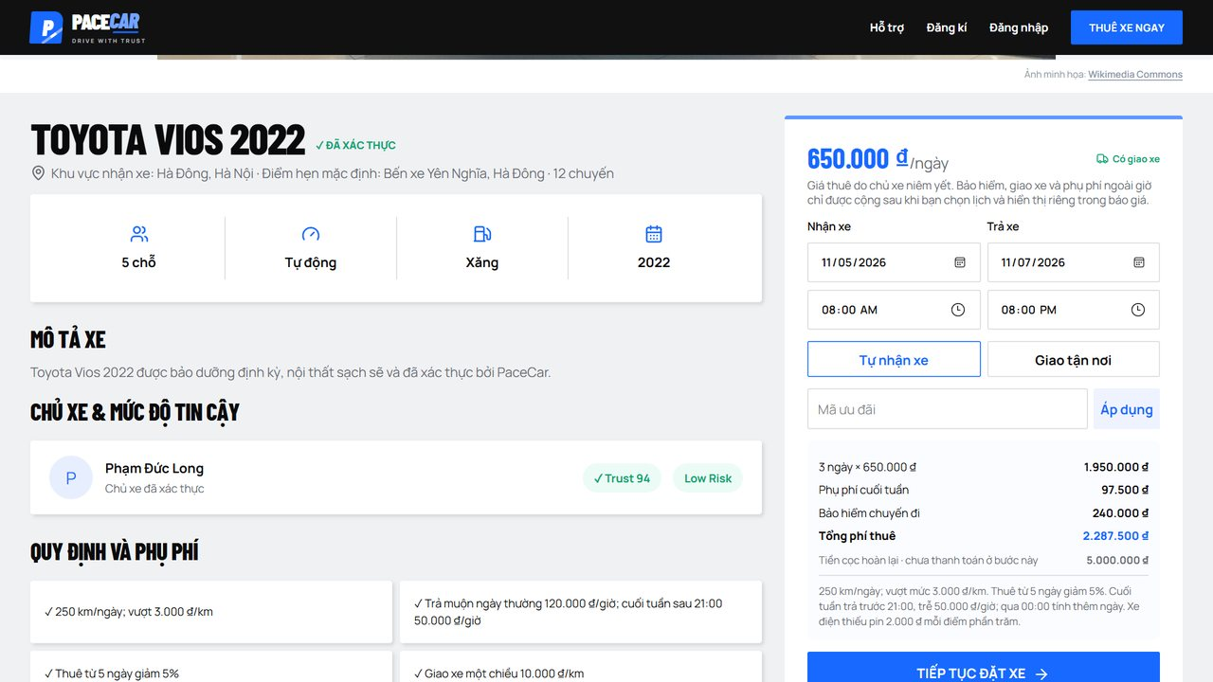
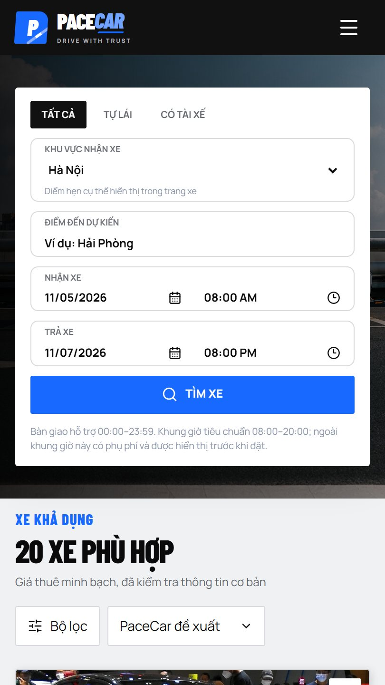
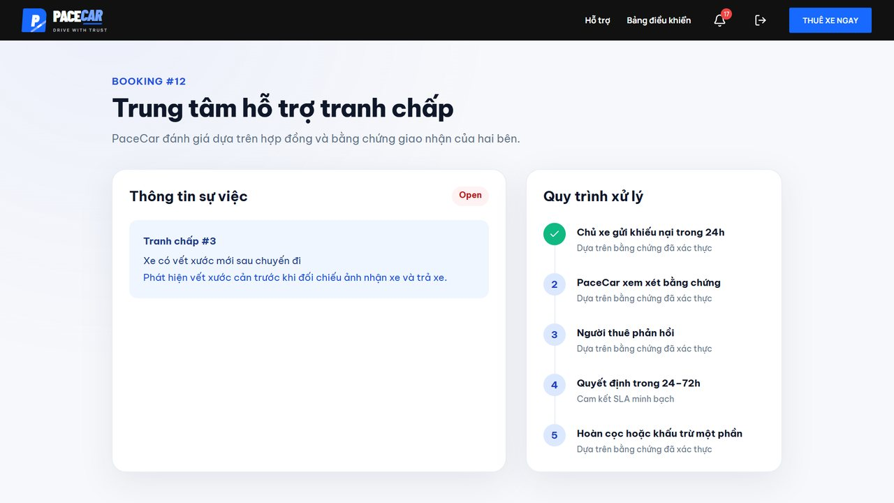
P
PACE
11
CAR
09 • PRODUCT LEVELS
The completed product at three levels
More than a website: the product combines a core need, the actual experience, and added value.
01
CORE PRODUCT
Transparent car rental connection
Right schedule • clear total cost
02
ACTUAL PRODUCT
A multi-device website
Search / filter / book • QR • contract
03
AUGMENTED PRODUCT
Confidence beyond the rental itself
Trust Score • evidence • disputes
HIGHER VALUE → HARDER TO REPLACE WITH OFF-PLATFORM TRANSACTIONS
Classification based on Core / Actual / Augmented Product in Section 3.2 of the technical report.

Slide 12
P
PACE
12
CAR
10 • PRODUCT SCOPE
Current product: 16 feature groups
Four capability clusters create a closed operating loop.
01
DISCOVERY
02
TRANSACTION
03
OPERATION
04
PLATFORM
Schedule-based search
15-minute quote
Photo-based handover
Vehicle management
Filter & sort
Rental request
Deposit refund & review
3–5% commission
Details + Trust Score
Deposit & rental QR
Disputes & reports
Admin & analytics
Digital contract
Notifications / activity log
Favorites
3 features
4 features
4 features
4 features
THREE ROLES THROUGHOUT: RENTER • VEHICLE OWNER • ADMINISTRATOR
Source: Table 3.1 — Active features.

Slide 13
P
PACE
13
CAR
11 • TECHNICAL OVERVIEW
Technical platform & delivery
A lean stack for the MVP, with a clear path to scalable data and automation.
CLIENT
API
DATA
PAYMENT
DELIVERY
→
→
→
→
React • Vite • Tailwind
Node.js • Express
PostgreSQL • images in DB
VietQR / SePay
GitHub → Render
DELIVERY LOOP
01 CODE
02 TEST
03 BUILD
04 DEPLOY
05 MONITOR
56 commits
Playwright • Lighthouse
Vite production build
Render auto deploy
Health check + analytics
The MVP stored data in a file; the later version supports PostgreSQL and more durable image storage.

Slide 14
P
PACE
14
CAR
12 • QUALITY & PERFORMANCE
QA: solid functionality, mobile remains the bottleneck
MOBILE BOTTLENECK
9/11
LCP
PAGE SIZE
5.9 seconds
8.5 MB
checks passed
Main causes
● Four large PNG images
● Evidence images not displayed
● BMW 330i images return 404
FUNCTIONAL TEST
Lighthouse /100
PRIORITY: COMPRESS IMAGES
Test run on 04 Nov 2026: live website (read-only), end-to-end test environment, and 2/2 automated test suites.

Slide 15
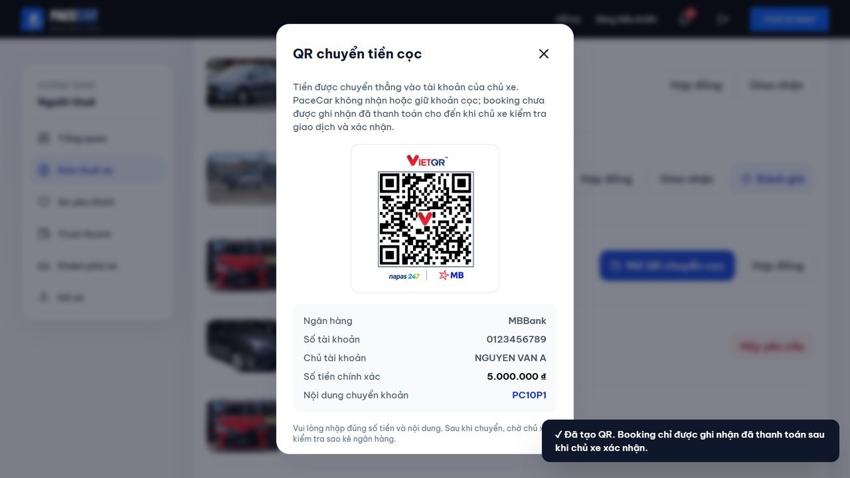
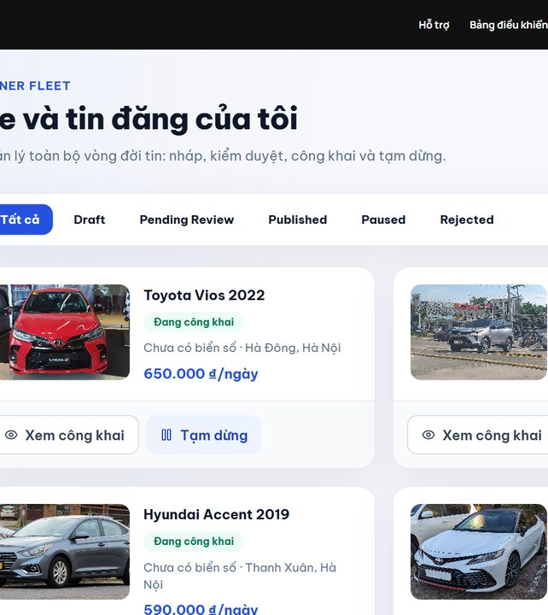
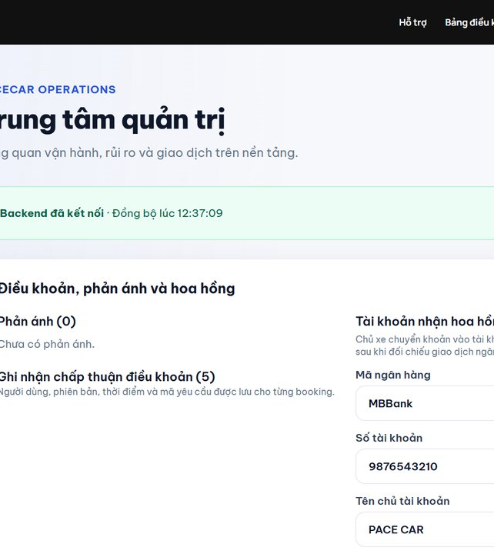
P
PACE
15
CAR
13 • PRODUCT IN ACTION
The product has moved beyond a vehicle search website
New modules turn the experience into a controlled operating system.
DEPOSIT QR
DISPUTES
VEHICLE MANAGEMENT
ADMIN
Transparent quotes • Direct QR • Digital contracts • Handover • Disputes • Analytics
Screenshots from the current version documented in the technical report.

Slide 16
P
PACE
16
CAR
14 • RISKS & NEXT STEPS
Complete for EXE201—not yet production-ready
Priorities ranked by impact on trust and real-customer operations.
P0
Security & data
Replace demo admin credentials • fix evidence images • back up DB
NEXT ITERATION GOAL
From a “working demo”
to a “trusted service”
P1
Performance & payment
Compress images • bank webhook • enable email verification
P2
Real-world operations
Owner cancellation • replacement vehicle • off-platform transactions
● Real users
● Real vehicle-owner partners
● Clean conversion data
P3
Market validation
Interview rental operators • real-user pilot • measure conversion
Deliberate conclusion: the product is complete for the course scope, with four workstreams remaining before commercial expansion.

Slide 17
P
PACE
17
CAR
15 • VISUAL EVIDENCE
Visual examples of the three product levels
Each level is illustrated with a screen from the current version.
CORE PRODUCT
ACTUAL PRODUCT
AUGMENTED PRODUCT
Transparent quote
Multi-device experience
Dispute support
Renters see the rental price, surcharges, discounts, and deposit before submitting a request.
Search, filtering, and booking work on both desktop and mobile screens.
The process receives cases, reviews evidence, and updates decisions directly in the account.
Image source: screenshots embedded in BAO_CAO_KY_THUAT_PACECAR.docx.

Slide 18
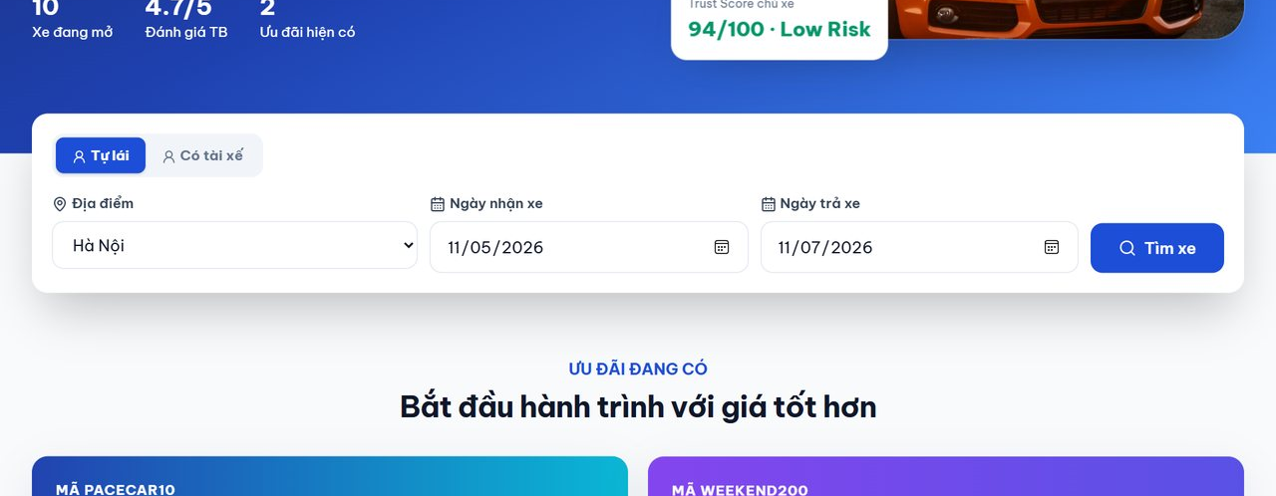
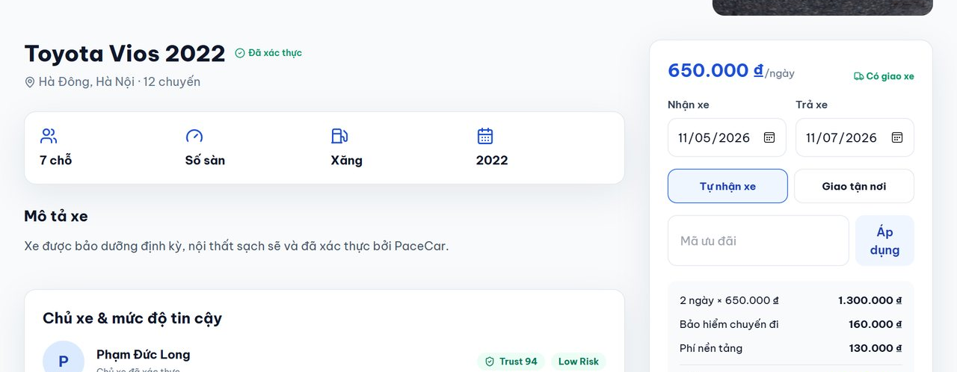
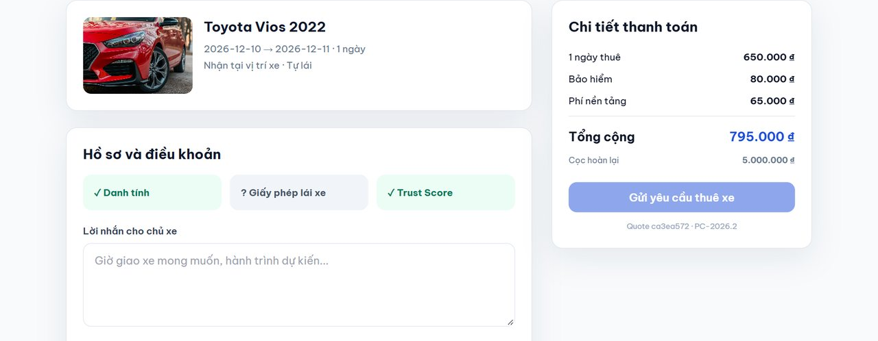
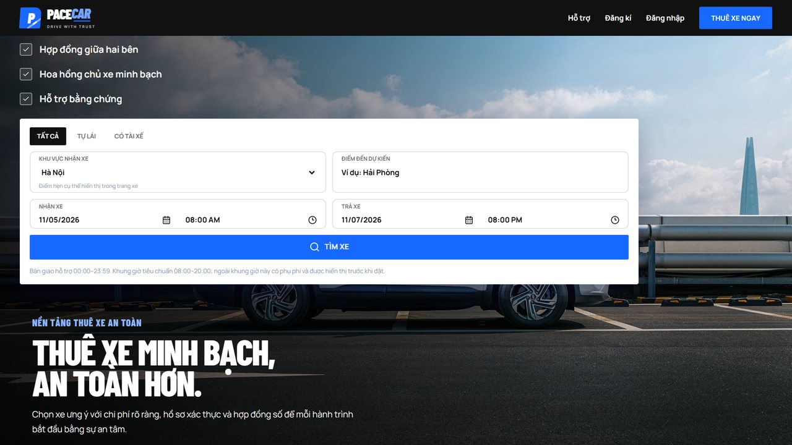
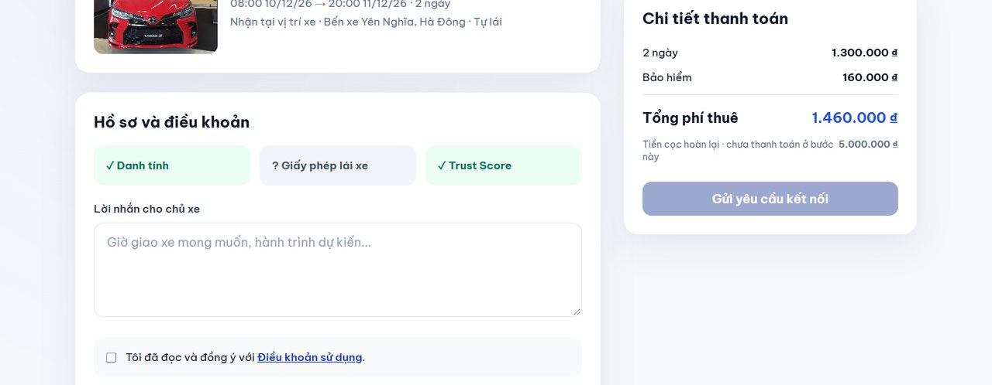
P
PACE
18
CAR
16 • BEFORE / AFTER
How did feedback change the product?
Three like-for-like examples make the changes visible instead of merely describing them.
SEARCH
QUOTE
SUBMIT REQUEST
BEFORE
BEFORE
BEFORE
↓
↓
↓
AFTER
AFTER
AFTER
Added destination, date + time, and clearer error feedback.
Itemized fees, deposit, and rental conditions.
Two explicit confirmations before connecting.
Before-and-after evidence comes from the image pairs in Section 2.4 of the technical report.

Slide 19
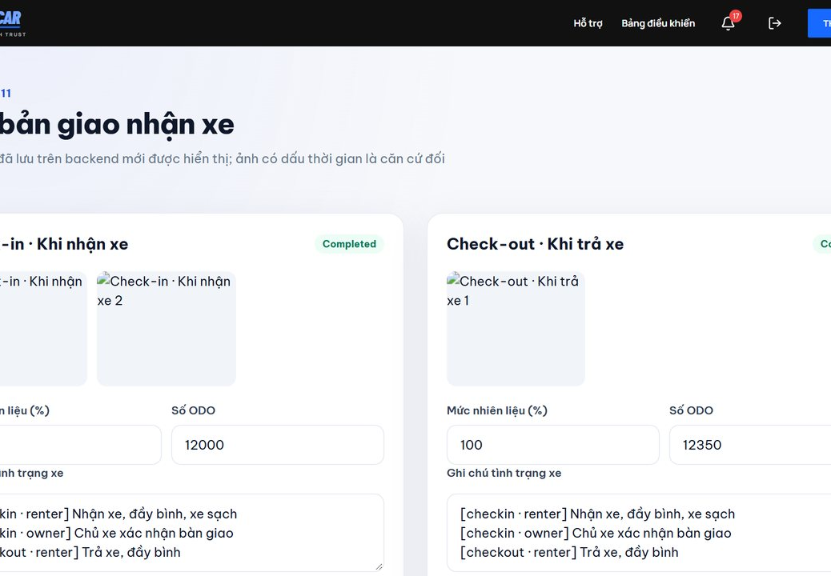
P
PACE
19
CAR
17 • END-TO-END EVIDENCE
A rental journey across four screens
The interface screens show that the key steps form a usable connected flow.
→
→
→
01
SEARCH
02
VIEW QUOTE
03
PAY DEPOSIT
04
PICKUP / RETURN
Choose area, destination, date, and time
Rental price, surcharges, and deposit
QR with the correct amount and reference
Photos, fuel level, and mileage
The full flow continues with contract signing, rental payment, trip completion, commission, and dispute support.

Slide 20
P
PACE
CAR
CONCLUSION
PACE CAR COMPLETES
A FULL VALUE CYCLE
From search to contract, payment, handover, and dispute support—with evidence, clear roles, and a defined business model.
Next step: pilot with real renters and owners to validate commercial viability.
THANK YOU
PaceCar • EXE201 Product Development Deck • 05.11.2026

