Slide 1

Database Security
Chapter 2
Database Review

Slide 2
Objectives
Review the basic components of a database
Define a database and identify the basic components of a database management system
Identify the different database management system models and applications
Identify and describe the architecture of Oracle, MySQL, and Microsoft SQL Server
Database Security

Slide 3
Database Defined
Database
  A collection of data stored on a computer using a database management system (DBMS)
DBMS
  Application that allows others to search stored data
  Goal: provide means to manipulate, analyze, store, and retrieve information
Example: school library
  Librarian (on-campus library) or Web site (online library) acts as DBMS
Database Security

Slide 4
Database Structure Components
Method of storing information in a database
  Depends on database type
Common components of digital database management applications
  Tables
  Keys
  Queries
Database Security

Slide 5
Tables
Basic unit of storage within a database
Represents unique and specific data objects
Composed of vertical columns and horizontal rows
Column
  Also known as field
  Contains a general category of information with similar data types
Row
  Also known as record or tuple
  Holds distinct units of data
Database Security

Slide 6
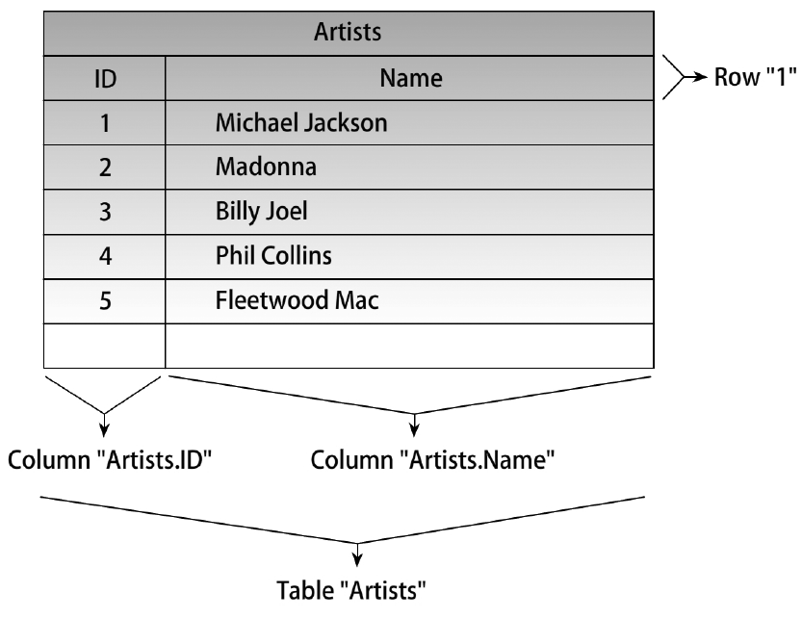
Figure 2-1 Common table found in a database
© Cengage Learning 2012
Database Security

Slide 7
Keys
Single field or group of fields used to identify an entry in a table
Used to access or manipulate records or rows within a relational database
Primary key
  Field containing a unique label identifying a record or row in a table
  Each table has a least one primary key
  Keys should be meaningful to the data being stored
  Key examples: employee ID number, Social Security number
Database Security

Slide 8
Keys (cont’d.)
Foreign key
  Field within a table containing a label used to build a relationship between two tables
  Often refers to a unique entry or primary key in a different table
Other keys
  Secondary or alternative key
  Candidate key
  Composite key
  Sort or control key
  Alternate key
Database Security

Slide 9
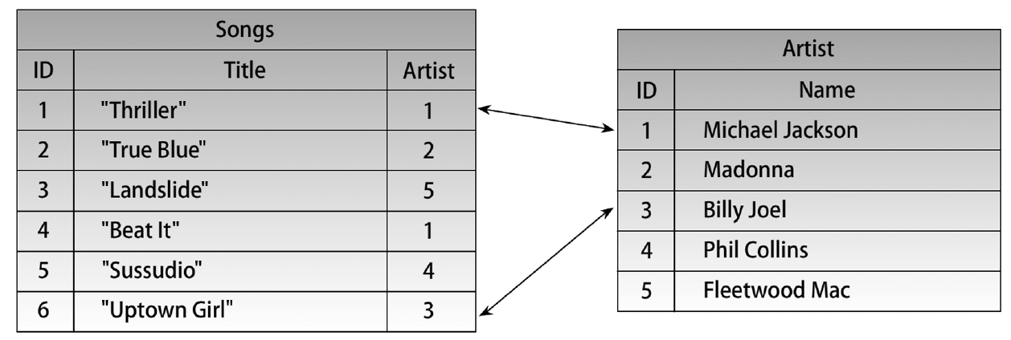
Figure 2-2 Use of foreign keys
© Cengage Learning 2012
Database Security

Slide 10
Queries
Searches initiated by users to retrieve information from the database
Consist of sets of variables or keywords formatted in a query language
  SQL is query language used in this text
Display information in a report
Example of SQL query
  SELECT title FROM songs, artists, WHERE songs.artists=groups.ID AND groups. Name= ‘Madonna’
Database Security

Slide 11
Database Models
Representation of the way data is stored
Determines how data is retrieved and manipulated
Four main database models
  Flat
  Relational
  Hierarchical
  Network
Database Security

Slide 12
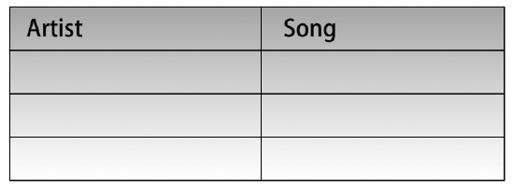
Flat Model
Two-dimensional list of data entries
  All data within a field are similar
  All data within a record are related to one another
  Similar to a sign-in sheet at a doctor’s office
Figure 2-3 Flat database model
© Cengage Learning 2012
Database Security

Slide 13
Flat Model (cont’d.)
Flat model disadvantages
  Multiple efforts
  Redundant data
  System allows large margin for error
    Entries must be made in exactly the same way or query will not return complete results
    Example: one user might enter “Billy Joel” and “Uptown girl” and another user “Billie Joel” and Up Town girl”
Database Security

Slide 14
Hierarchical Model
Popular in late 1960s and through the 1970s
Uses tiers and parent-to-child relationships to represent records and relationships
  Similar in structure to a family tree
One-to-many approach greatly minimizes redundancy
Model builds relationships within one stem
  No direct relationships made across the tree
Database Security

Slide 15
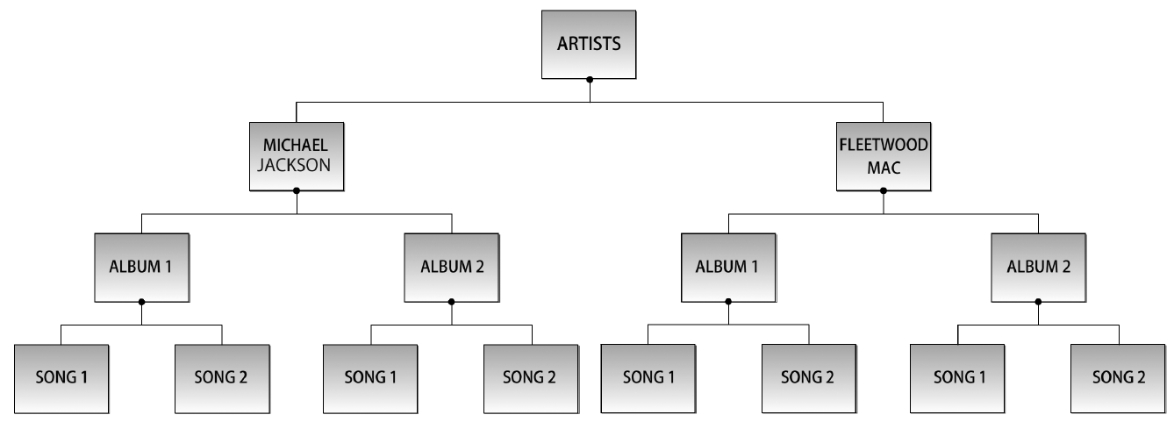
Figure 2-4 Hierarchical database model
© Cengage Learning 2012
Database Security

Slide 16
Network Model
Developed as a solution to one-to-many restrictive nature of hierarchical database model
Treelike structure using tiers and parent-child-like entities to represent relationships
Parent referred to as a set of which child entities are members
  Child entities may be members of more than one set
Advantages of many-to-many relationship
  Less resource intensive
  Easier to navigate
Database Security

Slide 17
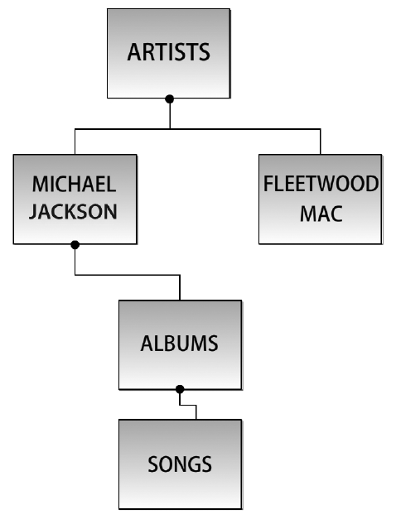
Figure 2-5 Network database model
© Cengage Learning 2012
Database Security

Slide 18
Relational Database
Common entities are stored within separate tables
  Tables given unique names
  Tables use unique key identifiers to build relationships among entities
Entity
  Person, place, or thing stored in a database table
  Has attributes and relationships
    Attribute: describing characteristic
    Relationship: defines association between two entities
Database Security

Slide 19
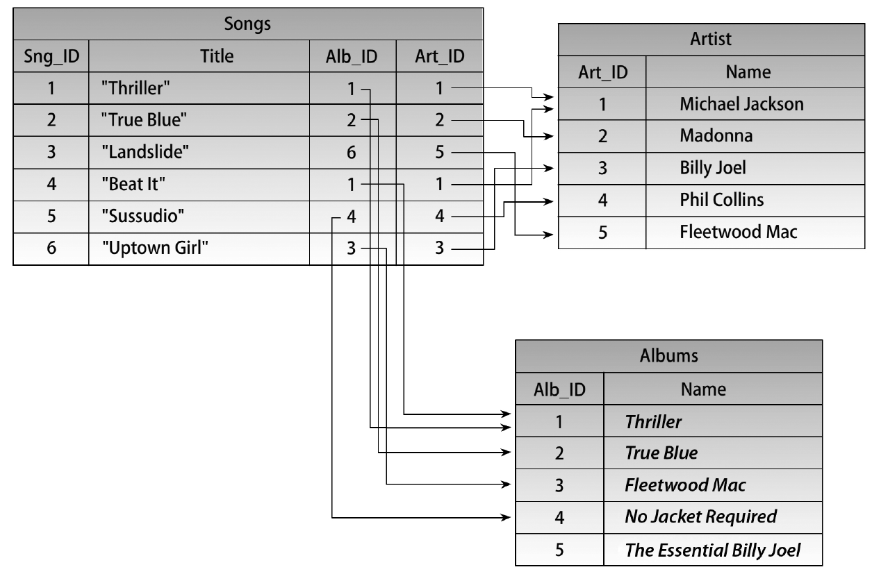
Figure 2-6 Relational database model
© Cengage Learning 2012
Database Security

Slide 20
Object-Oriented Databases
Object-oriented database management systems
  Allow storing and retrieving objects and complex data types
    CAD files
    Artificial intelligence objects
    XML-compatible objects
    General multimedia (audio and video)
  Were not widely adopted when released in 1985
  Used in specialized areas today
Database Security

Slide 21
Object-Relational Database
Introduced in the 1990s
Relational database with expanded group of data types
Middle ground between relational and object-oriented database management systems
Not widely used at this time
Database Security

Slide 22
Relationships
Define association between entities and bind them together
Relationship types
  One-to-one (1:1)
    Most simple relationship
    Rarely found in a relational database
  One-to-many (1:N)
    Entity has a sole relationship with entity that has several relationships
Database Security

Slide 23
Relationships (cont’d.)
Relationship types (cont’d.)
  Many-to-many (M:N)
    Entity has one or more partnerships with another entity that also has one or many partnerships
Database Security

Slide 24
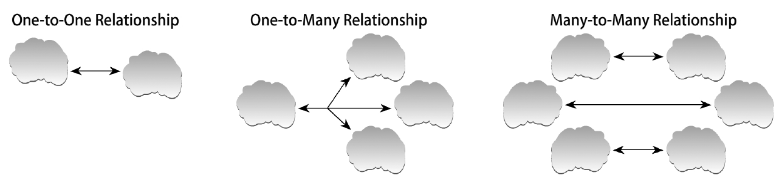
Figure 2-7 Entity relationship types
© Cengage Learning 2012
Database Security

Slide 25
Database Types
Database type is determined by data that will be housed in it
Types of databases
  Online transaction processing (OLTP)
  Online analytical processing or decision support system (OLAP/DSS)
Database Security

Slide 26
OLTP
Database created for real-time storage and manipulation of data within an organization
Created to be used in an active environment
Optimized to serve thousands of users simultaneously
Stores data resulting from large volumes of short transactions
Point of sales (POS) system
  Meant to handle cash register or sales transactions
Database Security

Slide 27
OLAP/DSS
Stores large volumes of historical data
Used for report generating and analyzing
Typically retrieves data from an OLTP
Data analyzed in a business environment to meet a specific need
Other names
  Data warehouse
  Data repository
Database Security

Slide 28
Database Management Systems
Application that provides means to manipulate, analyze, and query data
Almost all DBMSs existing today are developed to be used with relational databases
  Known as Relational Database Management Systems (RDBMSs)
Focuses of this text
  Oracle
  Microsoft SQL
  MySQL
Database Security

Slide 29
Oracle
RDBMS developed by Oracle Corporation in late 1970s
  Remains a popular database server
Advantages
  Portable
  Can run on almost any operating system
  Dominant role in providing business solutions
Current version addressed in this text
  Oracle 11g
Database Security

Slide 30
MySQL
RDBMS developed by Sun Microsystems
Most popular open source database server today
Advantages
  Speed
  Open source (available free of charge)
  Can be customized
  Platform independent
Database Security

Slide 31
Microsoft SQL
Often referred to as SQL Server
RDBMS developed by Microsoft
Primary query languages
  T-SQL
  ANSI SQL
Advantages
  Scalability
  Meets needs of any Windows environment
Database Security

Slide 32
Database Similarities
Read consistency
  Refers to accuracy and reliability of data within a database
  Depends on database ability to process and commit transactions in a timely manner
  Applies the following locking mechanisms:
    Transactions
    Concurrency
    Locks
    Commit
    Undo
Database Security

Slide 33
Query Management
Steps taken by a database management application to process a user query
Retrieving
Parsing
  Analyzing query construction for correct syntax and semantics
Optimizing
  Process of locating most efficient way to retrieve requested data
Queries can be processed individually or in parallel
Database Security

Slide 34
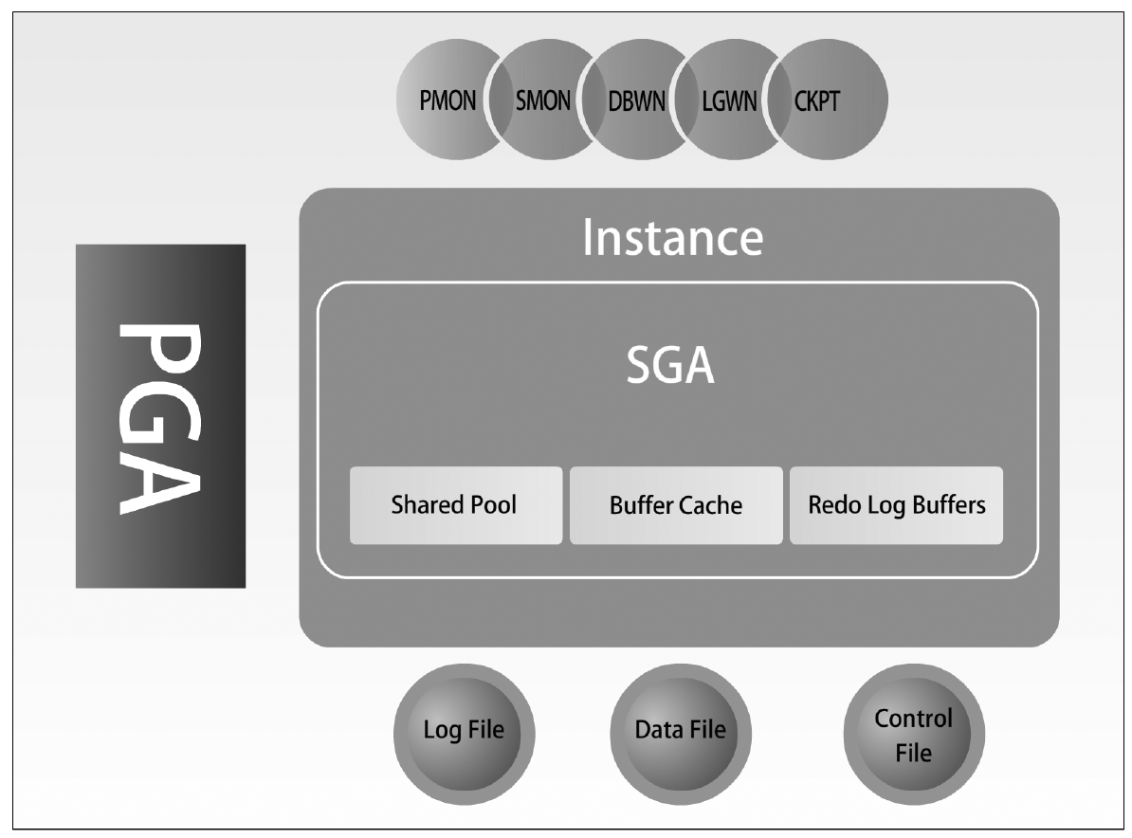
Oracle Architecture
Figure 2-8 Oracle architecture
© Cengage Learning 2012
Database Security

Slide 35
The Instance and the Database
Instance
  Refers to the background processes and structured memory used during interaction with a database
  To create, user must connect to a database and establish a session
Database portion of an Oracle server
  Holds database files that environment needs to run Oracle database
    Files help configure the instance, process SQL executions, and ensure alert and recovery from software and hardware failure
Database Security

Slide 36
The Physical Structure
Varies depending on operating system on which Oracle is installed
Files required with every Oracle install
  Datafile, control file, and redo log
  Files interact with OS
  Transparent to the user
Datafile
  Contains actual database data and holds information for all logical structures in the database
Database Security

Slide 37
The Physical Structure (cont’d.)
Control file
  Contains location and credentialing information of other files
  Database will not run if control file fails
Redo log
  Contains information about all changes made to database data
  Can be used to restore lost data
  Good practice to make a duplicate copy of this file
Database Security

Slide 38
The Memory Structure
Main memory and cache
  Quickest accessible storage in any system
In Oracle, nearly everything happens from main memory
  Oracle can reliably service many users concurrently
Query caching
  Queries cached into buffer area to increase speed of future query returns
Oracle memory structure divided into two parts
  System Global Area and Process Global Area
Database Security

Slide 39
The Memory Structure (cont’d.)
System Global Area (SGA)
  Central storage area for all shared data and processes
  Holds control data for one single instance in Oracle
  Oracle 11g uses dynamic SGA
Process Global Area (PGA)
  Central storage area for background and server processes
  Allocates space for each individual background process
  Content varies depending on Oracle configuration
Database Security

Slide 40
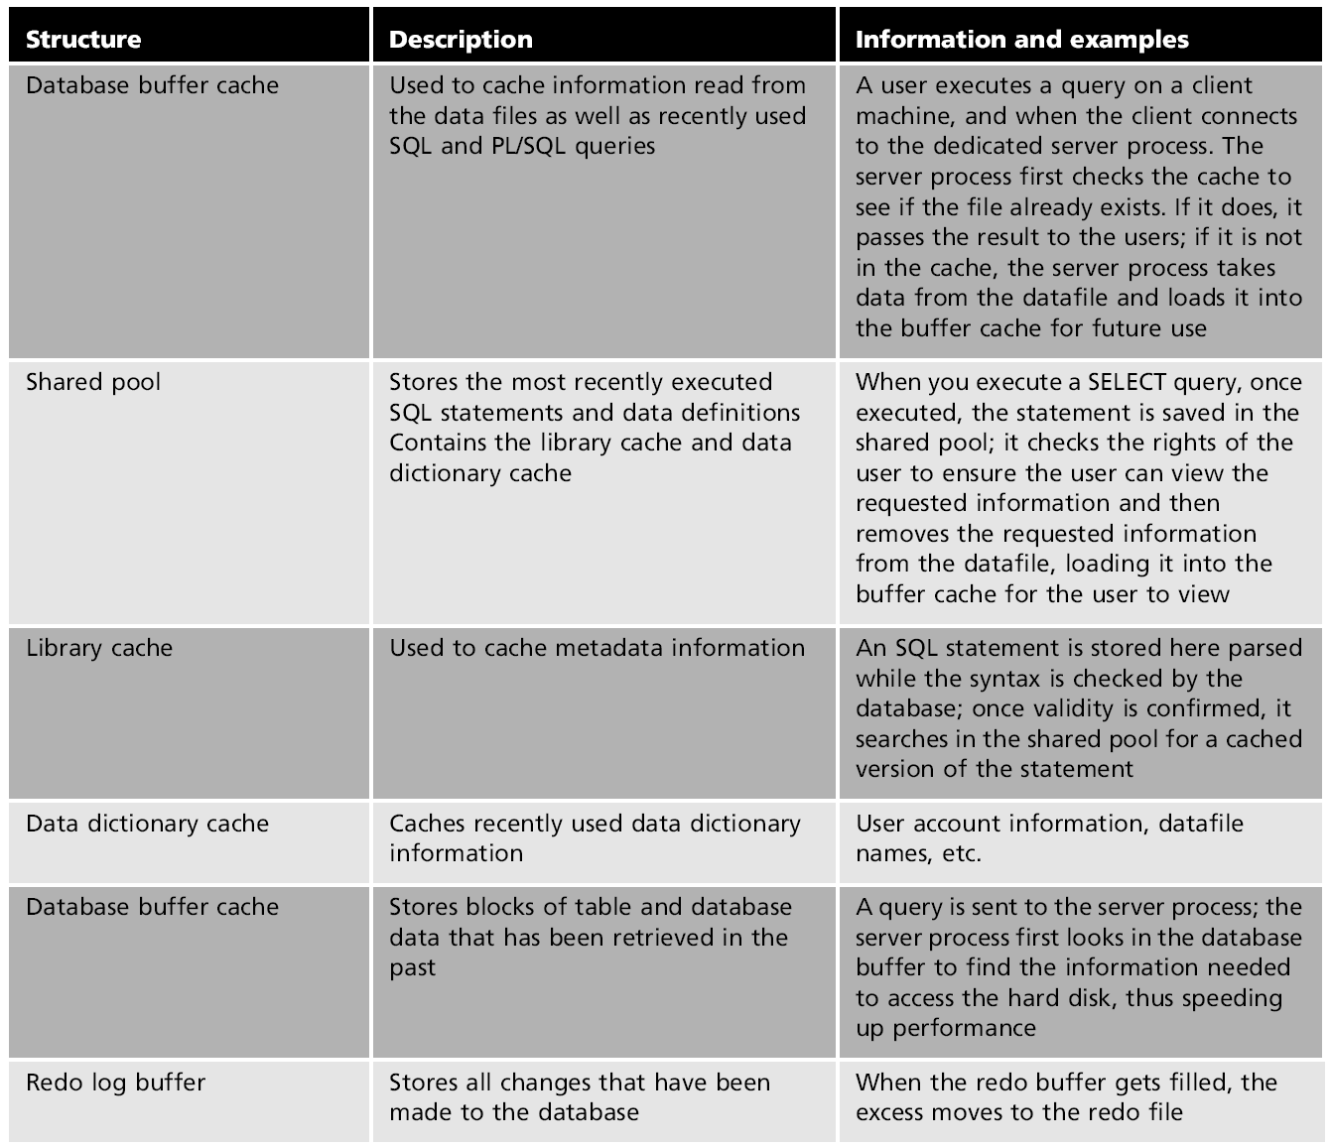
Table 2-1 Required memory structures within the SGA
Database Security

Slide 41
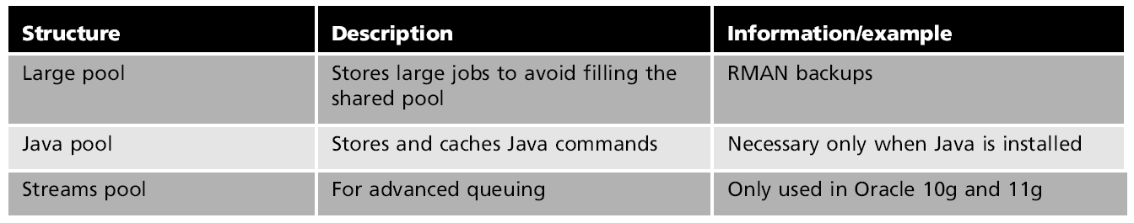
Table 2-2 Optional memory structures within the SGA
Database Security

Slide 42
The Processes
Process
  Instruction set executed by OS to complete a task
Tasks required to complete an instance in Oracle
  User runs application tool to request connection to Oracle server (user process)
  Server handles user’s request and runs process to create instance and complete the connection (server process)
Server processes can be shared or dedicated
Database Security

Slide 43
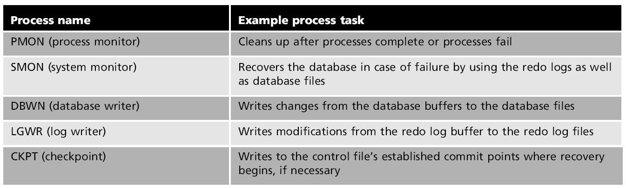
Table 2-3 Background processes
Database Security

Slide 44
MySQL Architecture
Developed for multiplatform use
  Solaris, Linux, Windows
Architecture components common to these operating systems
  Database connection manager
  Query engine
  Transaction manager
  Storage engine
Database Security

Slide 45
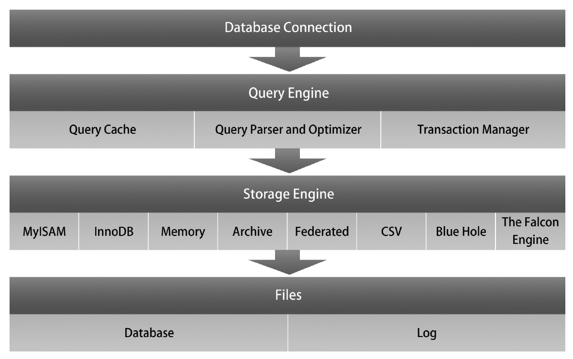
Figure 2-9 MySQL architecture
© Cengage Learning 2012
Database Security

Slide 46
Database Connection Manager
Manages connections to the MySQL server
  Virtually any client may connect
Methods for clients to connect via the connection management layer
  Application programming interfaces (APIs)
    Many programming languages are supported
    Clients using ODBC, Java, .net are supported
  TCP/IP is most common type of connection
Thread
  Execution running independently from other processes
Database Security

Slide 47
Query Engine
Architecture component that optimizes and manages queries and SQL statements
Built to use resources efficiently
Query steps
  User initiates query
  Query request received by MySQL server
  Query parser creates treelike structure of extracted SQL statements
  Data definition language provides access
Memory cache stores recently requested queries
Database Security

Slide 48
Transaction Manager
MySQL transaction
  Group of MySQL queries treated as a single process
Transaction manager maintains concurrency throughout the database
  Ensures simultaneous data handling will not corrupt data
Types of database environments
  Transactional
  Nontransactional
Database Security

Slide 49
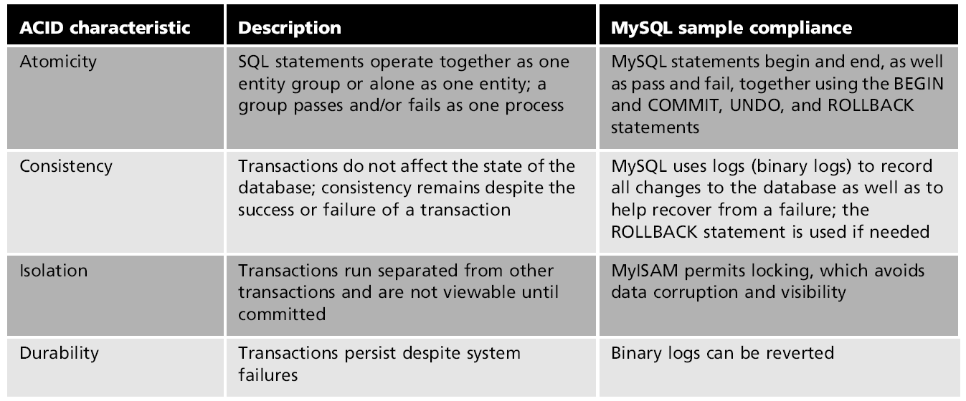
Table 2-4 ACID compliance and MySQL
Database Security

Slide 50
Storage Management
MySQL stores data files in secondary storage
  Dynamically traversing files is too slow
Storage management
  Process of storing and retrieving data throughout the database
  Most work takes place within main memory
  Three-tiered process uses resource manager, buffer manager, and storage manager
Database Security

Slide 51
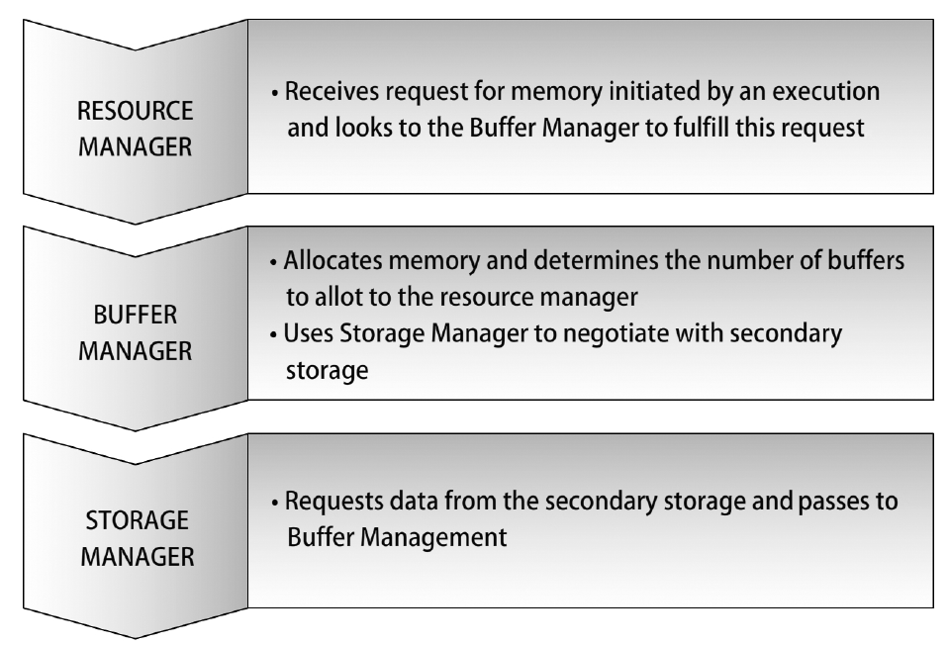
Figure 2-10 MySQL storage management
© Cengage Learning 2012
Database Security

Slide 52
The Storage Engine
Components that read and write data to and from the database
Customization options available
  Administrators can choose which storage engines to use for certain tables or applications
Storage engines available in MySQL
  MyISAM, InnoDB, Memory, Archive, Federated, Comma-separated values, Black Hole Engine, The Falcon Engine
Database Security

Slide 53
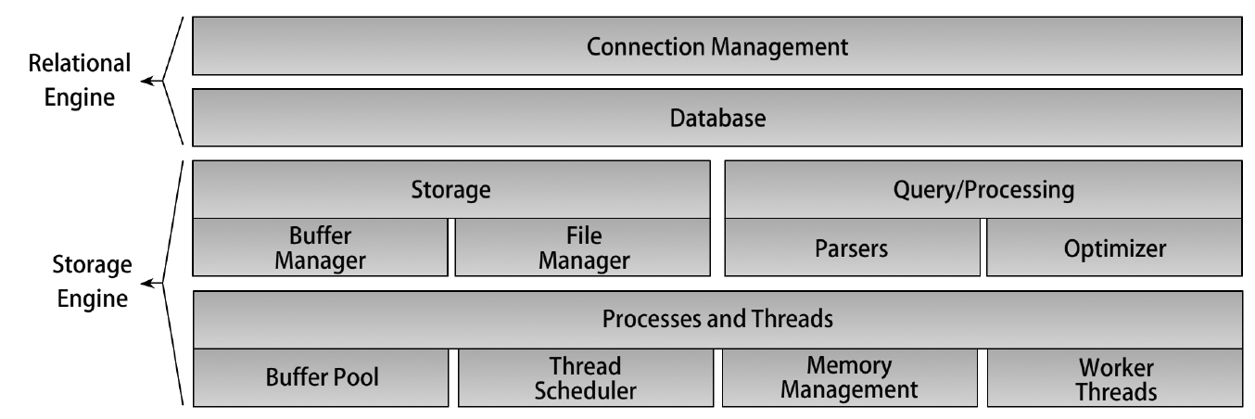
Microsoft SQL Server Architecture
Figure 2-11 Microsoft SQL Server architecture
© Cengage Learning 2012
Database Security

Slide 54
Architecture and Engines
Clients connect to the server using the Tabular Data Stream
Main components of SQL Server DBMS architecture
  The relational engine
    Responsible for query processing and data retrieval
  The storage engine
    Manages files, memory, recovery, logging, and transactions
Database Security

Slide 55
The Physical Structure
Three different types of files store data
  Primary data files
  Secondary data files
  Log files
Each installation of SQL server
  Has at least one primary file and one log file
Filegroups used to organize database into logical units of resources
  Primary filegroup
  User-defined filegroup
Database Security

Slide 56
Memory Management
SQL Server can dynamically allocate its own memory
  No need for administrator intervention
  Balances main memory use between database processes and storing and retrieving data
Virtual memory
  Technique for extending memory availability
  Units of storage from different memory devices appear as a single block of storage
  Fixed units of storage referred to as pages
Database Security

Slide 57
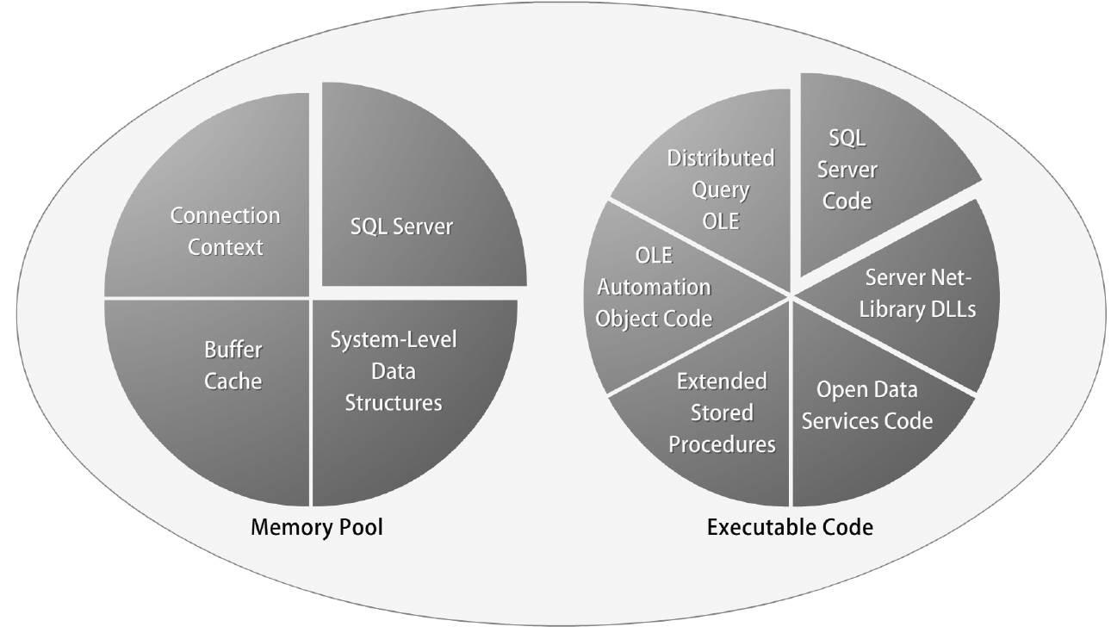
Figure 2-12 Microsoft SQL Server memory management
© Cengage Learning 2012
Database Security

Slide 58
Buffer Management
Buffer manager accesses data pages and updates the database
Buffer pool (buffer cache)
  Area in which data pages are stored
  Minimizes need to read and write from hard disk file
Steps to retrieve data after query processing
  Buffer manager accesses database files from hard disk and places in buffer cache pages
  Data read from the cache
  Page considered dirty if changes made to data while in buffer cache
Database Security

Slide 59
Threads and Processes
Threads and fibers used to perform several tasks simultaneously
  Threads handled by the operating system and allocated one per CPU
  Fibers handled by the server and allocated one per user command
Worker processes
  Pools of either threads or fibers for all user connections
  Number of threads or fibers within one worker process available depends on network size
Database Security

Slide 60
Summary
A database allows others to search, analyze, and manipulate stored data
Data is stored within a database using a table structure
Several types of keys are used to reference data
Query languages provide users a way to retrieve and manipulate data from a database
  SQL is most common query language
General query processing steps
  Parsing, optimization, execution of SQL statements
Database Security

Slide 61
Summary (cont’d.)
Different database models describe how data is stored within a database
  Flat, hierarchical, network, and relational
One-to-many relationships are most common relationships formed between tables in a relational database
Most common DBMSs include Oracle, MySQL, and Microsoft SQL Server
Read consistency and query management are important aspects of a DBMS
Database Security

