Slide 1
VULCA SOLUTION PACK V1
Public example sample / Page 1
VULCA Solution Pack v1
Release-evidence packets for AI-assisted visual assets.
AI-assisted visual production is scaling across commerce, campaign, generated media, and ad workflows. The bottleneck is no longer only making an asset. The bottleneck is explaining what it came from, what it represents, what still needs review, and who owns the release decision.
source
field read
owner gate
public examples only
source-backed
human-reviewed
Named companies are public examples only. They do not imply a VULCA customer, partner, endorsement, authorization source, or finding.

Slide 2
VULCA SOLUTION PACK V1
Public example sample / Page 2
What VULCA Produces
A compact packet that connects source context, visual or generated-output fields, review questions, owner route, and a bounded human review gate.
Lane A / Product-truth
Lane B / AI publishability
Lane C / AI ad workflow
Existing commercial material and product claims become source-backed evidence cards: visible claim, product representation, source context, channel role, and release owner.
Generated assets are paired with input or reference context, model or workflow context, output state, label posture, unresolved fields, and owner route.
Product URL, listing, or brief-to-ad workflows become handoff packets: source input, generated candidate, review anatomy, export state, and campaign owner.
Default reading order for this sample: Lane C is the main before/after workflow story. Lane A and Lane B show that the same source-backed method also works for product claims and generated assets.
Named companies are public examples only. They do not imply a VULCA customer, partner, endorsement, authorization source, or finding.

Slide 3
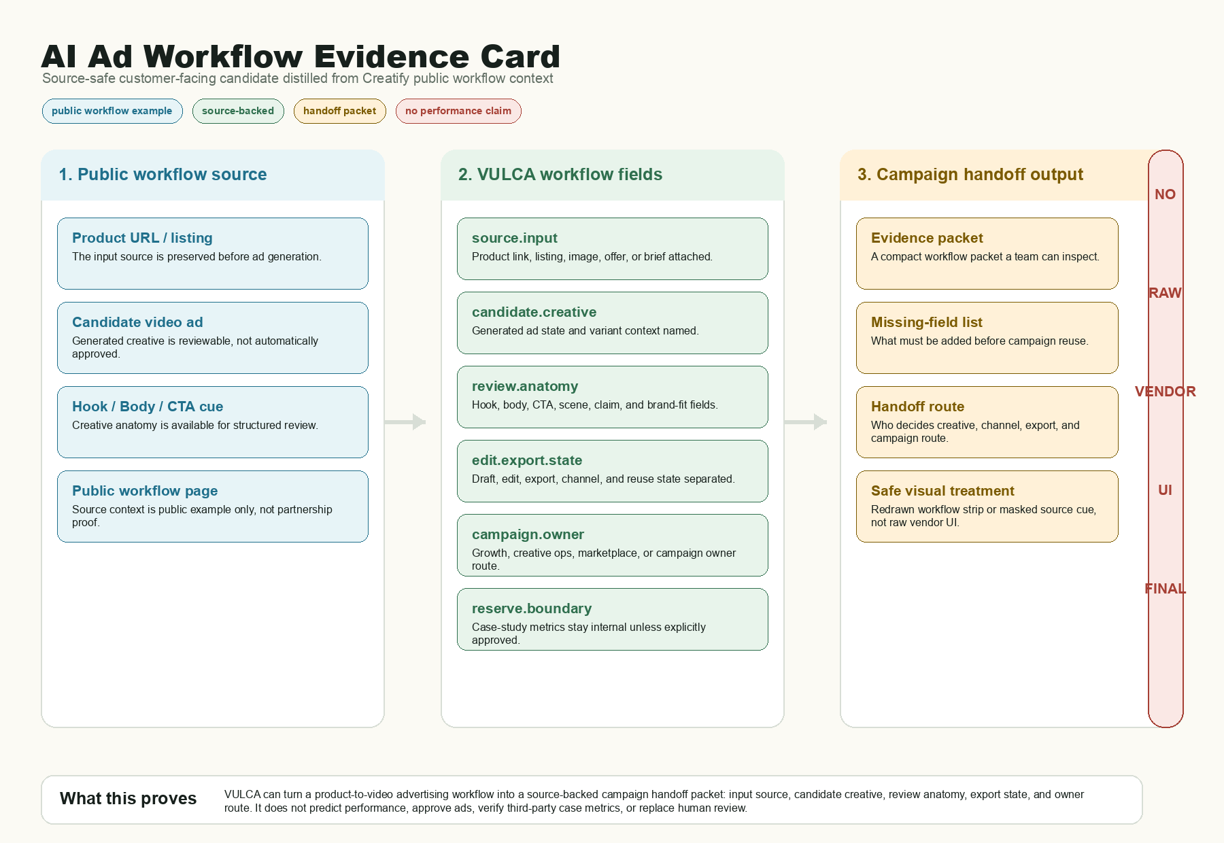
VULCA SOLUTION PACK V1
Public example sample / Page 3
Before / After: AI Ad Workflow Handoff
Before VULCA
Campaign candidates move faster than review context: source input, export state, missing fields, and owner route sit apart.
After VULCA
The same flow becomes one packet: source input, generated candidate, review anatomy, missing-field list, owner route, and human gate.
Source-safe example card; not vendor proof or performance prediction.
Named companies are public examples only. They do not imply a VULCA customer, partner, endorsement, authorization source, or finding.

Slide 4
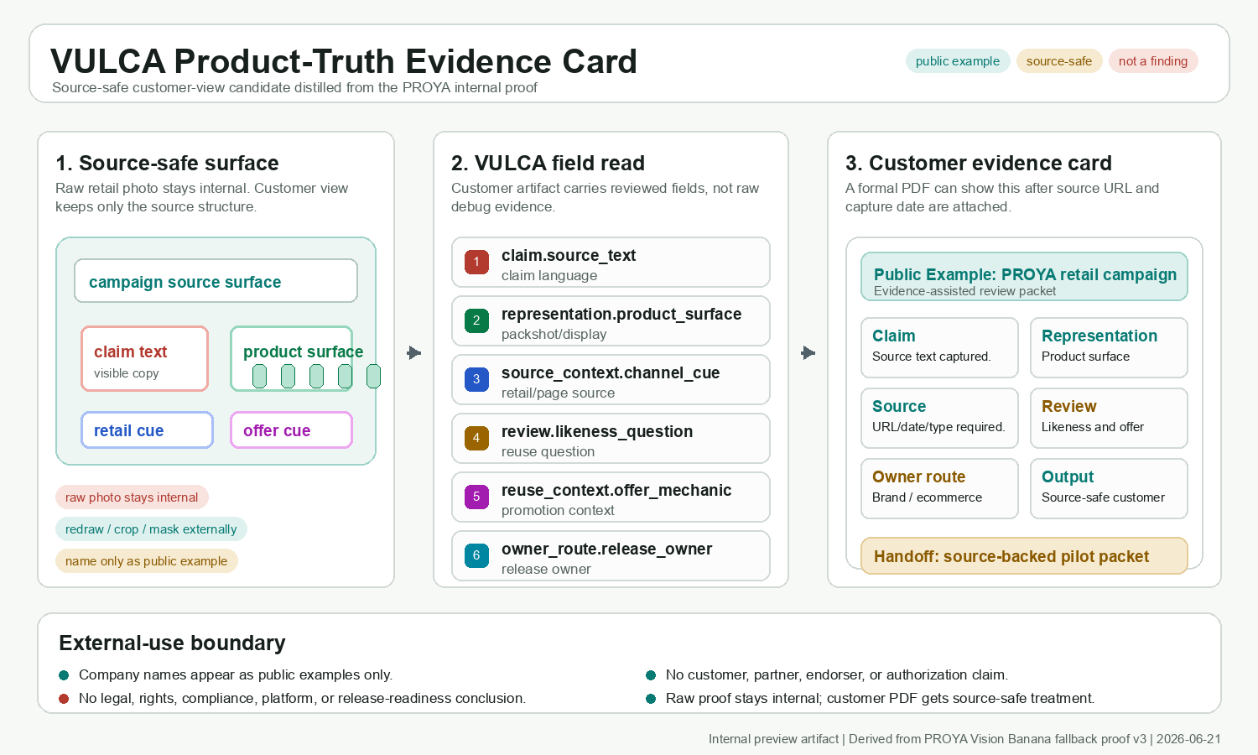
VULCA SOLUTION PACK V1
Public example sample / Page 4
Supporting Proof A: Product-Truth Evidence
A public product or campaign surface can be translated into reviewable fields before reuse.
1. Public source surface
2. VULCA field read
Material, product view, offer cue, and channel context.
Claim, representation, context, and owner route split into fields.
3. Review output
Boundary
Known, missing, and decision-owner fields become inspectable.
Workflow discussion only. No rights, platform, release, or relationship claim.
Named companies are public examples only. They do not imply a VULCA customer, partner, endorsement, authorization source, or finding.

Slide 5
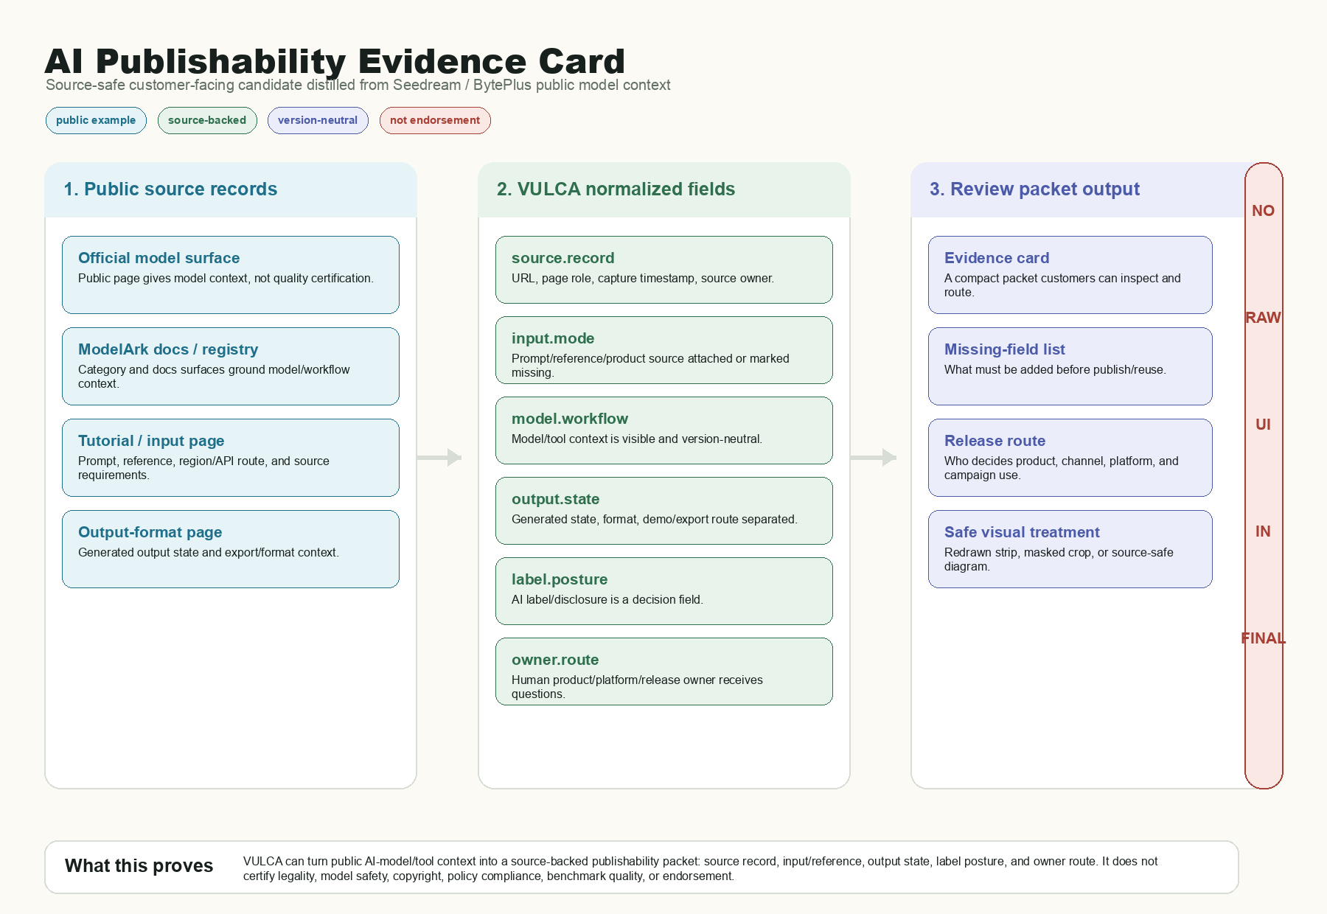
VULCA SOLUTION PACK V1
Public example sample / Page 5
Supporting Proof B: AI Publishability Context
Generated media should not be reviewed as a file alone. The packet needs source or reference context, model or workflow context, output state, label posture, and owner route.
1. Public records
2. Normalized fields
Official model, tool, and tutorial context become source records.
Model context, input reference, output state, label posture, owner.
3. Review packet
Boundary
Reviewable, missing, source-backed, and not-yet-approved fields.
No scoring, certification, clearance, approval, or benchmarks.
Named companies are public examples only. They do not imply a VULCA customer, partner, endorsement, authorization source, or finding.

Slide 6
VULCA SOLUTION PACK V1
Public example sample / Page 6
A Bounded Pilot Shape
The first useful step is small: public examples or sanitized assets, one review lane, a short readout, and a clear owner route.
1. Intake
2. Field Read
Public example, sanitized asset, product URL, listing, brief, or generated candidate.
Source context, visible claim or output context, review anatomy, output state, and missing fields.
3. Evidence Card
4. Readout
A compact review object that a human owner can inspect and route.
What is ready to discuss, what is missing, who owns the next decision, and what should wait.
Named companies are public examples only. They do not imply a VULCA customer, partner, endorsement, authorization source, or finding.

Slide 7
VULCA SOLUTION PACK V1
Public example sample / Page 7
Review Ask And Boundaries
Useful first response
Not claiming
Which visual workflow should be turned into a source-backed review packet first: product-truth, AI publishability, or AI ad workflow handoff?
No legal advice, rights clearance, platform approval, model-safety certification, release-readiness certification, performance measurement, ROI, CPA, CTR, ROAS, benchmark superiority, customer relationship, partnership, endorsement, authorization, or audit finding.
What the sample shows
A repeatable packet shape: source context, representation or generated-output field read, unresolved questions, owner route, and human review gate.
Named companies are public examples only. They do not imply a VULCA customer, partner, endorsement, authorization source, or finding.

