Slide 1
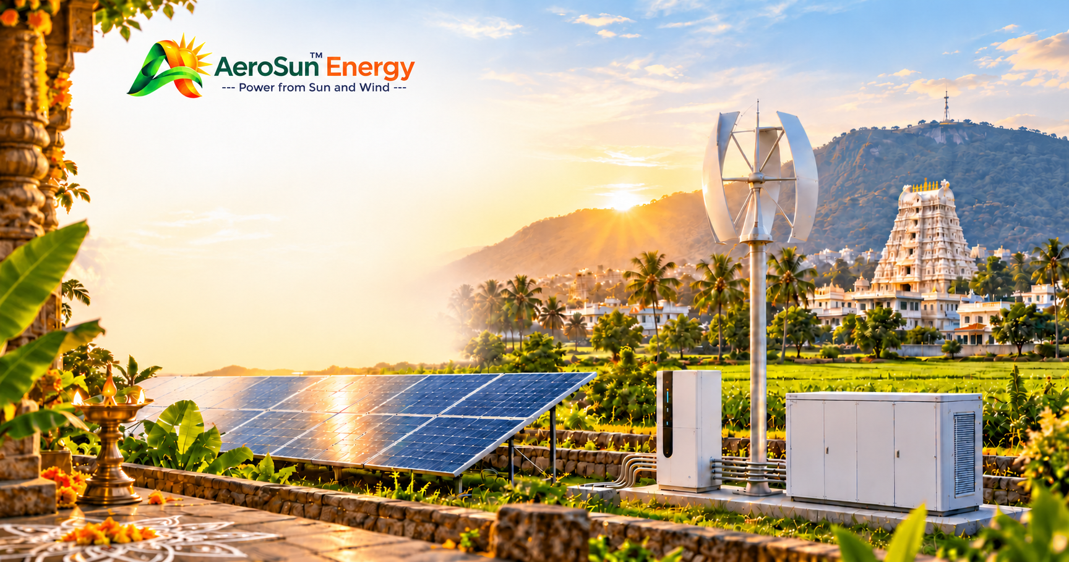
AEROSUN ENERGY
PRIVATE LIMITED
SOLAR & RENEWABLE ENERGY SOLUTIONS
Power from Sun, Wind, Water, Fire..
PRODUCT & SERVICES CATALOGUE | 2026
Solutions for homeowners, farmers, businesses and institutions
aerosunenergy.in | customercare@aerosunenergy.in | +91 8099181075

Slide 2
CLEAN ENERGY PORTFOLIO
Power your future with clean energy
Energy requirements differ for every home, farm and business.
AeroSun Energy aims to provide customised renewable-energy solutions designed around electricity consumption, site conditions, available resources and customer requirements.
PORTFOLIO FOCUS
SOLAR ENERGY
WIND DEVELOPMENT
BATTERY STORAGE
INTEGRATED SYSTEMS
System options are assessed for each project; suitability and final configuration depend on technical and site review.
AEROSUN ENERGY PRIVATE LIMITED
02

Slide 3
01 | RESIDENTIAL SOLAR
Clean energy for your home
Rooftop solar options planned around household electricity needs.
SUITABLE FOR
SYSTEM OPTIONS
•
Independent houses and villas
01
Grid-connected
Connected to the electricity grid, subject to applicable DISCOM approvals and regulations.
•
Residential buildings and apartments (subject to suitable common-area arrangements)
•
Residential properties with suitable rooftop space
02
Off-grid
Solar combined with battery storage for independent electricity supply.
POTENTIAL BENEFITS
•
Renewable electricity generation
03
Hybrid
Solar integrated with suitable storage and grid or backup arrangements.
•
Potentially lower grid purchases and reduced reliance on conventional energy
•
Better rooftop use; optional battery backup when appropriately designed
Capacity depends on electricity consumption, rooftop area, solar exposure, budget and applicable regulations.
AEROSUN ENERGY PRIVATE LIMITED
03

Slide 4
02 | COMMERCIAL & INDUSTRIAL
Smarter energy for businesses
Rooftop solar can generate electricity for commercial and industrial operations.
SUITABLE FOR
Retail shops • Offices • Warehouses • Manufacturing units
Hotels • Hospitals • Educational institutions • Commercial buildings
SOLUTIONS
POTENTIAL BENEFITS
•
Grid-connected commercial and industrial rooftop solar
•
Potential reduction in electricity expenditure
•
Solar for daytime energy consumption
•
Better use of available rooftop space
•
Hybrid solar with battery storage
•
Reduced dependence on conventional electricity
•
Customised energy assessment
•
Improved energy planning and support for sustainability objectives
AEROSUN ENERGY PRIVATE LIMITED
04

Slide 5
02 | PROJECT APPROACH
From energy review to commissioning
A coordinated process for commercial and industrial solar projects.
01
Understand
05
Propose
Electricity consumption
Commercial proposal
02
Review
06
Coordinate
Electricity bills
Installation through qualified partners
03
Assess
07
Commission
Site and rooftop suitability
Applicable checks and handover
04
Design
System configuration
Scope, system design and expected performance assumptions are prepared for the individual site.
AEROSUN ENERGY PRIVATE LIMITED
05

Slide 6
03 | AGRICULTURAL SOLAR
Solar power for agriculture
For irrigation, water pumping, farm lighting and other suitable farm loads.
APPLICATIONS
SYSTEM CONFIGURATIONS
•
Solar irrigation pumps
01
Solar pump
PV modules supply electricity to a compatible agricultural pump.
•
Agricultural water pumping
•
Farm lighting and off-grid farm electricity
02
Standalone
•
Agricultural energy systems and rural applications
Independent solar system for suitable agricultural loads.
03
Hybrid
Solar plus battery storage or another compatible source.
Sizing requires review of pump capacity, water requirement, total dynamic head, water source, operating hours and site conditions.
Potential benefits include renewable solar use, reduced grid or diesel dependence, remote-site suitability and customised sizing.
Subsidies depend on current scheme rules, state allocation, eligibility, approved equipment and official sanction; they are not guaranteed by AeroSun Energy.
AEROSUN ENERGY PRIVATE LIMITED
06

Slide 7
04 | OFF-GRID SOLAR
Independent energy for remote locations
Solar generation, battery storage and power conversion for suitable independent supply.
SUITABLE FOR
SYSTEM COMPONENTS
•
Remote houses and farmhouses
•
Solar PV modules
•
Agricultural fields and rural facilities
•
Charge controller or compatible inverter
•
Small commercial establishments and isolated buildings
•
Battery storage
•
Suitable telecom and monitoring applications
•
Protection equipment
•
Distribution panel, wiring and accessories
DESIGN CONSIDERS
Connected load • Daily energy use • Peak demand • Backup duration
Solar resource • Battery capacity • Future expansion
An off-grid system is customised to demand and site conditions.
AEROSUN ENERGY PRIVATE LIMITED
07

Slide 8
05 | ENERGY STORAGE
Store energy. Use it when needed.
Battery storage can support suitable solar systems and applications.
APPLICATIONS
SELECTION PROCESS
•
Residential and commercial backup
•
Customer load profile
•
Off-grid systems
•
Backup requirements and energy capacity
•
Solar hybrid installations
•
Battery chemistry and inverter compatibility
•
Remote power applications
•
Battery management and protection
•
Warranty and service arrangements
STORAGE OPTIONS
Battery selection depends on the application and may include suitable lithium-based or other compatible battery technologies.
Potential benefits: energy storage, backup electricity, better use of solar generation and support for off-grid operation.
AEROSUN ENERGY PRIVATE LIMITED
08

Slide 9
06 | WIND ENERGY
Small wind-generator development
Customised product direction for decentralised electricity requirements.
PROPOSED DEVELOPMENT RANGE
INTENDED APPLICATIONS
100 W – 10 kW
•
Agricultural properties
•
Rural locations
PRODUCT DEVELOPMENT FOCUS
•
Remote facilities
•
Customised generator capacities
•
Small businesses
•
Permanent-magnet generator technology
•
Suitable distributed-energy installations
•
Vertical-axis turbine concepts
•
Mechanical and electrical integration
•
Low-wind-speed performance investigation
•
System monitoring and testing
The range and product performance are under development and require engineering validation and testing.
AEROSUN ENERGY PRIVATE LIMITED
09

Slide 10
06 | PRODUCT DEVELOPMENT
AeroSun AS-WG-3000
Flagship 3 kW hybrid vertical-axis wind-turbine development project.
PROPOSED CONFIGURATION
•
3 kW target electrical output
•
Hybrid Savonius–Darrieus vertical-axis turbine
•
Three external helical Darrieus blades
•
Central Savonius starter rotor
•
Direct-drive permanent-magnet generator concept
•
Electrical power conversion and protection
DEVELOPMENT STATUS
Rated output, starting wind speed, power curve, efficiency, reliability and operating limits remain subject to engineering validation and physical testing.
AEROSUN ENERGY PRIVATE LIMITED
10

Slide 11
07 | INTEGRATED SYSTEMS
Solar–wind hybrid energy systems
Two renewable sources can complement one another under suitable environmental conditions.
PROPOSED SYSTEM ARCHITECTURE
SUITABLE APPLICATIONS
•
Solar PV modules
•
Farms
•
Wind generator
•
Remote buildings and rural facilities
•
Compatible power conversion equipment
•
Small commercial operations
•
Battery storage
•
Off-grid installations
•
Energy management system
•
Suitable institutional applications
•
Electrical protection, monitoring and control
Potential benefits include two-source renewable generation, diversified supply, battery integration and a customised energy architecture.
A hybrid system does not guarantee uninterrupted power unless generation, storage, load management and backup are properly designed.
AEROSUN ENERGY PRIVATE LIMITED
11

Slide 12
08 | PLANNING SERVICES
Renewable-energy consultation & feasibility
Make an informed energy investment by understanding actual requirements first.
•
Electricity consumption assessment
•
Off-grid and solar–wind hybrid feasibility
•
Solar rooftop suitability assessment
•
Preliminary system sizing and equipment selection
•
Wind-resource assessment coordination
•
Project cost and energy-generation estimation
•
Agricultural energy requirement assessment
Assessments and estimates are preliminary until validated for the specific site, selected equipment and project scope.
AEROSUN ENERGY PRIVATE LIMITED
12

Slide 13
08 | PROJECT DEVELOPMENT
A clear project development process
01
Customer enquiry
05
Commercial proposal
Understand energy needs.
Share estimated cost, scope and performance assumptions.
02
Requirement assessment
06
Procurement & execution
Review bills, loads and usage patterns.
Coordinate procurement and installation through qualified partners.
03
Site evaluation
07
Testing & handover
Review rooftop, land, solar exposure, wind and installation needs.
Complete applicable checks, commissioning and customer handover.
04
System design
Prepare a suitable preliminary technical configuration.
AEROSUN ENERGY PRIVATE LIMITED
13

Slide 14
WORKING TOGETHER
Why choose AeroSun Energy?
A customer-oriented approach built around actual project requirements.
•
Solar and wind energy solutions
•
Solar–wind hybrid technology
•
Customised system planning
•
Equipment integration
•
Agricultural and rural applications
•
Quality-conscious supplier selection
•
Small wind-generator development
•
Customer-oriented technical assessment
We aim to plan around customer requirements rather than offer one configuration for every application.
AEROSUN ENERGY PRIVATE LIMITED
14

Slide 15
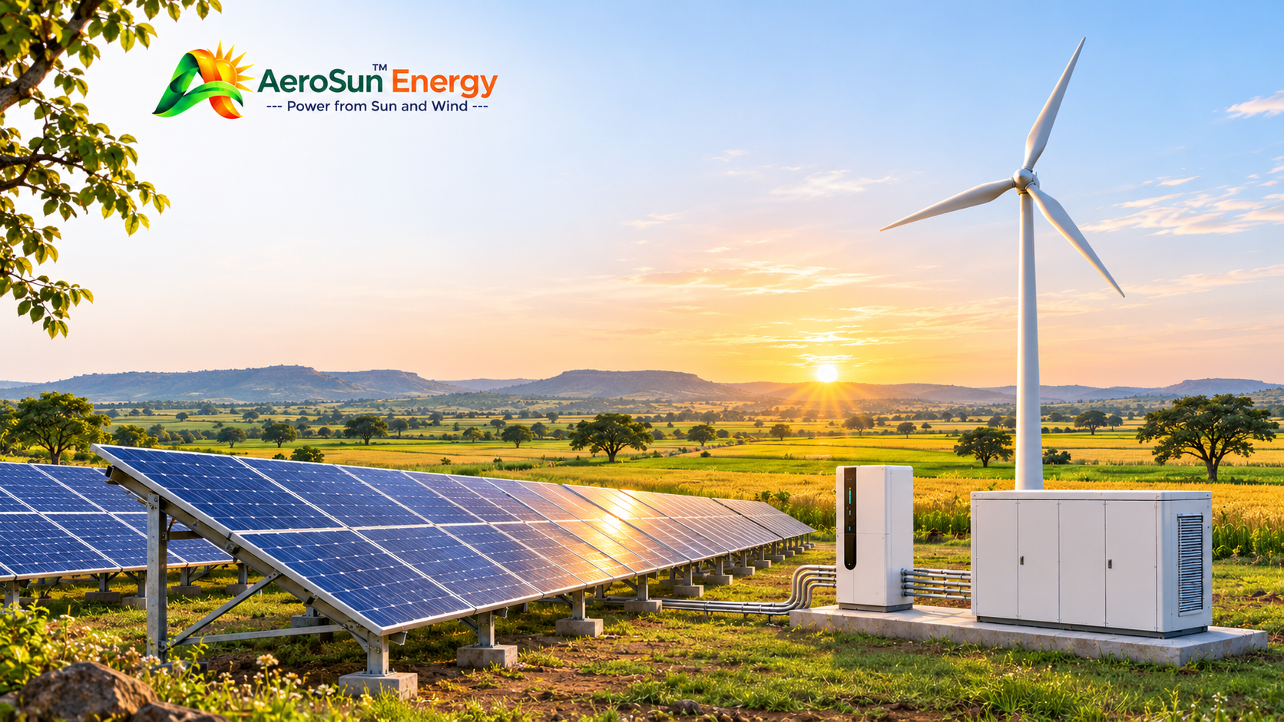
LET’S DISCUSS YOUR ENERGY REQUIREMENTS
AEROSUN ENERGY
PRIVATE LIMITED
Power from Sun, Wind, Water, Fire.
D. No. 11-184, Gollavanigunta, T.N. Pallem, Tirupati, Andhra Pradesh – 517501, India
https://aerosunenergy.in/ | customercare@aerosunenergy.in | +91 8099181075
Homeowners, farmers, business owners and institutions are welcome to discuss suitable renewable-energy
options.
PROJECT BASIS:
All systems are subject to technical feasibility, site conditions, applicable approvals and equipment availability.
Specifications, savings and generation estimates depend on individual project assessment. Government incentives
and subsidies are subject to current official scheme rules and approval.

