Slide 1
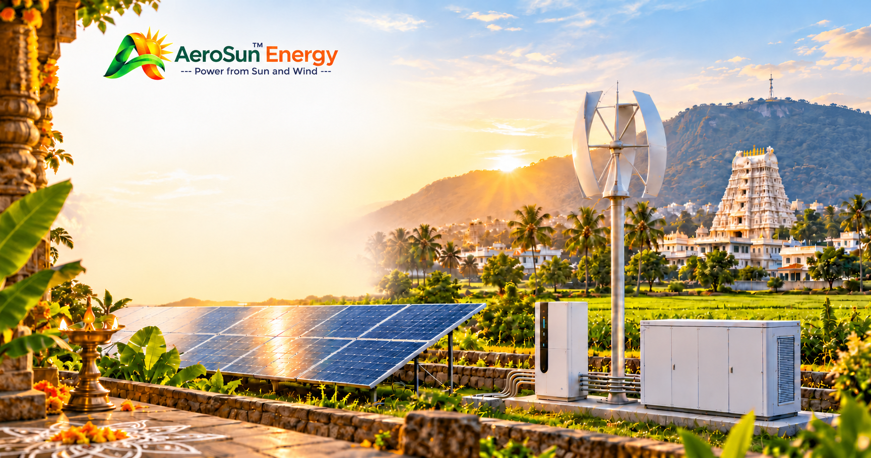
AEROSUN ENERGY
PRIVATE LIMITED
Power from Sun, Wind, Water, Fire.
COMPANY PROFILE | 2026
Registered Office:
D. No. 11-184, Gollavanigunta, T.N. Pallem, Tirupati, Andhra Pradesh – 517501, India
CIN: U35106AP2026PTC128748
aerosunenergy.in | customercare@aerosunenergy.in | +91 8099181075

Slide 2
COMPANY OVERVIEW
About AeroSun Energy
AeroSun Energy Private Limited is an Indian renewable-energy company focused on developing and delivering practical clean-energy solutions using solar and wind power.
Our business vision is to make renewable energy more accessible, adaptable and useful for households, agricultural operations, commercial establishments and remote communities.
We aim to combine renewable-energy products, customised system design, engineering, equipment integration and technical services to address different energy requirements.
Long-term direction
Customised small wind generators, solar power systems and integrated solar–wind hybrid solutions.
AEROSUN ENERGY PRIVATE LIMITED
02

Slide 3
PURPOSE
Vision & mission
OUR VISION
OUR MISSION
To become a trusted renewable-energy solutions company by promoting accessible, reliable and sustainable energy technologies for a cleaner future.
•
Promote adoption of solar and wind energy.
•
Develop customised solutions for different power requirements.
•
Explore innovative small-scale wind-generation technologies.
•
Integrate solar, wind and battery storage systems.
•
Support agricultural, residential and commercial energy needs.
•
Build reliable customer, manufacturer and technology relationships.
•
Contribute to environmental sustainability through renewable-energy adoption.
AEROSUN ENERGY PRIVATE LIMITED
03

Slide 4
BUSINESS AREAS
Solar energy solutions
Solutions intended for homes, businesses, industry and agriculture.
•
Residential rooftop installations
•
Commercial rooftop installations
•
Industrial solar applications
•
Agricultural solar pumps
•
Off-grid solar power systems
•
Solar battery storage
•
Solar energy feasibility and consultation
AEROSUN ENERGY PRIVATE LIMITED
04

Slide 5
BUSINESS AREAS
Wind energy development
PROPOSED PRODUCT DIRECTION
Customised small wind generators in a proposed capacity range from 100 W to 10 kW.
INITIAL ENGINEERING FOCUS
3 kW hybrid vertical-axis wind turbine (VAWT), combining Savonius and Darrieus rotor concepts.
•
Customised power capacities
•
Investigation of low-wind-speed performance
•
Permanent-magnet generator integration
•
Mechanical and electrical system optimisation
•
Performance monitoring and testing
•
Farm, rural and distributed-energy applications
Development remains subject to engineering validation, prototype testing and applicable certification.
AEROSUN ENERGY PRIVATE LIMITED
05

Slide 6
BUSINESS AREAS
Solar–wind hybrid energy
A customised system concept combining renewable generation and storage.
SYSTEM ELEMENTS
POTENTIAL APPLICATIONS
Solar PV generation
Wind generation
Energy storage
Suitable power electronics
•
Farms and agricultural operations
•
Remote buildings
•
Small businesses
•
Rural facilities
•
Off-grid applications
•
Commercial energy systems
Final configuration depends on site conditions, load requirements and technical feasibility.
AEROSUN ENERGY PRIVATE LIMITED
06

Slide 7
OFFERINGS
Products & services
Residential solar
Wind energy
Rooftop solar systems
Small wind-generator development and proposed product range
Commercial solar
Hybrid energy
Business and commercial rooftop systems
Solar, wind and battery integration
Agricultural solar
Energy consultation
Solar-powered agricultural applications and pumps
Site assessment and renewable-energy feasibility
Off-grid solar
Energy storage
Independent solar electricity systems
Battery-based storage integration
AEROSUN ENERGY PRIVATE LIMITED
07

Slide 8
TECHNOLOGY
Development approach
A structured process from customer requirements through support.
01
Understand
05
Integrate
Customer energy requirements
Selected system components
02
Evaluate
06
Inspect & test
Site and environmental conditions
Applicable inspections and performance testing
03
Design
07
Document
A suitable system configuration
System performance
04
Source
08
Support
Reliable equipment and manufacturing partners
Technical support and maintenance arrangements
For wind-energy products, engineering validation and prototype testing are essential before commercial performance claims are made.
AEROSUN ENERGY PRIVATE LIMITED
09

Slide 9
MARKETS
Industries & customer segments
•
Individual homeowners
•
Industrial facilities
•
Farmers and agricultural businesses
•
Rural communities
•
Small and medium-sized enterprises
•
Remote and off-grid facilities
•
Commercial establishments
•
Renewable-energy project developers
•
Educational institutions
AEROSUN ENERGY PRIVATE LIMITED
10

Slide 10
COMMITMENTS
Quality & safety
Intended practices for renewable-energy products and installations.
•
Equipment specification verification
•
Mechanical inspection
•
Supplier qualification
•
Installation quality control
•
Material inspection
•
Commissioning documentation
•
Electrical safety checks
•
Warranty and service coordination
Products and installations will be subject to applicable technical standards, statutory requirements and manufacturer specifications.
AEROSUN ENERGY PRIVATE LIMITED
12

Slide 11
PARTNERSHIP
Why work with AeroSun Energy?
•
Solar and wind energy focus
•
Agricultural and rural energy applications
•
Customised renewable-energy solutions
•
Manufacturer and technology partnerships
•
Interest in innovative small wind generators
•
Customer-oriented project planning
•
Solar–wind hybrid system development
•
Engineering-led product development
We aim to establish long-term relationships with customers, suppliers, installation partners and technology developers.
AEROSUN ENERGY PRIVATE LIMITED
13

Slide 12
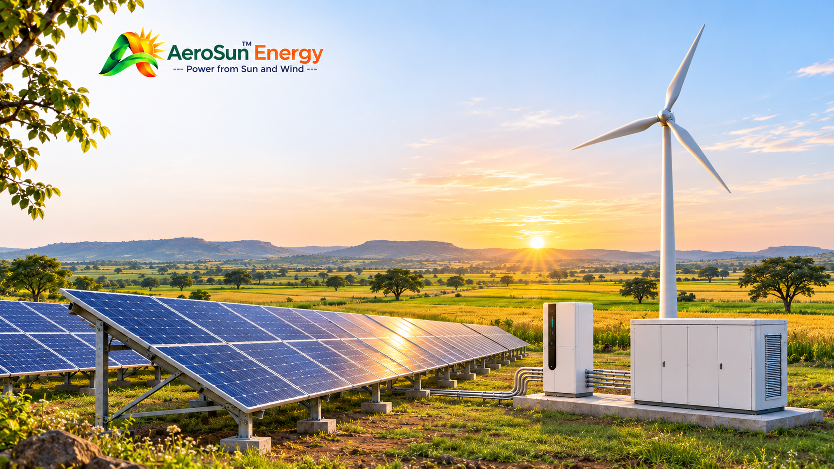
AEROSUN ENERGY
PRIVATE LIMITED
CONTACT
Power from Sun, Wind, Water, Fire..
REGISTERED OFFICE
D. No. 11-184, Gollavanigunta, T.N. Pallem, Tirupati,
Andhra Pradesh – 517501, India
CIN: U35106AP2026PTC128748 WEBSITE: https://aerosunenergy.in/
EMAIL: customercare@aerosunenergy.in PHONE: +91 8099181075
Let’s build a cleaner and more sustainable energy future together.

