Slide 1
From Java 8 to Java 21
Life is getting easier and easier

Slide 2
Forewords about Java 8
The legendary JDK version that forever changed Java

Slide 3
Forewords about Java 8
Released in 2014, Java 8 is still a groundbreaking, legendary release that till now, none other versions can hope to create again.
New lambda expression, paving the way for functional programming.
Still backed by functional interfaces, as Java is a static typing language
Modern java.time API
Java Stream API – write less, express more
Optional, Java’s attempt at null-safety
And so many more…
Read here: https://vulinhjava.io.vn/blog/java-road-to-21#a-tribute-to-the-legendary-jdk-8

Slide 4
Example of Underrated Optional
if (lifeCycleChange.getVehicle() != null && lifeCycleChange.getVehicle()
.getVehicleInfo() != null && lifeCycleChange.getVehicle()
.getVehicleInfo() .getEcuGeneration() != null) { attribute.put("ecuGeneration", lifeCycleChange.getVehicle()
.getVehicleInfo()
.getEcuGeneration()); }
Optional.ofNullable(lifeCycleChange.getVehicle()) .map(s -> s.getVehicleInfo()) .map(s -> s.getEcuGeneration()) .ifPresent(s -> attribute.put("ecuGeneration", s));

Slide 5
The End of a Legend
Spring Boot 2.7.x is the final version to support JDK 8
No more CVE fixing and patching, new Spring Boot project will start from Spring Boot 3;
Unless you pay Spring Boot team money to extend the support
And migration projects are well under way from SB2 to SB3.
Project that requires JDK below 17 may be considered a red flag.
Spring Boot 3 mandates JDK 17 as the minimum baseline
There is no simple "backporting" of a new Spring Boot application to an old JDK.
Therefore, you may as well make use of JDK 17+’s new features to make your life less tedious.
Some projects started using JDK 21’s Virtual Threads so it is good to know about new features in JDK 21.

Slide 6
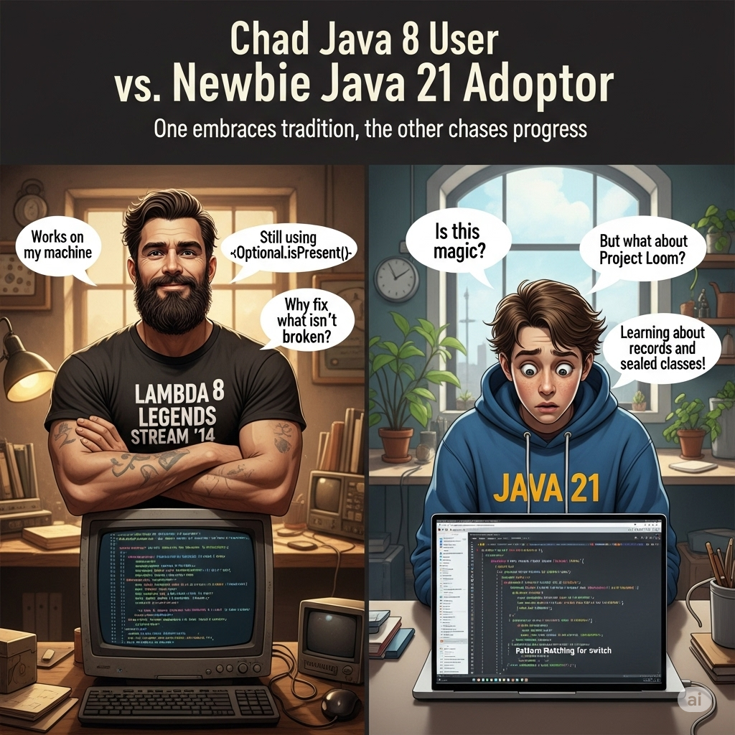

Slide 7
JDK 9 (September 2017)
The underrated underdog that was nevertheless revolutionary

Slide 8
JDK 9 (September 2017)
Collection factory method:
List.of, Set.of, Map.of, Map.ofEntry + Map.entry
Create shallowly immutable collection (no add, no remove and no modify)
Private methods inside interface
Support methods reserved only for the interface

Slide 9
JDK 10 (March 2018)
The advent of automatic data type inference

Slide 10
JDK 10 (March 2018)
var keyword allows for more concise coding
Work only for local variables
// automatically infer data type
var map1 = map(List.of(lifeCycleChange));
// explicitly specify data type
Map<String, List<LifeCycleChange>> map2 = map(List.of(lifeCycleChange));

Slide 11
var keyword
Is a contextual keyword (only applicable where it is intended, can still be used as idenfifier)
Consult your team’s coding convention before using var keyword.
It makes the code more concise, addressing Java’s notorious verbosity problem
It also makes code reviewing without IDE a bit more challenging
(Most of the time, there is no point in knowing the data type, especially when working with custom data types)

Slide 12
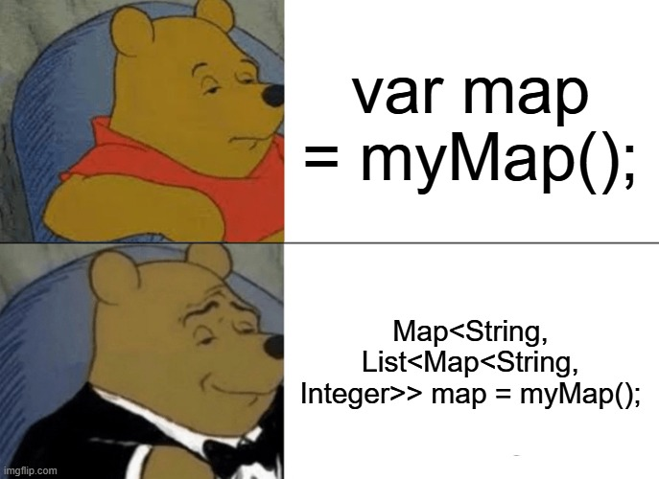

Slide 13
JDK 14 (March 2020)
Finally saying bye to a legacy feature from C/C++

Slide 14
JDK 14 (March 2020)
The new enhanced switch expression make writing switch-case less tedious
Can be used as an expression, as well as a statement like the old style
Introduce the yield keyword to escape the switch block instead of the method (return)

Slide 15
Enhanced switch expression
Old way
switch (month) { case 2: result = isLeapYear(year) ? 29 : 28; break; case 4: case 6: case 9: case 11: result = 30; break; default: result = 31; break; }
New way
return switch (month) { case 2 -> isLeapYear(year) ? 29 : 28; case 4, 6, 9, 11 -> 30; default -> 31; }
private static boolean isLeapYear(int year) { return year % 400 == 0
|| (year & 3) == 0
&& year % 100 != 0; }

Slide 16
JDK 15 (September 2020)
Outrageously beautiful hardcoded String

Slide 17
JDK 15 (September 2020)
Introduce the concept of text block
You can now write neat and outrageously beautiful text block

Slide 18
Text Block
var blyatifulJson = """ { "status": "ok", "message": "object created", "additional": { "id": "33663e80-3262-4197-aeb4-381a5447bd84", } } """;
var uglyJson = "{\n" + " \"status\": \"ok\",\n" + " \"message\": \"object created\",\n" + " \"additional\": {\n" + " \"id\": \"33663e80-3262-4197-aeb4-381a5447bd84\",\n" + " }\n" + "}\n";

Slide 19
Text Block
var notCool = "{\n" + " \"payload\": \"\\\"id\\\": \\\"123456\\\"\"\n" + "}"; var evenMoreBlyatfulText = """ { "payload": "\\"id\\": \\"123456\\"" }\ """;

Slide 20
JDK 16 (March 2021)
It is a new age, programmer!

Slide 21
JDK 16 (March 2021)
JDK 16 brings about pattern matching for instanceof check
Remove the need for manual casting when using instanceof
Java Records
Simple immutable data carrier

Slide 22
Pattern Matching for instanceof
Old way
private static String printInfoOld(Vehicle vehicle) { var name = vehicle.name; if (vehicle instanceof Vehicle.Tank) { return "This tank (%s) hurts, with the caliber of %s mm" .formatted(name, ((Vehicle.Tank) vehicle).gunCaliber); } if (vehicle instanceof Vehicle.Ship) { return "This beauty, called %s can displace about %s tons of water" .formatted(name, ((Vehicle.Ship) vehicle).waterDisplacement); } if (vehicle instanceof Vehicle.Airplane) { return
"""
We need to reach at least %s kmh to be able\
to take off this plane named %s
""".formatted(((Vehicle.Airplane) vehicle).takeOffSpeed, name); } throw new UnsupportedOperationException( "Unexpected vehicle type: " + vehicle); }
New way
private static String printInfo(Vehicle vehicle) { var name = vehicle.name; if (vehicle instanceof Vehicle.Tank tank) { return "This tank (%s) hurts, with the caliber of %s mm“ .formatted(name, tank.gunCaliber); } if (vehicle instanceof Vehicle.Ship ship) { return "This beauty, called %s can displace about %s tons of water" .formatted(name, ship.waterDisplacement); } if (vehicle instanceof Vehicle.Airplane airplane) { return
"""
We need to reach at least %s kmh to be able\
to take off this plane named %s
""".formatted(airplane.takeOffSpeed, name); } throw new UnsupportedOperationException( "Unexpected vehicle type: " + vehicle); }

Slide 23
Java Records
Simple immutable data carrier
Java’s “named” tuple
Aside from JPA entities, and some other cases that need data mutation (rare), Java Records should be your default choice for DTO (Data Transfer Object).
Immutable objects like Java Records benefit a lot from thread safety and JVM optimization (for example, scalarization…)
Thread safety: https://vulinhjava.io.vn/blog/java-thread-safety#the-unbreakable-immutability-once-born-forever-fixed

Slide 24
Java Records
Old way (with Lombok’s support)
@Value @Builder @With public class Point { double x; double y; }
New way
@With @Builder public record Point(double x, double y) {}

Slide 25
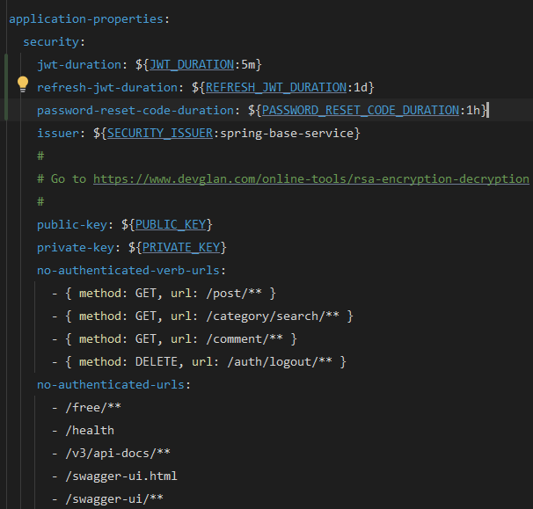
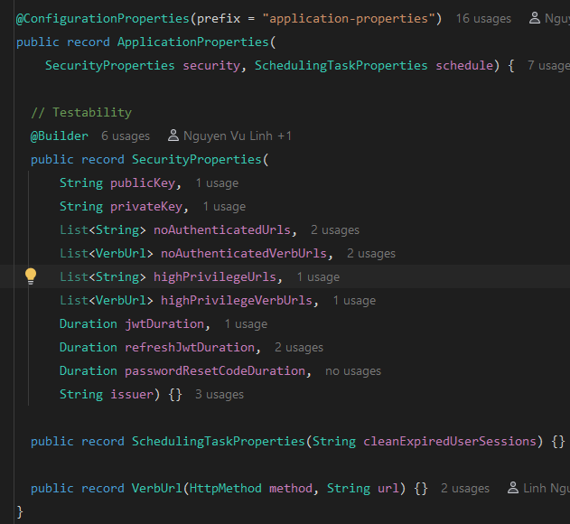

Java Records
Your new way to make use of Spring Boot’s configuration properties:
Example of YAML file

Slide 26
JDK 21 (September 2023)
Fancy using Virtual Threads? There are more than meet the eyes

Slide 27
JDK 21 (September 2023)
Pattern matching for switch expression
Record deconstruction for switch expression and instanceof check
Virtual Threads
Didn’t necessarily completely replace reactive programming paradigm;
But it promises less steeper learning curve and blocking-worry-free imperative paradigm
Most popular frameworks now support Virtual Threads.

Slide 28
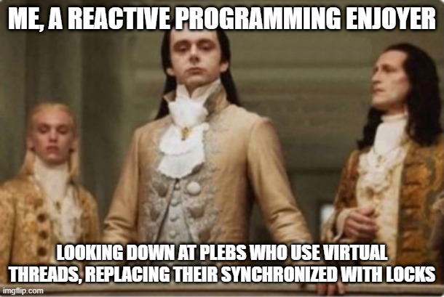

Slide 29
Pattern Matching for Switch Expression
private static String printInfo(Vehicle vehicle) { var name = vehicle.name; if (vehicle instanceof Vehicle.Tank tank) { return "This tank (%s) hurts, with the caliber of %s mm" .formatted(name, tank.gunCaliber); } if (vehicle instanceof Vehicle.Ship ship) { return "This beauty, called %s can displace about %s tons of water" .formatted(name, ship.waterDisplacement); } if (vehicle instanceof Vehicle.Airplane airplane) { return """ We need to reach at least %s kmh to be\ able to take off this plane named %s """ .formatted(airplane.takeOffSpeed, name); } throw new UnsupportedOperationException( "Unexpected vehicle type: " + vehicle); }
private static String printInfo(Vehicle vehicle) { var name = vehicle.name; return switch (vehicle) { case Vehicle.Tank tank -> "This tank (%s) hurts, with the caliber of %s mm“ .formatted(name, tank.gunCaliber); case Vehicle.Ship ship -> "This beauty, called %s can displace about %s tons of water" .formatted(name, ship.waterDisplacement); case Vehicle.Airplane airplane -> """ We need to reach at least %s kmh to \ be able to take off this plane named %s\ """ .formatted(airplane.takeOffSpeed, name);
default -> throw new UnsupportedOperationException( "Unexpected vehicle type: " + vehicle); }; }

Slide 30
Record Deconstruction
private static double calculateArea(Shape shape) { if (shape instanceof Circle(var r)) { return Math.PI * r * r; } if (shape instanceof Rectangle(var w, var h)) { return w * h; } // Heron's formula for calculating the area of a triangle if (shape instanceof Triangle(var a, var b, var c)) { var halfPerimeter = (a + b + c) / 2; return Math.sqrt( halfPerimeter * (halfPerimeter - a) * (halfPerimeter - b) * (halfPerimeter - c)); } // A method must return or throw something throw new IllegalArgumentException( "Unknown shape: " + shape.getClass().getName()); }
private static double calculatePerimeter(Shape shape) { return switch (shape) { case Circle(var r) -> Math.PI * 2 * r; case Rectangle(var w, var h) -> 2 * (w + h); case Triangle(var a, var b, var c) -> a + b + c; }; }

Slide 31
The Shift Towards Data-Oriented Programming in Java
Data is the heart of all systems. Your code can compile, but nothing will work without the data it needs to process.

Slide 32
The Shift Towards Data-Oriented Programming in Java
Java is evolving to be more focused on data, rather than just behavior.
This paradigm emphasizes simple, transparent data structures over complex, stateful objects.
The goal is to reduce boilerplate and create more readable, predictable code.
The focus is on "what the data is" rather than "what the object can do".

Slide 33
The Shift Towards Data-Oriented Programming in Java
Modern language features directly support this data-oriented approach.
Records: A concise syntax for creating immutable data carrier classes, automatically providing a constructor, getters, equals(), hashCode(), and toString().
Pattern Matching for instanceof: Simplifies type checking and casting by combining the check and variable assignment into a single, cleaner expression.
Pattern Matching for switch: Allows switch statements to work on types, not just primitive values or enums, enabling more expressive and type-safe conditional logic.
Sealed Classes: Explicitly declare which classes can extend a parent class or interface, providing a powerful way to work with a known hierarchy of types in conjunction with pattern matching.

Slide 34
Q & A
New shiny things get confused and refused to elaborate

Slide 35
Thank You!
Now go forth and migrate your projects to Java 17+ responsibly!

