Slide 1
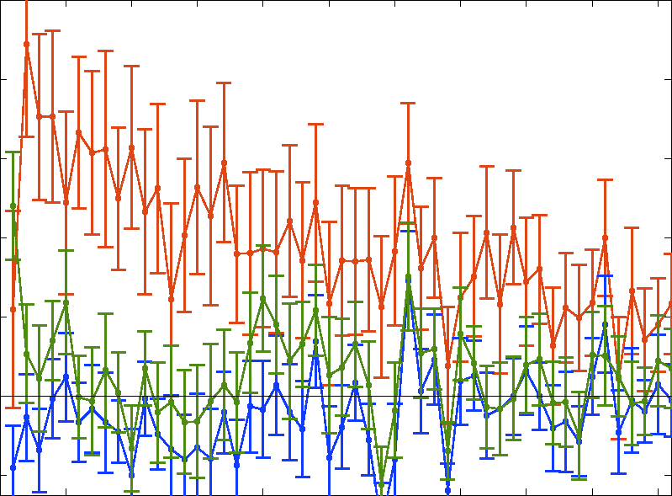
0.10
0.08
0.06
0.04
0.02
0.0
-0.02
Error ACF
Response ACF
Stimulus ACF
Correlation
0 5 10 15 20 25 30 35 40 45 50
Autocorrelation Lag

Slide 2
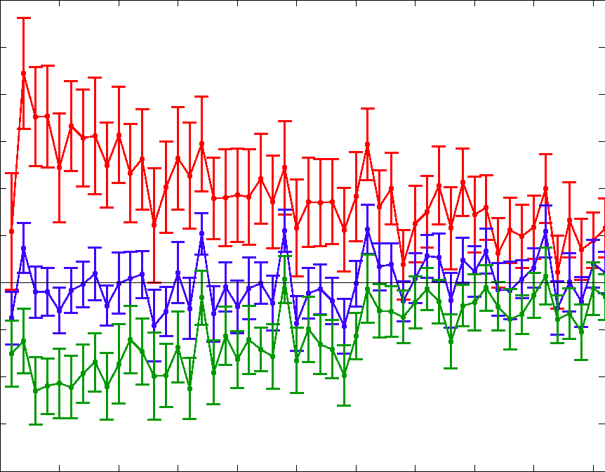
0.12
0.10
0.08
0.06
0.04
0.02
0.00
-0.02
-0.04
-0.06
-0.08
Error-Error ACF
Error-Response XCF
Error-Stimulus XCF
Correlation
0 5 10 15 20 25 30 35 40 45 50
Autocorrelation Lag

Slide 3
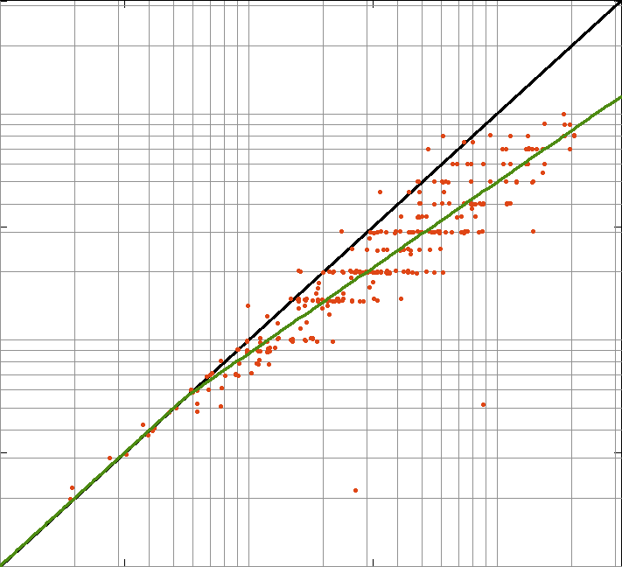
200
100
10
1
Number reported
1 10 100 200
Number presented

