Slide 2
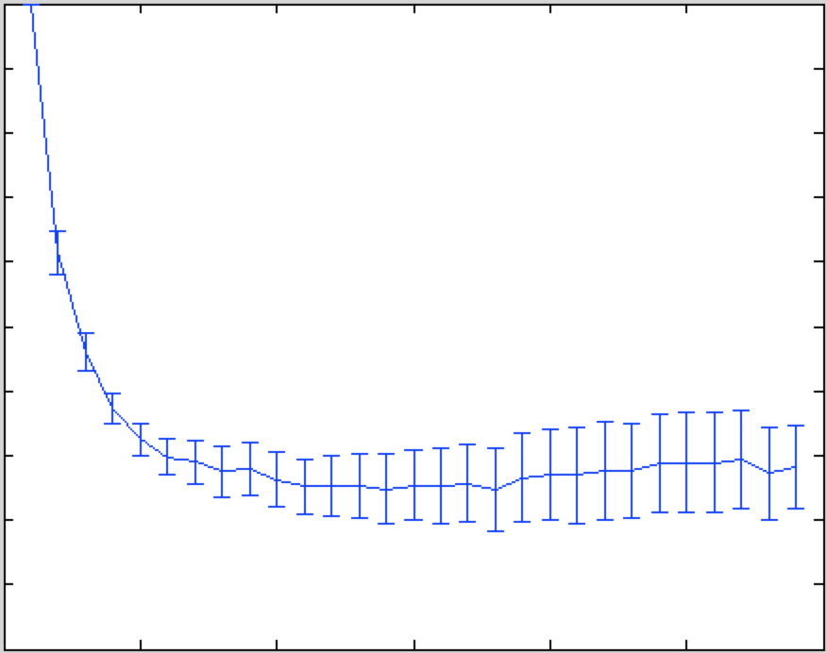
numexpt

Slide 3
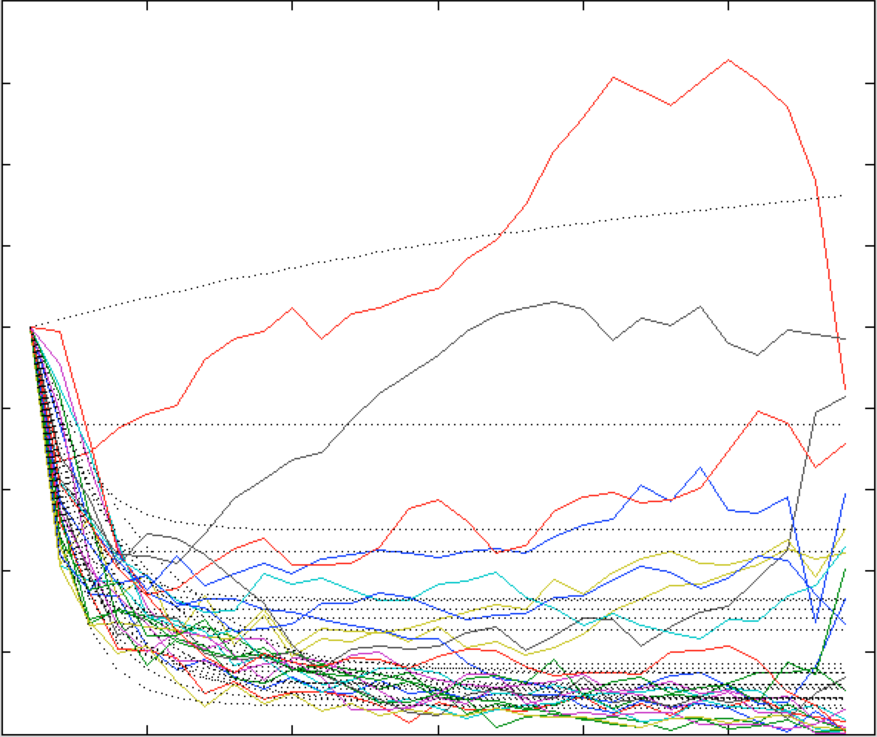
95% confidence interval on time constant (x10): 0.7879 2.4468
95% confidence interval on floor: 0.6085 0.8584
numexpt

