Slide 1
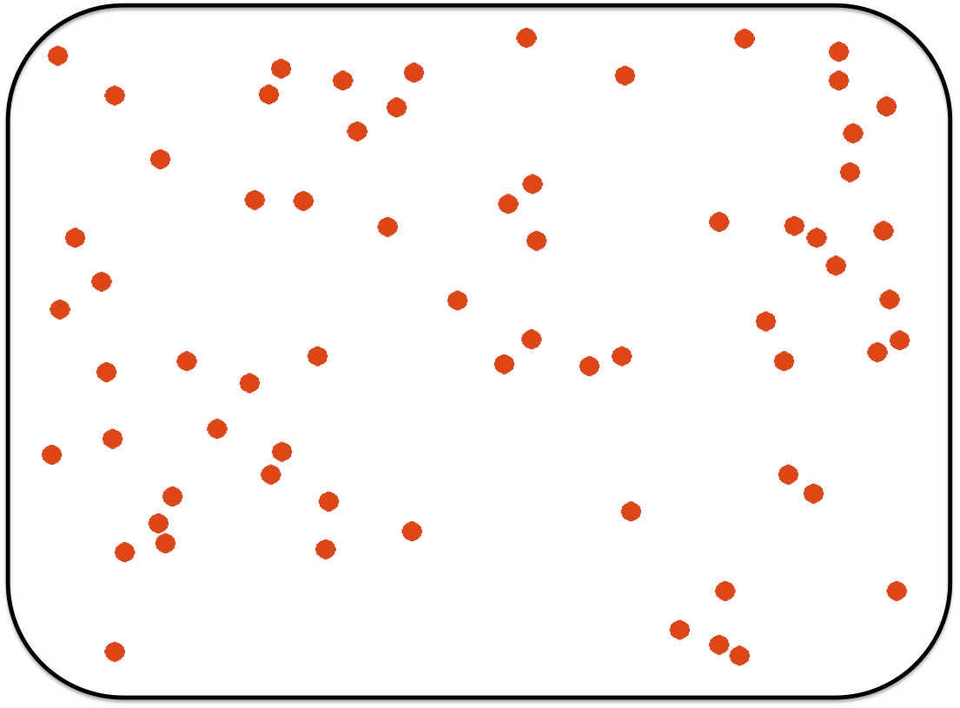
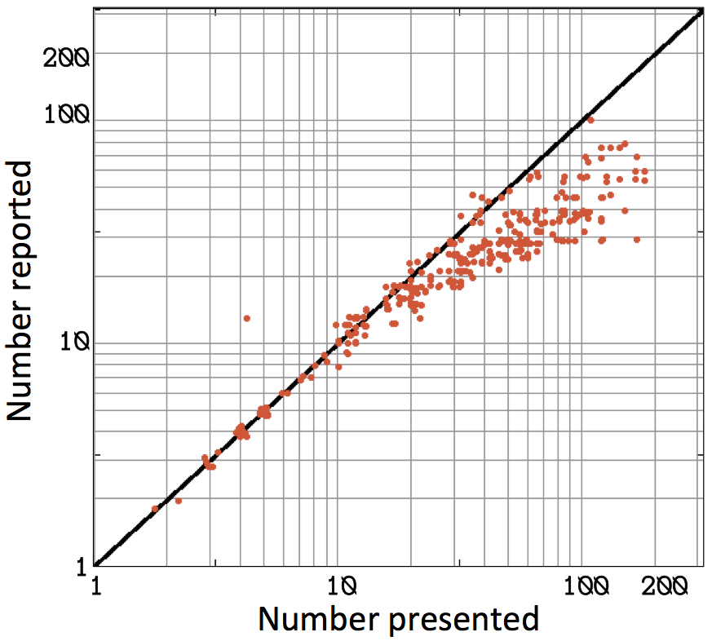

Slide 2

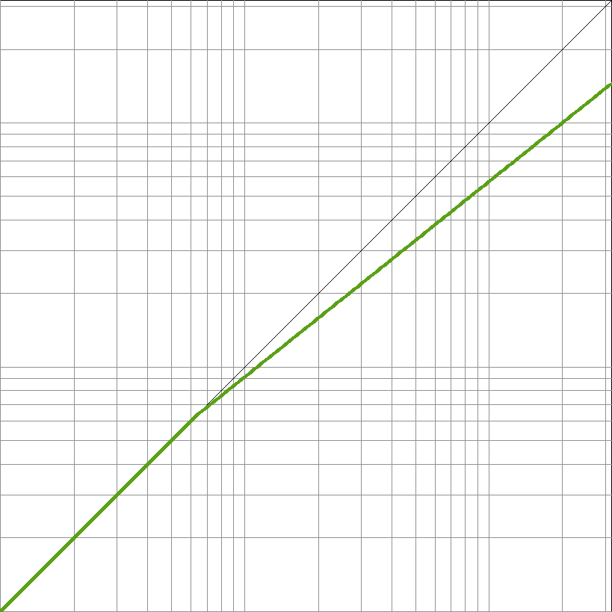

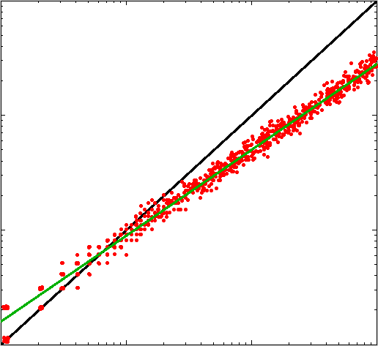
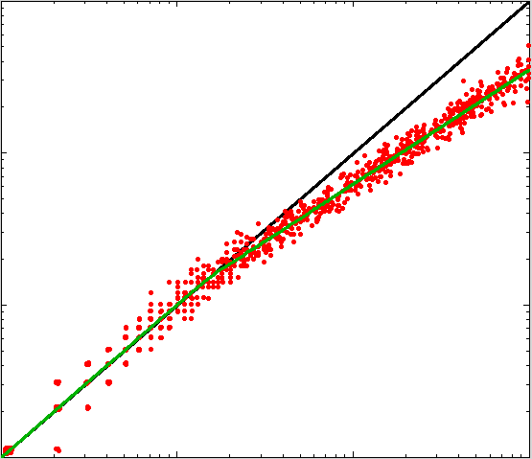
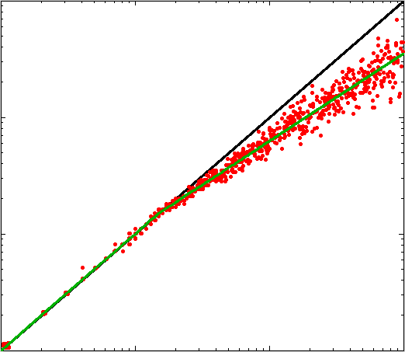
|50|
“33”
Numerosity representation
Verbal numbers
Physical stimulus
Numerosity representation
40
|50|
Representative subject data
Weber noise + constant
linear scaling
Weber noise +
constant bilinear
scaling
Weber noise + variable bilinear scaling

Slide 3
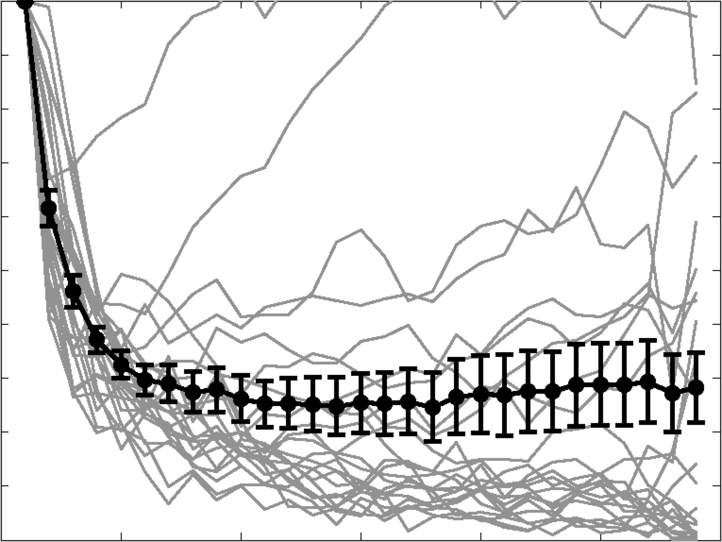
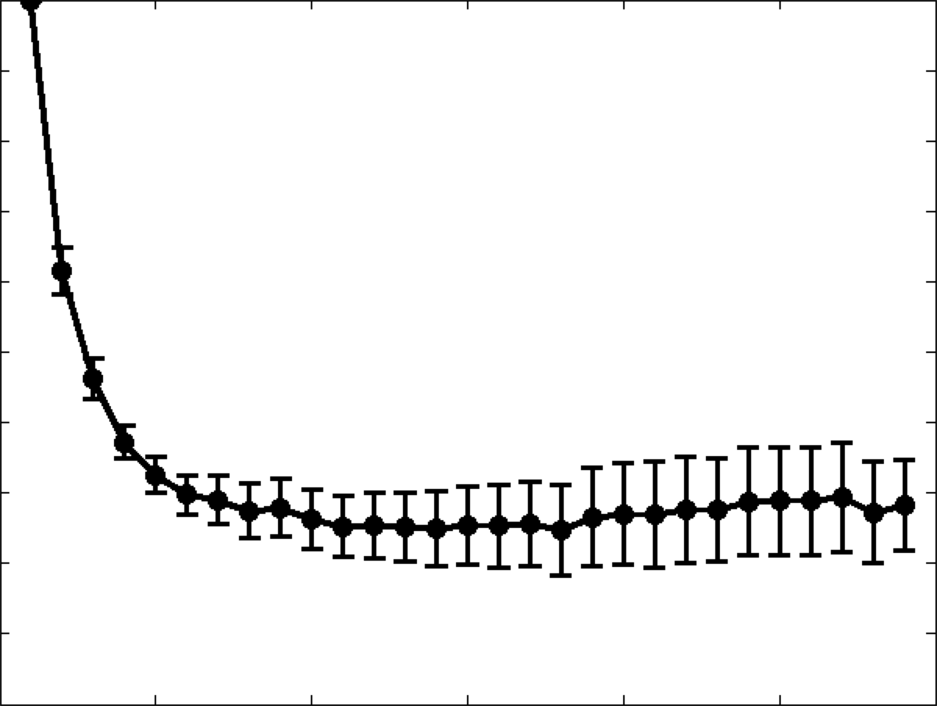
1.0
0.8
0.6
0.4
0.2
0.0
var_{k}/(k*var₁)
0 5 10 15 20 25 30
Separation (k) in 10-trial blocks

Slide 4
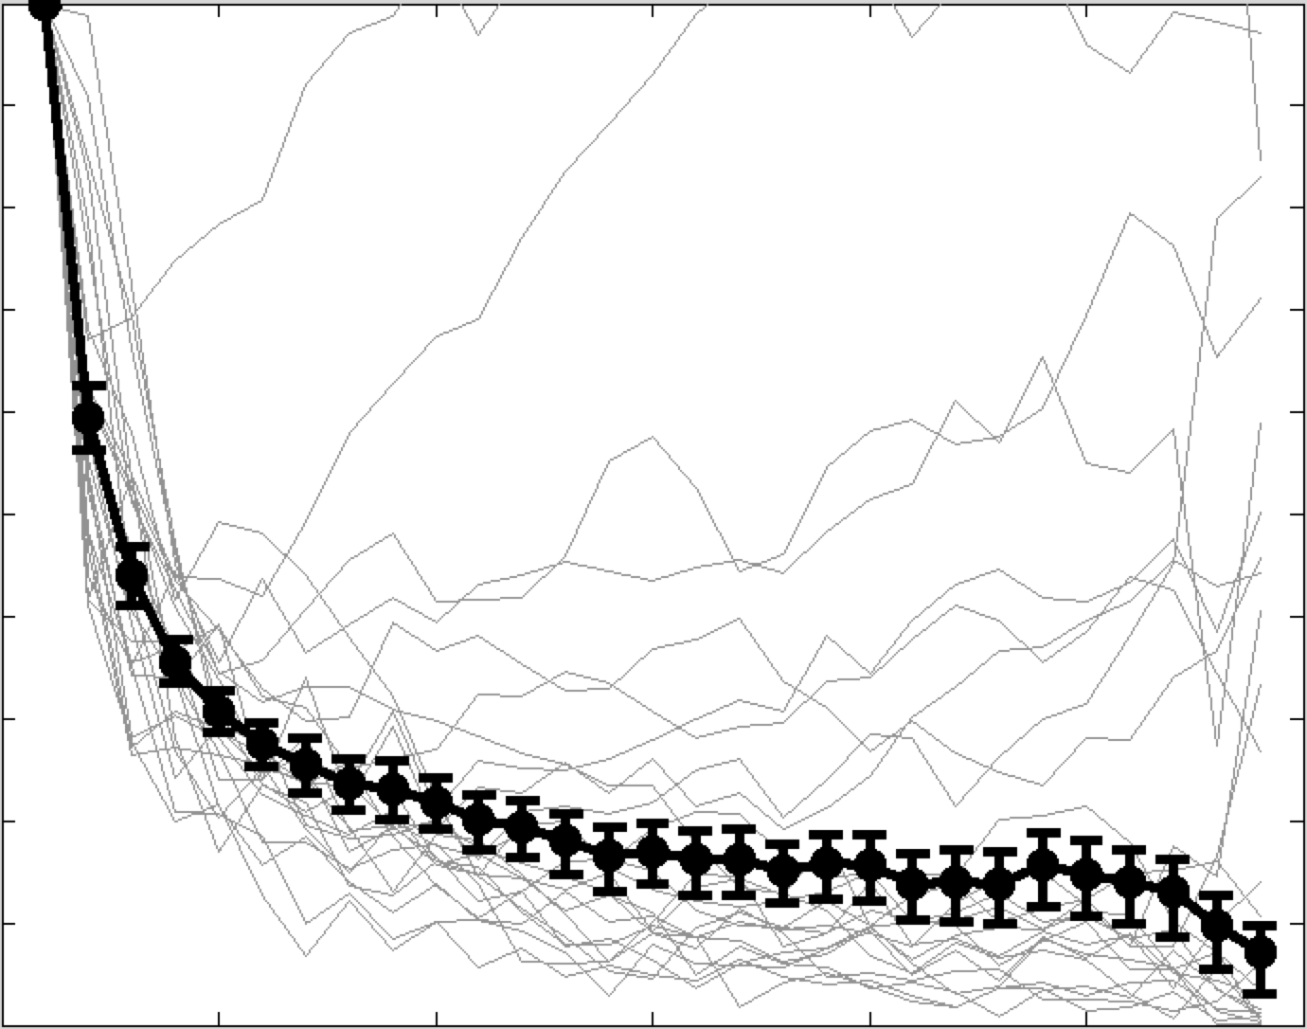
1.0
0.8
0.6
0.4
0.2
0.0
var_{k}/(k*var₁)
0 5 10 15 20 25 30
Separation (k) in 10-trial blocks

Slide 5
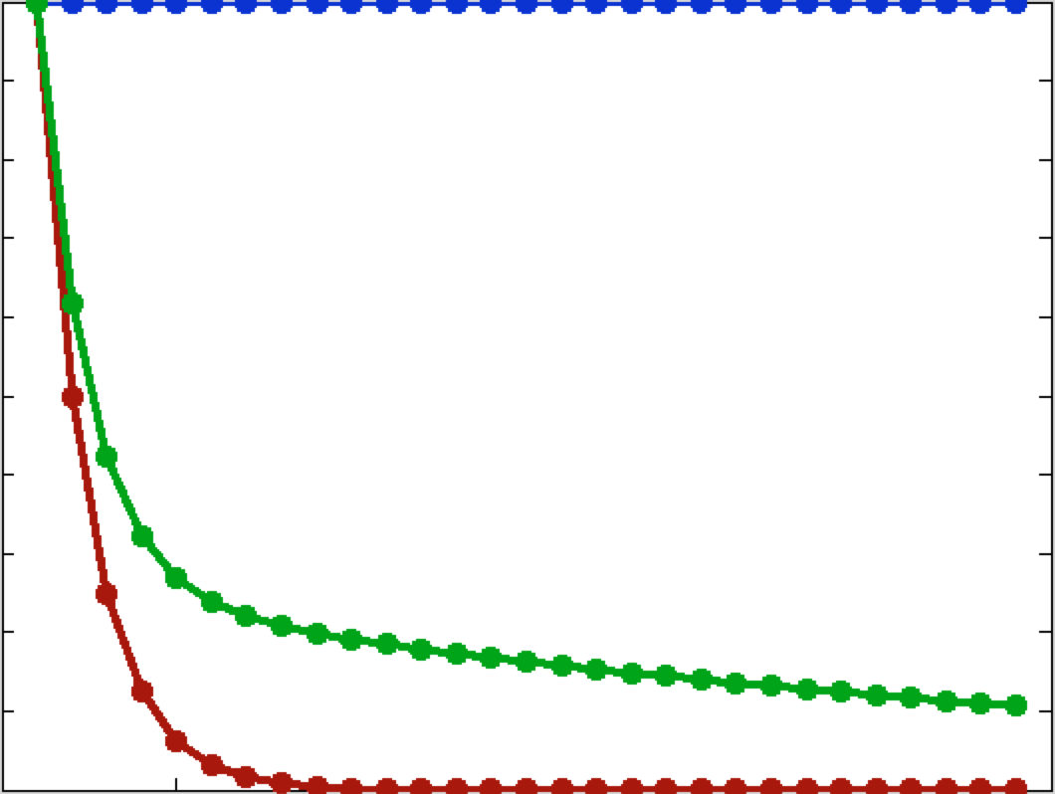
1.0
0.0
Autoregressive process
Two timescales
Random walk
var_{k}/(k*var₁)
0 30
Separation (k) in 10-trial blocks

Slide 6
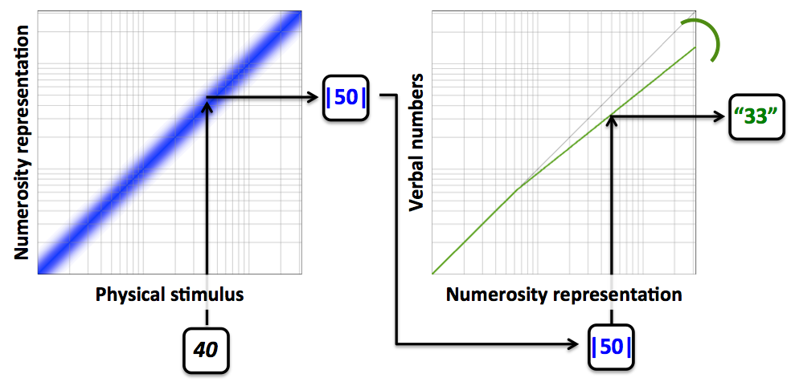
Representative subject data
Weber noise + constant
linear scaling
Weber noise +
constant bilinear
scaling
Weber noise + variable bilinear scaling

Slide 7
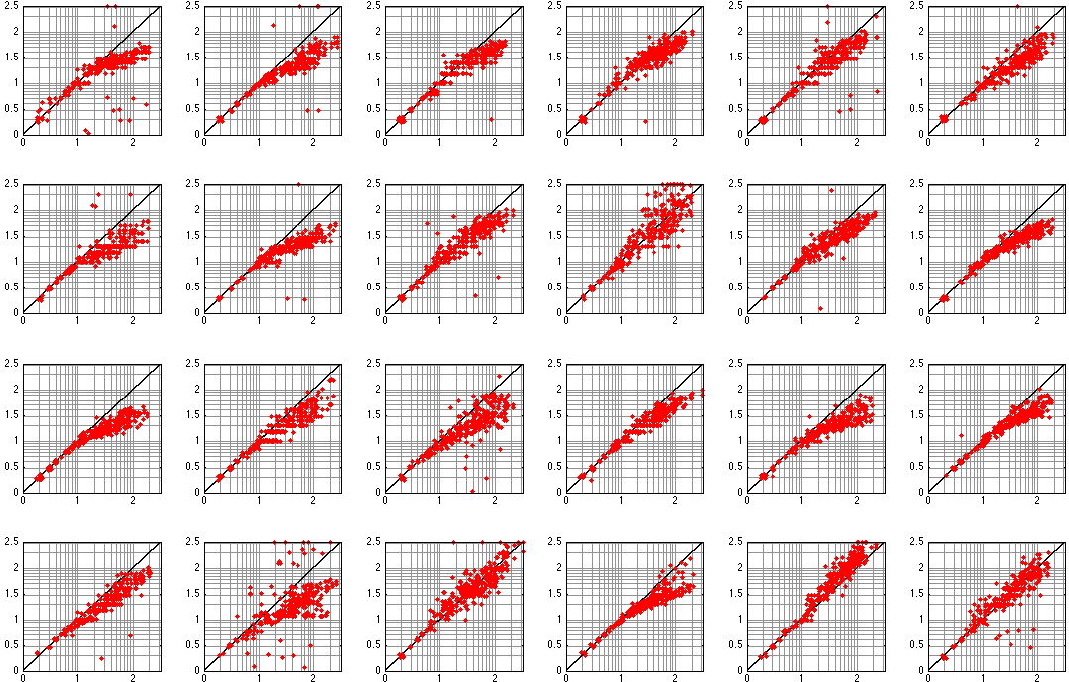
Subject 1
Subject 2
Subject 3
Subject 4
Subject 5
Subject 6
Subject 7
Subject 8
Subject 9
Subject 10
Subject 11
Subject 12
Subject 13
Subject 14
Subject 15
Subject 16
Subject 17
Subject 18
Log₁₀(Reported number)
Subject 19
Subject 20
Subject 21
Subject 22
Subject 23
Subject 24
Log₁₀(Presented number)

Slide 8
Subject 1
Subject 2
Subject 3
Subject 4
Subject 5
Subject 6
Subject 7
Subject 8
Subject 9
Subject 10
Subject 11
Subject 12
Subject 13
Subject 14
Subject 15
Subject 16
Subject 17
Subject 18
Subject 19
Subject 20
Subject 21
Log₁₀(Reported number)
Subject 23
Subject 22
Subject 24
Log₁₀(Presented number)

Slide 9
Subject 1
Subject 2
Subject 3
Subject 4
Subject 5
Subject 6
Subject 7
Subject 8
Subject 9
Subject 10
Subject 11
Subject 12
Subject 13
Subject 14
Subject 15
Subject 16
Subject 17
Subject 18
Subject 19
Subject 20
Subject 21
Subject 22
Subject 23
Subject 24
Log₁₀(Reported number)
Log₁₀(Presented number)

Slide 10
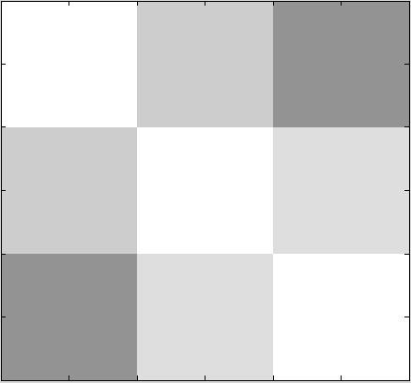
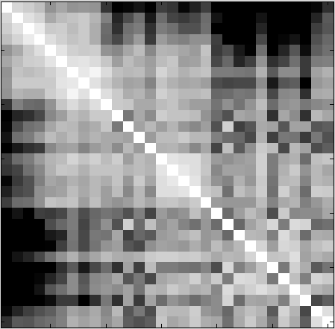
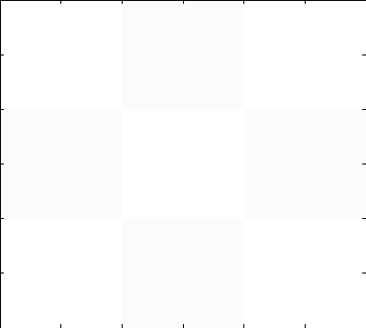
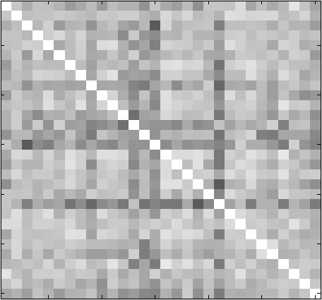
0.5
1.0
Split into 30ths (10 trials each)
1st
2nd
3rd
1st
Blocked
2nd
3rd
1st
2nd
3rd
1st
Modular
2nd
3rd

Slide 11
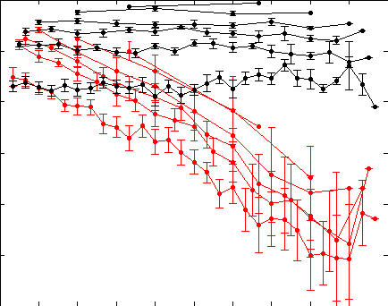
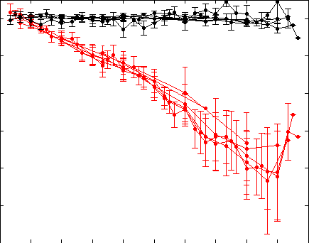
1.0
0.4
Reliability across subjects
(correlation of slopes)
Modular split
Blocked split
1.0
0.4
Normalized correlation
Modular split
Blocked split
0 300
Distance between nths (trials)

