Slide 1
Skill – Inference: Timing

Slide 2









Training
time
16 blocks of 20 trials each with 90% reliability
Subjects told background is irrelevant
RT

Slide 3
Inference test
What shape is likely to occur next?

Slide 4
Skill test
time
4 blocks of 20 trials each with 25% (chance) reliability
RT

Slide 5
Instructions
Before training:
  You will see one of four symbols on each trial, shown below. "
  We want you to respond by pressing one of the four keys on the bottom row of the keyboard. "
  Each key (Z, X, N, M) corresponds to one of the symbols, as shown below. "
  So if you see a smiley face, press the 'Z' key. And so on."
  Throughout the experiment, please keep your fingers on the keyboard. "
  Use your left middle and index fingers for the leftmost response keys (Z and X), "
  and your right index and middle fingers for the rightmost keys (N and M). "
  The symbols will be presented on an irrelevant background; you can ignore the background shape and color."
  We siply want you to respond extremely rapidly to the symbol. "
  Try to be accurate, but the machine will insist that you respond so quickly to the letter that you will make many errors. "
  "Every few minutes there will be a break in the experiment. During the break, the computer will tell you how you're doing."
Before Inference Test
  "You will now be presented with just the background colors you saw in the previous blocks.
  On each trial, please indicate which symbol you think is most likely to be presented with this color by pressing one of the four corresponding keys
  You may be presented with a given background color multiple times: you do not need to make consistent responses for a particular background color if you do not want to."
Before Skill test
  Great, you will now be presented with more trials where your objective is to identify the symbol as quickly as possible. "
  Again, you can ignore the background colors, simply try to press the key associated with the symbol as soon as it appears. "
  And again, please try to respond as quickly and accurately as possible. "

Slide 6
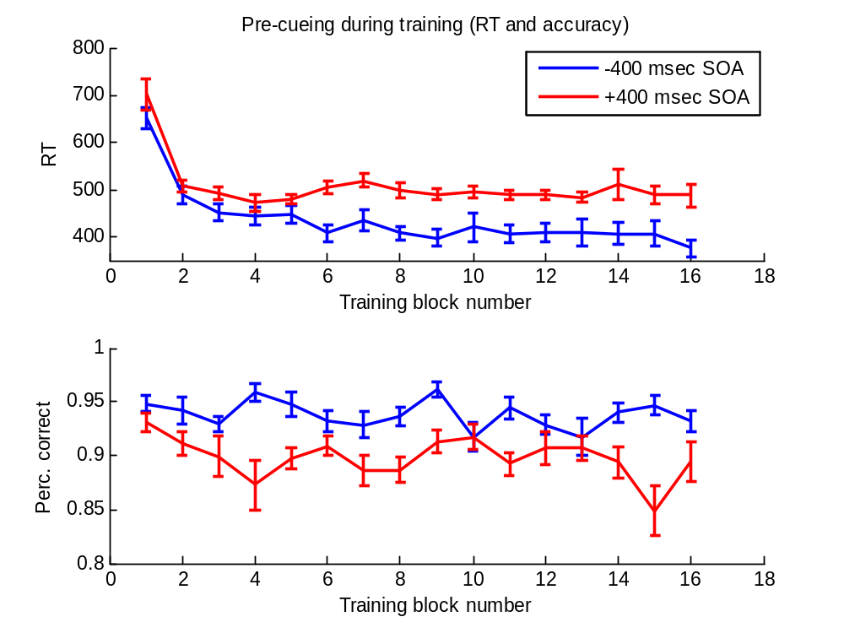
Training
Blocks 3, 6-16
are significantly
different in RT
Blocks 2-9, 11, 14-16
are significantly different
in %correct

Slide 7
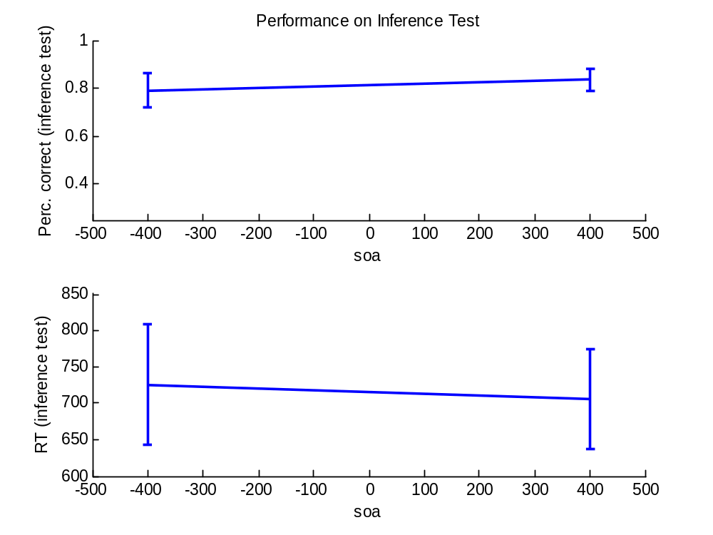
Inference test
Both significantly different from chance. Not different from each other (T < 1, p > .5)

Slide 8
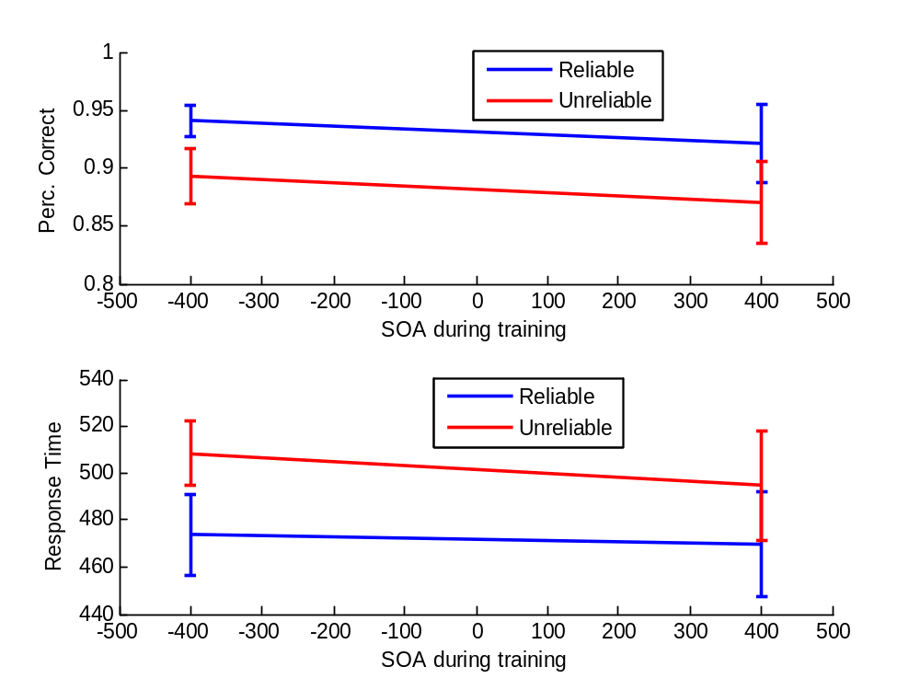
Skill test
ANOVA, significant main effect of reliability
No main effect of SOA
No interaction.

