Slide 1
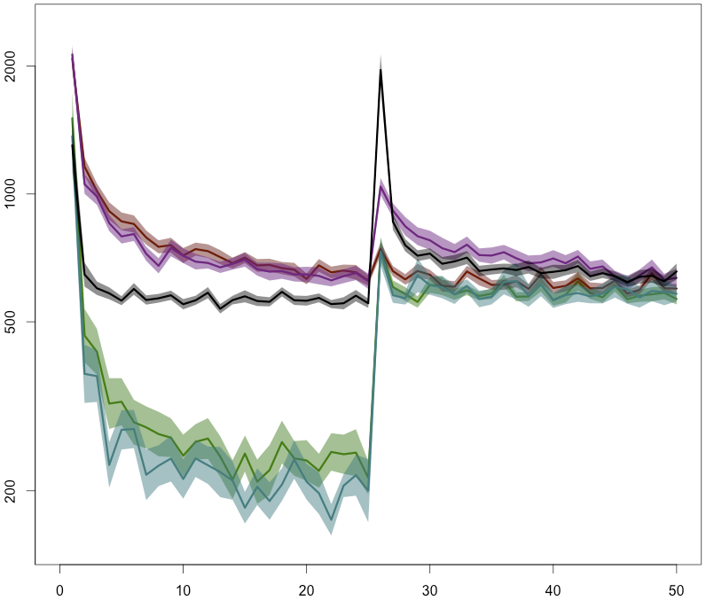
Training:
Easy +
Easy -
Hard +
Hard -
Motor only
Testing:
Constant for all
Mapping the same as training in positive conditions.
Correct response time (log10 scale mean +/- 1 sem)
Block number (10 trials/block)
Training: block 1-25
Testing: block 26-50

