Slide 1
WHO SPEAKS
FOR THE CROWD?
• Cross-Constituency Aggregation
• for Community Notes
01

Slide 2
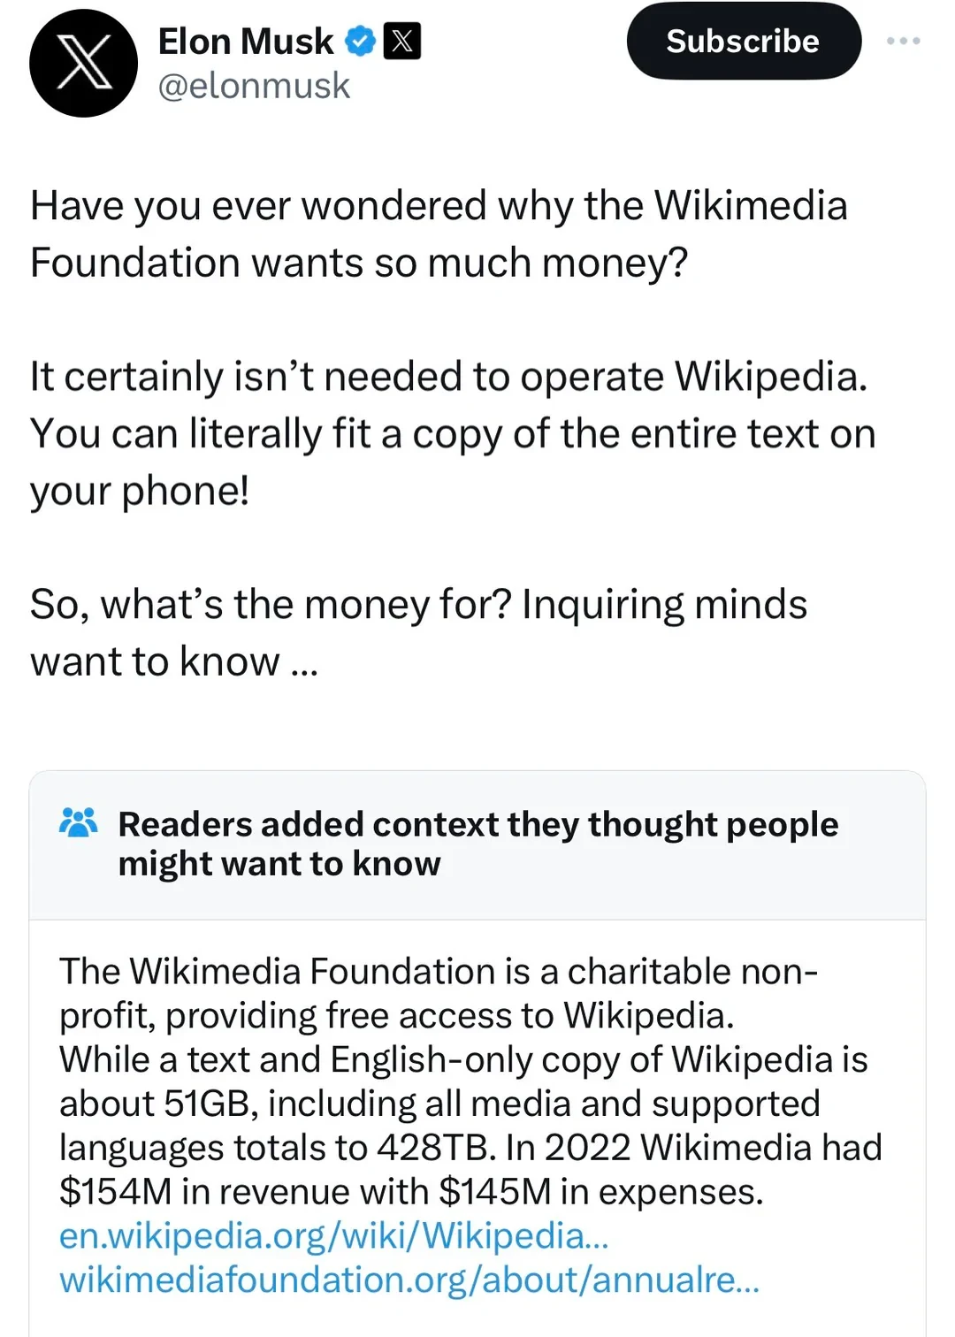
WHAT IS COMMUNITY NOTES?
02
One note. One decision.
→
• Sees the note
• Rates helpfulness
• Reads the context
• X Community Notes (2026)

Slide 3
WHAT IS COMMUNITY NOTES?
02
One note. One decision.
→
• Sees the note
• Rates helpfulness
• Reads the context
• X Community Notes (2026)

Slide 4
WHAT IS COMMUNITY NOTES?
02
One note. One decision.
→
• Sees the note
• Rates helpfulness
• Reads the context
• X Community Notes (2026)

Slide 5
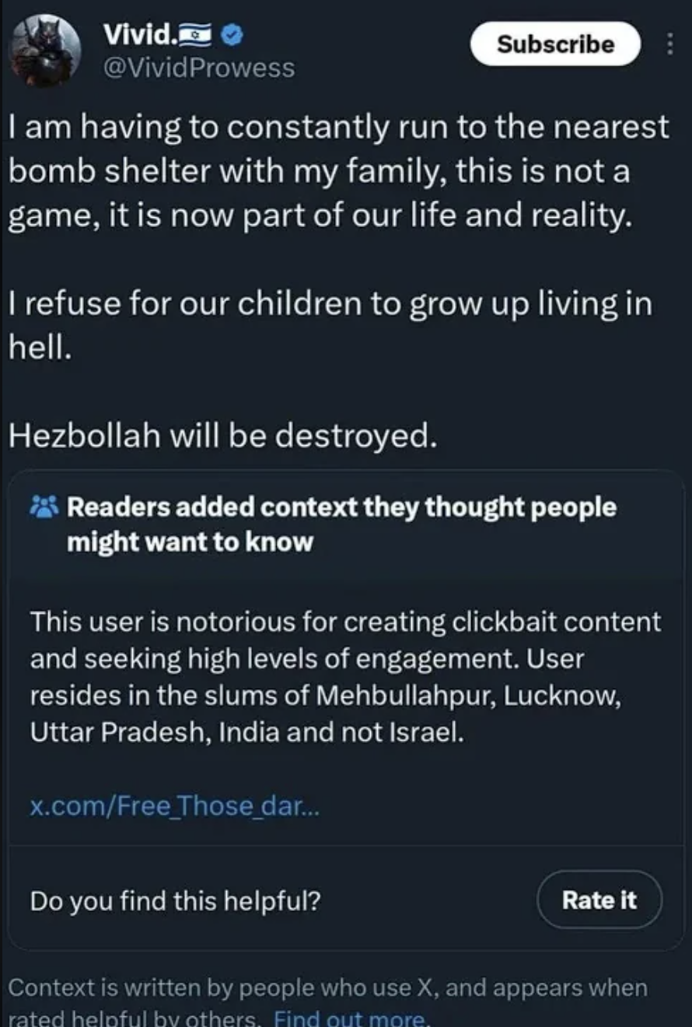
WHAT IS COMMUNITY NOTES?
02
One note. One decision.
→
• Sees the note
• Rates helpfulness
• X Community Notes (2026)

Slide 6
THE CROWD
03
Now multiply that by thousands
→
• Same action
• Thousands of raters
• One visibility decision
• X Community Notes (2026)

Slide 7
THE CROWD
03
Now multiply that by thousands
→
• Same action
• Thousands of raters
• One visibility decision
• X Community Notes (2026)

Slide 8
HOW SYSTEM WORKS 1 - 2
04
It reads the rater
AMIGO
ENEMIES SHAKE HANDS
HELPFUL
fᵤ · fₙ
iₙ —
fᵤ · fₙ ≈ 0
iₙ ↑
UNEXPECTED
• Cross-viewpoint surprise
• The model asks who voted
• Wojcik et al. (2022); Buterin (2023); X Community Notes (2026)

Slide 9
HOW SYSTEM WORKS 1 - 2
04
It reads the rater
AMIGO
ENEMIES SHAKE HANDS
HELPFUL
fᵤ · fₙ
iₙ —
fᵤ · fₙ ≈ 0
iₙ ↑
EXPECTED
UNEXPECTED
• Predictable partisan support
• Cross-viewpoint surprise
• The model asks who voted
• Wojcik et al. (2022); Buterin (2023); X Community Notes (2026)

Slide 10
HOW SYSTEM WORKS 1 - 2
04
It reads the rater
AMIGO
ENEMIES SHAKE HANDS
HELPFUL
fᵤ · fₙ
iₙ —
fᵤ · fₙ ≈ 0
iₙ ↑
EXPECTED
UNEXPECTED
• Predictable partisan support
• Cross-viewpoint surprise
• The same click receives different credit
• The model asks who voted
• Wojcik et al. (2022); Buterin (2023); X Community Notes (2026)

Slide 11
HOW SYSTEM WORKS 1 - 2
04
It reads the rater
AMIGO
ENEMIES SHAKE HANDS
HELPFUL
fᵤ · fₙ
iₙ —
fᵤ · fₙ ≈ 0
iₙ ↑
EXPECTED
UNEXPECTED
• Predictable partisan support
• Cross-viewpoint surprise
• The same click receives different credit
• The model asks who voted
• Wojcik et al. (2022); Buterin (2023); X Community Notes (2026)

Slide 12
HOW SYSTEM WORKS 1 - 2
04
It reads the rater
AMIGO
ENEMIES SHAKE HANDS
HELPFUL
fᵤ · fₙ
iₙ —
fᵤ · fₙ ≈ 0
iₙ ↑
EXPECTED
UNEXPECTED
• Predictable partisan support
• Cross-viewpoint surprise
• The same click receives different credit
• The model asks who voted
• Wojcik et al. (2022); Buterin (2023); X Community Notes (2026)

Slide 13
HOW SYSTEM WORKS 3
05
The same hands draw the map
CLASSROOM METAPHOR
• A few users supply most of the map
• The active core becomes ‘the community’
• Nudo et al. (2026); authors’ 200k analysis

Slide 14
HOW SYSTEM WORKS 3
05
The same hands draw the map
CLASSROOM METAPHOR
• A few users supply most of the map
• The active core becomes ‘the community’
• Nudo et al. (2026); authors’ 200k analysis

Slide 15
HOW SYSTEM WORKS 3
05
The same hands draw the map
CLASSROOM METAPHOR
• A few users supply most of the map
• The active core becomes ‘the community’
• Nudo et al. (2026); authors’ 200k analysis

Slide 16
HOW SYSTEM WORKS 3
05
The same hands draw the map
CLASSROOM METAPHOR
VIEWPOINT MAP
64
11×
• power raters
• more active
• A few users supply most of the map
• The active core becomes ‘the community’
• Nudo et al. (2026); authors’ 200k analysis

Slide 17
BRIDGING, REFRAMED
06
The handshake is right. The electorate is not.
GOOD INSTINCT
SELECTION BALANCE
THEN IT GETS MESSIER
BALANCED
PARTISAN
fᵤ · fₙ
changes the credit
πA = .50 πB = .50
• The same click is interpreted differently
2(.50)(.50) = 50%
50% → 18%
ENEMIES SHAKE HANDS
OBSERVED
ACTIVITY
πg
follows ratings—not people
• Cross-group agreement is valuable
πA = .90 πB = .10
2(.90)(.10) = 18%
• Active users represent each side
• Keep consent. Make representation explicit.
• Toy illustration—not the Community Notes scoring formula; Buterin (2023); Wojcik et al. (2022); Nudo et al. (2026)

Slide 18
BRIDGING, REFRAMED
06
The handshake is right. The electorate is not.
GOOD INSTINCT
SELECTION BALANCE
THEN IT GETS MESSIER
BALANCED
PARTISAN
fᵤ · fₙ
changes the credit
πA = .50 πB = .50
• The same click is interpreted differently
2(.50)(.50) = 50%
50% → 18%
ENEMIES SHAKE HANDS
OBSERVED
ACTIVITY
πg
follows ratings—not people
• Cross-group agreement is valuable
πA = .90 πB = .10
2(.90)(.10) = 18%
• Active users represent each side
• Keep consent. Make representation explicit.
• Toy illustration—not the Community Notes scoring formula; Buterin (2023); Wojcik et al. (2022); Nudo et al. (2026)

Slide 19
BRIDGING, REFRAMED
06
The handshake is right. The electorate is not.
GOOD INSTINCT
SELECTION BALANCE
THEN IT GETS MESSIER
BALANCED
PARTISAN
fᵤ · fₙ
changes the credit
πA = .50 πB = .50
• The same click is interpreted differently
2(.50)(.50) = 50%
50% → 18%
ENEMIES SHAKE HANDS
OBSERVED
ACTIVITY
πg
follows ratings—not people
• Cross-group agreement is valuable
πA = .90 πB = .10
2(.90)(.10) = 18%
• Active users represent each side
• Keep consent. Make representation explicit.
• Toy illustration—not the Community Notes scoring formula; Buterin (2023); Wojcik et al. (2022); Nudo et al. (2026)

Slide 20
BRIDGING, REFRAMED
06
The handshake is right. The electorate is not.
GOOD INSTINCT
SELECTION BALANCE
THEN IT GETS MESSIER
BALANCED
PARTISAN
fᵤ · fₙ
changes the credit
πA = .50 πB = .50
• The same click is interpreted differently
2(.50)(.50) = 50%
50% → 18%
ENEMIES SHAKE HANDS
OBSERVED
ACTIVITY
πg
follows ratings—not people
• Cross-group agreement is valuable
πA = .90 πB = .10
2(.90)(.10) = 18%
• Active users represent each side
• Keep consent. Make representation explicit.
• Toy illustration—not the Community Notes scoring formula; Buterin (2023); Wojcik et al. (2022); Nudo et al. (2026)

Slide 21
COLLECTIVE DECISIONS
07
This problem predates platforms
SWITZERLAND
BELGIUM
NL
+
FR
→
• Parallel majorities
PEOPLE
+
BOSNIA
B
+
C
+
S
→
VETO
• Vital-interest veto
CANTONS
N. IRELAND
U
+
N
→
• Parallel consent
• Double majority
• No group decides alone
• But online, who are the groups? →
• Linder & Mueller (2021); Lijphart (1977); Bieber (2006); McGarry & O’Leary (2009)

Slide 22
OUR SHIFT · RECOVERY
08
From ratings to constituencies
• Rate notes
• Find matching patterns
• Recover constituencies
✓
✓
×
✓
×
✓
✓
×
✓
×
✓
✓
×
×
×
→
→
×
×
✓
×
✓
×
×
✓
✓
✓
×
×
✓
✓
×
CONSTITUENCY A
CONSTITUENCY B
USERS
NOTES
• Similar co-rating patterns → same behavioral constituency
• Authors’ 100k-note / 200k-rater pipeline

Slide 23
OUR SHIFT · RECOVERY
08
From ratings to constituencies
• Rate notes
• Find matching patterns
• Recover constituencies
✓
✓
×
✓
×
✓
✓
×
✓
×
✓
✓
×
×
×
→
→
×
×
✓
×
✓
×
×
✓
✓
✓
×
×
✓
✓
×
CONSTITUENCY A
CONSTITUENCY B
USERS
NOTES
• Similar co-rating patterns → same behavioral constituency
• Authors’ 100k-note / 200k-rater pipeline

Slide 24
OUR SHIFT
09
Consult constituencies directly
• Recover groups
• Ask each group
• Aggregate explicitly
• Recover groups → consult each one → aggregate explicitly
• Authors’ cross-constituency aggregation

Slide 25
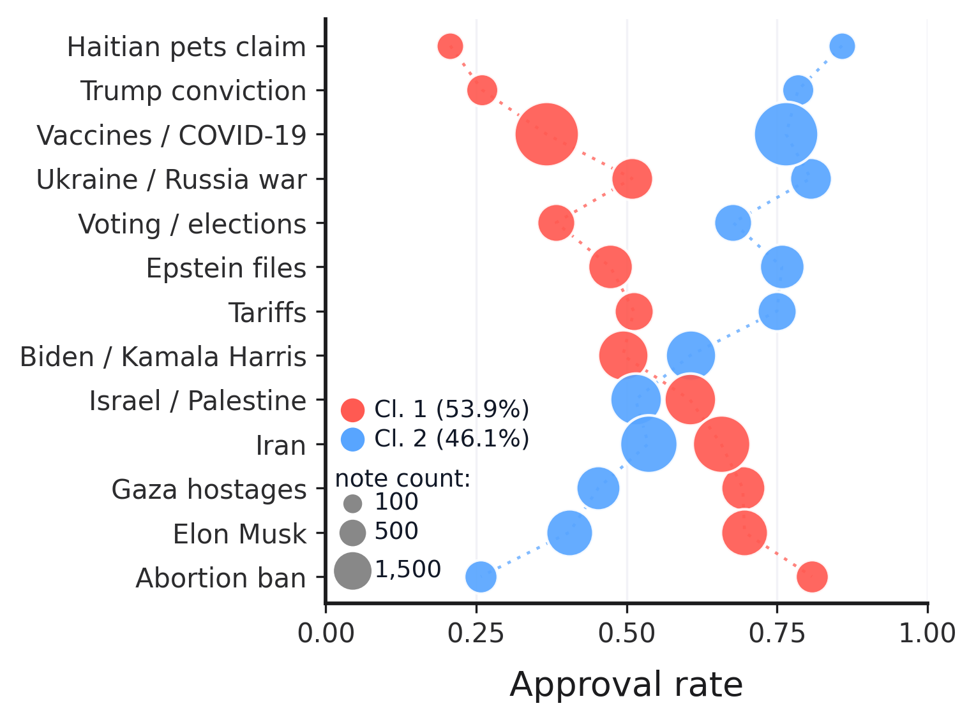
TOPIC MODELING
10
Disagreement changes by topic
HOW TO READ
• x-position = approval rate
• bubble size = note count
• color = recovered constituency
KEY RESULT
• Approval leadership flips across topics
• Constituencies are content-dependent
• The clusters are not simply ‘strict’ versus ‘lenient’
• Authors’ BERTopic analysis · Method-B clusters

Slide 26
PRINCIPLES
11
Four design principles
P1
Presence
• Every group enters
P2
Non-compensation
• Rejection still matters
P3
Symmetry
• No default winner
P4
Behavioral recovery
• No outside labels

Slide 27
IMPLEMENTATION
12
Principles become operations
CHECK 1 · PRESENCE
P1
≥3 ratings
• from every group
SAME NOTE
CONSTITUENCY A
90 ratings
CONSTITUENCY B
2 ratings
NO SCORE YET
• ≥3 from every group
• Toy illustration—not the Community Notes scoring formula; authors’ CCA design

Slide 28
IMPLEMENTATION
12
Principles become operations
CHECK 2 · NON-COMPENSATION
P1
≥3 ratings
• from every group
A · 81 / 90 = 90%
B · 1 / 10 = 10%
POOLED VOTES
P2
Geometric mean
• a soft veto
(81 + 1) / (90 + 10) = 82%
PASS
CCA
√(.90 × .10) = 30%
DOES NOT PASS
• Enthusiasm cannot erase rejection
• Toy illustration—not the Community Notes scoring formula; authors’ CCA design

Slide 29
IMPLEMENTATION
12
Principles become operations
CHECK 3 · SYMMETRY
P1
≥3 ratings
• from every group
90 RATERS
10 RATERS
P2
Geometric mean
• a soft veto
90 raters ≠ 9× weight
P3
Same rule
• no size weighting
√(sA × sB) = √(sB × sA)
√(.90 × .10) = √(.10 × .90) = 30%
• Group size does not change the rule
• Toy illustration—not the Community Notes scoring formula; authors’ CCA design

Slide 30
IMPLEMENTATION
12
Principles become operations
CHECK 4 · BEHAVIORAL RECOVERY
P1
≥3 ratings
• from every group
→
→
P2
Geometric mean
• a soft veto
200k RATERS
CO-RATING
A / B
P3
Same rule
• no size weighting
METHOD B
• No party · country · ideology labels
P4
200k raters
• Method-B recovery
• Authors’ 200k Representative pipeline

Slide 31
RESULTS · REPRESENTATIVE
13
What the platform shows—and hides
6,832
44,722
• shown · 15%
→
• Representative picks
37,890
13,655
→
• not shown · 85%
• CCA rescue candidates
INSIDE THE HIDDEN POOL
• CCA searches inside the hidden Representative pool
• Authors’ 200k Representative pipeline

Slide 32
VALIDATION
WORK IN PROGRESS
13
Gabriel Validation
STAGE 1
STAGE 2
Nature + sourcing
Rescue worthiness
0–100
PASS
• sourced factual information
• source traceability
STOP
• unsourced context / claim
• claim–source connection
• opinion / speculation
• clarity and neutrality
• hostile / derogatory
• constructive presentation
• irrelevant / spam
VISIBLE EXTERNAL SOURCE POINTER REQUIRED
≥50
→ VALIDATED
• Missing sourcing is a validation failure—not proof that the claim is false
• Historical Gabriel method · model-based validation

Slide 33
RESULTS · VALIDATION
WORK IN PROGRESS
13
From candidates to validated rescues
13,655
8,051
3,896
→
→
• CCA candidates
• Stage 1 pass
• Stage 2 pass · ≥50
5,604 STAGE 1 STOP
4,155 STAGE 2 STOP
3,610 opinion / speculation
687 irrelevant / trivial / spam
4,155 rescue-worthiness < 50
616 hostile / troll / derogatory
474 unsourced context / claim
217 unresolved / strict ties
GPT-4o-mini baseline
→
MiMo v2.5 Pro rerun
• higher reasoning capacity
• accuracy expected to improve
FINAL COUNTS WILL CHANGE
• Historical Gabriel outputs · MiMo rerun underway

Slide 34
CHERRY-PICKED CASE · BIDEN CLEMENCY
13
The winner changes with the rule
SIMPLE MAJORITY PICK
NOTE 1971737848320758040
CCA / REPRESENTATIVE PICK
NOTE 1971775923088244749
77.6%
57.9%
GABRIEL 82/100
overall approval
overall approval
C0 93.8%
C1 4.0%
277 ratings
C0 27.7%
C1 98.5%
461 ratings
√(.938 × .040) = 19.4%
BRIDGE FAIL
√(.277 × .985) = 52.2%
BRIDGE PASS
NNN — While the individual pardons are 80 in total, this does not include Categorical pardons. Factoring in Categorical pardons issued by the Biden administration, the total number of pardons are the number reported in OP’s image.
The table mislabels clemency actions as “pardons.” Biden issued ~80 pardons and 4,165 commutations (total: 4,245), not 8,064 pardons. Bush: 189 pardons/11 commutations. Obama: 212/1,715. Trump: 143/94.
SOURCES Biden White House · DOJ
SOURCES DOJ · Pew Research
• Higher overall approval can hide near-zero support in one constituency
• Authors’ Representative selection · historical Gabriel output

Slide 35
VALIDATION · STAGE 2
13
What makes a note worth rescuing?
MODEL SEES
HOLISTIC JUDGMENT
0–100 SCORE
specific + traceable source pointer
90–100
outstanding
70–89
strong
clear claim ↔ source connection
→
→
40–69
mixed
self-contained explanation
50
≥50 VALIDATED
SOURCE POINTER
factual + neutral wording
10–39
weak
• note text
concise + constructive presentation
0–9
minimal
• visible source pointer
• No URL opening · No original post · Visible note quality only
• Gabriel Stage-2 prompt · historical threshold ≥50

