Slide 1
WHO SPEAKS
FOR THE CROWD?
Emrecan Ulu / Shi Jingyao
01

Slide 2
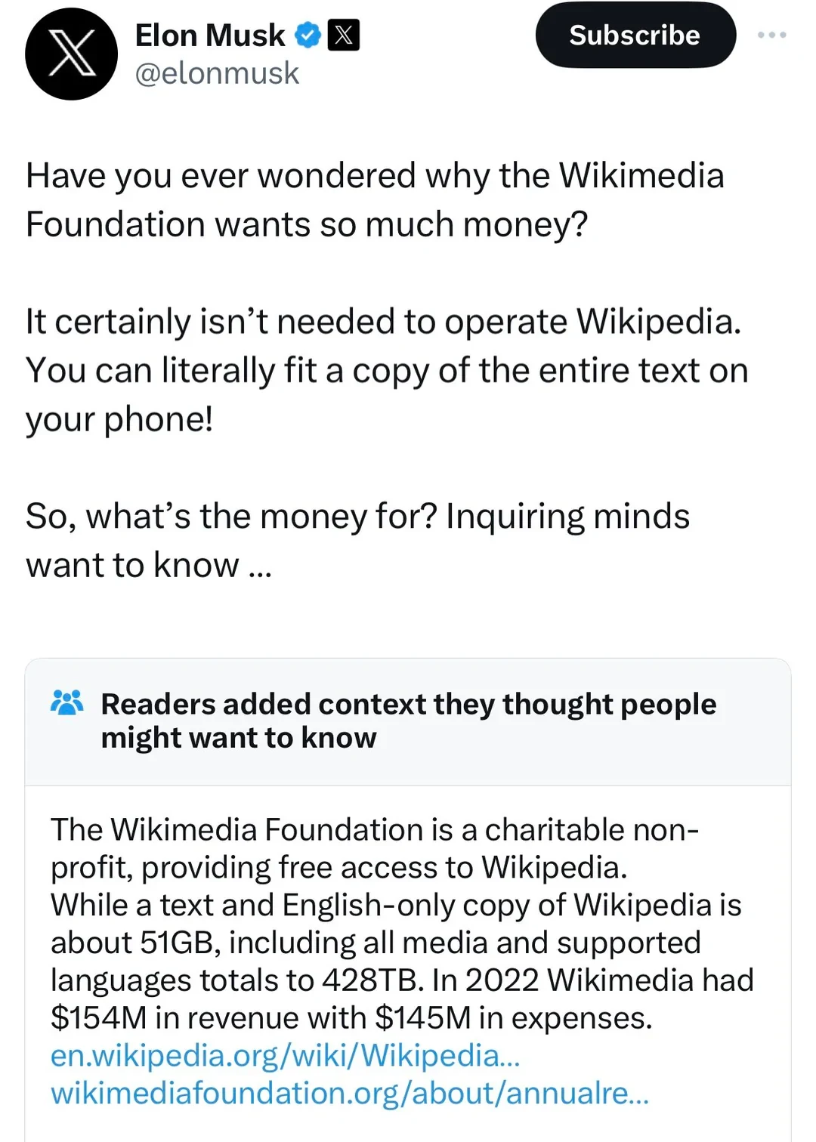
WHAT IS COMMUNITY NOTES?
02
One note. One decision.
→
• Sees the note
• Rates helpfulness
• Reads the context
• X Community Notes (2026)

Slide 3
WHAT IS COMMUNITY NOTES?
02
One note. One decision.
→
• Sees the note
• Rates helpfulness
• Reads the context
• X Community Notes (2026)

Slide 4
WHAT IS COMMUNITY NOTES?
02
One note. One decision.
→
• Sees the note
• Rates helpfulness
• Reads the context
• X Community Notes (2026)

Slide 5
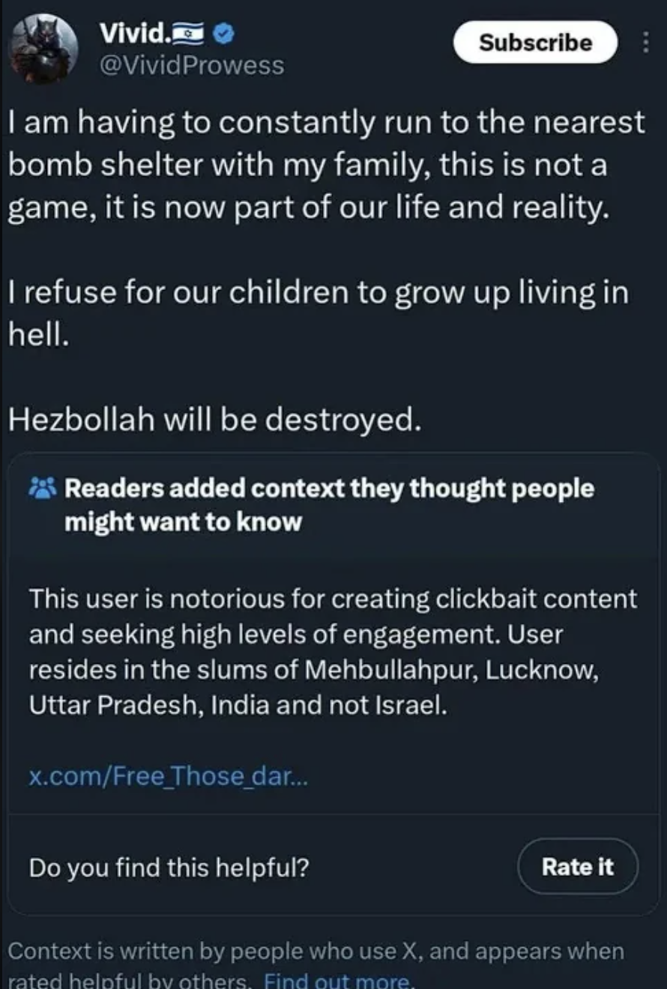
WHAT IS COMMUNITY NOTES?
02
One note. One decision.
→
• Sees the note
• Rates helpfulness
• X Community Notes (2026)

Slide 6
THE CROWD
03
Now multiply that by thousands
→
• Same action
• Thousands of raters
• One visibility decision
• X Community Notes (2026)

Slide 7
THE CROWD
03
Now multiply that by thousands
→
• Same action
• Thousands of raters
• One visibility decision
• X Community Notes (2026)

Slide 8
HOW SYSTEM WORKS 1 - 2
04
It reads the rater
AMIGO
ENEMIES SHAKE HANDS
HELPFUL
fᵤ · fₙ
iₙ —
fᵤ · fₙ ≈ 0
iₙ ↑
UNEXPECTED
• Cross-viewpoint surprise
• The model asks who voted
• Wojcik et al. (2022); Buterin (2023); X Community Notes (2026)

Slide 9
HOW SYSTEM WORKS 1 - 2
04
It reads the rater
AMIGO
ENEMIES SHAKE HANDS
HELPFUL
fᵤ · fₙ
iₙ —
fᵤ · fₙ ≈ 0
iₙ ↑
EXPECTED
UNEXPECTED
• Predictable partisan support
• Cross-viewpoint surprise
• The model asks who voted
• Wojcik et al. (2022); Buterin (2023); X Community Notes (2026)

Slide 10
HOW SYSTEM WORKS 1 - 2
04
It reads the rater
AMIGO
ENEMIES SHAKE HANDS
HELPFUL
fᵤ · fₙ
iₙ —
fᵤ · fₙ ≈ 0
iₙ ↑
EXPECTED
UNEXPECTED
• Predictable partisan support
• Cross-viewpoint surprise
• The same click receives different credit
• The model asks who voted
• Wojcik et al. (2022); Buterin (2023); X Community Notes (2026)

Slide 11
HOW SYSTEM WORKS 1 - 2
04
It reads the rater
AMIGO
ENEMIES SHAKE HANDS
HELPFUL
fᵤ · fₙ
iₙ —
fᵤ · fₙ ≈ 0
iₙ ↑
EXPECTED
UNEXPECTED
• Predictable partisan support
• Cross-viewpoint surprise
• The same click receives different credit
• The model asks who voted
• Wojcik et al. (2022); Buterin (2023); X Community Notes (2026)

Slide 12
HOW SYSTEM WORKS 1 - 2
04
It reads the rater
AMIGO
ENEMIES SHAKE HANDS
HELPFUL
fᵤ · fₙ
iₙ —
fᵤ · fₙ ≈ 0
iₙ ↑
EXPECTED
UNEXPECTED
• Predictable partisan support
• Cross-viewpoint surprise
• The same click receives different credit
• The model asks who voted
• Wojcik et al. (2022); Buterin (2023); X Community Notes (2026)

Slide 13
HOW SYSTEM WORKS 3
05
The same hands draw the map
CLASSROOM METAPHOR
• A few users supply most of the map
• The active core becomes ‘the community’
• Nudo et al. (2026); authors’ 200k analysis

Slide 14
HOW SYSTEM WORKS 3
05
The same hands draw the map
CLASSROOM METAPHOR
• A few users supply most of the map
• The active core becomes ‘the community’
• Nudo et al. (2026); authors’ 200k analysis

Slide 15
HOW SYSTEM WORKS 3
05
The same hands draw the map
CLASSROOM METAPHOR
• A few users supply most of the map
• The active core becomes ‘the community’
• Nudo et al. (2026); authors’ 200k analysis

Slide 16
HOW SYSTEM WORKS 3
05
The same hands draw the map
CLASSROOM METAPHOR
VIEWPOINT MAP
64
11×
• power raters
• more active
• A few users supply most of the map
• The active core becomes ‘the community’
• Nudo et al. (2026); authors’ 200k analysis

Slide 17
BRIDGING, REFRAMED
06
The handshake is right. The electorate is not.
GOOD INSTINCT
SELECTION BALANCE
THEN IT GETS MESSIER
BALANCED
PARTISAN
fᵤ · fₙ
changes the credit
πA = .50 πB = .50
• The same click is interpreted differently
2(.50)(.50) = 50%
50% → 18%
ENEMIES SHAKE HANDS
OBSERVED
ACTIVITY
πg
follows ratings—not people
• Cross-group agreement is valuable
πA = .90 πB = .10
2(.90)(.10) = 18%
• Active users represent each side
• Keep consent. Make representation explicit.
• Toy illustration—not the Community Notes scoring formula; Buterin (2023); Wojcik et al. (2022); Nudo et al. (2026)

Slide 18
BRIDGING, REFRAMED
06
The handshake is right. The electorate is not.
GOOD INSTINCT
SELECTION BALANCE
THEN IT GETS MESSIER
BALANCED
PARTISAN
fᵤ · fₙ
changes the credit
πA = .50 πB = .50
• The same click is interpreted differently
2(.50)(.50) = 50%
50% → 18%
ENEMIES SHAKE HANDS
OBSERVED
ACTIVITY
πg
follows ratings—not people
• Cross-group agreement is valuable
πA = .90 πB = .10
2(.90)(.10) = 18%
• Active users represent each side
• Keep consent. Make representation explicit.
• Toy illustration—not the Community Notes scoring formula; Buterin (2023); Wojcik et al. (2022); Nudo et al. (2026)

Slide 19
BRIDGING, REFRAMED
06
The handshake is right. The electorate is not.
GOOD INSTINCT
SELECTION BALANCE
THEN IT GETS MESSIER
BALANCED
PARTISAN
fᵤ · fₙ
changes the credit
πA = .50 πB = .50
• The same click is interpreted differently
2(.50)(.50) = 50%
50% → 18%
ENEMIES SHAKE HANDS
OBSERVED
ACTIVITY
πg
follows ratings—not people
• Cross-group agreement is valuable
πA = .90 πB = .10
2(.90)(.10) = 18%
• Active users represent each side
• Keep consent. Make representation explicit.
• Toy illustration—not the Community Notes scoring formula; Buterin (2023); Wojcik et al. (2022); Nudo et al. (2026)

Slide 20
BRIDGING, REFRAMED
06
The handshake is right. The electorate is not.
GOOD INSTINCT
SELECTION BALANCE
THEN IT GETS MESSIER
BALANCED
PARTISAN
fᵤ · fₙ
changes the credit
πA = .50 πB = .50
• The same click is interpreted differently
2(.50)(.50) = 50%
50% → 18%
ENEMIES SHAKE HANDS
OBSERVED
ACTIVITY
πg
follows ratings—not people
• Cross-group agreement is valuable
πA = .90 πB = .10
2(.90)(.10) = 18%
• Active users represent each side
• Keep consent. Make representation explicit.
• Toy illustration—not the Community Notes scoring formula; Buterin (2023); Wojcik et al. (2022); Nudo et al. (2026)

Slide 21
COLLECTIVE DECISIONS
07
This problem predates platforms
SWITZERLAND
BELGIUM
NL
+
FR
→
• Parallel majorities
PEOPLE
+
BOSNIA
B
+
C
+
S
→
VETO
• Vital-interest veto
CANTONS
N. IRELAND
U
+
N
→
• Parallel consent
• Double majority
• No group decides alone
• But online, who are the groups? →
• Linder & Mueller (2021); Lijphart (1977); Bieber (2006); McGarry & O’Leary (2009)

Slide 22
OUR SHIFT · RECOVERY
08
From ratings to constituencies
• Rate notes
• Find matching patterns
• Recover constituencies
✓
✓
×
✓
×
✓
✓
×
✓
×
✓
✓
×
×
×
→
→
×
×
✓
×
✓
×
×
✓
✓
✓
×
×
✓
✓
×
CONSTITUENCY A
CONSTITUENCY B
USERS
NOTES
• Similar co-rating patterns → same behavioral constituency
• Authors’ 100k-note / 200k-rater pipeline

Slide 23
OUR SHIFT · RECOVERY
08
From ratings to constituencies
• Rate notes
• Find matching patterns
• Recover constituencies
✓
✓
×
✓
×
✓
✓
×
✓
×
✓
✓
×
×
×
→
→
×
×
✓
×
✓
×
×
✓
✓
✓
×
×
✓
✓
×
CONSTITUENCY A
CONSTITUENCY B
USERS
NOTES
• Similar co-rating patterns → same behavioral constituency
• Authors’ 100k-note / 200k-rater pipeline

Slide 24
OUR SHIFT
09
Consult constituencies directly
• Recover groups
• Ask each group
• Aggregate explicitly
• Recover groups → consult each one → aggregate explicitly
• Authors’ cross-constituency aggregation

Slide 25
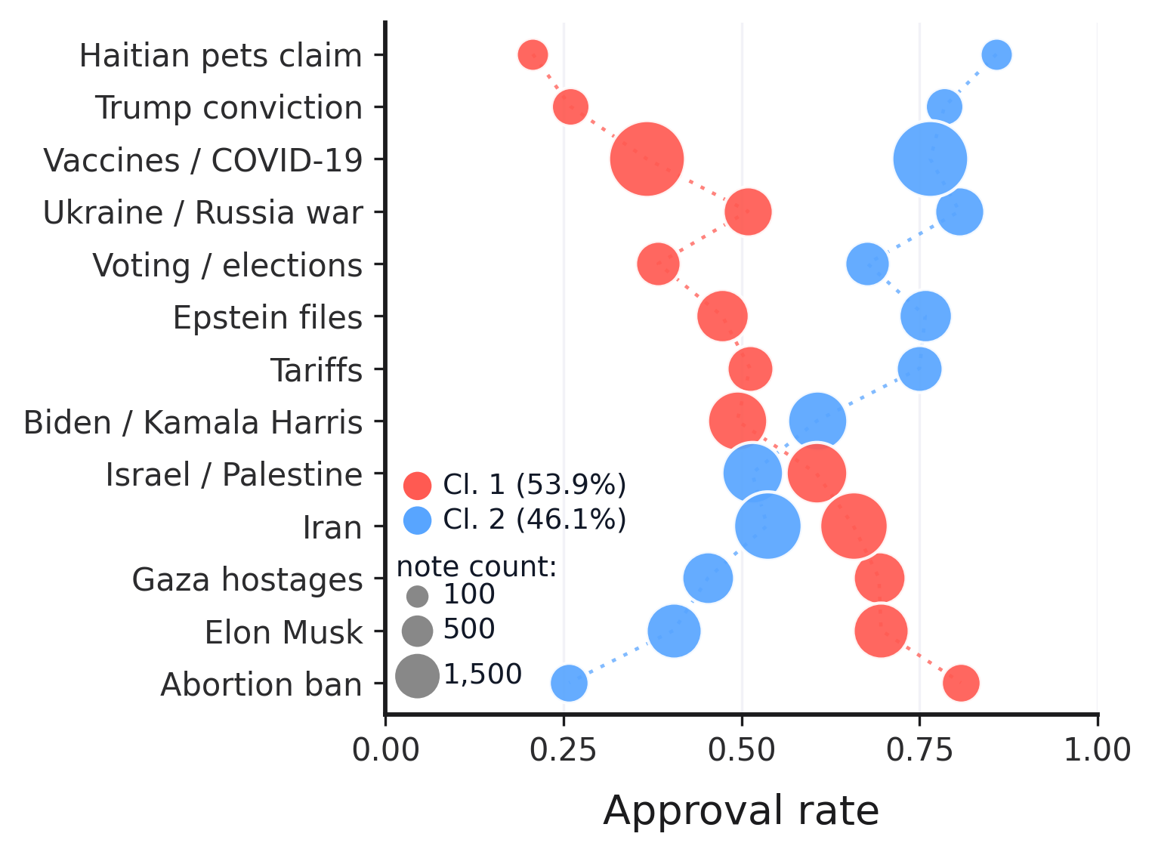
TOPIC MODELING
10
Disagreement changes by topic
HOW TO READ
• x-position = approval rate
• bubble size = note count
• color = recovered constituency
KEY RESULT
• Approval leadership flips across topics
• Constituencies are content-dependent
• The clusters are not simply ‘strict’ versus ‘lenient’
• Authors’ BERTopic analysis · Method-B clusters

Slide 26
PRINCIPLES
11
Four design principles
P1
Presence
• Every group enters
P2
Non-compensation
• Rejection still matters
P3
Symmetry
• No default winner
P4
Behavioral recovery
• No outside labels

Slide 27
IMPLEMENTATION
12
Principles become operations
CHECK 1 · PRESENCE
P1
≥3 ratings
• from every group
SAME NOTE
CONSTITUENCY A
90 ratings
CONSTITUENCY B
2 ratings
NO SCORE YET
• ≥3 from every group
• Toy illustration—not the Community Notes scoring formula; authors’ CCA design

Slide 28
IMPLEMENTATION
12
Principles become operations
CHECK 2 · NON-COMPENSATION
P1
≥3 ratings
• from every group
A · 81 / 90 = 90%
B · 1 / 10 = 10%
POOLED VOTES
P2
Geometric mean
• a soft veto
(81 + 1) / (90 + 10) = 82%
PASS
CCA
√(.90 × .10) = 30%
DOES NOT PASS
• Enthusiasm cannot erase rejection
• Toy illustration—not the Community Notes scoring formula; authors’ CCA design

Slide 29
IMPLEMENTATION
12
Principles become operations
CHECK 3 · SYMMETRY
P1
≥3 ratings
• from every group
90 RATERS
10 RATERS
P2
Geometric mean
• a soft veto
90 raters ≠ 9× weight
P3
Same rule
• no size weighting
√(sA × sB) = √(sB × sA)
√(.90 × .10) = √(.10 × .90) = 30%
• Group size does not change the rule
• Toy illustration—not the Community Notes scoring formula; authors’ CCA design

Slide 30
IMPLEMENTATION
12
Principles become operations
CHECK 4 · BEHAVIORAL RECOVERY
P1
≥3 ratings
• from every group
→
→
P2
Geometric mean
• a soft veto
200k RATERS
CO-RATING
A / B
P3
Same rule
• no size weighting
METHOD B
• No party · country · ideology labels
P4
200k raters
• Method-B recovery
• Authors’ 200k Representative pipeline

Slide 31
RESULTS · REPRESENTATIVE
13
What the platform shows—and hides
6,750
• already shown · 33%
44,722
CCA BRIDGE SCORE
20,405
→
≥ 50%
→
• Representative picks
• CCA-qualified · 46%
13,655
• hidden rescue candidates · 67%
24,317
• below threshold · 54%
• CCA identifies one qualified pool—some already shown, others hidden
• Authors’ 200k Representative pipeline

Slide 32
RESULTS · REPRESENTATIVE
13
What the platform shows—and hides
6,750
• already shown · 33%
44,722
CCA BRIDGE SCORE
20,405
→
≥ 50%
→
• Representative picks
• CCA-qualified · 46%
13,655
• hidden rescue candidates · 67%
24,317
• below threshold · 54%
• CCA identifies one qualified pool—some already shown, others hidden
• Authors’ 200k Representative pipeline

Slide 33
RESULTS · REPRESENTATIVE
13
What the platform shows—and hides
6,750
• already shown · 33%
44,722
CCA BRIDGE SCORE
20,405
→
≥ 50%
→
• Representative picks
• CCA-qualified · 46%
13,655
• hidden rescue candidates · 67%
24,317
• below threshold · 54%
• CCA identifies one qualified pool—some already shown, others hidden
• Authors’ 200k Representative pipeline

Slide 34
VALIDATION
13
Gemma Validation
STAGE 1
STAGE 2
Nature + sourcing
Rescue worthiness
0–100
PASS
• sourced factual information
• source traceability
RECHECK
• opinion / speculation
• claim–source connection
STAGE 1.5 · SOURCED FACTUAL CORE
• unsourced context / claim
• clarity and neutrality
STOP
• hostile / derogatory
• constructive presentation
• irrelevant / spam
VISIBLE EXTERNAL SOURCE POINTER REQUIRED
≥50
→ VALIDATED
• Missing sourcing is a validation failure—not proof that the claim is false
• Canonical Gemma prompts · model-based validation

Slide 35
VALIDATION · INFERENCE
13
A 30.7B model, pinned end to end
30.7B
2× L40S
64
15h 51m
DENSE PARAMETERS · GEMMA 4 31B IT
46,068 MiB EACH · TENSOR PARALLEL 2
CONCURRENT REQUESTS · MAX SEQUENCES
FIRST OUTPUT → FINAL OUTPUT
MODEL + DECODING
SCCKN + SERVING
INFERENCE CONTRACT + AUDIT
• google/gemma-4-31B-it
• AMD EPYC host · 8 CPU slots
• one note → one independent user prompt
• revision 518276fb130dc81caf9a4f772e65e63ef2526493
• 64 GB h_vmem / slot · ~52 GB observed peak
• no system prompt · no guided generation
• BF16 · no quantization
• CUDA 13.2 · GPU utilization target 90%
• strict JSON validation after generation
• thinking on · gemma4 reasoning parser
• vLLM 0.25.0 · async scheduling
• no tweet context · no URL fetching
• temperature 0.2
• PyTorch 2.11.0+cu130
• no retrieval · embeddings · vector store
• seed = SHA-256(stage, note, attempt)
• Transformers 5.13.1
• no Gabriel scaffold or label in context
• 8,192 context · 4,096 completion
• 32,768 batched tokens · prefix cache on
• ≤3 attempts · durable per-attempt records
• language-model-only · local OpenAI-compatible endpoint
• 25,734 judgments · 25,804 total attempts
• 32.1M tokens · 99.75% first-attempt valid
ACTIVE PHASES
7h 18m
STAGE 1
+
36m
STAGE 1.5
+
4h 35m
STAGE 2
=
12h 28m
OBSERVED ACTIVE TIME
LOCAL vLLM · NO HOSTED API
• Canonical run manifests · SCCKN scheduler records · call timestamps · Google Gemma 4 model card

Slide 36
RESULTS · VALIDATION
13
From candidates to validated rescues
13,655
10,376
8,558
62.7%
→
→
• of candidates validated by the LLM
• CCA candidates
• Stage 2 judgments
• Final rescues · ≥50
frozen universe
10,096 strict + 280 recall
8,527 strict + 31 recall
8,558 / 13,655
3,279 CONTENT STOP
1,818 BELOW 50
1,423 opinion / factual core absent
• 90–100 outstanding · clear, traceable, self-contained
1,340 irrelevant / trivial / spam
• 70–89 strong · well-supported and useful
373 unsourced context / claim
• 40–69 mixed · useful elements, material gaps
142 hostile / derogatory
• 10–39 weak · limited support or clarity
• 0–9 minimal · little usable justification
1 unresolved
• ≥50 validated · display-quality threshold
GEMMA 4 31B IT
COMPLETED CANONICAL RUN
• 8,527 strict route
• 31 recall route
10,376 / 10,376 complete · zero unresolved Stage 2 judgments
• Canonical Gemma 4 31B IT run · SCCKN · BF16 · threshold ≥50

Slide 37
RESULTS · VALIDATION
13
From candidates to validated rescues
13,655
10,376
8,558
62.7%
→
→
• of candidates validated by the LLM
• CCA candidates
• Stage 2 judgments
• Final rescues · ≥50
frozen universe
10,096 strict + 280 recall
8,527 strict + 31 recall
8,558 / 13,655
3,279 CONTENT STOP
1,818 BELOW 50
1,423 opinion / factual core absent
• 90–100 outstanding · clear, traceable, self-contained
1,340 irrelevant / trivial / spam
• 70–89 strong · well-supported and useful
373 unsourced context / claim
• 40–69 mixed · useful elements, material gaps
142 hostile / derogatory
• 10–39 weak · limited support or clarity
• 0–9 minimal · little usable justification
1 unresolved
• ≥50 validated · display-quality threshold
GEMMA 4 31B IT
COMPLETED CANONICAL RUN
• 8,527 strict route
• 31 recall route
10,376 / 10,376 complete · zero unresolved Stage 2 judgments
• Canonical Gemma 4 31B IT run · SCCKN · BF16 · threshold ≥50

Slide 38
RESULTS · VALIDATION
13
From candidates to validated rescues
13,655
10,376
8,558
62.7%
→
→
• of candidates validated by the LLM
• CCA candidates
• Stage 2 judgments
• Final rescues · ≥50
frozen universe
10,096 strict + 280 recall
8,527 strict + 31 recall
8,558 / 13,655
3,279 CONTENT STOP
1,818 BELOW 50
1,423 opinion / factual core absent
• 90–100 outstanding · clear, traceable, self-contained
1,340 irrelevant / trivial / spam
• 70–89 strong · well-supported and useful
373 unsourced context / claim
• 40–69 mixed · useful elements, material gaps
142 hostile / derogatory
• 10–39 weak · limited support or clarity
• 0–9 minimal · little usable justification
1 unresolved
• ≥50 validated · display-quality threshold
GEMMA 4 31B IT
COMPLETED CANONICAL RUN
• 8,527 strict route
• 31 recall route
10,376 / 10,376 complete · zero unresolved Stage 2 judgments
• Canonical Gemma 4 31B IT run · SCCKN · BF16 · threshold ≥50

Slide 39
CASE · RUSSIA / UKRAINE
13
Same claim. Different standard.
PLATFORM-SHOWN NOTE
NOTE 1741061371389743362
CCA / REPRESENTATIVE PICK
NOTE 1741110453764239596
83.7%
CURRENTLY_RATED_HELPFUL
86.9%
NEEDS_MORE_RATINGS
overall approval
overall approval
GEMMA 82/100
C0 57.5%
C1 93.8%
824 ratings
C0 66.5%
C1 95.2%
890 ratings
√(.575 × .938) = 73.4%
PLATFORM SHOWS
√(.665 × .952) = 79.6%
CCA PICKS
Russian state-controlled television regularly promotes shooting people who don’t want to live under Russian occupation, advocating for raping Ukrainian grannies and drowning Ukrainian children, and nuking the UK & invading further west.
Russia does in fact consider western countries to be its enemies (a practice which actually predates the illegal full-scale Russian invasion of Ukraine) and regularly threatens them with nuclear and other strikes. Labelling Russia as enemy state is fully accurate.
SOURCES YouTube · Newsweek · Business Insider
SOURCES Euractiv · Reuters · Brookings · Expats.cz
• Cross-constituency selection favors the more neutral formulation
• Authors’ Representative selection · canonical Gemma output

Slide 40
CASE · RUSSIA / UKRAINE
13
Same claim. Different standard.
PLATFORM-SHOWN NOTE
NOTE 1741061371389743362
CCA / REPRESENTATIVE PICK
NOTE 1741110453764239596
83.7%
CURRENTLY_RATED_HELPFUL
86.9%
NEEDS_MORE_RATINGS
overall approval
overall approval
GEMMA 82/100
C0 57.5%
C1 93.8%
824 ratings
C0 66.5%
C1 95.2%
890 ratings
√(.575 × .938) = 73.4%
PLATFORM SHOWS
√(.665 × .952) = 79.6%
CCA PICKS
Russian state-controlled television regularly promotes shooting people who don’t want to live under Russian occupation, advocating for raping Ukrainian grannies and drowning Ukrainian children, and nuking the UK & invading further west.
Russia does in fact consider western countries to be its enemies (a practice which actually predates the illegal full-scale Russian invasion of Ukraine) and regularly threatens them with nuclear and other strikes. Labelling Russia as enemy state is fully accurate.
SOURCES YouTube · Newsweek · Business Insider
SOURCES Euractiv · Reuters · Brookings · Expats.cz
• Cross-constituency selection favors the more neutral formulation
• Authors’ Representative selection · canonical Gemma output

Slide 41
Thank You

Slide 42
VALIDATION · STAGE 2
13
What makes a note worth rescuing?
MODEL SEES
HOLISTIC JUDGMENT
0–100 SCORE
specific + traceable source pointer
90–100
outstanding
70–89
strong
clear claim ↔ source connection
→
→
40–69
mixed
self-contained explanation
50
≥50 VALIDATED
SOURCE POINTER
factual + neutral wording
10–39
weak
• note text
concise + constructive presentation
0–9
minimal
• visible source pointer
• No URL opening · No original post · Visible note quality only
• Canonical Gemma Stage-2 prompt · threshold ≥50

