Slide 1
WHO SPEAKS
FOR THE CROWD?
Emrecan Ulu / Shi Jingyao
01

Slide 2
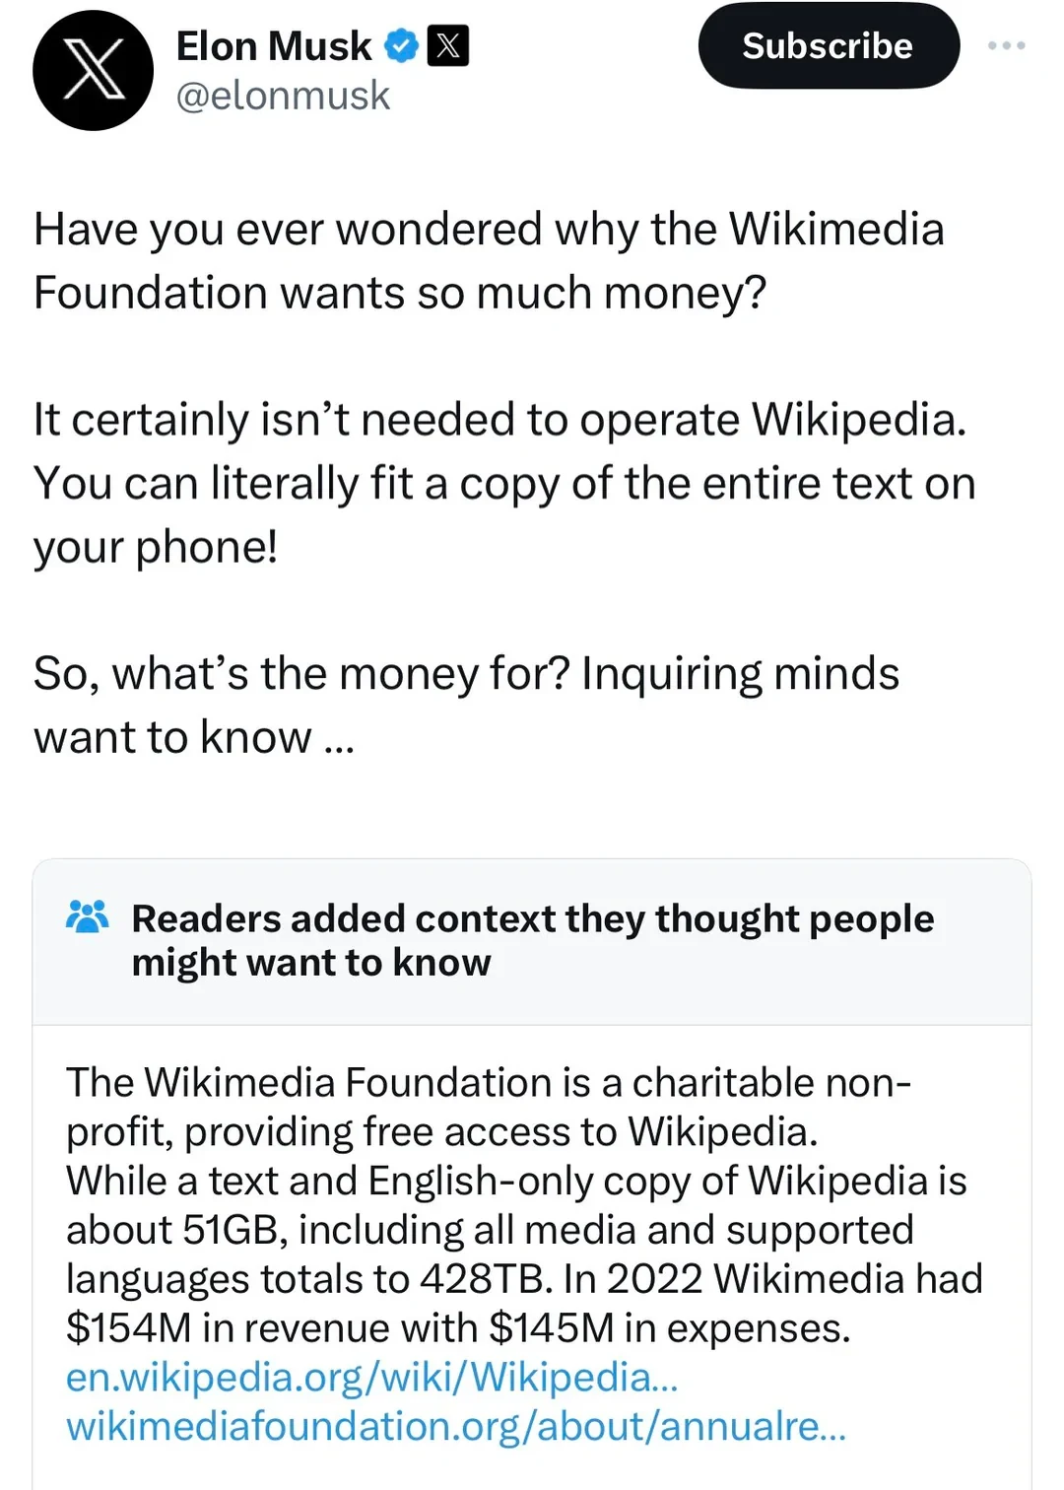
WHAT IS COMMUNITY NOTES?
02
One note. One decision.
→
• Sees the note
• Rates helpfulness
• Reads the context
• X Community Notes (2026)

Slide 3
WHAT IS COMMUNITY NOTES?
02
One note. One decision.
→
• Sees the note
• Rates helpfulness
• Reads the context
• X Community Notes (2026)

Slide 4
WHAT IS COMMUNITY NOTES?
02
One note. One decision.
→
• Sees the note
• Rates helpfulness
• Reads the context
• X Community Notes (2026)

Slide 5
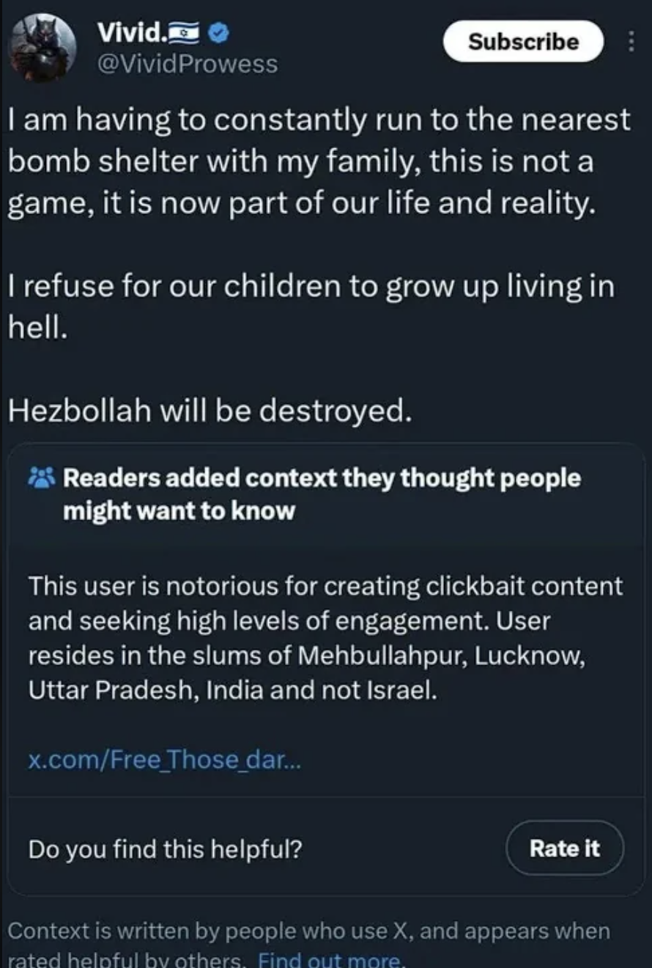
WHAT IS COMMUNITY NOTES?
02
One note. One decision.
→
• Sees the note
• Rates helpfulness
• X Community Notes (2026)

Slide 6
THE CROWD
03
Now multiply that by thousands
→
• Same action
• Thousands of raters
• One visibility decision
• X Community Notes (2026)

Slide 7
THE CROWD
03
Now multiply that by thousands
→
• Same action
• Thousands of raters
• One visibility decision
• X Community Notes (2026)

Slide 8
HOW SYSTEM WORKS 1 - 2
04
It reads the rater
AMIGO
ENEMIES SHAKE HANDS
HELPFUL
fᵤ · fₙ
iₙ —
fᵤ · fₙ ≈ 0
iₙ ↑
UNEXPECTED
• Cross-viewpoint surprise
• The model asks who voted
• Wojcik et al. (2022); Buterin (2023); X Community Notes (2026)

Slide 9
HOW SYSTEM WORKS 1 - 2
04
It reads the rater
AMIGO
ENEMIES SHAKE HANDS
HELPFUL
fᵤ · fₙ
iₙ —
fᵤ · fₙ ≈ 0
iₙ ↑
EXPECTED
UNEXPECTED
• Predictable partisan support
• Cross-viewpoint surprise
• The model asks who voted
• Wojcik et al. (2022); Buterin (2023); X Community Notes (2026)

Slide 10
HOW SYSTEM WORKS 1 - 2
04
It reads the rater
AMIGO
ENEMIES SHAKE HANDS
HELPFUL
fᵤ · fₙ
iₙ —
fᵤ · fₙ ≈ 0
iₙ ↑
EXPECTED
UNEXPECTED
• Predictable partisan support
• Cross-viewpoint surprise
• The same click receives different credit
• The model asks who voted
• Wojcik et al. (2022); Buterin (2023); X Community Notes (2026)

Slide 11
HOW SYSTEM WORKS 1 - 2
04
It reads the rater
AMIGO
ENEMIES SHAKE HANDS
HELPFUL
fᵤ · fₙ
iₙ —
fᵤ · fₙ ≈ 0
iₙ ↑
EXPECTED
UNEXPECTED
• Predictable partisan support
• Cross-viewpoint surprise
• The same click receives different credit
• The model asks who voted
• Wojcik et al. (2022); Buterin (2023); X Community Notes (2026)

Slide 12
HOW SYSTEM WORKS 1 - 2
04
It reads the rater
AMIGO
ENEMIES SHAKE HANDS
HELPFUL
fᵤ · fₙ
iₙ —
fᵤ · fₙ ≈ 0
iₙ ↑
EXPECTED
UNEXPECTED
• Predictable partisan support
• Cross-viewpoint surprise
• The same click receives different credit
• The model asks who voted
• Wojcik et al. (2022); Buterin (2023); X Community Notes (2026)

Slide 13
HOW SYSTEM WORKS 3
05
The same hands draw the map
CLASSROOM METAPHOR
• A few users supply most of the map
• The active core becomes ‘the community’
• Nudo et al. (2026); authors’ 200k analysis

Slide 14
HOW SYSTEM WORKS 3
05
The same hands draw the map
CLASSROOM METAPHOR
• A few users supply most of the map
• The active core becomes ‘the community’
• Nudo et al. (2026); authors’ 200k analysis

Slide 15
HOW SYSTEM WORKS 3
05
The same hands draw the map
CLASSROOM METAPHOR
• A few users supply most of the map
• The active core becomes ‘the community’
• Nudo et al. (2026); authors’ 200k analysis

Slide 16
HOW SYSTEM WORKS 3
05
The same hands draw the map
CLASSROOM METAPHOR
VIEWPOINT MAP
64
11×
• power raters
• more active
• A few users supply most of the map
• The active core becomes ‘the community’
• Nudo et al. (2026); authors’ 200k analysis

Slide 17
BRIDGING, REFRAMED
06
The handshake is right. The electorate is not.
GOOD INSTINCT
SELECTION BALANCE
THEN IT GETS MESSIER
BALANCED
PARTISAN
fᵤ · fₙ
changes the credit
πA = .50 πB = .50
• The same click is interpreted differently
2(.50)(.50) = 50%
50% → 18%
ENEMIES SHAKE HANDS
OBSERVED
ACTIVITY
πg
follows ratings—not people
• Cross-group agreement is valuable
πA = .90 πB = .10
2(.90)(.10) = 18%
• Active users represent each side
• Keep consent. Make representation explicit.
• Toy illustration—not the Community Notes scoring formula; Buterin (2023); Wojcik et al. (2022); Nudo et al. (2026)

Slide 18
BRIDGING, REFRAMED
06
The handshake is right. The electorate is not.
GOOD INSTINCT
SELECTION BALANCE
THEN IT GETS MESSIER
BALANCED
PARTISAN
fᵤ · fₙ
changes the credit
πA = .50 πB = .50
• The same click is interpreted differently
2(.50)(.50) = 50%
50% → 18%
ENEMIES SHAKE HANDS
OBSERVED
ACTIVITY
πg
follows ratings—not people
• Cross-group agreement is valuable
πA = .90 πB = .10
2(.90)(.10) = 18%
• Active users represent each side
• Keep consent. Make representation explicit.
• Toy illustration—not the Community Notes scoring formula; Buterin (2023); Wojcik et al. (2022); Nudo et al. (2026)

Slide 19
BRIDGING, REFRAMED
06
The handshake is right. The electorate is not.
GOOD INSTINCT
SELECTION BALANCE
THEN IT GETS MESSIER
BALANCED
PARTISAN
fᵤ · fₙ
changes the credit
πA = .50 πB = .50
• The same click is interpreted differently
2(.50)(.50) = 50%
50% → 18%
ENEMIES SHAKE HANDS
OBSERVED
ACTIVITY
πg
follows ratings—not people
• Cross-group agreement is valuable
πA = .90 πB = .10
2(.90)(.10) = 18%
• Active users represent each side
• Keep consent. Make representation explicit.
• Toy illustration—not the Community Notes scoring formula; Buterin (2023); Wojcik et al. (2022); Nudo et al. (2026)

Slide 20
BRIDGING, REFRAMED
06
The handshake is right. The electorate is not.
GOOD INSTINCT
SELECTION BALANCE
THEN IT GETS MESSIER
BALANCED
PARTISAN
fᵤ · fₙ
changes the credit
πA = .50 πB = .50
• The same click is interpreted differently
2(.50)(.50) = 50%
50% → 18%
ENEMIES SHAKE HANDS
OBSERVED
ACTIVITY
πg
follows ratings—not people
• Cross-group agreement is valuable
πA = .90 πB = .10
2(.90)(.10) = 18%
• Active users represent each side
• Keep consent. Make representation explicit.
• Toy illustration—not the Community Notes scoring formula; Buterin (2023); Wojcik et al. (2022); Nudo et al. (2026)

Slide 21
COLLECTIVE DECISIONS
07
This problem predates platforms
SWITZERLAND
BELGIUM
NL
+
FR
→
• Parallel majorities
PEOPLE
+
BOSNIA
B
+
C
+
S
→
VETO
• Vital-interest veto
CANTONS
N. IRELAND
U
+
N
→
• Parallel consent
• Double majority
• No group decides alone
• But online, who are the groups? →
• Linder & Mueller (2021); Lijphart (1977); Bieber (2006); McGarry & O’Leary (2009)

Slide 22
OUR SHIFT · RECOVERY
08
From ratings to constituencies
• Rate notes
• Find matching patterns
• Recover constituencies
✓
✓
×
✓
×
✓
✓
×
✓
×
✓
✓
×
×
×
→
→
×
×
✓
×
✓
×
×
✓
✓
✓
×
×
✓
✓
×
CONSTITUENCY A
CONSTITUENCY B
USERS
NOTES
• Similar co-rating patterns → same behavioral constituency
• Authors’ 100k-note / 200k-rater pipeline

Slide 23
OUR SHIFT · RECOVERY
08
From ratings to constituencies
• Rate notes
• Find matching patterns
• Recover constituencies
✓
✓
×
✓
×
✓
✓
×
✓
×
✓
✓
×
×
×
→
→
×
×
✓
×
✓
×
×
✓
✓
✓
×
×
✓
✓
×
CONSTITUENCY A
CONSTITUENCY B
USERS
NOTES
• Similar co-rating patterns → same behavioral constituency
• Authors’ 100k-note / 200k-rater pipeline

Slide 24
OUR SHIFT
09
Consult constituencies directly
• Recover groups
• Ask each group
• Aggregate explicitly
• Recover groups → consult each one → aggregate explicitly
• Authors’ cross-constituency aggregation

Slide 25
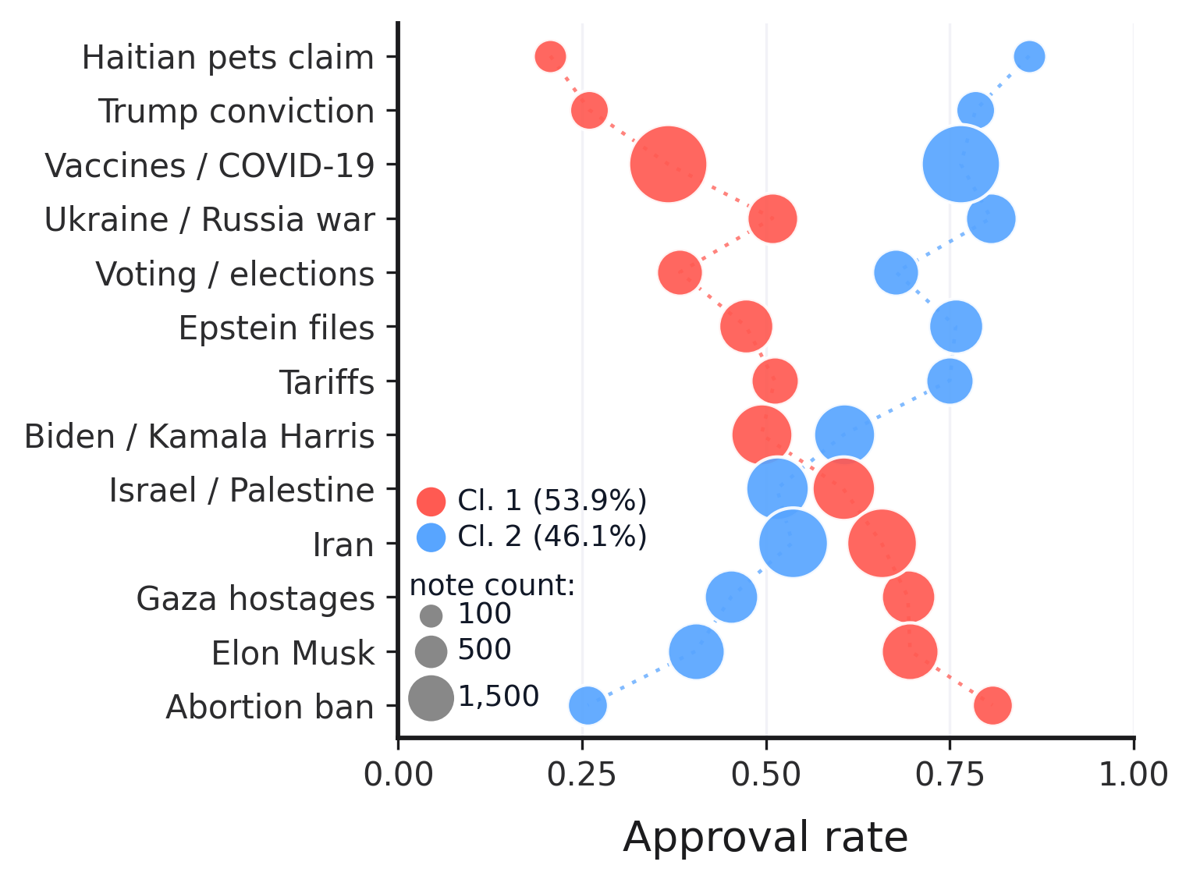
TOPIC MODELING
10
Disagreement changes by topic
HOW TO READ
• x-position = approval rate
• bubble size = note count
• color = recovered constituency
KEY RESULT
• Approval leadership flips across topics
• Constituencies are content-dependent
• The clusters are not simply ‘strict’ versus ‘lenient’
• Authors’ BERTopic analysis · Method-B clusters

Slide 26
PRINCIPLES
11
Four design principles
P1
Presence
• Every group enters
P2
Non-compensation
• Rejection still matters
P3
Symmetry
• No default winner
P4
Behavioral recovery
• No outside labels

Slide 27
IMPLEMENTATION
12
Principles become operations
CHECK 1 · PRESENCE
P1
≥3 ratings
• from every group
SAME NOTE
CONSTITUENCY A
90 ratings
CONSTITUENCY B
2 ratings
NO SCORE YET
• ≥3 from every group
• Toy illustration—not the Community Notes scoring formula; authors’ CCA design

Slide 28
IMPLEMENTATION
12
Principles become operations
CHECK 2 · NON-COMPENSATION
P1
≥3 ratings
• from every group
A · 81 / 90 = 90%
B · 1 / 10 = 10%
POOLED VOTES
P2
Geometric mean
• a soft veto
(81 + 1) / (90 + 10) = 82%
PASS
CCA
√(.90 × .10) = 30%
DOES NOT PASS
• Enthusiasm cannot erase rejection
• Toy illustration—not the Community Notes scoring formula; authors’ CCA design

Slide 29
IMPLEMENTATION
12
Principles become operations
CHECK 3 · SYMMETRY
P1
≥3 ratings
• from every group
90 RATERS
10 RATERS
P2
Geometric mean
• a soft veto
90 raters ≠ 9× weight
P3
Same rule
• no size weighting
√(sA × sB) = √(sB × sA)
√(.90 × .10) = √(.10 × .90) = 30%
• Group size does not change the rule
• Toy illustration—not the Community Notes scoring formula; authors’ CCA design

Slide 30
IMPLEMENTATION
12
Principles become operations
CHECK 4 · BEHAVIORAL RECOVERY
P1
≥3 ratings
• from every group
→
→
P2
Geometric mean
• a soft veto
200k RATERS
CO-RATING
A / B
P3
Same rule
• no size weighting
METHOD B
• No party · country · ideology labels
P4
200k raters
• Method-B recovery
• Authors’ 200k Representative pipeline

Slide 31
RESULTS · REPRESENTATIVE
13
What the platform shows—and hides
6,750
• already shown · 33%
44,722
CCA BRIDGE SCORE
20,405
→
≥ 50%
→
• Representative picks
• CCA-qualified · 46%
13,655
• hidden rescue candidates · 67%
24,317
• below threshold · 54%
• CCA identifies one qualified pool—some already shown, others hidden
• Authors’ 200k Representative pipeline

Slide 32
RESULTS · REPRESENTATIVE
13
What the platform shows—and hides
6,750
• already shown · 33%
44,722
CCA BRIDGE SCORE
20,405
→
≥ 50%
→
• Representative picks
• CCA-qualified · 46%
13,655
• hidden rescue candidates · 67%
24,317
• below threshold · 54%
• CCA identifies one qualified pool—some already shown, others hidden
• Authors’ 200k Representative pipeline

Slide 33
RESULTS · REPRESENTATIVE
13
What the platform shows—and hides
6,750
• already shown · 33%
44,722
CCA BRIDGE SCORE
20,405
→
≥ 50%
→
• Representative picks
• CCA-qualified · 46%
13,655
• hidden rescue candidates · 67%
24,317
• below threshold · 54%
• CCA identifies one qualified pool—some already shown, others hidden
• Authors’ 200k Representative pipeline

Slide 34
VALIDATION
13
Gemma Validation
STAGE 1
STAGE 2
Nature + sourcing
Rescue worthiness
0–100
PASS
• sourced factual information
• source traceability
RECHECK
• opinion / speculation
• claim–source connection
STAGE 1.5 · SOURCED FACTUAL CORE
• unsourced context / claim
• clarity and neutrality
STOP
• hostile / derogatory
• constructive presentation
• irrelevant / spam
VISIBLE EXTERNAL SOURCE POINTER REQUIRED
≥50
→ VALIDATED
• Missing sourcing is a validation failure—not proof that the claim is false
• Canonical Gemma prompts · model-based validation

Slide 35
VALIDATION · INFERENCE
13
A 30.7B model, pinned end to end
30.7B
2× L40S
64
15h 51m
DENSE PARAMETERS · GEMMA 4 31B IT
46,068 MiB EACH · TENSOR PARALLEL 2
CONCURRENT REQUESTS · MAX SEQUENCES
FIRST OUTPUT → FINAL OUTPUT
MODEL + DECODING
SCCKN + SERVING
INFERENCE CONTRACT + AUDIT
• google/gemma-4-31B-it
• AMD EPYC host · 8 CPU slots
• one note → one independent user prompt
• revision 518276fb130dc81caf9a4f772e65e63ef2526493
• 64 GB h_vmem / slot · ~52 GB observed peak
• no system prompt · no guided generation
• BF16 · no quantization
• CUDA 13.2 · GPU utilization target 90%
• strict JSON validation after generation
• thinking on · gemma4 reasoning parser
• vLLM 0.25.0 · async scheduling
• no tweet context · no URL fetching
• temperature 0.2
• PyTorch 2.11.0+cu130
• no retrieval · embeddings · vector store
• seed = SHA-256(stage, note, attempt)
• Transformers 5.13.1
• no Gabriel scaffold or label in context
• 8,192 context · 4,096 completion
• 32,768 batched tokens · prefix cache on
• ≤3 attempts · durable per-attempt records
• language-model-only · local OpenAI-compatible endpoint
• 25,734 judgments · 25,804 total attempts
• 32.1M tokens · 99.75% first-attempt valid
ACTIVE PHASES
7h 18m
STAGE 1
+
36m
STAGE 1.5
+
4h 35m
STAGE 2
=
12h 28m
OBSERVED ACTIVE TIME
LOCAL vLLM · NO HOSTED API
• Canonical run manifests · SCCKN scheduler records · call timestamps · Google Gemma 4 model card

Slide 36
RESULTS · VALIDATION
13
From candidates to validated rescues
13,655
10,376
8,558
62.7%
→
→
• of candidates validated by the LLM
• CCA candidates
• Stage 2 judgments
• Final rescues · ≥50
frozen universe
10,096 strict + 280 recall
8,527 strict + 31 recall
8,558 / 13,655
3,279 CONTENT STOP
1,818 BELOW 50
1,423 opinion / factual core absent
• 90–100 outstanding · clear, traceable, self-contained
1,340 irrelevant / trivial / spam
• 70–89 strong · well-supported and useful
373 unsourced context / claim
• 40–69 mixed · useful elements, material gaps
142 hostile / derogatory
• 10–39 weak · limited support or clarity
• 0–9 minimal · little usable justification
1 unresolved
• ≥50 validated · display-quality threshold
GEMMA 4 31B IT
COMPLETED CANONICAL RUN
• 8,527 strict route
• 31 recall route
10,376 / 10,376 complete · zero unresolved Stage 2 judgments
• Canonical Gemma 4 31B IT run · SCCKN · BF16 · threshold ≥50

Slide 37
RESULTS · VALIDATION
13
From candidates to validated rescues
13,655
10,376
8,558
62.7%
→
→
• of candidates validated by the LLM
• CCA candidates
• Stage 2 judgments
• Final rescues · ≥50
frozen universe
10,096 strict + 280 recall
8,527 strict + 31 recall
8,558 / 13,655
3,279 CONTENT STOP
1,818 BELOW 50
1,423 opinion / factual core absent
• 90–100 outstanding · clear, traceable, self-contained
1,340 irrelevant / trivial / spam
• 70–89 strong · well-supported and useful
373 unsourced context / claim
• 40–69 mixed · useful elements, material gaps
142 hostile / derogatory
• 10–39 weak · limited support or clarity
• 0–9 minimal · little usable justification
1 unresolved
• ≥50 validated · display-quality threshold
GEMMA 4 31B IT
COMPLETED CANONICAL RUN
• 8,527 strict route
• 31 recall route
10,376 / 10,376 complete · zero unresolved Stage 2 judgments
• Canonical Gemma 4 31B IT run · SCCKN · BF16 · threshold ≥50

Slide 38
RESULTS · VALIDATION
13
From candidates to validated rescues
13,655
10,376
8,558
62.7%
→
→
• of candidates validated by the LLM
• CCA candidates
• Stage 2 judgments
• Final rescues · ≥50
frozen universe
10,096 strict + 280 recall
8,527 strict + 31 recall
8,558 / 13,655
3,279 CONTENT STOP
1,818 BELOW 50
1,423 opinion / factual core absent
• 90–100 outstanding · clear, traceable, self-contained
1,340 irrelevant / trivial / spam
• 70–89 strong · well-supported and useful
373 unsourced context / claim
• 40–69 mixed · useful elements, material gaps
142 hostile / derogatory
• 10–39 weak · limited support or clarity
• 0–9 minimal · little usable justification
1 unresolved
• ≥50 validated · display-quality threshold
GEMMA 4 31B IT
COMPLETED CANONICAL RUN
• 8,527 strict route
• 31 recall route
10,376 / 10,376 complete · zero unresolved Stage 2 judgments
• Canonical Gemma 4 31B IT run · SCCKN · BF16 · threshold ≥50

Slide 39
CASE · YARMOUK / MU'TAH
13
High approval. Wrong battle.
PLATFORM-SHOWN NOTE
NOTE 1988138343385731249
CCA / REPRESENTATIVE PICK
NOTE 1988182086097006685
92.2%
CURRENTLY_RATED_HELPFUL
91.2%
NEEDS_MORE_RATINGS
overall approval
overall approval
GEMMA 95/100
C0 98.3%
C1 60.9%
282 ratings
C0 95.2%
C1 73.7%
204 ratings
√(.983 × .609) = 77.4%
PLATFORM SHOWS
√(.952 × .737) = 83.7%
CCA PICKS
The Battle of Mu'tah was fought between the Byzantine Empire and the First Islamic State. The true size of the armies is considered to be around 10,000 for the Byzantines and 3000 for the Muslims. It ended with a Byzantine victory.
The post refers to the Battle of Yarmouk (636 AD), but reliable estimates put Muslim forces at 15,000–40,000, not 3,000, versus 15,000–150,000 Byzantines. 3,000 Muslims fought at the earlier Battle of Mu'tah (629 AD).
SOURCES Wikipedia (Mu'tah) · Islam365
SOURCES Wikipedia (Yarmouk, Mu'tah) · Britannica
• Platform approval favored the wrong battle; CCA selected the relevant correction
• Authors’ Representative selection · canonical Gemma output

Slide 40
CASE · YARMOUK / MU'TAH
13
High approval. Wrong battle.
PLATFORM-SHOWN NOTE
NOTE 1988138343385731249
CCA / REPRESENTATIVE PICK
NOTE 1988182086097006685
92.2%
CURRENTLY_RATED_HELPFUL
91.2%
NEEDS_MORE_RATINGS
overall approval
overall approval
GEMMA 95/100
C0 98.3%
C1 60.9%
282 ratings
C0 95.2%
C1 73.7%
204 ratings
√(.983 × .609) = 77.4%
PLATFORM SHOWS
√(.952 × .737) = 83.7%
CCA PICKS
The Battle of Mu'tah was fought between the Byzantine Empire and the First Islamic State. The true size of the armies is considered to be around 10,000 for the Byzantines and 3000 for the Muslims. It ended with a Byzantine victory.
The post refers to the Battle of Yarmouk (636 AD), but reliable estimates put Muslim forces at 15,000–40,000, not 3,000, versus 15,000–150,000 Byzantines. 3,000 Muslims fought at the earlier Battle of Mu'tah (629 AD).
SOURCES Wikipedia (Mu'tah) · Islam365
SOURCES Wikipedia (Yarmouk, Mu'tah) · Britannica
• Platform approval favored the wrong battle; CCA selected the relevant correction
• Authors’ Representative selection · canonical Gemma output

Slide 41
Thank You

Slide 42
VALIDATION · STAGE 2
13
What makes a note worth rescuing?
MODEL SEES
HOLISTIC JUDGMENT
0–100 SCORE
specific + traceable source pointer
90–100
outstanding
70–89
strong
clear claim ↔ source connection
→
→
40–69
mixed
self-contained explanation
50
≥50 VALIDATED
SOURCE POINTER
factual + neutral wording
10–39
weak
• note text
concise + constructive presentation
0–9
minimal
• visible source pointer
• No URL opening · No original post · Visible note quality only
• Canonical Gemma Stage-2 prompt · threshold ≥50

