Slide 1
WHO SPEAKS
FOR THE CROWD?
• Cross-Constituency Aggregation
• for Community Notes
01

Slide 2
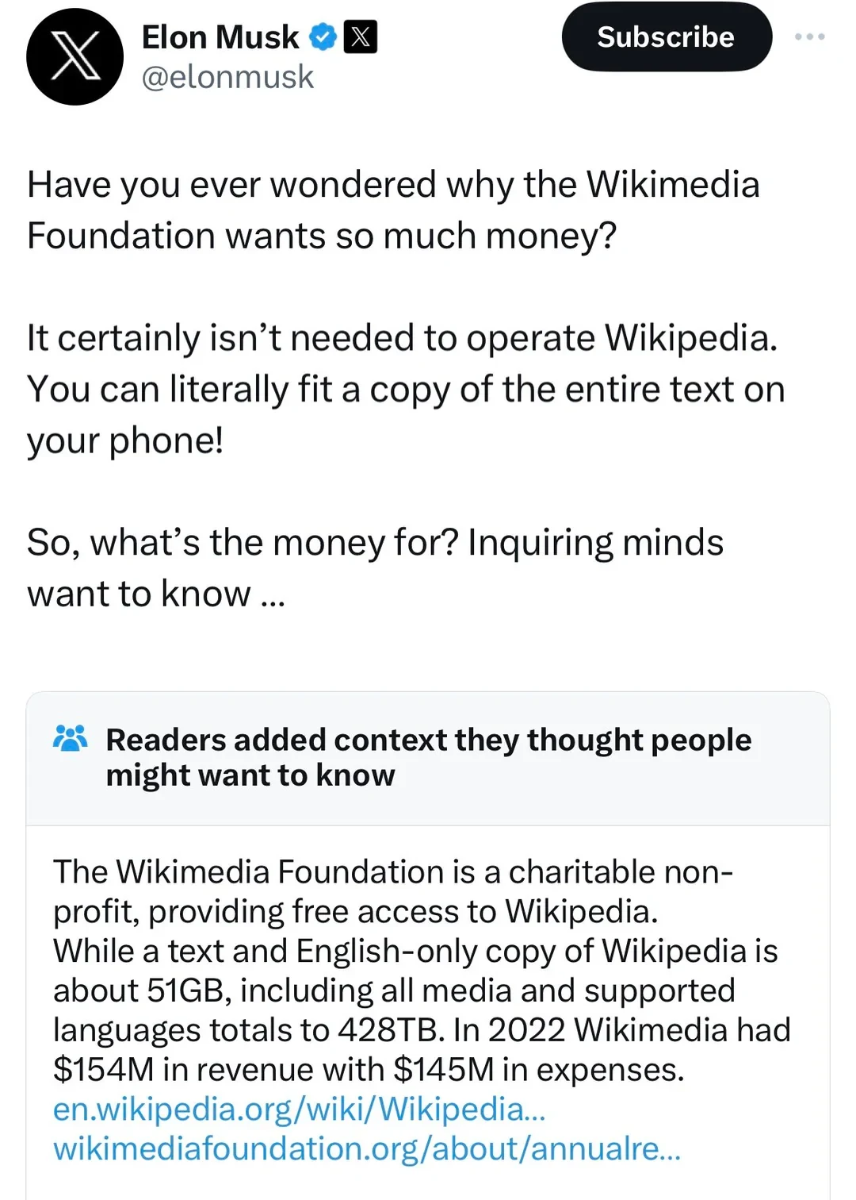
WHAT IS COMMUNITY NOTES?
02
One note. One decision.
→
• Sees the note
• Rates helpfulness
• Reads the context
• X Community Notes (2026)

Slide 3
WHAT IS COMMUNITY NOTES?
02
One note. One decision.
→
• Sees the note
• Rates helpfulness
• Reads the context
• X Community Notes (2026)

Slide 4
WHAT IS COMMUNITY NOTES?
02
One note. One decision.
→
• Sees the note
• Rates helpfulness
• Reads the context
• X Community Notes (2026)

Slide 5

WHAT IS COMMUNITY NOTES?
02
One note. One decision.
→
• Sees the note
• Rates helpfulness
• X Community Notes (2026)

Slide 6
THE CROWD
03
Now multiply that by thousands
→
• Same action
• Thousands of raters
• One visibility decision
• X Community Notes (2026)

Slide 7
THE PROBLEM
04
But the crowd is not equal
power raters dominating
• A few rate constantly
• Most rate occasionally
• Nudo et al. (2026); authors’ 200k analysis

Slide 8
CURRENT BRIDGING
05
Activity moves the bridge
BEFORE · EQUAL ACTIVITY
AFTER · CORAL RATES 5× MORE
100 × 10% = 10
100 × 90% = 90
100 × 10% = 10
500 × 90% = 450
50% SIGNAL
77% SIGNAL
(10 + 90) / 200 = 50%
(10 + 450) / 600 ≈ 77%
• Same within-group support: 10% | 90%
√(.10 × .90) = 30%
• unchanged by rating volume
CCA STAYS SYMMETRIC
• Toy illustration—not the Community Notes scoring formula.
• X Community Notes (2026); Nudo et al. (2026)

Slide 9
OUR SHIFT
06
Consult constituencies directly
• Recover groups
• Ask each group
• Aggregate explicitly
• Switzerland · Belgium · Bosnia · Northern Ireland
• Linder & Mueller (2021); Lijphart (1977); Bieber (2006); McGarry & O’Leary (2009)

Slide 10
PHILOSOPHY
07
Four design principles
P1
Presence
• Every group enters
P2
Non-compensation
• Rejection still matters
P3
Symmetry
• No default winner
P4
Behavioral recovery
• No outside labels

Slide 11
IMPLEMENTATION
08
Principles become operations
P1
≥3 ratings
• from every group
90%
×
10%
→
30%
P2
Geometric mean
• a soft veto
• not 50%
P3
Same rule
• no size weighting
P4
200k raters
• Method-B recovery
100k notes → 200k raters → > .5 → Gabriel
• Authors’ 200k Representative pipeline

Slide 12
RESULTS
09
From hidden to validated
44,722
6,832
13,655
3,896
→
+
→
• representative picks
• shown · 15%
• CCA candidates
• validated
• 46% potential before validation
• 3,896 pass Gabriel
• Authors’ results · two camps · behavioral ≠ demographic · model-based validation

Slide 13
TAKEAWAY
10
An aggregation problem
• Make groups explicit
• Require cross-group support
• Validate content separately
PRESERVE DISAGREEMENT BEFORE AGGREGATING IT

