Slide 1
Vulp
dp fn fib(int n) -> int {
if n <= 1: return n;
return fib(n - 1) + fib(n - 2);
}
TC: {
read int n;
read int[n] a;
int best = a[0];
for x in a: best = max(best, x);
println(fib(n), " ", best);
}
A language and compiler for competitive programming
V1 project report
Vibhaas · October 2026
github.com/vulp-lang/vulp
Vulp V1 · 1
Notes:
Vulp is a small statically typed language for competitive programming, compiled with LLVM. This talk shows the language through examples, then measures it against C++ and Python on six classic problems.

Slide 2
MOTIVATION
Contest code today: fast or short, rarely both
C++
Python
Vulp
Fast, but verbose
Short, but slow
Short and fast
• Every solution repeats fast-I/O setup, the testcase loop and memo tables.
• Out-of-bounds and overflow bugs fail silently.
• 4–26× slower than C++ on our benchmarks.
• Often over the time limit; deep recursion needs workarounds.
• Contest constructs built into the language: TC:, read, dp fn, any-width integers.
• Compiled with LLVM: C++ speed, with runtime checks.
Vulp V1 · 2
Notes:
Contestants choose between C++ (fast but boilerplate-heavy and unsafe) and Python (short but slow). Vulp aims to be both short and fast.

Slide 3
LANGUAGE
Vulp at a glance
example.vp
• Integers iN / uN of 1–256 bits, rounded up to 8, 16, 32, 64, 128 or 256; int<lo..hi>
• int, char, bool, float, string, arrays, vec, map, struct, ranges [1..n]
• if / elif / else, while, for ( ; ; ), for x in …
• Functions, & references, recursion on a 1 GiB stack
• dp fn: compiler-checked pure functions, memoised automatically
• TC: testcase blocks, fast read / print / println
• Run from source (LLVM JIT) or build a native executable
int MOD = 1_000_000_007;
dp fn ways(int n) -> int { # memoised
if n <= 1: return 1;
return (ways(n - 1) + ways(n - 2)) % MOD;
}
TC: { # t testcases
read int n;
read int[n] a;
a.sort();
println(ways(n), " ", a);
}
Vulp V1 · 3
Notes:
The whole V1 feature list on one slide. Everything on the left is a complete program: no main, no includes, no I/O setup.

Slide 4
EXAMPLES
The testcase loop
Vulp · 10 lines · 59 tokens
C++ · 20 lines · 134 tokens
TC: {
read int n;
read int[n] a;
int best = a[0], cur = 0;
for x in a: {
cur = max(cur + x, x);
best = max(best, cur);
}
println(best);
}
#include <bits/stdc++.h>
using namespace std;
int main() {
ios::sync_with_stdio(false); cin.tie(nullptr);
int t; cin >> t;
while (t--) {
int n; cin >> n;
vector<long long> a(n);
for (auto& x : a) cin >> x;
long long best = a[0], cur = 0;
for (long long x : a) {
cur = max(cur + x, x); best = max(best, cur);
}
cout << best << "\n";
}
}
200,000 testcases: Vulp 0.071 s · C++ 0.073 s · Python 0.383 s
Vulp V1 · 4
Notes:
TC: reads the testcase count and runs the block that many times. read uses a buffered reader, so there are no sync_with_stdio tricks, and it is as fast as the tuned C++.

Slide 5
EXAMPLES
dp fn: write the recurrence, get the cache
dp fn fib(int n) -> int {
if n <= 1: return n;
return fib(n - 1) + fib(n - 2);
}
println(fib(42));
Checked by the compiler
• Parameters: integers, chars or bools
• Result: a scalar
• No global writes, no I/O — also through callees
• May read globals: then its cache is cleared before every testcase, in O(1)
0.92 s
< 0.01 s
$ vulpc -v examples/08_lcs_testcases.vp
[vulpc] dp fn lcs: memoised; cache cleared
before every TC iteration (reads globals)
fn fib(42): 867 million calls
dp fn fib(42): 43 states
The only difference is the keyword dp.
Vulp V1 · 5
Notes:
dp turns a naive recursion into a memoised one. The compiler proves the function is safe to cache and decides whether the cache must be reset between testcases.

Slide 6
EXAMPLES
Mistakes caught early, with clear messages
At compile time (exit code 65)
type.vp:2:6: semantic error: condition of 'if' must be bool, found i64
if n % 2: println("odd");
^
purity.vp:3:5: semantic error: dp function 'f' must not modify global variables (its results are cached)
dangle.vp:6:11: semantic error: cannot pass an element of 'all' by reference together with 'all' itself:
'grow' could resize or replace the container and leave the element reference dangling
grow(all, all[0]);
^
At run time (exit code 1)
vulp runtime error (line 3): index 3 out of bounds for length 3
Bounds, division by zero, empty pop, end of input, input overflow. Cost: ≤ 10%; --no-checks removes them.
Vulp V1 · 6
Notes:
Type errors, dp purity violations and dangling references are rejected before the program runs. Runtime errors print the line and stop instead of producing a wrong answer.

Slide 7
EXAMPLES
Integers of any width
widths.vp
• Any width from 1 to 256 bits, rounded up to 8, 16, 32, 64, 128 or 256
• int<lo..hi> picks the smallest width that holds the range
• Widths are storage: arithmetic on narrow types runs in 64 bits, so x * x cannot overflow
• An i32 DP table halves memory and runs 1.4× faster than int
int<0..1000000007> m = 1000000007; # -> i32
i21 small = 1000000; # -> i32
i256 f = 1;
for i in [1..50]: f *= i; # 50!
println("50! = ", f);
u128 two = 1;
two <<= 127;
println("2^127 = ", two);
50! = 30414093201713378043612608166064768844377641568960512000000000000
2^127 = 170141183460469231731687303715884105728
Vulp V1 · 7
Notes:
Big-number problems up to 256 bits need no library. Narrow types are a memory and speed tool, as the ablation later shows.

Slide 8
COMPILER
How the compiler works
Lexer
Parser
Sema
Codegen
LLVM -O2
JIT: run now
›
›
›
›
›
tokens
Pratt · AST
types · purity · aliasing
LLVM IR
optimise
native binary
Component | Lines of C++
Lexer | 471
Parser + AST | 1,136
Semantic analysis | 1,733
Code generation | 1,945
Driver, diagnostics, CLI | 502
Runtime library | 1,031
Total | 6,818
• dp fn → a hash table, the body, and a wrapper every call goes through; O(1) reset per testcase
• Value semantics without a GC: one owner per buffer, generated copy / free helpers
• One code generator, two back ends: ORC JIT or object file + libvulprt.a
Vulp V1 · 8
Notes:
A classic pipeline modelled on the vex compiler, lowering a typed AST straight to LLVM IR. About 6,800 lines of C++ in total.

Slide 9
EVALUATION
Benchmark: six classic problems, three languages
Problem | Input | Stresses
Sieve | primes ≤ 2·10⁷ | tight array loops
Sort + I/O | 10⁶ integers | parsing, sort, output
LCS | two 3000-char strings | 2-D DP, 9·10⁶ states
Dijkstra | 10⁵ V, 5·10⁵ E | structs, heap, refs
Testcases | 2·10⁵ small tests | TC: and small reads
Map count | 10⁶ ops, 64-bit keys | ordered map
• Vulp: vulpc -O2
• C++: g++ -O2, idiomatic contest style
• Python 3.12: idiomatic, built-ins
• 7 interleaved rounds, pinned to one CPU; median reported
• All outputs byte-identical (SHA-256), or the run aborts
• Seeded inputs; one script reproduces everything
Vulp V1 · 9
Notes:
Each problem has a Vulp, C++ and Python version. The harness checks that all of them print the same bytes before any time is recorded. Runs are interleaved because the machine is shared.

Slide 10
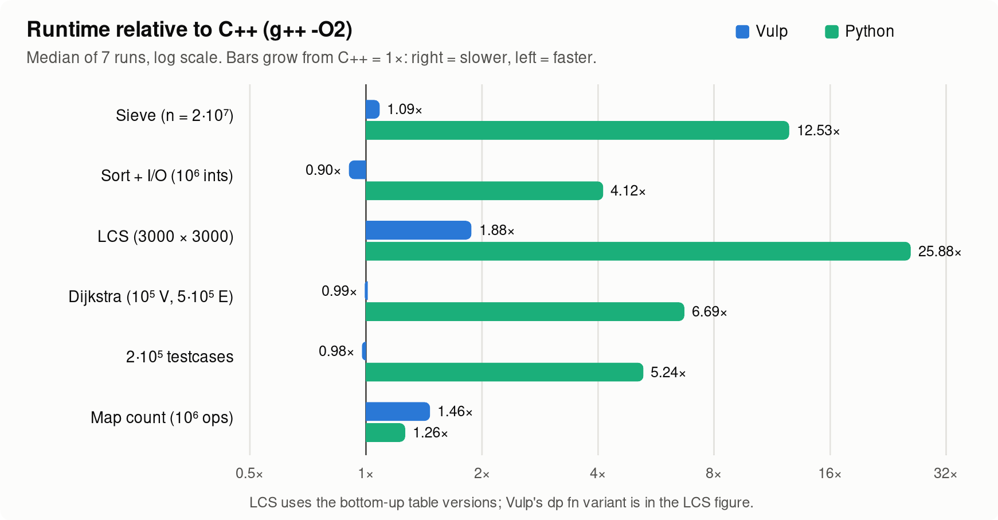
RESULTS
Runtime: C++ speed, 4.5–14× faster than Python
• Equal to C++ on sieve, Dijkstra and testcases
• 10% faster on sort + I/O: Vulp's reader and printer beat untied iostreams
• LCS table 1.88×: int (64-bit) vs C++'s 32-bit int; with i32 it is 1.13×
• Map 1.46×: values in separate allocations, calls into the runtime
Vulp V1 · 10
Notes:
Four of six problems are within 10% of C++. The two gaps are understood: the element width in the LCS table, and the map implementation.

Slide 11
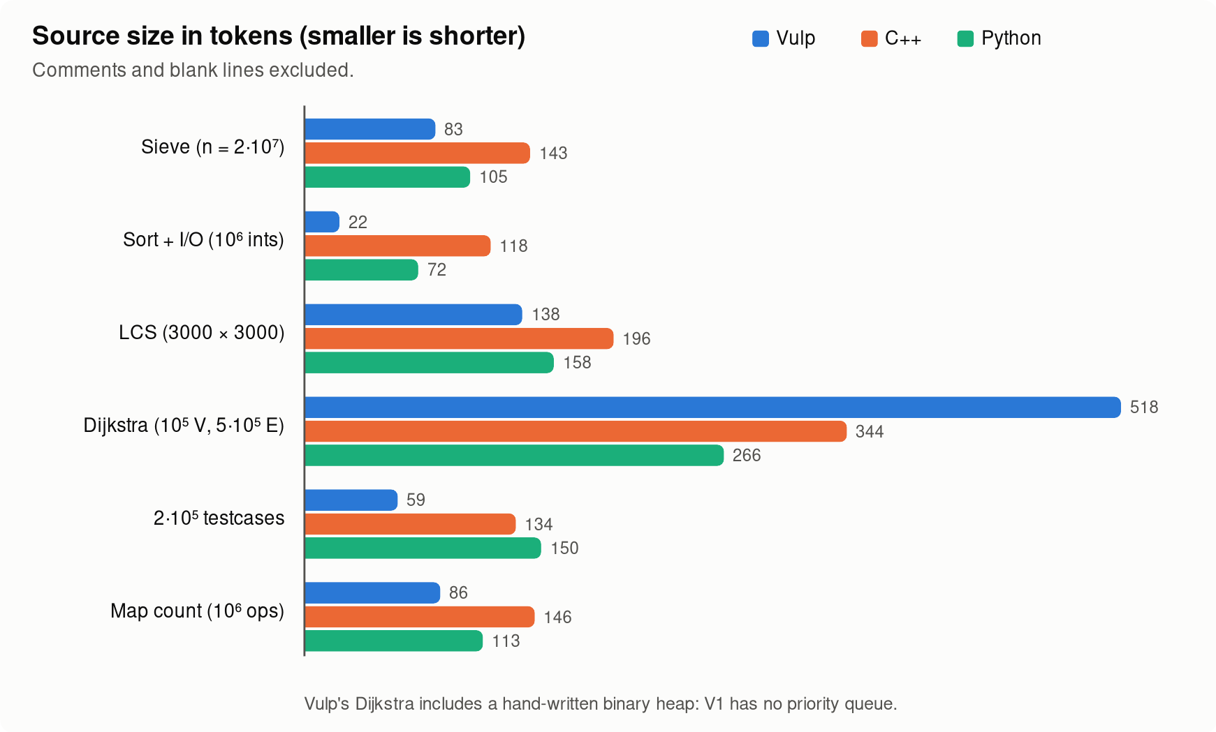
RESULTS
Code: 30–81% fewer tokens than C++
All of sort + I/O: 22 tokens
read int n;
read int[n] a;
a.sort();
println(a);
• Shortest of the three languages on 5 of 6 problems
• Dijkstra is longer: V1 has no priority queue, so the program carries a 30-line heap
Vulp V1 · 11
Notes:
Tokens, not lines, so formatting does not matter. The Dijkstra outlier points at the most useful library addition for V2.

Slide 12
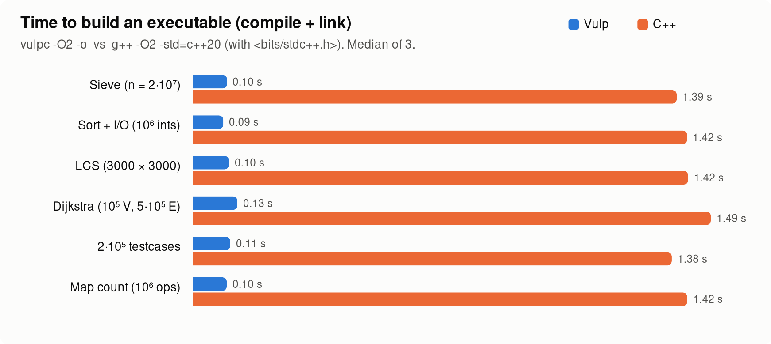
RESULTS
Build in 0.1 s, or run straight from source
0.09–0.13 s
vulpc: build a native executable
1.38–1.49 s
g++ -O2 with <bits/stdc++.h>
+20–45 ms
JIT: compile in memory and run
Vulp V1 · 12
Notes:
About 14× faster builds than g++, mostly because g++ parses all of bits/stdc++.h. The JIT adds only tens of milliseconds, so edit-run cycles are instant.

Slide 13
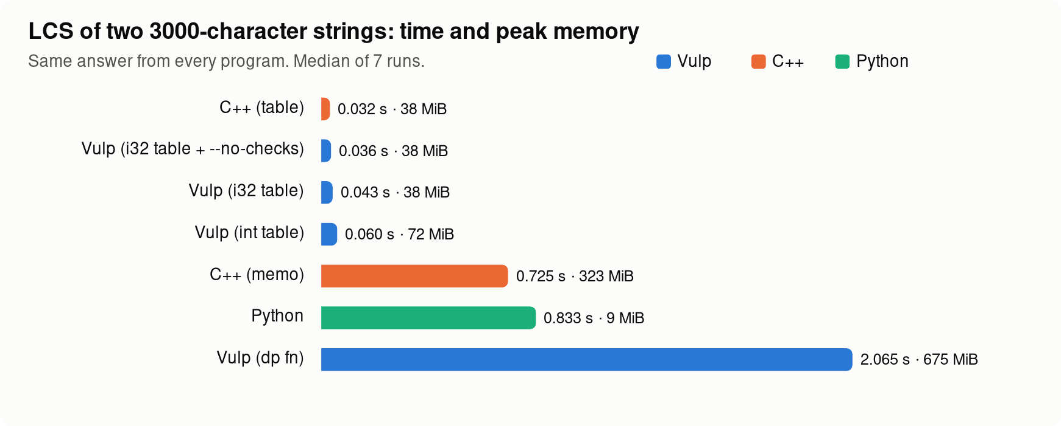
RESULTS
The price of dp fn
• On 9·10⁶ states, dp fn is 2.8× slower and 2.1× larger than hand-memoised C++
• Causes: byte-wise hashing, two probes per miss, 28-byte entries, rehash on growth
• Typical contest sizes (≤ 10⁶ states) still finish well under a second
• A table is always faster: dp fn buys brevity and safety
Vulp V1 · 13
Notes:
This is the honest weak spot. A memoised recursion can't beat a table, but the memo table itself should reach parity with C++ unordered_map; the fixes are inside the runtime.

Slide 14
RESULTS
Ablations: checks are cheap, widths matter
Runtime checks on vs off
int vs i32 elements (LCS table)
Program | Checks | --no-checks | Cost
Sieve | 0.057 s | 0.059 s | -3%
Sort + I/O | 0.138 s | 0.138 s | +1%
LCS (dp fn) | 2.071 s | 2.062 s | +0%
LCS (table) | 0.060 s | 0.054 s | +10%
Dijkstra | 0.124 s | 0.122 s | +2%
Testcases | 0.072 s | 0.071 s | +1%
Map count | 0.537 s | 0.552 s | -3%
LCS table element | Time | Memory
int | 0.061 s | 72 MiB
int + --no-checks | 0.055 s | 72 MiB
i32 | 0.043 s | 38 MiB
i32 + --no-checks | 0.036 s | 38 MiB
• Checks cost ≤ 10%, only in the innermost loop of a dense DP
• One word, int → i32, halves memory and gives 1.4×
Vulp V1 · 14
Notes:
Bounds checks stay on by default because they are nearly free. Picking the element width is the bigger lever, and Vulp makes it a one-word change.

Slide 15
QUALITY
Tested at every step, reviewed until satisfied
142
34 × 3
88
26
unit tests
end-to-end programs: JIT, binary, poisoned frees
AddressSanitizer runs, 0 reports
review findings, all fixed + tested
Round | Findings | Examples
1 | 10 | memory never freed (1 GB loops), MIN / -1, O(capacity) dp reset, input overflow
2 | 7 | dangling & references after a resize, float → i256 crash, leaked temporaries
3–5 | 7 + 1 | aliasing bypass f(v, v), recursive-struct crash, evaluation order
6–7 | 0 + 1 | satisfied: 300 generated programs, 110 under ASan; + 1 self-found fix (erase key)
Vulp V1 · 15
Notes:
An independent reviewer agent attacked the compiler in a loop until it found nothing more. Every finding became a regression test.

Slide 16
WRAP-UP
Limitations and next steps
Not in V1
Next, guided by the measurements
• Lambdas, generics, custom comparators
• Priority queue and sorted set
• Fixed-precision float output, line input
• Runtime checks of int<lo..hi>
• The & rules are conservative: a few safe calls are rejected
• pq<T> and set<T>: removes Dijkstra's hand-written heap
• Memo table specialised by key size, one probe per miss: target parity with C++ (now 2.8×)
• Map values stored inline, for k, v in m: close the 1.46× gap
• Suggest i32 when DP values provably fit (1.4×)
Vulp V1 · 16
Notes:
Each next step is tied to a number measured in this report.

Slide 17
WRAP-UP
Try it
cmake -S . -B build -G Ninja && cmake --build build
./build/vulpc examples/01_hello.vp # JIT
./build/vulpc examples/03_testcases.vp -o tc # binary
./tc < examples/03_testcases.in
(cd build && ctest) # all tests
python3 docs/report/bench/run_bench.py # benchmarks
github.com/vulp-lang/vulp
• docs/tutorial.md: step-by-step guide
• docs/language.md: reference
• docs/report/REPORT.md: this evaluation
• examples/: 10 runnable programs
Thank you
Vulp V1 · 17
Notes:
Needs CMake, a C++20 compiler and LLVM 18. Every number in this deck is reproduced by the scripts in docs/report/bench.

