Slide 3

Simulate and Analyze
a Digital Communication System using Matlab
Instructor: Prof. Nguyễn Văn Đức

Slide 4
CONTENT
Introduction
Method
Experimental results
Conclusion

Slide 5
INTRODUCTION
Our goals:
Designed and simulated a digital communication system using
QPSK modulation/demodulation
LDPC coding/decoding
AWGN and Rayleigh fading channel.
Analyzed system performance through BER.

Slide 6
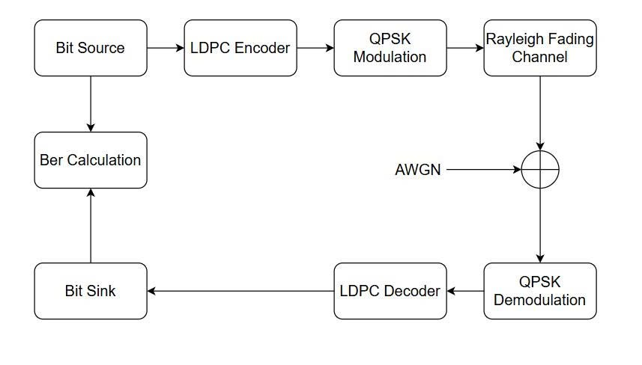
INTRODUCTION

Slide 7
2. METHOD
2.1. Bit source
Generate bit source with the length of 10^6 bits

Slide 8
2. METHOD
2.2. LDPC Codes
Low-Density Parity-Check Codes
Proposed by Robert Gallager in his 1960 PhD thesis at MIT.
Used in
Wi-Fi networks
5G NR data channels
SSDs

Slide 9
2. METHOD
LDPC codes are codes specified by a matrix containing mostly 0's and relatively few 1's.
Each column contains a small fixed number j of 1's
Each row contains a small fixed number k of 1's

Slide 10
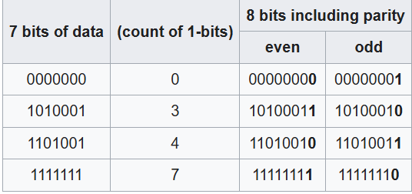
2. METHOD

Slide 11
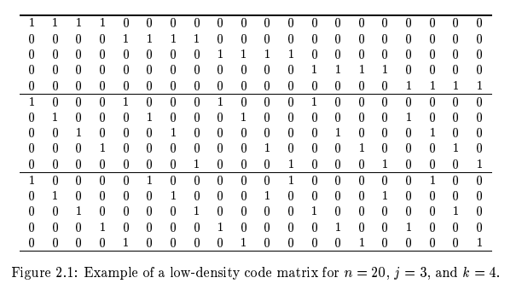
2. METHOD

Slide 12

2. METHOD
Sydrome Check (S) = zeros vector, the algorithm will stop.
Decoding Algorithm
Hard Decision: Bit-Flipping
Soft Decision: LLR + Min Sum Algorithm

Slide 13
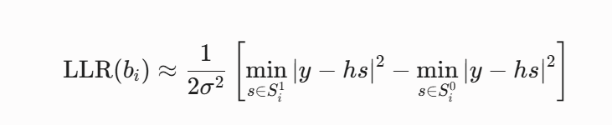
2. METHOD
Calculate Log-Likelihood Ratio
LLR > 0: Bit có khả năng cao là 0.
LLR < 0: Bit có khả năng cao là 1.
Y: received signal
H: channel coefficient
S: reference point
Sigma: variance of noise

Slide 14
2. METHOD
Min-Sum algorithm
Definition: reduces computational overhead by replacing complex non-linear mathematical operations (like tanh) with simple minimum comparisons and additions.
How it works:
Sign Parity Check: The sign of the message sent to a target node is the product of the signs of all other incoming messages.
Magnitude: The magnitude of the message is simply the smallest absolute value (the minimum) among all other incoming messages. It assumes the reliability of the parity check is bounded by its least reliable bit.

Slide 15
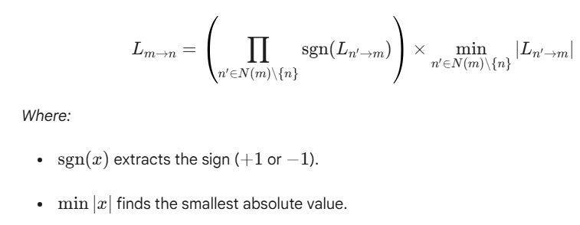
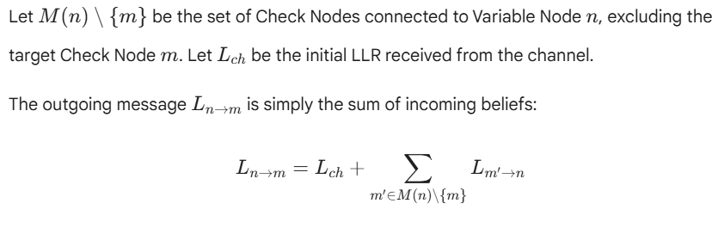
2. METHOD
Min-Sum algorithm

Slide 16
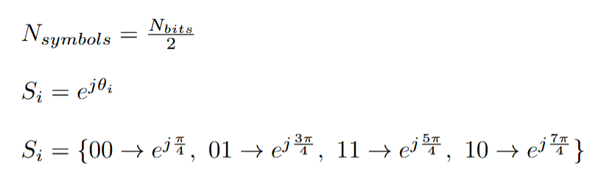
2. METHOD
2.3. QPSK Modulation
Bit grouping: Processes the bit source by grouping it into pairs of two bits at a time using a step size of 2. In QPSK, each symbol carries exactly 2 bits.
Phase mapping: Evaluates each 2-bit combination and maps it to a phase angle on a complex plane using Euler's formula.

Slide 17
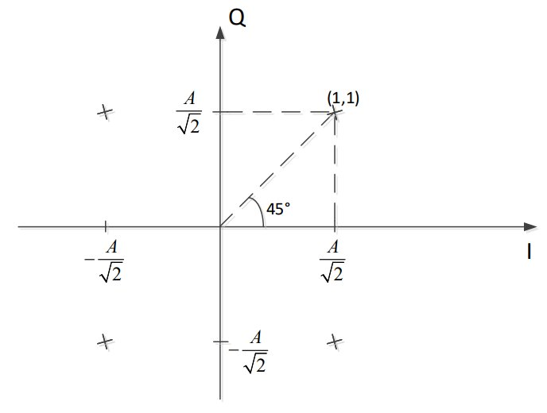
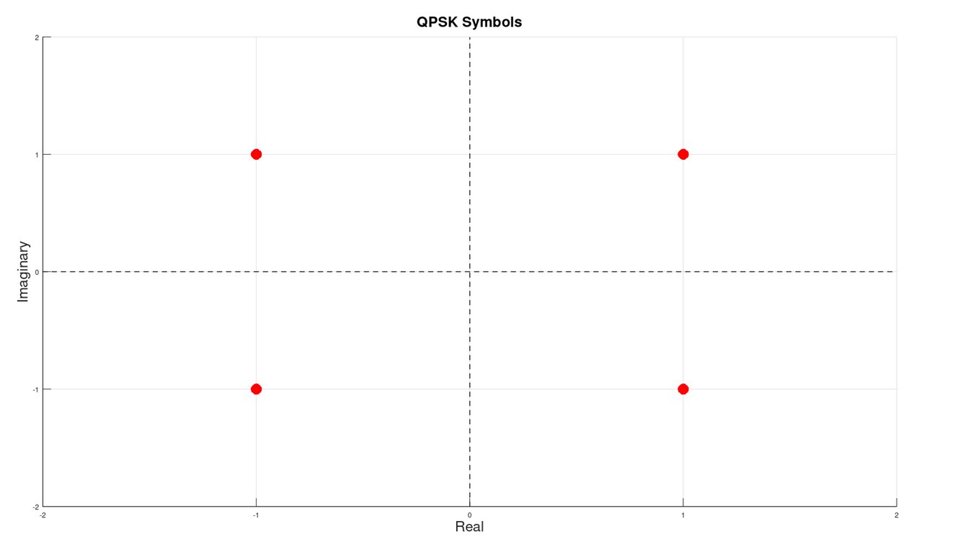
2. METHOD
2.3. QPSK Modulation

Slide 18
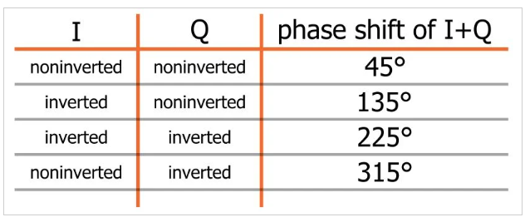
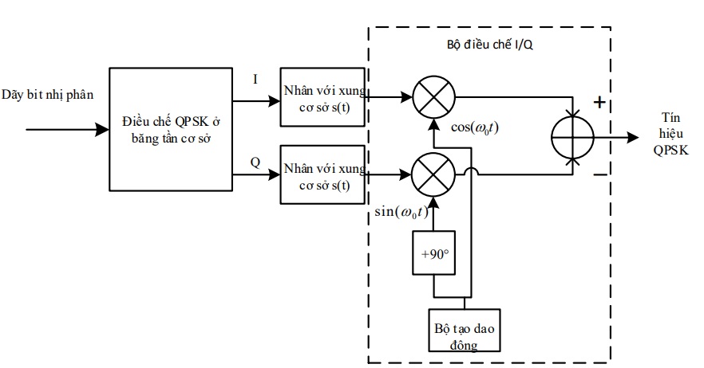
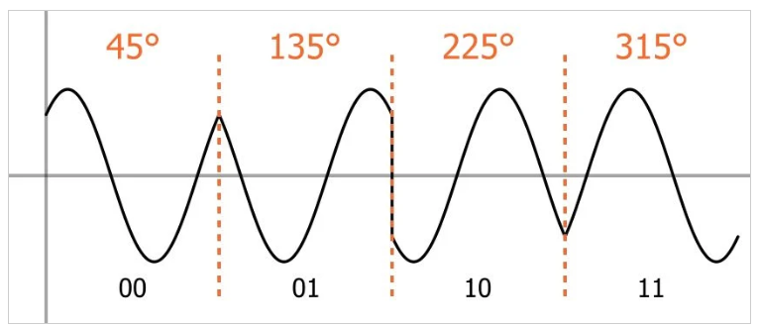
2. METHOD
2.3. QPSK Modulation

Slide 19
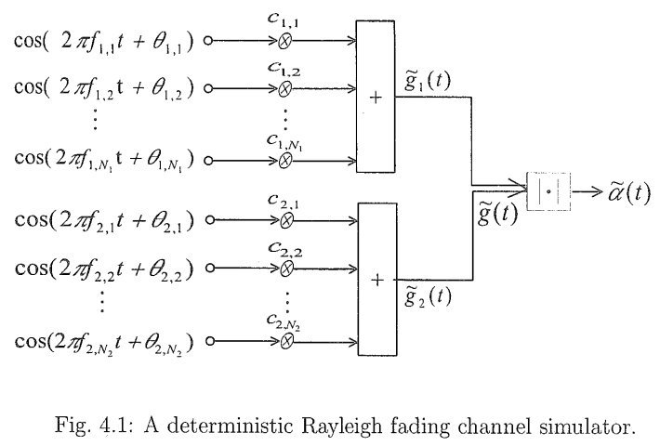
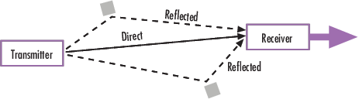
2. METHOD
2.4. Rayleigh fading channels:
Mathematical model used to describe realistic wireless propagation environments. It is primarily characterized by multipath propagation under Non-Line of Sight (NLOS) conditions.
How signal change:
Amplitude Changes (Fading & Deep Fades)
Phase Changes (Random Phase Shift)
Frequency Changes (Doppler Spread)

Slide 20
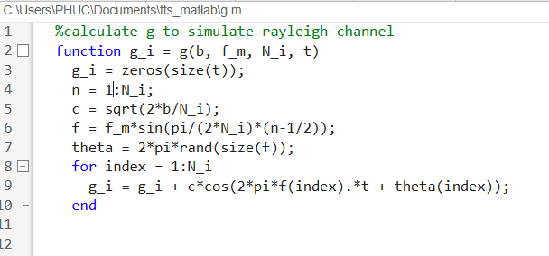
2. METHOD

Slide 21
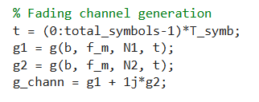
2. METHOD

Slide 22
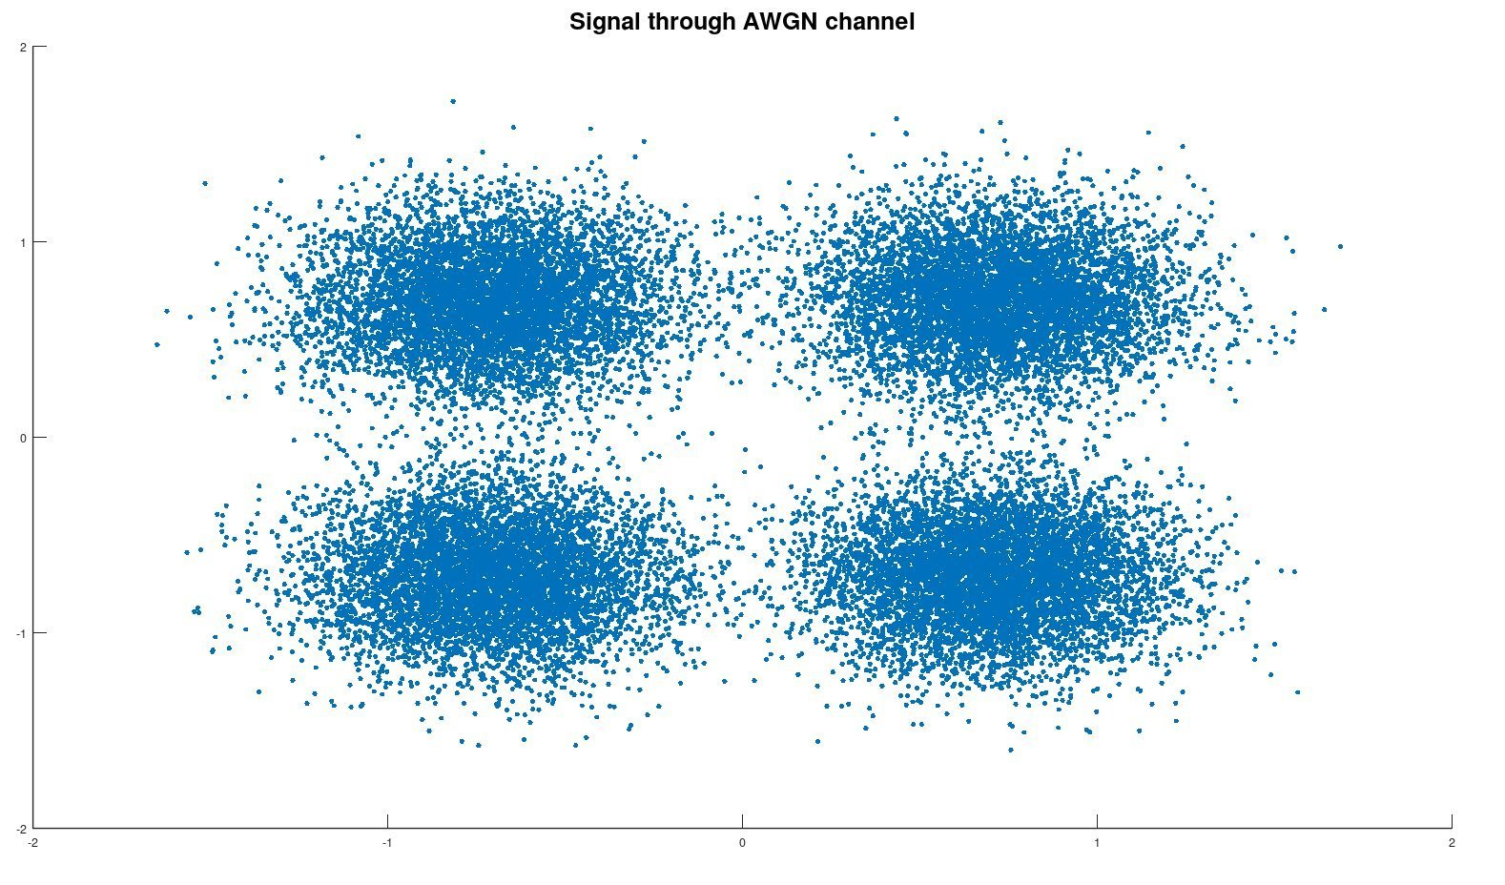
2. METHOD
2.5. AWGN:
Additive: The noise is added to the transmitted signal.
White: The noise has a flat power spectral density across all frequencies.
Gaussian: The amplitude of the noise follows a Gaussian distribution.

Slide 23
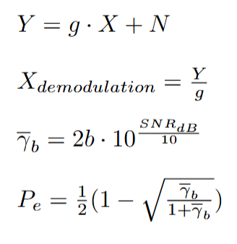
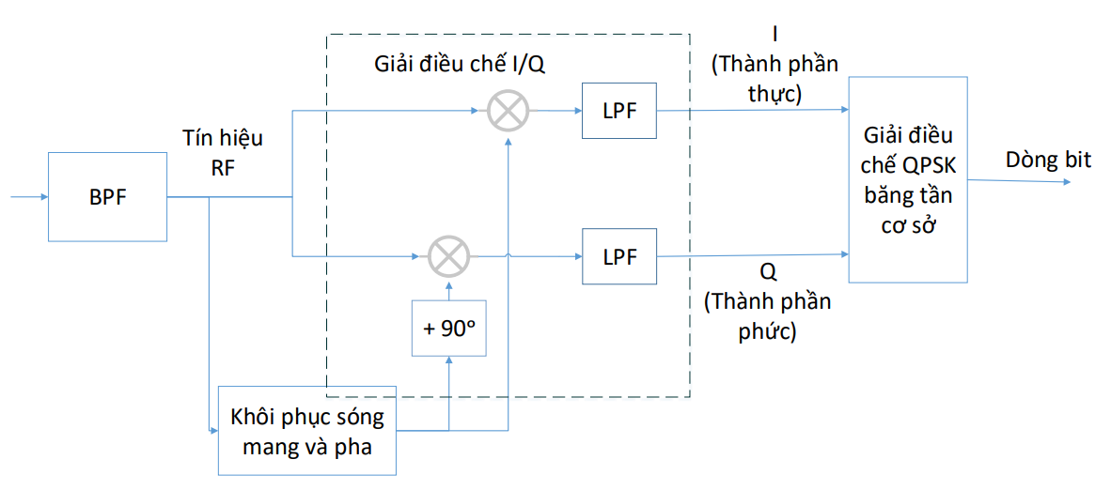
2. METHOD
2.6. Rayleigh fading channel + AWGN + QPSK demodulation
Channel propagation: The transmitted signal X is distorted by the Rayleigh fading channel coefficient g and Additive White Gaussian Noise N.
Zero-forcing equalization: To recover the signal, the receiver divides the received signal Y by the channel coefficient g to reverse the fading and phase rotation before demodulation.
Calculates the average BER and theoretical BER

Slide 24
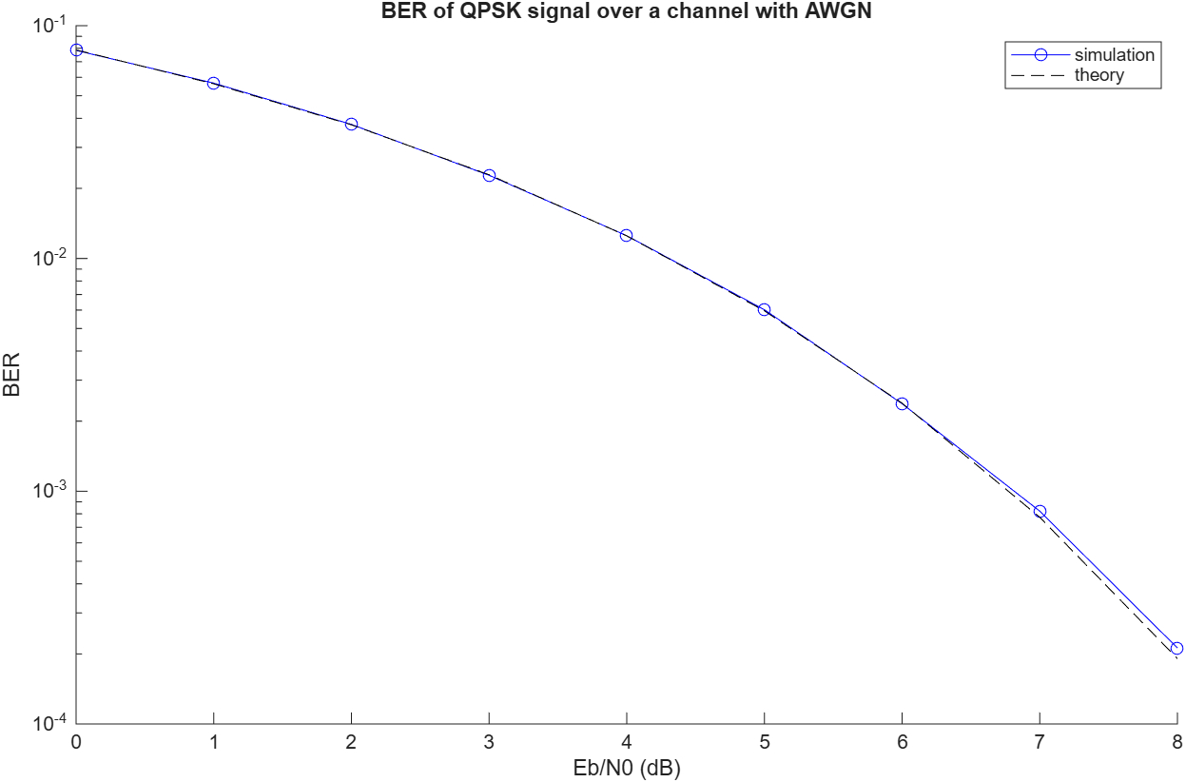
3. Experimental results

Slide 25
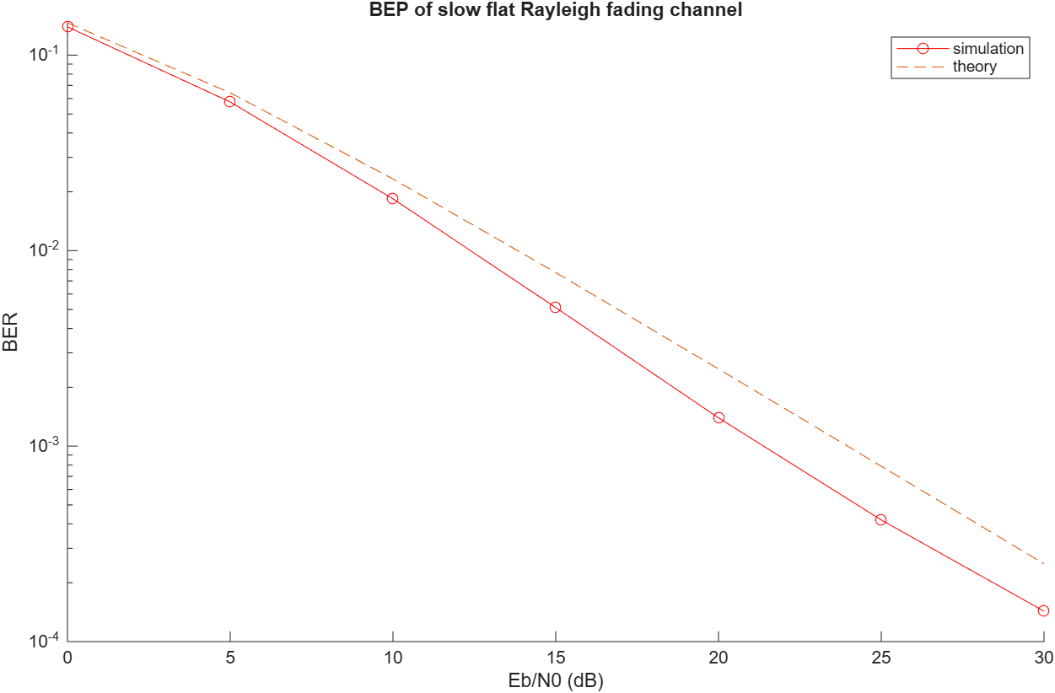
3. Experimental results

Slide 26
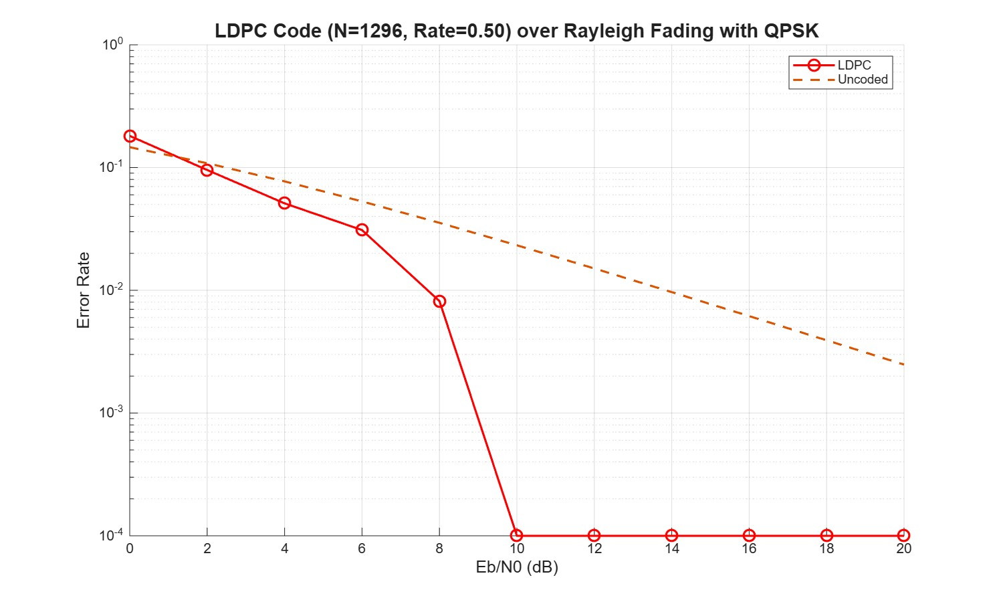
3. Experimental results

Slide 27
4. Conclusion
General trend: Across all channel conditions, an increase in SNR consistently results in a lower BER.
AWGN Channel (Ideal): Demonstrates the best performance with an exponential decrease in BER as SNR improves, serving as the theoretical baseline.
Rayleigh Fading Channel: Suffers severe performance degradation due to multipath fading. The BER drops much slower compared to AWGN.
LDPC codes: Reduce BER to 0 with relatively low SNR (10 dB) even being affected of Rayleigh Fading Channel.

Slide 28
THANK YOU !

