Slide 1
Kubernetes training by Lazy guy
Quang, VU

Slide 2
Step 0: Env env env
K8s (I use k3s)
Cert-manager ready
An ingress-controller ready (I use Kong)
Octant (very important one, as we are Lazy)

Slide 3
The 20 in 80/20 Pareto rule
The Pareto Principle states that 80% of consequences come from 20% of the causes.

Slide 4
K8s is Declarative not Imperative
The commands you need to remember
kubectl create
kubectl delete
Delete stubborn pod:
kubectl delete pod --grace-period=0 --force --namespace wireguard-vpn wireguard-8657c7fc-vqld2
kubectl rollout restart
kubectl rollout restart deployment <deployment-name> -n <namespace>
Debug: to run shell of a pod
kubectl exec -it pod-name -- /bin/bash
kubectl -n kube-system port-forward --address 0.0.0.0 service/<servicename> <hostport>:<serviceport> --namespace your-namespace
kubectl -n kube-system port-forward --address 0.0.0.0 service/abcApp 20000:80 --namespace apps

Slide 5
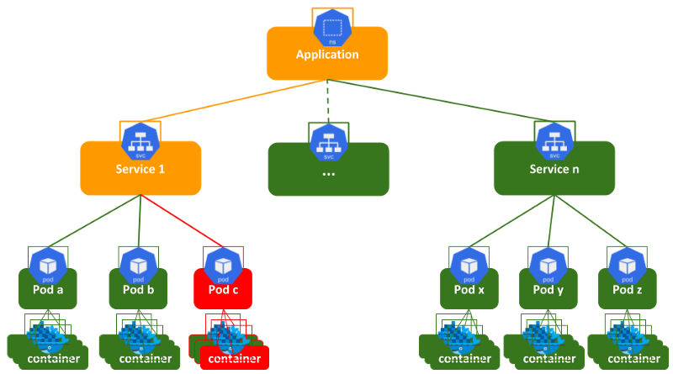

Slide 6
Our application provides the features via:
n smaller Services.
The services NOT do anything, except PROXY for Pods.
The pods NOT do anything, except PROXY for (docker) Containers.
The container do the jobs.
Via the management tools (Services & Pods), Kubernetes ensures
the containers co-operation
the continuous providing of services
replace a container when there are errors
rolling update code in the containers

Slide 7
Step 1: convert docker-compose to k8s
Modify docker-compose a bit to make it work for Kompose
Run Kompose and get the k8s code

Slide 8
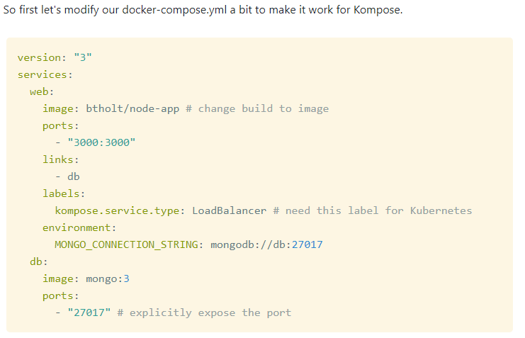
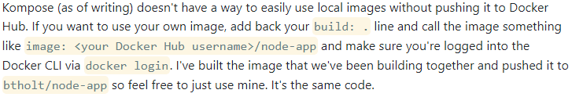

Slide 9
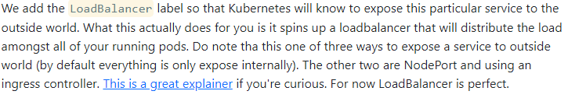

Slide 10
https://btholt.github.io/complete-intro-to-containers/kompose

Slide 11
kompose convert -f ../docker-compose.yml

Slide 12
Step 2: Run the code and use Octant to track
To run
kubectl apply -f .
To stop
kubectl remove -f .

Slide 13
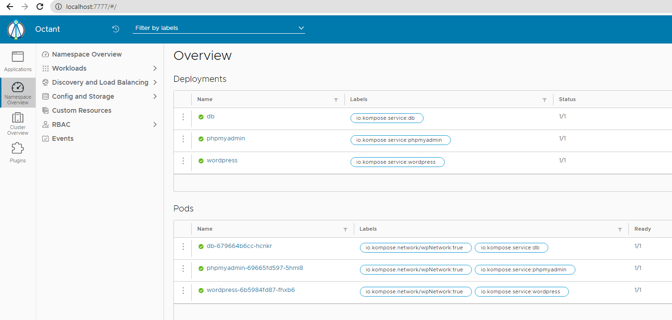

Slide 14
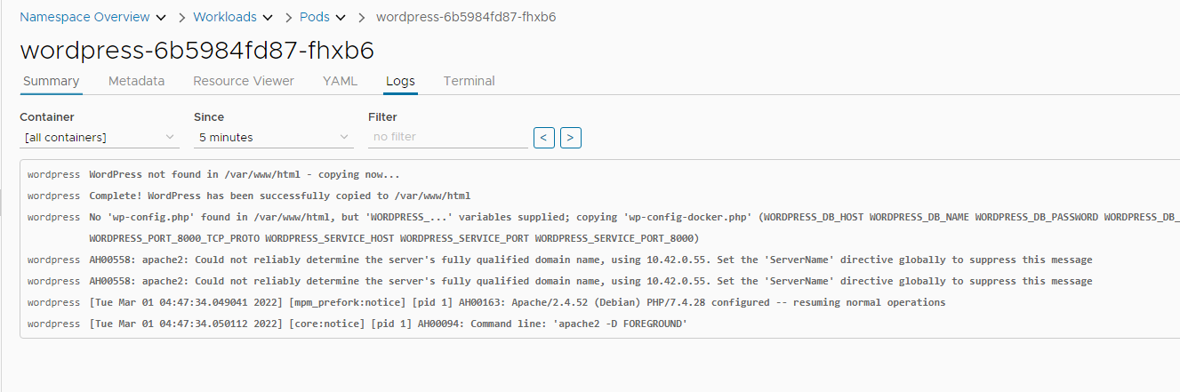
Via log & terminal, easy to debug the deployment of the pods

Slide 15
Other 80

Slide 16
Step 3: Inspect the code created by Kompose
In the created code, Kompose separates each “docker-compose service” into services+pods
For example
Service db
Service wService
Service adminSvr
docker-compose
MySQL: db
Wordpress: wService
PhpMyAdmin: adminSvr
..
Pod dbxxx
Pod wServicexxx
Pod adminSvrxxx
Docker Container
Image: MySQL
Docker Container
Image: Wordpress
Docker Container
Image: PhpMyAdmin

Slide 17
Step 3: Inspect the code created by Kompose
Consider if we need to do that: 1 service, 1 pod, n containers?
Service db
Service wService
Service adminSvr
Service wService
Pod dbxxx
Pod wServicexxx
Pod adminSvrxxx
Pod wServicexxx
Docker Container
Image: MySQL
Docker Container
Image: Wordpress
Docker Container
Image: PhpMyAdmin
Docker Container
Image: MySQL
Docker Container
Image: Wordpress
Docker Container
Image: PhpMyAdmin

Slide 18
Step 3: Inspect the code created by Kompose
Consider if we need to do that: 1 service, 1 pod, n containers?
Service db
Service wService
Service adminSvr
Service wService
Pod dbxxx
Pod wServicexxx
Pod adminSvrxxx
x
Pod wServicexxx
Docker Container
Image: MySQL
Docker Container
Image: Wordpress
Docker Container
Image: PhpMyAdmin
Docker Container
Image: MySQL
Docker Container
Image: Wordpress
Docker Container
Image: PhpMyAdmin
ANSWER: NOT, it will affect when we want to upgrade the containers

Slide 19
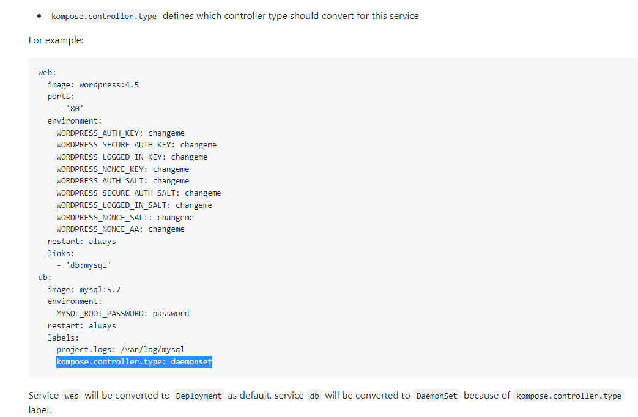
Step 4: go back to docker-compose and set for labels
For example
https://github.com/kubernetes/kompose/blob/master/docs/user-guide.md

Slide 20
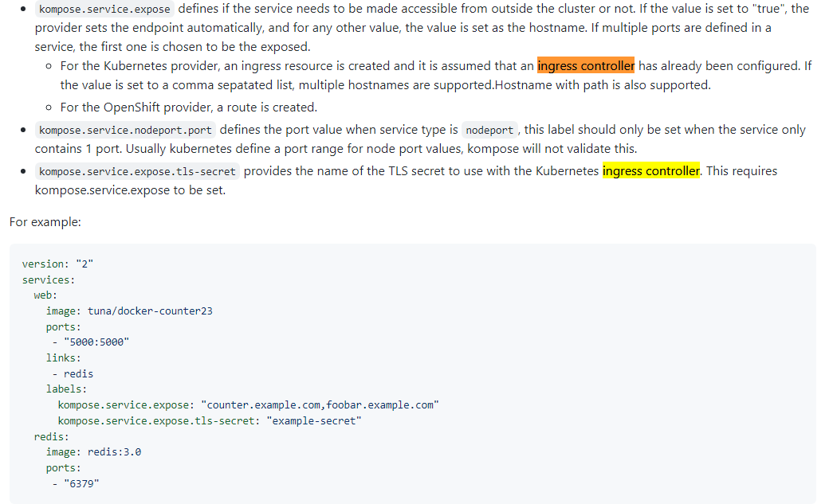
Step 5: set the domain for ingress controller

