Slide 1

Advanced RAG
Ollama + Langchain + SuperPOD
Presented by Tue Vu, PhD
AI/ML Research Scientist
SMU OIT Research Tech. Service

Slide 2
Agenda
Introduction to RAG
Why need RAG Advanced
Why Ollama + Langchain + SuperPOD
Hands-on
Q&A

Slide 3
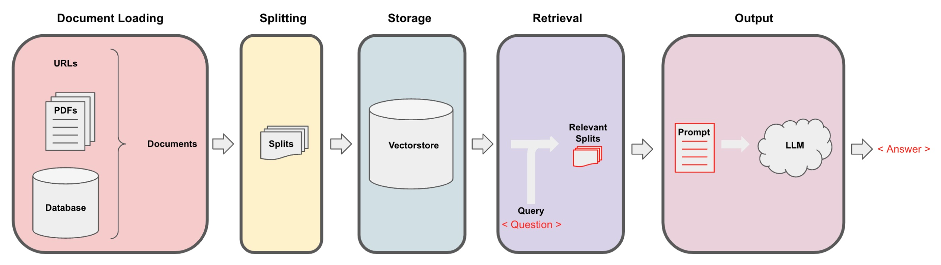
RAG
RAG helps LLM to avoid Hallucination from out of corpus training
RAG helps LLM to focus and response fast
RAG has been used in multiple documents search

Slide 5


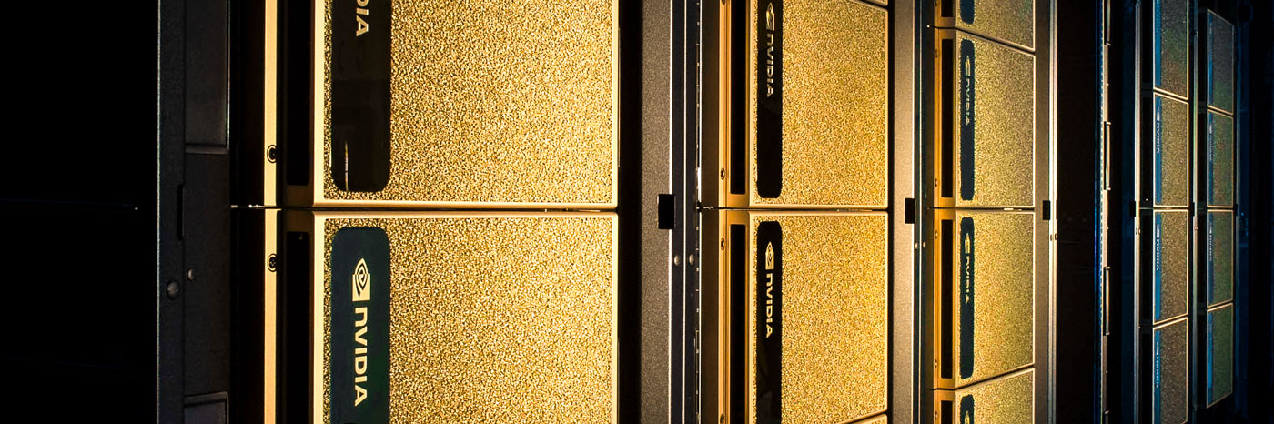
Open-source LLMs
Open-source Embeddings
Connect the LM workflow
Provide GPUs
Provide storage

Slide 6
Disadvantage of simple RAG
Require specific prompting
Not always return the right chunks
Not working for all RAG workflow

Slide 7
Advanced RAG
https://github.com/NirDiamant/RAG_Techniques/tree/main
The provided github works with older version of Langchain and using OpenAI API key
The revised version works with Langchain version 1.2.8 (>1) and using Ollama running on SuperPOD that can be applied to any workflow running locally
Step by step instructions

Slide 8

Simple RAGs Technique

Slide 9
1. Simple RAG
Embedding model from Ollama
Vectorstore:
FAISS
Chroma
RecursiveCharacterTextSplitter
Chunk size
Chunk overlap
PyPDF to load pdf
- With given query:
Similarity search:
Max marginal relevance
LLM from Ollama
LCEL to get output

Slide 10
2. Simple RAG for CSV tabular
Embedding model from Ollama
Vectorstore:
FAISS
Chroma
- With given query:
Similarity search:
Max marginal relevance
LLM from Ollama
LCEL to get output
CSV loader to load csv
Each row is a chunk

Slide 11
3. Reliable RAG
For Standard RAG, if Retrieval return irrelevant chunk it still continue => Hallucination
- With given query:- Ask LLM to rate if the shortlisted chunks are relevant to the query or not and retain these chunks
Embedding model from Ollama
Vectorstore:
FAISS
Chroma
RecursiveCharacterTextSplitter
Chunk size
Chunk overlap
PyPDF to load pdf
LLM from Ollama
LCEL to get output

Slide 12
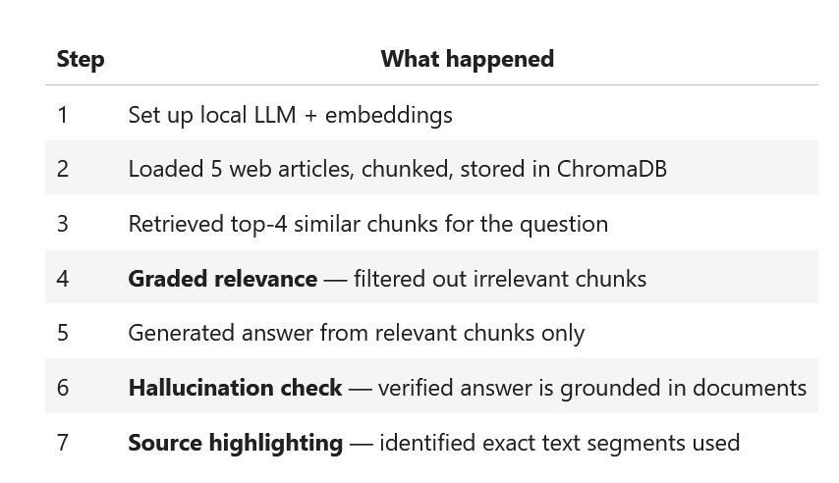
3. Reliable RAG
Ask LLM to check for Hallucination from the generated answer
Ask LLM to Highlight the source segment
- With given query:
Ask LLM to rate if the shortlisted chunks are relevant to the query or not and retain these chunks to generate answer

Slide 13

Query

Slide 14
4. Query Transformation
For complex & ambiguous queries
Query Rewriting | Step-back prompting | Sub-query Decomposition
Using LLM to rewrite the query to expands include specific aspect: “You are an AI assistant tasked with reformulating user queries to improve retrieval in a RAG system. Given the original query, rewrite it to be more specific, detailed, and likely to retrieve relevant information” | Using LLM to rewrite the query to retrieve broader context and background: “You are an AI assistant tasked with generating broader, more general queries to improve context retrieval in a RAG system. Given the original query, generate a step-back query that is more general and can help retrieve relevant background information.” | Using LLM to rewrite the query to breakdown into smaller questions: “You are an AI assistant tasked with breaking down complex queries into simpler sub-queries for a RAG system. Given the original query, decompose it into 2-4 simpler sub-queries that, when answered together, would provide a comprehensive response to the original query.”

Slide 15
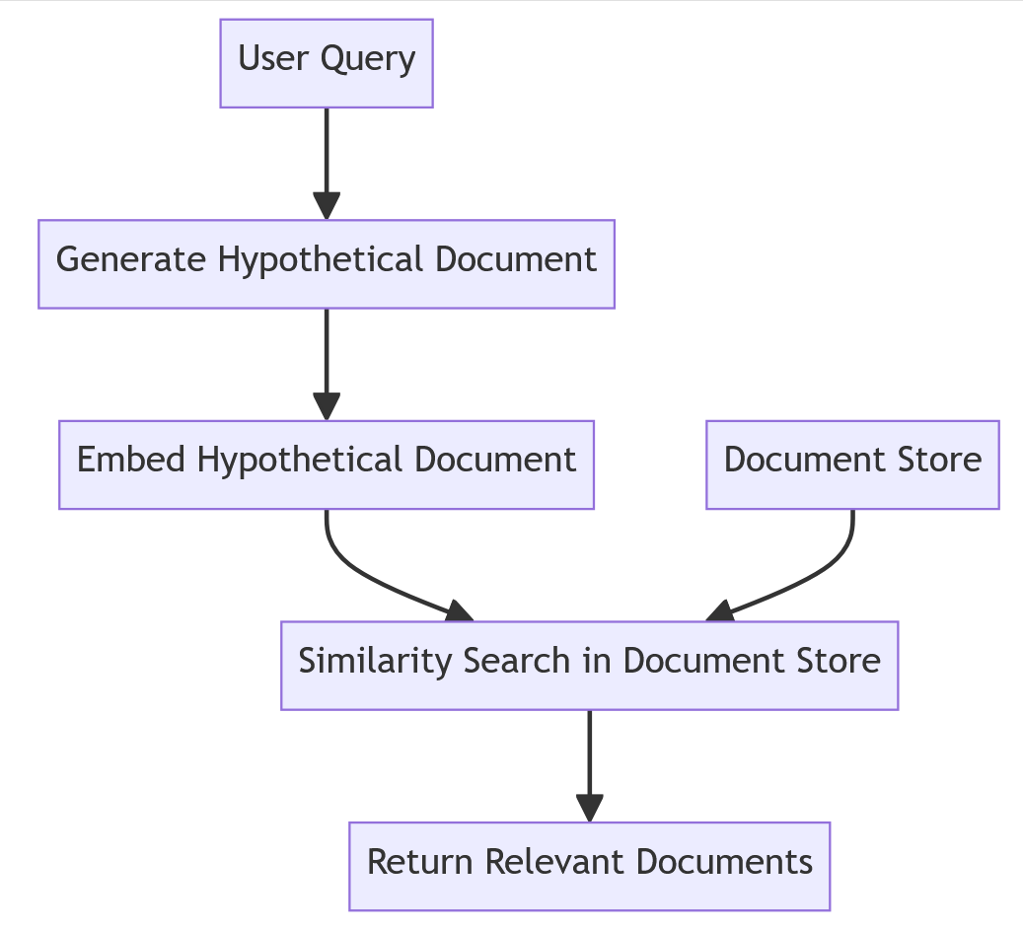
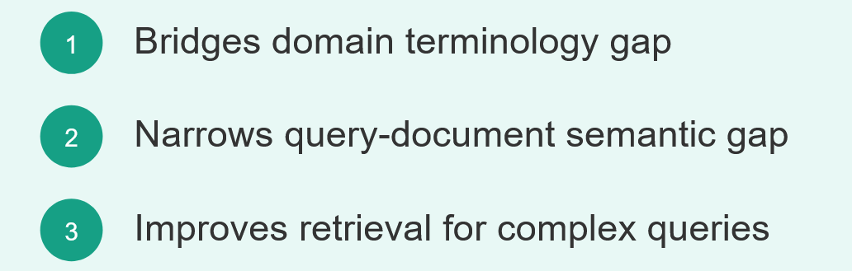
5. Hypothetical Document Embedding (HyDE)
To create longer documents and get better match
Standard Retrieval | HyDE Retrieval
Query → embed → search | Query → generate hypothetical answer → embed answer → search
Short query vs. long chunks (mismatch) | Full document vs. long chunks (better match)

Slide 16
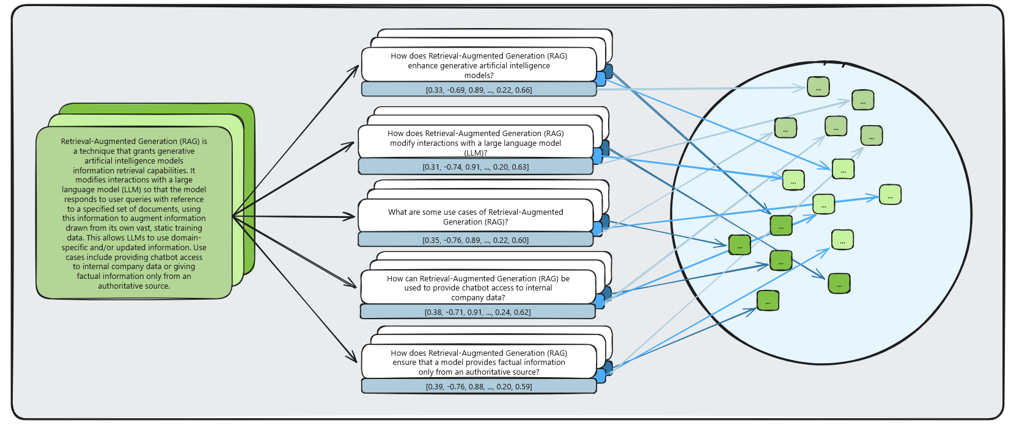
6. Hypothetical Prompt Embedding (HyPE)
HyPE is reverse of HyDE
Technique | When it generates | What it generates | Search type
HyDE | At query time | A hypothetical answer document | document → document
HyPE | At indexing time | Hypothetical questions per chunk | question → question

Slide 17

All about CHUNKS

Slide 18
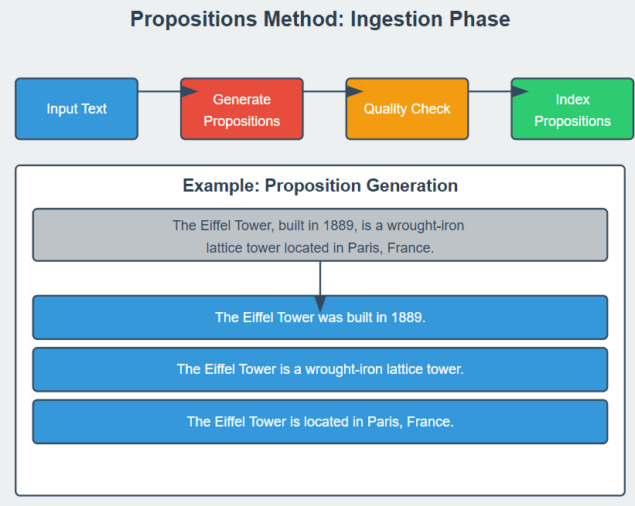
7. Proposition Chunking
Further splitting the chunk into smaller chunks with more focus
Standard Chunking | Proposition Chunking
Splits text by character count | Splits text into individual facts
One chunk = many mixed ideas | One proposition = one specific fact
May return irrelevant context | Returns only the relevant fact

Slide 19
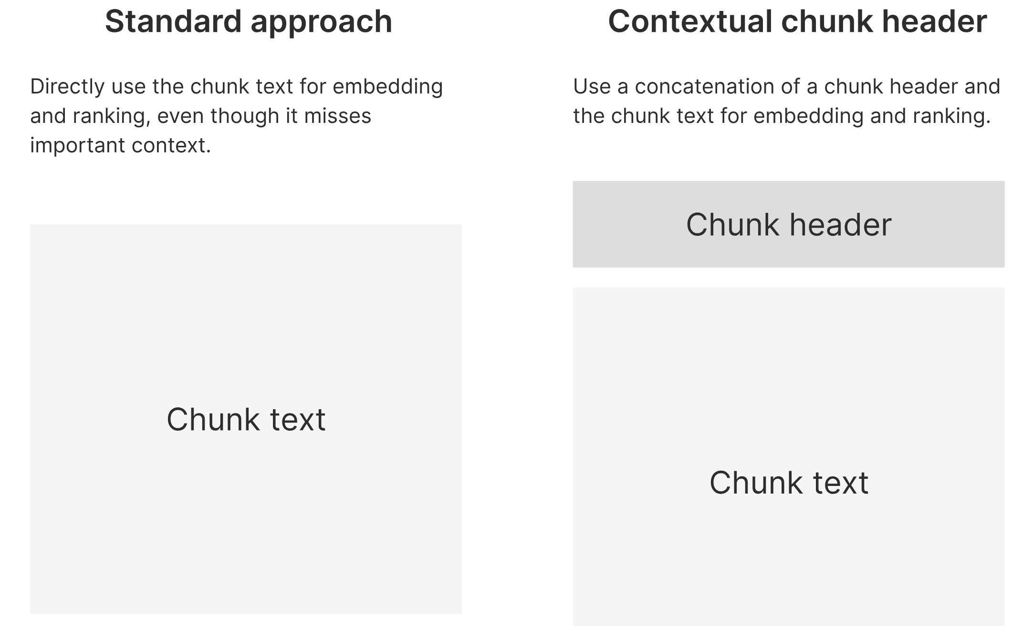
8. Contextual Chunk Headers (CCH)
CCH prepending a header for each chunk
Without CCH | With CCH
"the company reduced emissions by 30%" | "Document Title: Nike 2023 Annual Report the company reduced emissions by 30%"
Query "Nike climate change" → low match | Query "Nike climate change" → high match

Slide 20
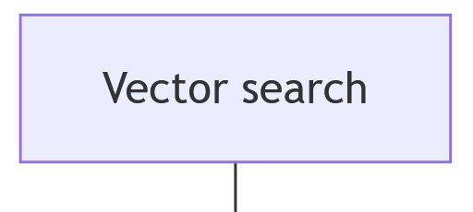
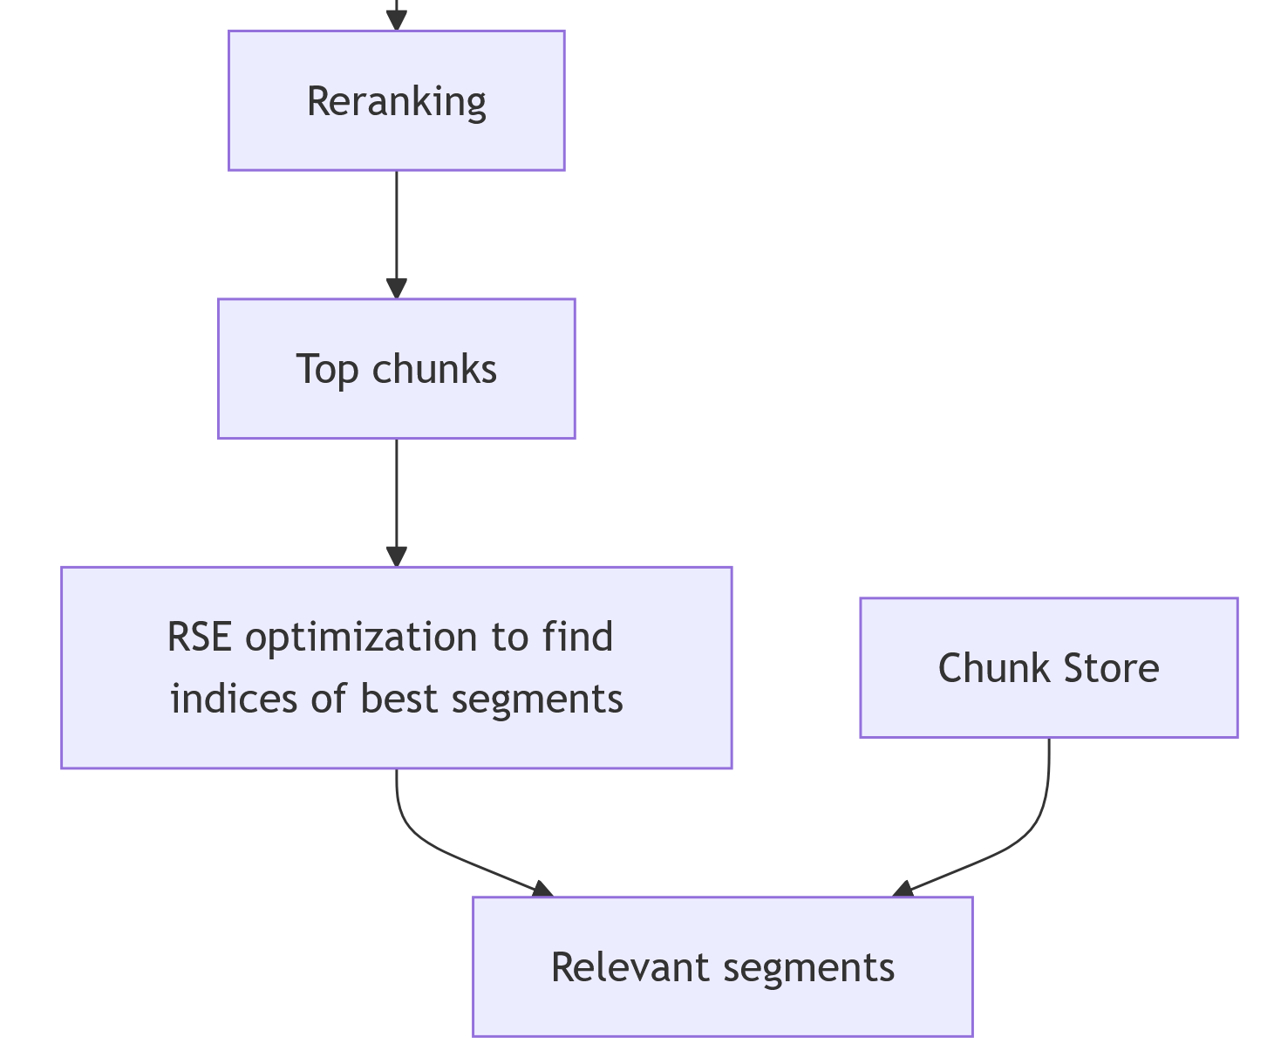
9. Relevant Segment Extraction (RSE)
If answer spans multiple consecutive chunk instead single?
Standard Top-k | RSE
Returns isolated chunks | Returns contiguous segments of the original document
May miss chunks between relevant ones | Fills in "sandwiched" chunks for complete context
Fixed-size results | Dynamic-length segments (short or long as needed)

Slide 21
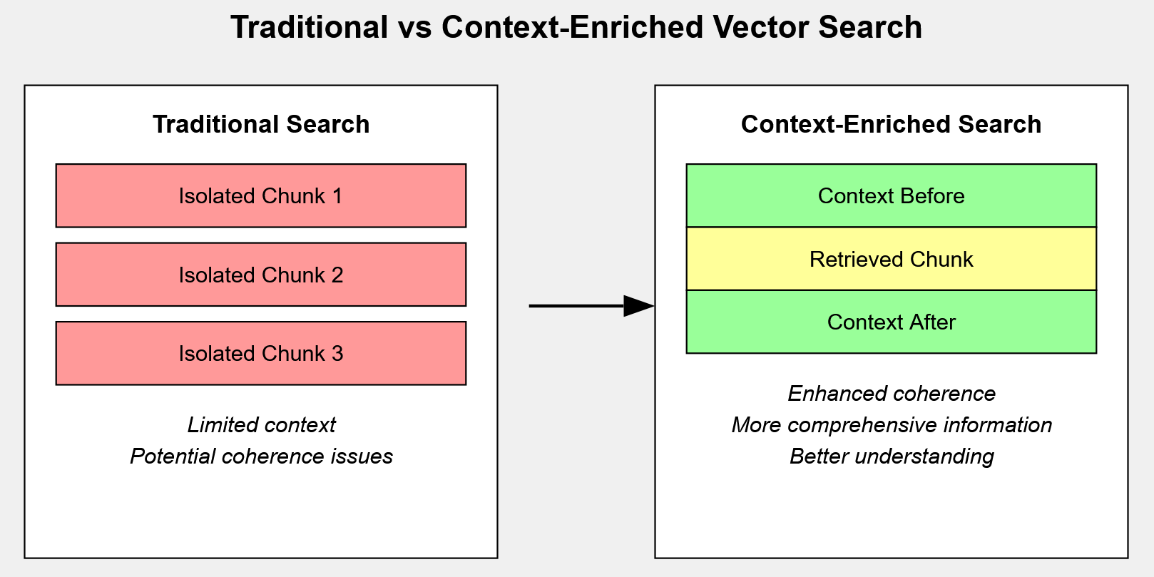
10. Context Enrichment Window (CEW)
CEW pads each retrieved chunked with its neighbouring chunks
Standard Retrieval | Context Enrichment
Returns the matched chunk only | Returns the matched chunk + neighbors before/after
May cut off mid-sentence | Provides a complete, coherent window
Fixed-size context | Wider, more informative context

Slide 22
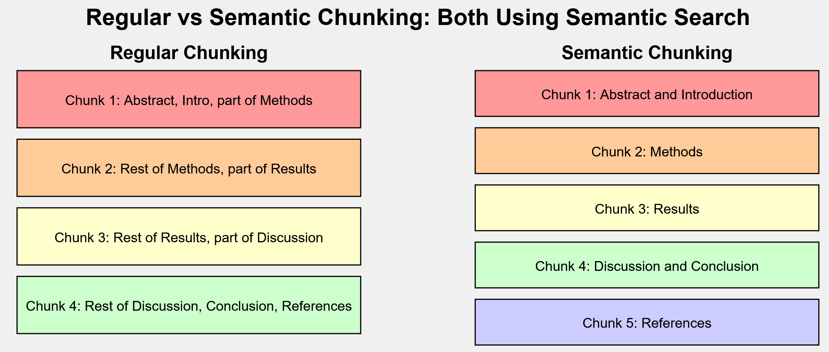
11. Semantic chunking
Splitting based on Semantic meaning
Fixed-Size Chunking | Semantic Chunking
Splits every N characters | Splits where meaning shifts
May cut mid-sentence or mid-idea | Keeps complete ideas together
Chunks may lack coherence | Chunks are semantically coherent

Slide 23

Retrieval

Slide 24
12. Contextual Retrieval
Uses LLM to extract only the relevant parts from retrieved chunk
Standard Retrieval | Contextual Compression
Returns full chunks (may contain irrelevant text) | Returns only the relevant parts of each chunk
LLM must sift through noise | LLM gets focused, compressed context
Given the following context, extract only the parts that are relevant to the question.

Slide 25
13. Document Augmentation through Question Generation
Use LLM to generate related questions and store with original text
Standard RAG | Augmented RAG
Store: original chunks only | Store: original chunks + generated questions
Query matches chunk text | Query matches a similar question → maps back to chunk
May miss semantically equivalent queries | Catches more query phrasings

Slide 26
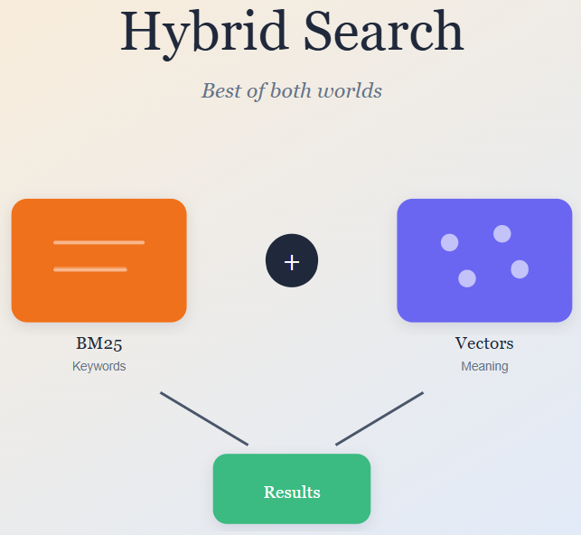
14. Fusion Retrieval
Combine semantic vector search + keyword search
Method | Strengths | Weaknesses
Vector search (FAISS) | Understands meaning, synonyms, paraphrases | May miss exact keyword matches
BM25 (keyword) | Excellent at exact term matching | No semantic understanding
Fusion | Both meaning AND keywords | Slightly more complex
Weighted_avg = alpha * vector_score + (1-alpha) * bm25_score

Slide 27
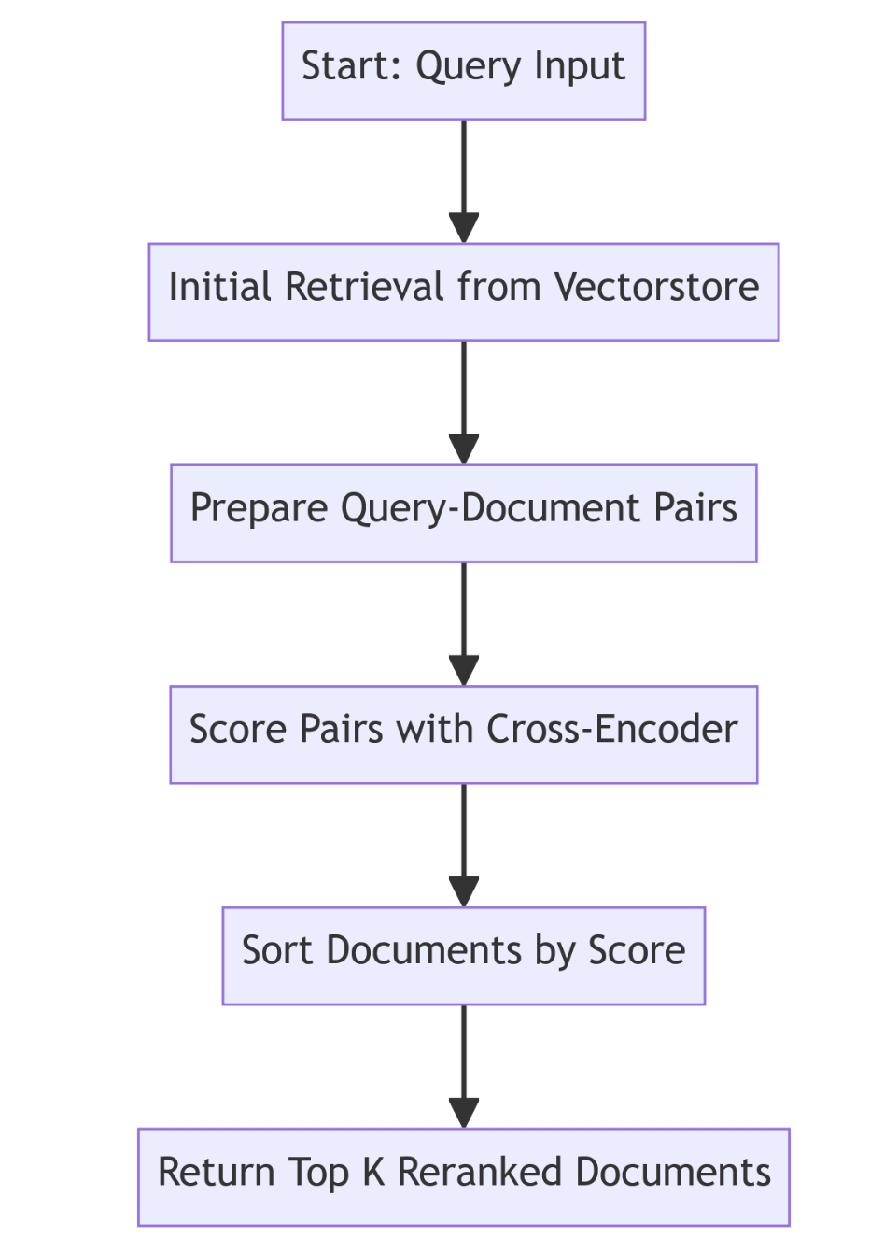
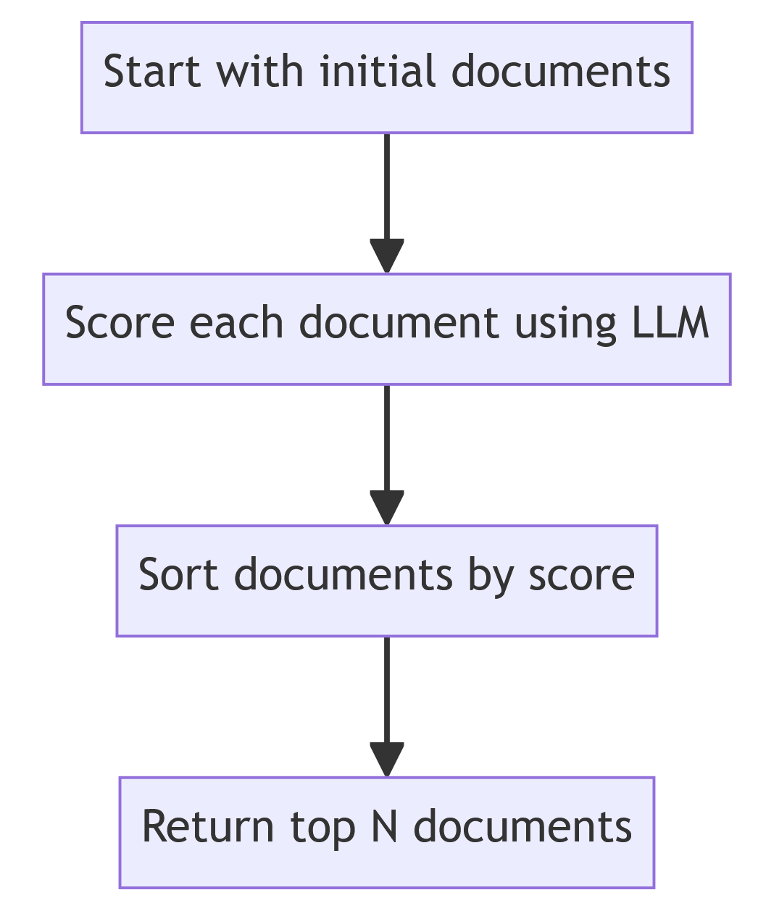
15. Reranker
After initial retrieval, apply Reranker to rearrange the retrieved chunks
Method | How it scores | Speed | Accuracy
LLM-based | Ask the LLM to rate each document 1-10 | Slow (one LLM call per doc) | High (leverages LLM reasoning)
Cross-Encoder | Feed (query, doc) pairs into a specialized model | Fast | High (trained specifically for relevance)
Method 1: Using LLM to rerank | Method 2: Using Cross Encoder

Slide 28
16. Adaptive RAG
**Adaptive RAG** first classifies the query, then picks the right strategy.
Query Type | Example | Strategy
Factual | "What is the distance to the Sun?" | Enhance the query for precision, then rank by relevance
Analytical | "How does distance from the Sun affect climate?" | Break into sub-questions, retrieve broadly, select diverse results
Opinion | "What are theories about the origin of life?" | Find multiple viewpoints, ensure diversity
Contextual | "How does Earth's position affect habitability?" | Incorporate user context, personalize retrieval

Slide 29
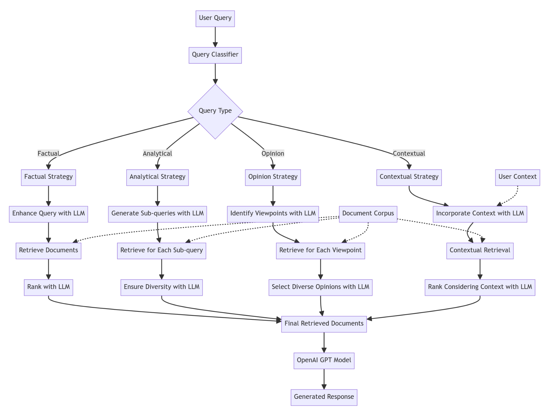
16. Adaptive RAG

Slide 30
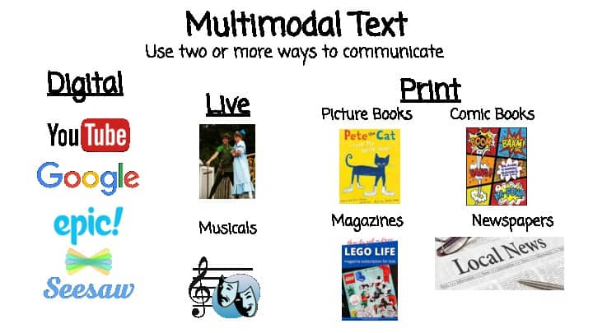
Advanced RAG

Slide 31
17. Multimodal RAG
Embed both Texts and Images
Standard RAG | Multi-Modal RAG
Extract text only | Extract text + images
Images are ignored | Images are captioned by a vision model
Vector store has text chunks | Vector store has text chunks + image captions

Slide 32
18. RAG Evaluation metrics
RAGAS = RAG + ASsement
Metric | What it measures | Score range
Answer Correctness | Is the answer factually correct compared to the ground truth? | 0 to 1
Faithfulness | Is the answer grounded in the retrieved context (no hallucination)? | 0 to 1
Context Precision | Are the retrieved chunks actually relevant and well-ranked? | 0 to 1
from ragas import evaluate
from ragas.metrics import faithfulness, answer_correctness, context_precision
from ragas.llms import LangchainLLMWrapper
from ragas.embeddings import LangchainEmbeddingsWrapper

Slide 33
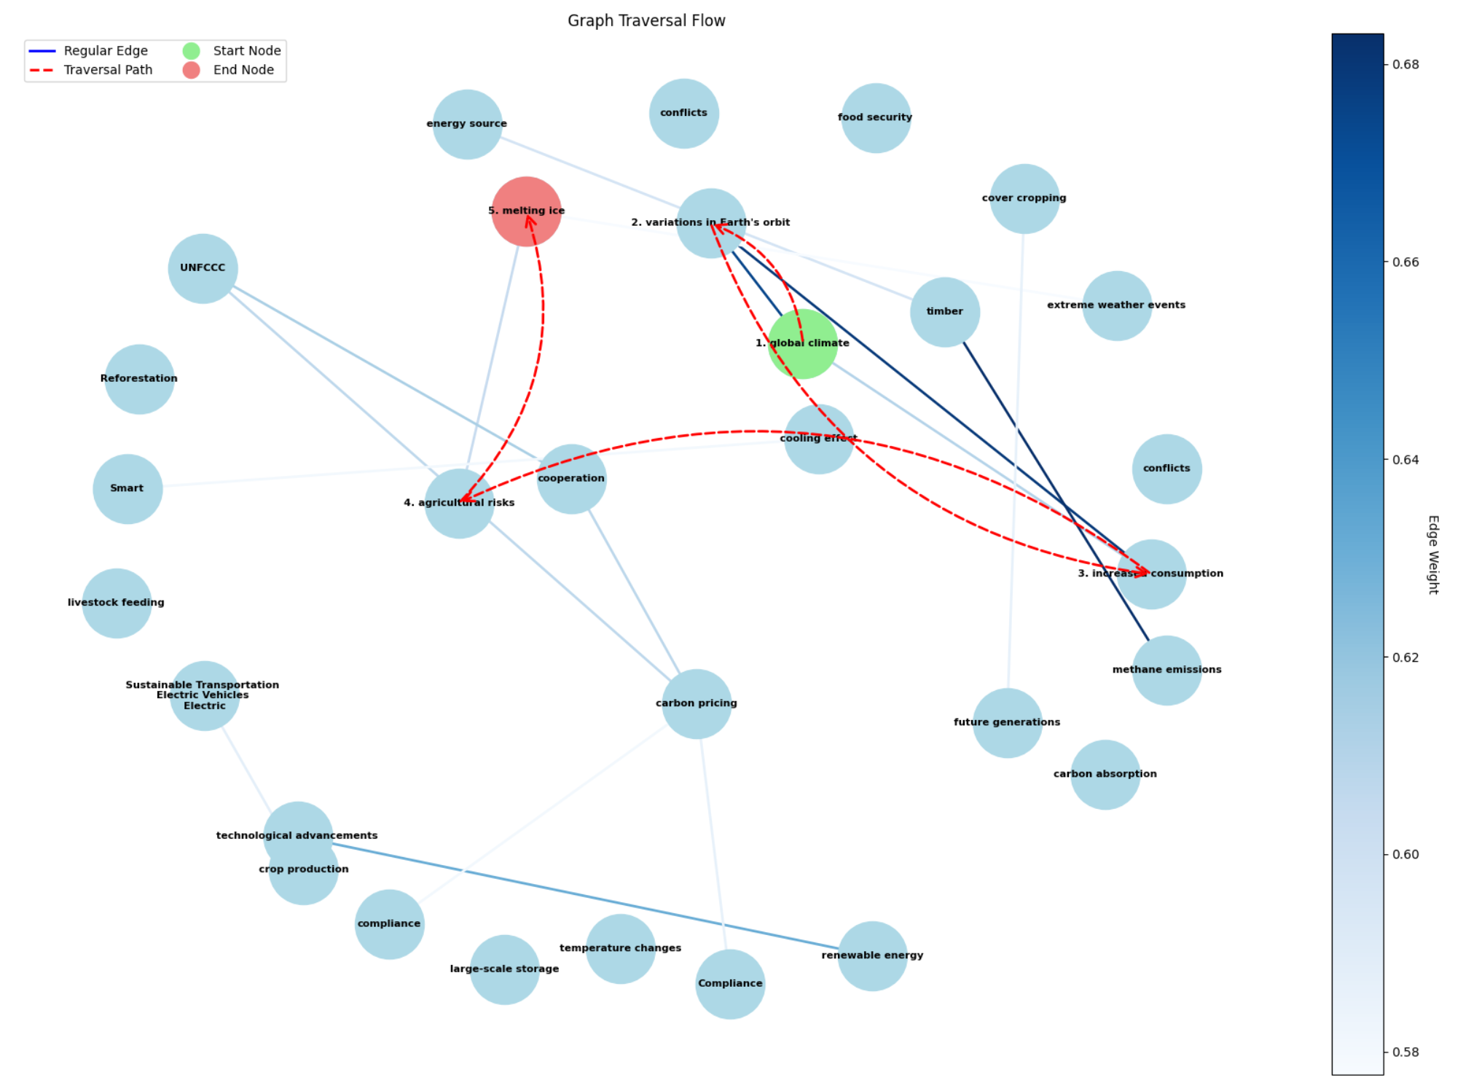
19. Graph - RAG
Build a knowledge Graph: chunk is a node, semantic concept is edge
Node = chunk
Extract NER
Key concept
Edge = semantic similarity+concept
Starting from strongest nodes
Use LLM to ask if the node match the query
If not, traverse to the neighbor’s node with strongest edge weights

Slide 34
20. Self-RAG
Instead of blindly retrieving, Self-RAG asks itself series of question at each step
Step | Question the system asks itself
1. Retrieval Decision | "Do I even need to retrieve documents for this query?"
2. Document Retrieval | Fetch top-k similar documents from the vector store
3. Relevance Check | "Is each retrieved document actually relevant to the query?"
4. Response Generation | Generate a response for each relevant context
5. Support Assessment | "Is my response supported by the context, or did I hallucinate?"
6. Utility Evaluation | "How useful is this response to the user?" (1–5 score)
7. Best Response Selection | Pick the response with the best support + utility

Slide 35
21. C-RAG (dynamic Correction)
CRAG extends RAG by evaluating whether retrieved docs are useful and correcting the approach if they are not
Relevance Score | Action | Source
High (> 0.7) | Use the retrieved document directly | Local knowledge base
Low (< 0.3) | Discard documents, do a web search instead | Web
Ambiguous (0.3–0.7) | Combine retrieved document + web search | Both

Slide 36
22. Multimodal RAG
Docling + Fusion + Reranker
Tool | Action
Docling | Extract Text, Image, Table separately Image is analyzed by Vision Transformer model Table is converted to markdown, convenient for retrieval
Fusion | Combine keyword search + semantic search for wider coverage
Reranker | Cross encoder reranker faster than LLM reranker

