Slide 1
Network Analysis of the Knuth Miles Dataset
Deep Learning Analysis - MSDS 7335
Tue Vu
Homework 2

Slide 2
Project Overview & Objectives
The Knuth Miles Dataset
128 major North American cities with complete pairwise distances
Compiled by Donald E. Knuth (1993)
Key Objectives:
Construct weighted undirected graph representation
Examine network properties and topological characteristics
Identify key cities using centrality measures
Understand geographical patterns and clustering
Derive insights about urban connectivity

Slide 3
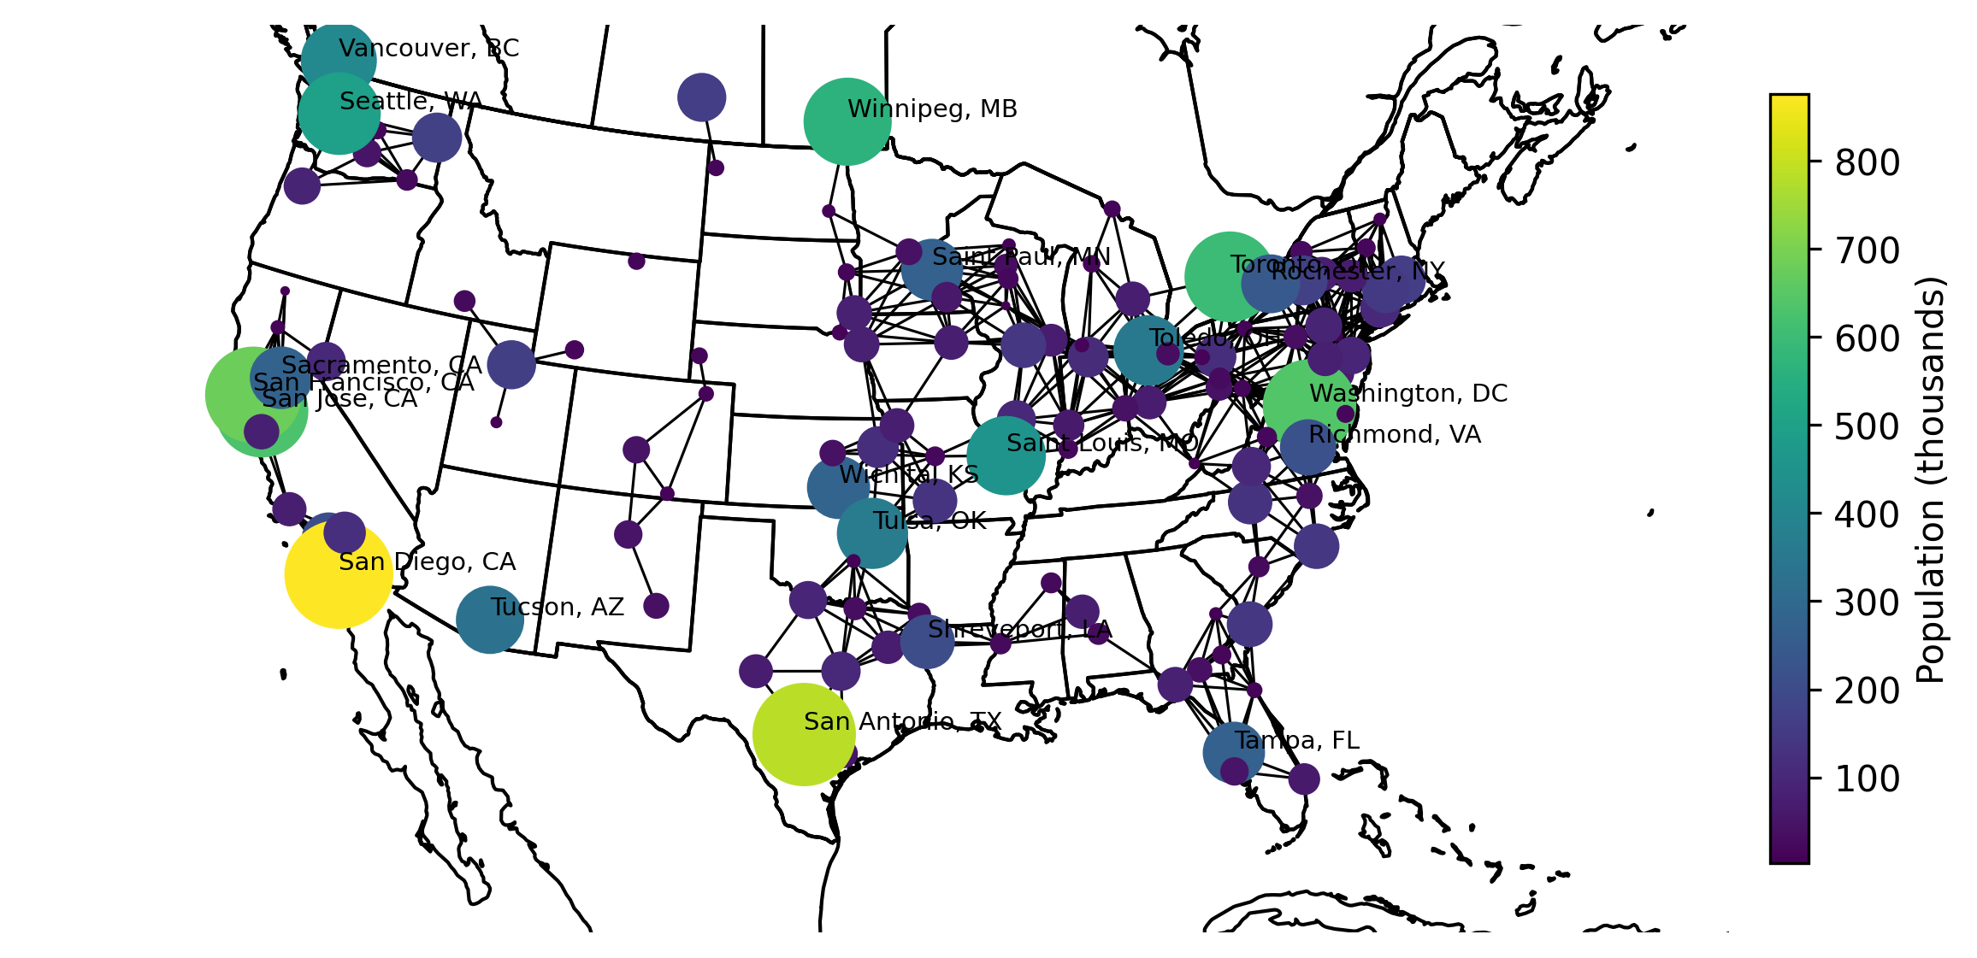
Dataset Structure & Geographic Distribution
Network Properties
128 nodes (cities)
8,128 edges (complete graph)
Weighted edges (distances in miles)
Network density: 1.0
Node Attributes
Geographic coordinates
Population (3K - 876K)
City identifiers

Slide 4
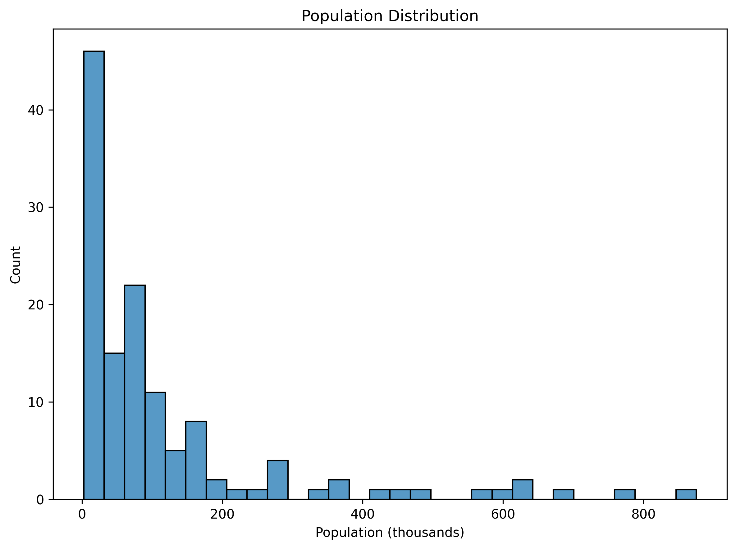
Population Distribution Analysis
Population Statistics
Mean: 120,000
Median: 68,000
Range: 3,000 - 876,000
Right-skewed distribution
Key Findings
Dense clusters in Northeast/Midwest
Sparse connections in West/South
Natural geographical barriers
Metropolitan area concentration

Slide 5
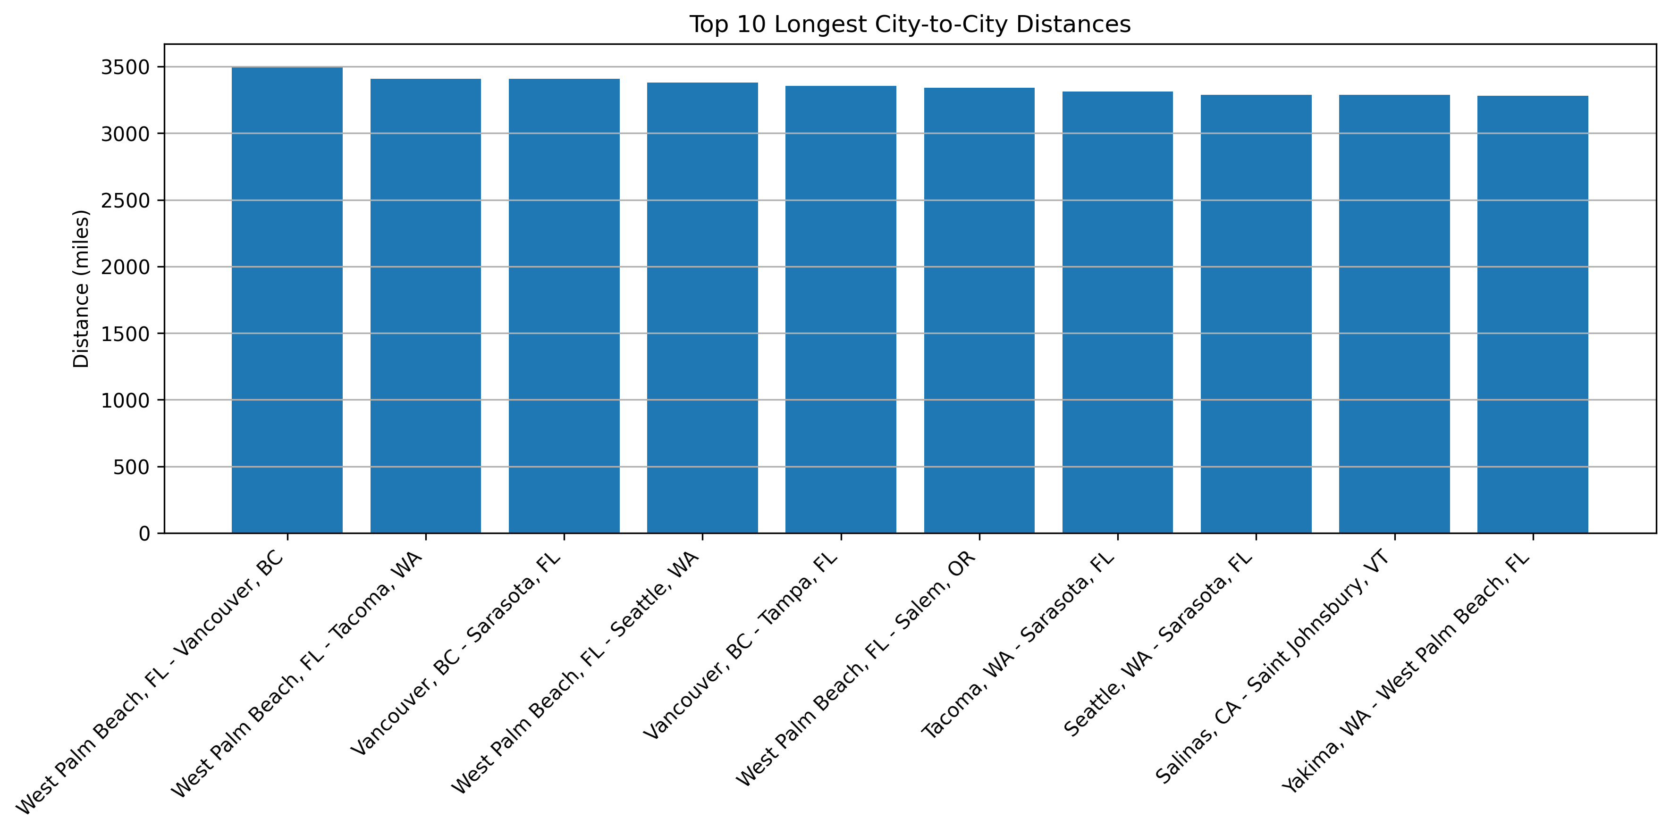
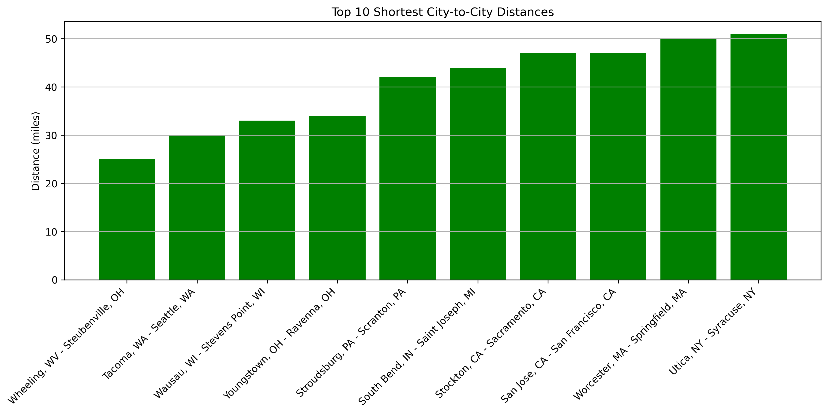
Distance Analysis
Key Insights: Maximum distances exceed 3,000 miles (cross-continental). Shortest distances under 50 miles (metropolitan clustering).

Slide 6
Centrality Measures Overview
Three Key Centrality Types Analyzed
Degree Centrality
All cities equal (1.0) - complete graph structure
Betweenness Centrality
Measures transit importance and regional connectivity
Identifies cities on shortest paths between others
Closeness Centrality
Measures accessibility to all other cities
Identifies centrally located cities

Slide 7
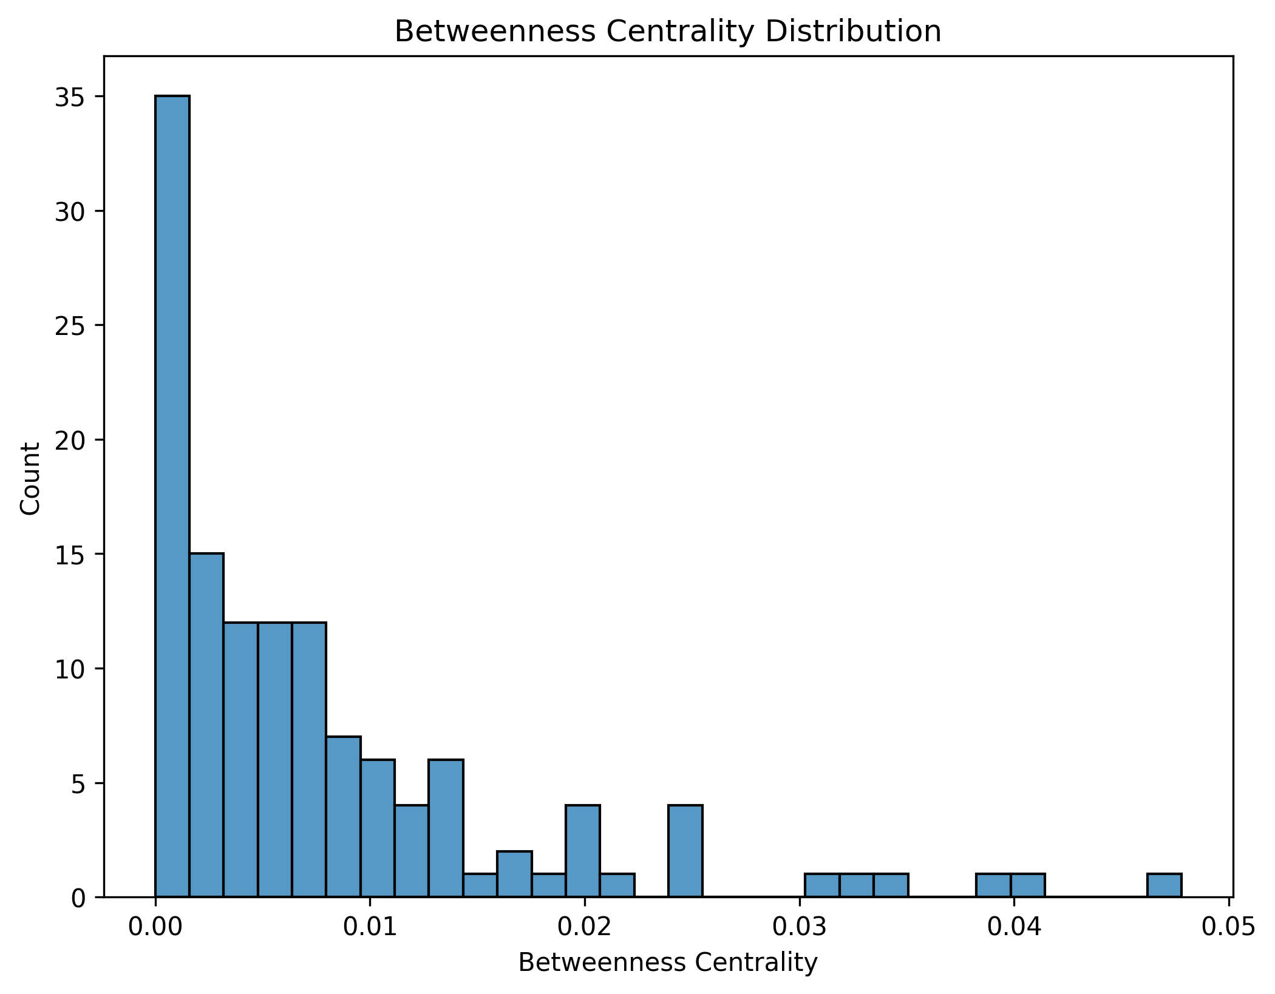
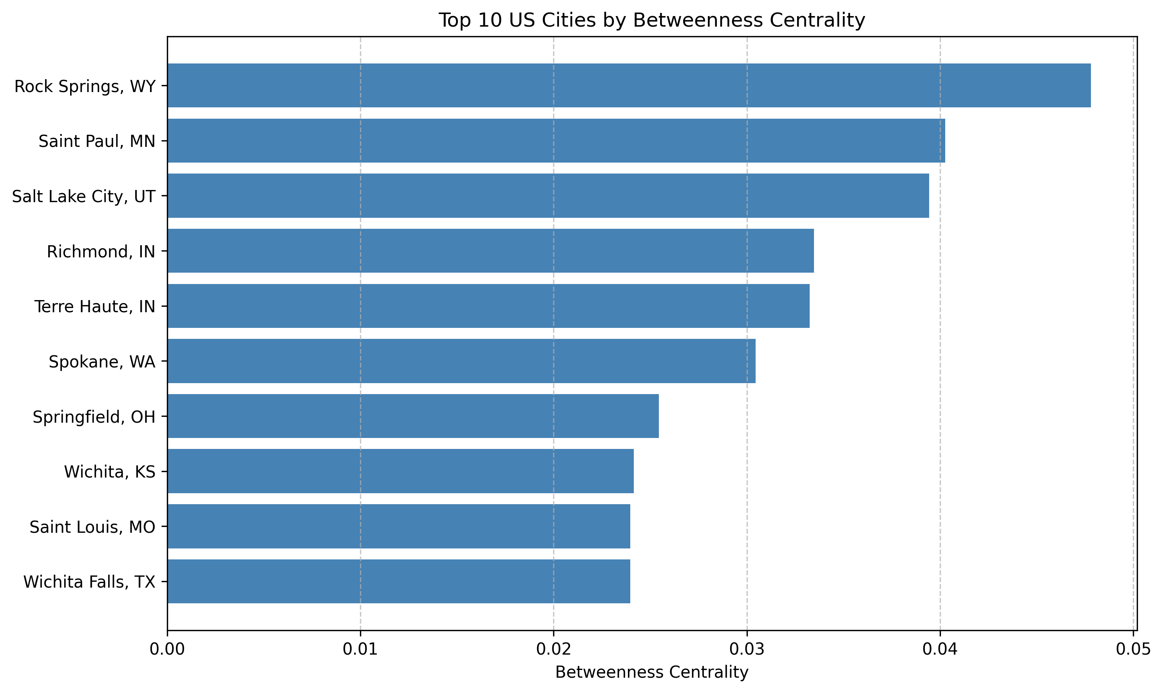
Betweenness Centrality Results
Top 5 Cities
1. Rock Springs, WY (0.0478)
2. Saint Paul, MN (0.0403)
3. Salt Lake City, UT (0.0394)
4. Richmond, IN (0.0335)
5. Terre Haute, IN (0.0332)

Slide 8
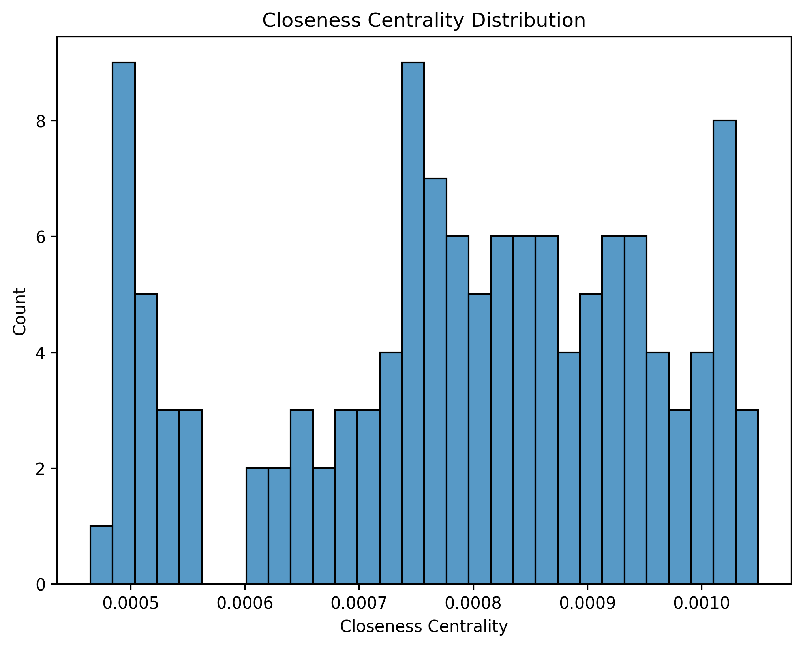
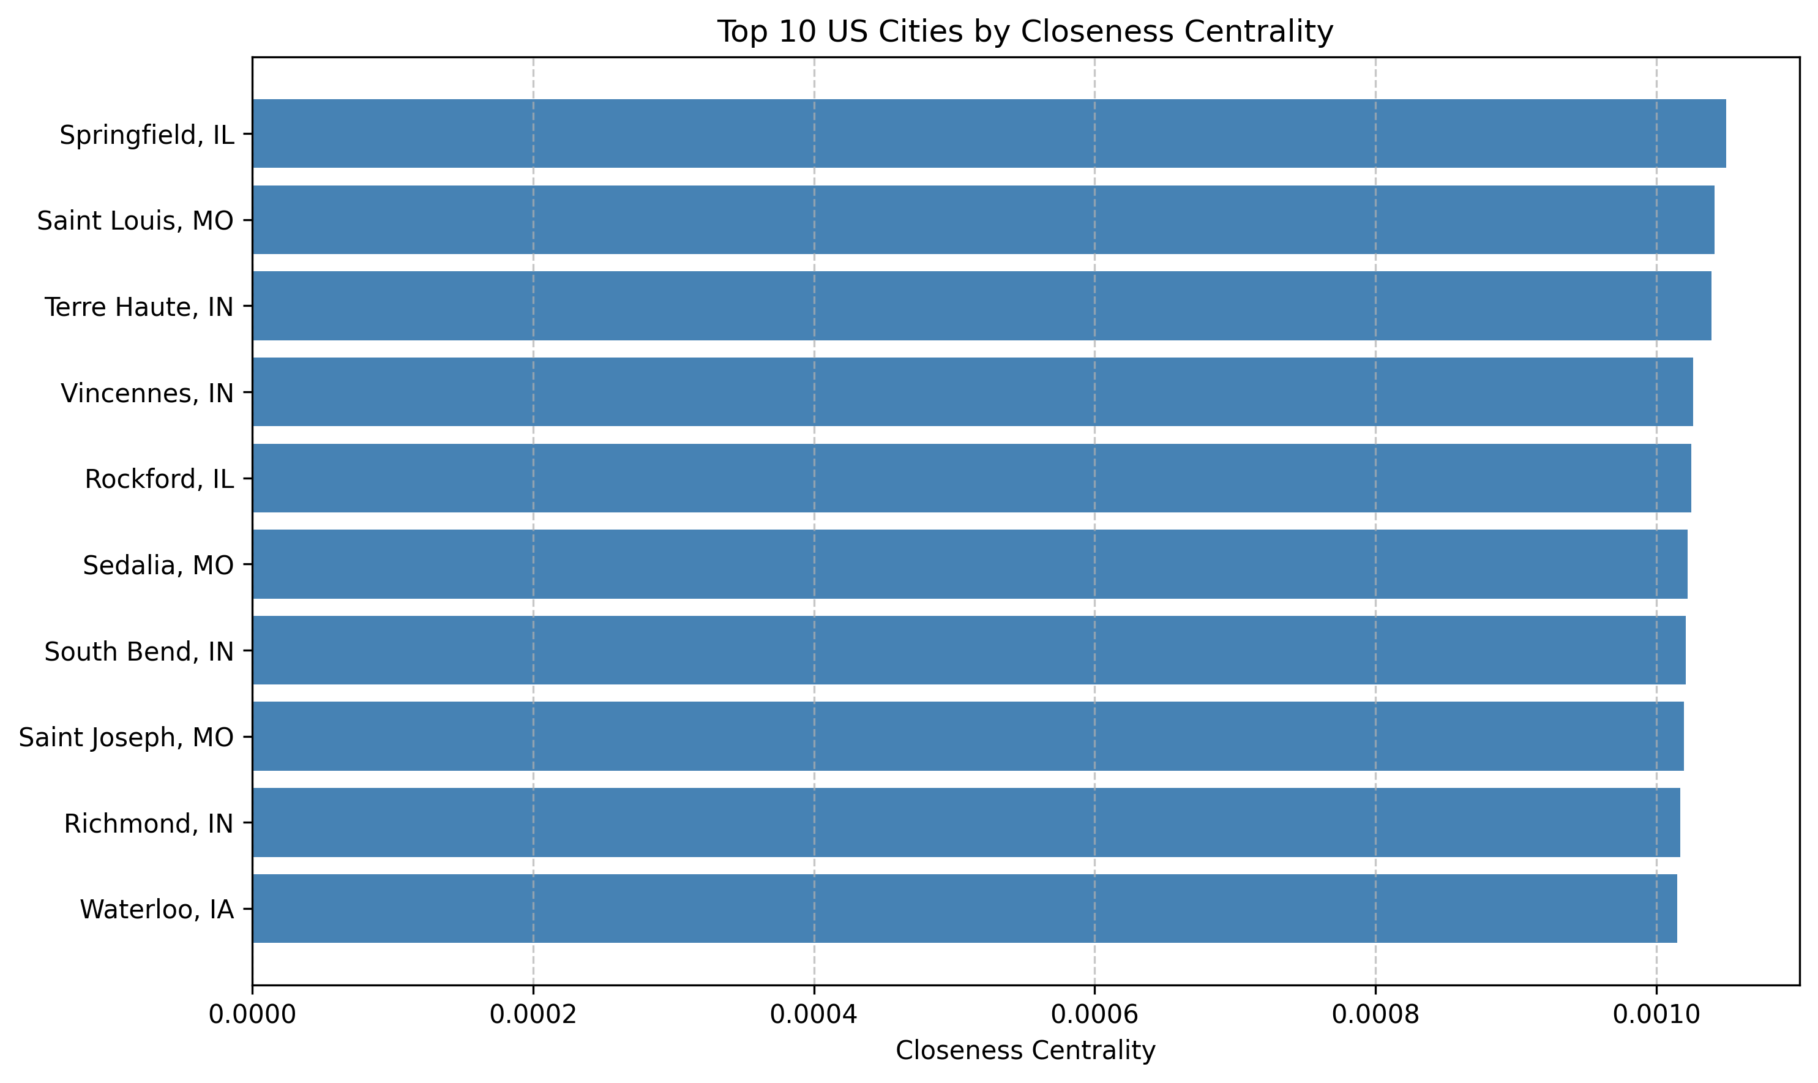
Closeness Centrality Results
Top 5 Cities
1. Springfield, IL (0.0010)
2. Saint Louis, MO (0.0010)
3. Terre Haute, IN (0.0010)
4. Vincennes, IN (0.0010)
5. Rockford, IL (0.0010)

Slide 9
Implications & Applications
Transportation Planning
Focus on high-betweenness cities for transit hubs
Develop regional transportation networks
Optimize inter-city connections
Regional Development
Understand city roles in regional networks
Identify potential growth centers
Plan for regional connectivity
Urban hierarchy analysis

Slide 10
Conclusions & Future Research
Key Conclusions
Central US cities are crucial network hubs
Geography shapes urban network structure
Network analysis informs urban planning
Multiple centrality measures reveal different insights
Future Research Directions
Incorporate temporal dynamics
Integrate economic/social factors
Analyze actual transportation networks
Develop dynamic network models

