Slide 1

Sexy Using Cucumber - BDD in your project
Presented by :
Mr. Vu Nguyen
Senior Automation Engineer

Slide 2

- Working as an QA Automation
- Over 8 years experience in software engineering experience
- Skype ID: vunguyen2588
- Email: hoaivunguyenpham@gmail.com

Slide 3
Agenda
Behavior Driven Development
Cucumber
Advantages of Cucumber
Environment Setup
Gherkins Language
Cucumber Execution Flow
Runner Class
Features
Steps Definitions
Cucumber Data
Cucumber Report
Creating project cucumber with maven

Slide 4

Behavior Driven Development
Product Owners
Architects
THE GAP
A set of test scenarios with the simple english language
Developers
Testers
Implementing an application by describing its behaviour by the perspective of its stakeholders
Notes:
- In order to get better advantage of the software testing, they implement important acceptance test scenarios while development is in-progress. This approach is commonly known as Behavior Driven Development (BDD).
- In the beginning, developers, project managers, QAs, user acceptance testers and the product owner, all get together and brainstorm about which test scenarios should be passed in order to call this software/application successful.
- This way they come up with a set of test scenarios by the simple English language, and serves the purpose of documentation also.

Slide 5


Cucumber
THE OPEN SOURCE TOOL
SUPPORTS BDD
SUPPORTS MANY DIFFERENT LANGUAGES
FEATURE FILE
STEP DEFINITION
RUNNER CLASS
Notes:
- It is the open source tool, which supports behavior driven development. It can be defined as a testing framework, driven by plain English text.
- Cucumber supports many different software platforms like Ruby on Rails, Selenium, PicoContainer, Spring Framework, Watir ... And because this, it has become the reason for Cucumber's popularity over other frameworks, like JBehave, JDave, Easyb ....
- Cucumber has three important sections Feature File, Step Definition and Runner Class

Slide 6
Advantages of Cucumber
A bridge between the business and technical language
Supports multiple platform, OS and the browsers
Develop and maintenance easily
Notes:
Cucumber supports different languages like Java, .Net and Ruby
It acts as a bridge between the business and technical language
It allows the test script to be written without knowledge of any code
It serves the purpose of end-to-end test framework
Due to simple test script architecture, Cucumber provides code reusability

Slide 7

Environment Setup
Notes:
- Java SE — Java 8 (Java 9 is not yet supported by Cucumber)
http://www.oracle.com/technetwork/java/javase/downloads/index.html
- Maven — Version 3.3.1 or higher
https://maven.apache.org/download.cgi
- Eclipse IDE
https://eclipse.org/downloads/
- A Cucumber plugin for your IDE
http://cucumber.github.com/cucumber-eclipse/update-site

Slide 8
Gherkins Language
Is a language, which is used to write features, scenarios and steps.
Have the extension .feature
Define set of keywords
Each keyword has it own significance: Feature, Scenarios, Given, When, Then, Add, But, Background ...

Slide 9
Cucumber Execution Flow
Runner Class
Feature Files
Step Definitions
Results Reports

Slide 10
Runner Class
Tells JUnit that tests should run using Cucumber class present in cucumber.api.junit package
package sample;
import org.junit.runner.RunWith;
import cucumber.api.CucumberOptions;
import cucumber.api.junit.Cucumber;
@RunWith(Cucumber.class)
@CucumberOptions(
features = src/test/java/sample/Demo.feature",
format = { "pretty", "html:target/cucumber-reports" }
)
public class RunnerClass {
}
Tells Cucumber a lot of things like where to look for feature files, what reporting system to use and some other things also
features: provides the location of the feature file
glue: provides the path of the step definition class
format: all report formaters to use
tags: what tags in the features file should be executed

Slide 11
Runner Class
As main class in typical java program from where the execution starts
An interlink between feature files and step definition classes
Multiple types of test runners such as JUnit runner, CLI runner, Android runner ...
Notes:
- The test runner class also acts as an interlink between feature files and step definition classes.
- There are multiple types of test runners such as JUnit runner, CLI runner, Android runner etc, that you can use to run Cucumber feature file.
- With a test runner class, you have the option to run either a single feature file, or multiple feature files as well
- In simple terms, this can be referred as main class in typical java program from where the execution starts. In Cucumber, the execution starts from the RunnerClass
- With a cucumber-based framework, you cannot run a feature file on its own.
- You will need to create a java class, which in turn will run this cucumber feature file.
- We call this class as cucumber test runner class.

Slide 12
Features
A functionality of a project
A list of scenarios to be tested
Feature
The extension of the feature file is ‘.feature’
The keyword in Gherkins is ‘Feature’

Slide 13
Features
Feature:
As a user
I want to be able to login to gmail
So that i can view my email
Scenario: The user login to gmail
Given The user navigate to gmail page
When The user click on Sign in button
And The user input the right username
And The user input the right password
And The user click on Login button
Then The user login to gmail successfully
Name of the feature under test
Describe about feature under test - optional
What is the test scenario
Prerequisite before the test steps get executed
Specific condition which should match in order to execute the next step
Keyword is used to show conjunction between two conditions
What should happen
Notes:
- Feature: Name of the feature under test.
- Description (optional): Describe about feature under test.
- Scenario: What is the test scenario.
- Given: Prerequisite before the test steps get executed.
- When: Specific condition which should match in order to execute the next step.
- Then: What should happen if the condition mentioned in WHEN is satisfied.
- AND keyword is used to show conjunction between two conditions. AND can be used with any other keywords like GIVEN, WHEN and THEN

Slide 14
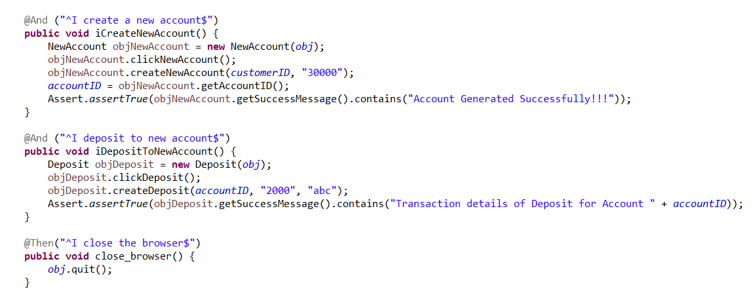
Steps Definitions
The mapping between each step of the scenario defined in the feature file with a code of function to be executed
This function can be written both Java and Selenium commands
Notes:
Steps definition file stores the mapping between each step of the scenario defined in the feature file with a code of function to be executed.
When Cucumber executes a step of the scenario mentioned in the feature file, it scans the step definition file and figures out which function is to be called.
So with each function, whatever code you want to execute with each test step (i.e. GIVEN/THEN/WHEN), you can write it within Step Definition file.
Make sure that code/function has been defined for each of the steps.
This function can be Java functions, where we can use both Java and Selenium commands in order to automate our test steps.

Slide 15
Cucumber Data
Cucumber Data Driven
Cucumber Data
Cucumber Data Table
Pass data from cucumber feature files to your test cases
Pass parameters from feature files in tabular format
Passing more than one parameters
Data table with a header
Passing the integer values
Data table without a header
Passing double values
Passing string parameters without double quotes
Passing a set of limited values instead of (.*)
Notes:
Steps definition file stores the mapping between each step of the scenario defined in the feature file with a code of function to be executed.
When Cucumber executes a step of the scenario mentioned in the feature file, it scans the step definition file and figures out which function is to be called.
So with each function, whatever code you want to execute with each test step (i.e. GIVEN/THEN/WHEN), you can write it within Step Definition file.
Make sure that code/function has been defined for each of the steps.
This function can be Java functions, where we can use both Java and Selenium commands in order to automate our test steps.

Slide 16
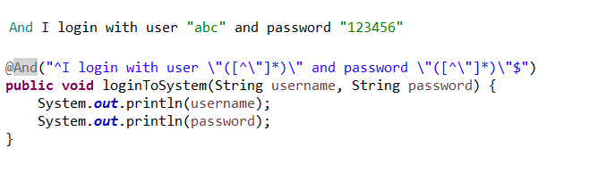
Passing more than one parameters
On feature file, we use “(string)”
On step definition file, we use \”([^\”]*)\”

Slide 17
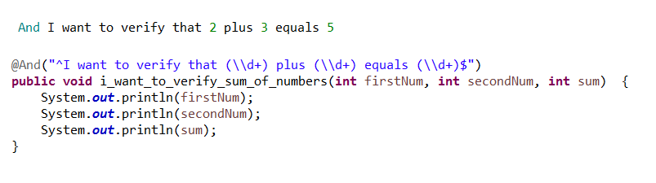
Passing the integer values
On feature file, we use (int)
On step definition file, we use (\\d+)

Slide 18
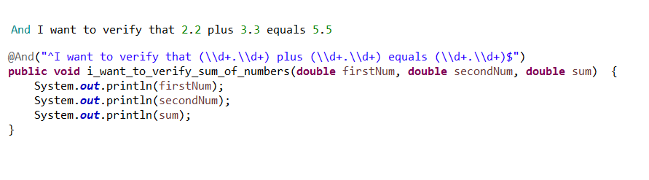
Passing double values
On feature file, we use (double)
On step definition file, we use (\\d+.\\d+)

Slide 19
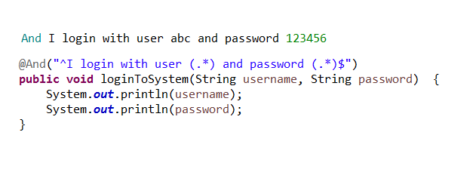
Passing string parameters without double quotes
On feature file, we use (string)
On step definition file, we use (.*)

Slide 20
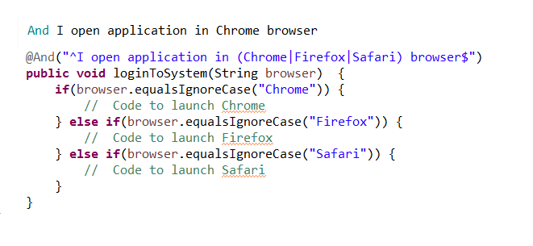
Passing a set of limited values
On feature file, we use (String|String|....)
On step definition file, we use (String)

Slide 21
Cucumber Data
Cucumber Data Driven
Cucumber Data
Cucumber Data Table
Pass data from cucumber feature files to your test cases
Pass parameters from feature files in tabular format
Passing more than one parameters
Data table with a header
Passing the integer values
Data table without a header
Passing double values
Passing string parameters without double quotes
Passing a set of limited values instead of (.*)
Notes:
Steps definition file stores the mapping between each step of the scenario defined in the feature file with a code of function to be executed.
When Cucumber executes a step of the scenario mentioned in the feature file, it scans the step definition file and figures out which function is to be called.
So with each function, whatever code you want to execute with each test step (i.e. GIVEN/THEN/WHEN), you can write it within Step Definition file.
Make sure that code/function has been defined for each of the steps.
This function can be Java functions, where we can use both Java and Selenium commands in order to automate our test steps.

Slide 22
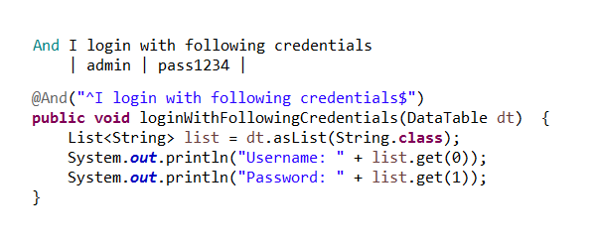
Cucumber data table without header
On feature file, we use (|values|values |...)
On step definition file, we use (DataTable) List<String> list = dt.asList(String.class);

Slide 23
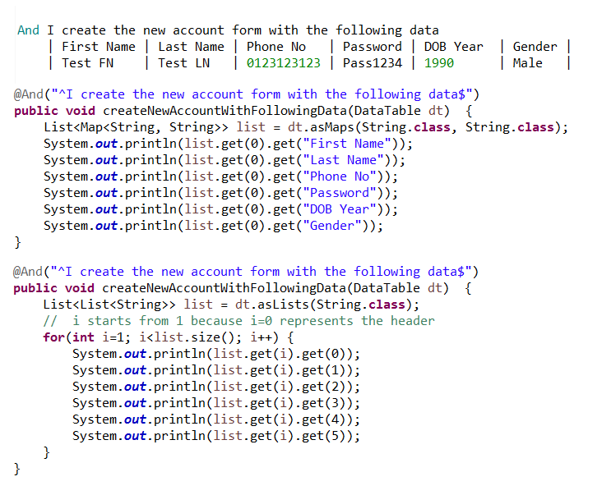
Cucumber data table with header
On feature file, we use |Header 1|Header 2|...| |values |values |...|
On step definition file, we use (DataTable) List<Map<String, String>> list = dt.asMaps(String.class, String.class); List<List<String>> list = dt.asLists(String.class);

Slide 24
Reports
REPORT
Report console
Report output
Pretty Report
Monochrome Mode Reporting
Usage Report
HTML Reports
JSON Report
JUNIT XML Report
Notes:
When we execute Cucumber Scenarios, it automatically generates an output in the eclipse console. There is a default behavior associated with that output and we can also configure that output as per our needs also.
Pretty Report
Monochrome Mode Reporting
Usage Report

Slide 25
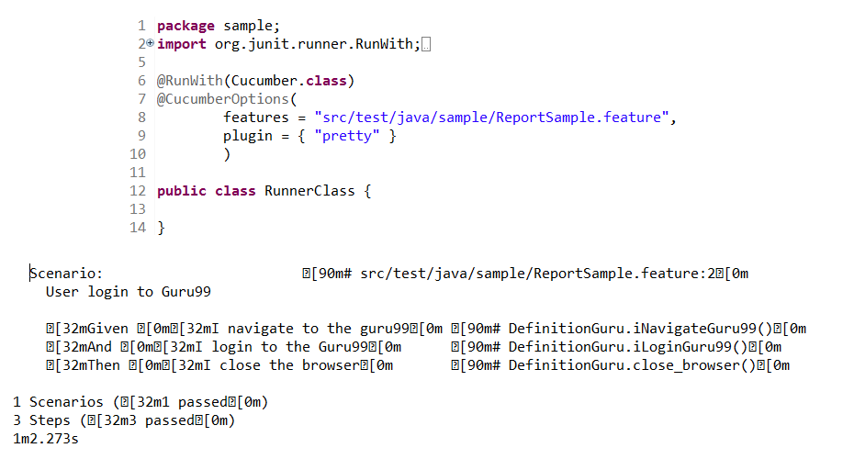
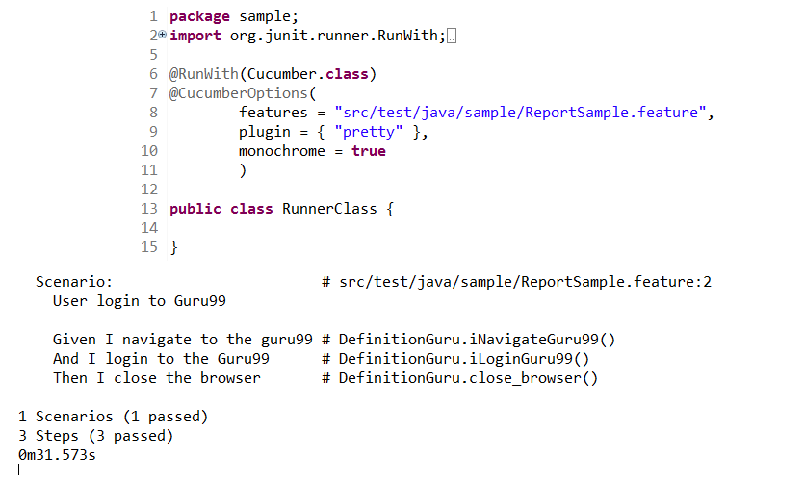
Reports Console
Notes:
When we execute Cucumber Scenarios, it automatically generates an output in the eclipse console. There is a default behavior associated with that output and we can also configure that output as per our needs also. Default monochrome value is false.
Pretty Report
Monochrome Mode Reporting
Usage Report

Slide 26
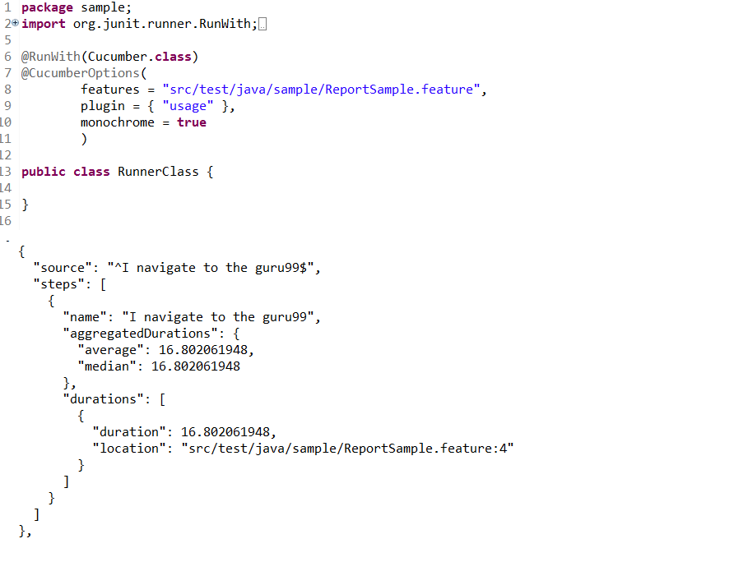
Reports Console
Notes:
When we execute Cucumber Scenarios, it automatically generates an output in the eclipse console. There is a default behavior associated with that output and we can also configure that output as per our needs also. Default monochrome value is false.
Pretty Report
Monochrome Mode Reporting
Usage Report

Slide 27
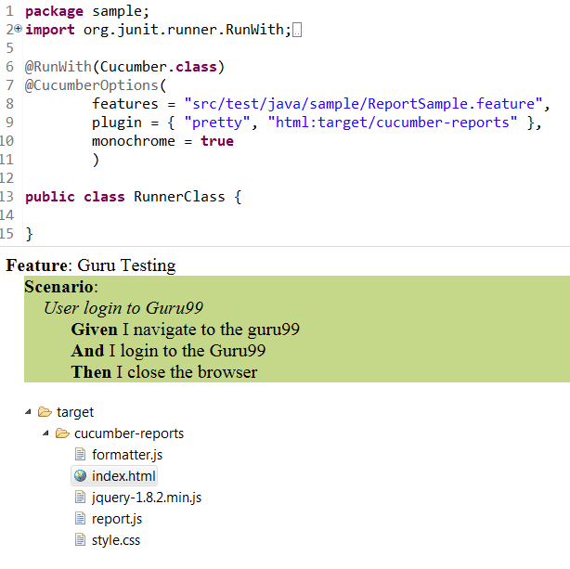
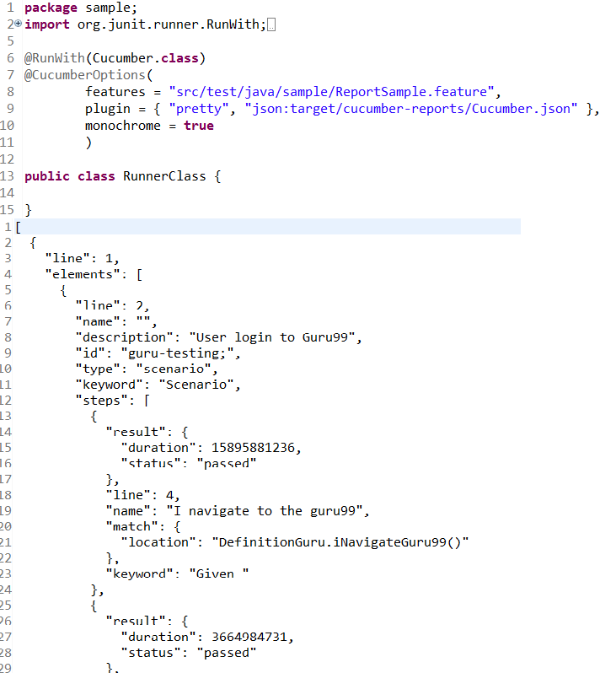
Report Output
Notes:
You must be wondering that all we have seen above is actually good for a test or for couple of tests. But if we run a full test suite, this report is not much useful in that case. On top of that it is difficult to keep these console output safe for future use.
Cucumber gives us capability to generate reports as well in the form of HTML, XML, JSON & TXT. Cucumber frameworks generate very good and detailed reports, which can be shared with all stake holders. There are multiple options available for reports which can be used depending on the requirement.
Cucumber HTML Reports
Cucumber JSON Report
Cucumber JUNIT XML Report

Slide 28
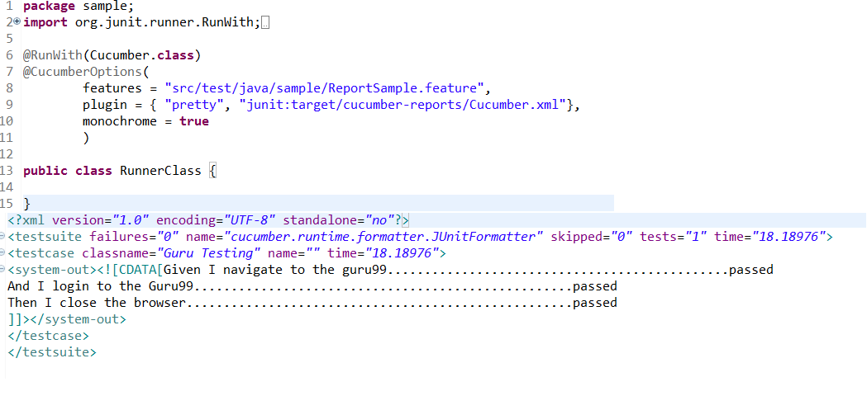
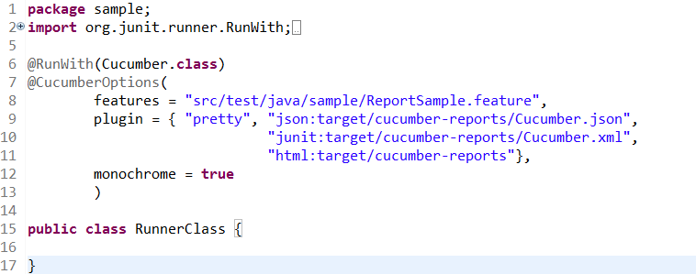
Report Output
Notes:
You must be wondering that all we have seen above is actually good for a test or for couple of tests. But if we run a full test suite, this report is not much useful in that case. On top of that it is difficult to keep these console output safe for future use.
Cucumber gives us capability to generate reports as well in the form of HTML, XML, JSON & TXT. Cucumber frameworks generate very good and detailed reports, which can be shared with all stake holders. There are multiple options available for reports which can be used depending on the requirement.
Cucumber HTML Reports
Cucumber JSON Report
Cucumber JUNIT XML Report
Combine
plugin = { "pretty", "json:target/cucumber-reports/Cucumber.json",
"junit:target/cucumber-reports/Cucumber.xml",
"html:target/cucumber-reports"},

Slide 29
Creating project cucumber with maven
Create a Maven project.
Add dependencies
Create a feature file
Create a step definition file
Create a JUnit runner
Notes:
Step 1 − Create a Maven project.
Go to File → New → Others → Maven → Maven Project → Next.
Step 2 − Open pom.xml and add dependencies: Selenium, Cucumber-Java, Cucumber-JUnit, JUnit
Step 3 − Create a feature file
Step 4 − Create a step definition file
Step 5 − Create a JUnit runner to run the test

Slide 30
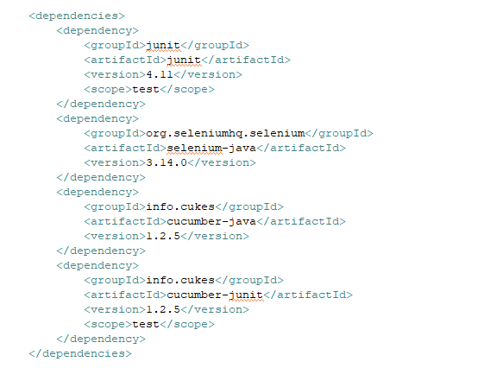
Creating project cucumber with maven
Notes:
1. JUnit
<dependency>
<groupId>junit</groupId>
<artifactId>junit</artifactId>
<version>4.11</version>
<scope>test</scope>
</dependency>
2. Selenium-Java
<dependency>
<groupId>org.seleniumhq.selenium</groupId>
<artifactId>selenium-java</artifactId>
<version>3.7.1</version>
</dependency>
3. Cucumber-Java
<dependency>
<groupId>info.cukes</groupId>
<artifactId>cucumber-java</artifactId>
<version>1.2.5</version>
</dependency>
4. Cucumber-Junit
<dependency>
<groupId>info.cukes</groupId>
<artifactId>cucumber-junit</artifactId>
<version>1.2.5</version>
<scope>test</scope>
</dependency>
5. Extents-Report:
<dependency>
<groupId>com.vimalselvam</groupId>
<artifactId>cucumber-extentsreport</artifactId>
<version>3.0.2</version>
</dependency>
<dependency>
<groupId>com.aventstack</groupId>
<artifactId>extentreports</artifactId>
<version>3.1.2</version>
</dependency>

Slide 31

Q&A

Slide 32
Reference
http://toolsqa.com
http://www.automationtestinghub.com
https://stackoverflow.com
https://www.tutorialspoint.com
https://www.slideshare.net/

