Slide 1

<Carrio-Motors>
Documentation
Authors | C2206L-Group 1
 | Lưu Quốc Vượng Nguyễn Duy Dương Trương Chí Hiếu Nguyễn Xuân Khang
Date | 05/01/2023
Instructor | Trần Văn Điệp

Slide 2
1Problem Definition 1.1 Problem Abstraction
Car is a moving art form mixed with utility, at a rare intersection where those qualities combine to form an experience, and the value associated with that experience may exceed the value of its transportive utility alone.
There are costs and benefits to car use. The costs to the individual include acquiring the vehicle, interest payments (if the car is financed), repairs and maintenance, fuel, depreciation, driving time, parking fees, taxes, and insurance. The costs to society include maintaining roads, land use, road congestion, air pollution, public health, healthcare, and disposing of the vehicle at the end of its life. Traffic collisions are the largest cause of injury-related deaths worldwide.

Slide 3
Personal benefits include on-demand transportation, mobility, independence, and convenience. Societal benefits include economic benefits, such as job and wealth creation from the automotive industry, transportation provision, societal well-being from leisure and travel opportunities, and revenue generation from taxes. People's ability to move flexibly from place to place has far-reaching implications for the nature of societies. There are around one billion cars in use worldwide. Car usage is increasing rapidly, especially in China, India, and other newly industrialized countries.

Slide 4
1.2 The Current System
Carrio-motors is providing the market with a high-end car product line, which is a car that comes from many famous car companies. The company's products are always diversified and meet all needs of customers.

Slide 5
1.3 The Proposed System
The purpose is to help users easily access and follow news on the website. We have created a website with some of the following features:
Registration and login function.
Function to correct information, retrieve passwords, and confirm email on the admin side.
Function to add, edit, and delete information, and images to articles about products
The function of displaying and searching for products
Function to search, receive and send feedback from customers.
Boundaries of the System
Users can only use functions such as registering, logging in, viewing articles, booking products, test drive tickets, and sending feedback to the system for the current system.

Slide 6
Hardware and Software Requirements
Hardware:
Intel Core i5 Processor or higher
6GB RAM or higher-
Color SVGA
80 GB Hard Disk space
CD-ROM or DVD-ROM drive
Software:
Windows 8, 10, or higher
HTML5 and JavaScript supporting browser
PHP
Visual code or another HTML editor.

Slide 7
Customer and Admin Requirements Specification
Customers.
Admin.
View articles about Cars
Book test drive tickets.
Search information content by keyword.
Send feedback to the system.
Contact the salers.
User account management.
Information management of articles (Products, customer information).
Management of customer feedback.
Manage booking information of each customer.
Searching for user and article information

Slide 8
System functions
Customers.
View detail
Booking request
Booking confirm
Input | Select an article to view detailed products
Process | Access data to get article information
Output | Display detailed products of the selected article
Input | Select pre-requested booking data
Process | Access the requested booking information
Output | Display successful booking confirmation and send it to the system.
Feedback
Input | Submit a booking request for a car you want to participate in
Process | Access data to get information about the event requested to be booked
Output | Display event information is booked and waiting for confirmation
Input | Enter the content you want to send feedback
Process | Generate customer feedback data stored in the database
Output | Notify users who have successfully submitted feedback

Slide 9
System functions
Admin
View user info
Add new products
Edit products
Input | Input new information to be edited and updated
Process | Validate, submit, and update the database
Output | Show the article after the edit
Input | Select the information the user wants to display
Process | Check the user information stored in the data
Output | Display user information
Edit products
Delete products
Input | Enter new post information
Process | Validate, submit, and insert a new record in the database
Output | Show the new article
Input | Select the article to delete
Process | Delete the record in the database
Output | Return to the home site after deleting the article

Slide 10
Search order
Manage user feedback
Manage user feedback
Input | Enter search name (article, user)
Process | Search in database
Output | Display search result
Input | Select customer information to book tickets
Process | Check the booking information stored in the database
Output | Show booking information
Input | Select user feedback
Process | Check user feedback stored in a database
Output | Show response content

Slide 11
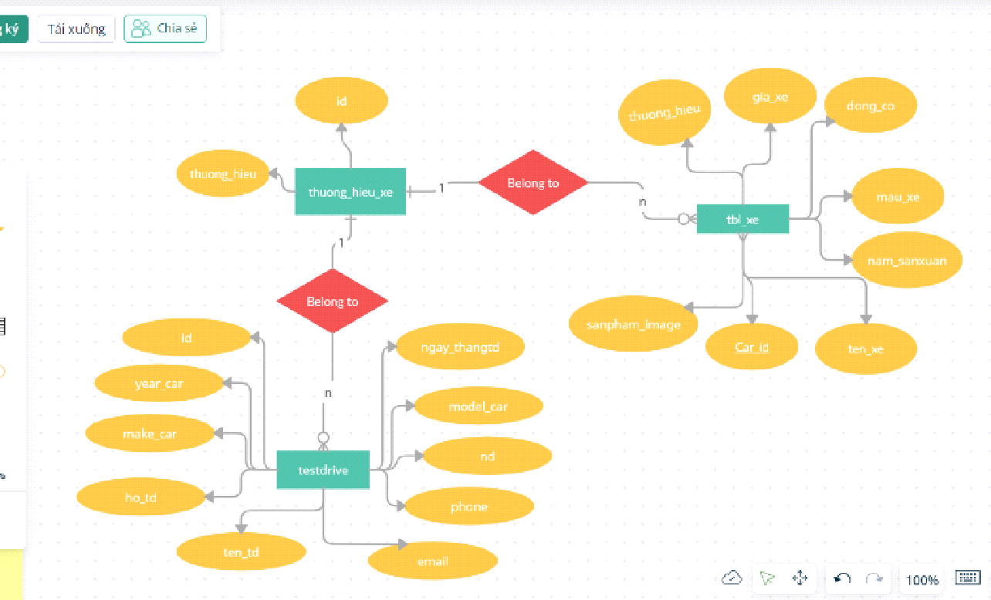
Entity-relationship Entity-relationship of tables in thuong_hieu_xe

Slide 12
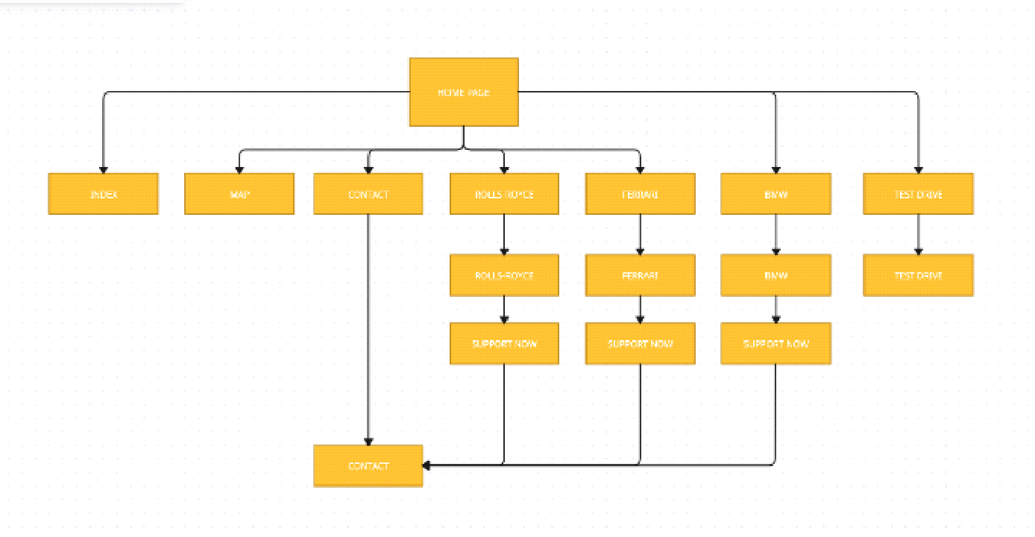

Slide 13
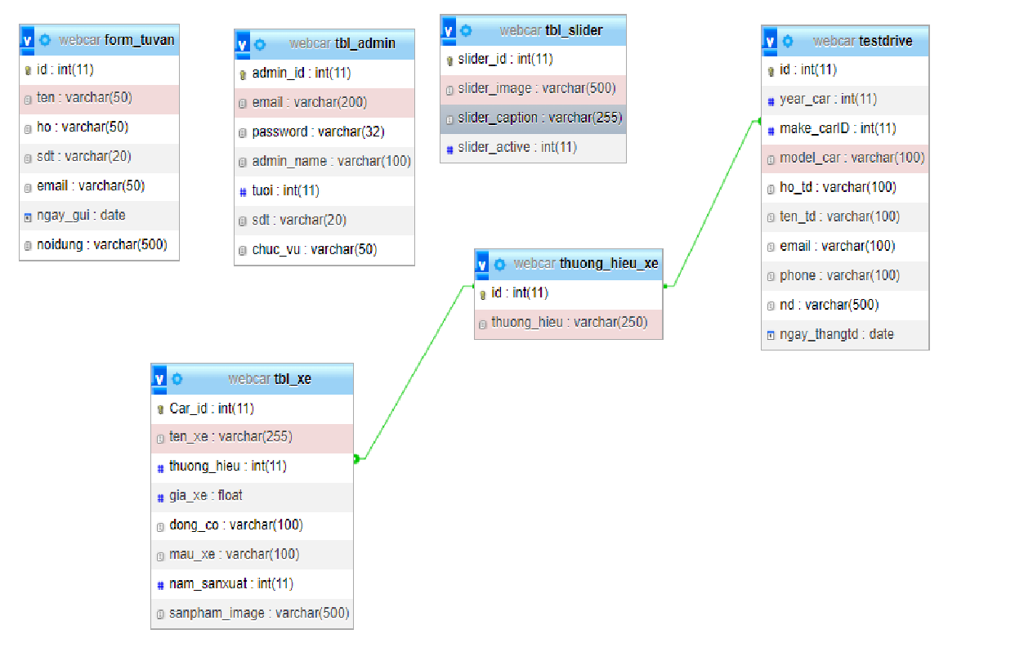
Database Design Table relationship

Slide 14
Table detail
Form_Tuvan
tbl_admin
Column | Data type | Constraint | Description
id | INT(11) | -primary key -unsigned | account id
ten | Varchar (50) |  | Name
ho | varchar(50) |  | First name
sdt | varchar(20) |  | Phone number
email | Varchar (50) |  | User email
ngay_gui | Date |  | Date of birthday
noidung | varchar(500)
Column | Data type | Constraint | Description
admin_id | INT(11) | -primary key -unsigned | admin id
email | Varchar (50) |  | User email
password | varchar(32) |  | password
admin_name | varchar(100) |  | Name
tuoi | int(11) |  | age
sdt | varchar(20) |  | phone
chuc_vu | varchar(50)

Slide 15
tbl_xe
tbl_slider
Column | Data type | Constraint | Description
slider_id | int(11) | -primary key -unsigned | slider id
slider_image | varchar(500) |  | image
slider_caption | varchar(255) |  | caption
slider_active | int(11)
Column | Data type | Constraint | Description
Car_id | int(11) | -primary key -unsigned | Car id
ten_xe | varchar(255) |  | Car name
thuong_hieu | int(11) | Foreign key | company
gia_xe | Float |  | price
dong_co | varchar(100) |  | engine
mau_xe | varchar(100) |  | color
nam_sanxuat | int(11) |  | year
sanpham_image | varchar(500 |  | Product_image

Slide 16
testdrive
thuong_hieu_xe
Column | Data type | Constraint | Description
id | int(11) | -primary key -unsigned | id
year_car | int(11) |  | year of the car
make_carID | int(11) | Foreign key | car id
model_car | varchar(100) |  | model
ho_td | varchar(100) |  | first name
ten_td | varchar(100) |  | name
email | varchar(50) |  | customer's email
phone | varchar(100) |  | phone
nd | varchar(100)
ngay_thangtd | date |  | date
Column | Data type | Constraint | Description
id | int(11) | -primary key -unsigned | id
thuong_hieu | varchar(250) |  | company

Slide 17
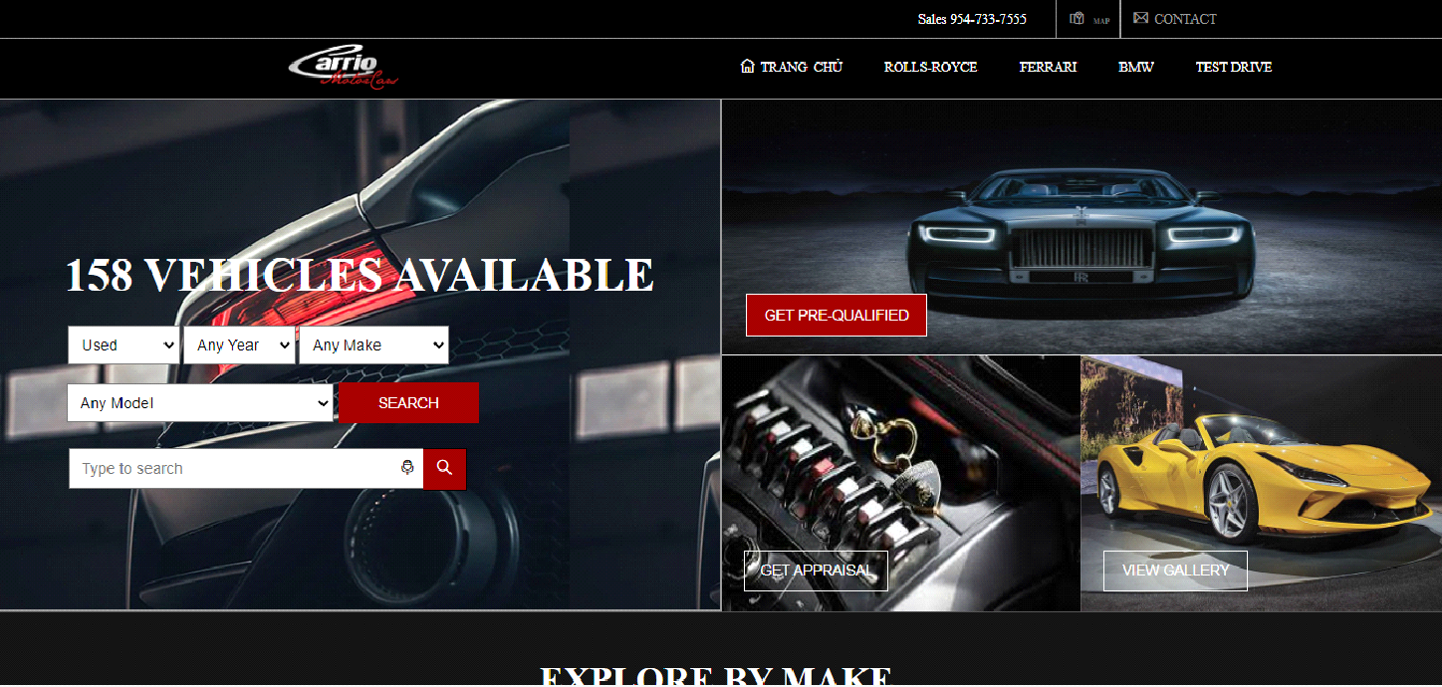
System functions design User’s Interface Header

Slide 18
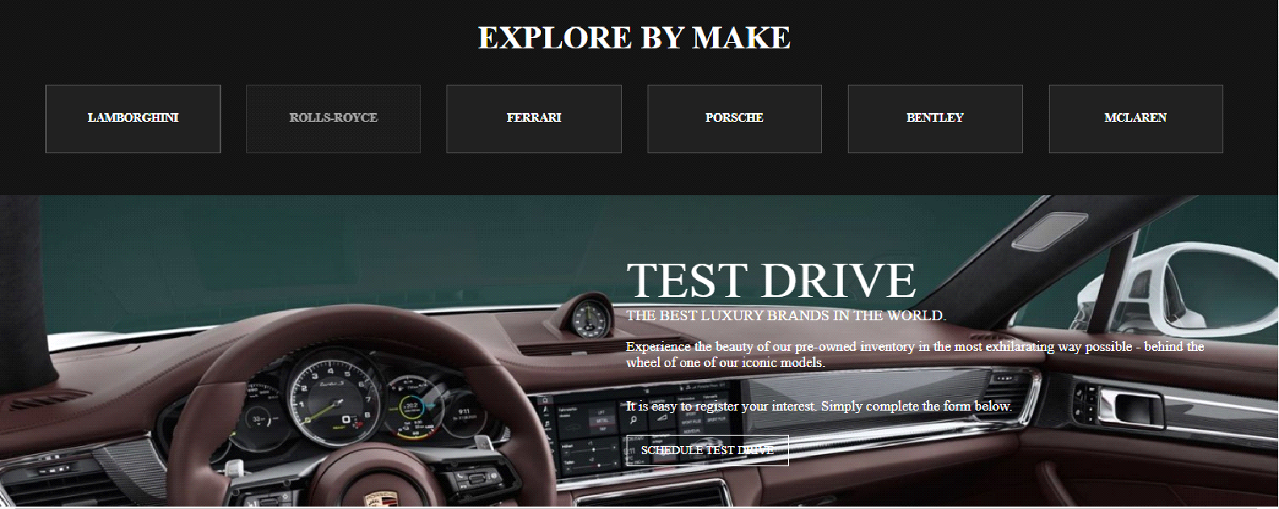
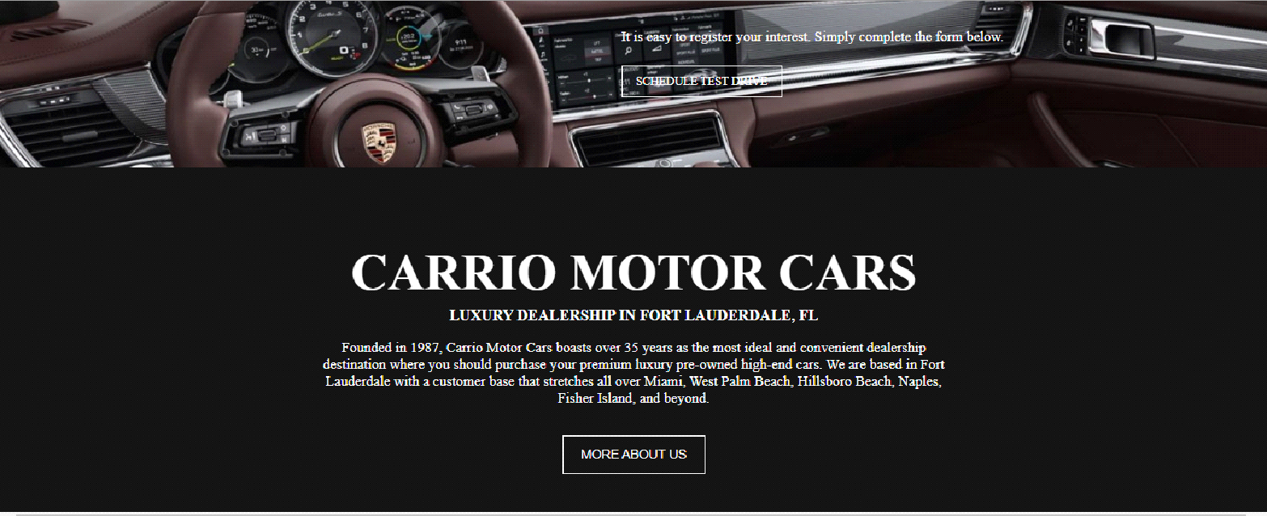
Body

Slide 19
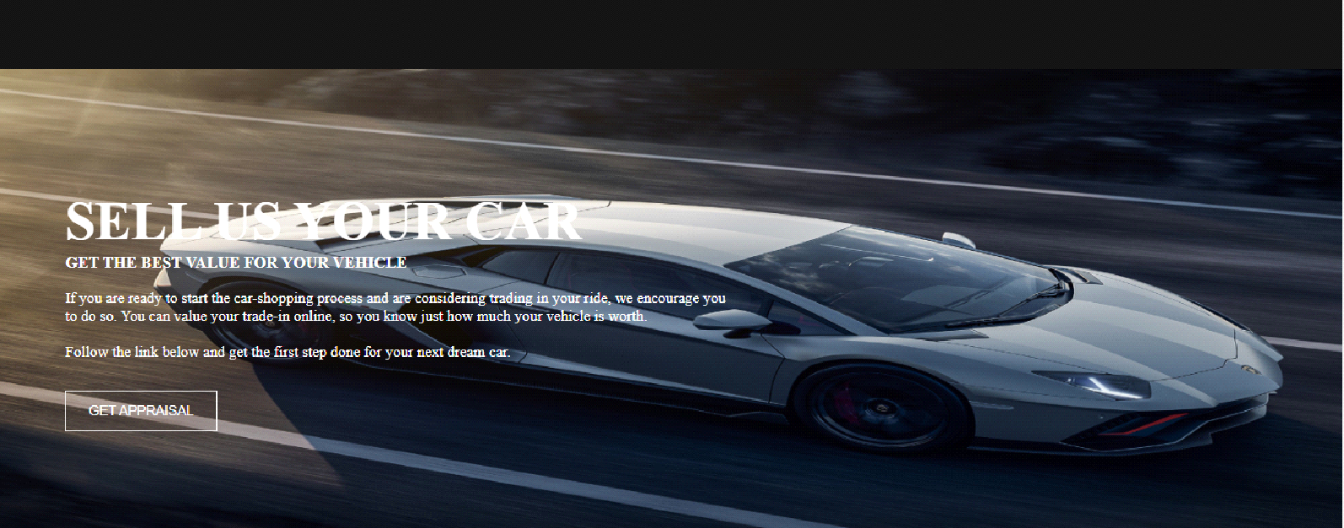

Slide 20
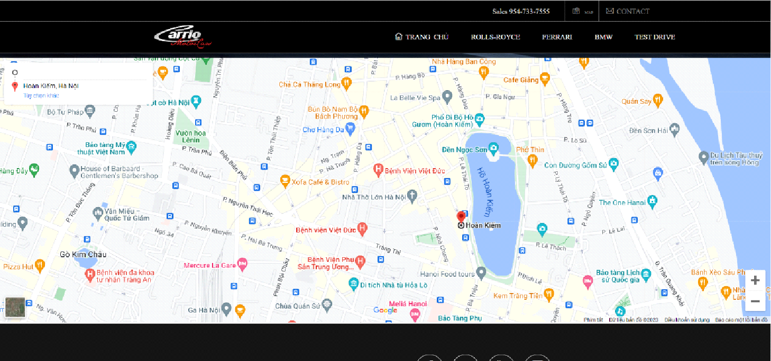
Footer & Contact

Slide 21
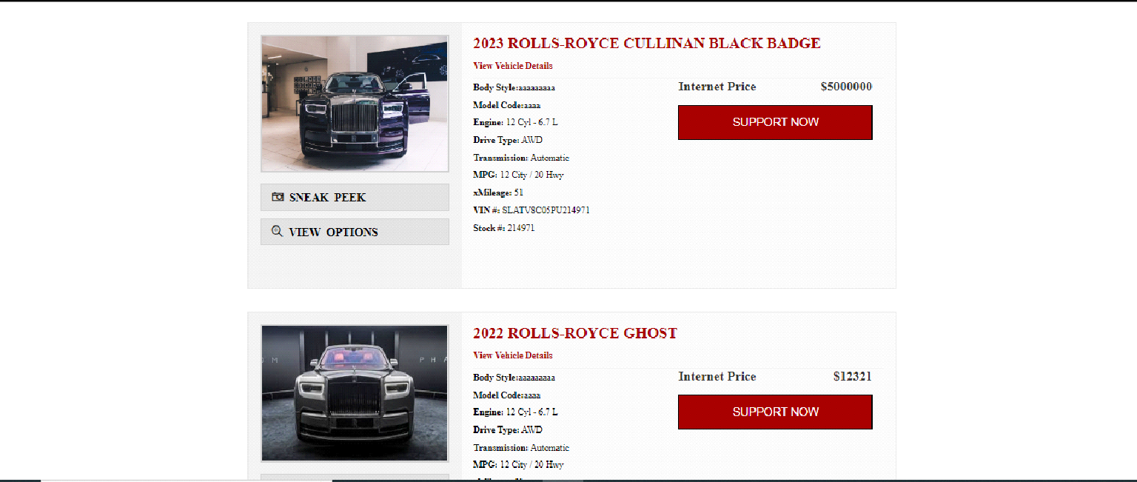
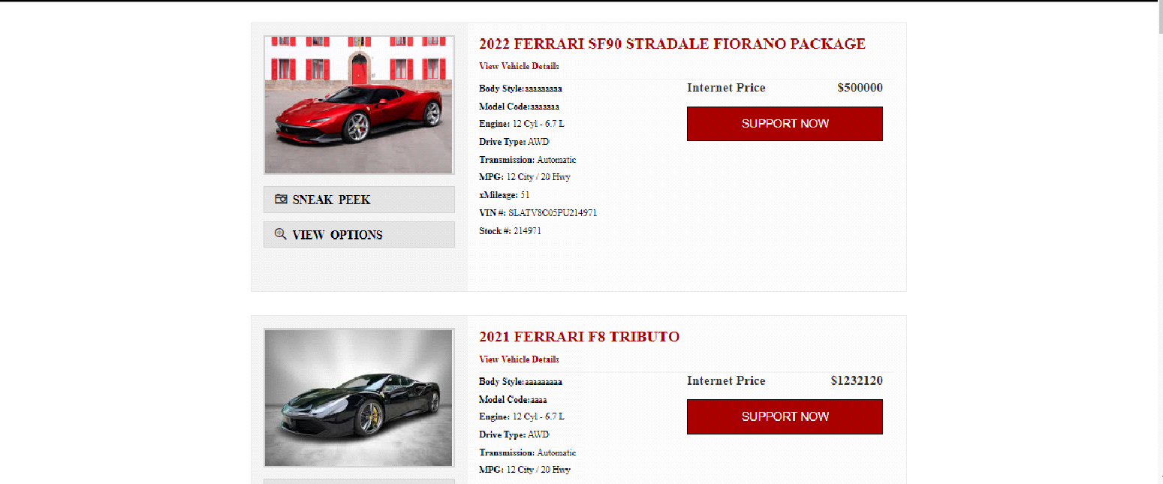
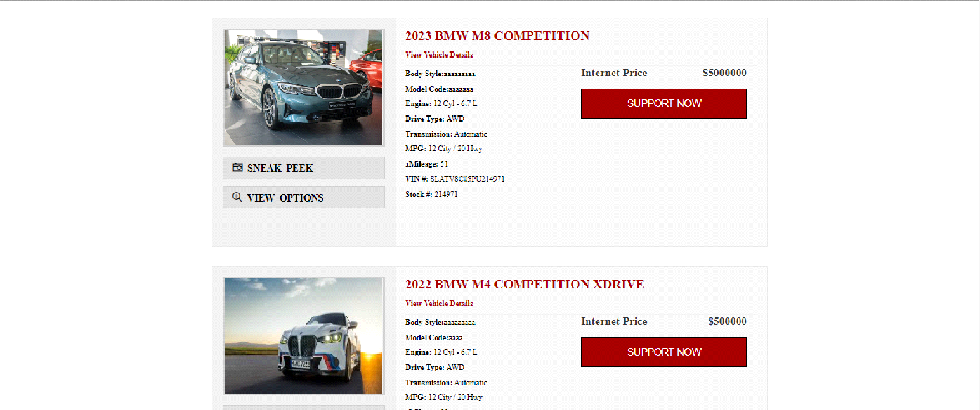
products page

Slide 22
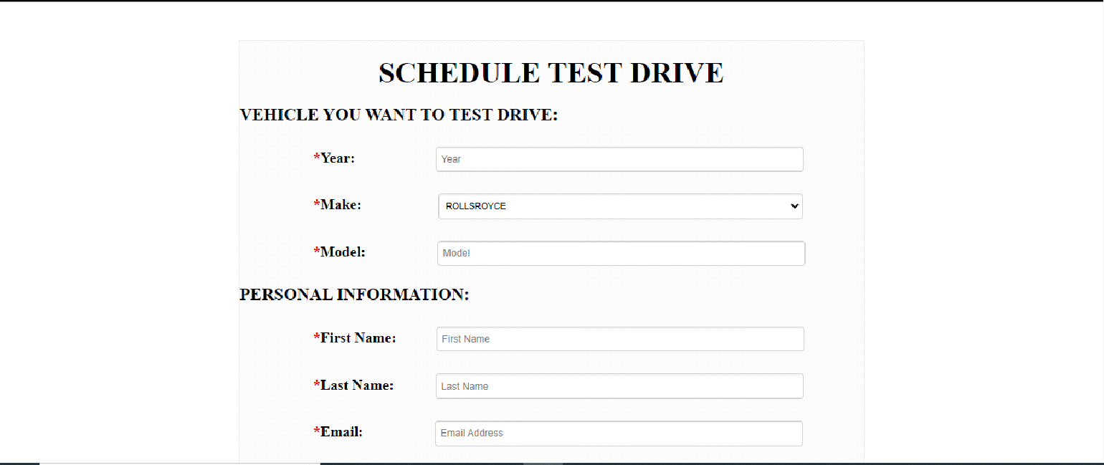
TEST DRIVE page

Slide 23
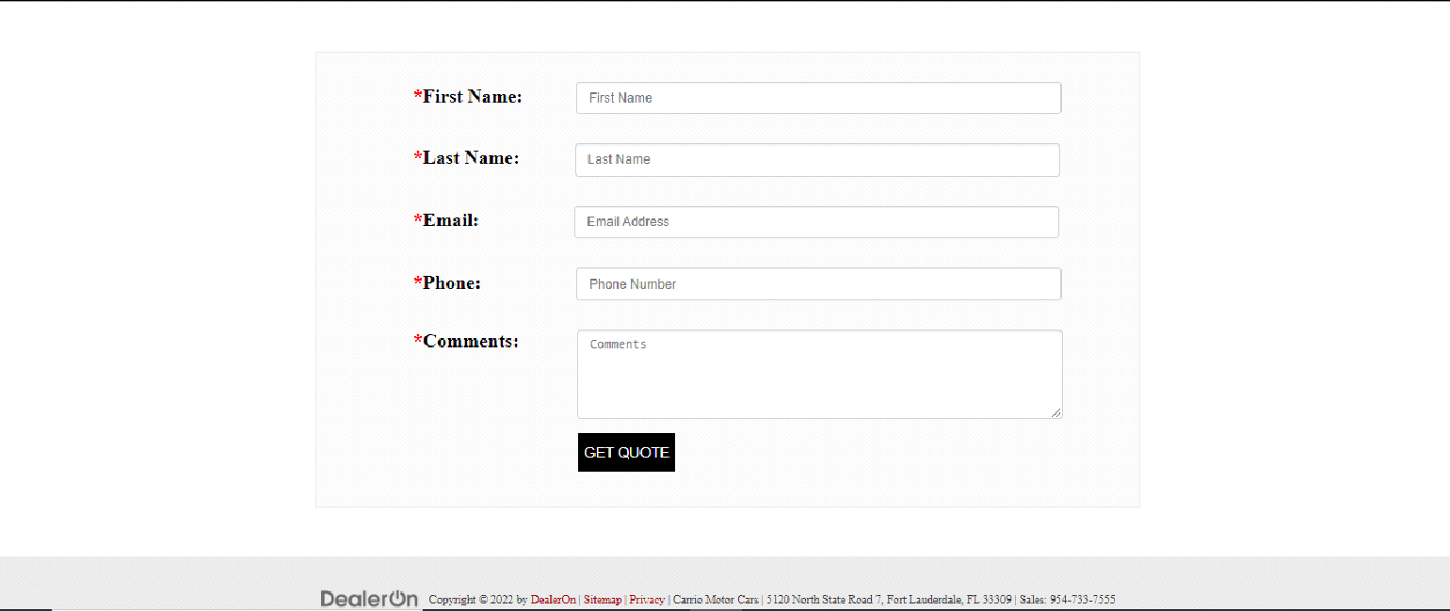
contact page

Slide 24

Admin page

Slide 25
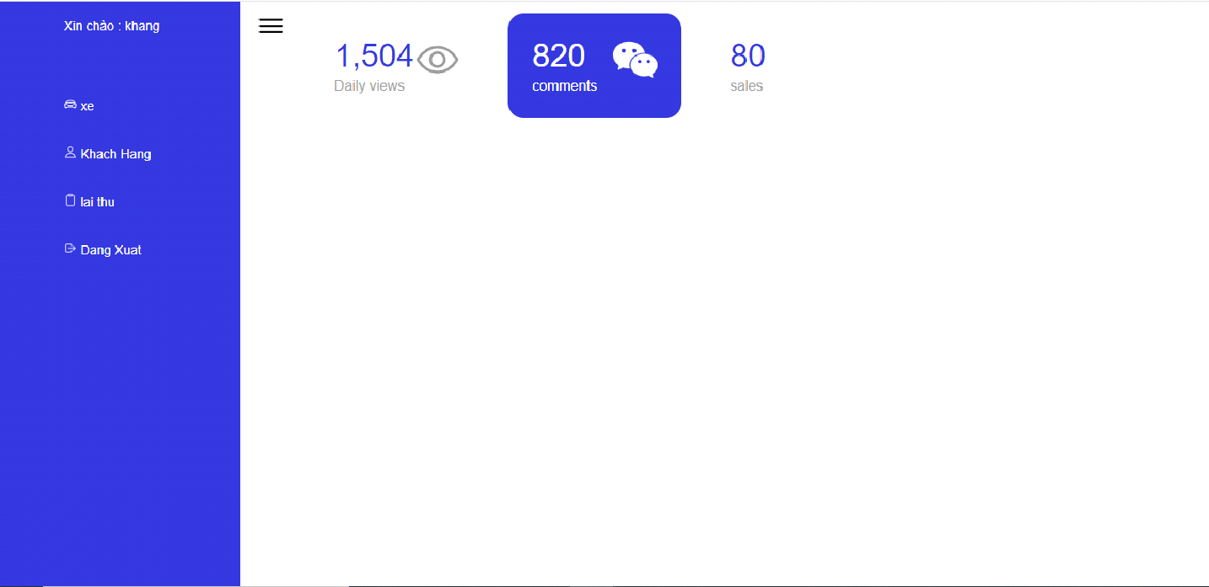

Slide 26
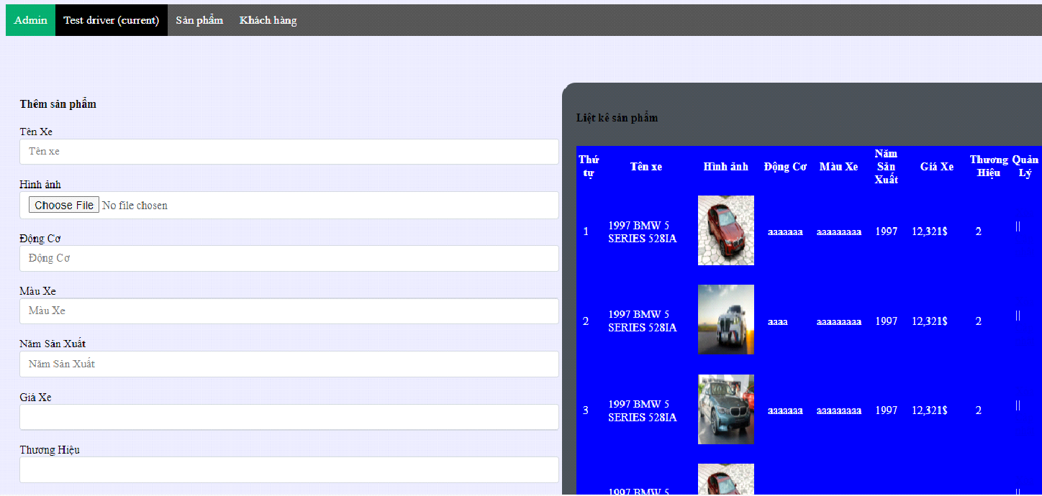
Admin edit products

Slide 27
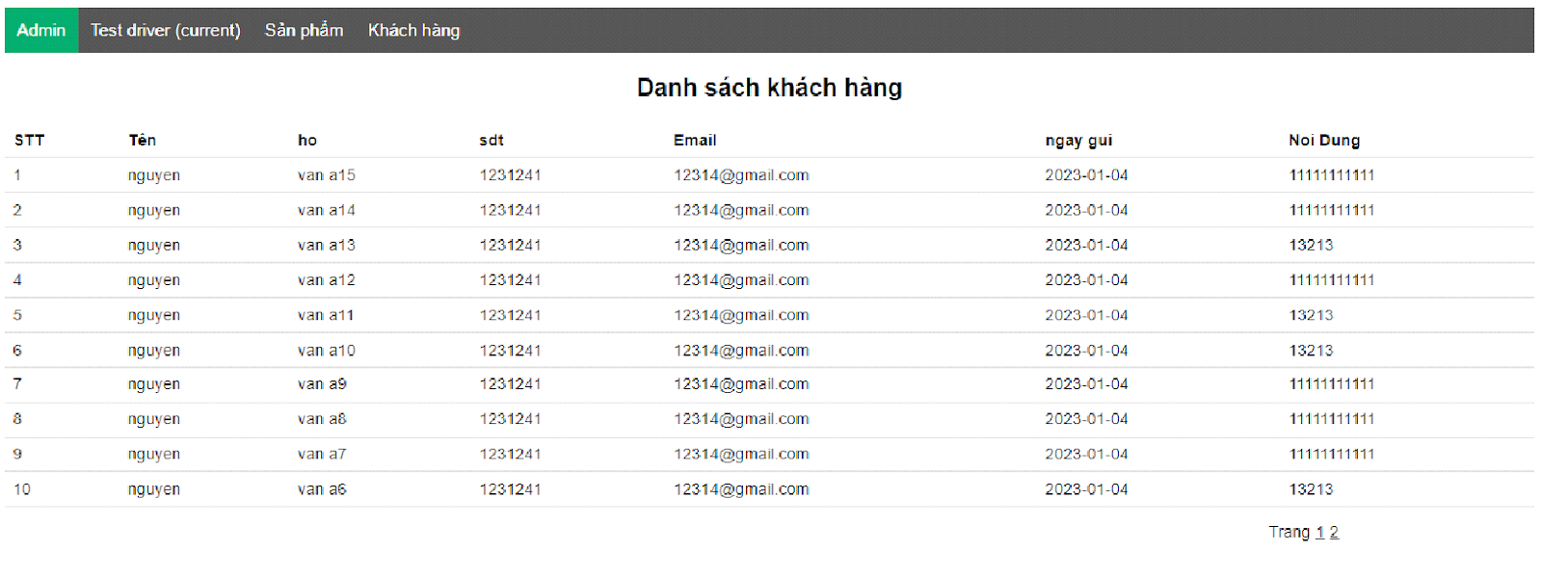
Admin view customer detail

Slide 28
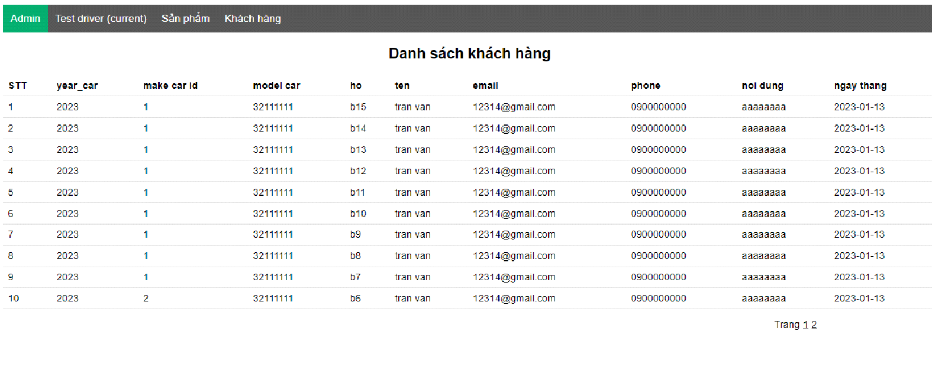
admin views test drive detail

