Slide 1


Slide 2
What’s today about?
What is Aurelia
Why use Aurelia
Why Aurelia fits .NET devs
But not about:
How to configure webpack
Why is everything so difficult with NPM
Notes:
First I’m going to quickly explain what Aurelia is and what is it used for
Then I’ll show what makes Aurelia stand out by explaining a bit more in details some of the features. I’ll include some examples that can make Aurelia easier to adopt for .NET developers.
So, I won’t be diggin into the 230-line webpack.config that the Aurelia CLI generates. And I (hopefully) won’t be spending much time showing how to avoid incompatible depencency version issues or caching packages that might disappear from NPM registry.

Slide 3

Who am I?
Software Engineer @
  .NET, Web, Desktop
...thinks web is actually a good idea
...likes optimising the inner loop in development
...but still draws plans with UML
Notes:
I’m a software engineer building Web and Desktop application at Codify
I tend to prefer Web as a platform (in situations where someone else might not).
I think optimising the developers inner loop makes coding more pleasant and efficient. And that’s where a lot of the web development tooling comes in.
But I’m not totally on the cutting edge all the time, for example, I still like to get a pen an paper to draw some UML class digrams.

Slide 4
History of Aurelia
November 2015
Beta
July 2016
1.0
January 2015
First Release

Slide 5
Aurelia at Codify
2015
Pilot project
2016
Several new projects
Template
2017 ->
Default for web

Slide 6
What is Aurelia

Slide 7
Single Page Application

Slide 8
Why Aurelia
What makes Aurelia stand out?

Slide 9
Simple / unobstrusive

Slide 10
Standards

Slide 11
Dependency Injection

Slide 12
Data Binding

Slide 13
Getting started
Building your first Aurelia application

Slide 14
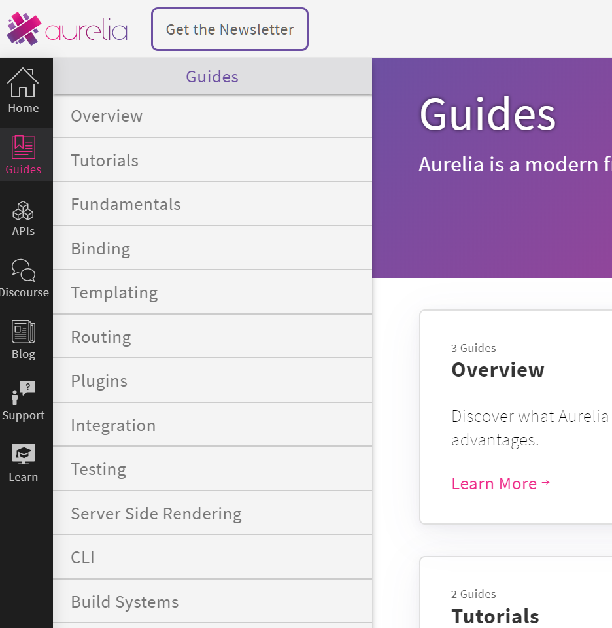
Documentation
Guides & Tutorials
Concepts
Notes:
The basic concepts are well documented, and it’s easy to get started
Some advanced scenarios require a bit more digging
API reference is not quite there yet

Slide 15
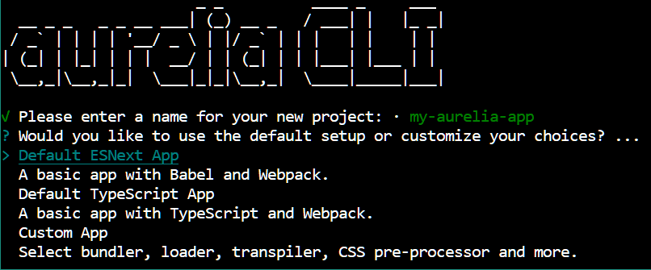
CLI
Notes:
The easiest way to start writing your application by far
Sets up a lot of configuration, and it’s a lot of work trying to understand that all
Similar to other CLIs (Vue, Angular, React)

Slide 16
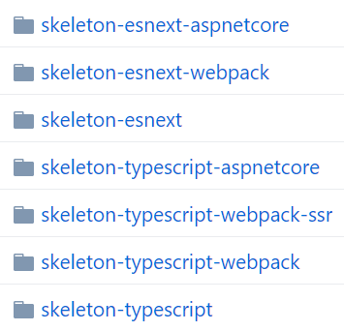
Skeleton Application
github.com/aurelia/skeleton-navigation
Good for reference
Complicated
Limited tooling choises
Notes:
An excellent reference for understanding different set-up and building your own
May be overly complicated if not all the configured tools are needed
If the tooling choices don’t match with what’s needed, then understanding and modifying the configuration might be needed

Slide 17
Custom Skeleton
github.com/vuorinem/aspnet-aurelia-webpack-skeleton
ASP.NET Core / Aurelia / Webpack
Built for VS
HMR
...until 10 days ago:
Obsoleting Microsoft.AspNetCore.SpaServices and Microsoft.AspNetCore.NodeServices
Notes:
Easy to get started with Aurelia on VS: open project and run
Publishing from VS works out of the box
Hot Module Replacement: component code is updated without refreshing the page, preserving application state
Microsoft announced on August 5th that SpaServices and NodeServices are obsolete and will be removed in .NET 5. This includes UseWebpackDevMiddleware and aspnet-webpack npm module that this skeleton relies on. A lot of Vue users have the same issue.

Slide 18
Aurelia .NET Tooling
Coming
github.com/aurelia/dotnet
Templates (dotnet new aurelia)
  Basic, MVC-integrated, authentication, SSR
VSCode plugin
Scaffolding (Api -> Client model + view)
Notes:
- Does not rely on obsolete SpaServices or NodeServices
Templates
dotnet new aurelia - Api based no security quick start
dotnet new aurelia-mvc - Usage of MVC views and integration of Aurelia
dotnet new aurelia-secure - Add token based authentication and dashboard to manage. All built with Aurelia
dotnet new aurelia-ssr - Generate a dotnet template that will use the embedded node process to render the Aurelia application

Slide 19
Examples

Slide 20
Template

Slide 21
Component

Slide 22
Binding

Slide 23
Events (Standard DOM)

Slide 24
Events (Pub/Sub)

Slide 25
Value Converter
XAML
Aurelia
<El Attr="{Binding Context.Property, Converter={StaticResource MyValueConverter}}">
<el attr.bind="context.property | myValueConverter"></el>
public class MyValueConverter : IValueConverter
{
public object Convert(object value, Type targetType, object parameter, CultureInfo culture)
{
// Convert view
}
public object ConvertBack(object value, Type targetType, object parameter, CultureInfo culture)
{
// Convert from view
}
}
export class MyValueConverter {
toView(value, param1, param2) {
// Convert to view
}
fromView(value, param1, param2) {
// Convert from view
}
}
<li repeat.for=”items | filterBy:filterText"></el>
<li repeat.for=”items | filterBy:filterText | sortBy:sortProperty"></el>
Notes:
The Aurelia ValueConverter interface uses toView and fromView methods, which make it quite clear which direction the data is flowing. This is in contrast to Xaml's IValueConverter, which uses Convert and ConvertBack.
In Aurelia, converter parameters can be data-bound. This is something that was missing in Xaml and enables more advanced binding scenarios.
Aurelia value converter methods can accept multiple parameters
Multiple value converters can be composed using pipes (|).
Aurelia value converter can have a class field named signals, which accepts an array of string that will be used to manually trigger updating the view. This is to handle the situations where the value converter relies on variables that are defined outside of Aurelia application, such as language, locale etc.

Slide 26
Binding Behaviour
Notes:
”Custom Behaviour” in WPF

Slide 27
Wrap-up

Slide 28
Why Learn Aurelia
Learn standards
ES5, ES2016, ES2017...
Web Standards
Notes:
Learn standards:
Building Aurelia application is mostly just writing JavaScript or TypeScript and HTML
Even advanced features of Aurelia make use of web standards, for example content projection with <slot> elements

Slide 29
Why Use Aurelia
Simple
Standards
”Hidden away”
Powerful
Conventions
Standards
Stable
Data binding
Configurable conventions
Advanced features
Plugin architecture
Notes:
Simple:
Default conventions make it simple to start the development from the application instaed of framework configuration
Standards make learning easier and useful outside Aurelia as well
Data binding allows declarative templates, and with two-way data binding updating ”just works” without extra code
Stable:
Following standards means changes to how the framework is used are less frequent and a result of wider community effort
Less framework code in the application means less changes if the framework changes
Separation of core and plugins allows stable core with flexibility in plugins when needed
Powerful:
-

