Slide 1
Dynamic workload experiment on TMS320C6678
Risto Vuorio
Embedded Software Group
4.6.2015

Slide 2
OpenEM
Runtime system for Multicore platforms
Dynamically load balanced applications with run-to-completion principle
Notes:
----- Meeting Notes (27/05/15 11:15) -----
define events, eos, queues, scheduler, dispatcher

Slide 3
Terminology
Event is the unit of communication in OpenEM. Events are typically used to carry data to process but can be data-less tokens as well
The event descriptors are allocated at initialization of the Queues
Execution objects encapsulate the algorithm to execute when an event is received
Queues connect events (data) and execution objects (algorithms). Each queue is associated with one execution object and all queued events will be processed by this execution object.
Scheduler moves allocated events to queues
User calls the dispatcher in dispatch loop. Dispatcher calls the ‘receive’ function of the Execution object of the connected queue

Slide 4
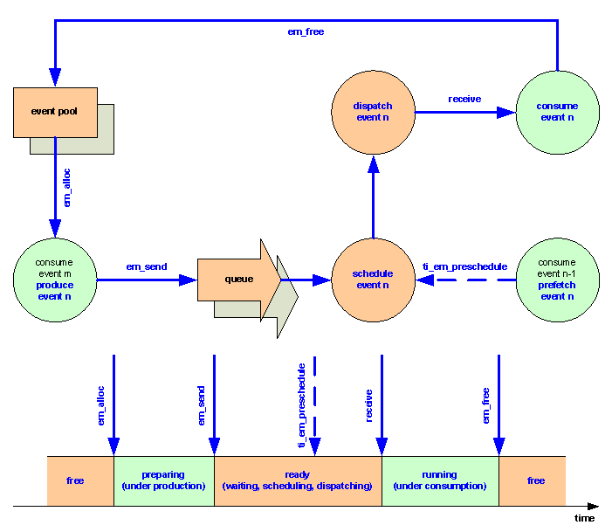
Notes:
----- Meeting Notes (27/05/15 11:15) -----
event pool specifics
event implementation in hw and sw
dynamic workload

Slide 5
TI OpenEM 1.0.0.2
Texas Instruments implementation of Open Event Machine runtime system
Included in Multi Core Software Development Kit MCSDK
<ti/runtime/openem/event_machine.h>
OS Agnostic
OpenEM dispatcher can be called from bare metal SW or from an OS thread. Scheduler always runs on PDSP core.
Leverages Multicore Navigator
Hardware queues and packet communication
Multicore Navigator is hidden from the user after initialization

Slide 6
TI OpenEM Implementation
Initialization
A fairly universal initialization sequence for OpenEM and QMSS is included in an example
QMSS
Queue Management Sub System
Contains two PDSP cores which run the scheduler
Scheduler loaded as machine language
<ti/runtime/openem/firmware/event_machine_firmware.h>
Load Balancing
Lazy (or passive): cores request events when ready.
Eager (or active): send events to core dedicated queues by user decision
Static
Notes:
----- Meeting Notes (27/05/15 11:15) -----
no I/O in experiment but thesis should explain how it could be possible
----- Meeting Notes (04/06/15 16:11) -----
scheduler specifics, koodivälimuisti, execution object specifics, core groups

Slide 7
Events in memory
Events appear as packets to the QMSS. Packet descriptors are preallocated in the free queue from which they are “em_alloc”ed for use in the application
There can only be a predetermined number of events
If user tries to allocate an event while there are no free events in the specified pool, an error value EM_EVENT_UNDEF is returned
The example application just while loops until no error is returned

Slide 8
Memory areas 1/2
OpenEM requires a set of memory areas to be created
The TI OpenEM package contains a mapping that describes the memory areas required by OpenEM

Slide 9
Memory areas 2/2
Specific memory regions are required for the QMSS, PKTDMA and EM libraries, the abstraction layer and the application
The memory areas required by the libraries are predefined in a memory mapping provided in the example
The abstraction layer defines the mappings for its own memory areas
The user has to define memory sections for Public and Preload events buffers

Slide 10
Dynamic event allocation
Events can be allocated at runtime
Events can contain the data to be processed or just pointer to the shared memory location of the data buffer

Slide 11
Execution Objects
Execution objects can be created any time during execution but they cannot be deleted at runtime
Created using em_eo_create()

Slide 12
Event Queues
Eqs created by the application are virtual queues, not QMSS HW queues
Application can create thousands of queues
EQs are mapped to HW queues according to their priorities and core masks

Slide 13
Queue Groups
An EQ belongs to a queue group
Core masks are attached to queue groups
Allows selecting which cores will be getting events from specific EQ
Dynamically created
Defaults to all cores

Slide 14
Scheduling
All objects shared among all cores
Queues belong to Queue Groups that can have core masks attached to them
Events will be scheduled on all cores in the queue group according to four queue selection criteria
Priority
Atomicity
Locality
Order

Slide 15
PREESM Actors

Slide 16
PREESM Generated Code for TI
PREESM is capable of generating code from the actor model program defined using graphical tools for C6678
Eclipse LUNA needed for graphical tools
The generated code requires a custom target platform in CCS which alters the default memory layout
5.3 > CCS Version > 5.2 required
Requires sys/bios and ipc
BIOS MCSDK 2.x
<ti/ipc/Ipc.h>
<ti/sysbios/knl/Semaphore.h>
etc

Slide 17
Thesis experiment
Video filtering application with PREESM
Convert the PREESM application to OpenEM
Analyze both applications
Static analysis
Dynamic analysis
Notes:
----- Meeting Notes (27/05/15 11:15) -----
sketch a simulation model for PSE

Slide 18
Video Filter Application using PREESM
Multiple input video streams
Sobel & Gaussian filters capable of processing the same stream on multiple cores
Manually scheduled
Actors divided between cores depending on the number of input streams

Slide 19
Actors in OpenEM
Map Actors to Execution Objects
PREESM Actor model guarantees memory independency between Actors and the data is moved in static size units

Slide 20
Implementing the experiment with OpenEM
Input
Data preloaded in to memory
A regular for loop em_allocing events outside the OpenEM operating context
Low priority Queue for input events that em_alloc actual data events and new input events
Output
Low priority queues which collect events holding the results that are allocated by the actual filter EO
Collect statistics and free events
Processing
Filters implemented as Execution objects

Slide 21
I/O
This thesis does not take the effect of I/O in to account
The video streams are preloaded in to memory and there is no output stream
The TMS320C6678 contains a switch fabric called TeraNet which connects the Multicore Shared Memory Controller with peripherals
The TeraNet is connected to ethernet and PCIe both of which could function as the external I/O interface

Slide 22
Analysis
PSE – dynamic
Sketch a PSE model
Static analysis tool
TI doesn’t provide one (?)

