Slide 1
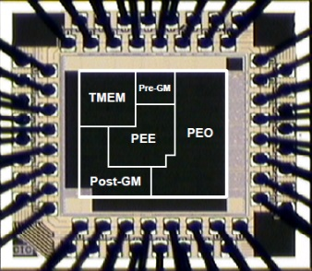
Introduction to Timing Constraints
Song-Nien Tang
Department of Information & Computer Engineering
Chung Yuan Christian University
sntang@ice.cycu.edu.tw

Slide 2
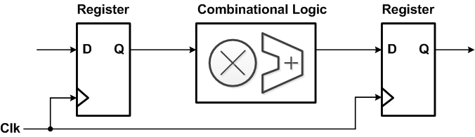

Setup time & Hold time Criterion [1]
in
Propagation time
out
xxxxxxxxxx
out@cycle2
out@cycle3
cycle1
cycle2
cycle3
setup time
hold time

Slide 3
Setup time & Hold time Criterion [2]
Setup time violation
Propagation time was too long !!
setup time
setup time
out@cycle2
out@cycle3
cycle1
cycle2
cycle3
violation
violation
hold time violation
Propagation time was too short !!
hold time
hold time
out@cycle2
out@cycle3
cycle1
cycle2
cycle3
violation
violation

Slide 4
Setup time & Hold time Criterion [3]
Setup time violation issues raised when edge → “lead”
setup time
out@cycle2
cycle1
cycle2
clock uncertainty (clock jitter)
Hold time violation issues raised when edge → “lag”
hold time
out@cycle2
out@cycle3
cycle1
cycle2
clock uncertainty (clock jitter)

Slide 5
Register-to-Register Timing Constraints
Propagation time
(T_{p})
T
For Setup time criterion
T_{p} <= T – T_{setup}– T_{jitter}
For Hold time criterion
T_{p} >= T_{hold} + T_{jitter}

