Slide 1
Pathway Data Integration
Vo Phuc Tho
Hoang Quang Minh

Slide 2
Motivation
Many pathway databases available (KEGG, Wikipathways, Ingenuity, etc.)
No common formatting and/or labelling standard
Integration to make full use of heterogeneous data sources

Slide 3
Problem Definition
Define score(p,q) = similarity index between pathway p and pathway q
Given two pathway databases D₁ and D₂
For any pathway p_{i} in D₁ , find a pathway q_{j} in D₂ such that score(p_{i} , q_{j}) is maximized and score(p_{i}, q_{j}) is greater than or equal to a predetermined threshold T.
How to calculate score(p,q) ?

Slide 4
Preprocessing
Sources: KEGG, Wikipathways, Intpath
Output format: XML
Project Platform: Java

Slide 5
Metrics
Gene agreement count
Gene pair agreement count
String comparison of pathway names

Slide 6
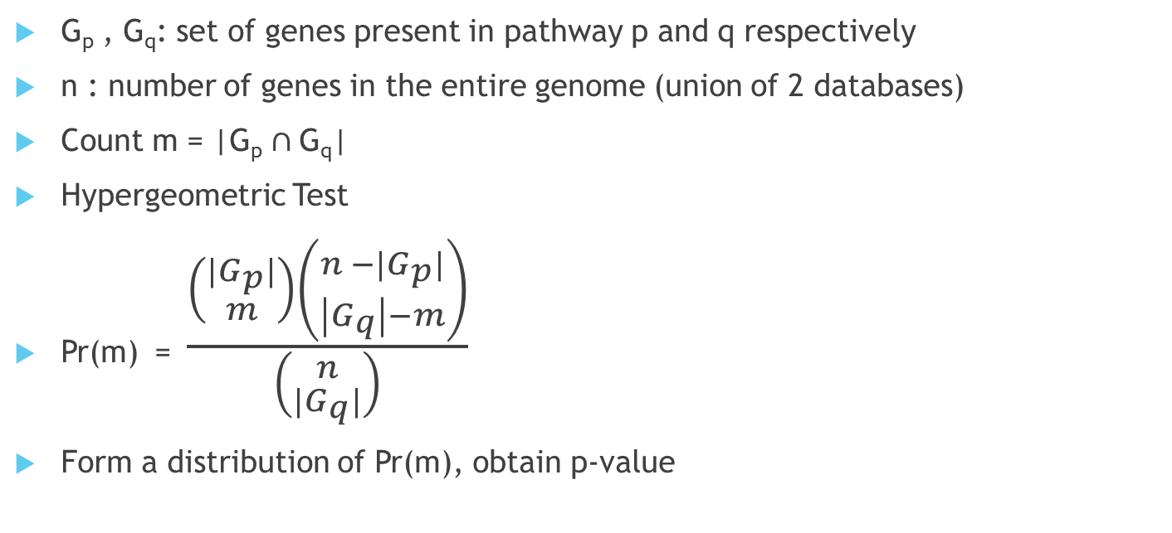
Gene Agreement
G_{p} , G_{q}: set of genes present in pathway p and q respectively
n : number of genes in the entire genome (union of 2 databases)
Count m = |G_{p} $∩$G_{q}|
Hypergeometric Test
Pr(m) = $\frac{\left({|G_{p}| \atop m}\right)\left({n −|G_{p}| \atop \left|G_{q}\right|−m}\right)}{\left({n \atop |G_{q}|}\right)}$
Form a distribution of Pr(m), obtain p-value

Slide 7
Gene Pair Agreement
Similar to gene agreement
Hypergeometric test
Obtain p-value

Slide 8
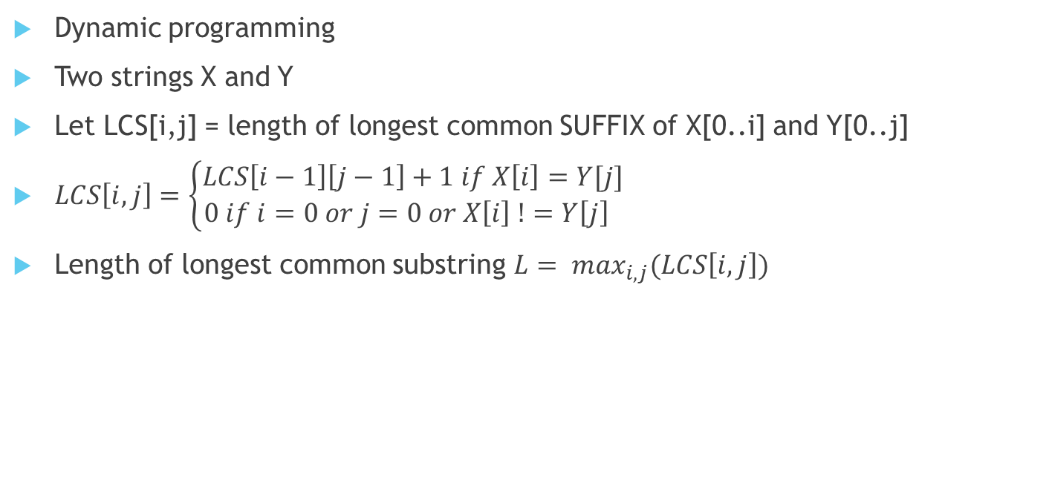
Longest Common Substring (LCS)
Dynamic programming
Two strings X and Y
Let LCS[i,j] = length of longest common SUFFIX of X[0..i] and Y[0..j]
$LCS\left[i,j\right]=\left\{\begin{aligned}LCS\left[i−1\right]\left[j−1\right]+1 if X\left[i\right]=Y[j] \\ 0 if i=0 or j=0 or X\left[i\right] !=Y\left[j\right] \end{aligned}\right.$
Length of longest common substring $L= \max_{i,j}(LCS\left[i,j\right])$

Slide 9
Integrated Scoring Scheme
Define score(p,q) = w₀ + w₁S_{GA}(p,q) + w₂S_{GP} (p,q) + w₃LCS(p,q)
Where:
S_{GA}(p,q) = p-value from hypergeometric test for Gene agreement,
S_{GP}(p,q) = p-value from hypergeometric test for Gene pair agreement,
LCS(p,q) = length of longest common substring of p’s name and q’s name
w₀ , w₁ , w₂ , w₃ are corresponding weights

Slide 10

Integrated Scoring Scheme
Sigmoid function c(x) = 1 / (1 + e^{-x})
Define $label\left(p,q\right)= \left\{\begin{aligned}0 if c\left(score\left(p,q\right)\right)<T \\ 1 otherwise \end{aligned}\right.$
Classification problem

Slide 11
Learning weights
Without training data: Heuristic
With training data:
Stochastic gradient descent
Artificial Neural Network (ANN)
Support Vector Machine (SVM)

Slide 12
Further consideration
Other metrics ?
Non-parametric methods ?

