Slide 1
Pathway Data Integration
Vo Phuc Tho
Hoang Quang Minh

Slide 2
Motivation
Many pathway databases available (KEGG, Wikipathways, Ingenuity, etc.)
No common formatting and/or labelling standard
Integration to make full use of heterogeneous data sources

Slide 3
Problem Definition
Define score(p,q) = similarity index between pathway p and pathway q
Given two pathway databases D₁ and D₂
For any pathway p_{i} in D₁ , find a pathway q_{j} in D₂ such that score(p_{i} , q_{j}) is maximized and score(p_{i}, q_{j}) is greater than or equal to a predetermined threshold T.
How to calculate score(p,q) ?

Slide 4
Preprocessing
Sources: KEGG, Wikipathways, Intpath
Output format: XML
Project Platform: Java

Slide 5
Metrics
Gene agreement count
Gene pair agreement count
String comparison of pathway names

Slide 6
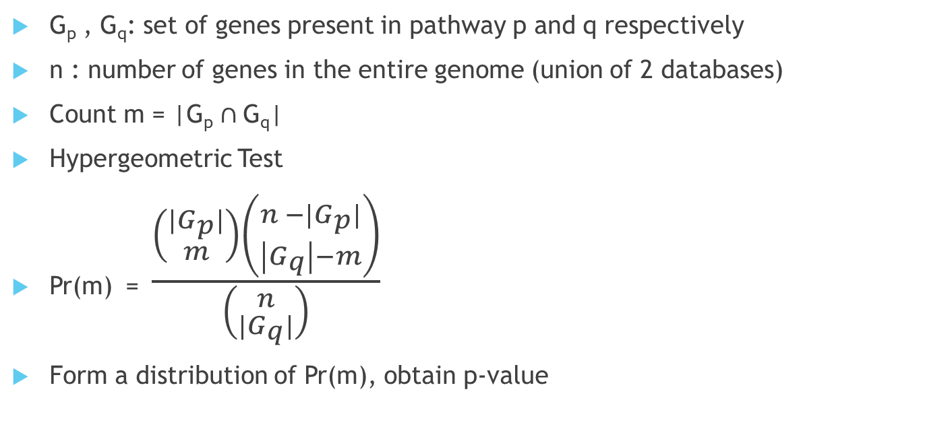
Gene Agreement

Slide 7
Gene Pair Agreement
Similar to gene agreement
Hypergeometric test
Obtain p-value

Slide 8
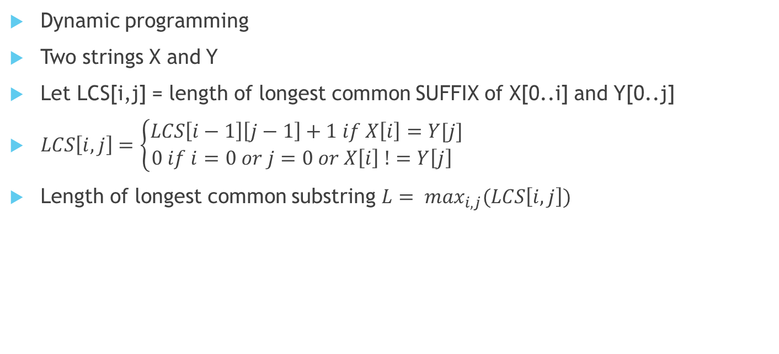
Longest Common Substring (LCS)

Slide 9
Integrated Scoring Scheme
Define score(p,q) = w₀ + w₁S_{GA}(p,q) + w₂S_{GP} (p,q) + w₃LCS(p,q)
Where:
S_{GA}(p,q) = p-value from hypergeometric test for Gene agreement,
S_{GP}(p,q) = p-value from hypergeometric test for Gene pair agreement,
LCS(p,q) = length of longest common substring of p’s name and q’s name
w₀ , w₁ , w₂ , w₃ are corresponding weights

Slide 10
Learning weights
Supervised Learning : No training data
Intuition: Average score of top matches should be distinctively higher than average score of other matches.
→ Fitness function: f(D₁,D₂,W) = Average score of top matches / Average score of remaining matches
→ Genetic algorithm

Slide 11
Genetic algorithm
Survival of the fittest.
Parent selection
Crossover operator
Mutation operator

Slide 12
Survival of the Fitness
Individual in population competes for resources and mates
Individual more successful in each generation will have produce more offsprings than ones performing poorly
Genes from good individuals of last generation propagate throughout the next generation so that offsprings of good parents might perform better than either parent
Thus, each successive generation will become more suited to their environment
Genetic algorithm continues to create new generation until terminated conditions are satisfied.

Slide 13
Parent Selection
For each generation, calculate the fitness scores of all individuals
Fitness function: f(D₁,D₂,W) = Average score of top matches / Average score of remaining matches
Select parents with preference to individuals with higher fitness scores
Round wheel algorithm, tournament algorithm, etc.
End selection if number of offspring are enough for next generation

Slide 14
Crossover
Offsprings inherit a part of genes from both 2 parents, and likely to have better performance than their parents
Example: parent1 = {0.5, 0.2, 0.3, 0.7}; parent2 = {0.6, 0.3, 0.6, 0.4}
Crossover point is randomly chosen: crossover = 3
=> offspring = {0.5, 0.6, 0.3, 0.4}

Slide 15
Mutation
Sometimes, crossover alone cannot create individuals with exceptional performance => ‘dead-end’
With some low probability (mutation chance), a portion of new generation will have their genes being mutated
Mutation chance must be low!!!

