Slide 1
Glitch-Free Clock Multiplexer with Symmetric Failover: Design and Implementation
Tutor: PhD. Thuan Van Le
Contributor 1: Hai Minh Truong
Contributor 2: Vu Thi Phuong

Slide 2
Introduction

Slide 3
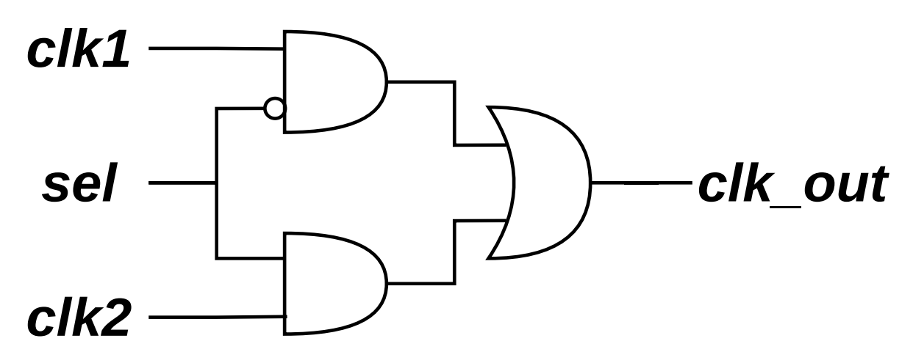
Problems:
Definition of Glitch
Notes:
Glitch (unsynchronized)

Slide 4
Problems:
Metastabilities between 2 clock domain (2flipflop to solve)
Synchronize?
Probs (H or L ?)
Solution
Notes:
metastability

Slide 5
Main problem:
Notes:
Prob: unsynchronize (purely combinational logic) -> adding flipflops

Slide 6
Trad model:
Notes:
Glitch (unsynchronized)

Slide 7
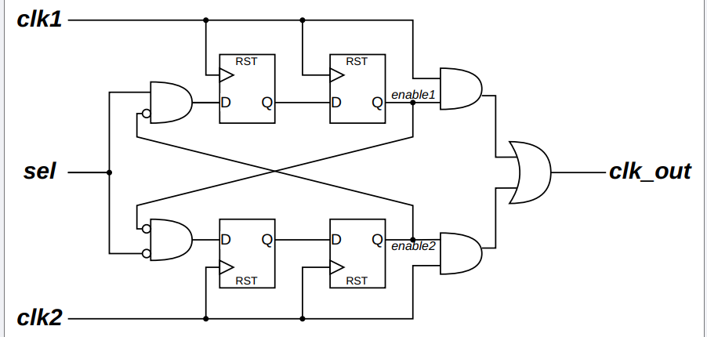
Break-before-make model:
Posedge?

Slide 8
Break-before-make model:
Solutions

Slide 9
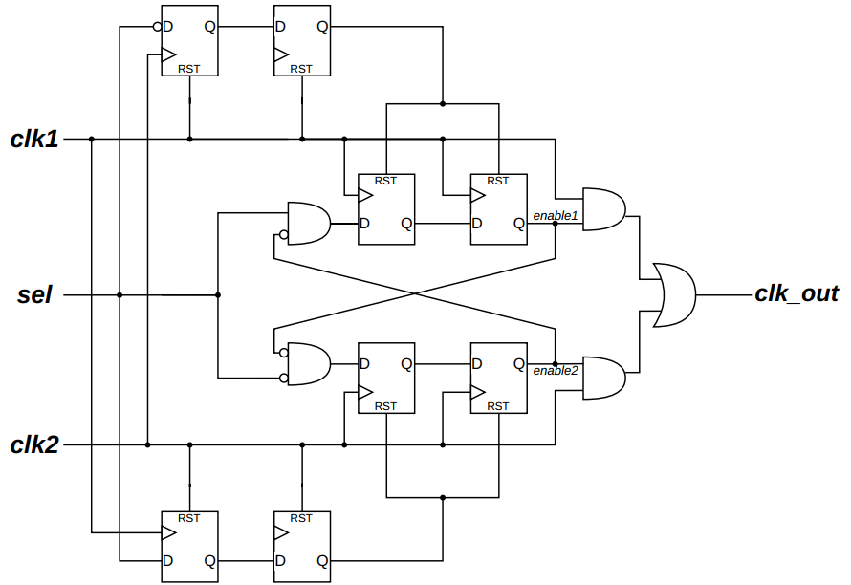
Timer-based model:

Slide 10
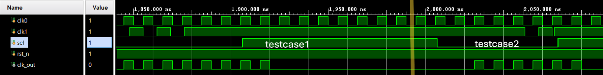
Timer-based model:

Slide 11
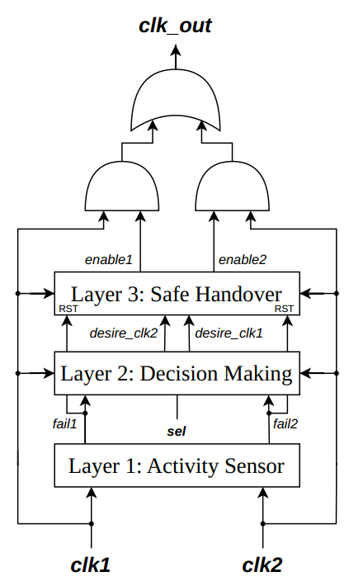
Proposed-block diagram
Notes:
Layer 1: die or live
Layer 2: sync with sel (if selected clock died, other lives) → others. And normal, normal
Layer 3: synchronize and break before make

Slide 12
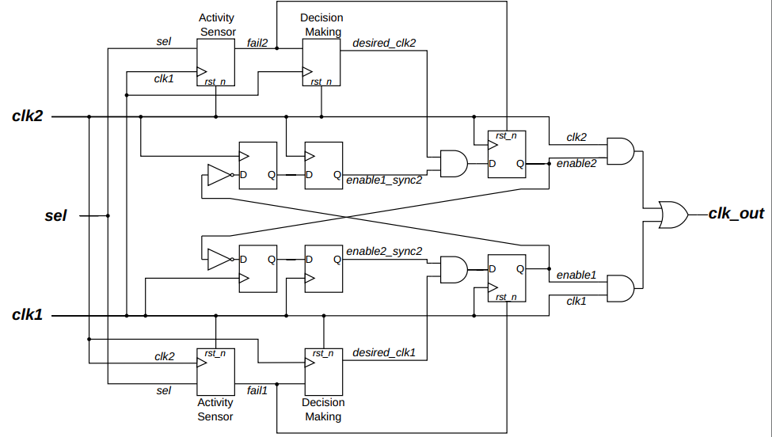
Proposed-scheme

Slide 13
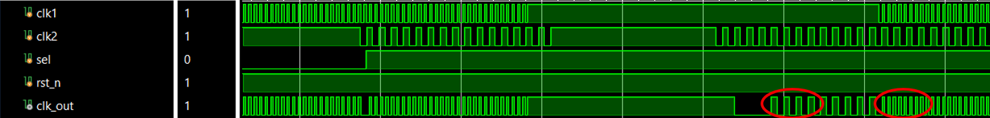
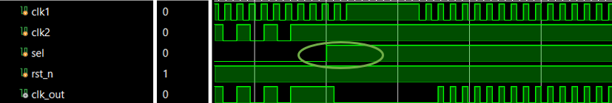
Proven:

Slide 14
Content
Problems:
Classical Model:
Requirements:
Proposed solution:

Slide 15
2. Classical model:

Slide 16
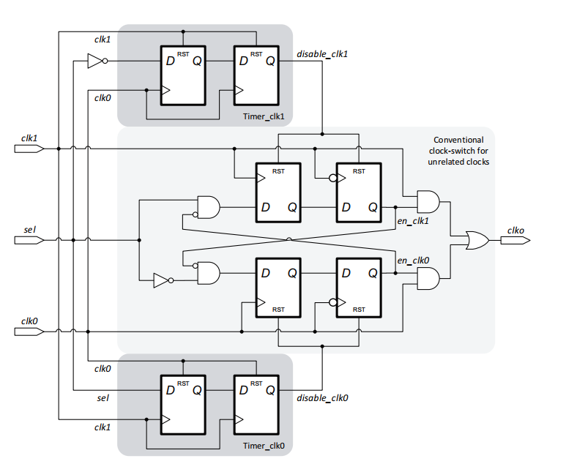
Novelty model:
nice
1 limitation

Slide 17
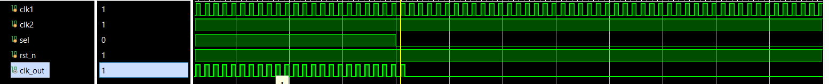
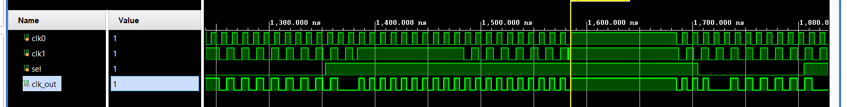

Slide 18
3. Requirement:

Slide 19
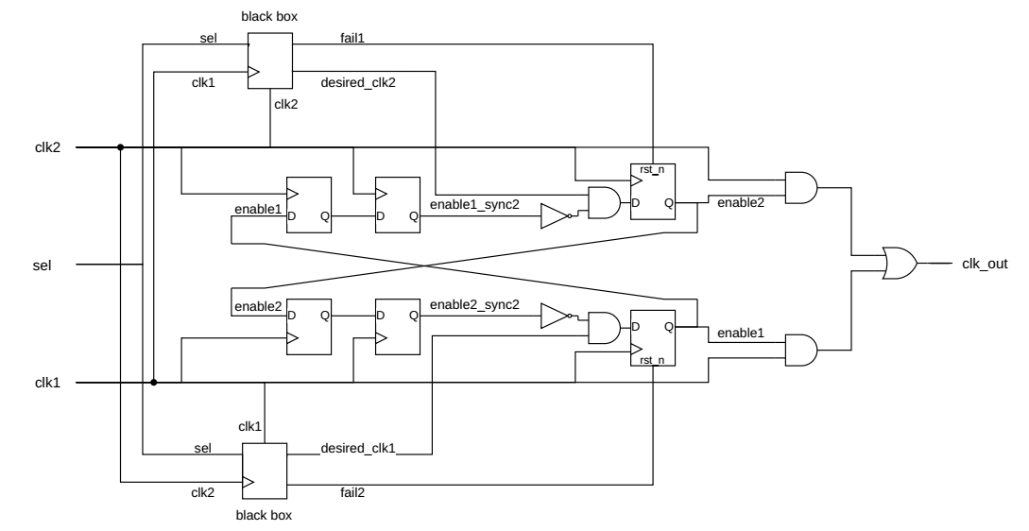
4. Proposed solution:
Layer 2
Layer 1

Slide 20
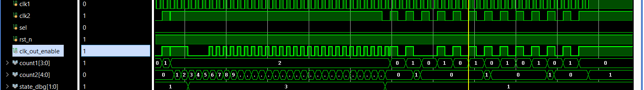
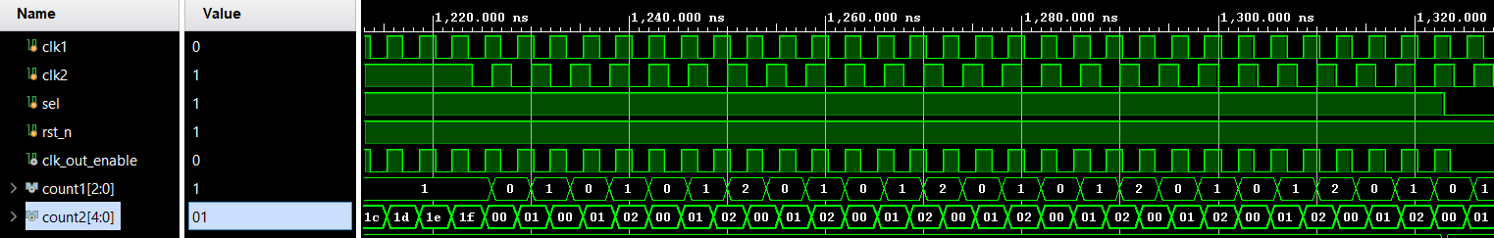

Slide 21
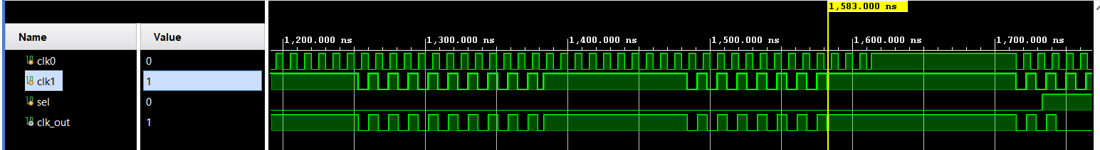
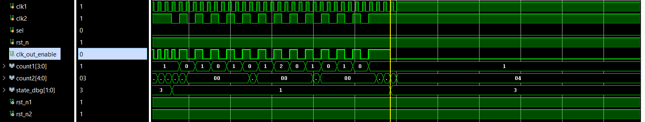
Solved problems:
Old version: cannot solve
New version: can solve

Slide 22
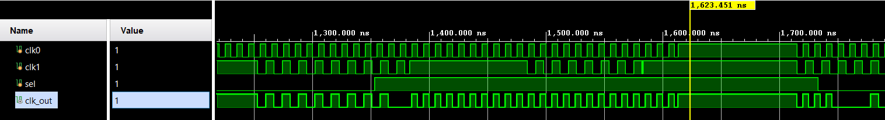
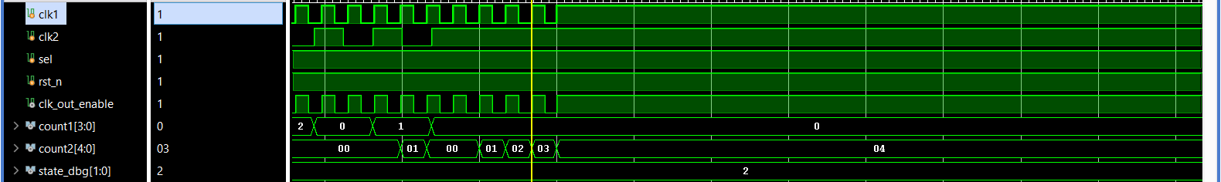
Still can’t solve
Old
New

Slide 23
4. Proposed solution:

Slide 24
Problems solving:
Go each problems and solution through old version to ours
Or
Integrating all problems together and talk through each solutions (Like interpret the problems first and comparet this condition through each method?)

