Slide 1
Glitch-Free Clock Multiplexer with Symmetric Failover: Design and Implementation
Tutor: PhD. Thuan Van Le
Contributor 1: Hai Minh Truong
Contributor 2: Phuong Thi Vu

Slide 2
Introduction
Clock switching in multi-clock SoC/FPGA systems is a critical challenge
Conventional designs suffer from glitches, metastability, and deadlock under clock failure
Existing solutions cannot simultaneously guarantee glitch-free, deadlock-free, and autonomous failover
This work proposes a novel GFCM architecture enabling safe switching and reliable recovery without external reference clock

Slide 3
Contents
Problems
Prior Work and Limitations
Design Objectives
Proposed solution
Results

Slide 4
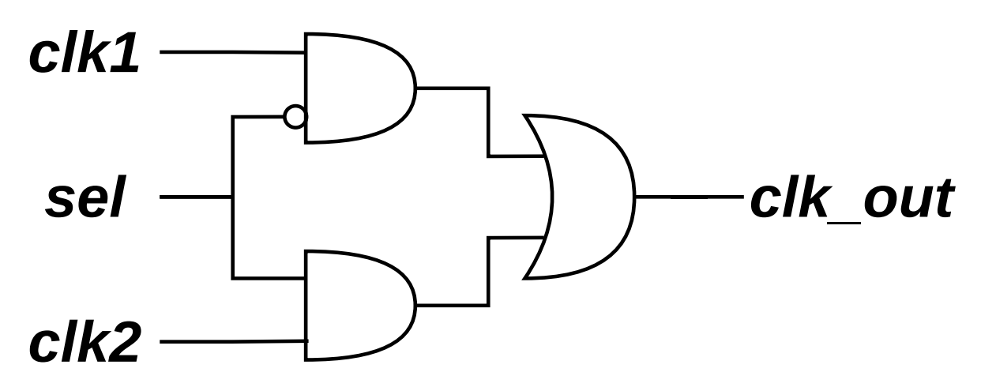
1.Problems:
Glitch: an unwanted short pulse at the output caused by unsynchronized switching between signals or clocks
Notes:
Glitch (unsynchronized)

Slide 5
Metastabilities between 2 clock domain (2flipflop to solve)
Synchronize?
Probs (H or L ?)
Solution
Indeterminate state caused by asynchronous sampling near clock edge
Notes:
metastability

Slide 6
Deadclock
Deadclock
The system enters a deadlock condition, resulting in the output clock being stuck at a constant logic level (no toggling)

Slide 7
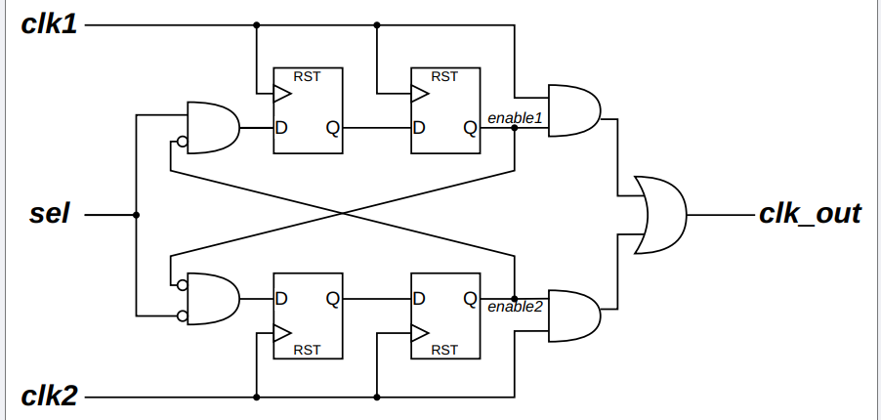
Break-before-make model:
2. Prior Work and Limitations
2. Classical Model
Posedge?

Slide 8
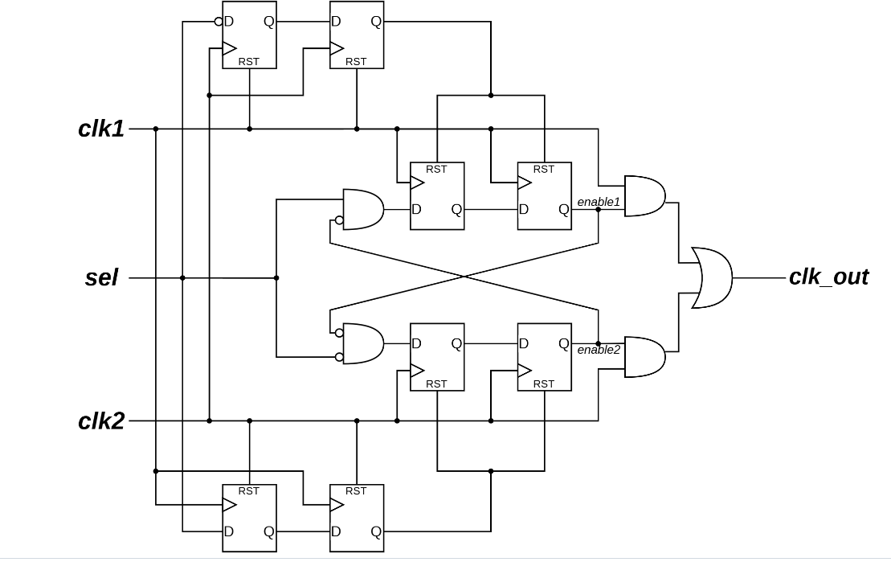
Timer-based model:

Slide 9
3. Design Objectives
Glitch-free switching
Deadlock-free operation under clock failure
Autonomous failover and safe recovery
Safe operation under dual-clock failure scenarios
No external reference clock required
Safe CDC across clock domains

Slide 10
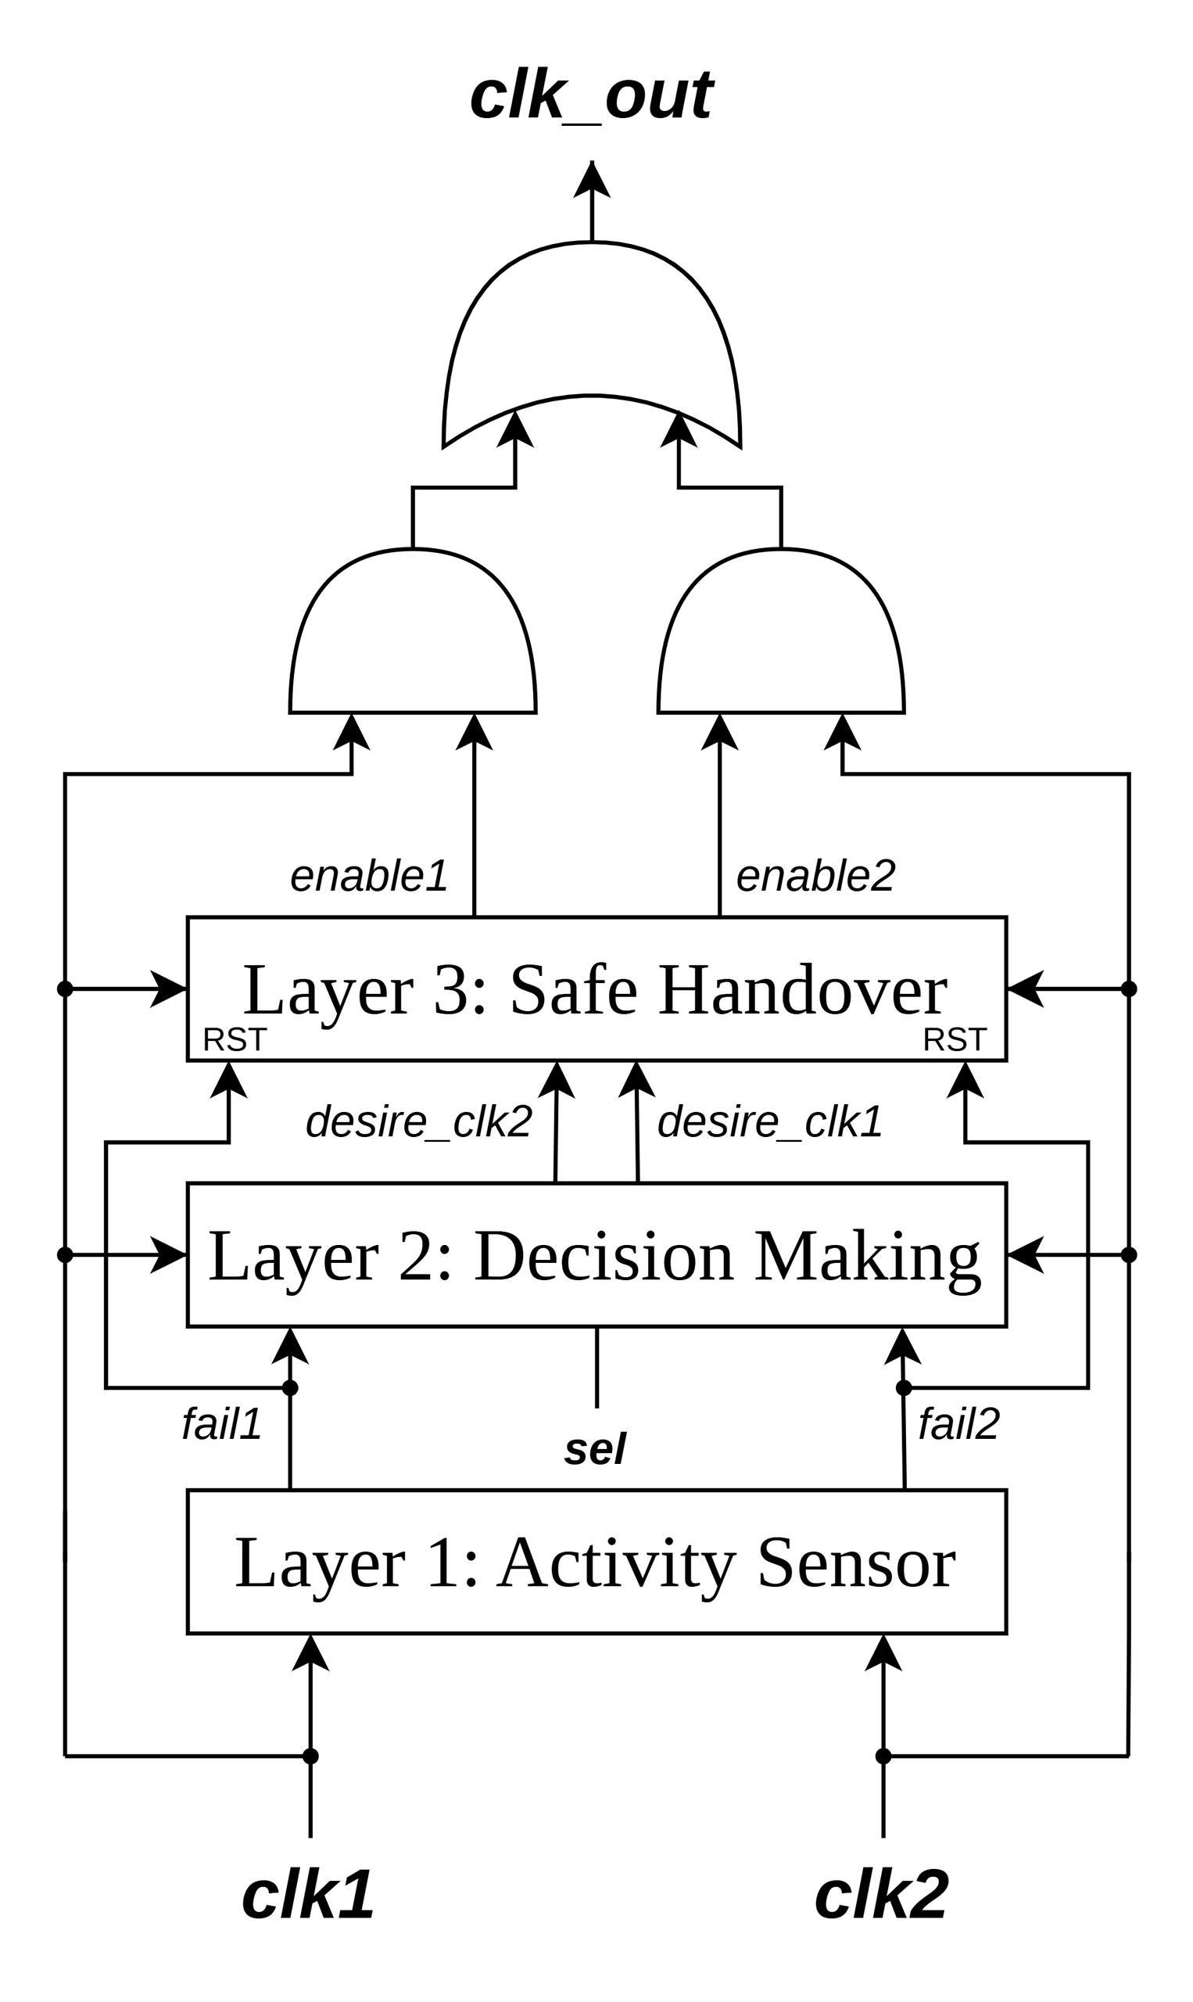
Proposed-block diagram
4. Proposed solution
Notes:
Layer 1: die or live
Layer 2: sync with sel (if selected clock died, other lives) → others. And normal, normal
Layer 3: synchronize and break before make

Slide 11
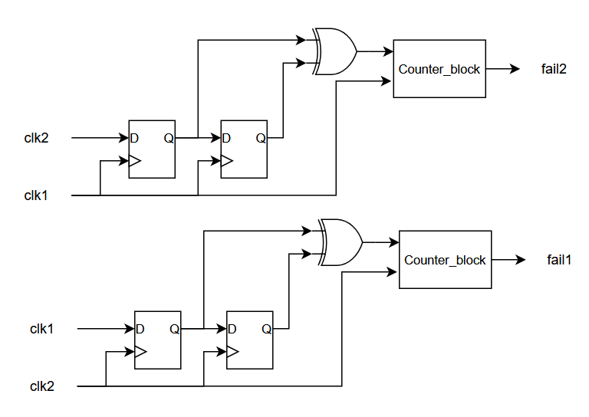
Layer 1: Activity Sensor

Slide 12
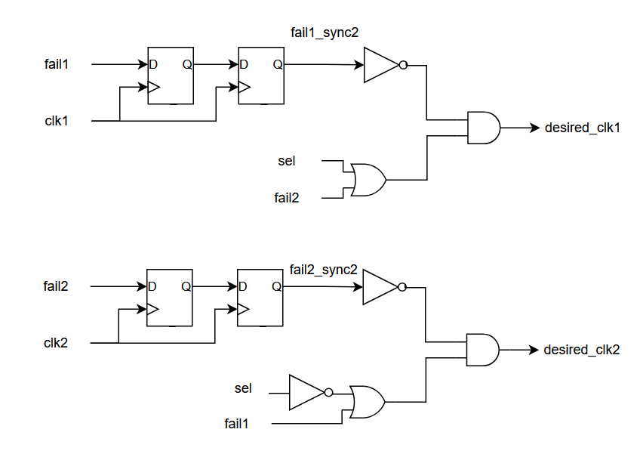
Layer 2: Decision Making

Slide 13
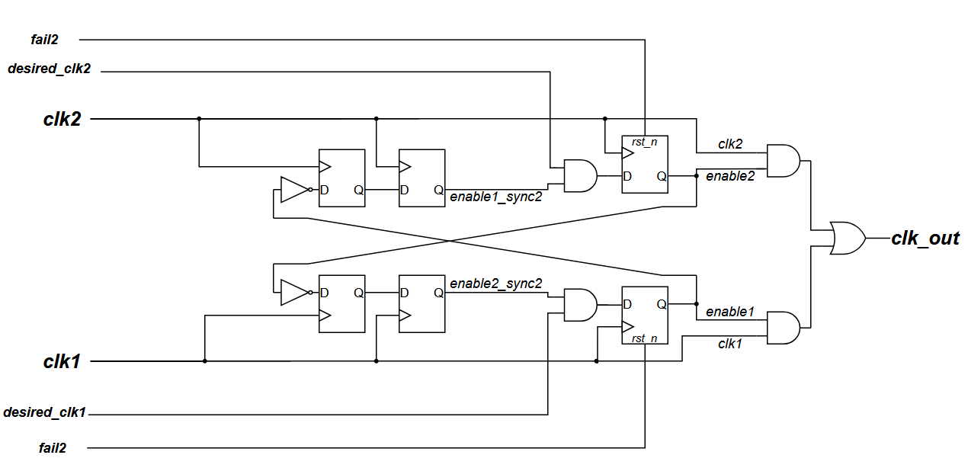
Layer 3: Safe Handover

Slide 14
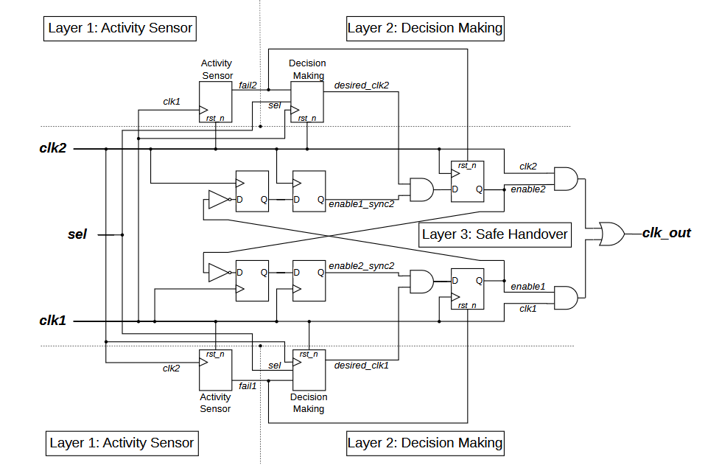
Proposed-scheme

Slide 15
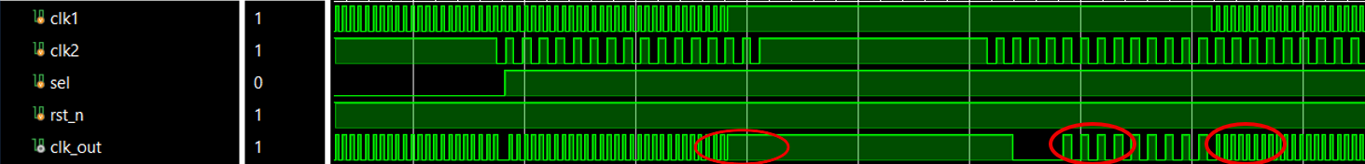
5. Results

Slide 16
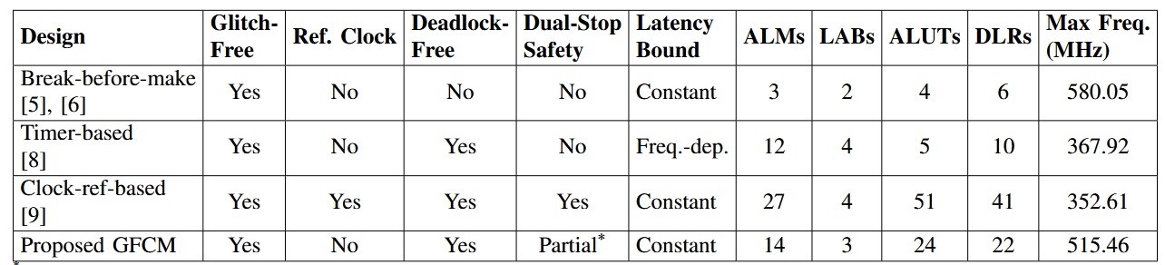
Table: Feature and Implementation Comparison for Various Clock Multiplexer Designs

Slide 17
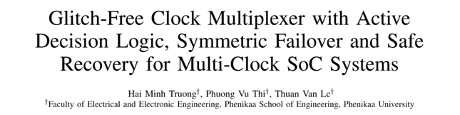
Academic Validation and Publication
This work has been written as a full scientific paper and submitted to the 2nd IEEE International Conference on Information,
Implementation and Innovation in Technology 2026

Slide 18
Thank you for your attention!

