Slide 1

ServiceNow Ai_Agent

Slide 2
Introduction
Manual ticket handling is slow and prone to errors. This demo automates ServiceNow ticket creation by analyzing support emails using AI, saving time and improving accuracy.

Slide 3

Problem Statement
Support teams spend significant time reading and categorizing emails manually. This delays incident resolution and increases workload.

Slide 4

Objective
Automate email classification and ticket management in ServiceNow, reducing manual intervention and speeding up incident handling.

Slide 5

Solution Overview
Emails are fetched via Gmail API, analyzed by Google Gemini AI, and tickets are created or updated in ServiceNow through its REST API.

Slide 6
Tools & Technologies
Python for automation scripting
Gmail API for email access
Google Gemini API for natural language understanding
ServiceNow REST API for ticket management

Slide 7

Why Gmail API?
Gmail API allows secure, programmatic email retrieval and filtering, enabling automated processing without manual intervention.

Slide 8
Why ServiceNow API?
ServiceNow API offers flexible REST endpoints to create and update incidents and change requests seamlessly.

Slide 9
Initial AI Model Choice: Hugging Face
Initially planned Hugging Face transformers for email classification — open source and customizable but required training and complex setup.

Slide 10
Switching to Google Gemini API
Gemini provides advanced language understanding out-of-the-box with minimal setup, improving accuracy and reducing development time.
Gemini is Google’s generative AI model that understands and extracts structured data from emails, enabling automated ticket actions.

Slide 11
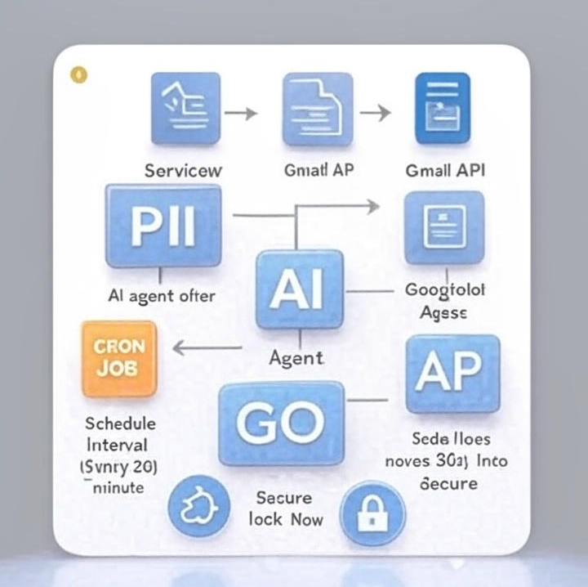
Architecture Diagram
Email → Gmail API → Gemini AI analysis → ServiceNow ticket creation/update → Logs & notifications

Slide 12
Gmail Integration and AI Analysis
Fetch emails securely using OAuth2.0, filter relevant messages, and extract subject and body for analysis.
Send email content to Gemini API, parse JSON response to identify action type, priority, status, and ticket type.

Slide 13

Ticket Handling in ServiceNow
Create new tickets or update existing ones based on AI analysis, including approval workflows and status changes.
Python logging tracks success and failures. Retries handle API rate limits and transient errors gracefully.

Slide 14

Demo Results
Multiple tickets created automatically with unique IDs. Status updates and approvals processed via email replies.

Slide 15

Benefits of AI Agent
Speeds up ticket processing
Reduces human errors
Automates approval processes
Improves IT support efficiency

Slide 16
Use Cases
IT helpdesk automation
Change request approvals
Incident prioritization
SLA compliance monitoring

Slide 17

Resource Justification
Chosen APIs and models provide a secure, scalable, and efficient way to automate email-to-ticket workflows with minimal development effort.

Slide 18
Challenges Faced
Managing Gmail OAuth securely
Handling API rate limits
Parsing AI responses reliably
Coordinating multi-step ticket workflows

Slide 19

Future Enhancements
Expand
Expand AI to handle more ticket categories
Add
Add real-time alerts on Slack/Teams
Build
Build a monitoring dashboard
Enhance
Enhance error handling and retry logic

Slide 20

Summary
Demo automates ServiceNow ticketing via email using AI, reducing manual workload and improving incident response time.

Slide 21

Q&A
Thank you! Happy to answer any questions.

