Slide 1
FLARRE AI INNOVATION CHALLENGE 2026
Flarre-Fuzz
BULLY
An AI boxing ring that attacks AI-written insurance code before it reaches a carrier's systems
REFEREE
[Your Full Name] | [Your College Name]

Slide 2
THE PROBLEM
Small math errors can misprice many policies
AI writes the code
Humans test by hand
Errors scale
Insurance platforms now use AI agents to write pricing and rating logic.
Speed goes up. So does the risk of a quiet error.
Engineers write test cases for the situations they already expect.
It is slow, and the rare cases slip through.
One bug runs on every policy it touches.
The cost is lost revenue, unhappy customers and regulatory exposure.
Wrong boundary. Missing cap. Bad rounding.
Slow and incomplete
Trust is the real price
Flarre-Fuzz | Flarre AI Innovation Challenge 2026

Slide 3
THE SOLUTION
Four roles, one rule: code judges correctness
Bully
Referee
Fixer
Human
Invents attack inputs: boundary values, random fuzzing, and rare profiles from an LLM.
Checks every result against must-always-hold rules and a trusted reference. No LLM.
Explains each failure and proposes a patch, then the full suite re-runs on it.
Sees the diff and the re-test result, then approves or rejects. Everything is logged.
LLM + validated code
Deterministic code
LLM + re-verification
Final decision
Flarre-Fuzz | Flarre AI Innovation Challenge 2026

Slide 4
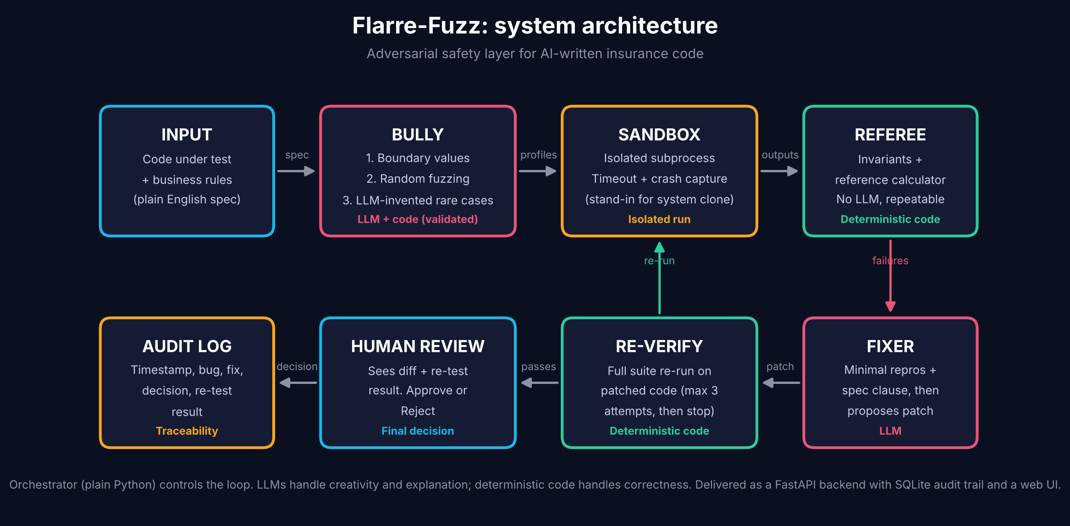
ARCHITECTURE
How it flows
Flarre-Fuzz | Flarre AI Innovation Challenge 2026

Slide 5
PROTOTYPE RESULTS
Tested on a calculator with five planted bugs
5 of 5
1,126
0
planted bugs detected
edge-case profiles tested
false alarms on correct code
Hand-picked boundaries miss the age-29 bug; random fuzzing finds it.
Caps are caught by invariants and the reference; the LLM layers are not yet measured.
Each failure is traced to the business rule it broke.
Toy calculator written for this project. Deterministic scan took about 0.1 s.
Flarre-Fuzz | Flarre AI Innovation Challenge 2026

Slide 6
POSITIONING AND LIMITS
Built to complement Flarre's Testing Agent
Where it fits
What we do not claim
Flarre's Testing Agent validates code against requirements.
Flarre-Fuzz adds a second opinion: an agent whose only job is to break the code with rare and extreme cases before deployment.
It is an extra layer, not a replacement for engineers.
No "100% safe": testing finds bugs, it cannot prove there are none.
The Referee is only as good as its rules and reference.
LLM patches can be wrong, so they are re-verified and a human approves.
The prototype uses a simple calculator and a subprocess sandbox.
Flarre-Fuzz | Flarre AI Innovation Challenge 2026

Slide 7
WHAT COMES NEXT
Next steps and scale
1
Measure the LLM layers
Run Bully and Fixer repeatedly and report patch quality.
2
More rule sets
New spec plus reference, no pipeline change.
3
Production hardening
Container isolation, durable workflows, plug into an existing testing agent.
Faster, broader, auditable testing, with a human in charge.
Flarre-Fuzz | Flarre AI Innovation Challenge 2026

